Slide 1

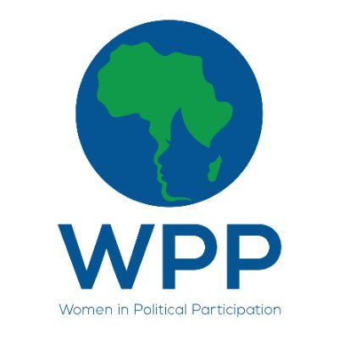
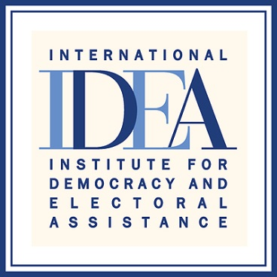

Regional Media training on Women’s Political Participation
Johannesburg, South Africa , 7-9 March 2022,
Nduduzo Tshuma
“Women’s Quota Comes To An End”
Published on : 27 February 2021
Follow up story published on : 10 May 2021
“Enhancing Women's Political Participation through media.”

Slide 2
SYNOPSIS
focuses on the women’s quota, adopted with the constitution in 2013 and its coming to an end in 2023 amid Government efforts to extend it.
. explores its successes and failures in promoting women political participation.
promoting debutant parliamentarians who went on to contest in the open election after their initial terms and for boosting the number of female representatives.
After the 2018 elections, there is a noted decline in the number of women in Parliament and Senate
parties accused of using the women’s quota to abdicate their obligations through other mechanisms to promote gender
captures voices advocating for the extension of the quota system but not in its original format but to also expand it to local government.
calls for its extension or a more permanent framework, with calls for other supportive mechanisms outside the quota system to achieve gender parity in politics.
“Enhancing Womens Political Participation through media”

Slide 3
Background
“Intended to be a special provision to redress gender imbalance in the National Assembly. In the longer term it was hoped that the imbalance would be rectified by political parties selecting more women to stand as constituency candidates.” – legal and constitutional watchdog Veritas on Women’s Quota.
To gauge the effectiveness of the women's quota and how its extension would impact women political participation.
Responding to statistics showing that despite the introduction of the women's quota the number of female political representatives kept decreasing.
The story therefore sought to explore views on what should be done to make sure that the women's quota succeeds, is complimented or modified to ensure that its objective is achieved.
To generate debate on interventions by Government and political parties on measures to make sure that more women participate in politics in line with local, regional and international instruments
To gauge the effectiveness of the women's quota and how its extension would impact women political participation.
Responding to statistics showing that despite the introduction of the women's quota the number of female political representatives kept decreasing.
The story therefore sought to explore views on what should be done to make sure that the women's quota succeeds, is complimented or modified to ensure that its objective is achieved.
To generate debate on interventions by Government and political parties on measures to make sure that more women participate in politics in line with local, regional and international instruments
Enhancing Women’s Political Participation through media

Slide 4
Key Objectives
To raise awareness on the importance of the women's quota, in promoting women’s participation in politics.
To stimulate debate on what needs to be done to introduce permanent legal frameworks
Raising awareness on the importance of gender and electoral processes.
“Enhancing Women’s Political Participation through media”

Slide 5
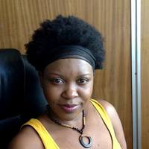
Target audience
“The lack of political accountability with regard to gender equality within political parties has ensured that women remain under-represented in national politics despite the existence of reserved seats.” - Dr Delta Ndou.
. Legislators
. Politicians
. Advocacy groups
. Political parties
Enhancing Women's Political Participation through media

Slide 6
Sources and accessibility
used interviews to interview four female respondents and cited the fifth female source in a file story that i cited.
made reference to pronouncements by President Mnangagwa taken from file stories cited.
used secondary sources like Veritas, African Portal and statistics from the Inter Parliamentary Union on women political participation.
Hon Masuku to get perspectives from beneficiaries of he women's quota and how it has helped as an entry point for women into positions of power .
Dr Ndou an expert on women's issues to unpack the women's quota and also give a critique on it ad also give suggestions on the way forward.
Women Leaders Network National Chapter Steering Committee Member and Vice Chairperson of the national executive Women in Local Government Forum (WILGF), Alderman Resta Dzvinyangoma and African Women Leaders Network, National Youth Caucus Steering Committee Member, Mantate Mlotshwa to give broader perspectives from women's organizations.
the constitution and regional and international protocols to show the obligations the country has on promoting women political participation
“Enhancing Women’s Political Participation through media”

Slide 7
Challenges encountered in putting the story together
Personally affected by Covid-19
Scepticism over physical contact
Lack of adequate PPE
Restricted traveI due to lockdown prevention measures
Enhancing Women's Political Participation through media

Slide 8
Impact
We are pleased to announce that the AWLN Zimbabwe will be rolling out trainings for women political candidates in collaboration with UN Women, the African Union and the Embassy of Ireland in Pretoria to promote women’s increased participation in Zimbabwe’s upcoming elections.” Alderman Resta Dzvinyangoma and African Women Leaders Network
. Wide circulation as story was published in print and online versions of the paper
. Gender Commission announced that it would be engaging in a number of programmes to promote women political participation showing the importance of the subject of the story.
. shared the story on my social media platforms and also sent the link on a number of WhatsApp groups
. Wide circulation as story was published in print and online versions of the paper
. Gender Commission announced that it would be engaging in a number of programmes to promote women political participation showing the importance of the subject of the story.
. shared the story on my social media platforms and also sent the link on a number of WhatsApp groups
Enhancing Womens Political Participation through media

Slide 9
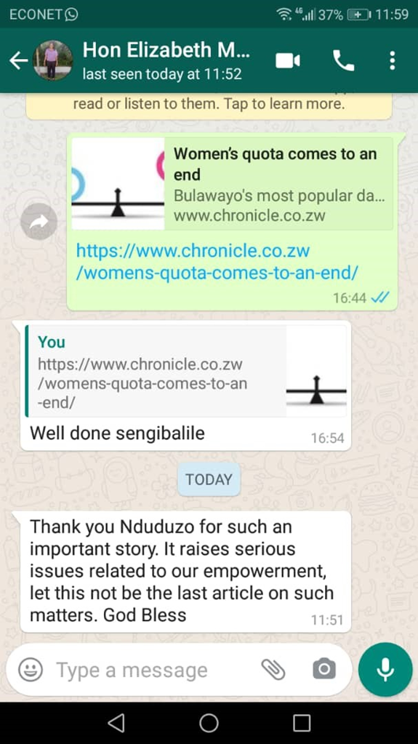
Feedback
“Thank you Nduduzo for such an important story. It raises serious issues related to our empowerment, let this not be the last article on such matters.”- message from Elizabeth Masuku (MP under Women’s quota).
Enhancing Women's Political Participation through media

Slide 10
Follow up story published
https://www.chronicle.co.zw/gender-activists-celebrate-constitution-amendment/
10 May 2021 a follow up was made after Constitutional Amendment No2
Extension of women’s quota by 10 more years
Additional 10 seats for youth to have gender balance
30 percent quota in councils
Gender activists calling for political will
Enhancing Women's Political Participation through media

