Slide 1
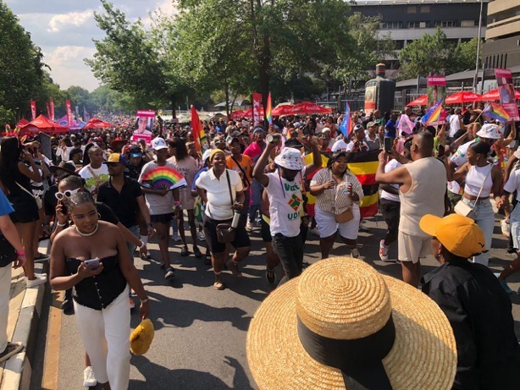
Sexual Diversity in Southern Africa: State of LGBTQI+ Rights and SOGIESC
A snapshot of the 2025 SADC Barometer

Slide 2
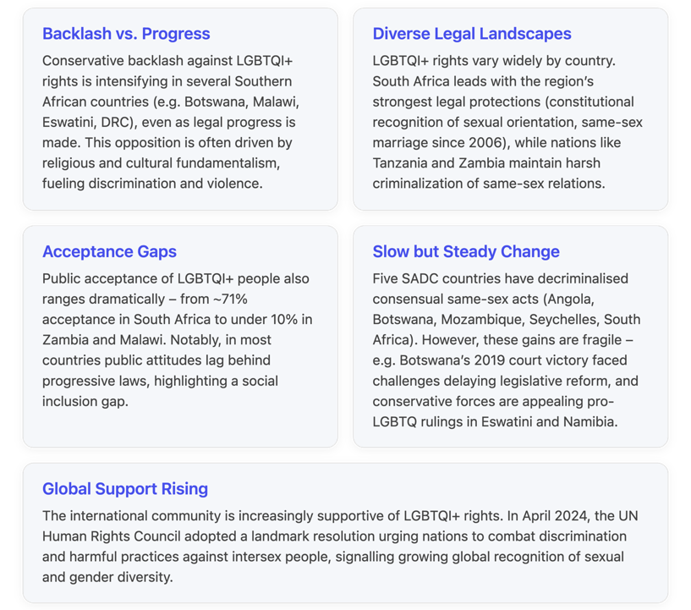
A snapshot of the 2025 SADC Barometer

Slide 3
Regional Overview: Legal Landscape of LGBTQI+ Rights
Consensual same sex
8/16 countries have decriminalised consensual same sex relationships
Workplace discrimination
7 countries provide for protection against discrimination in the workplace
Laws and policies toward LGBTQI+ people vary dramatically across the 16 SADC countries, ranging from very progressive to highly repressive
Same sex marriage
1 country (South Africa) allows for same sex marriage and joint adoption
Conversion therapy
0 country has outlawed harmful “conversion therapy” practices aimed at changing one’s sexual orientation or gender identity.

Slide 4
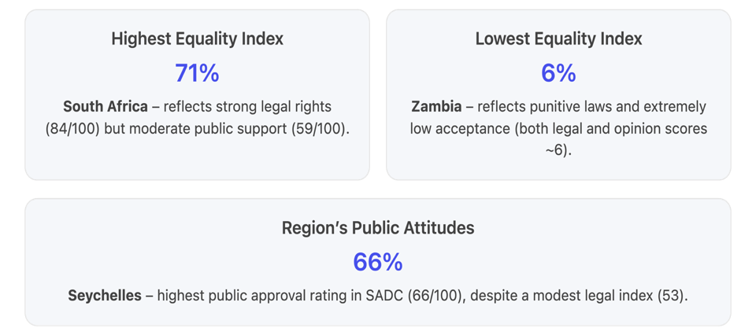
Public Attitudes and Acceptance
Public opinion on LGBTQI+ people across Southern Africa ranges from relatively accepting in some countries to highly intolerant in others, and often trails behind the legal reforms
Notes:
Equaldex’s Equality Index combines legal rights and public attitudes into a composite score (0 to 100) for each country. According to the latest Equality Index data, South Africa ranks highest in the region at 71, whereas Zambia scores the lowest at 6 (For context, this means that overall LGBTQI+ inclusion in Zambia is assessed to be only ~6% of an ideal scenario, reflecting extremely hostile laws and attitudes.) Only six SADC countries have an Equality Index above 50 (the halfway point)[1], indicating that in most of the region, LGBTQI+ citizens still face significant ineqality.

Slide 5
Country | Equality | Legal | Public opinion
South Africa | 71 | 84 | 59
Seychelles | 60 | 53 | 66
Botswana | 55 | 59 | 51
Mauritius | 53 | 55 | 52
Mozambique | 48 | 50 | 47
Lesotho | 45 | 58 | 32
Namibia | 44 | 54 | 33
Angola | 42 | 52 | 35
Madagascar | 31 | 40 | 22
Eswatini | 27 | 21 | 32
DRC | 23 | 38 | 8
Comoros | 16 | 15 | 16
Zimbabwe | 13 | 16 | 10
Tanzania | 12 | 10 | 14
Malawi | 8 | 10 | 5
Zambia | 8 | 9 | 8
Equality Index: a rating from 0 to 100 (with 100 being the most equal) to help visualise legal rights and public attitudes towards LGBTQI+ people in each region.
Legal Index measures the current legal status of 13 different issues, such as the legal status of homosexuality, same-sex marriage, transgender rights, discrimination protections, and censorship laws.
The Public Opinion Index examines public attitudes through surveys and polls conducted by reputable organisations. Equaldex scores it by averaging the results of all surveys in each region.
The Equality Index is an average of two indices: the Legal Index and the Public Opinion Index.

Slide 6
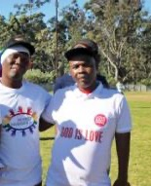
Public Attitudes and Acceptance
Gaps between Laws and Attitudes: This means governments have, in some cases, advanced LGBTQI+ rights faster than their societies have embraced them.
Spectrum of Acceptance: Social attitudes often mirror cultural and religious norms, generally, countries with urbanisation and stronger human rights cultures tend to show more acceptance. In contrast, ambient homophobia is intense in many other countries – surveys indicate extremely low acceptance in Malawi and Zambia
Influence of Religion and Culture: Traditional social values and religious doctrines heavily influence attitudes. In nations like Malawi, Zambia, Zimbabwe, and Tanzania, religious leaders commonly preach against ‘homosexuality’, shaping public opinion to be very negative.
Visibility and allyship are slowly increasing. Pride marches and community dialogues are now held in a few more countries each year. Such events, along with educational campaigns, are helping shift attitudes among younger and urban populations.

Slide 7

Progress Through Activism
Community and NGO initiatives: Many of the above milestones were achieved through persistent advocacy by local LGBTQI+ organisations and their allies
In Botswana, the organisation LEGABIBO (Lesbians, Gays and Bisexuals of Botswana) and others supported the legal challenges that led to decriminalisation and also a 2017 High Court case that secured transgender rights to change official documents
Namibia, activists like Omar van Reenen and groups like Equality Namibia have pressed cases through the courts, and litigants like Anita and Keibonang (plaintiffs in the marriage recognition case) bravely put their names forward to advance the cause.
Malawi’s community, despite setbacks, have kept fighting through groups like the Nyasa Rainbow Coalition.
Mauritius has active NGOs (e.g., Collectif Arc-en-Ciel) that helped bring the constitutional case to fruition in 2023.

Slide 8
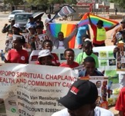
Progress Through Activism
Alliances with broader human rights movements: A notable trend is the building of alliances between LGBTQI+ activists and other social justice movements
Tanzania, a feminist network (referred to as “the Consortium” for security) has been working with lesbian and transgender women in rural communities, framing LGBTQI+ rights as part of a broader fight for bodily autonomy and freedom from gender-based violence
South Africa’s Limpopo province, a collaboration between a chaplaincy (faith-based group) and an LGBTQI+ organization has mobilized communities to address gender-based violence inclusive of LGBTQI+ persons, showing that unlikely partnerships can shift local attitudes.
This kind of coalition-building – aligning with feminist, youth, or HIV/AIDS organizations – has strengthened advocacy messages and provided mutual support.

Slide 9

Progress Through Activism
International support: International donors and networks have increasingly directed support to local LGBTQI+ initiatives, viewing it as a human rights priority.
A new regional funding mechanism, the Marang Fund (launched by Gender Links and partners in 2025), is specifically aimed at strengthening LGBTQI+ organizations in countries like Botswana, Lesotho, Madagascar, Mauritius, and Namibia.
This kind of support helps sustain advocacy, community safe spaces, and strategic litigation. Moreover, global advocacy organizations (including the UN and African Commission on Human and Peoples’ Rights) have given local activists platforms to raise issues internationally, adding pressure on governments to reform.

Slide 10
Strategies to consider
A multifaceted approach is necessary, combining legal advocacy, public education, alliance-building, and vigilant protection against backlash.
1. Tracking and documenting
2. Countering and campaigning
3. Regional advocacy and coalition-building
4. Sustaining and growing

Slide 11
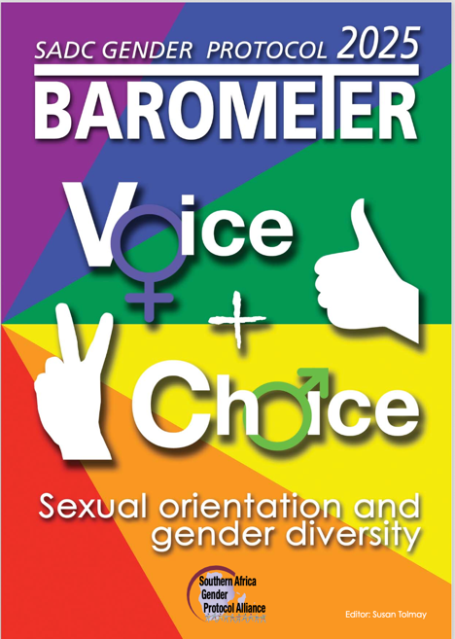
Tracking and documenting
Invest in “opposition tracking.” Researching and monitoring those groups or individuals who oppose LGBTQI+ rights – understanding their narratives, strategies, and funding sources.
Use information to anticipate attacks and respond effectively. Creating an accurate record of incidents (violence, discrimination cases, hate speech incidents) and opposition activities can help advocacy in the long run.
Documentation raises awareness internationally and nationally about the reality on the ground, which can build pressure for change. It also ensures that abuses don’t happen in the dark – for example, recording instances of police harassment or conversion therapy can support legal challenges and media exposes.

Slide 12
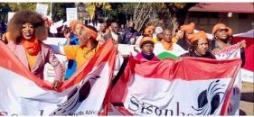
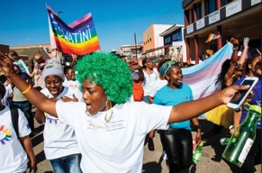
Countering and campaigning
Critical to develop proactive counter-narratives to combat the myths and negative stereotypes about LGBTQI+ people.
Public education campaigns (through media, workshops, social media, etc.) should aim to correct false information (such as “homosexuality is unnatural” or “LGBTQ rights threaten culture”) with fact-based, culturally resonant messaging.
Visibility of LGBTQI+ role models and success stories can humanise the issue. Essentially, meet the hate speech and propaganda head-on with truthful, positive messaging about diversity and inclusion.

Slide 13
A POSITIVE CAMPAIGN
We believe in fostering a culture of support, empowerment, and unity in a world often dominated by backlash and negativity.
We aim to inspire individuals and communities to champion equality, highlighting the strength and resilience of women and LGBTQI+ people everywhere.
Through engaging stories, uplifting experiences, and collective action, we aim to shift the narrative from fear to hope, creating a brighter future where everyone can thrive regardless of gender.
The goal is to learn from and share such examples, particularly those linked to sustainable traction and change in gender norms.
It is crucial to delve deeper into the effectiveness of resistance strategies—what has proven successful in mobilising support and effecting change, and what approaches have fallen short.
Understanding these dynamics will provide valuable insights into the broader feminist movement and its ongoing efforts to combat the challenges it faces.

Slide 14
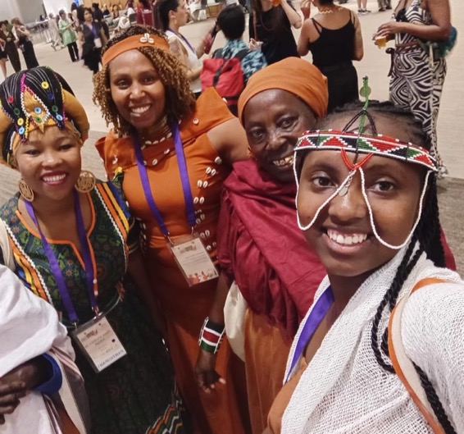
Regional advocacy and coalition-building
Join forces with other human rights and social justice movements – women’s rights, youth movements, civil rights, health advocacy, unions, including sensitising influential allies (like sympathetic religious leaders, traditional chiefs, or celebrities) who can champion the cause within their communities.
Look beyond individual countries and engage in regional advocacy. A coordinated SADC-wide campaign – create momentum and share resources across borders, recognising differences within LGBTQI+ communities and ensuring all voices are included

Slide 15

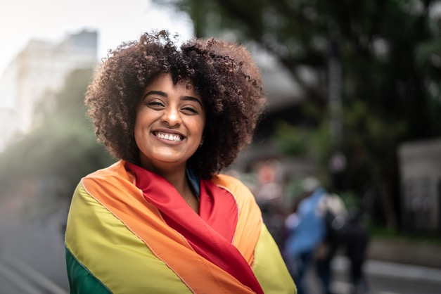
Sustaining and growing
Safeguard the progress already made. Eg legal defence funds to fight any attempts to roll back rights in court,
Continual public awareness so that new generations value equality, and rapid response networks to address crises (such as arrests or violence spikes).
Lobby global organisations and donors to continue supporting local advocates, both financially and through diplomatic pressure when needed.

Slide 16


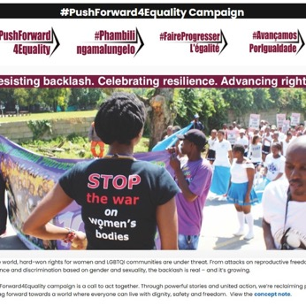
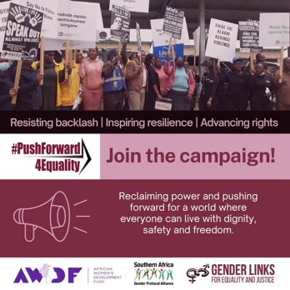

Take Action! Join the campaign!
Visit the campaign page
for information & stories
Join social media campaign using the toolkit
Pitch a blog for the campaign series.

Slide 17

CALL FOR BLOGS
How individuals and communities keep pushing forward to protect their rights, lives and livelihoods.
Actionable tips from activists.
Strategies and tactics that have worked at the community and country levels.
Experiences and voices about organising and action to #PushForward4Equality
Lived experiences spotlighting leadership and resilience from women, girls, LGBTQI+ people and marginalised communities,
Advocacy and protesting to hold leaders accountable and push for policy change.
Resistance from alliances and regional feminist organising to everyday actions.
New strategies that are being employed to dismantle patriarchy.

Slide 18
Blog submission process has four parts https://survey.alchemer.com/s3/8389407/PushForward4Equality-blog-pitch-form
Complete the first part of the form to pitch your blog idea to the regional team (200-word pitch).
You will receive a response, either accepting or rejecting the pitch, along with an explanation and/or suggestions.
If accepted, you should compile the blog within two weeks of approval and upload it to the link you will receive. Here, you can upload high-resolution photos, radio and video clips. Articles should be between 800 and 1200 words, and you are required you to complete the editorial sign-off sheet on submission
Once the blog has been accepted for publication, GL will make a payment of $50.
Note: AI can be a powerful tool to support and strengthen our work, we do not accept AI-generated stories, photos or images. We are seeking thoughtful and authentic ideas, perspectives, and approaches that reflect real experiences, critical analysis, and unique creative voices.

