Slide 1

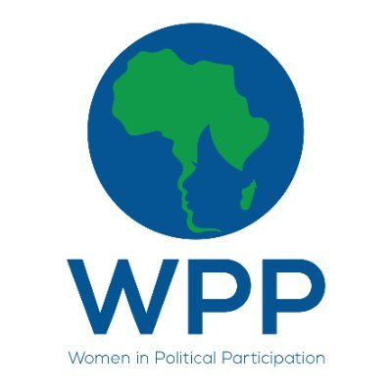
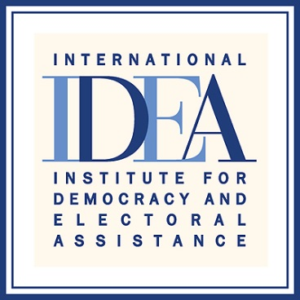

Regional Media training on Women’s Political Participation
Johannesburg, South Africa , 7-9 March 2022,
Gibson Mhaka
Zimbabwe
Title of story: Traditional systems, customs suppress women’s aspirations for leadership.
https://www.chronicle.co.zw/traditional-systems-customs-suppress-womens-aspirations-for-leadership/
Published on 09 February, 2021
Follow up story: Rural women sidelined in local governance : Published 2 February 2021
“Enhancing Women's Political Participation through media.”

Slide 2
SYNOPSIS
The story is about how traditional systems, customs suppress women’s aspirations for political leadership. It reflects how existing traditional systems and cultural norms are making it more difficult for women to leave their traditionally domestic roles outside of their homes and participate in the upper echelons of national and international political activities.
The story also highlights numerous problems brought about by culture and traditions that continue to suppress women’s participation in politics. This is despite the fact that participation of women through gender equality is a prominent issue at the global, national, levels through the enactment of laws, policies and conventions.
“Enhancing Womens Political Participation through media”

Slide 3
Background
Zimbabwe, being a patriarchal society, just like other African states has led women to being socialised to believe that they are the ‘helper’ and not the leader. A woman’s place is kept in the private sphere and not to lead in public
The story then highlights how the country is thriving under traditional leadership systems that are making it difficult for women to leave their traditionally domestic roles outside of their homes and participate in the upper echelons of national and international political activities.
It also shows how customs and traditions still constitute an obstacle to women’s enjoyment of their human rights despite the fact that the Government of Zimbabwe has subscribed to international agreements and instituted national policies to improve women’s representation
Enhancing Women’s Political Participation through media

Slide 4
Key Objectives
To show that although women constitute more than 50 percent of the country’s population, they do not have adequate representation in politics due to numerous cultural practices that are subjugating them to men and hindering their equal and influential participation into politics
To explore how gender imbalance in politics is sometimes is a result of traditional systems and customs that excludes women on the basis of culture.
“Enhancing Women’s Political Participation through media”

Slide 5
Target audience
Members of the public particularly women who are suppressed in their quest to participate in politics on the basis of culture
regional bodies like Sadc highlighting that its member states are not committing themselves to Sadc’s Declaration on Gender and Development which seeks 50-50 representation,
The Government of Zimbabwe to ‘expose’ its lack of commitment to promote women’s inclusion in politics as enshrined in conventions, protocols and international agreements,
The country’s political parties who on paper have brilliant gender policies which are however, not being implemented, gender activists so that they push for the emancipation of women’s participation in politics and
Traditional leaders (e.g Chiefs) who are custodians of culture and traditional beliefs that continue to suppress women
Enhancing Women's Political Participation through media

Slide 6
Sources and accessibility
Zimbabwe Gender Commission (ZGC) commissioner Mrs Sibongile Chambakale Mauye who is also co-chair of the Thematic Working Group of Stakeholders on Gender, Socio-Cultural and Religious Issues
Senior legal practitioner and human rights defender Mrs Nikiwe Ncube-Tshabalala
Traditional leaders e.g Chiefs Gorden Bango and Chief Ndube, born is a female chief whose family also experienced a gender-power division when she fought a six-year drawn-out battle with her family members to succeed her late father
Policy analyst and Gender activist Tinashe Madamombe
Reached through phone calls and face to face interviews
“Enhancing Women’s Political Participation through media”

Slide 7
Challenges encountered in putting the story together
Female chiefs were not easy to reach since they are very few in the country (six female chiefs out of 272 ,according to Sadc Gender Protocol Barometer of 2018)
Mlotshwa family which form the basis of the story through its gender-power divisions could not be interviewed since the matter is still pending at the court therefore is prohibited from public discussion
Female politicians were afraid to be interviewed saying they first need clearance from their political parties
Enhancing Women's Political Participation through media

Slide 8
Impact
The story has managed to show how patriarchy hinder women from obtaining leadership positions even in political participation. It makes women seen not as political actors but rather as pawns to be used in the political maneuvers of men.
It has also managed to show how the country is thriving under traditional leadership systems that are responsible for making it more difficult for women to leave their traditionally domestic roles outside of their homes and participate in the upper echelons of national and international political activities.
Enhancing Womens Political Participation through media

Slide 9
Feedback
Masaisai • 17 days ago
I think we have to decide if we should be cultural or modern. Trying to mix the two will yield more confusion. My great grandmother was a chief, having inherited it from her father. But this was a direct instruction from my grandfather, then the chief. I don't see how modern courts can take jurisdiction over cultural traditions. In this particular case, on what basis, cultural practice, law or modern law or statute is this lady claiming chieftainship?
manyears mdutshwa chuchu • 18 days ago
zvakanaka muchitaura pachirungu asi nyaya iripo iri ye hunhu pachivanhu zvotisiyanei zvino muchatoregwa humambo nevatogwa ngekuti mwana wamai mambo achada kutora umambo hwa mai vake…”
(In short the contributor is also against the idea for a daughter inheriting her late father as a chief saying that will lead or create problems in future when the son of that daughter wanted to inherit her mother as a chief after she dies. The contributor is also saying as Africans we should not allow western culture to dominate or diffuse our cultural practices).
Enhancing Women's Political Participation through media

Slide 10
Follow up story published
Rural women sidelined in local governance
Published 2 February 2021
Enhancing Women's Political Participation through media

