Slide 1


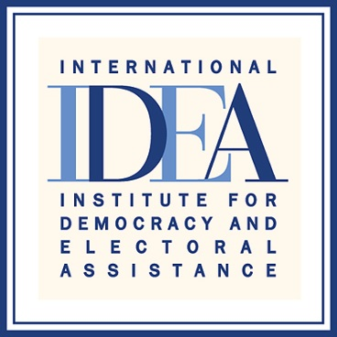

Regional Media training on Women’s Political Participation
Johannesburg, South Africa , 7-9 March 2022, Nokuthaba Dlamini
Title of story
Elusive Votes: Binga female politicians battle patriarchy
Published on January 23 2021
Follow up story published/broadcast on : February 21 2021
“Enhancing Women's Political Participation through media.”

Slide 2
SYNOPSIS
News Day, National print and online media.
The story focused on elusive votes faced by women
in Binga District due to patriarchal practices.
The story focused on the effects of patriarchal
practises and cultural traditions that hinder women
from penetrating into politics as the district with an estimated population of 139 000 has no female political leader.
The story is a good example of gender awareness and
sensitivity because there is very few representation
of women in local councils, Senate and Parliament.
Which has turn, resulted in gender inequality.
“Enhancing Womens Political Participation through media”

Slide 3
Background
In Zimbabwe, women make up 52.3% of the population according to the
2012 census but the political leadership of the country's legislative bodies
and local Authorities is dominated by men.
According to Zimbabwe Electoral Commission (ZEC) , 54%
registered voters during 2018 elections were women but in the parliamentary
constituency run, women won only 26 of 210 seats.
A 2018 study by Gender Links show that there was a decline in
female candidates in Zimbabwe's local government elections
The study says, out of 6 800 candidates who contested for seats in the
country's 92 local authorities, 1 756/17% were females and only 14% was
won by women .
In Binga District, only one female councillor won in the 2018 elections yet in
senate and Parliament position they have no representation.
It is therefore against this background that the story sought to unpack the
reasons behind the mentioned background with Binga district in
Matabeleland North being used as a case study to tell a national story
Enhancing Women’s Political Participation through media

Slide 4
Key Objectives
The major goal is to achieve 50 –50 equality in
politics between men and women.
“Enhancing Women’s Political Participation through media”

Slide 5
Target audience
Communities
Politicians from all Political parties
Civic groups lobing for equal
opportunities in politics between men
and women
Relevant Government ministries
The story was a success because it was
shared in social media , newspapers and online websites
Enhancing Women's Political Participation through media

Slide 6
Sources and accessibility
One on one interviews conducted. The sources were selected based on
their previous experiences in the political arena.
Three aspiring female politicians were contacted for interviews in
addition to other two other political male sources.
Electoral reliable research documents were also used as sources of
information in building up the story.
More so, additional information was retrieved from civil organisations such as Gender Links who advocates for equal opportunities in politics among men and women.
“Enhancing Women’s Political Participation through media”

Slide 7
Challenges encountered in putting the story together
Travelling to meet the interviewees one on one was minimized due to Covid-19 travelling restrictions.
Some political such as ZAPU and ZANU PF parties refused to be drawn into the story
Due to fear of victimisation, some aspiring female politicians also refused to be interviewed.
Enhancing Women's Political Participation through media

Slide 8
Impact
The story was shared on WhatsApp groups and Facebook.
It was also shared on various domestic and international online
websites as it sparked some debate on what oughts to be done going
forward.
Enhancing Womens Political Participation through media

Slide 9
Feedback
Social media sparked some debates on whether there should be
inequality change or not and in the next coming 2023 elections, some political parties have fielded their female members for candidature posts, although at local authority level
Enhancing Women's Political Participation through media

Slide 10
Follow up story published
https://thestandard.newsday.co.zw/2021/02/21/lobby-groups-prop-up-aspiring-female-candidates-for-2023/
Enhancing Women's Political Participation through media

