Slide 1

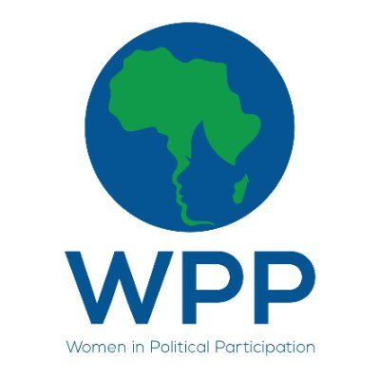
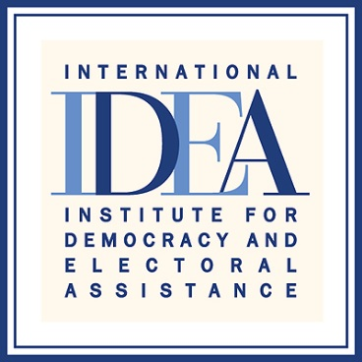

Regional Media training on Women’s Political Participation
Johannesburg, South Africa , 7-9 March 2022, Taboka Ngwako
No change in structural disparities-study
Published on :22 December 2020
“Enhancing Women's Political Participation through media.”

Slide 2
SYNOPSIS
The positive impact of women in politics is undeniable and in order to meet global development goals and build strong, sustainable democracies, women must be encouraged, empowered and supported in becoming strong political and community leaders.
My article titled 'No change in structural disparities' is about two powerful women who are actively involved in politics in Botswana.
My article was aimed at highlighting the resilience traits that women posses and hopefully inspire the next female to take up politics as well. One of my sources, Ms Daisy Bathusi is an opposition party activist who is currently contesting for the Vice president position in her party (a position that has always been male dominated), who walked us through her journey in politics, and what traits she thought helped her to remain resilient and steadfast.
My second source, is Ms Motamma Horatius, who is the youngest councilor currently serving her community. She details her transition from being a beauty queen to actively participating in politics in order to make a meaningful contribution to the society especially the youth.
“Enhancing Womens Political Participation through media”
Notes:
Quoting National Democratic Institute Chairperson, Ms Maidelene Albright, women in power can be on to raise issues that others overlook, to support ideas that others overlook and to seek an end to abuses that others accept.

Slide 3
Background
Women's representation in politics is not the only factor, but it is a critical factor for the development of inclusive, responsive, and transparent democracies. I believe that there is is growing recognition of the untapped capacity and talents of women and women's leadership especially in policy making but if we as the media, do not highlight the positive impacts that women make in our lives, then females will be continuously underrepresented in every context of the society.
Enhancing Women’s Political Participation through media

Slide 4
Key Objectives
Women's political participation results in tangible gains for democracy, including greater responsiveness to citizen needs, increased cooperation across party and ethnic lines, and a more sustainable future.
“Enhancing Women’s Political Participation through media”

Slide 5
Target audience
I hope to inspire more families in Botswana to participate in the democracy of their society. I did reach my audience, given the high number of positive comments left both on my two sources facebook pages.
Enhancing Women's Political Participation through media

Slide 6
Sources and accessibility
I made telephone and face to face interviews, with my female sources. I chose the sources because they formed an integral part in my article
“Enhancing Women’s Political Participation through media”

Slide 7
Challenges encountered in putting the story together
The only challenge that I faced in putting the story is clash of schedules.
My sources are busy women in their own right so finding a suitable interview time proved to be a daunting task.
Enhancing Women's Political Participation through media

Slide 8
Impact
Highlighting the journey of female politicians proves that investing in girls' and women's right to political participation is a necessary step to achieving global gender equality and democratic governance.
Enhancing Womens Political Participation through media

Slide 9
Feedback
Social media is a powerful tool that reaches the masses either positively or negatively, In essence every post or article posted on social media is a stage for one to connect with their desired audience.
My sources contacted me following the publishing of my article online.
Feedback was positive, especially on facebook.
Enhancing Women's Political Participation through media

Slide 10
Follow up story published
No.
Enhancing Women's Political Participation through media

