Slide 1
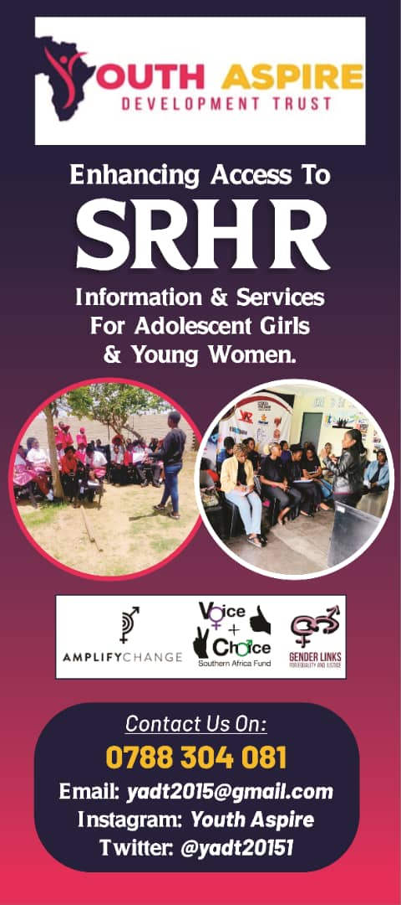
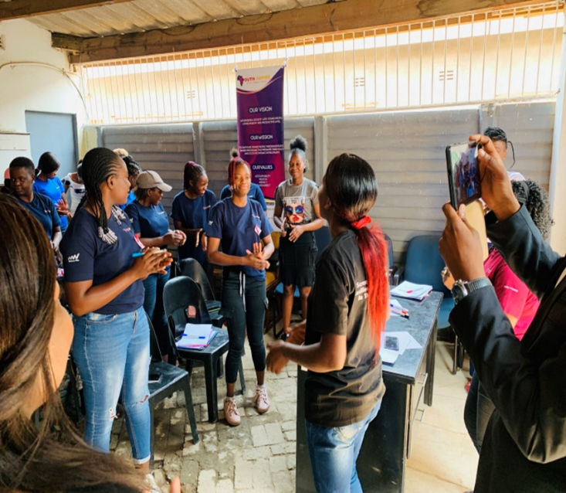
YOUTH ASPIRE
Wesley T Nyabaya
Wesley T Nyabaya
Youth Aspire

Slide 2
Project Summary
  Youth Aspire Development Trust (YADT) is implementing a project aimed at enhancing access to sexual and reproductive health and rights (SRHR) services for adolescent girls and young women (AGYW) in Chitungwiza District. This initiative focuses on building the capacity of 25 youth advocates to effectively advocate for SRHR, engaging religious leaders to foster supportive environments, and training health service providers to offer youth-friendly services. Additionally, the project leverages social media to raise awareness and engage the community on SRHR issues. By addressing the barriers that hinder AGYW from accessing essential SRHR services, the project aims to reduce teenage pregnancies, unsafe abortions, and child marriages, ultimately empowering young women and girls to make informed decisions about their health and futures.

Slide 3
Problem statement
The project addresses the significant barriers that adolescent girls and young women (AGYW) in Chitungwiza District face in accessing sexual and reproductive health and rights (SRHR) services. These barriers include cultural and religious norms that stigmatize discussions around SRHR, lack of youth-friendly health services, and limited knowledge and advocacy skills among youth. As a result, AGYW are at a higher risk of teenage pregnancies, unsafe abortions, and child marriages, which have long-term negative impacts on their health, education, and economic opportunities. The project seeks to create an enabling environment where AGYW can access comprehensive SRHR services without fear of stigma or discrimination, ensuring they have the knowledge and support needed to make informed decisions about their sexual and reproductive health.

Slide 4
Project Goal and Objectives
Goal:
  Enhance access to SRHR services for AGYW in Chitungwiza District through capacity building, community engagement, and advocacy.
Short-term Objectives:
  Train youth advocates on SRHR advocacy.
  Secure commitments from religious leaders to support SRHR initiatives.
  Enhance the capacity of health service providers to offer youth-friendly SRHR services.
  Increase awareness and engagement on SRHR issues through social media.
Long-term Objectives:
  Sustain a supportive environment for SRHR advocacy in the community.
  Ensure continuous access to high-quality, youth-friendly SRHR services.
  Achieve a significant reduction in teenage pregnancies, unsafe abortions, and child marriages.
  Empower AGYW to make informed decisions about their sexual and reproductive health, leading to improved health outcomes and greater opportunities for education and economic participation.

Slide 5
Target Group
  The target group for this project is adolescent girls and young women (AGYW) in Chitungwiza District 10-24 years . This group was selected because they face significant barriers in accessing sexual and reproductive health and rights (SRHR) services, including cultural and religious stigma, lack of youth-friendly services, and limited knowledge about SRHR. These challenges put AGYW at higher risk of teenage pregnancies, unsafe abortions, and child marriages, which can severely impact their health, education, and future opportunities. By focusing on AGYW, the project aims to empower them with the knowledge, support, and services needed to make informed decisions about their health and well-being.

Slide 6
Project Reach
Direct Beneficiaries: The project directly benefited 25 AGYW who were trained as SRHR advocacy champions. These young women became key influencers and leaders within their communities.
Indirect Beneficiaries: Through the outreach activities conducted by the advocacy champions, the project reached over 1,000 young people in Chitungwiza. These activities included school visits, community workshops, and social media campaigns, which collectively broadened the project’s impact.
Health Services Utilization: The advocacy efforts led to a significant increase in the utilization of SRHR and HIV services. Local health facilities reported a 30% rise in the number of young people accessing HIV testing and counseling services. Additionally, there was a 25% increase in the uptake of contraceptive services among adolescents.
Community Involvement: The project engaged over 500 community members including parents, teachers and local leaders in dialogues and awareness campaigns. This broader community involvement helped to create a more supportive environment for young people seeking SRHR services.

Slide 7
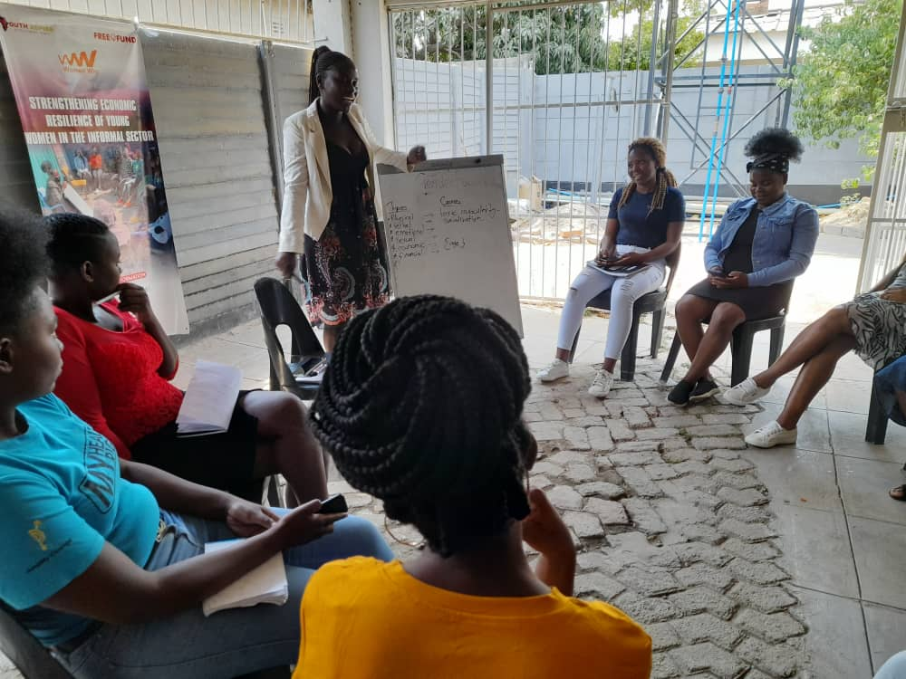
Project Activities and Approach
Youth Advocates Capacity Building:
  Training workshops on SRHR advocacy.
  Development of advocacy materials.
  Peer education sessions.
Engagement with Religious Leaders:
  Meetings and dialogues.
  Workshops on SRHR issues.
  Development of commitment statements.
Health Service Providers Training:
  Capacity building workshops on youth-friendly services.
  Development of guidelines and protocols.
  Monitoring and evaluation of service provision.
Social Media Engagement:
  Creation of SRHR content for social media.
  Campaigns and online discussions.
  Collaboration with influencers and partners.

Slide 8
Strategies and Success
Strategies Employed:
  Youth Advocates Capacity Building.
  Engagement with Religious Leaders.
  Health Service Providers Training.
  Social Media Engagement.
Success:
  Increased knowledge and skills among youth advocates.
  Supportive environment created by religious leaders.
  Improved quality and accessibility of SRHR services.
  High levels of engagement and awareness through social media.

Slide 9
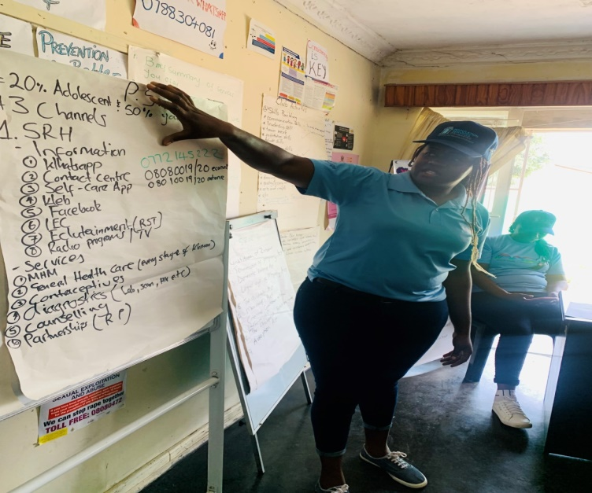
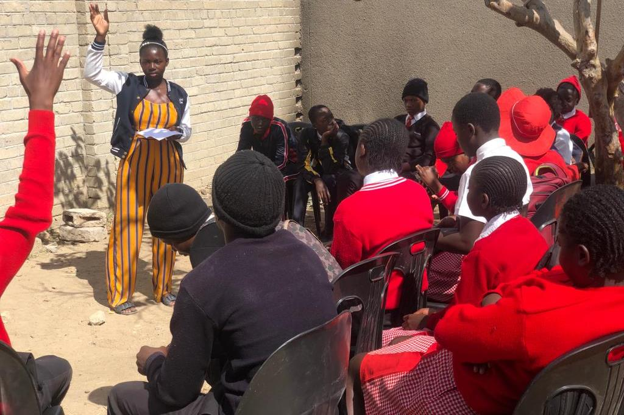
Partnerships
Partners and Their Roles:
  Local Clinics: Provided venues and practical insights.
  Religious Leaders: Disseminated SRHR information and reduced stigma.
  Gender Links: Offered technical support and resources.
  Amplify Change: Provided funding and strategic guidance.
  Local Schools: Organized peer education sessions.

Slide 10
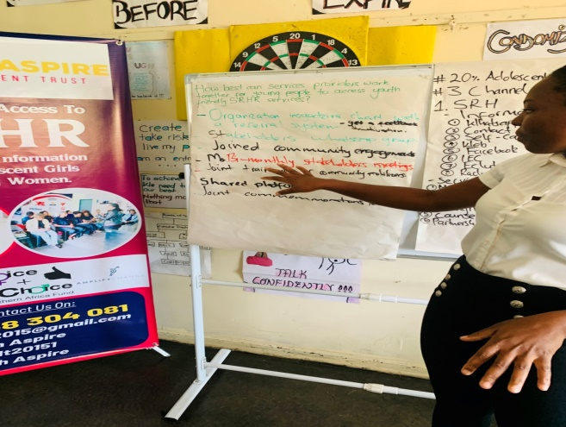
Challenges and Solutions
Challenges:
  Cultural and religious barriers.
  Limited resources.
  Resistance from health service providers.
Solutions:
  Engaged religious leaders to reduce stigma.
  Partnered with organizations for funding and support.
  Conducted targeted training for health service providers.

Slide 11
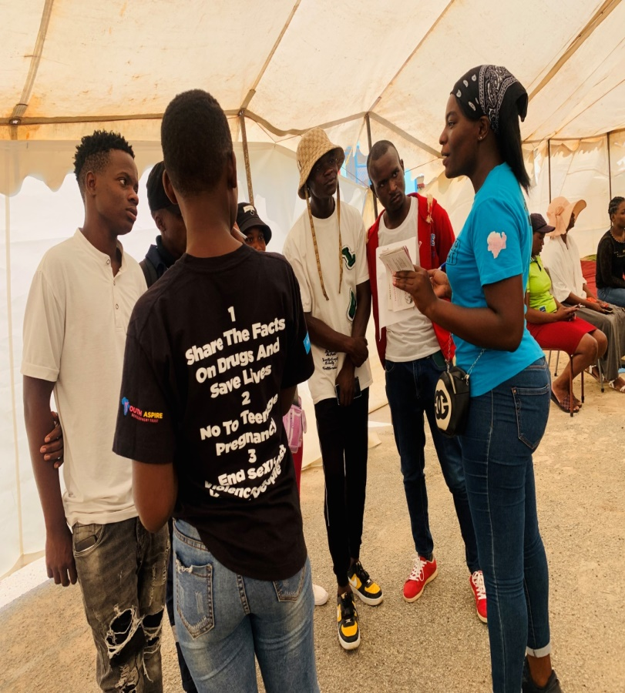
Lessons Learned and Application
Key Lessons:
  Importance of community involvement.
  Flexibility and adaptability.
  Continuous capacity building.
  Leveraging technology.
  Holistic approach.
  Importance of monitoring and evaluation.
  Building sustainable partnerships.
  Addressing gender attitudes.
Application:
  Prioritize community engagement.
  Incorporate adaptive planning.
  Establish continuous professional development.
  Integrate digital strategies.
  Use a holistic approach.
  Implement strong M&E frameworks.
  Focus on sustainable partnerships.
  Continue addressing gender attitudes.

Slide 12
Success Stories
Tanatswa’s Journey to Empowerment: Tanatswa, one of the trained advocacy champions, used her newfound knowledge to educate her peers about the importance of HIV testing and safe sexual practices. She organized weekly discussion groups at her school, where she shared information and answered questions. Her efforts led to a significant increase in the number of students getting tested for HIV. Tanatswa’s leadership and dedication earned her recognition from both her peers and the school administration.
Tanyaradzwa’s Impact on Her Community: Tanyaradzwa, another advocacy champion, focused on reaching out to young women in her neighborhood. She conducted door-to-door visits, providing information on SRHR services and encouraging young women to visit local health facilities. Tayaradzwa’s personal approach helped break down barriers and build trust within the community. As a result, many young women who were previously hesitant to seek SRHR services felt more comfortable doing so. Tanyaradzwa’s efforts contributed to an increase in the uptake of contraceptive services in her area.
Marvellous’s Role in Reducing Stigma: Marvellous, inspired by her training, took on the challenge of addressing stigma and misconceptions about HIV in her community. She organized community dialogues and invited local leaders to participate. Through open and honest conversations, Marvellous helped change negative attitudes and reduce stigma associated with HIV. Her work not only improved the community’s understanding of HIV but also created a more supportive environment for those living with the virus.

Slide 13
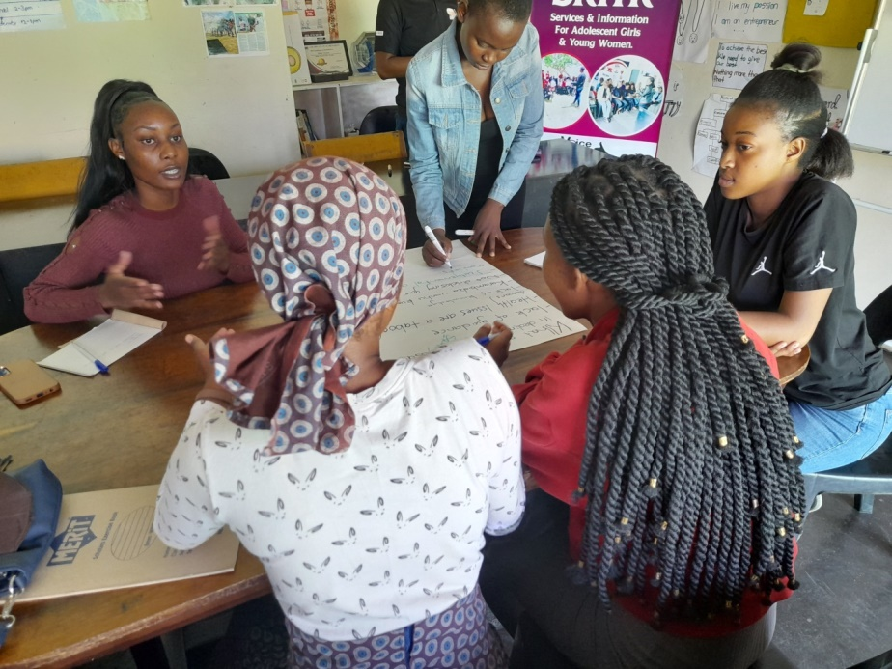
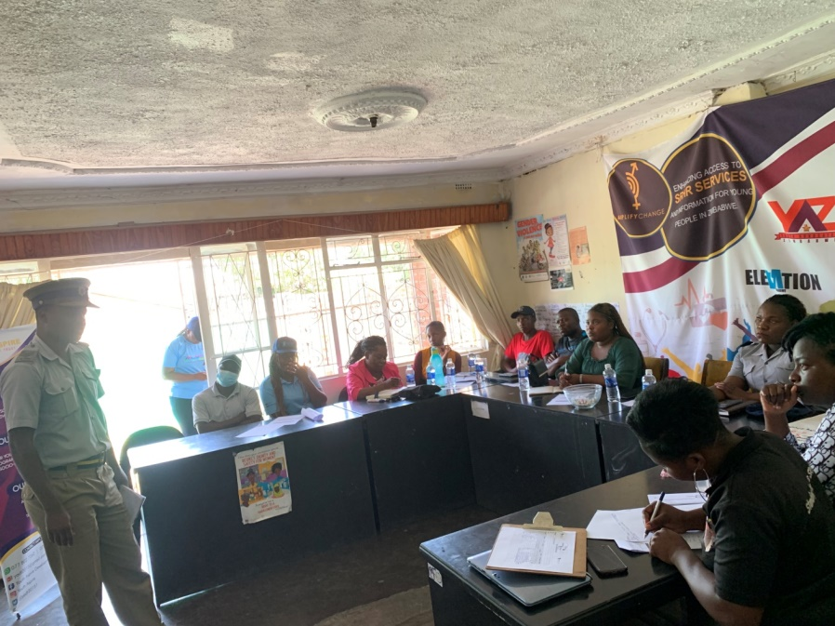
Acknowledgements
Thank You Note
Partners and Supporters:
Gender Links, Amplify Change,

