Slide 1







LEARNING
AND SHARING
SUMMIT 2025
Drivers of Change Template
(Zimbabwe, Gweru, 20 February 2025, Tendai Ncube)
Women’s Voice and Leadership Learning and Sharing Summit 2025

Slide 2
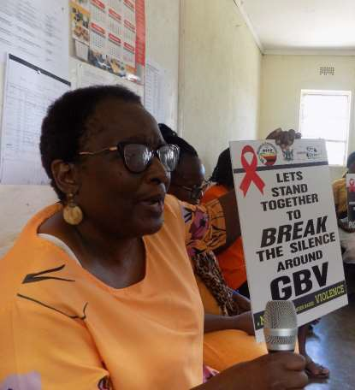
Who is this leader?
Rebecca Tendai Chirenga, Gweru ,Zimbabwe
Gender Champion,Community Developer
Background upbringing, determination,achievements and aspirations
Women’s Voice and Leadership Learning and Sharing Summit 2025

Slide 3
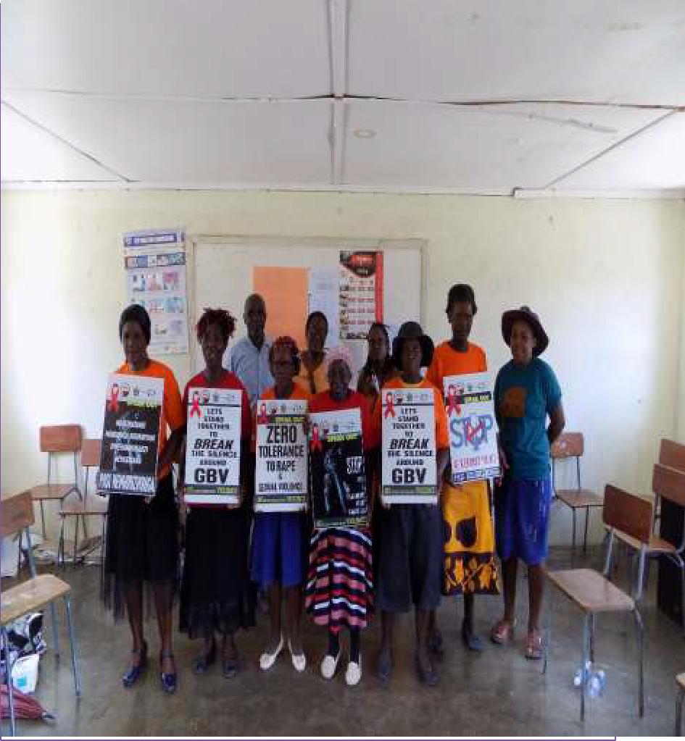
What drives you?
The desire to change women ‘s lives through addressing issues to do with their rights as well as improve their standard of living.
To have a positive impact in lives of people I interact with from all walks of life .
My driving force towards gender equality is driven by our mantra “ Human rights are Women rights” which is the backdrop of my commitment towards gender equality .
Women’s Voice and Leadership Learning and Sharing Summit 2025

Slide 4
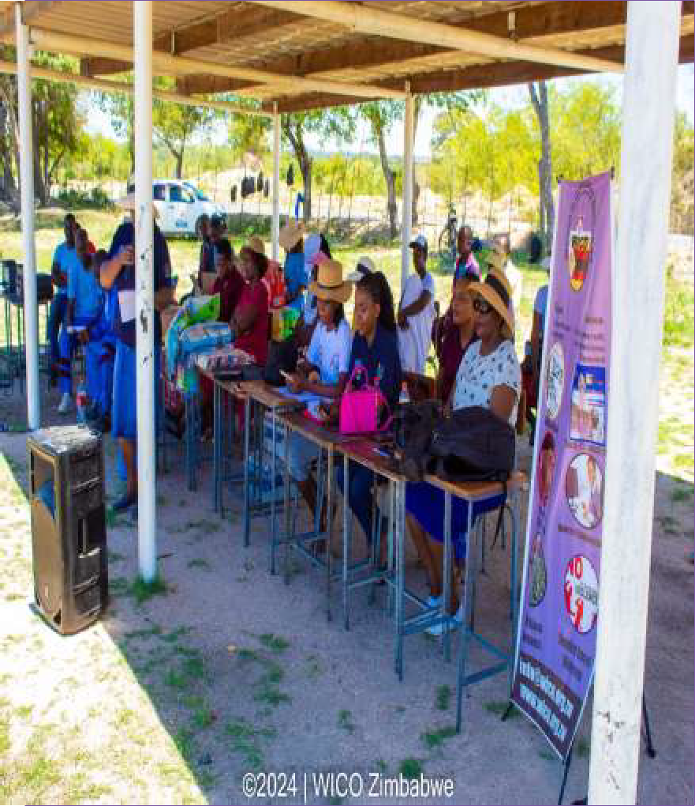
What do you do?
DETAIL
Community development programs that seek to provide women the opportunities to acquire knowledge
,values ,attitudes ,commitment and skills needed to improve their livelihoods and ensure sustainable development .
Women’s Voice and Leadership Learning and Sharing Summit 2025

Slide 5
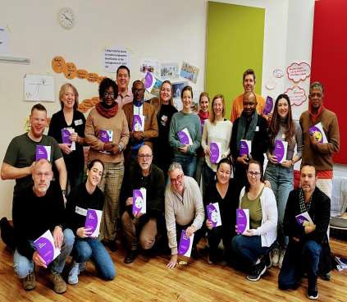
Personal achievements
DETAIL
Widowed at 32 with 5 children to look after now a grandmother of 7 beautiful children ,High school teacher , Lecturer by profession , a Mentor ,Women ‘s Rights Activist , Trainer of Trainers (accredited by SPHERE ) , Award winning Author (My Train Journey) ,Founder and Director of WICO , Sits on several
boards as a board member nationally recognized and 1 internationally recognized board .
Women’s Voice and Leadership Learning and Sharing Summit 2025

Slide 6
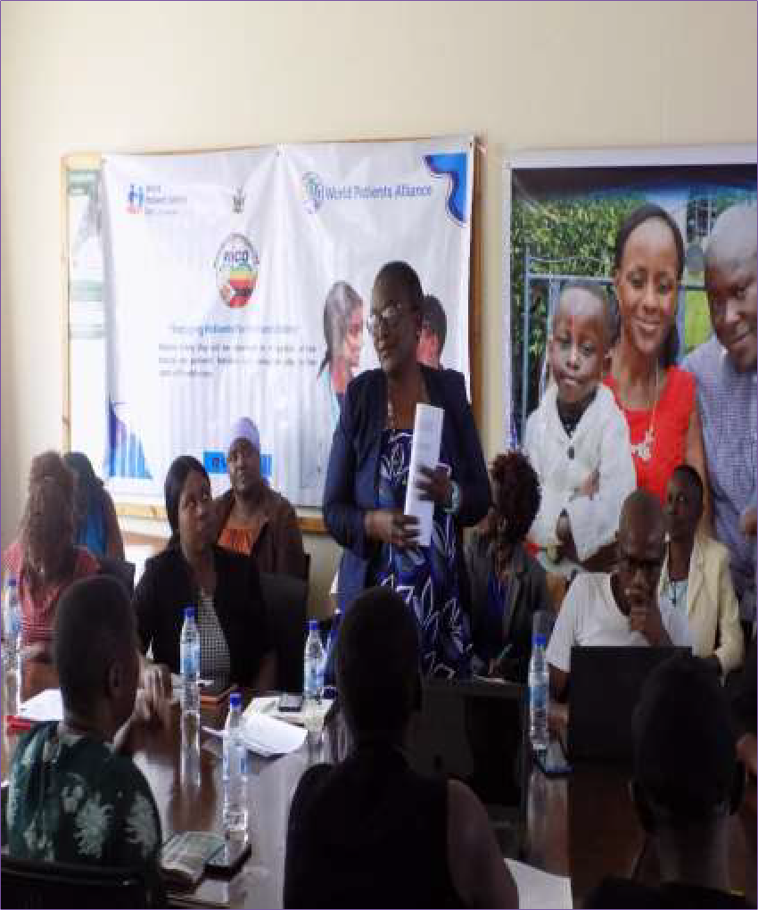
Change at the individual level
Ability to network ,ability to relate to other people’s stories ,ability to grow in the work that we do and the ability to drive change within the communities that we serve .
Information dissemination
,Negotiating skills with relevant
stakeholders to implement programs
,advocacy through story telling and best practices ,influencing change within communities through dialogue and awareness of SRHR /HIV
Local authorities ,line ministries
,parents and guardians and the learners themselves who have been a part of the program
Women’s Voice and Leadership Learning and Sharing Summit 2025

Slide 7
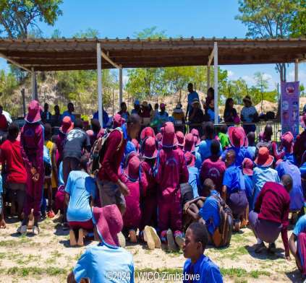
Achievements at community level
Established an SRHR system at the schools that we worked with for the benefit of the learners through training of 13–18-year- olds.
Establishment of Youth friendly corners to improve access to information and regular provision of sanitary wear .
We also launched a ‘’Bridging the
generational gap” campaign to improve communication between parents/guardians, teachers and learners and creating a stigma free environment .
Peer to peer training has improved
relations between learners
Schools now uphold a new policy of constantly providing sanitary wear to learners to reduce absenteeism
Women’s Voice and Leadership Learning and Sharing Summit 2025

Slide 8
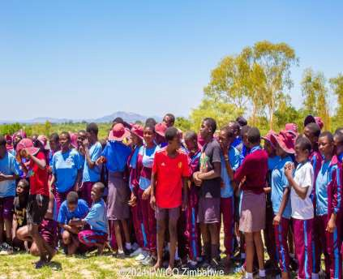
Achievements at societal level
The change maker engaged with school authorities ,parents and guardians to agree on provision of sanitary wear .
Parents and learners were allowed to revisit their rights and understand their impact on society .
The adage “It takes a community to raise a
child’’ became a new community law
through sharing of best practices and stories of change
The community has been able to adopt the true meaning of rights . The children who has misinterpreted their rights were able to apply without violating their parents and best practices
Women’s Voice and Leadership Learning and Sharing Summit 2025

Slide 9
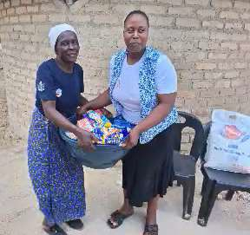
Leadership qualities
Ability to have a shared vision for the
future
Effective communication and ability to listen actively even through criticism
Empathy –putting herself in other people ‘s shoes and circumstances for a better understanding and course of action to alleviate negative conditions
Accountability and taking responsibility
towards one ‘s actions and decisions
Women’s Voice and Leadership Learning and Sharing Summit 2025

Slide 10
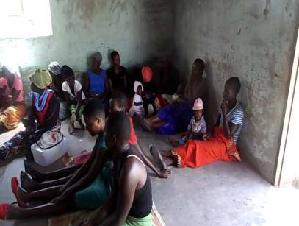
Contribution to gender equality
Gender equality in working with men and women on the same by teaching everyone with respect ,dignity without stereotyping or bias .
Educate herself and others about gender equality
Advocate for equal opportunities in
leadership positions
Women’s Voice and Leadership Learning and Sharing Summit 2025

Slide 11
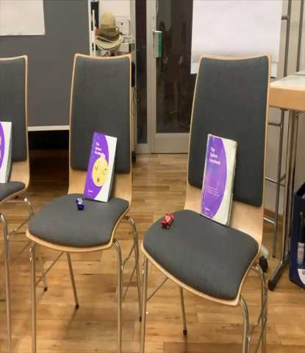
Next steps
To continue with advocacy work towards gender equality ,advocating against GBV as well as influencing stories of change from women of diverse backgrounds and nationalities holding the torch and being a beacon of hope to all women in African .
Women’s Voice and Leadership Learning and Sharing Summit 2025

