Slide 1








LEARNING
AND SHARING
SUMMIT 2025
Mobilising the Interfaith Sector as a credible and effective stakeholder in ending GBV and contributing to the National Strategic Plan (GBVF)
We Will Speak Out South Africa and
Faith Action Collective to End GBV
Women’s Voice and Leadership Learning and Sharing Summit 2025

Slide 2
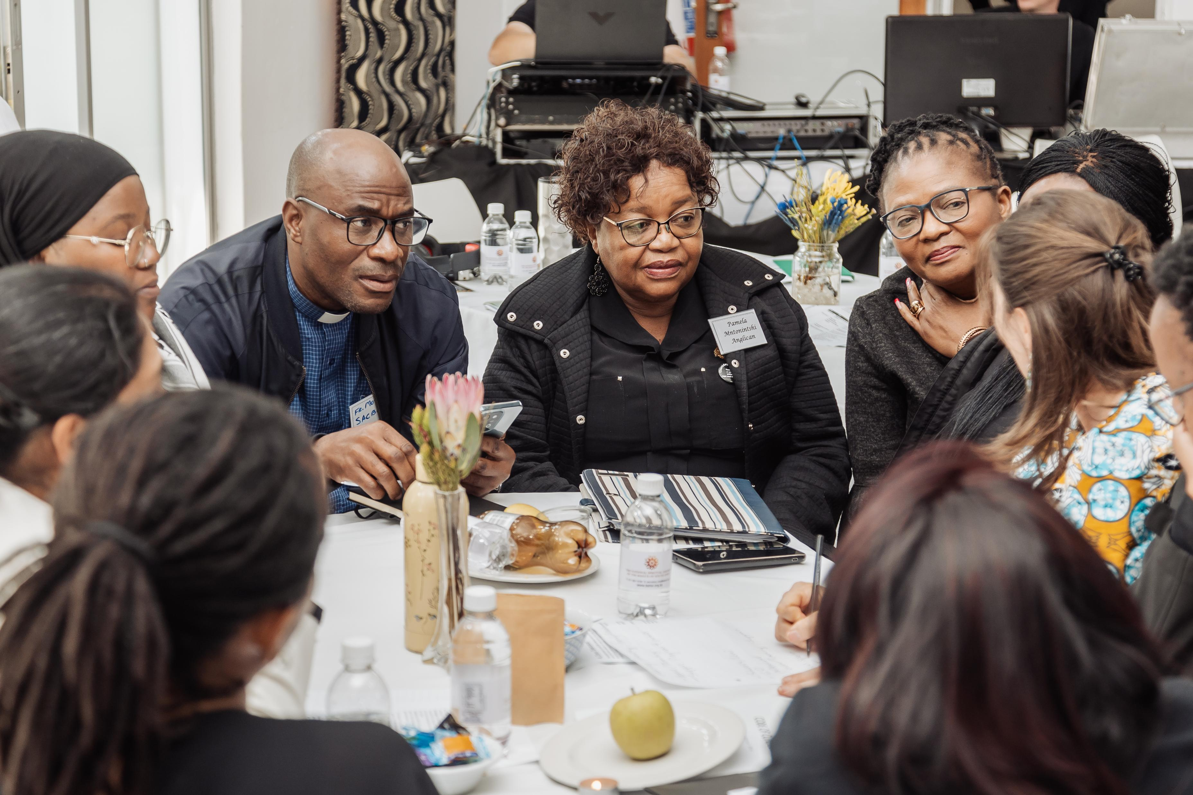
Summary
SNAPSHOT 2023-2024
8 different faith traditions – sharing, listening, learning – courageous conversations
1000+ people of faith have engaged to date
2 in-person consultations to learn about each other’s faiths wrt gender and GBV
2 faith sector Summits – attendance over 300 in total in-person and online
Monthly online Interfaith Forums of the Faith Action Collective to End GBV
8 interfaith Webinars (with global partners Side by Side and Bread for the World)
1 ground-breaking united Interfaith GBV Statement of Commitment
Over 700 Signatories to the Statement
1 formal Interfaith GBV Prevention and Mitigation Plan (2024-2030)
Detailed systematic Monitoring, Evaluation and Learning Framework ready for implementation
https://drive.google.com/drive/folders/1VYCgzSeD1CkoiZkft6xolZrj20NjZfRp?usp=sharing (FULL VIDEO)
Voice and Choice Learning and Sharing Summit 2025

Slide 3
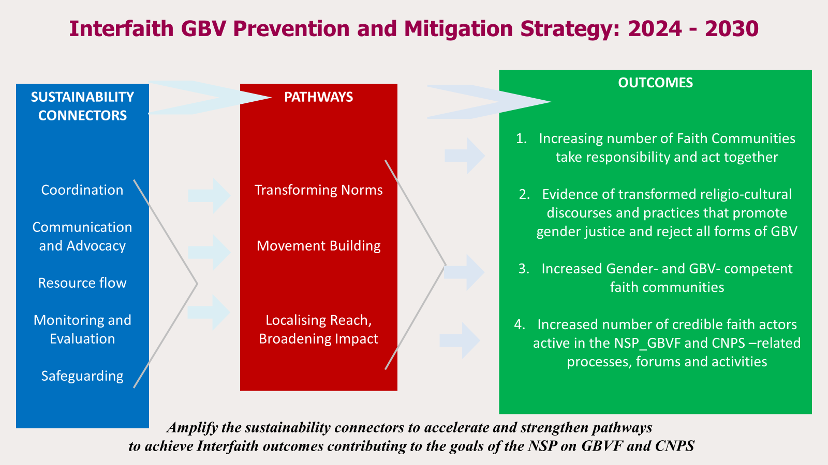
Initiatives and strategies
The Faith Action Collective: vehicle for building unity and offering shared directions for the effective implementation of the new Interfaith Strategy 2024-2030. WWSOSA is its Secretariat
Voice and Choice Learning and Sharing Summit 2025
Notes:
How will your initiative contribute to building stronger and more inclusive movements?
What strategies will you use to strengthen collaboration and solidarity?

Slide 4
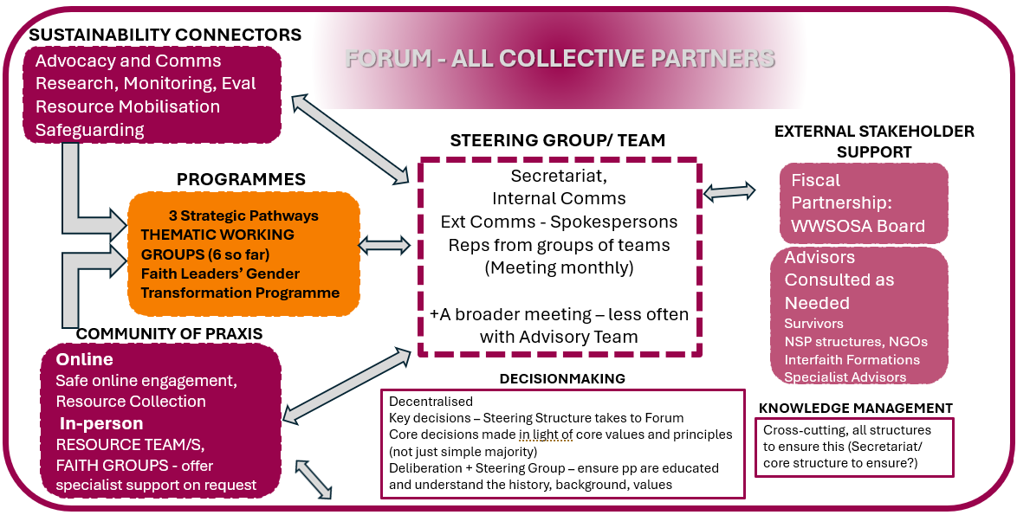
Governance & Resource Allocation
Voice and Choice Learning and Sharing Summit 2025
Notes:
How will you ensure active participation and decision-making from all members? To ground the strategy in concrete actionable joint initiatives and independent actions amongst faith sector stakeholders, and holding every person and organisation involved accountable to one another, its people and to the Almighty, compassionate One for whom every person is of equal value. A culture of Voluntarism enables the work to continue between funding sources, but it is relly not ideal. (The work has never actually been adequately funded)
How will you distribute resources across partners to promote equity and sustainability within the movement?
Joint funding proposals
Sharing online resources
Resource teams

Slide 5

Inclusive Leadership & Coordination
How will you leverage expertise and diverse connections to strengthen advocacy efforts?
Voice and Choice Learning and Sharing Summit 2025
Notes:
By partnering with multiple stakeholders e.g.:
Specialists in key areas (UJAMAA, GIN, Heartlines, Phephisa)
UNISA (Research base, Accreditation)
DWYPD
NSP Pillar Groups (2, 4)
GBV CSOs, Networks (Global, Regional, National, Local) KZN Network on Violence Against Women
Hindu Maha Sabha, SACC, Religions for Peace, TEASA, Social Development Arms of various churches, Baha’i Centre

Slide 6
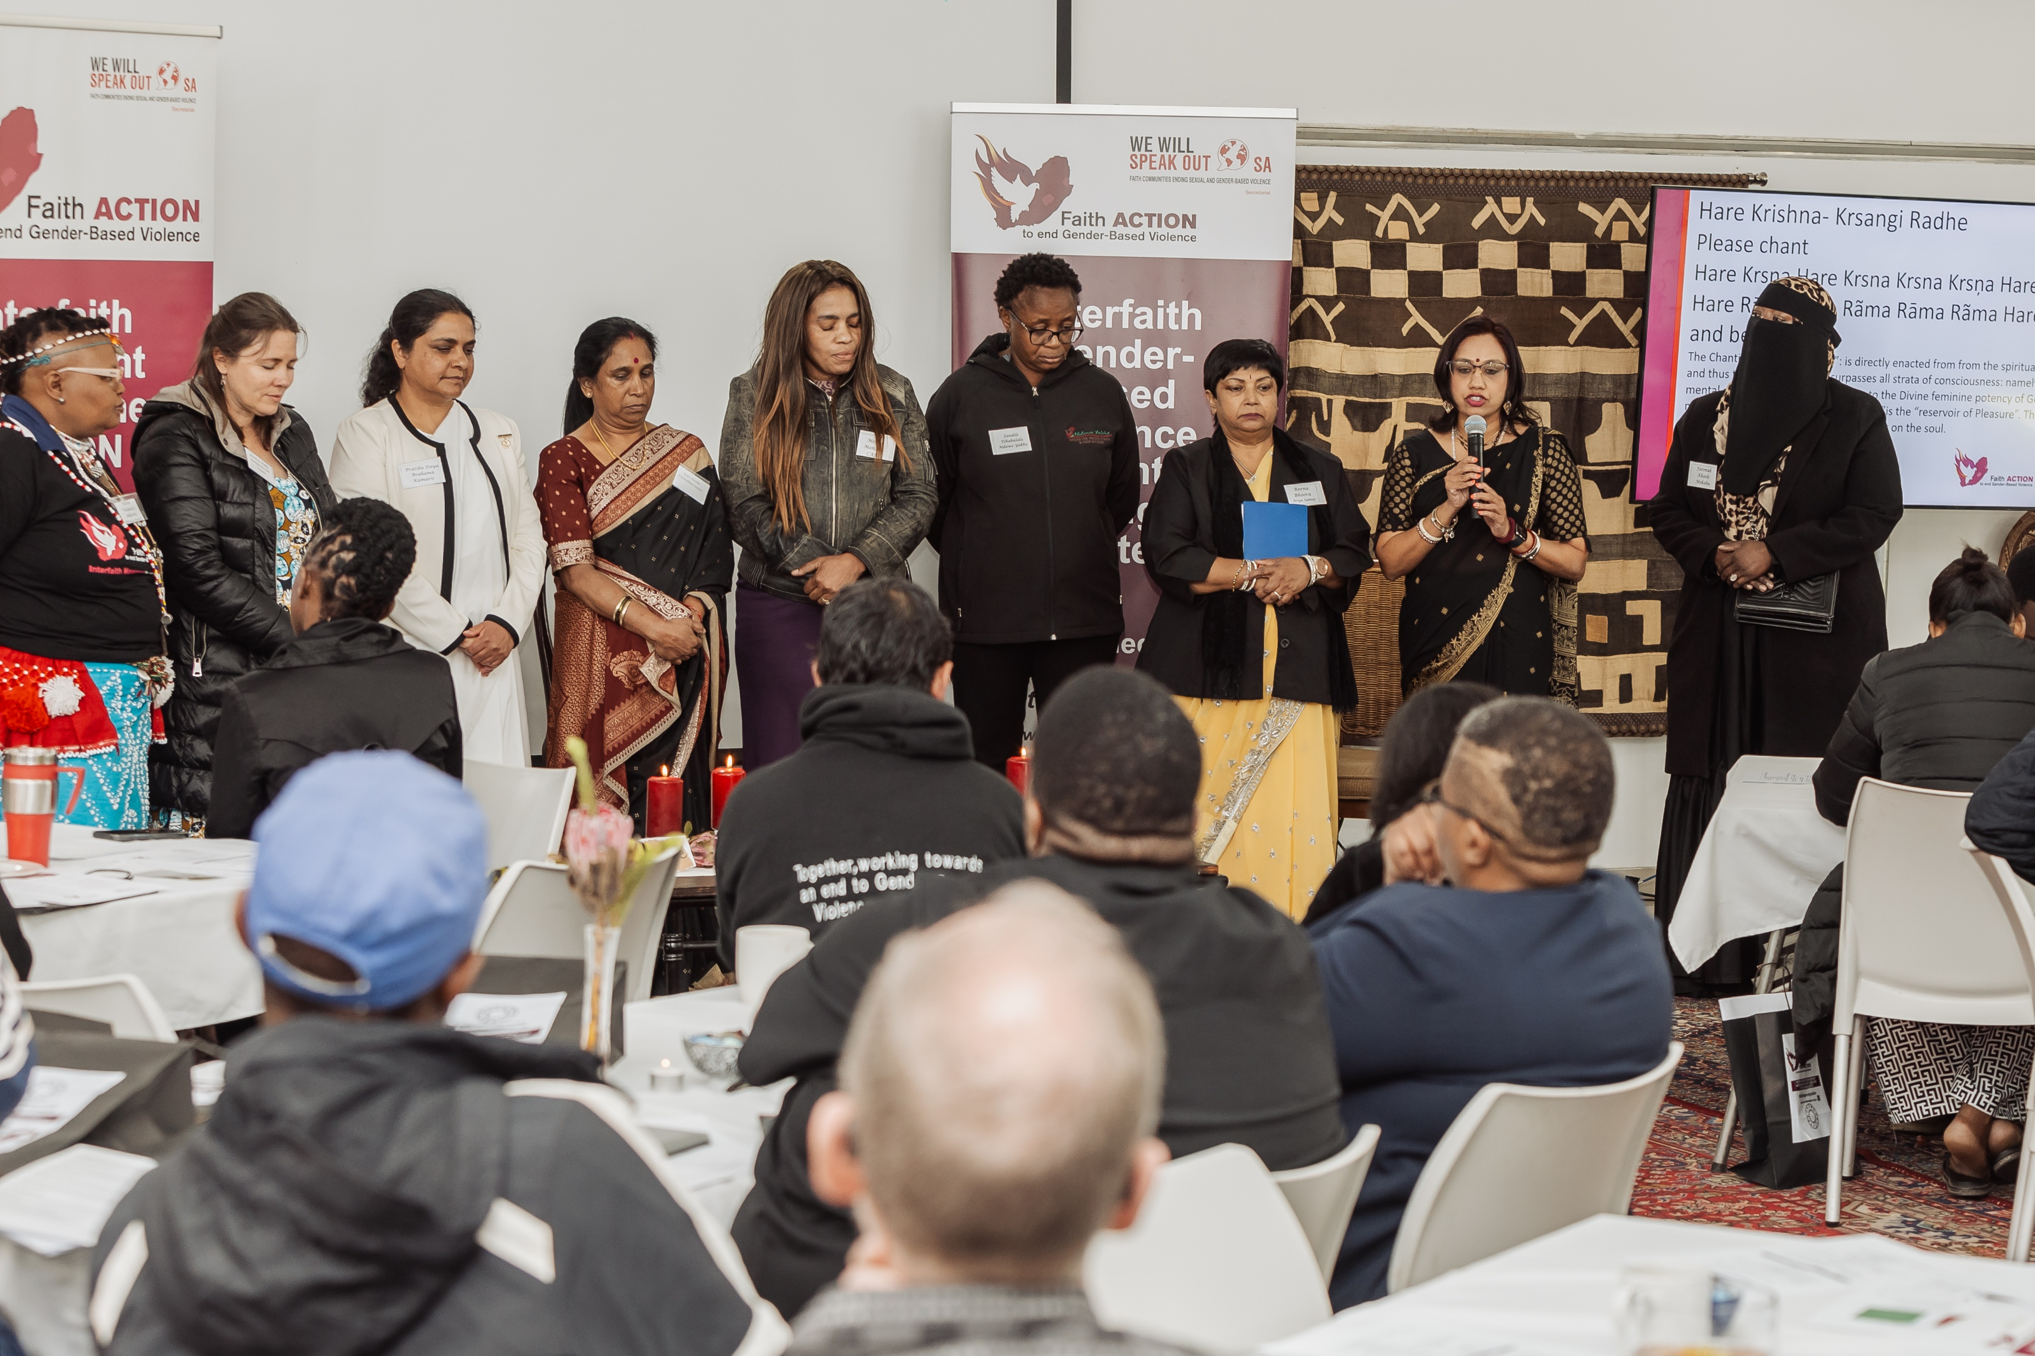
Inclusive Leadership & Coordination
What strategies will you implement to coordinate campaigning?
Forum Meetings and Webinars, Practical skills modules – Faith Action Collective
Thematic Working Groups and Resource Teams
A communication and advocacy strategy that intentionally:
builds connectedness and shapes community,
affirms the voices of the most oppressed by GBV – survivors,
demands accountability and affirm justice as well as challenging injustice
Voice and Choice Learning and Sharing Summit 2025

Slide 7
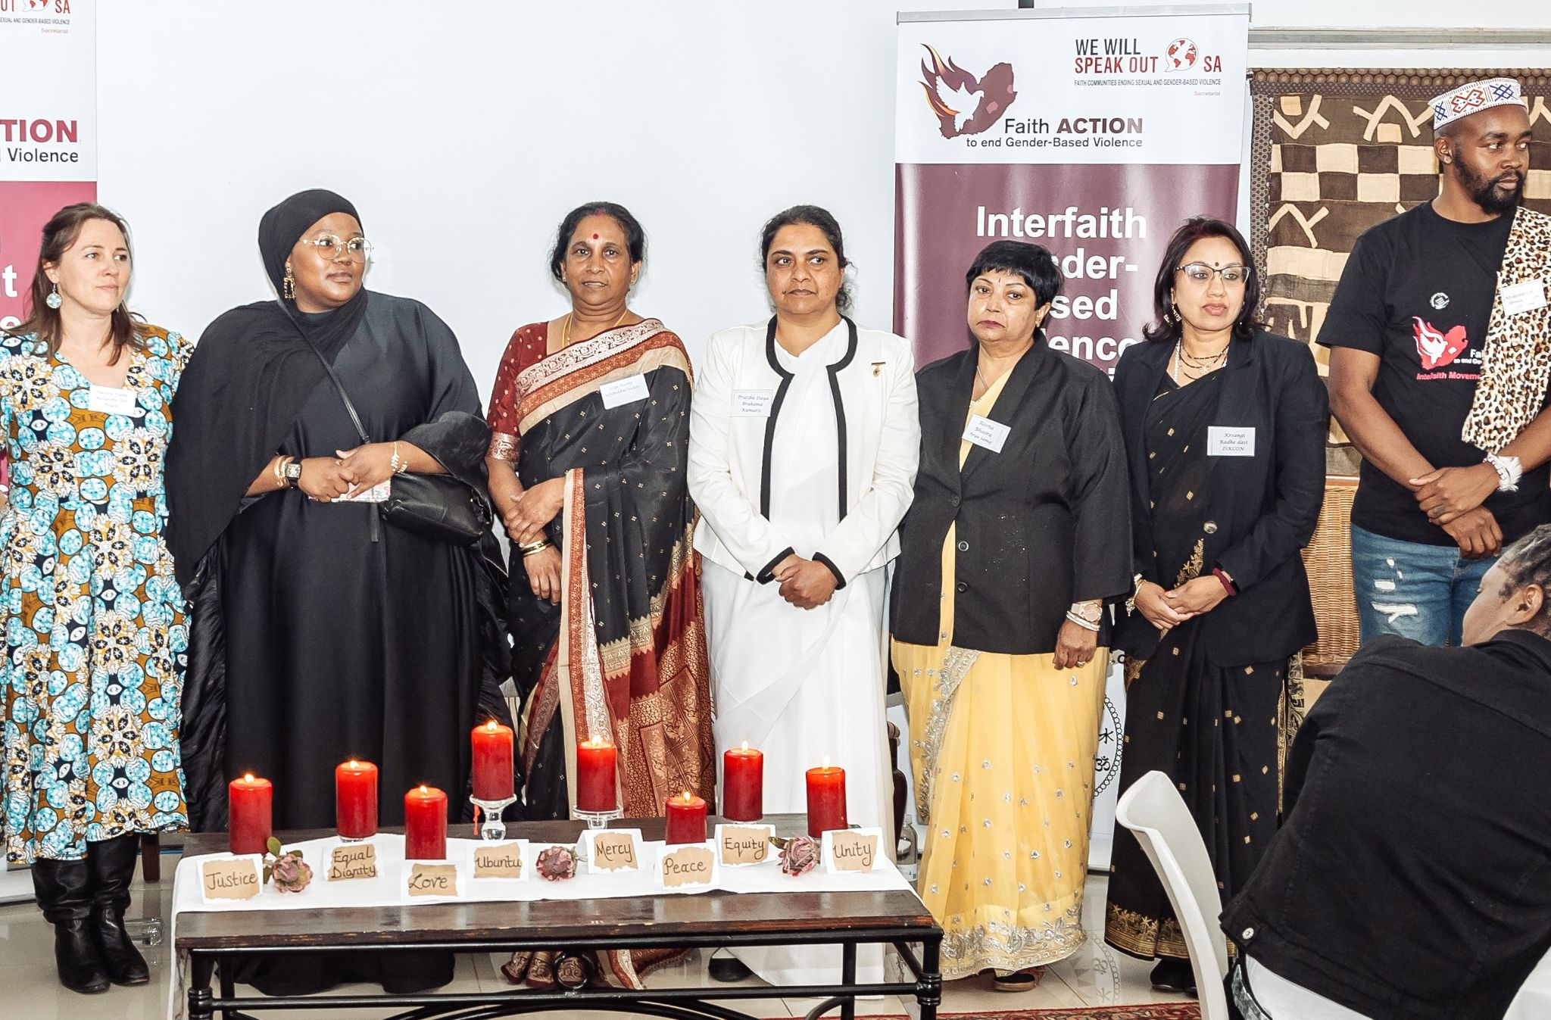
Connecting & Community-Building
What approaches will you use to build and sustain relationships within the advocacy community?
Shared faith values - foundation
Human Rights and Human Dignity Framework
Transformative Gender Justice
GBV as one form of Intersectional violence
Whole-of-Society - Faith = Credible Stakeholder
Shared Accountability and Shared Responsibility
Internal and External Transformation
Spiritual Abuse as key to understanding GBV and the religious sector
Internal consistency – to model the society we strive for
Based on a Clear Theory of Change
Voice and Choice Learning and Sharing Summit 2025

Slide 8
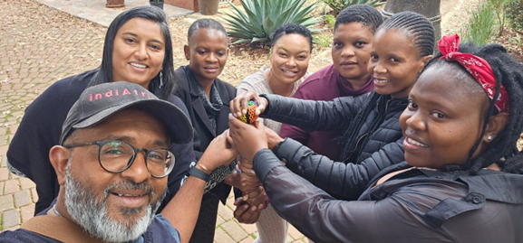
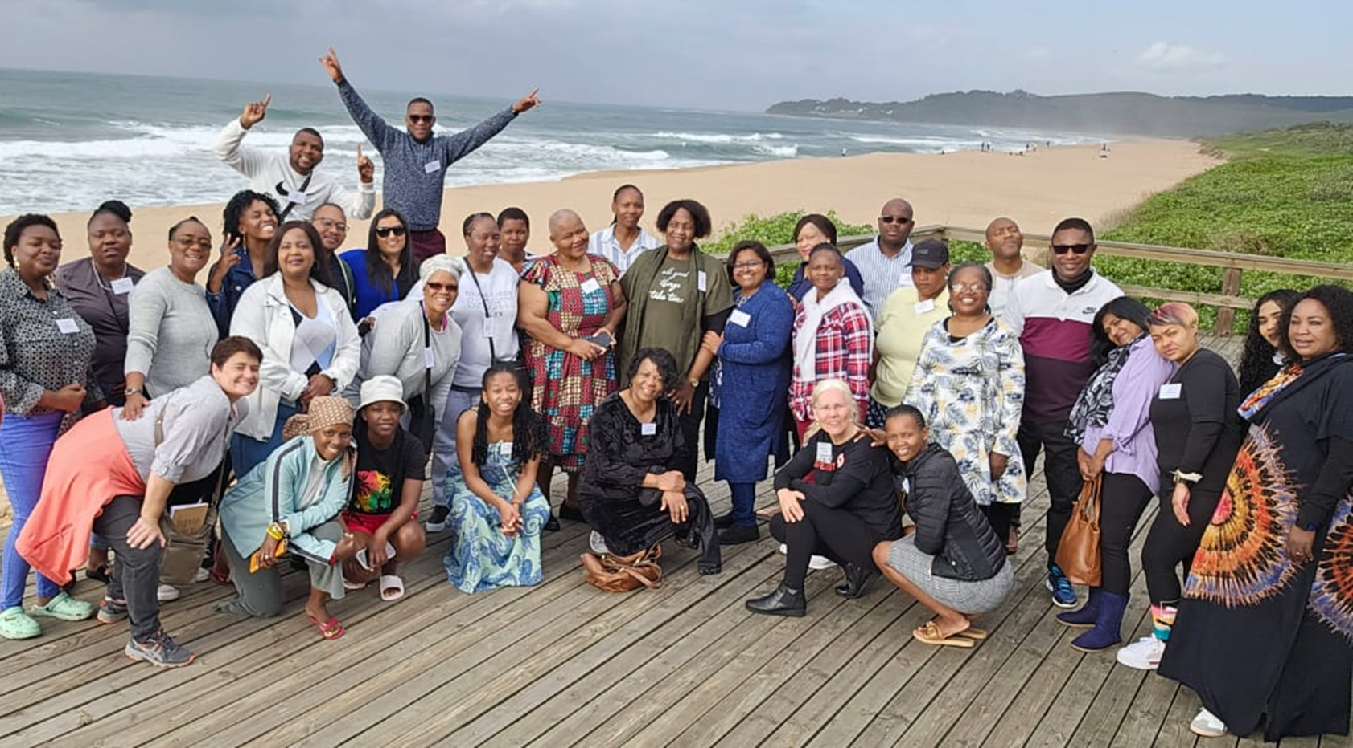
Connecting & Community-Building
Mentoring, convening, and peer exchanges among professional advocates and emerging leaders?
Flagship training: 10-month Faith Leaders Gender Transformation Programme:
SNAPSHOT
10-month programme, piloted 3 times
3 positive reviews – internal and external
75 lay, ordained Christian faith leaders
52 graduates - 70 % Pass rate
Current focus Christian (move to interfaith FLGTP - consultation)
Participants from 7/9 provinces and diverse economic backgrounds, sexualities.
Participants came from 51 diverse Christian churches and FBOs
6/51 (11%) churches/ FBOs have developed or in process of developing
gender, GBV or Safeguarding policy frameworks
*14 mentors
Indirect reach- 5200 people of faith (ave. 100 per leader)
20 collaboration partners over 3 pilots
95% of graduates would recommend the programme to other faith leaders
Voice and Choice Learning and Sharing Summit 2025
Notes:
Tdifferent teams, accompaniment eg FLGTP, Forum meetings, organisationa;l profiles, Webinars and short modules with differentworkinggroups and partners sharing their expertise

Slide 9
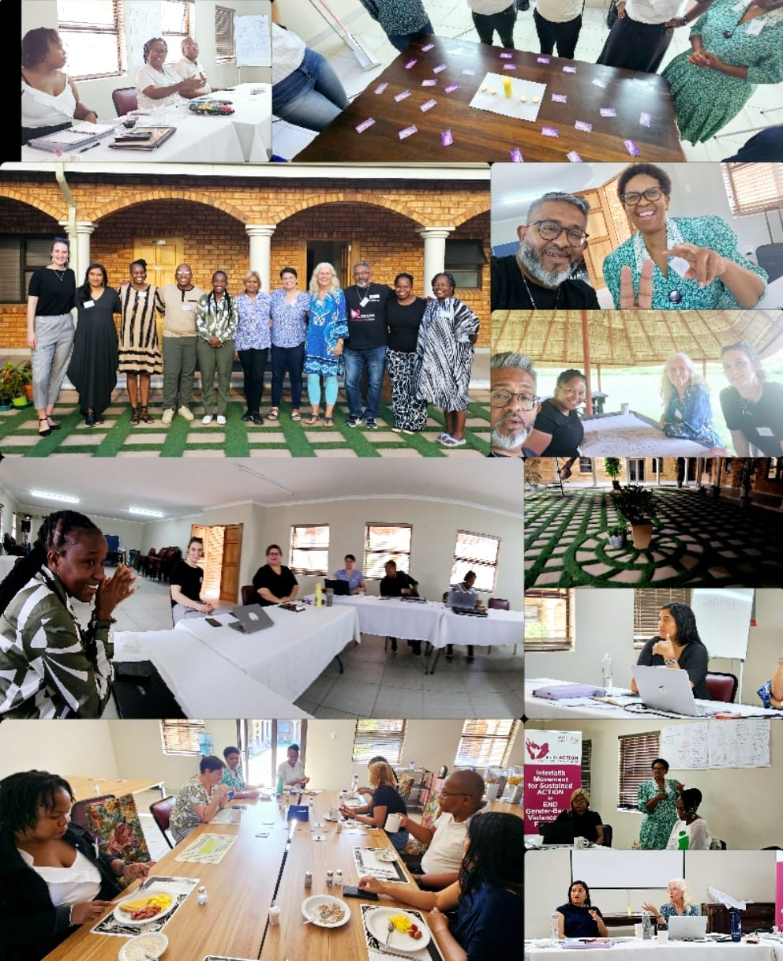
Connecting & Community-Building
Mentoring, convening, and peer exchanges among professional advocates and emerging leaders
SHORT PRACTICAL SKILLS MODULES:
CBS Contextual Bible Studies
Trauma Response and Basic Counselling
GBV, Culture, Tradition, Faith and the Law
Gender & GBV Facilitation Skills in a faith context
Integrating Gender and GBV-transformative approaches in worship/liturgy/prayer and sermons
Grappling with LGBTQI+ and Faith
Defrosting and Pushback
Men, Fathering & the Father Wound and our role as churches
Local Resource Mobilisation
CAPACITY RESOURCE TEAMS:
Faith-specific and interfaith skilled Resource Teams offer support and training on request
ONLINE COMMUNITY OF PRAXIS AND LEARNING
(See OVERLEAF)
Notes:
Tdifferent teams, accompaniment eg FLGTP, Forum meetings, organisationa;l profiles, Webinars and short modules with differentworkinggroups and partners sharing their expertise

Slide 10
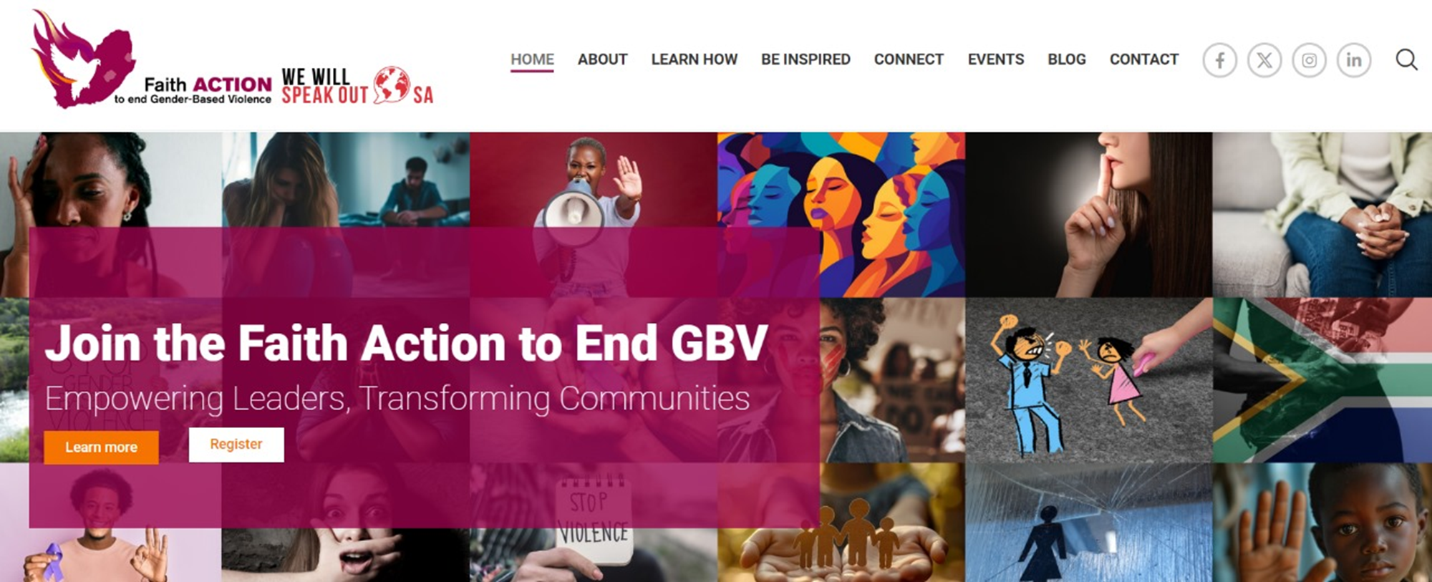
Linking & Learning:
Growing an Interfaith Community of Praxis and Ongoing Learning
In-person:
Specific faith teams – scholars, leaders, activists
Resource Team/s to be called upon for in-person support
Short GBV Skills Modules (or online)
"We plan to be the change the community needs.”
Monthly Online Forum Meetings
www.interfaithendgbv.org
Online Collaborative Engagement and Learning Platform
General website – basic information and support
Membership access:
Resources Collection
Engagement platform
Partner database – strengths and needs for mutual learning
Blogs
Shared Calendar of events
Notes:
How will you foster a culture of continuous learning and best practice sharing?
What mechanisms will you use to document and share lessons learned?

Slide 11
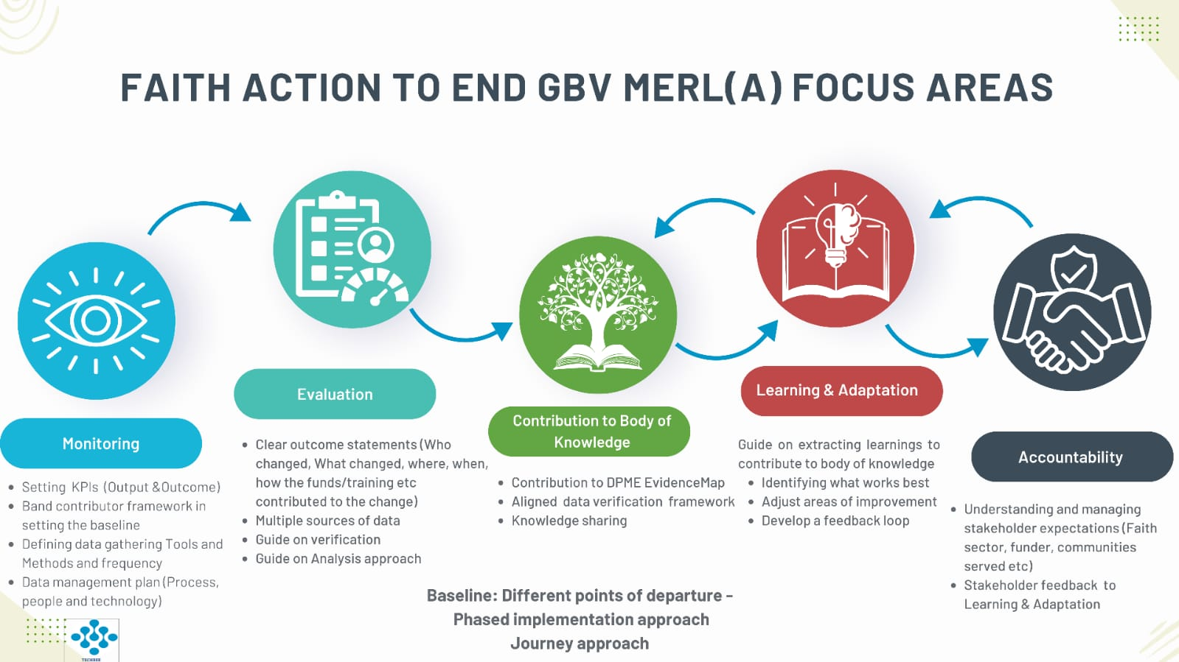
Linking & Learning: Continuous Learning for Best Practice
Voice and Choice Learning and Sharing Summit 2025
Notes:
How will you foster a culture of continuous learning and best practice sharing?
What mechanisms will you use to document and share lessons learned?

Slide 12
NEXT STEPS
Practical Implementation has already begun:
8 Working Groups were proposed at the Strategy launch.
4 have begun developing concept notes, budgets and work plans.
The core Faith Leaders Gender Transformation Programme (FLGTP) is moving towards UNISA accreditation, its final pilot in 2025 and roll-out by 2026.
Revised coordination and enabling mechanisms for the Faith Action Collective are being finalised.
Training of group convenors in use of the M,E and Learning tools and data collection
A team of practical skills specialists from diverse faiths has been formed to offer bespoke support to faith groups on request.
An ONLINE COMMUNITY OF PRAXIS PLATFORM offers safe networking, shared learning and joint advocacy planning spaces. https://www.interfaithendgbv.org.za/
MAIN CHALLENGE: LACK OF SUSTINABLE FUNDING

Slide 13
LEARNING
AND SHARING
SUMMIT 2025
THANK YOU! SIBONGILE! REALEBOGA! MERCI! THOKOZANI!
We Will Speak Out South Africa and
Faith Action Collective to End GBV
Daniela Gennrich (WWSOSA Coordinator)
Merrishia Singh-Naicker (Programmes Manager)
coordinator@wwsosa.org.za; programmes@wwsosa.org.za
Women’s Voice and Leadership Learning and Sharing Summit 2025

