Slide 1


Voice and Choice
Summit 2026-Story of Change Category
Tanzania: Parliament Extends Paid Maternity Leave for Mothers of Preterm Babies
Tanzania, Dar es Salaam | March 2026
Women Fund Tanzania Trust (WFT-T) & Tanzania SRHR Coalition
Voice and Choice Summit 2026 \ Voice and Choice Summit 2026

Slide 2
Synopsis– Tanzania's Parliament Amends Labour Laws to Protect Preterm Mothers
Name | Carol Mango
Designation | Head of Resource Mobilization and Communications
Organisation | Women Fund Tanzania Trust (WFT-T)
Country | Tanzania
Category | Story of Change – Policy and Legislative Reform
Summary: | WFT-T & the Tanzania SRHR Coalition led a multi-pronged advocacy campaign that resulted in Tanzania's Parliament amending Section 33 of the Labour Laws in 2024, extending paid maternity leave for mothers of preterm babies until their infants reach the full 40-week gestational age – benefiting approximately 332,000 mothers annually and establishing Tanzania as a regional leader in maternal and child health protection.
Voice and Choice Summit 2026 \ Voice and Choice Summit 2026

Slide 3

Background(problem, actions, change, evidence)
Context: Tanzania's 84-day maternity leave policy was grossly inadequate for mothers of preterm babies. Mothers were forced to return to work with infants barely one month old, far too fragile for alternative care.
Problem: Premature births account for 40% of Tanzania's neonatal deaths. Mothers faced impossible choices between employment and infant survival, with inadequate insurance coverage compounding financial distress.
Actions: WFT-T and the Tanzania SRHR Coalition deployed evidence-based research, stakeholder mobilization, grassroots advocacy across all 31 regions, and direct legislative engagement.
Change: In 2024, Parliament amended Section 33 of the Labour Laws, extending paid maternity leave for preterm mothers until infants reach full 40-week gestational age – one of the first such policies in Africa.
Voice and Choice Summit 2026 \ Voice and Choice Summit 2026

Slide 4

Background
Organisation: Women Fund Tanzania Trust (WFT-T) is Tanzania's first national feminist fund (est. 2008), supporting 450+ grassroots WROs across 31 regions. WFT-T partnered with the Tanzania SRHR Coalition, a countrywide membership network. https://youtu.be/N9fz0sfH64Q
Situation Before: Labour Laws provided only 84 days of maternity leave from birth. Preterm mothers returned to work with infants barely one month old. Premature births represent 16.6% of Tanzania's 2 million annual births and 40% of neonatal deaths.
Key Objectives: (1) Extend maternity leave for preterm mothers from 84 to 168 days; (2) Extend 168-day provision to all mothers; (3) Expand insurance coverage for full preterm care period; (4) Institutionalize policy reform; (5) Integrate preterm birth prevention education in school curricula.
Voice and Choice Summit 2026 \ Voice and Choice Summit 2026

Slide 5
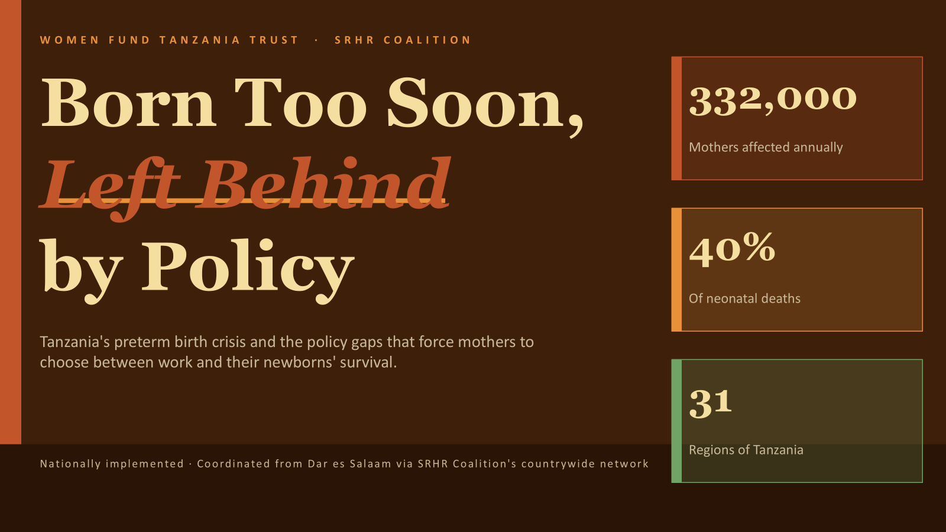
Context
Location: Nationally implemented across Tanzania's 31 regions, coordinated from Dar es Salaam via the SRHR Coalition's countrywide membership network.
Most Affected: Approximately 332,000 mothers annually (16.6% of 2 million births) deliver preterm. These mothers faced impossible choices between employment and infant survival, with premature births accounting for 40% of Tanzania's neonatal deaths.
Issues Addressed: Inadequacy of 84-day maternity leave for preterm mothers; absence of gestational-age calculations in leave policy; lack of comprehensive insurance coverage for preterm medical care; and the need for preventive education on biological risk factors for preterm births.
Voice and Choice Summit 2026 \ Voice and Choice Summit 2026

Slide 6
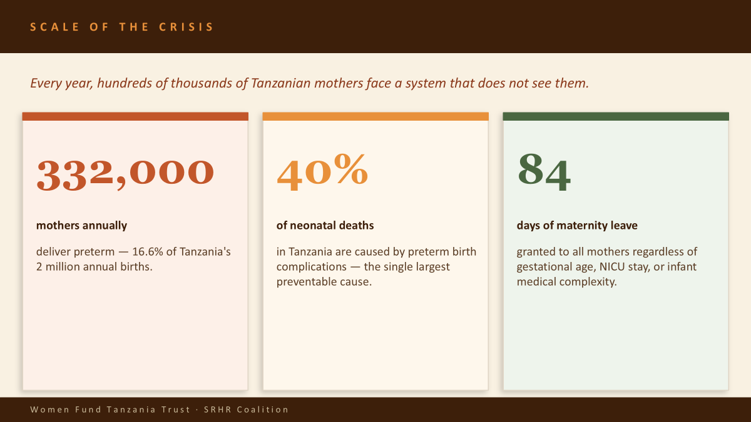
Context
Voice and Choice Summit 2026 \ Voice and Choice Summit 2026

Slide 7
FOUR CRITICAL POLICY GAPS
Structural failures in Tanzania's maternity policy that leave preterm mothers unprotected.
⏱
Inadequate Leave Duration
📅
No Gestational Age Calculation
84-day leave was designed for full-term birth. A preterm infant may need 60–120+ days of NICU care — erasing the entire leave period before the child comes home.
Policy does not distinguish a 28-week from a 40-week birth. Leave begins at delivery regardless of gestational age, treating radically different medical realities as identical.
🏥
Absent Insurance Coverage
📚
Lack of Preventive Education
Comprehensive coverage for extended preterm NICU care is largely unavailable, forcing families into catastrophic out-of-pocket expenditure during the most vulnerable weeks of life.
Mothers lack information on biological risk factors — hypertension, infections, multiple gestation — that predict preterm birth and could reduce prevalence through early intervention.
Women Fund Tanzania Trust · SRHR Coalition

Slide 8
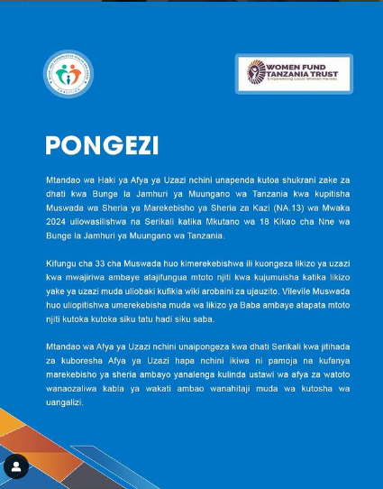
Actions
Leadership: WFT-T and Tanzania SRHR Coalition led the initiative, leveraging the Coalition's countrywide membership network and WFT-T’s thought leadership, expertise and feminist grant-making support.
Research & Evidence: Evidence-based research documented the inadequacy of 84-day maternity leave, building compelling cases for reform and informing proposals submitted to parliamentarians and labor ministry officials.
Grassroots Mobilization: The SRHR Coalition mobilized women's organizations across all 31 regions, creating localized pressure on policymakers while maintaining coordinated national advocacy. Public campaigns amplified mothers lived experiences.
Legislative Engagement: Direct dialogues with parliamentarians, labor ministry officials, and insurance regulators, presenting evidence-based proposals for extending maternity leave and expanding insurance coverage. Preterm mothers were strategically prioritized as the entry point.
Education Partnership: Educational institutions became crucial partners, with advocacy for integration of preterm birth prevention content into secondary school and teacher training college curricula.
Voice and Choice Summit 2026 \ Voice and Choice Summit 2026

Slide 9

The change - impact
The Change: In 2025, Tanzania's Parliament enacted a landmark amendment to Section 33 of the Labour Laws during the 18th Meeting of the Fourth Session, extending paid maternity leave until preterm infants reach full 40-week gestational age.
When & Where: National policy reform enacted in Tanzania's Parliament in 2024. Implementation across all 31 regions, affecting all employed mothers of preterm babies in both public and private sectors.
Positive Impact: The change is unequivocally positive. Approximately 332,000 mothers annually gain legally protected time for intensive caregiving during their babies' critical early development – directly addressing the stark reality that premature births account for 40% of Tanzania's neonatal deaths.
Situation Now: Mothers delivering two months early receive those additional two months fully paid, beyond standard leave. Tanzania is now established as a regional leader in maternal and child health protection – among the first in Africa with such a policy.
Voice and Choice Summit 2026 \ Voice and Choice Summit 2026

Slide 10
WHY THIS CHANGE MATTERS
Reforming maternity leave policy for preterm births is not a fringe ask — it is a systemic correction with transformative reach.
LIVES SAVED
Up to 133,000 infants at lower mortality risk annually
Global Precedent
When mothers can remain present through NICU care, breastfeeding, kangaroo care, and early bonding directly reduce preterm complication rates — the interventions that close the 40% mortality gap.
South Africa, Kenya, and several EU states already extend maternity leave based on gestational age at birth. Tanzania's reform would place it among progressive African policy leaders — and fulfill ILO Maternity Protection Convention obligations.
ECONOMIC SECURITY
Prevents income loss for 332,000 families each year
A mother forced back to work before her preterm infant is discharged faces simultaneous loss of income if dismissed, or loss of the child if she stays. Policy reform removes this impossible trade-off.
Movement Behind the Ask
WFT-T's SRHR Coalition spans all 31 regions. 450+ grassroots WROs, maternal health advocates, and labor rights networks are aligned behind this campaign — giving the reform genuine constituency, not just top-down advocacy.
GENDER JUSTICE
Closes a hidden gender penalty embedded in law
Preterm birth disproportionately affects younger, lower-income, and rural women. A one-size maternity policy that ignores gestational age structurally punishes the most vulnerable mothers.
Women Fund Tanzania Trust · SRHR Coalition

Slide 11
Challenges and Lessons Learnt:
Challenges: Private sector employer compliance is challenging - mitigated through monitoring mechanisms and labor inspector capacity-building. Insurance coverage gaps persist - requiring sustained engagement with NHIF and private insurers. Curriculum integration faces bureaucratic hurdles - requiring long-term partnership with the Ministry of Education. Gap between policy enactment and practice - WFT-T is committed to supporting implementation monitoring and helping mothers claim their rights.
Lessons Learnt: (1) Sustained evidence-based advocacy achieves transformative policy change. (2) Intersectional organizing centering affected women lived voices - combined with technical expertise - is powerful. (3) Targeting preterm mothers as an entry point builds credibility for universal coverage. (4) Coalition strength is amplified when grassroots legitimacy and institutional expertise are combined. (5) Policy reform requires simultaneous attention to implementation.
Voice and Choice Summit 2026 \ Voice and Choice Summit 2026

Slide 12
Beneficiaries
 | Number of participants
Female – Direct beneficiaries | 332,000
Male – Direct beneficiaries | 332,000
Female – Indirect beneficiaries (e.g. through other networks) | 1,200,000
Male – Indirect beneficiaries (e.g. through other networks) | 800,000
Female – Online beneficiaries (e.g. website access, mailing lists, scholarly articles) | 500,000
Male – Online beneficiaries (e.g. website access, mailing lists, scholarly articles) | 200,000
Total | 3,364,000
Voice and Choice Summit 2026 \ Voice and Choice Summit 2026

Slide 13
Sustainability:
Scale Up: (1) Pursue universal maternity leave extension to 168 days for all mothers, using the preterm precedent. (2) Expand insurance coverage with NHIF and private insurers. (3) Integrate reproductive health curriculum in secondary schools and teacher training colleges with the Ministry of Education. (4) Share Tanzania’s experience as a replicable model for East African countries.
Voice and Choice Summit 2026 \ Voice and Choice Summit 2026

Slide 14
Next Steps
1. Implementation Monitoring: Launch a systematic compliance monitoring program to ensure employers – particularly in the private sector – adhere to the new maternity leave provisions. Support mothers in claiming their rights and document violations.
2. Universal Maternity Leave Campaign: Initiate the next phase of advocacy for extension of maternity leave to 168 days for all mothers, framing this as logical progression from the preterm victory.
3. Insurance Coverage Reform: Engage the National Health Insurance Fund and private insurers to expand coverage for the entire preterm care period, addressing financial barriers the policy reform alone cannot eliminate.
4. Curriculum Integration: Begin sustained partnership with the Ministry of Education to integrate preterm birth prevention and reproductive health content into secondary school and teacher training college curricula.
5. Regional Knowledge Sharing: Document and disseminate Tanzania's experience as a replicable model for East African countries facing similar maternal health policy challenges, amplifying impact beyond national borders.
Voice and Choice Summit 2026 \ Voice and Choice Summit 2026

Slide 15
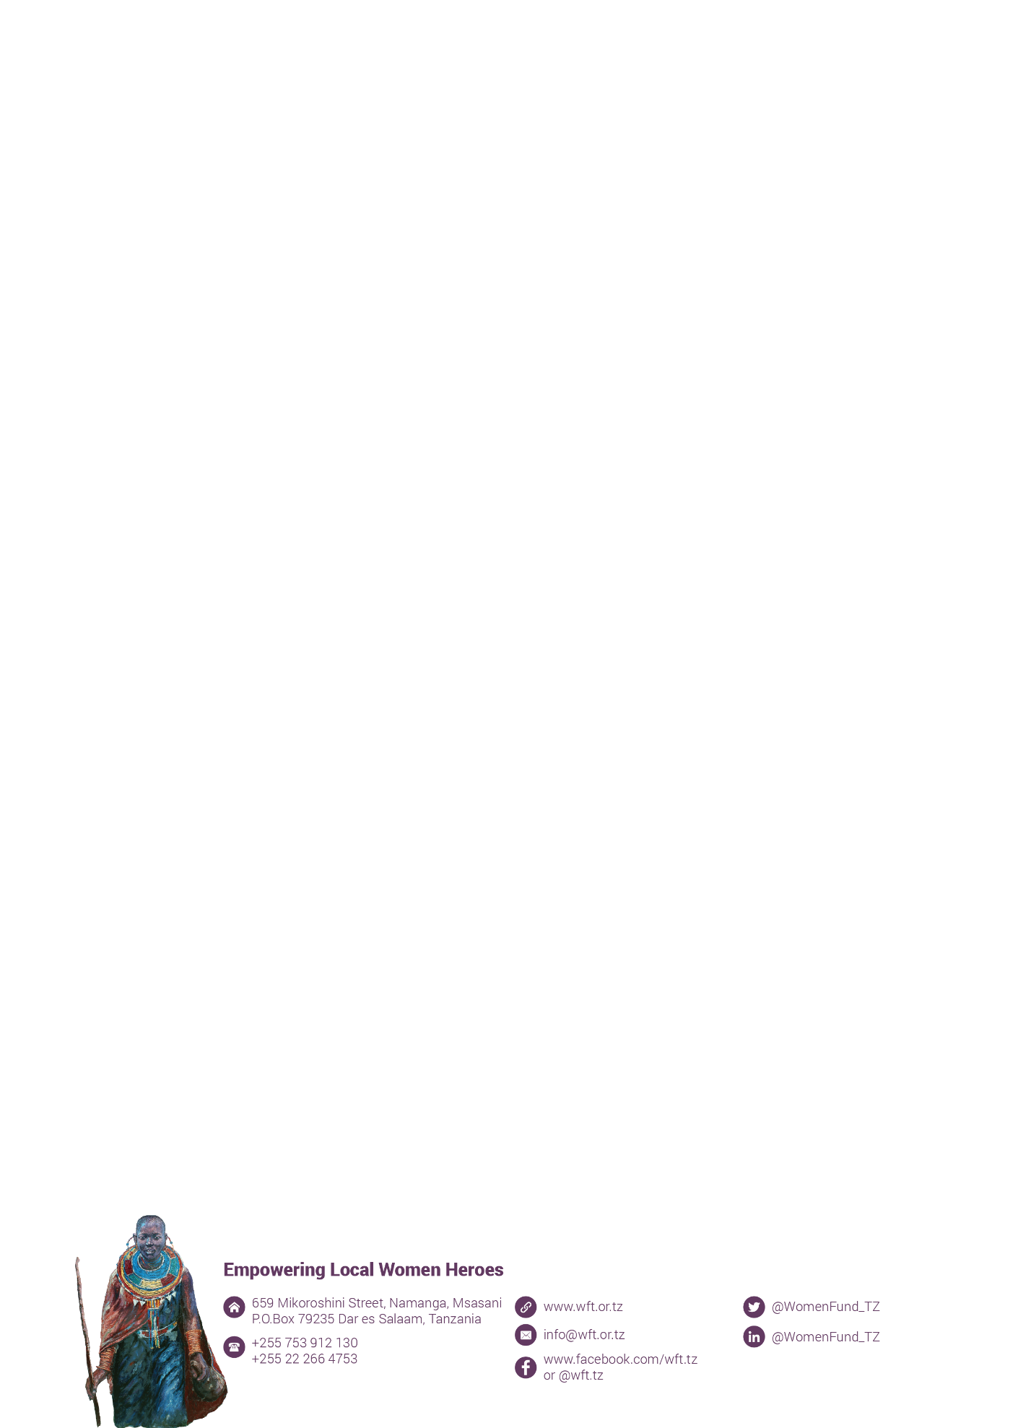
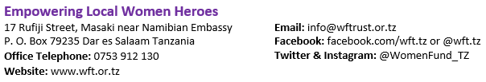
GRACIAS!

