Slide 1

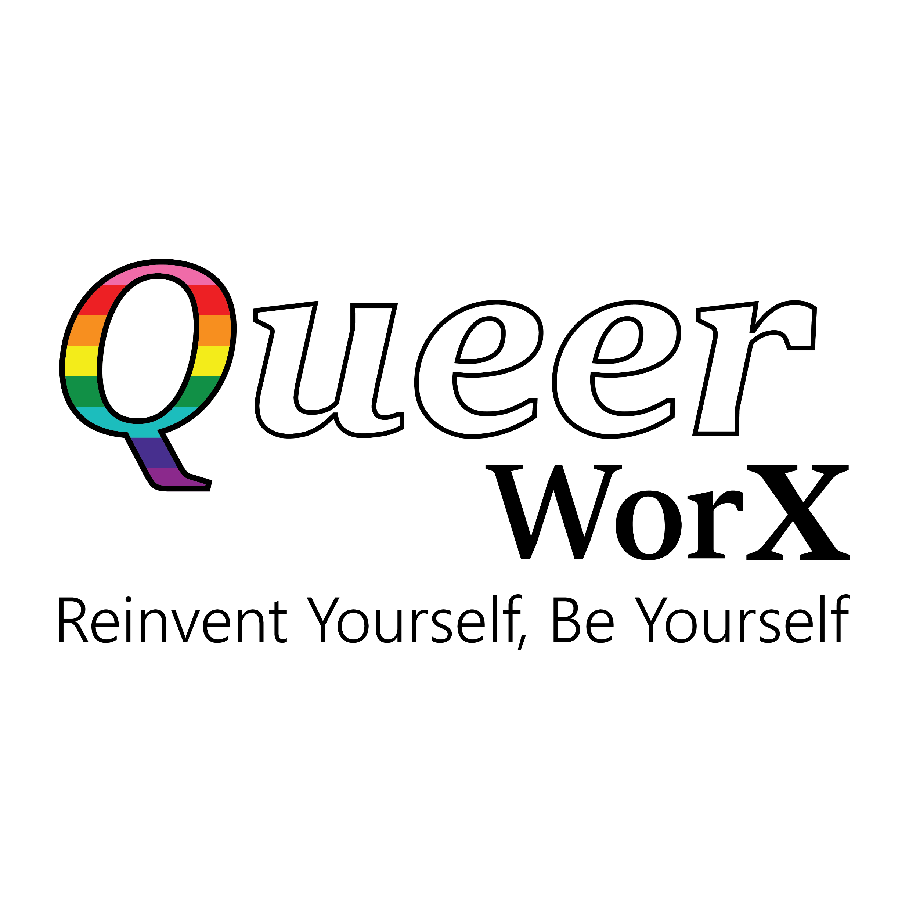
Voice and Choice Summit 2026 - Leadership Category
Lesotho: Building New Norms for LGBTIQ+ Economic Empowerment Through Mindset Change
Bokang Bane | Executive Director, Queer WorX | Lesotho
Driver of Change | Marang LGBTIQ Fund | Voice and Choice Summit 2026
Voice and Choice Summit 2026 \ Voice and Choice Summit 2026

Slide 2
Synopsis– brief overview what this is about
Name | Bokang Bane
Designation | Executive Director
Organisation | Queer WorX
Country | Lesotho
Category | Driver of Change | Marang LGBTIQ Fund
Summary | Lesotho’s LGBTIQ+ movement has made important progress in advancing visibility, health access, and protection from discrimination. These efforts remain essential in expanding space for LGBTIQ+ people to live more openly and safely. Building on this foundation, Queer WorX introduces an economic justice lens to LGBTIQ+ advocacy by focusing on economic participation, human capital development, and community capability. Through baseline research and community consultations, Queer WorX identified that many LGBTIQ+ people face barriers to employment, entrepreneurship, and financial systems due to stigma, limited access to skills, and lack of institutional knowledge. In response, the organization developed initiatives such as Queer Econ, legal education sessions, and the upcoming Phutheho Business Network, to improve economic participation , confidence and community collaboration and access to opportunities. By investing in skills, confidence, and public narratives, Queer WorX is contributing to the a broader understanding of inclusion one that recognizes LGBTIQ+ people not only as rights holders, but also as contributors to Lesotho’s social and economic development.
Voice and Choice Summit 2026 \ Voice and Choice Summit 2026

Slide 3
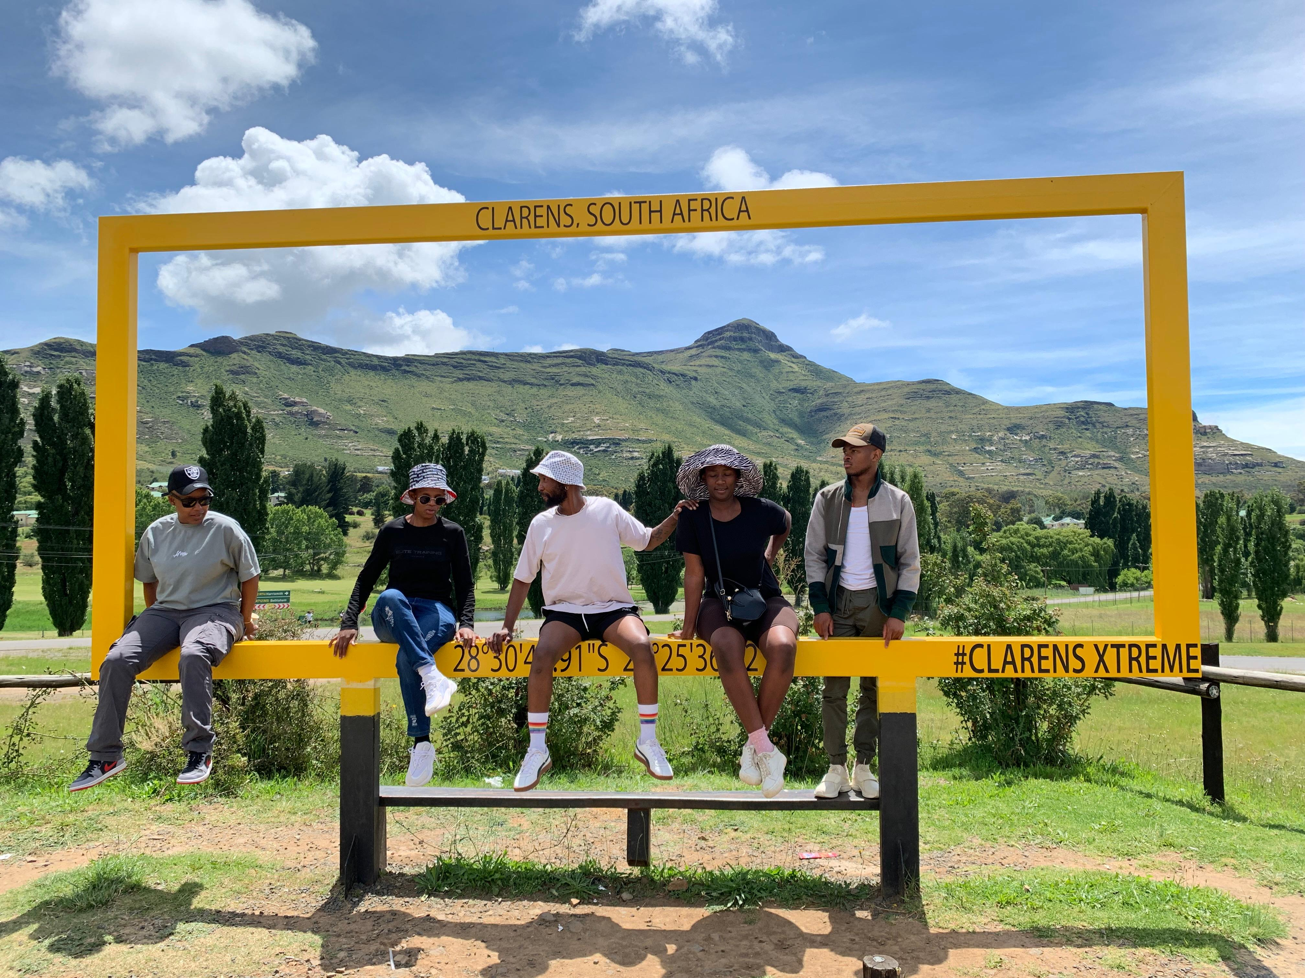
Background
Queer WorX is an emerging leader in Lesotho’s LGBTQI+ movement, advancing advocacy through an economic justice lens. The organisation connects human rights work with economic participation by building programmes that strengthen skills, knowledge, and confidence within LGBTQI+ communities.
Economic participation is closely linked to dignity, independence, and long-term inclusion. Recognising that limited access to skills, employment, entrepreneurship opportunities, and financial systems continues to marginalise LGBTQI+ people, Queer WorX focuses on strengthening the human capital and capabilities within communities so individuals can participate more fully in economic life.
Problem Being Addressed
Lesotho’s LGBTQI+ people continue to face significant economic marginalisation, including limited access to employment, entrepreneurship opportunities, financial services, and skills development. As a result, many remain excluded from meaningful economic participation despite broader progress in human rights advocacy.
How the Problem is Informed
Through community consultations, lived experiences within LGBTQI+ communities, and engagement with grassroots networks, Queer WorX identified economic exclusion as a critical but under-addressed barrier to dignity, independence, and long-term inclusion. These insights have shaped the organisation’s focus on economic empowerment as a key pathway for advancing LGBTQI+ equality in Lesotho.
Queer WorX Team at the end of year retreat and reflection
Voice and Choice Summit 2026 \ Voice and Choice Summit 2026

Slide 4
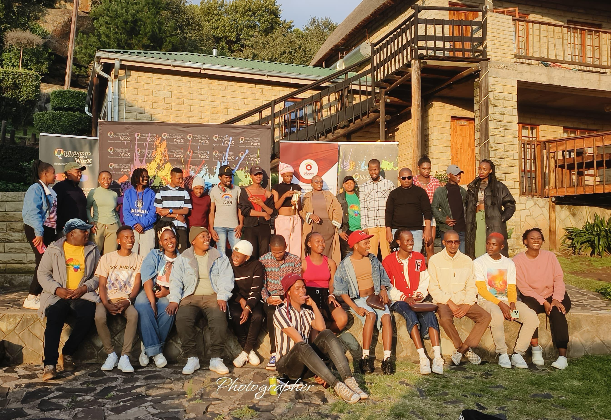
Background(problem, actions, change, evidence)
Queer WorX is one of the few LGBTQI+ organisations in Lesotho that places economic justice at the centre of its advocacy. While many initiatives focus primarily on legal or social rights, Queer WorX bridges human rights advocacy with economic empowerment, recognising that dignity and inclusion are closely tied to people’s ability to participate in economic life.
The organisation focuses on building human capital within LGBTQI+ communities by strengthening skills, knowledge, confidence, and entrepreneurship pathways. This approach positions economic participation not only as a livelihood strategy but also as a long-term pathway to social inclusion and resilience.
Many LGBTIQ+ people in Lesotho face barriers to economic participation.These include:
discrimination in employment and entrepreneurship
limited access to business and digital skills
fear of engaging institutions due to stigma
lack of inclusive national data systems
National surveys still recognise Basotho only within a male/female binary, leaving gender-diverse communities statistically invisible.
Without access to livelihoods and opportunities, inclusion remains fragile.
Leribe, Berea, and Butha-Buthe Participants
Voice and Choice Summit 2026 \ Voice and Choice Summit 2026

Slide 5
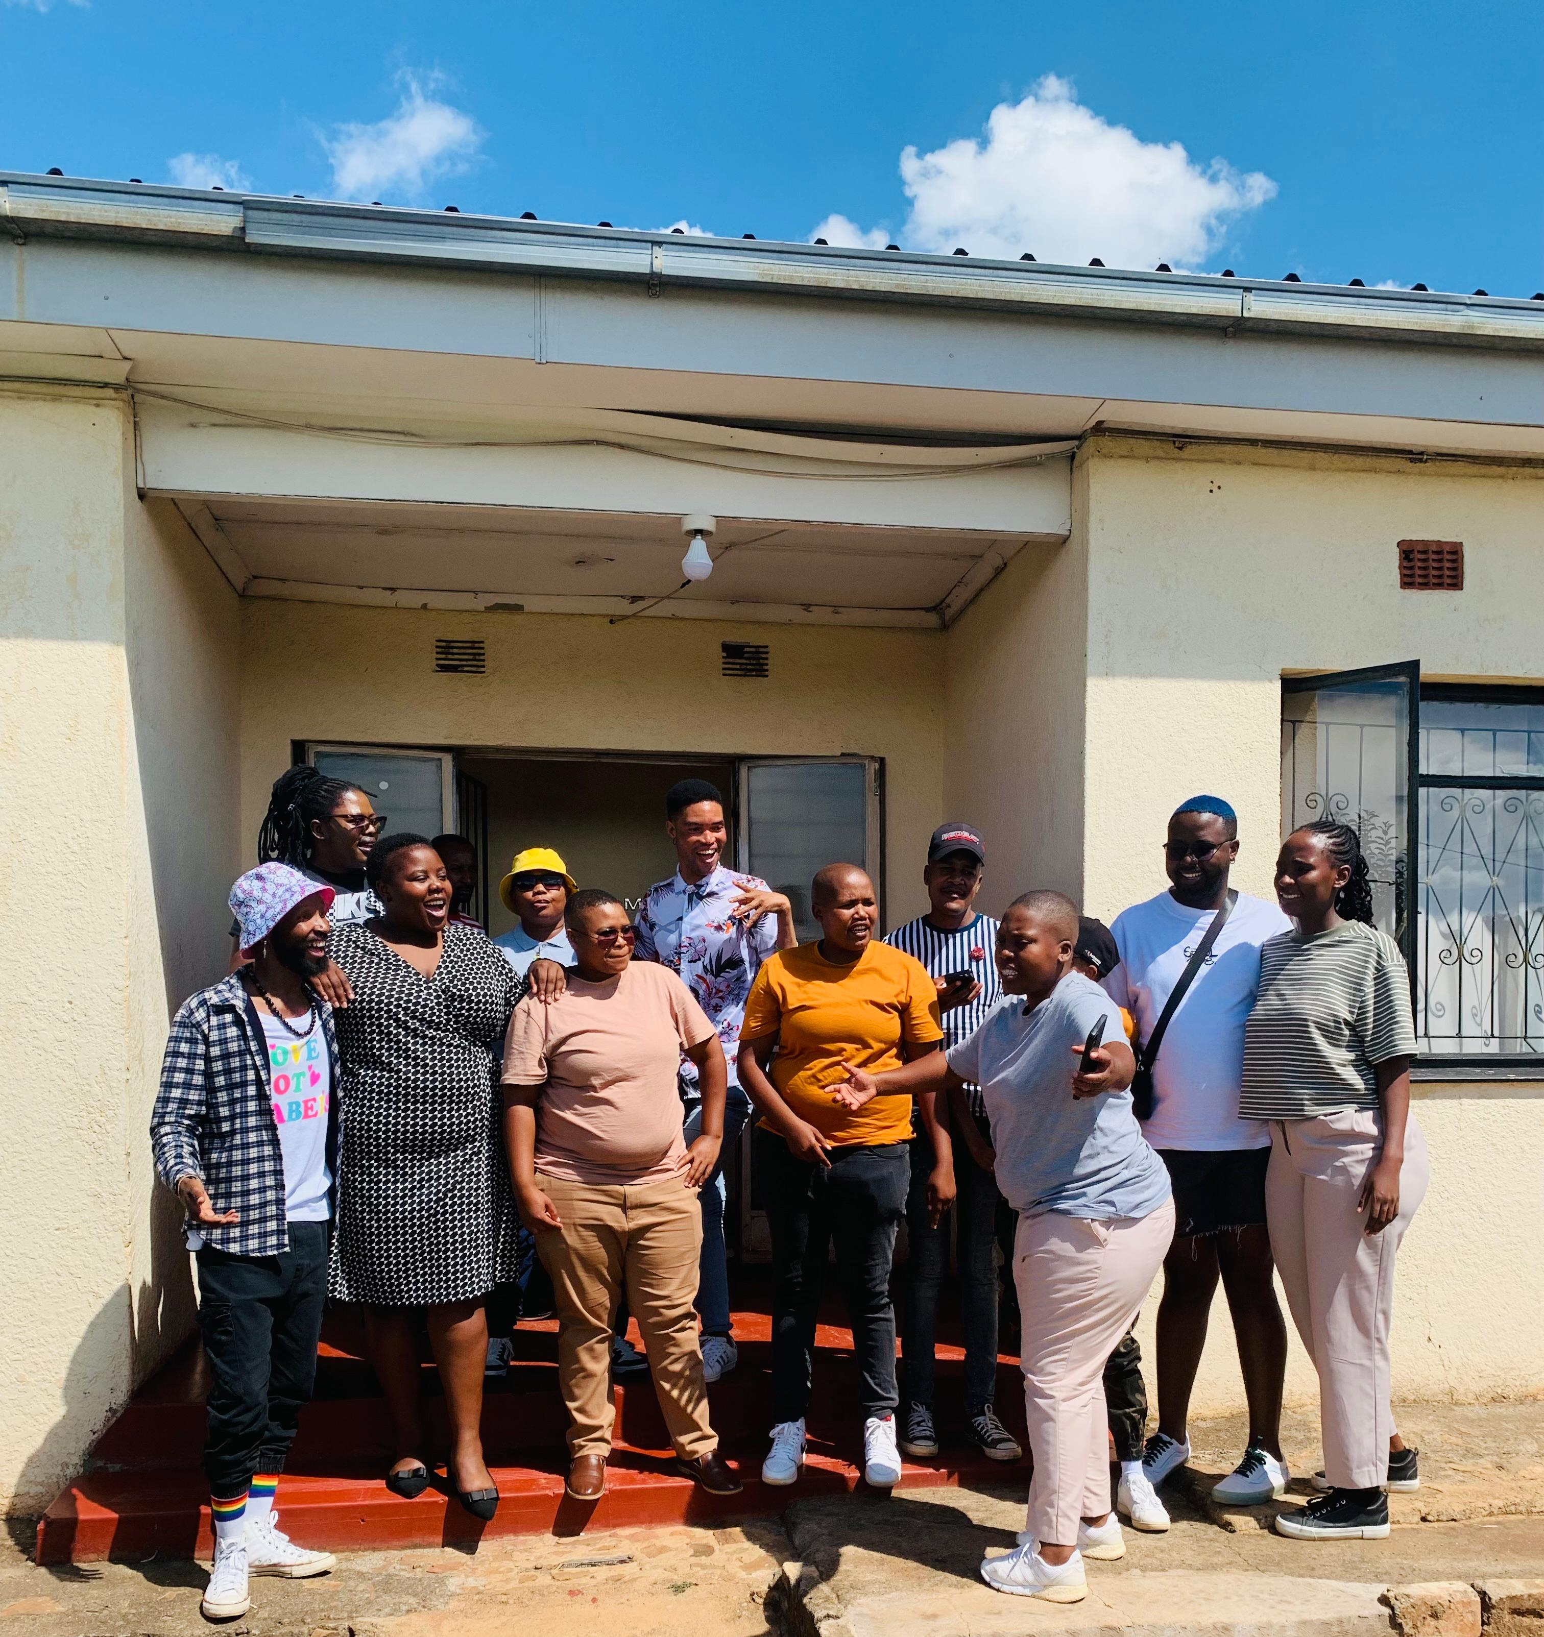
Change
This work is relatively new as a focus in activism, change can not be sudden - it needs to be deliberate, incremental, and rooted in a belief that human capability, not charity, is the foundation of lasting inclusion.
Anchored in the Human Capital and Capabilities Approach, our work starts from the premise that LGBTIQ+ people in Lesotho are not lacking potential—they lack the conditions to realise it.
Early participant feedback suggests something is beginning to move: not transformation overnight, but a growing sense of agency, readiness, and possibility where there was previously fear and exclusion
Leribe Queer Community focus group session (Baseline assessment)
Voice and Choice Summit 2026 \ Voice and Choice Summit 2026

Slide 6
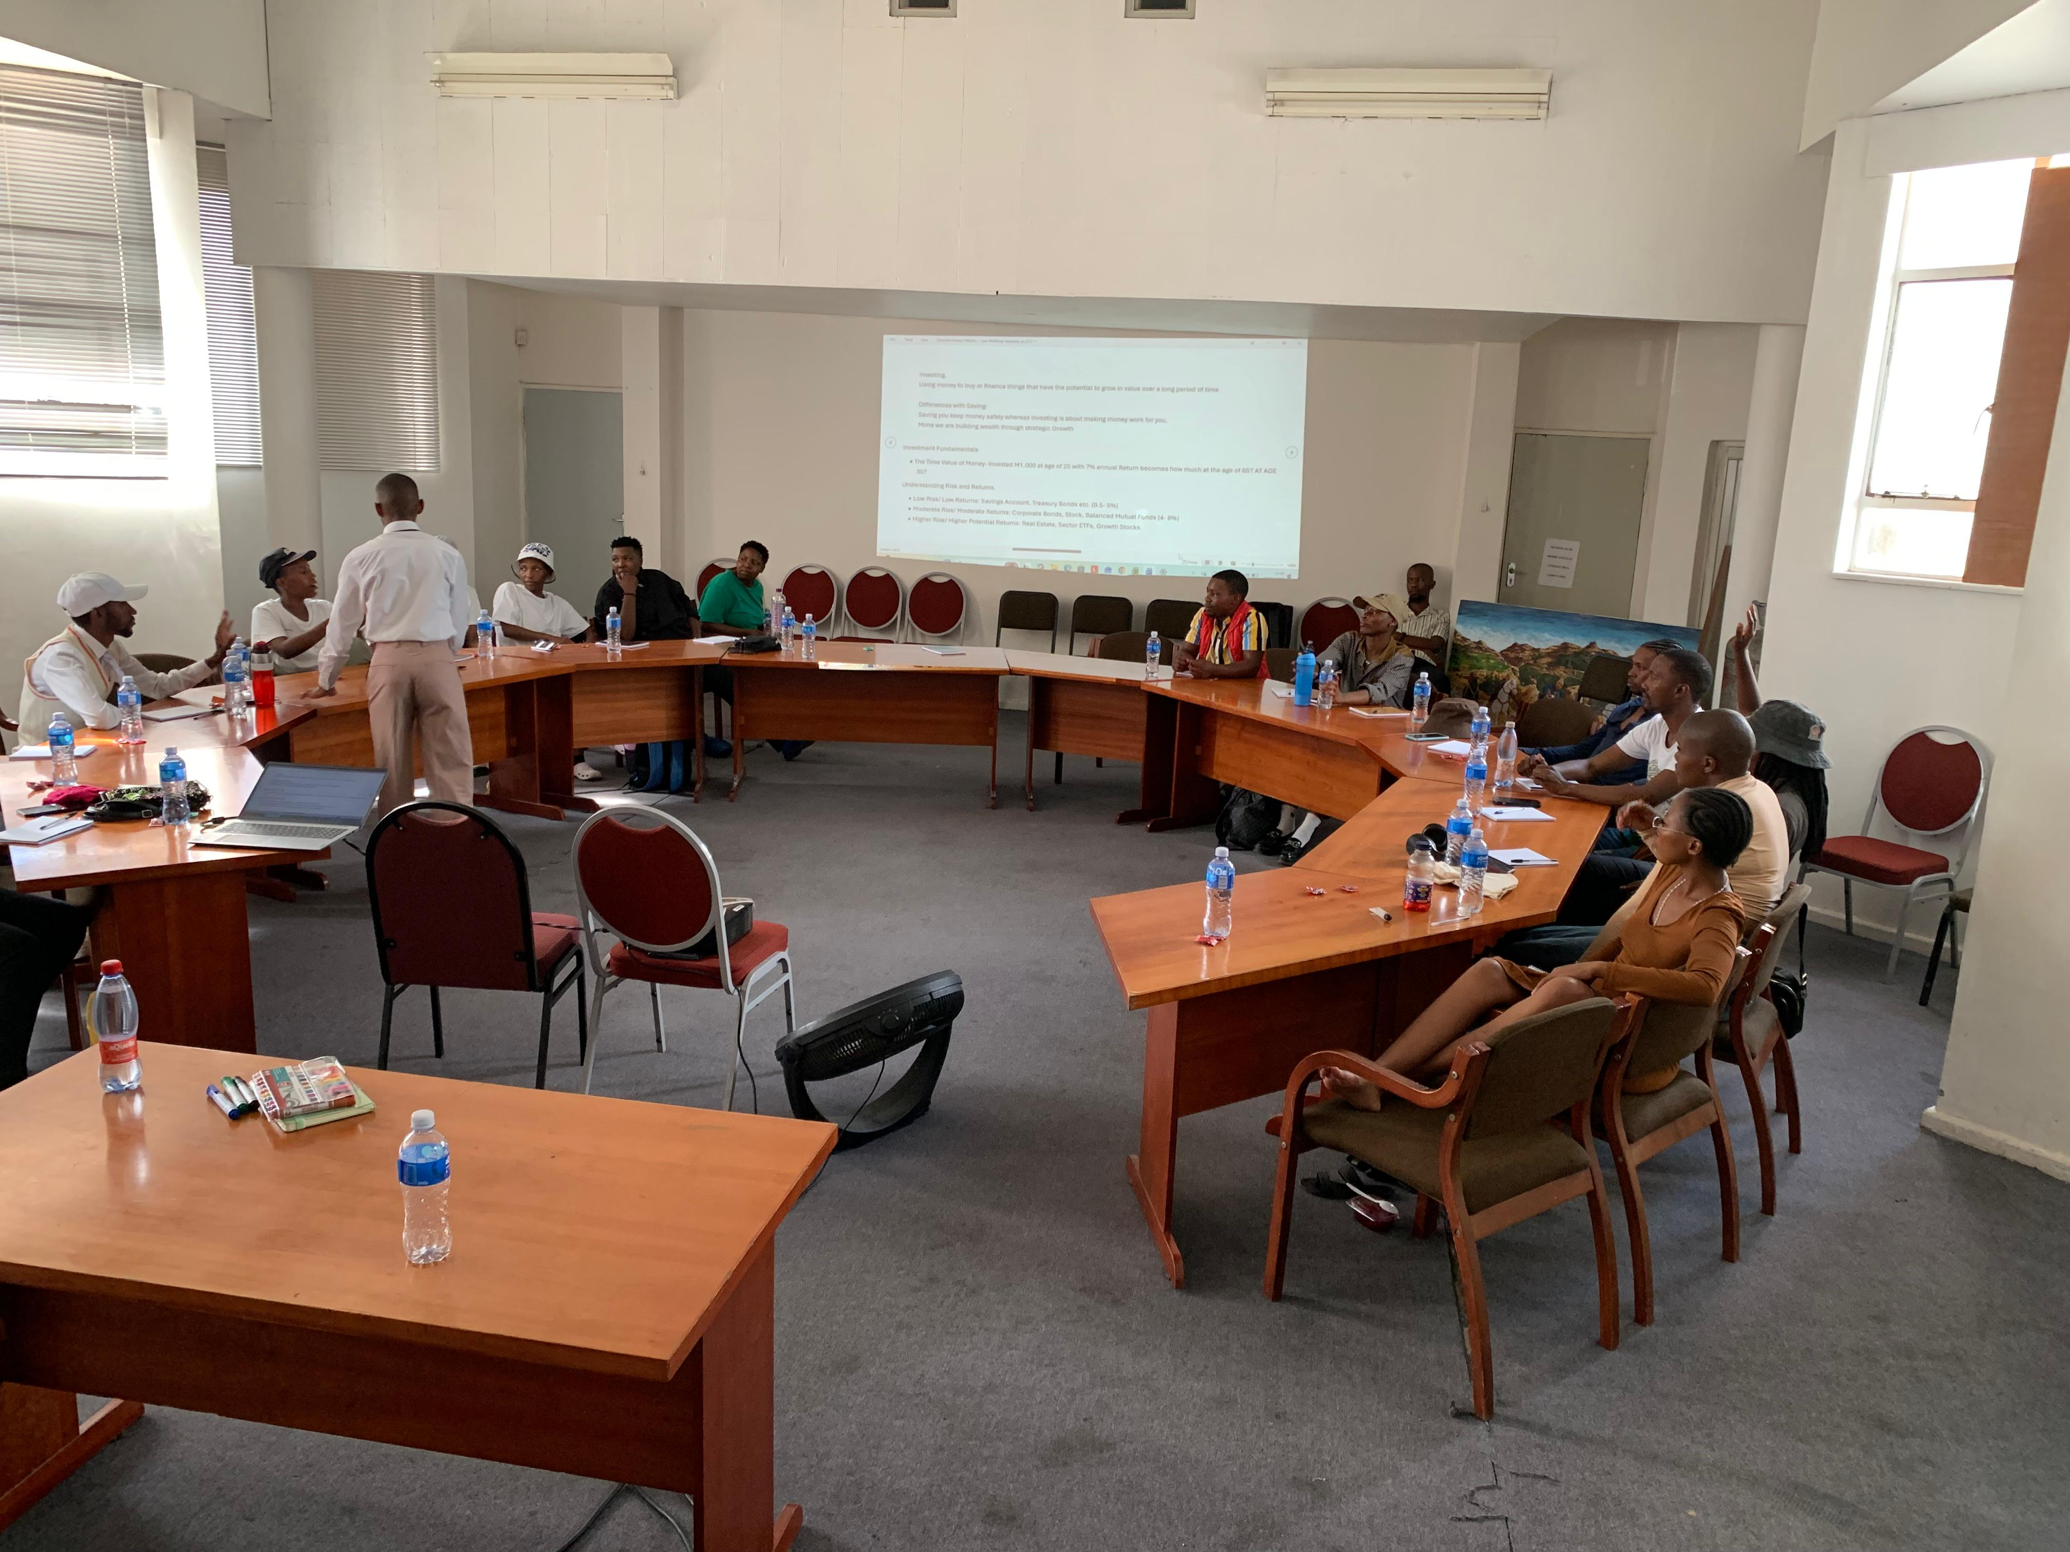
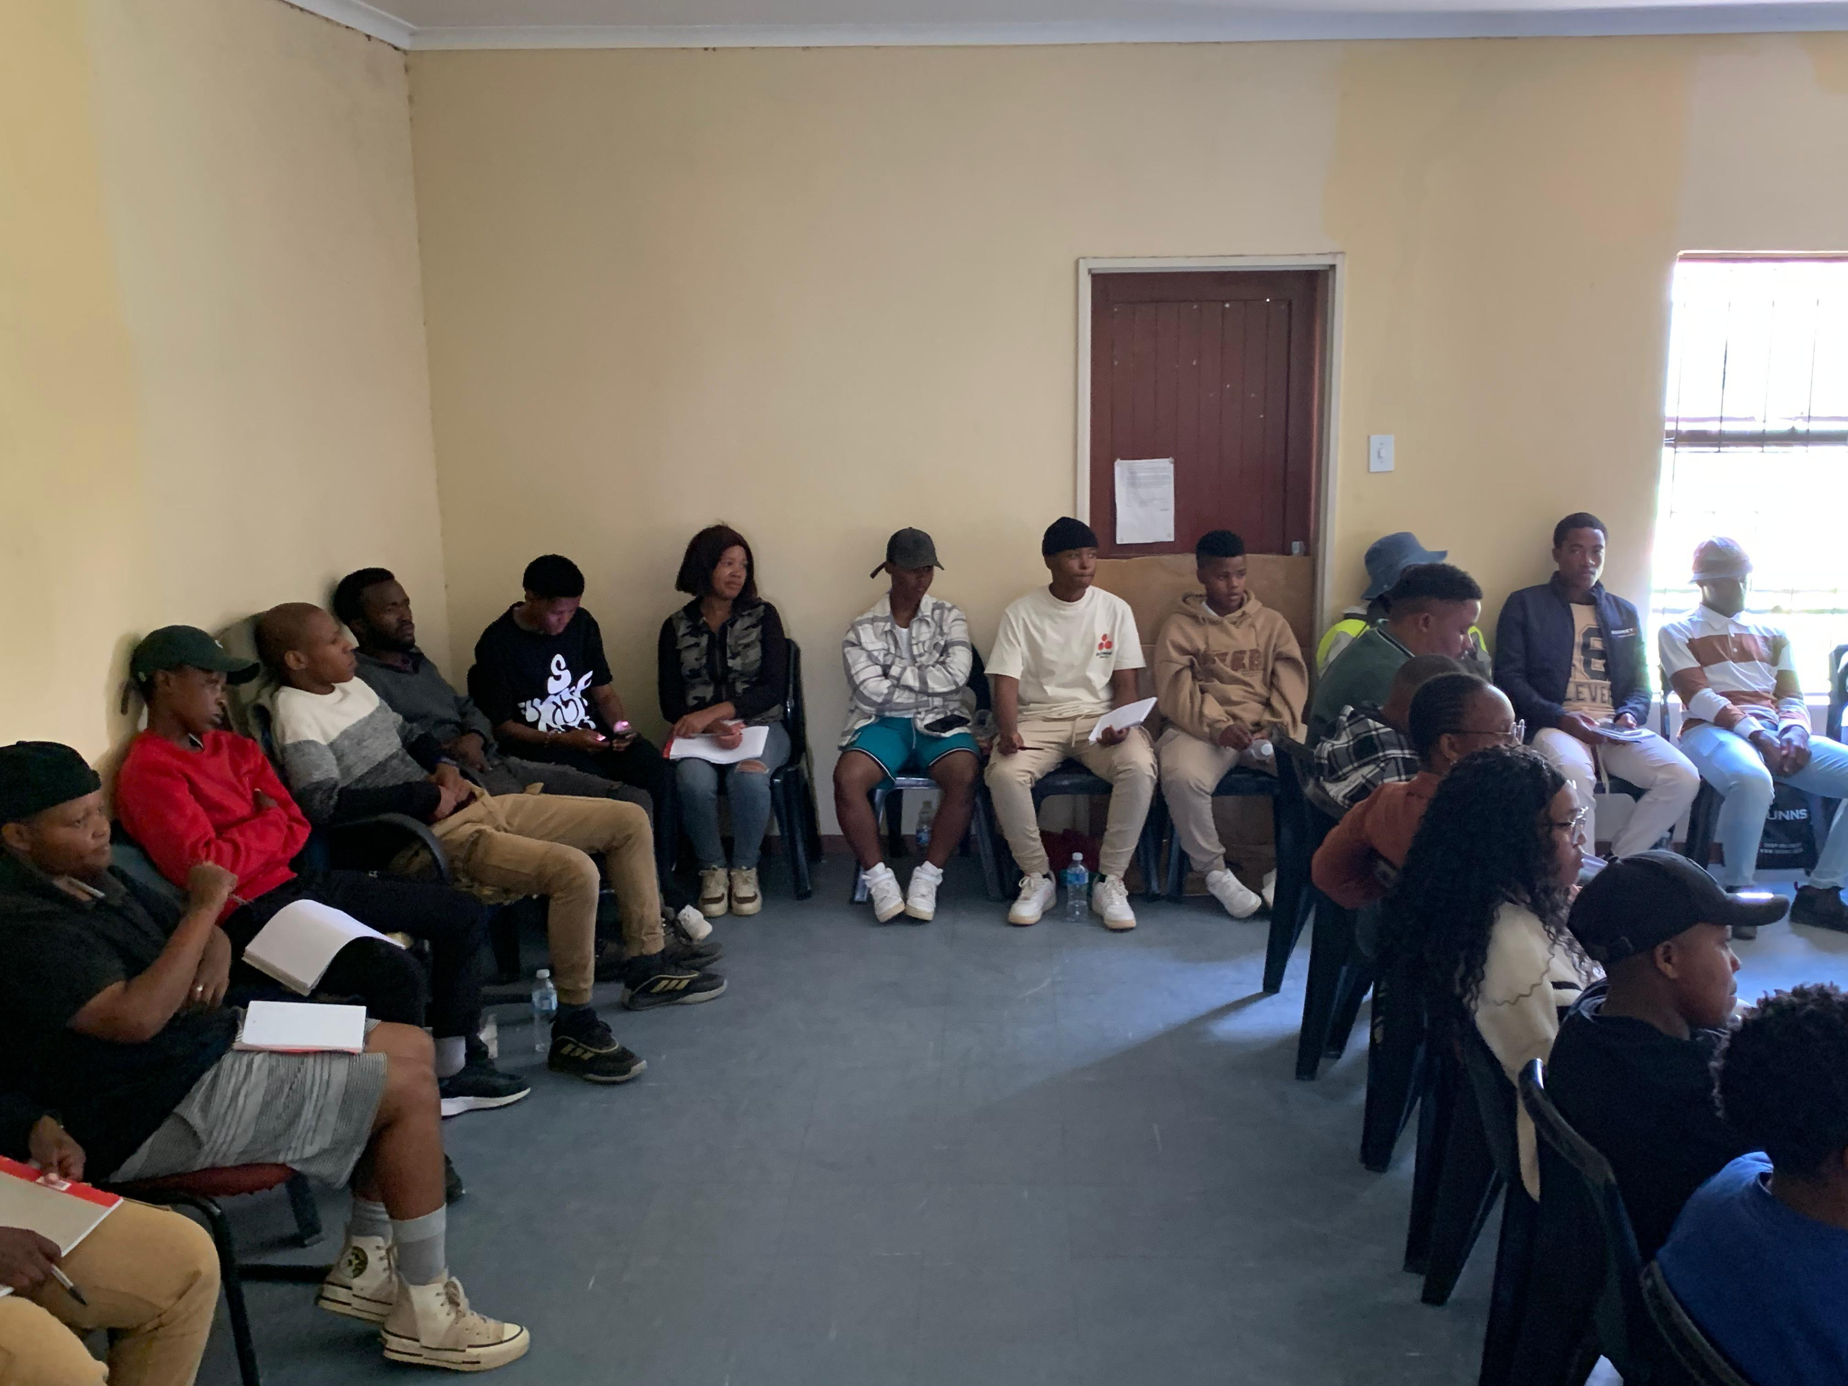
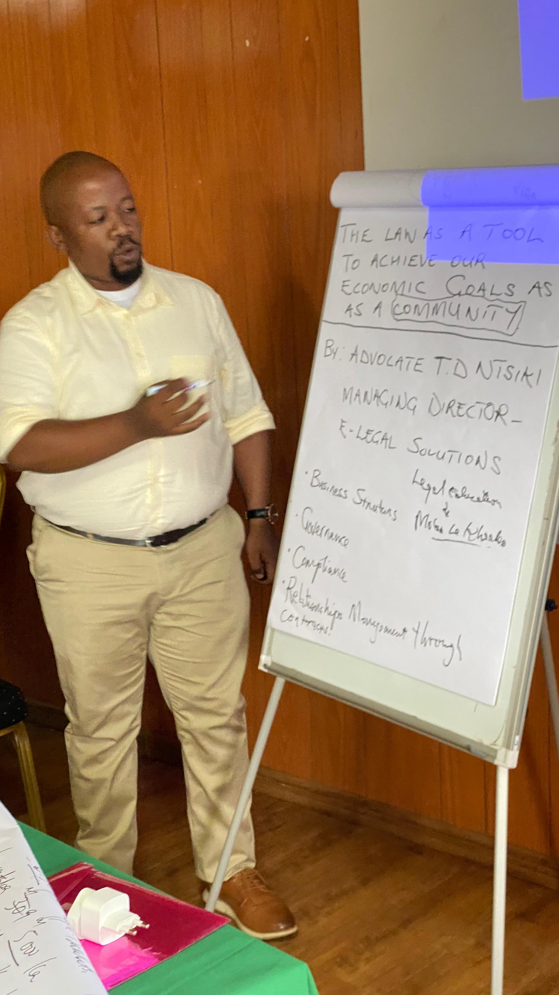
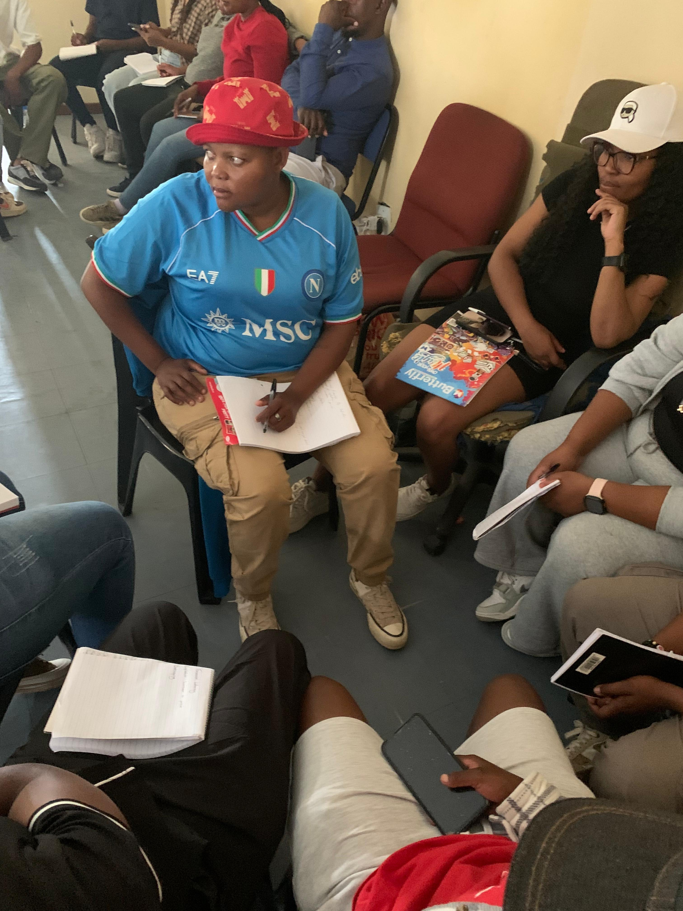
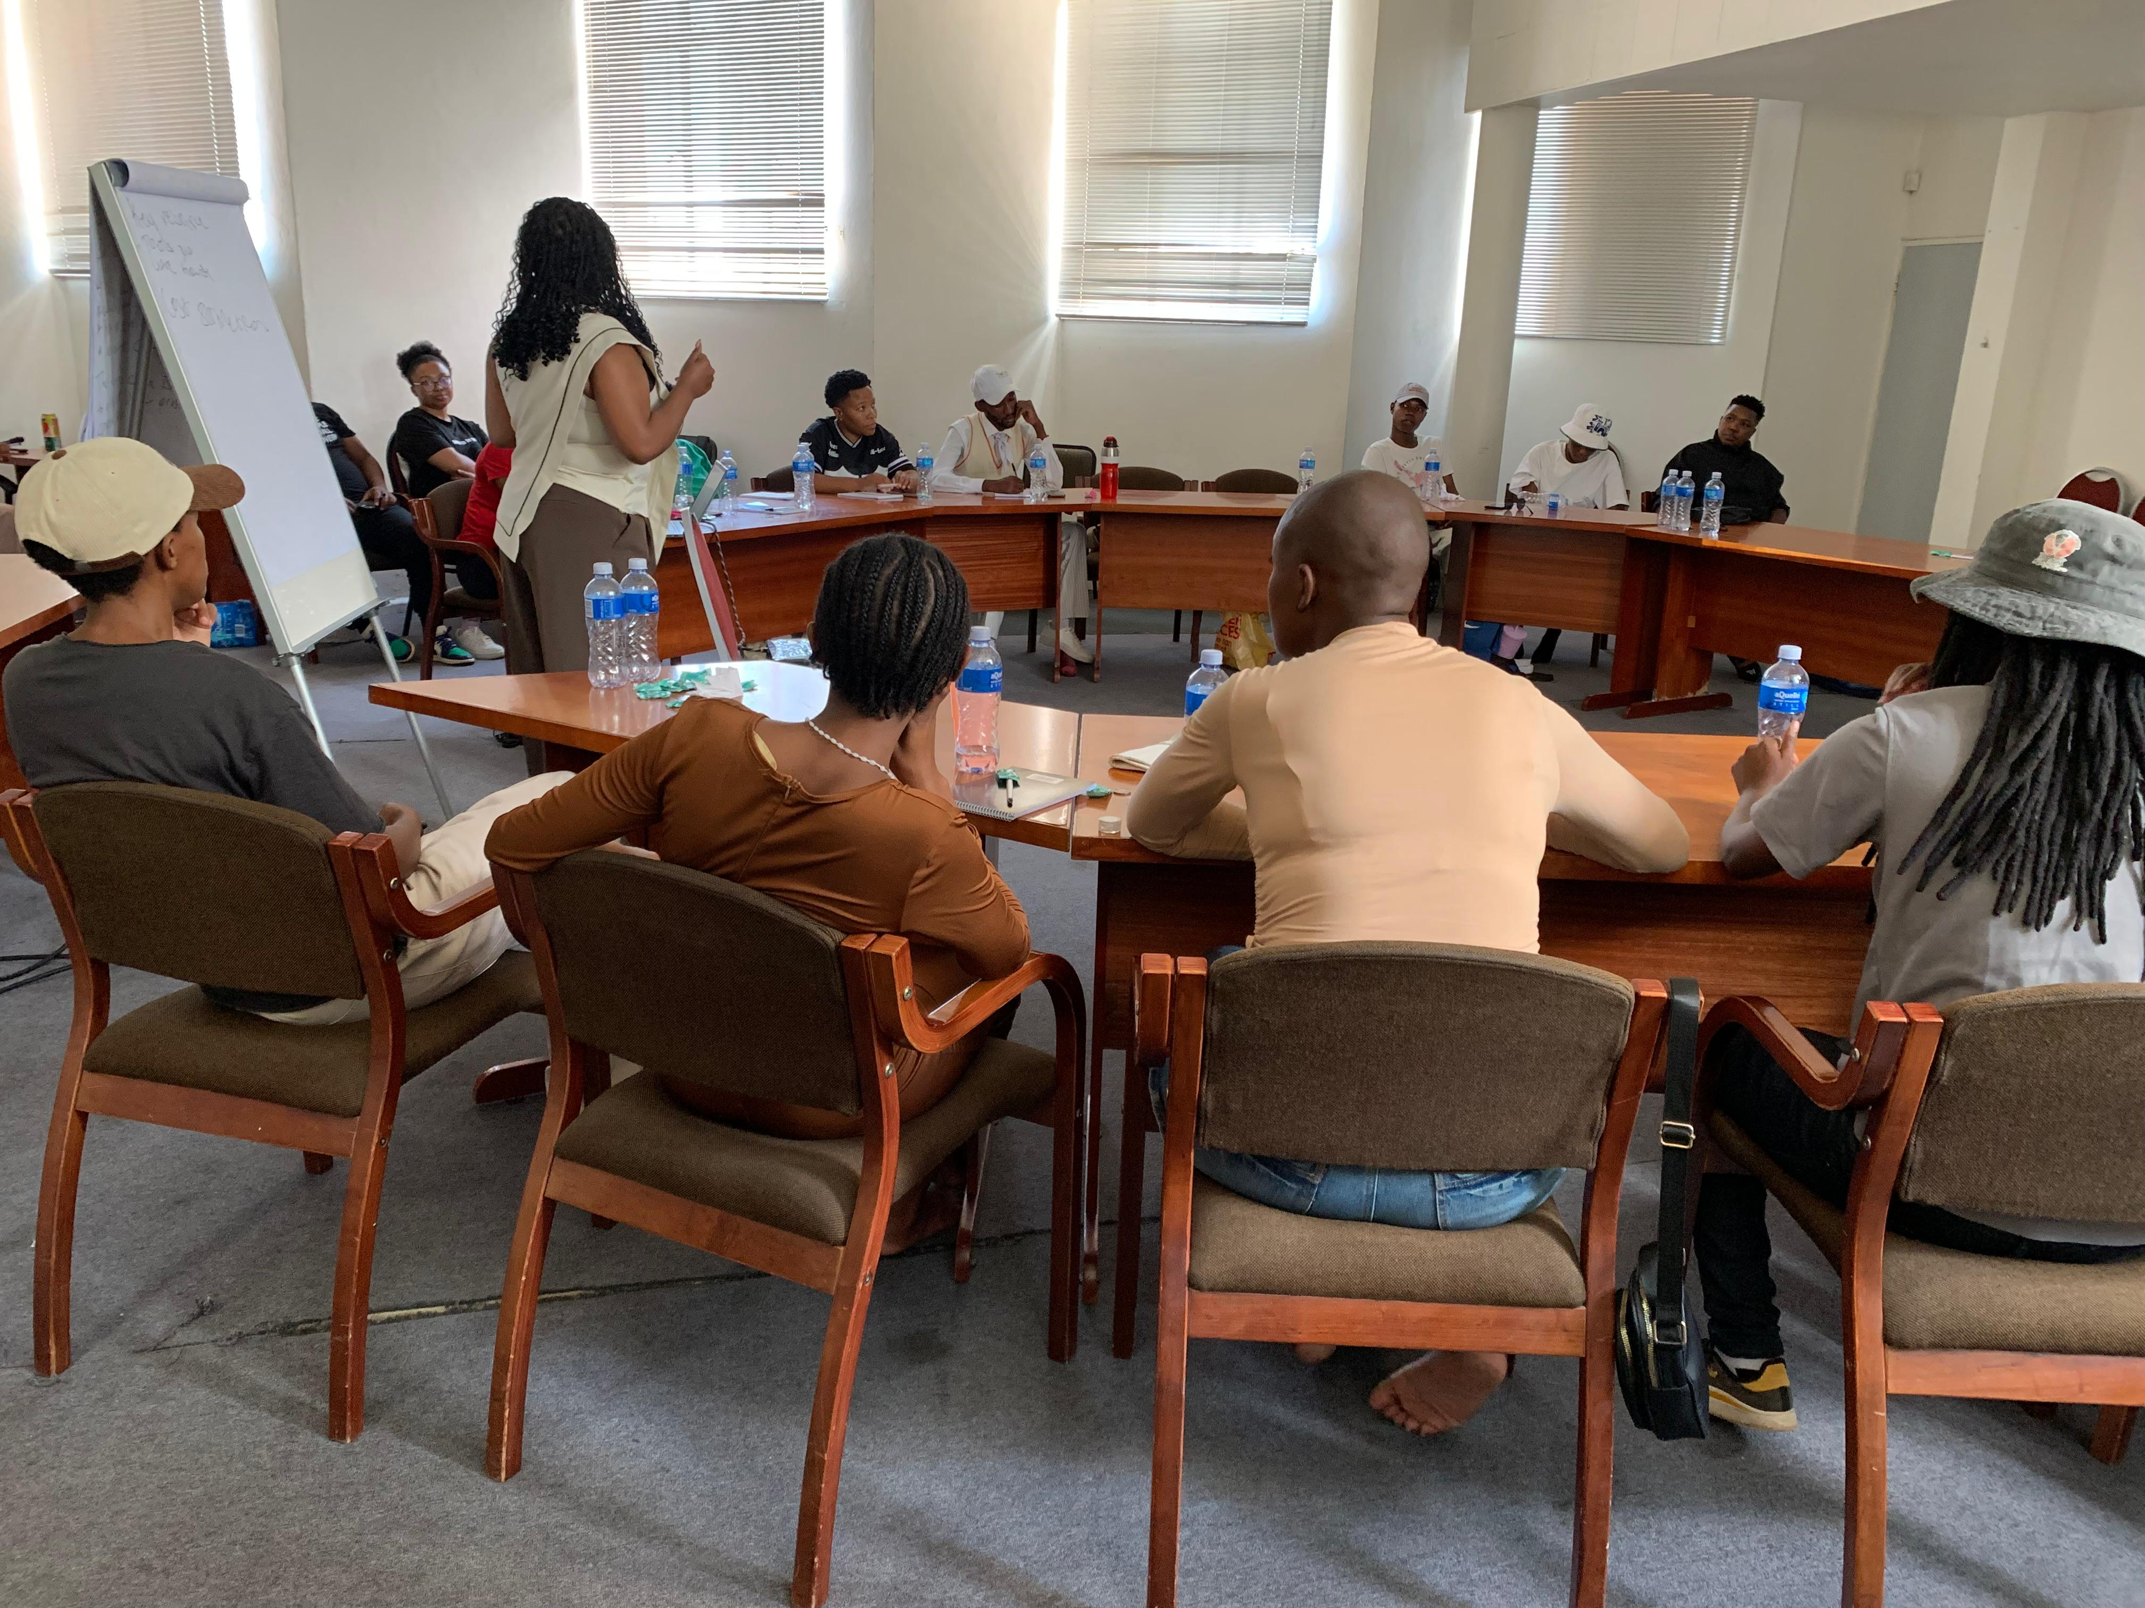
Change
Maseru Participants – Financial Literacy Session
Mafeteng and Mohale’s Hoek Participants
Maseru Participants – Mindset Change Session
Law and Business Session – Leribe
Teams working on their pitch
Voice and Choice Summit 2026 \ Voice and Choice Summit 2026

Slide 7


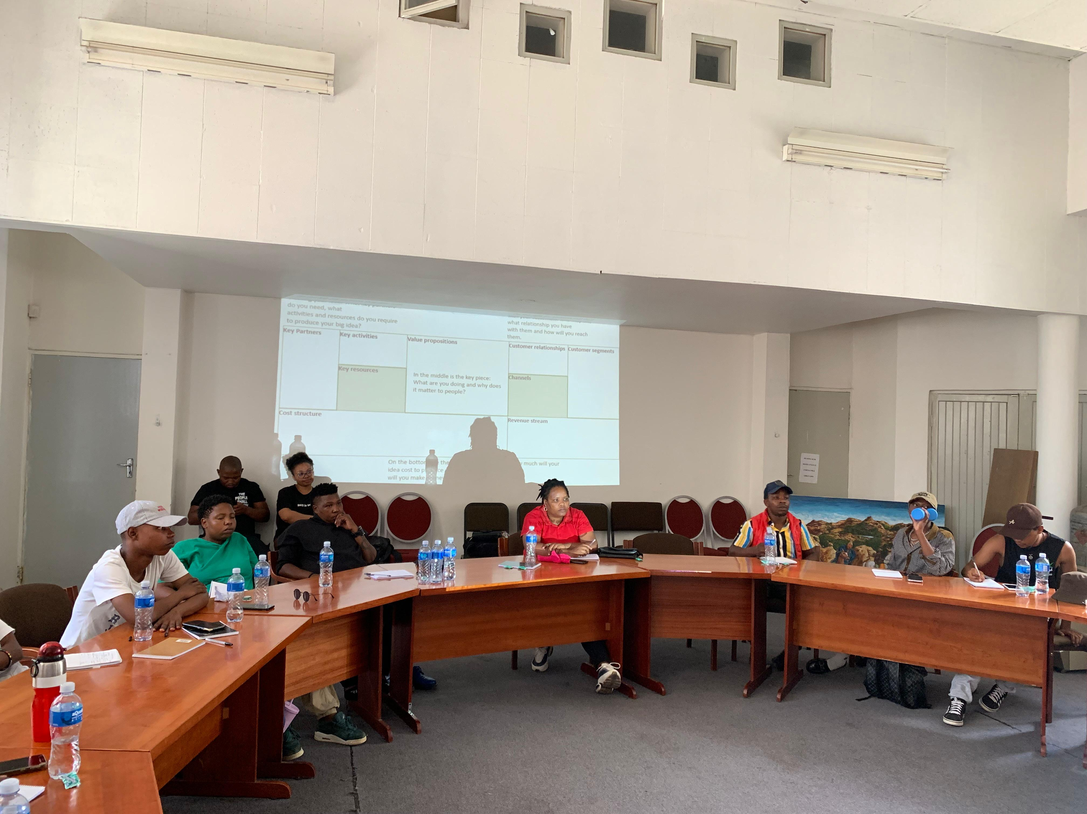


Change
Human Capital & Capabilities Approach — building conditions to exercise potential
SKILLS & MINDSET
LEGAL & VOICE
Queer Econ
Legal Education for Economic Participation
Business skills, digital literacy, and legal awareness — delivered alongside deliberate mindset and confidence-building.
Because skills alone mean little if people do not believe they belong in economic spaces.
Demystifying regulatory and compliance barriers.
legal literacy sessions
regulatory guidance for businesses
information on labour and rights frameworks
MEDIA & NARRATIVE
COMMUNITY & MARKETS
Junior Journalist Initiative
Phutheho — in development
Early-career and freelance journalists — still forming their values — are supported to tell queer economic stories ethically.
A long game: shaping how LGBTIQ+ lives are covered before habits form.
Lesotho’s first LGBTIQ+ Business Network and Market. Phutheho aims to provide:
peer networking for entrepreneurs
opportunities to showcase products and services
community-driven economic collaboration
"I would like to start a business, but I also wish we could come together and form a cooperative."— Participant
Voice and Choice Summit 2026 \ Voice and Choice Summit 2026

Slide 8
Impact (Early-Stage Change)
LGBTQI+ entrepreneurs and professionals in the marked districts are beginning to access practical business, financial literacy, digital, and legal skills that were previously out of reach. While this change is still early-stage, participants report:
Increased confidence, clearer understanding of economic systems, business and legal processes and motivation to pursue opportunities. The change is individual first — a person believing they can start a business, navigate a legal process, or tell their story publicly. Collectively, these shifts begin to build new norms.
Queer WorX is building the evidence, trust, and community readiness needed for future policy engagement.
Feeling more equipped and less alone, which is itself a meaningful step in communities where internalised stigma has long been a barrier to economic participation.
Evidence is emerging, not yet complete.
Calls for participation in Phutheho and the Junior Journalist Initiative have drawn early interest from community members, media houses, and journalists — signals of relevance and demand, even before full implementation.
Queer WorX treats this as evidence of need as much as evidence of change.
Leribe
Butha-Buthe
Berea
Maseru
Mafeteng
Mohale’s Hoek
Voice and Choice Summit 2026 \ Voice and Choice Summit 2026

Slide 9
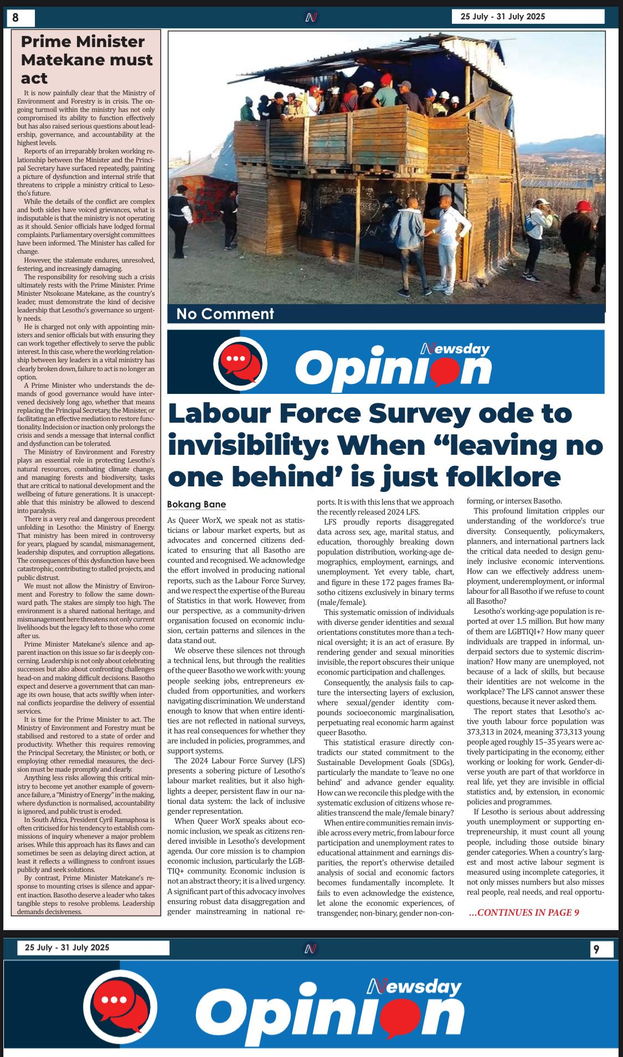
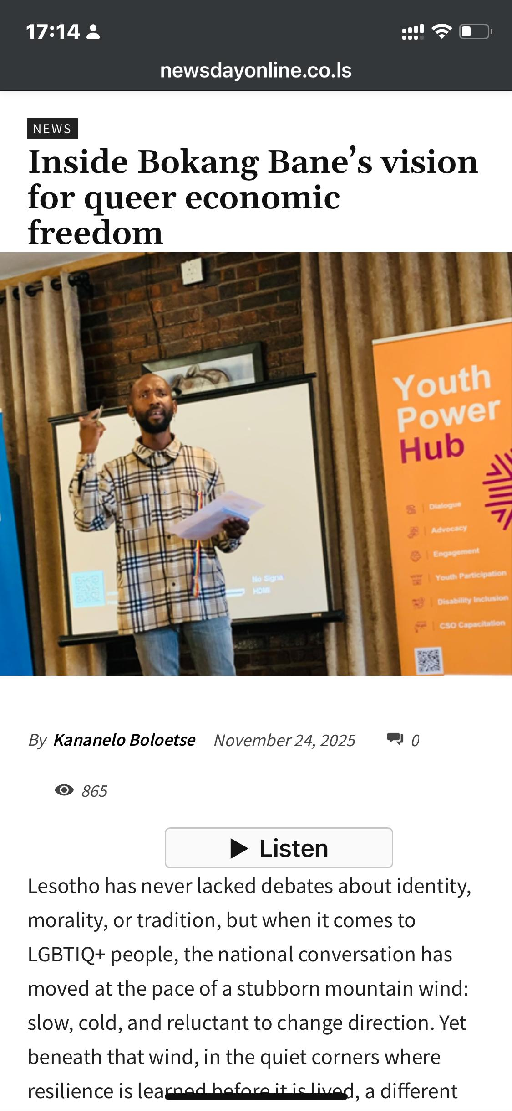
Impact (Early-Stage Change)
Queer WorX also contribute to public narratives on queer economic inclusion, through media advocacy.
Activities include:
opinion pieces and commentary
public discussions on economic inclusion
collaboration with media practitioners
These contributions help expand national conversations about LGBTIQ+ participation in society and the economy.
This positions media work as early narrative change.
https://newsdayonline.co.ls/inside-bokang-banes-vision-for-queer-economic-freedom/
https://newsdayonline.co.ls/labour-force-survey-ode-to-invisibility-when-leaving-no-one-behind-is-just-folklore/
Voice and Choice Summit 2026 \ Voice and Choice Summit 2026

Slide 10
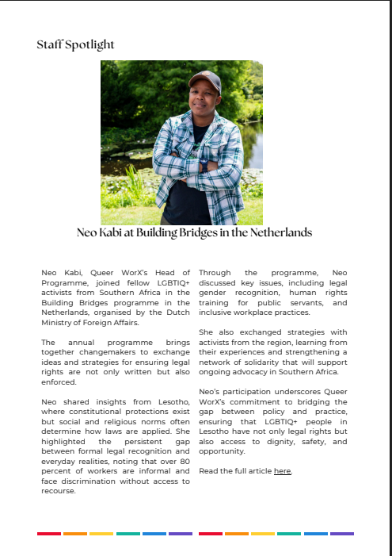
Recognition
The leadership of Queer WorX is increasingly recognised through invitations to contribute to regional and global platforms advancing economies and LGBTIQ+ rights.
Key engagements include:
International advocacy engagement through the Building Bridges Programme organised by the Dutch Ministry of Foreign Affairs.
Voice and Choice Summit 2026 \ Voice and Choice Summit 2026

Slide 11
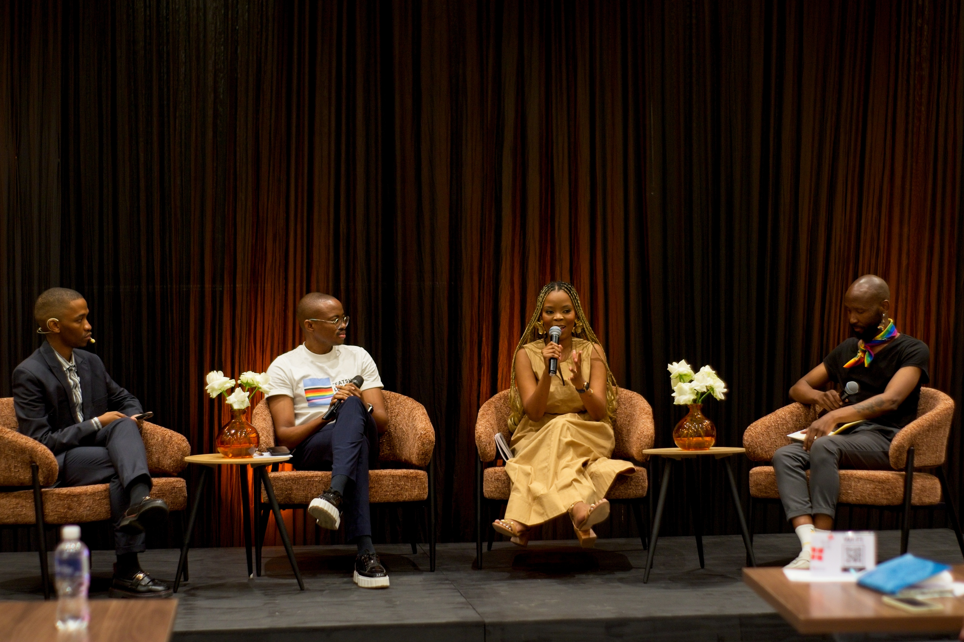
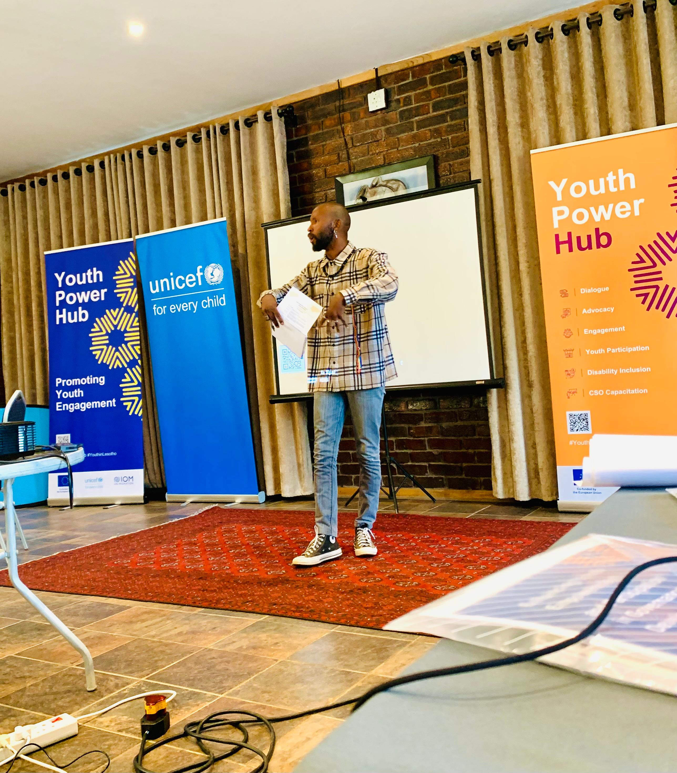
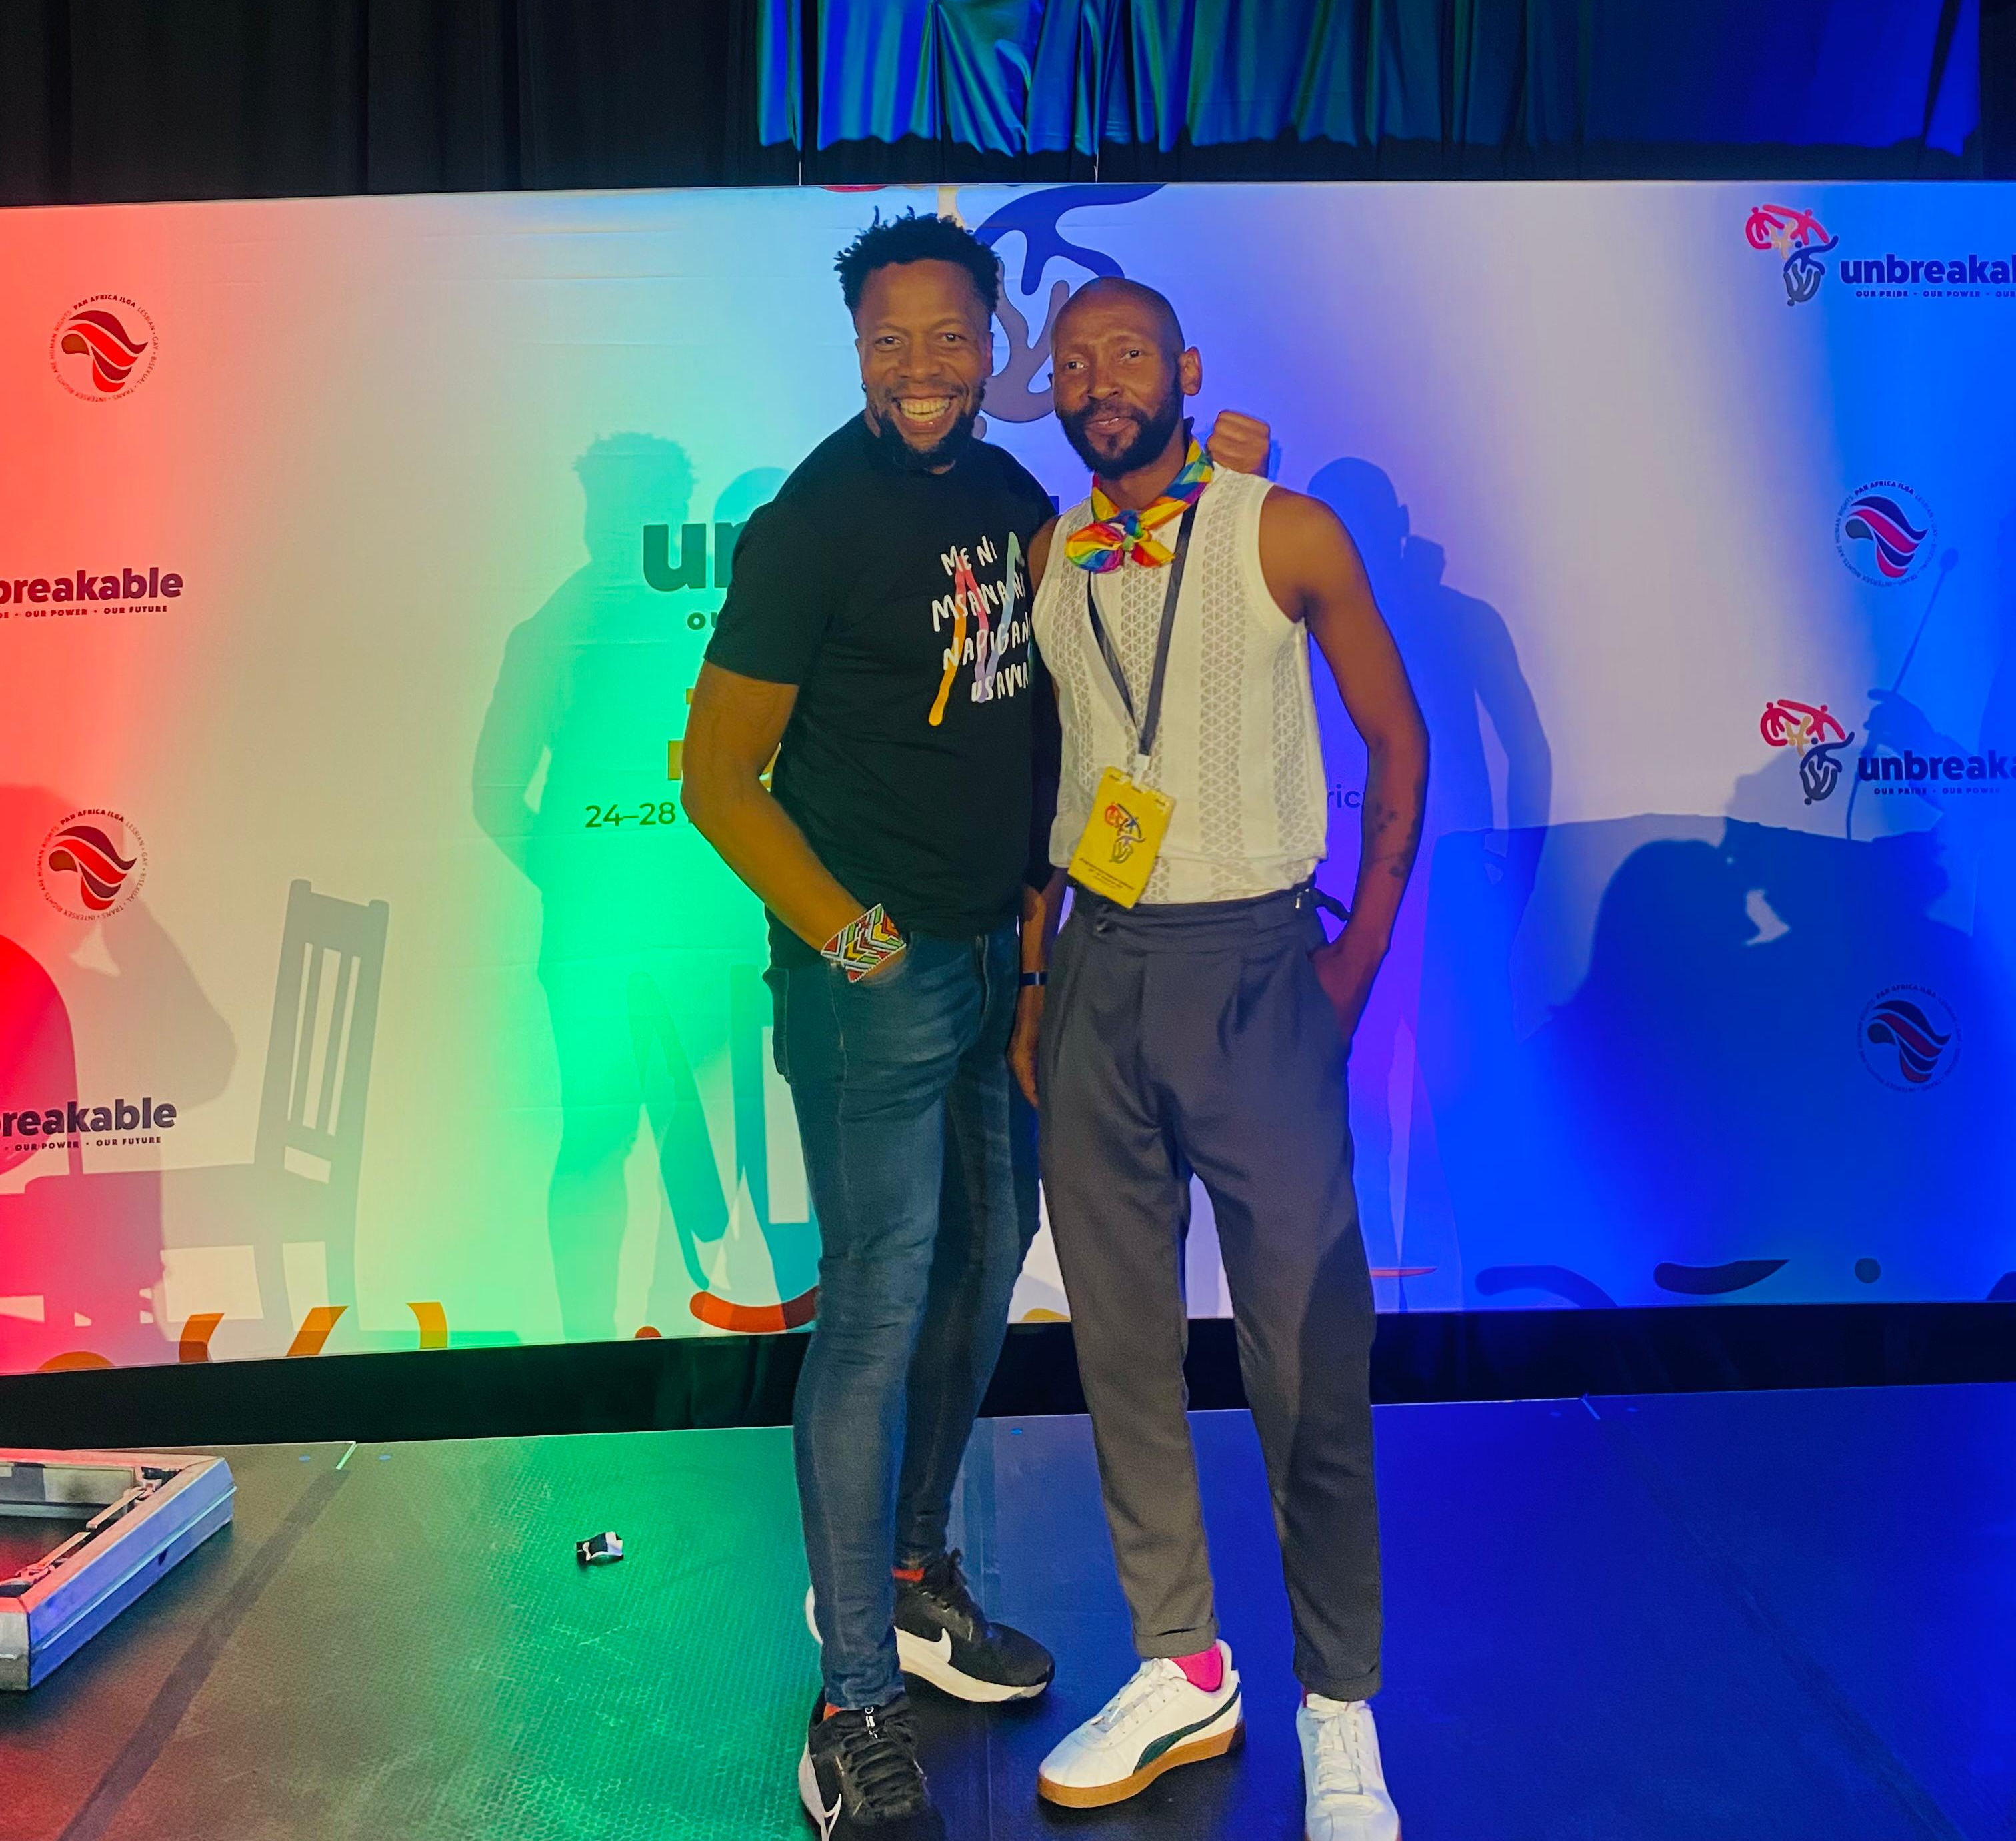
Recognition
The leadership of Queer WorX is increasingly recognised through invitations to contribute to regional and global platforms advancing economies and LGBTIQ+ rights.
Key engagements include:
Panel speaker at the Banana Club Economic Inclusion Forum in Gaborone, Botswana, contributing to discussions on legal and policy frameworks for inclusive economies.
Participation in the Pan Africa ILGA Conference, sharing perspectives from Lesotho’s LGBTIQ+ economic justice movement.
Engagement in the Business & Entrepreneurship Community of Practice hosted by Koppa Lab, connecting practitioners across Africa and Asia working on LGBTIQ+ economic empowerment.
Selection into the Youth Power Hub incubation programme, strengthening organisational leadership and governance capacity.
Voice and Choice Summit 2026 \ Voice and Choice Summit 2026

Slide 12
Challenges & Lessons learnt
Geographic barriers — LGBTIQ+ people outside Maseru struggle to access in-person training.
One participant noted: "I would participate more in those online courses if I didn’t have to travel to Maseru every time."
Mitigation: Exploring blended learning models and regional outreach.
Statistical invisibility — national data systems exclude gender-diverse people, weakening policy advocacy.
Mitigation: Documenting own baseline data to fill gaps.
Internalised stigma — fear of engaging institutions limits participation.
Mitigation: Confidence-building integrated into all programmes.
As a young organisation, building institutional credibility takes time.
Mitigation: Strategic partnerships strengthen legitimacy.
Several lessons have shaped our approach
Economic empowerment must include dignity and visibility.
Listening to community voices must come before programme design.
Skills training works best when combined with confidence-building.
Targeting early-career journalists creates longer-lasting media change than engaging established voices.
Peer networks and community ownership sustain impact beyond formal programmes.
Partnerships multiply reach and credibility without requiring large internal capacity.
Voice and Choice Summit 2026 \ Voice and Choice Summit 2026

Slide 13
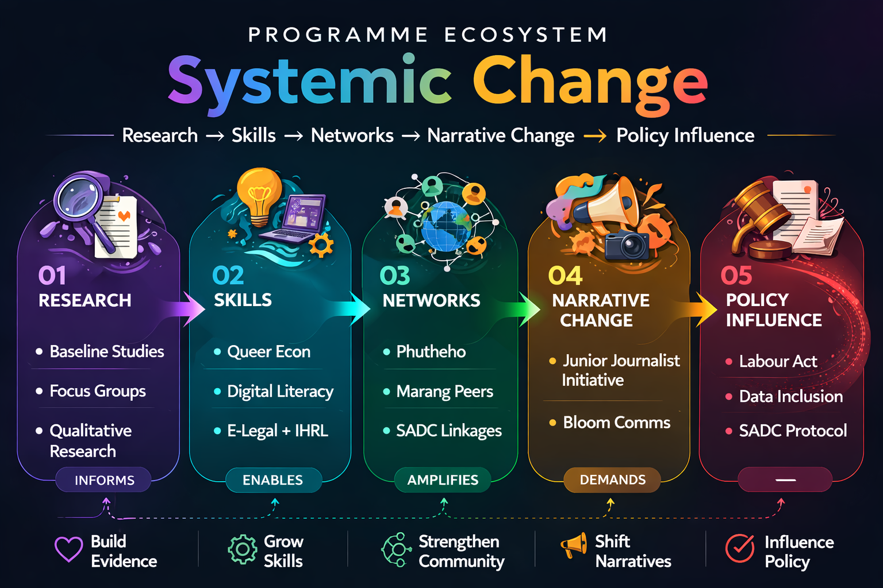
Sustainability
Community ownership — Queer Econ participants gain transferable skills they apply independently and share with peers.
Phutheho Business Network — repeated market events and networking opportunities create ongoing platforms for skills application, visibility, and peer connection.
Junior Journalist Initiative — shaping the values of future media leaders creates a ripple effect in public narratives long after the initial cycle.
Strategic partnerships with media houses, legal organisations, and regional LGBTIQ+ networks sustain momentum and extend impact.
SCALE-UP PLANS:
Blended learning to extend reach beyond Maseru.
Attract ongoing funding through demonstrated evidence and credibility with public and private sector actors.
Build a self-reinforcing cycle: as participants gain skills and confidence, they become advocates and mentors.
Move from individual impact to systemic and societal transformation — informing national discussions on inclusion and economic policy.
Voice and Choice Summit 2026 \ Voice and Choice Summit 2026

Slide 14
Next Steps
Next Steps
Launch Phutheho — Lesotho’s first LGBTIQ+ Business Network and Market (Oct 2026): create visibility, peer learning, and market access for LGBTIQ+ entrepreneurs in Lesotho.
Complete the Junior Journalist Development Initiative: support early-career journalists to produce ethical, human-centred reporting on LGBTIQ+ economic participation.
Expand Queer Econ training: reach communities beyond Maseru through blended and online learning models.
Develop and publish an advocacy toolkit: a SOGIE-inclusive economic framework to inform national conversations on inclusive economic planning.
Strengthen regional partnerships: deepen collaboration with organisations supported by the Marang Southern Africa LGBTIQ+ Fund and other Southern African LGBTQI+ networks.
Build the evidence base: document lessons, community stories, and economic participation data to strengthen advocacy and programme design.
Position for policy engagement: use evidence, partnerships, and public narratives to influence national discussions on inclusive economic policy and data systems.
Voice and Choice Summit 2026 \ Voice and Choice Summit 2026

