Slide 1


Voice and Choice Summit 2026-Change Strategies-Communications and Outreach Category
Your logo goes here
Botswana: Strengthening Law Enforcement Collaboration & Human Rights Documentation For LGBTIQ And IPV Advocacy
Voice and Choice Summit 2026 \ Voice and Choice Summit 2026

Slide 2
Synopsis– brief overview what this is about
Name | Thapelo Pako Johane
Designation | Assistant Project Officer
Organisation | Pilot Mathambo Centre For Men’s Health
Country | Botswana
Category | Communications and Outreach
Summary | LGBTIQ individuals and IPV survivors in Botswana’s North East Districts faced persistent stigma, underreporting of abuses, and weak collaboration with law enforcement. Violations often went undocumented, leaving victims vulnerable and underserved. Strategy • Built partnerships with Botswana Police Service across 15 police posts. • Conducted training on human rights and inclusive documentation. • Used digital advocacy (Facebook outreach reaching 1,095+ people). • Engaged MPs, government officials, and Gender & Child Protection Officers. Achievements • Improved police awareness and documentation of human rights violations. • Strengthened trust and collaboration between law enforcement and marginalized communities. • Expanded outreach through social media and community engagement. • Established protocols that restored confidence in police services. Significance (Importance of the change strategy) • Fostered a rights-based approach in policing. • Challenged stigma and discrimination. • Created a foundation for systemic reforms and policy advocacy. • Provided reliable data for evidence-based advocacy. Sustainability • Institutionalizing training in police academies. • Developing formal policies and SOPs. • Building multi-stakeholder partnerships. • Scaling successful approaches to other districts and sectors. Evidence (Quotes) • “Now, when I went to the police, they listened and documented what happened. It gave me hope.” – Tlhalefo Josias • “Officers are more respectful and take complaints seriously, which encourages more people to come forward.” – Phil Masole • “Victims no longer feel dismissed or ignored… trust in police services has been restored.” – M. Maiketso
Voice and Choice Summit 2026 \ Voice and Choice Summit 2026

Slide 3
Background(problem, actions, change, evidence)
Briefly describe the context or problem the Change Strategy set out to address.
Who is the organisation behind the strategy?
Where are you based / Where is the strategy being implemented?
Who was most affected by the problem and how?
What issue(s) did the strategy address?
What were the key objectives of the strategy?
Persistent human rights violations against LGBTIQ individuals & IPV survivors in Botswana’s North East District
Challenges: stigma, underreporting, weak collaboration with law enforcement
Strategy developed by Pilot Mathambo Centre for Men's Health
Focus: partnerships with Botswana Police Service to improve documentation & sensitivity
Document human rights abuses systematically
Strengthen collaboration with police for rights-based responses
Improve police data collection on IPV & key populations
Foster safer, inclusive environments for marginalized communities
Voice and Choice Summit 2026 \ Voice and Choice Summit 2026

Slide 4
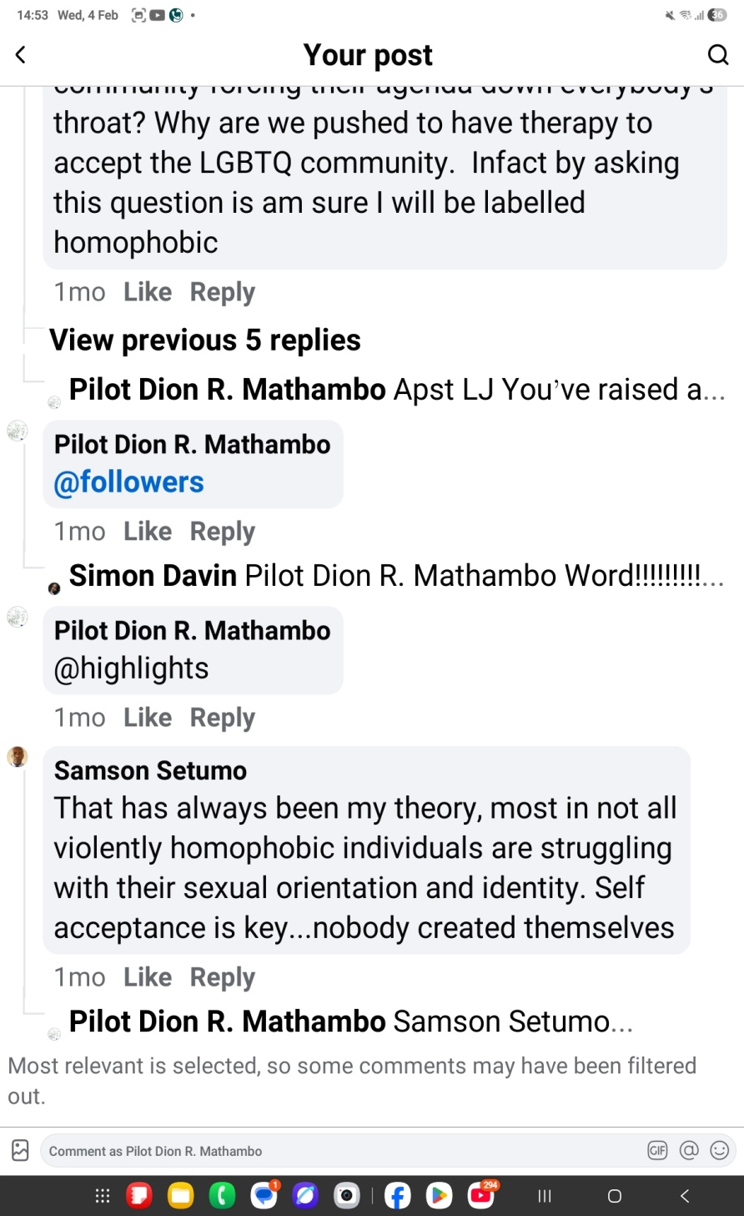
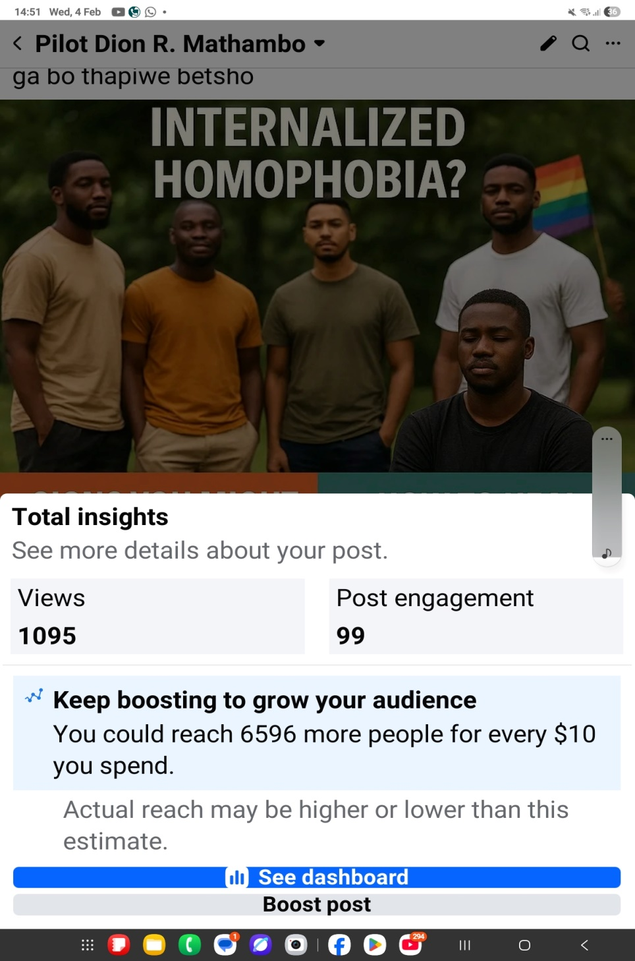
Followers | Before WVL/Marang | Current
Facebook | 119 | 2686
Twitter | - | -
Tik-Tok | 5000 | 20900
YouTube | - | -
Instagram | - | -
Please provide a concrete example of your post

Slide 5
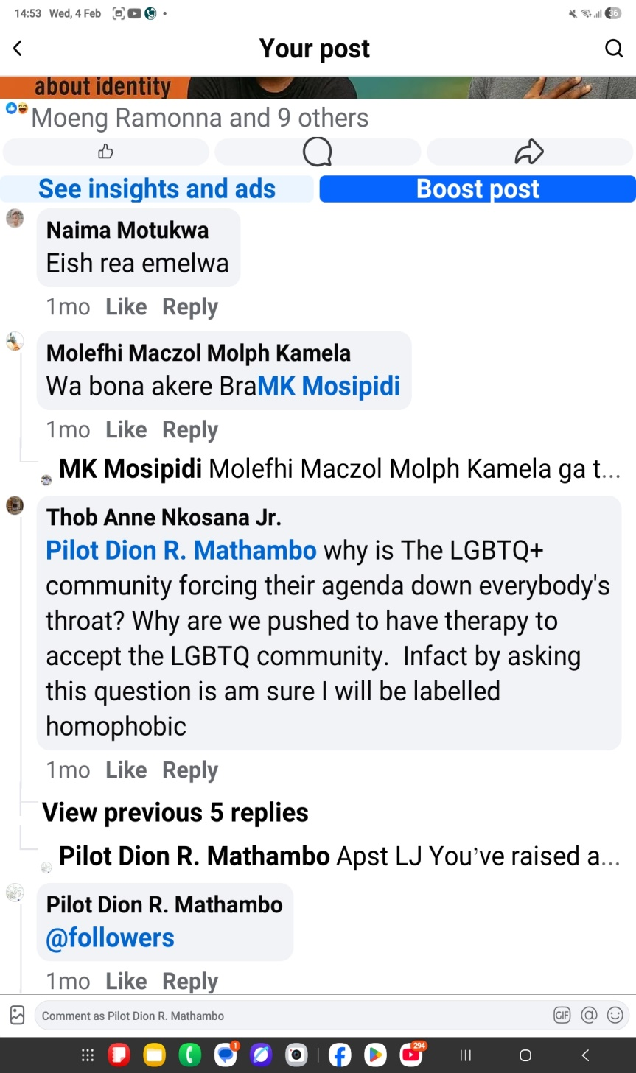
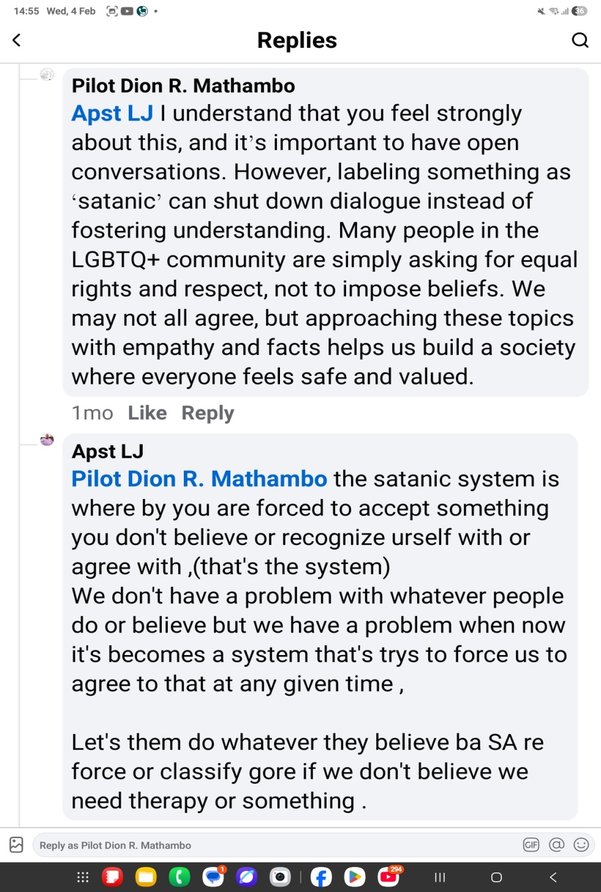
Likes | Before WVL/Marang | Current
Facebook | 119 | 2686
Twitter | - | -
Tik-Tok | 5000 | 20900
YouTube | - | -
Instagram | - | -
Please provide a concrete example of your post

Slide 6
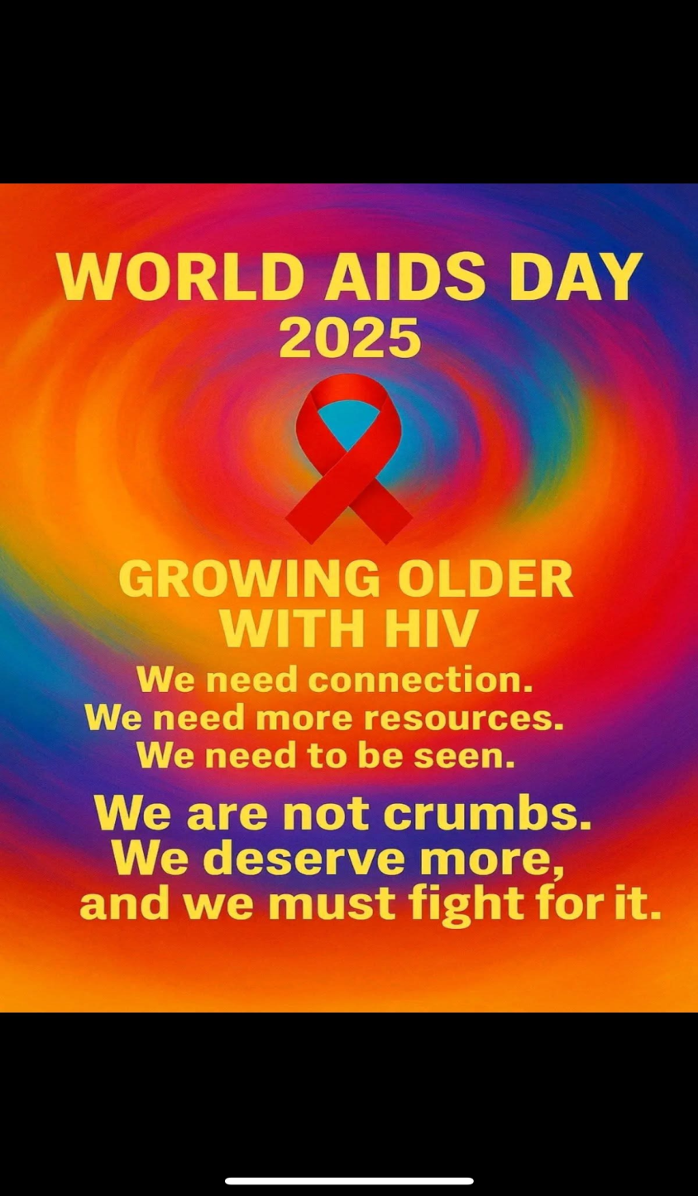
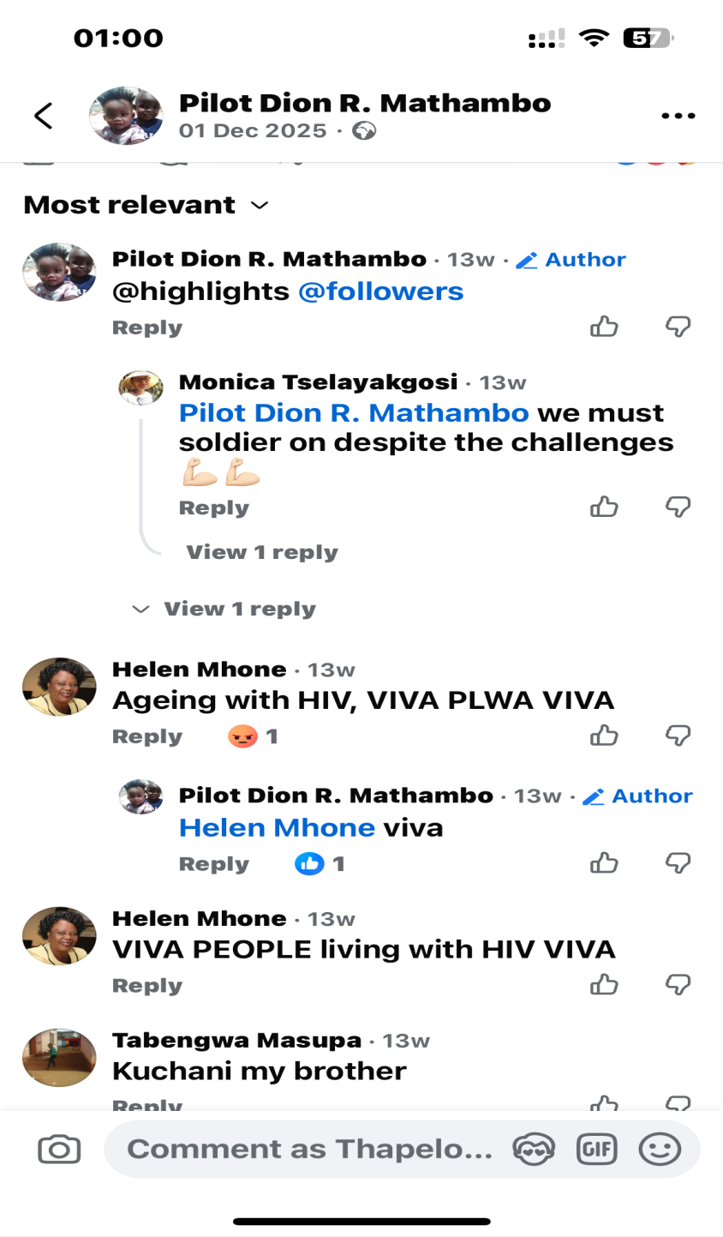
Impressions | Before WVL/Marang | Current
Facebook | 119 | 2686
Twitter | - | -
Tik-Tok | 5000 | 20900
YouTube | - | -
Instagram | - | -
Please provide a concrete example of your post

Slide 7
Sustainability
How will the change be sustained or scaled up?
How did you foster a culture of continuous learning and best practice sharing within the movement?
How did you generate and utilise evidence to assess the impact and effectiveness of advocacy efforts within your movement?
Institutionalize training & capacity building in police academies
Develop formal policies & SOPs for rights-based policing
Build partnerships with NGOs & international agencies
Continue monitoring, evaluation & accountability mechanisms
Expand to other districts & integrate across sectors (health, judiciary, social services)
Secure sustainable funding & resources
Voice and Choice Summit 2026 \ Voice and Choice Summit 2026

Slide 8
Beneficiaries
 | Number of participants
Female – Direct beneficiaries | 122
Male – Direct beneficiaries | 131
Female – Indirect beneficiaries (e.g. through other networks) | 312
Male – Indirect beneficiaries (e.g. through other networks) | 316
Female – Online beneficiaries (e.g. website access, mailing lists, scholarly articles) | 105
Male – Online beneficiaries (e.g. website access, mailing lists, scholarly articles) | 109
Total | 1095
Voice and Choice Summit 2026 \ Voice and Choice Summit 2026

Slide 9
Challenges & Lessons learnt
Challenges & mitigation
Stigma and fear of reporting
LGBTIQ individuals and IPV survivors were hesitant to approach police due to discrimination and lack of trust.
“Before, I was afraid to report the violence I faced because I thought no one would listen.” (Tlhalefo Josias)
Organized meetings at 15 police posts with officers and officials to build trust and raise awareness.
Limited police awareness and sensitivity
Officers lacked training on handling cases involving marginalized communities, leading to poor documentation and inadequate responses.
Capacity-building and training: Introduced an idea of human rights and inclusive documentation, improving sensitivity and responsiveness.
“Since we started the training… I see a real difference in how our officers treat victims.” (Phil Masole)
Weak collaboration structures
Prior to the initiative, there was minimal engagement between law enforcement and human rights advocates, resulting in fragmented efforts.
Digital advocacy and outreach
Leveraged Facebook platform to reach over 1,095 individuals, extending awareness beyond physical engagements.
What lessons have you learnt?
Trust is built through engagement
Direct dialogue with police officers and communities fosters cooperation and improves responsiveness.
• Documentation drives accountability
Systematic recording of violations provides evidence for advocacy, policy reform, and justice.
• Digital tools amplify impact
Social media outreach complements in-person efforts, expanding reach and visibility.
• Protocols restore confidence
Victims feel supported when clear procedures exist, encouraging more reporting and cooperation.
• Partnerships are essential
Collaboration across government, civil society, and communities strengthens systemic change.
Voice and Choice Summit 2026 \ Voice and Choice Summit 2026

Slide 10
Next Steps
What are your plans?
Institutionalise police training on LGBTIQ and IPV sensitivity.
• Advocate for formal policies and SOPs embedding rights-based policing.
• Expand partnerships with NGOs and international agencies.
• Scale successful approaches to other districts.
Voice and Choice Summit 2026 \ Voice and Choice Summit 2026

