Slide 1


Voice and Choice Summit 2026-Change Strategies-Communications and Outreach Category
Your logo goes here
Botswana: Engaging Men and Masculinities to Advance LGBTIQ+ Health and Rights
Voice and Choice Summit 2026 \ Voice and Choice Summit 2026

Slide 2
Synopsis– brief overview what this is about
Name | Pilot Mathambo
Designation | Project Lead
Organisation | Pilot Mathambo Centre For Men’s Health
Country | Botswana
Category | Communication And Outreach
Summary | Challenge: LGBTIQ+ communities in Botswana face stigma, unsafe disclosure, weak health referrals, and rigid gender norms. Approach: • Trained male peer educators & community champions. • Used digital storytelling (videos, WhatsApp lessons). • Built clinic-community partnerships for HIV, mental health & GBV services. • Engaged gatekeepers (faith leaders, coaches, barbers). Impact: • Increased referrals to affirming clinics. • Reduced stigma & harassment in community spaces. • Male allies actively support inclusion and health-seeking. Significance: • Reframes masculinity toward care & allyship. • Bridges narrative change with service delivery. • Offers replicable model for scaling across districts. Sustainability: • Peer networks, clinic MOUs, content libraries. • Hub-and-spoke model for district-level adaptation. • Diversified funding (philanthropy, corporate, public sector).
Voice and Choice Summit 2026 \ Voice and Choice Summit 2026

Slide 3
Background(problem, actions, change, evidence)
Briefly describe the context or problem the Change Strategy set out to address.
Who is the organisation behind the strategy?
Where are you based / Where is the strategy being implemented?
Who was most affected by the problem and how?
What issue(s) did the strategy address?
What were the key objectives of the strategy?
Context / Problem: LGBTIQ+ communities in Botswana face stigma, unsafe disclosure, rigid gender norms, and weak referral pathways for HIV, mental health, and GBV services.
• Organisation: Pilot Mathambo Centre for Men’s Health (PMCMH), supported by the Marang LGBTIQ Fund.
• Location: Based in Botswana; strategy implemented in urban and peri-urban communities. (Greater Francistown, North East District & Bobirwa)
• Who was most affected: Trans and gender-diverse people, men who have sex with men, and their partners—often excluded from safe, affirming health and support services.
• Issues addressed:
Stigma and discrimination
Limited uptake of affirming health services
Unsafe disclosure environments & GBV risks
Weak community-to-clinic linkages
• Key Objectives:
Engage men as allies in shifting harmful norms
Increase demand for stigma-free health services
Build visible, affirming narratives through digital storytelling
Strengthen confidential referral pathways between communities and clinics
Voice and Choice Summit 2026 \ Voice and Choice Summit 2026

Slide 4
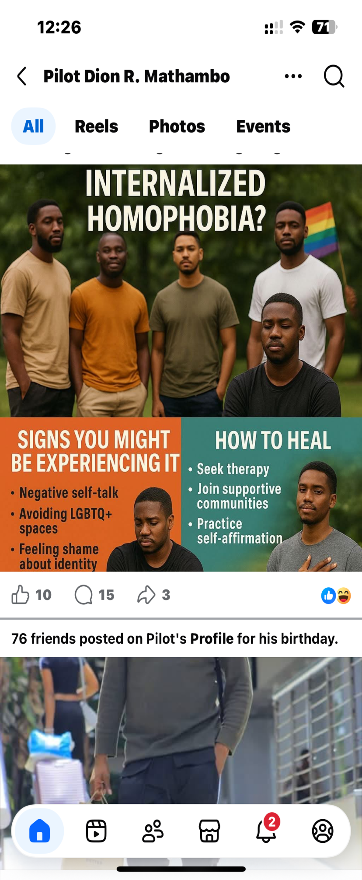
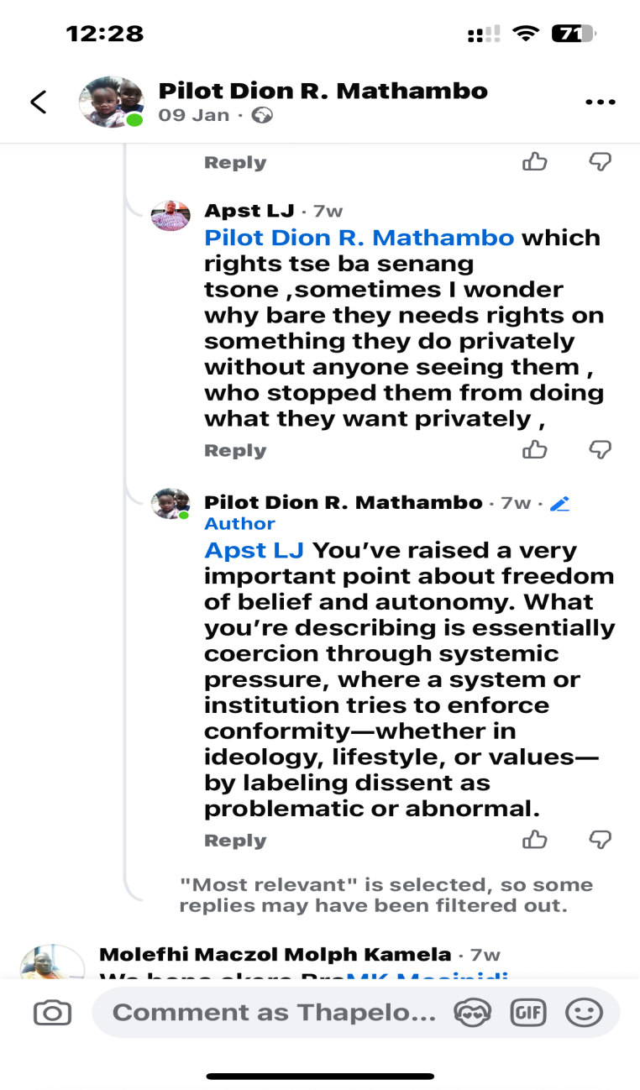
Followers | Before WVL/Marang | Current
Facebook | 119 | 2686
Twitter | - | -
Tik-Tok | 0 | 126
YouTube | - | -
Instagram | - | -
Please provide a concrete example of your post

Slide 5
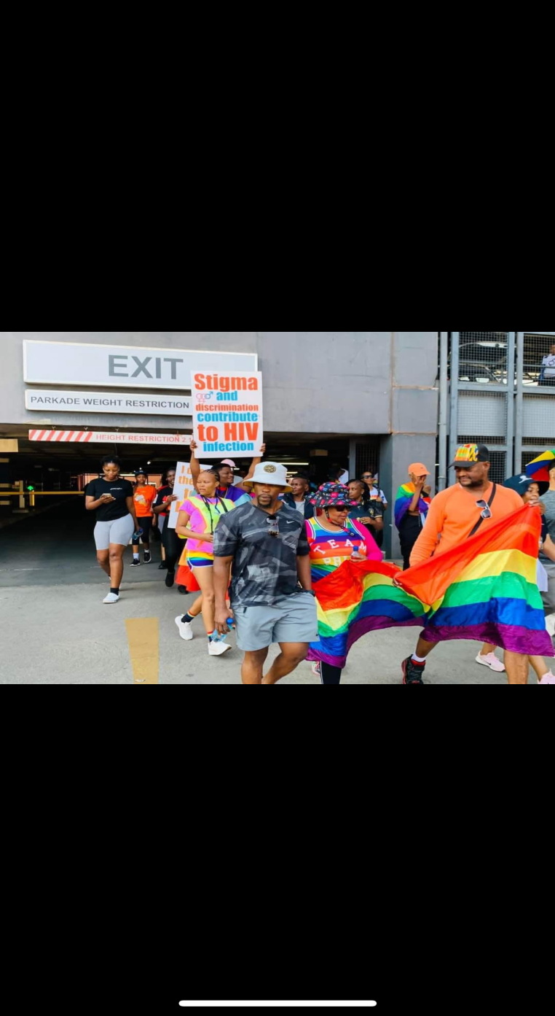
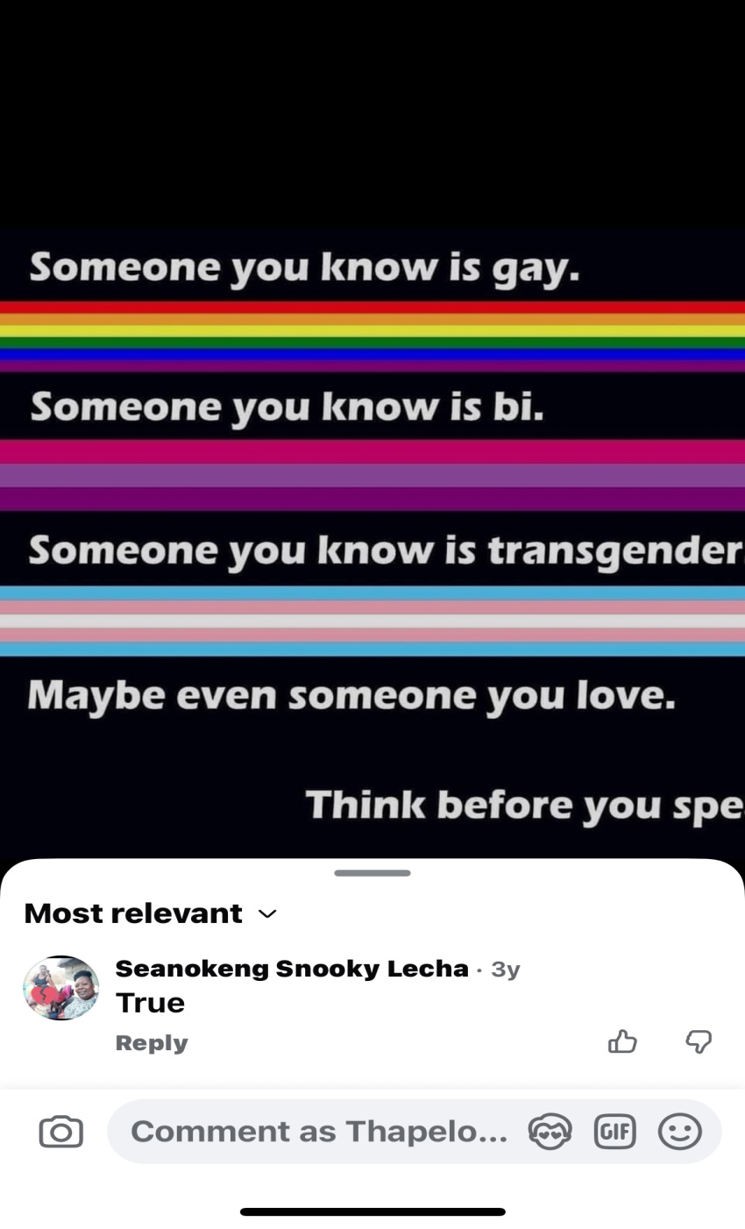
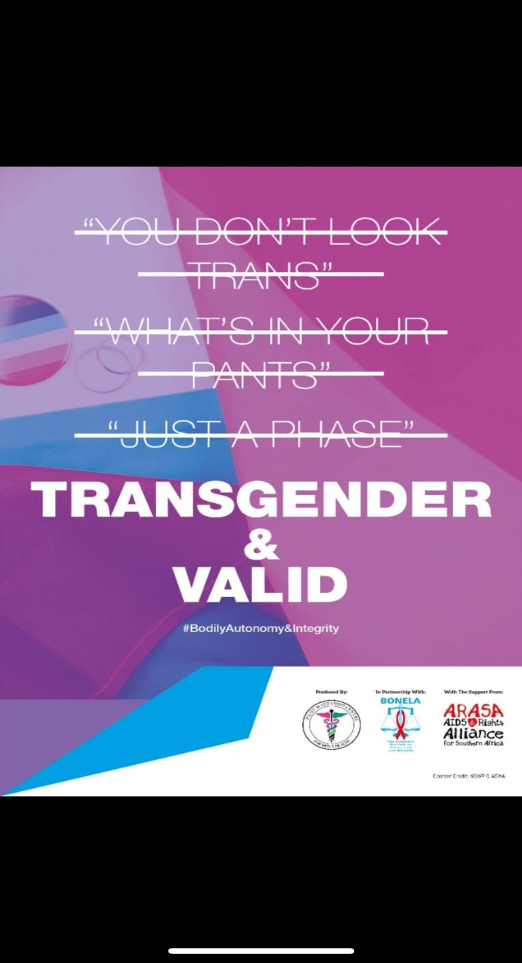
Likes | Before WVL/Marang | Current
Facebook | 119 | 2686
Twitter | - | -
Tik-Tok | 0 | 126
YouTube | - | -
Instagram | - | -
Please provide a concrete example of your post

Slide 6
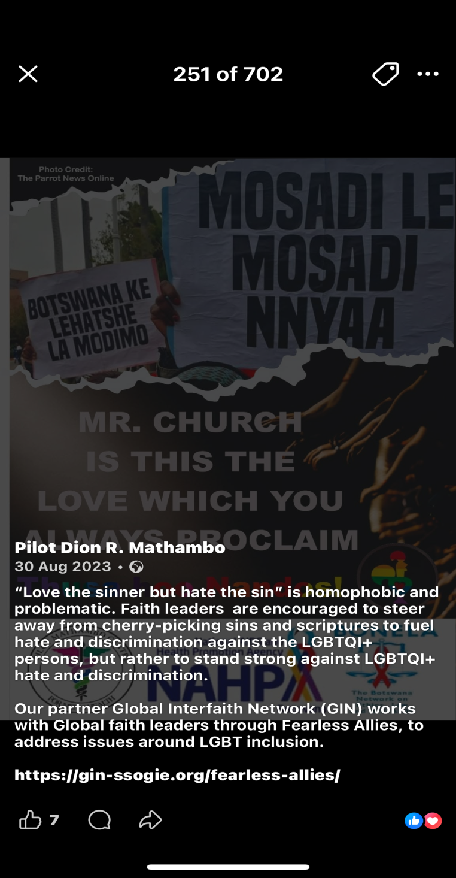
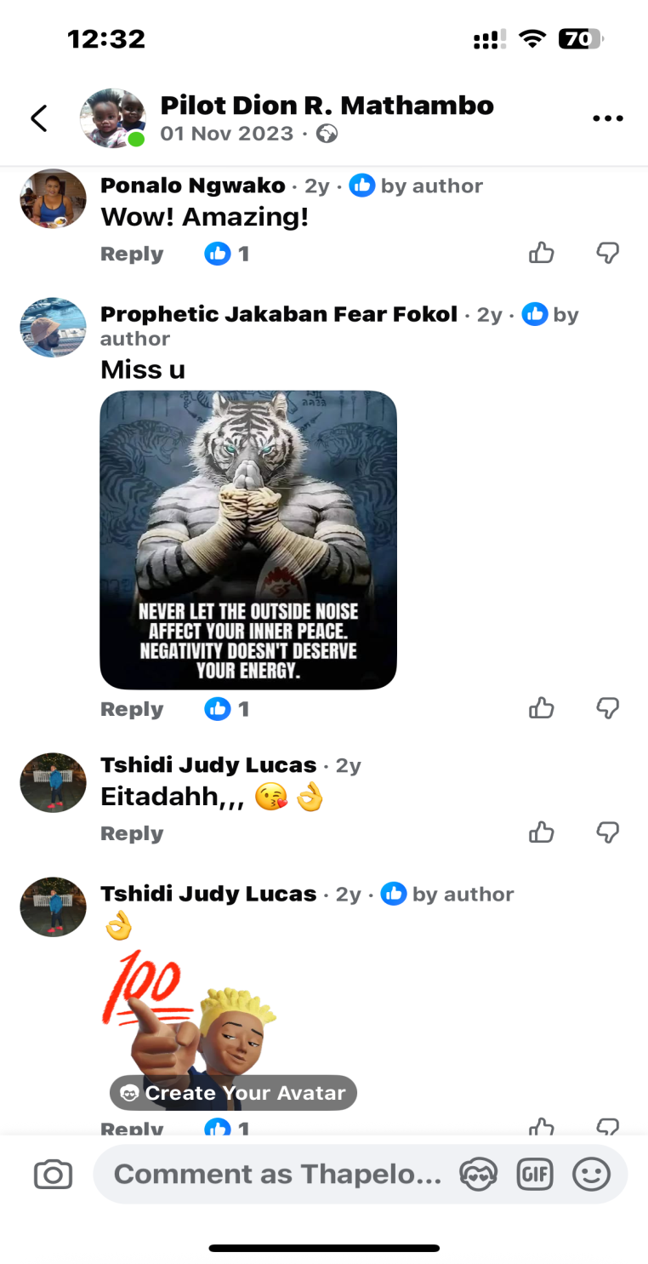
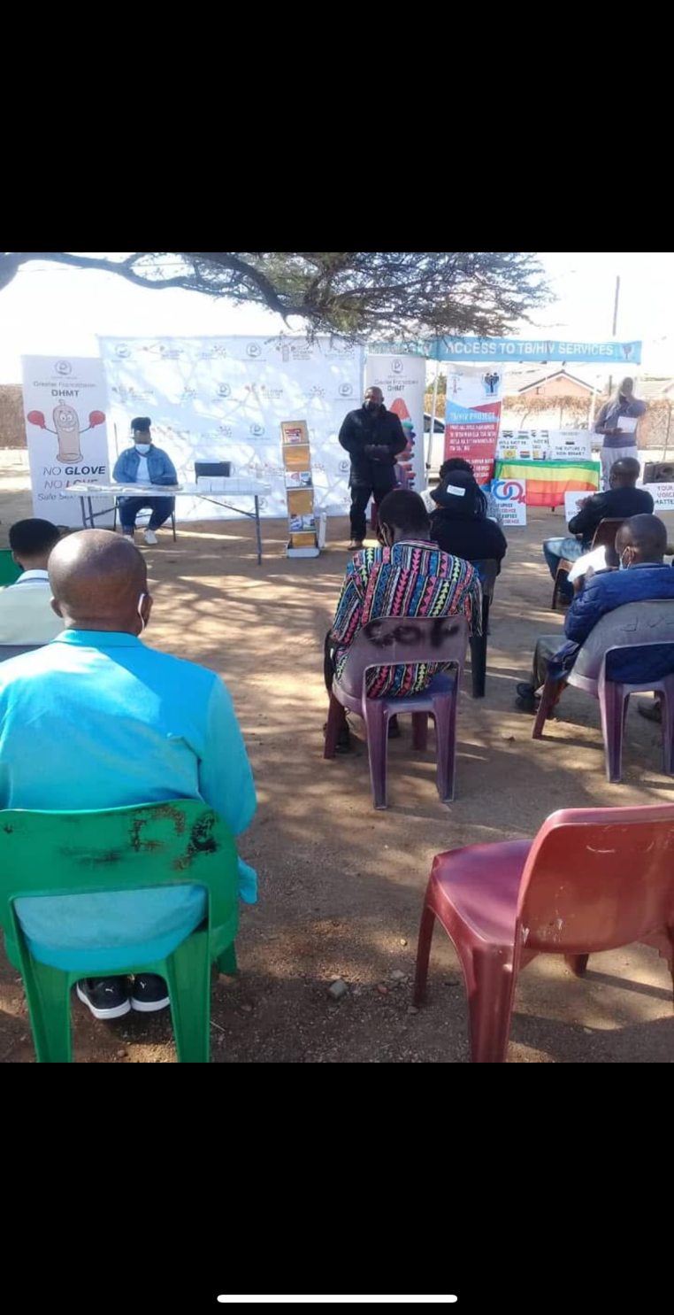
Impressions | Before WVL/Marang | Current
Facebook | 119 | 2686
Twitter | - | -
Tik-Tok | 0 | 126
YouTube | - | -
Instagram | - | -
Please provide a concrete example of your post

Slide 7
Sustainability
How will the change be sustained or scaled up?
How did you foster a culture of continuous learning and best practice sharing within the movement?
How did you generate and utilise evidence to assess the impact and effectiveness of advocacy efforts within your movement?
Peer Networks & Mentorship
Institutionalized peer networks and mentorship maintain and refresh the educator cohort through shared leadership and learning circles.
Formalized Partnerships
MOUs with clinics establish referral protocols and confidentiality standards ensuring sustained collaboration beyond project cycles.
Digital Resources & Scale
A digital content repository and hub-and-spoke model support district adaptation and ongoing use by partners and schools.
Data & Diversified Resourcing
Data dashboards enable adaptive management while diverse funding from public and private sectors strengthens sustainability.
Voice and Choice Summit 2026 \ Voice and Choice Summit 2026

Slide 8
Beneficiaries
 | Number of participants
Female – Direct beneficiaries | 99
Male – Direct beneficiaries | 121
Female – Indirect beneficiaries (e.g. through other networks) | 310
Male – Indirect beneficiaries (e.g. through other networks) | 316
Female – Online beneficiaries (e.g. website access, mailing lists, scholarly articles) | 103
Male – Online beneficiaries (e.g. website access, mailing lists, scholarly articles) | 88
Total | 1037
Voice and Choice Summit 2026 \ Voice and Choice Summit 2026

Slide 9
Challenges & Lessons learnt
Challenges & mitigation
Challenges:
• Resistance and stigma in male-dominated spaces.
•Risk of backlash from community gatekeepers (faith/traditional leaders).
• Unsafe disclosure environments and fear of harassment.
• Weak referral pathways between awareness and services.
Mitigation:
• Proactive engagement of gatekeepers through tailored briefings.
• Rapid response protocols to minimize backlash.
• Confidential clinic-community referral systems.
• Feedback loops (hotline, surveys, debriefs) to adapt messaging and improve trust.
What lessons have you learnt?
• Narrative change must be paired with service delivery for real impact.
• Male peer networks are effective in shifting norms and reducing stigma.
• Local champions increase credibility and reduce resistance.
• Continuous feedback strengthens sustainability and community ownership.
Voice and Choice Summit 2026 \ Voice and Choice Summit 2026

Slide 10
Next Steps
What are your plans?
Expanding Peer Networks
The strategy aims to grow peer networks across more districts to increase community engagement and support.
Strengthening Clinic Partnerships
Building stronger collaborations with clinics enhances service delivery and supports inclusive healthcare.
Digital Storytelling and Activism
Utilizing digital storytelling and art activism deepens awareness and promotes social change.
Documentation and Replication
Documenting strategies through toolkits and case studies supports adoption by partners beyond Botswana.
Voice and Choice Summit 2026 \ Voice and Choice Summit 2026

