Slide 1

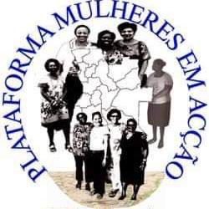
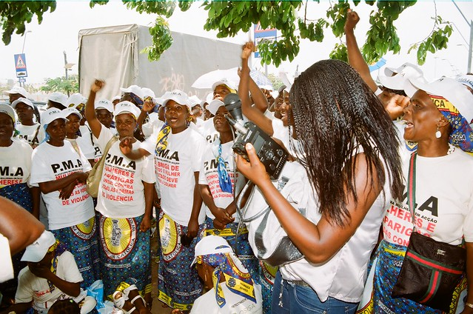
Voice and Choice Summit 2026-Change Strategies Category
Angola Building Youth Power to Transform Gender Norms and Promote more Inclusion
16 March by Liudmila da Conceicao
Voice and Choice Summit 2026 \ Voice and Choice Summit 2026

Slide 2
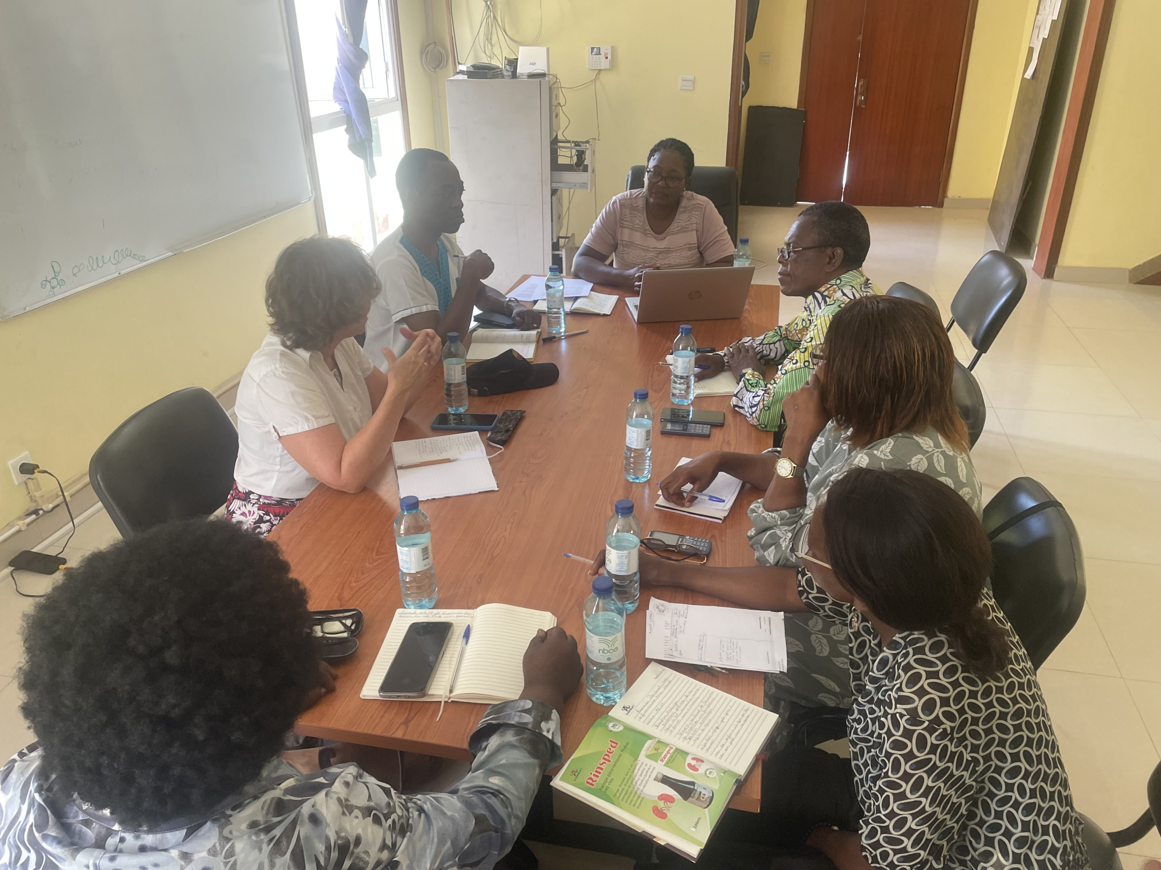
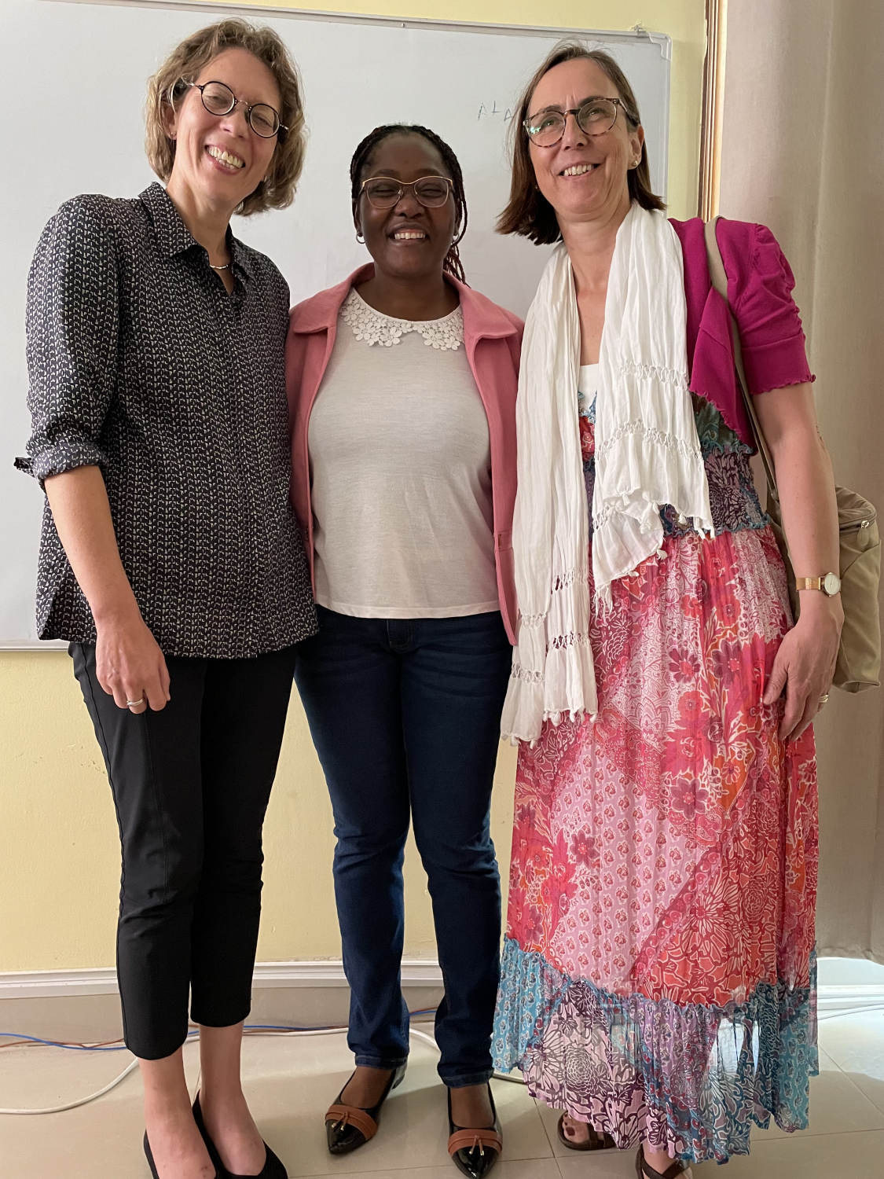
Background
Context / Problem
Current Situation
Prevalence & Vulnerability
Adolescent girls and young women (15–24) remain disproportionately affected in Angola, reflecting regional trends across Eastern and Southern Africa. In 2023, about 120,000 adolescent girls and young women in the region acquired HIV, highlighting the scale of risk .
In Angola, lack of sexual and reproductive health education contributes to early pregnancies and higher vulnerability to HIV among adolescent girls, especially in provinces like Kwanza Sul .(UNDP-Angol)
Access to Services
Funding cuts have severely impacted HIV prevention and treatment programs. For example, community outreach programs for young people and pregnant women have been paused, and only about 16% of people living with HIV are on treatment supported by PEPFAR.
Restrictive gender norms and limited youth participation in decision-making have historically reinforced inequality. Young women, men, and persons with disabilities often face barriers in education, employment, and civic leadership.
Underlying issue: In Angola, Financial and programmatic challenge: Before reforms, donor-driven frameworks restricted flexibility, and manual systems slowed adaptation to local realities.
Meetings with donors Misereor and Kasa partners from Amesterdan project negociations
Voice and Choice Summit 2026 \ Voice and Choice Summit 2026

Slide 3
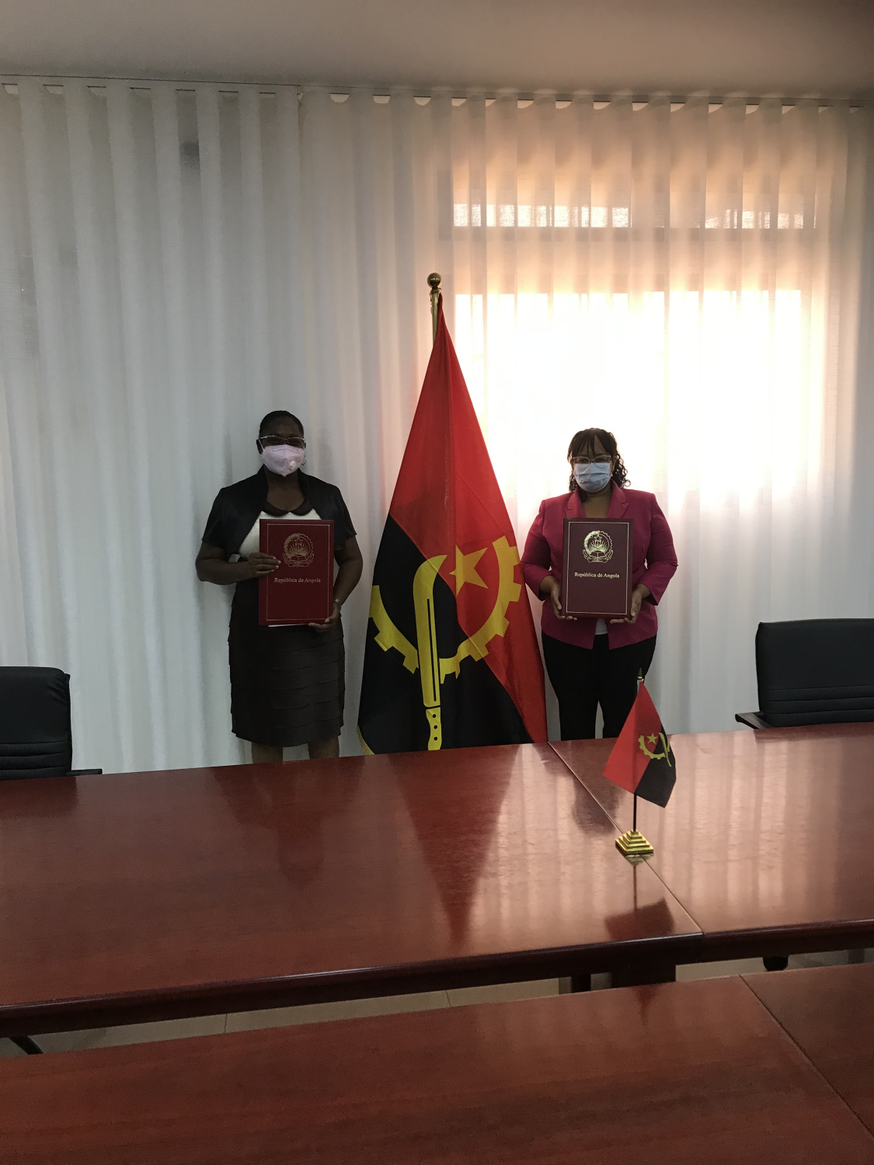
Change
How did the change come about?
Distribution of reports on CEDAW and women's and human rights, meetings with key government officials, the Civil House of the Presidency of the Republic, justice and provincial governments, were some of the entry points for many social advocacy successes. Work in local, regional, and international networks exerted its influence on structural and community changes.
What is the situation now?LGBTI Youth:
Greater visibility in advocacy and youth-led projects.
Some progress in policy language on non-discrimination, though legal protections remain limited.
Growing networks of support and solidarity, reducing isolation.
Evidence: Include Photos or videos
Recognition of PMA as a women's organization that supports VAW victims. Even without funds, we receive calls and help victims with moral, legal assistance and referral to SIC- Criminal department of Investigation, for procedural instruction of the crime.signature of the memorandum of understanding between the PMA and Women affairs GVB and gender, and leadership transformation.
Voice and Choice Summit 2026 \ Voice and Choice Summit 2026

Slide 4
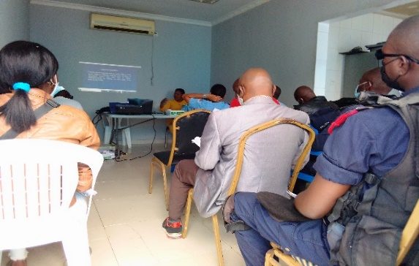
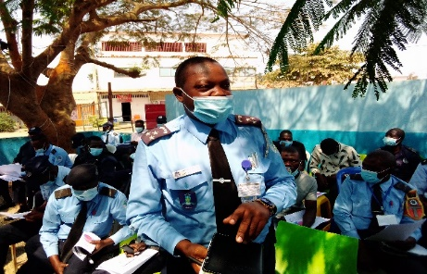
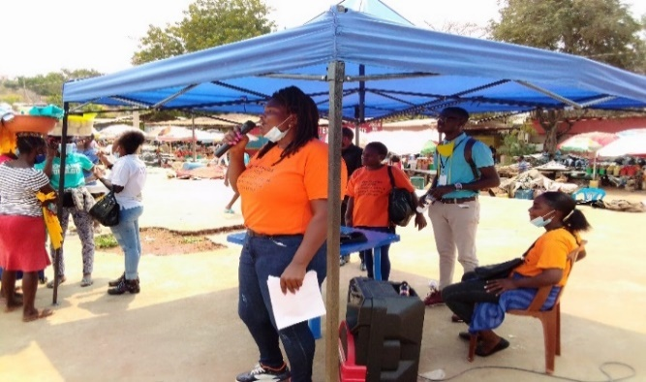
The Change
Change: The Angolan Parliament approved the Law Against Domestic Violence (Lei Contra a Violência Doméstica) in 2011, establishing legal recognition of GBV as a crime and creating mechanisms for prevention, protection, and punishment.
• When: 2011, following years of advocacy by civil society organizations, including PMA until 2022, the Law was up date until 2024
• Where: Angola, with national scope but strongest initial implementation in urban centers like Luanda.
2. Positive or Negative Change
• The change was positive, as it marked the first time GBV was formally recognized in law, providing survivors with legal protection and access to justice.
• It also aligned Angola with international human rights commitments, strengthening gender equality frameworks.
Training on the VGB Law for Police officers and community education expanded the dialogue with the government for the updating of the law and the increase pre-verifiers.
Voice and Choice Summit 2026 \ Voice and Choice Summit 2026

Slide 5
Change
The overarching lesson is that legal frameworks open doors, but social transformation sustains change. For both GBV and LGBTI advocacy, success depends on community ownership, inclusive programming, strong partnerships, and evidence-based monitoring. PMA’s role is pivotal in bridging policy and grassroots realities, ensuring reforms are not symbolic but lived in practice.

Slide 6
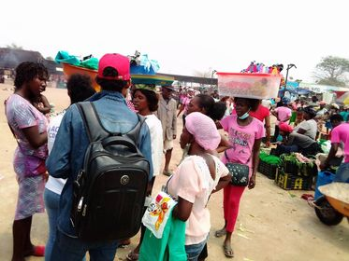
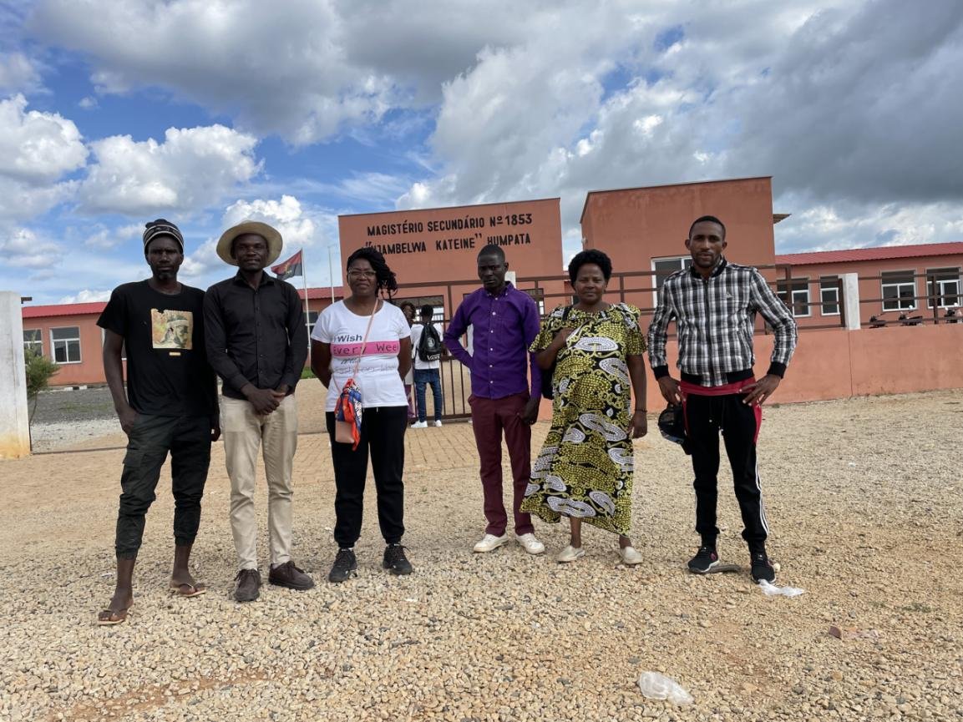
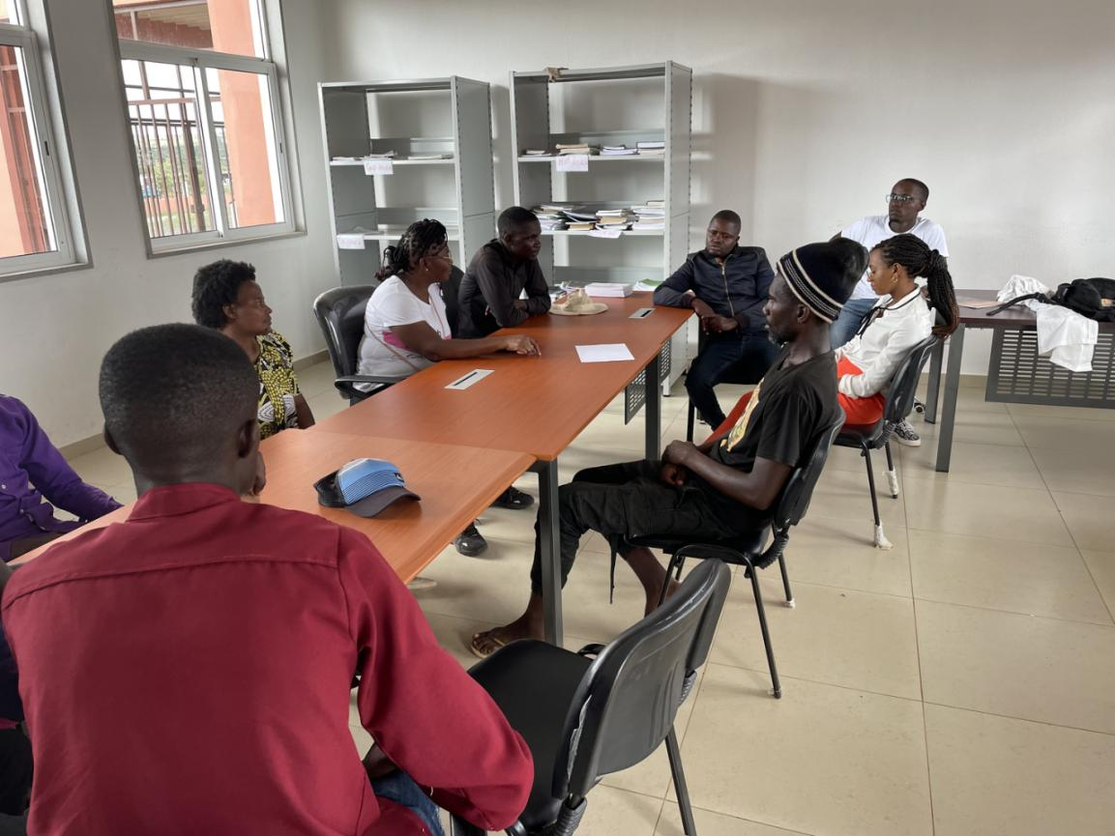
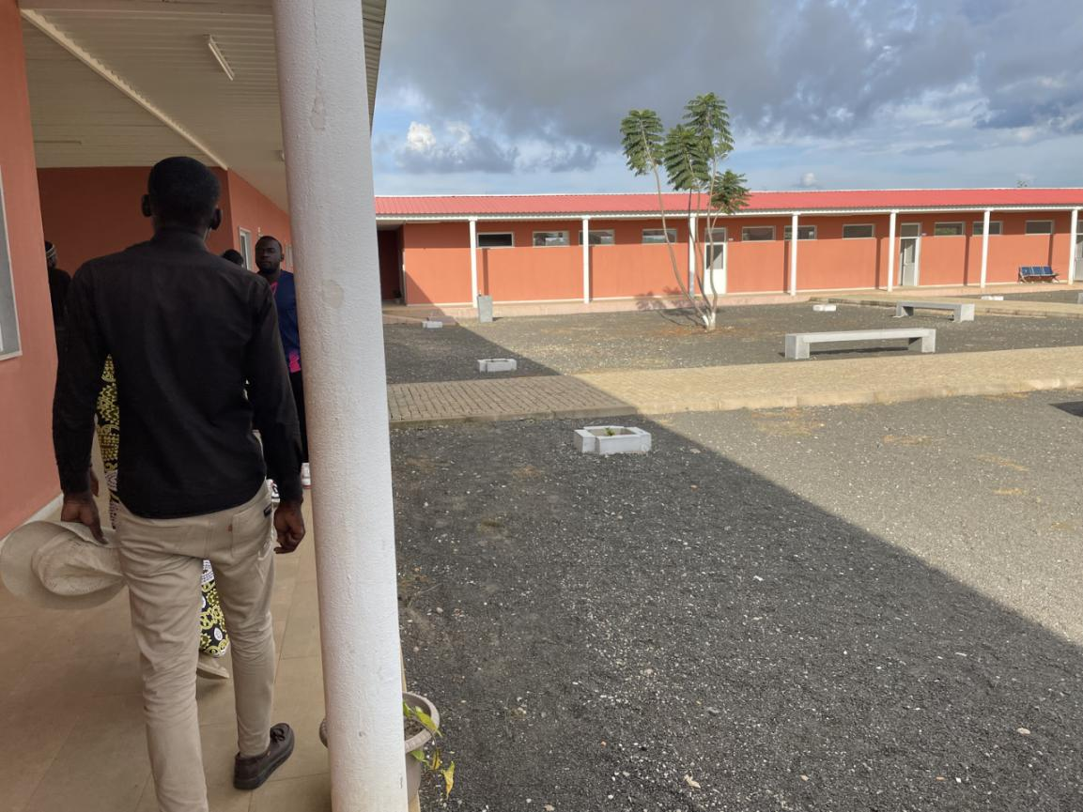
Significance/ Impact
Movement and Its Goals
• Legitimacy and Recognition:
• The GBV law (2011) gave civil society, including PMA, a legal foundation to demand accountability.
• LGBTI youth advocacy, though less advanced legally, gained visibility and recognition as part of broader human rights work.
Comunties affected by VGB seek PMA for assistance and the government recognizes the work carried out by the organization.
Members of the communities attend the PMA activists in community education, social projects such as schools were built to provide access to education in rural communities, Humpata Huila province
Voice and Choice Summit 2026 \ Voice and Choice Summit 2026

Slide 7
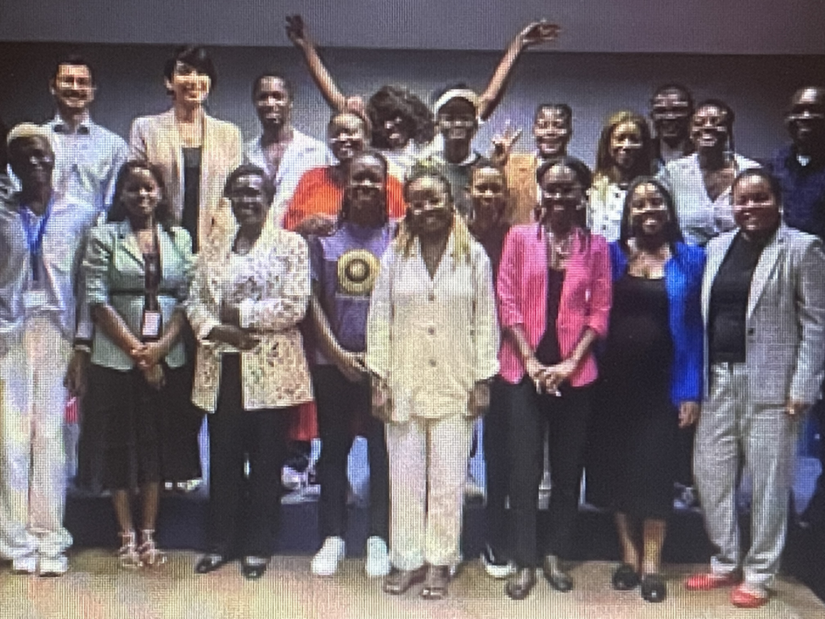
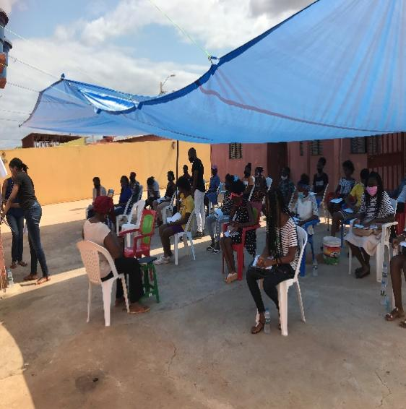
Sustainability
How will the change be sustained or scaled up? Institucional sustainability
Capacity building: Continuous training for police, judiciary, health workers, and social services to ensure consistent enforcement.
Integration into national policies: Align GBV law with broader frameworks like the National Gender Equality Policy (2013) and Angola’s commitments under CEDAW and the African Union.
Budget allocation: Advocate for dedicated government funding streams for GBV response, shelters, and survivor support.
2. Scaling Up Across Regions
Urban–rural expansion: Extend services beyond Luanda into provinces where enforcement is weaker. Mobile legal clinics and community paralegals can bridge gaps.
Community-based models: Train local leaders, youth, and women’s groups to act as first responders and advocates.
Training for young LGBTI and VGB and their empowerment in the communities, for the promotion of human rights.
Voice and Choice Summit 2026 \ Voice and Choice Summit 2026

Slide 8
Sustainability
Social Norms Change
Education campaigns: Embed GBV awareness in schools, youth programs, and community dialogues.
Engaging men and boys: Promote positive masculinities and community accountability.
Cultural adaptation: Work with traditional authorities to harmonize customary

Slide 9
Challenges & Lessons learnt
Challenges & mitigation GBV and LGBTI
Weak Enforcement
• Challenge: Police, judiciary, and local authorities often lack training or resources to apply the law consistently. Survivors may face secondary victimization.
• Mitigation:
• Continuous capacity building for police, judges, and health workers.
• Establish specialized GBV and LGBTI units within police stations and courts.
• Develop monitoring scorecards to track enforcement across provinces.
Legal Reform Is Necessary but Not Sufficient
• Lesson (GBV): Passing the 2011 GBV law was a milestone, but enforcement gaps showed that laws alone don’t change realities.
• Lesson (LGBTI): Legal recognition of rights remains limited; advocacy must combine legal reform with social acceptance campaigns.
• Takeaway: Laws must be paired with capacity building, survivor-centered services, and cultural change.
2. Community Engagement Is Critical
• Lesson (GBV): Survivors often face stigma; engaging traditional leaders, men, and youth helped shift norms.
• Lesson (LGBTI): Visibility and dialogue at community level reduce prejudice and create safe spaces.
Voice and Choice Summit 2026 \ Voice and Choice Summit 2026

Slide 10
Next Steps
What are your plans?
Plans for GBV (Gender-Based Violence)
• Consolidate Enforcement of the 2011 Law
• Strengthen police, judiciary, and health worker training.
• Push for consistent application of survivor-centered approaches.
• Expand Services Nationwide
• Scale shelters, counseling, and legal aid into rural provinces.
• Use mobile clinics and digital reporting platforms to reach underserved communities.
• Shift Social Norms
• Embed GBV awareness in schools and youth programs.
• Engage men and boys in positive masculinity campaigns.
• Monitoring & Accountability
• Develop MEL frameworks to track survivor outcomes and institutional responsiveness.
Voice and Choice Summit 2026 \ Voice and Choice Summit 2026

Slide 11
Plans for LGBTI Youth
Legal and Policy Advocacy
Push for explicit anti-discrimination protections in national law.
Align Angola’s frameworks with SADC and AU commitments on human rights.
Visibility and Safe Spaces
Support youth-led advocacy networks and peer support groups.
Create safe community hubs for LGBTI youth to access services and mentorship.
Intersectional Inclusion
Address overlapping vulnerabilities (e.g., rural LGBTI youth, those with disabilities).
Ensure inclusion in education, employment, and health programs.
Conclusion - Regional SolidarityThe plans for GBV and LGBTI youth work are about moving from recognition to transformation. For GBV, the priority is enforcement and survivor protection. For LGBTI youth, the priority is legal recognition and safe inclusion. Together, these plans strengthen the movement’s credibility, expand its reach, and set the stage for long-term cultural and structural change in Angola and across SADC.

Slide 12
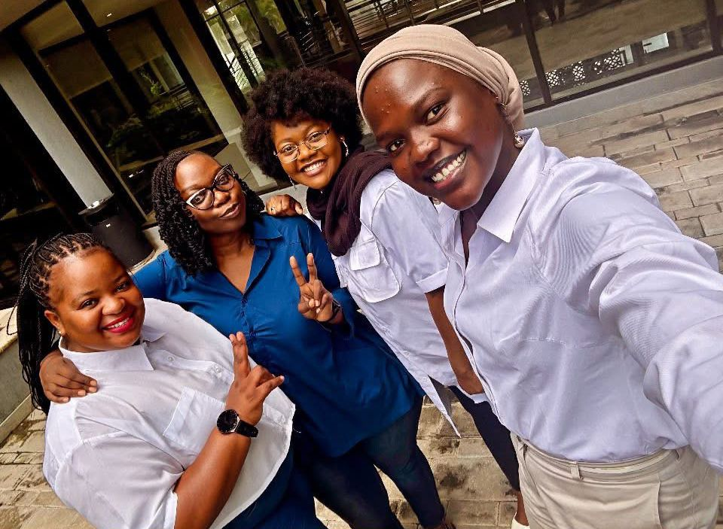
THANK YOU
MUITO OBRIGADA

