Slide 1







Logo goes here
LEARNING
AND SHARING
SUMMIT 2025
Story of Change Template
(South Africa, Cape Town , 5 March 2025 and Chantelle Goliath )
Please use your own photos to make your presentation unique.
Quotes and any other visuals make your presentation more engaging!
Women’s Voice and Leadership Learning and Sharing Summit 2025

Slide 2
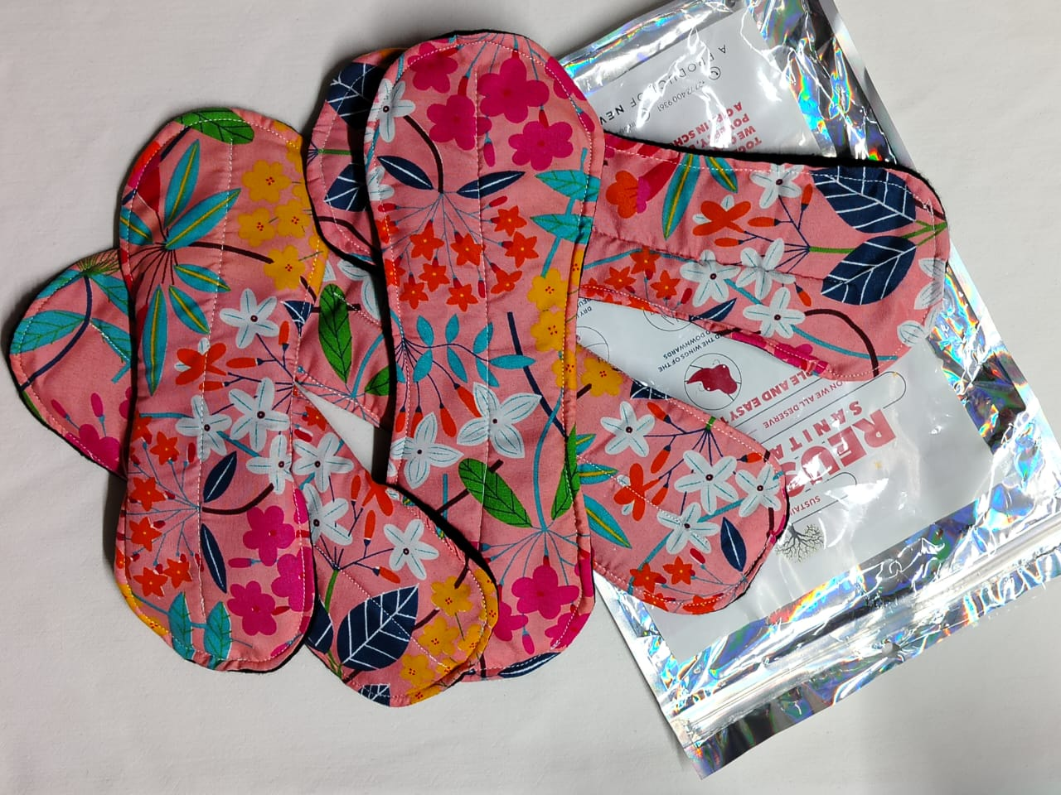
SYNOPSIS
Our story of change is about the acceptance of reusable products within our program by our beneficiaries and the boys championing ending period stigma with New heritage foundation.
women in prison is part of our change story too,they benefited from our reusable products and their lives was changed too.
Photo
Women’s Voice and Leadership Learning and Sharing Summit 2025

Slide 3
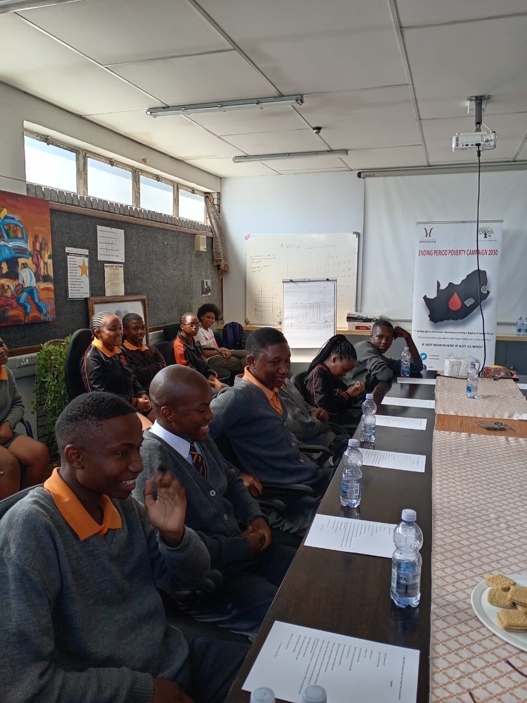
OBJECTIVES
Period poverty is just not about not sufficient sanitary products but inclusive education and including the boy child.
We supplied the reusable sanitary pads that gave girls the freedom and confidence to menstruate without shame and fear. Educated boys on their role to support girls which brought more support for girls and a equal opportunity to be present for her education without shame.
Photo
Women’s Voice and Leadership Learning and Sharing Summit 2025

Slide 4
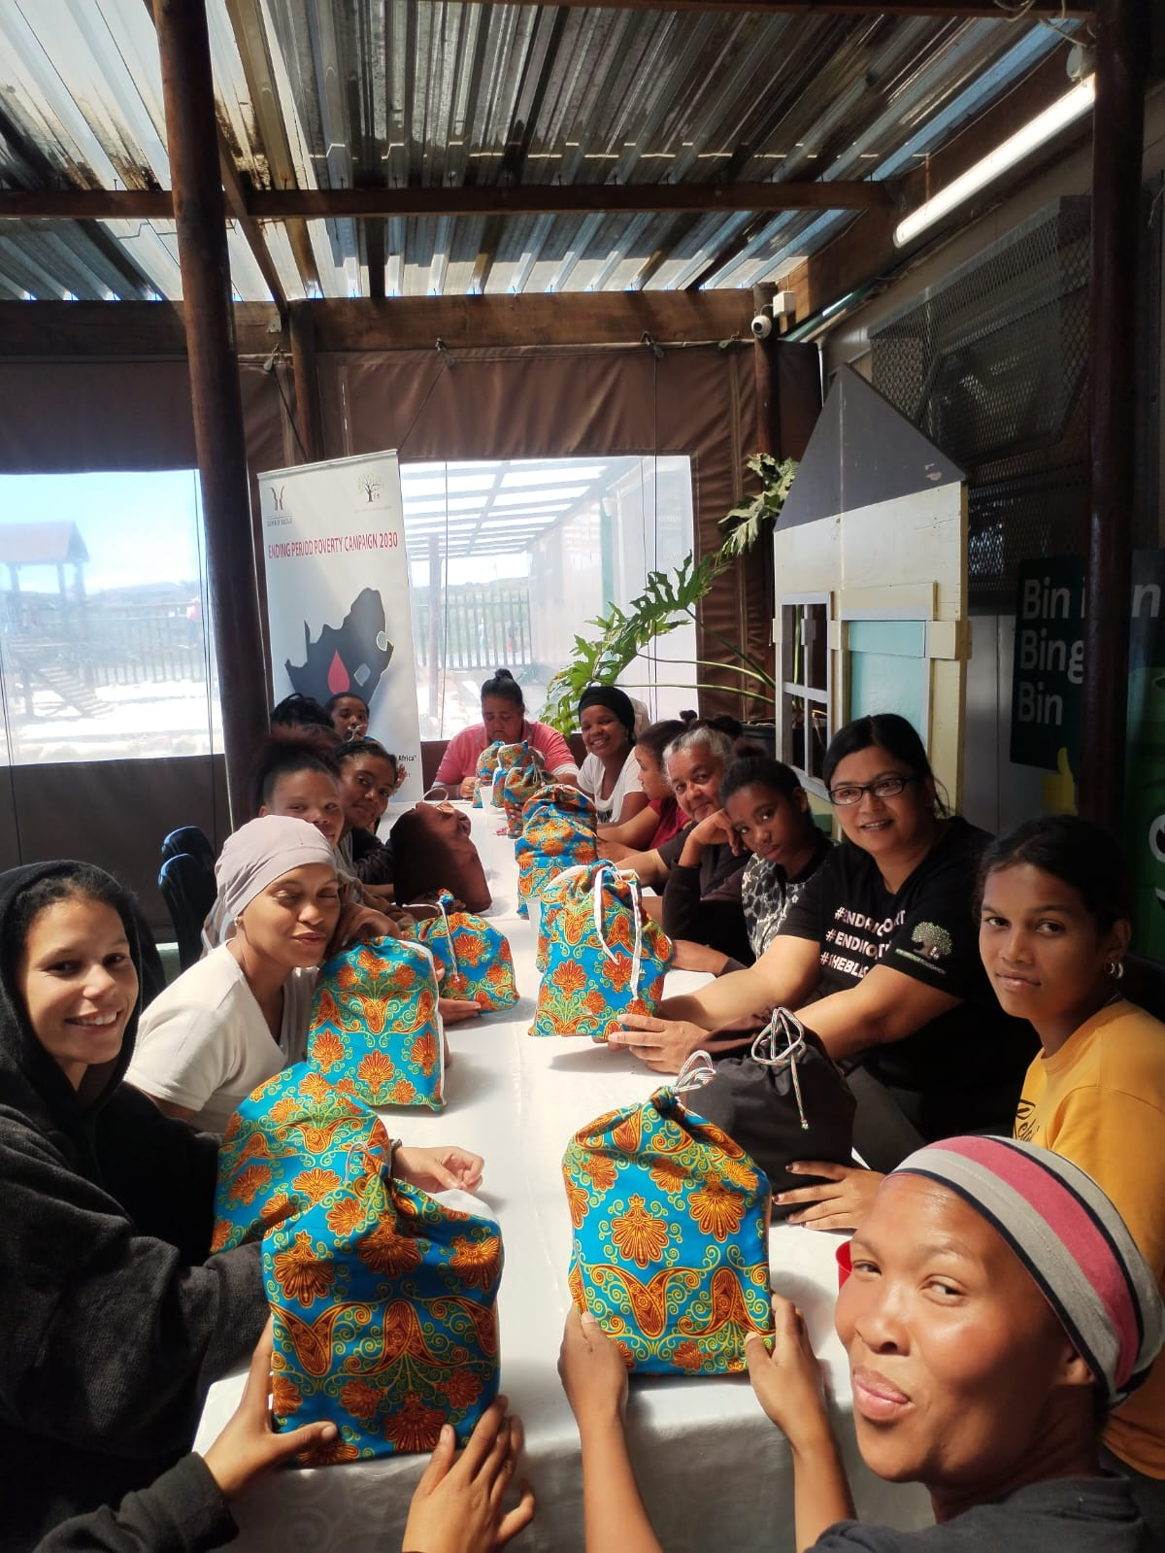
ACTIVITIES
Girls receiving dignity bags
Girls receiving reproductive health education
Understanding their bodies
Girls and boys making reusable pads and boys making those pads for their mom and sisters
Girls and boys sharing this initiative with their community
women in prison bleeding with dignity
Photo
Women’s Voice and Leadership Learning and Sharing Summit 2025

Slide 5
Contribution to change
Our organization has played a pivotal role in promoting menstrual dignity and challenging societal norms around menstruation. We've worked tirelessly to create a cultural shift, empowering girls to menstruate with dignity and boys to become better supporters.
Design digital educational programs in Powerpoint format
that are inclusive of all ages and genders and can be taught in any space locally or globally.
Writing and completing our own SRHR Text Book
Manufacturing our own reusable sanitary products locally that is environmentally friendly. a more sustainable solution to end period poverty!
Women’s Voice and Leadership Learning and Sharing Summit 2025

Slide 6
Population Group this change most closely related to
Category | Women | Men | Total | % Women
Direct beneficiaries | 508 | 224 | 732 | 69.4%
Indirect beneficiaries (e.g. through other networks) | 108 | 35 | 143 | 75.5%
Online beneficiaries (e.g. website access, mailing lists, scholarly articles) | 1369 | 107 | 1476 | 92.8%
Total | 1985 | 367 | 2351 | 84.5%
Women’s Voice and Leadership Learning and Sharing Summit 2025

Slide 7
Significance of change
Sharing our work and research with up and coming ngos in all of Africa where this kind of work is in dire need.
We can surely pivot our work on a bigger platform
Take our work out of silos and into collaboration with other partners in the SRHR spaces.
Our work already have a foundation and platform it is ready for further growth.
Women’s Voice and Leadership Learning and Sharing Summit 2025

Slide 8
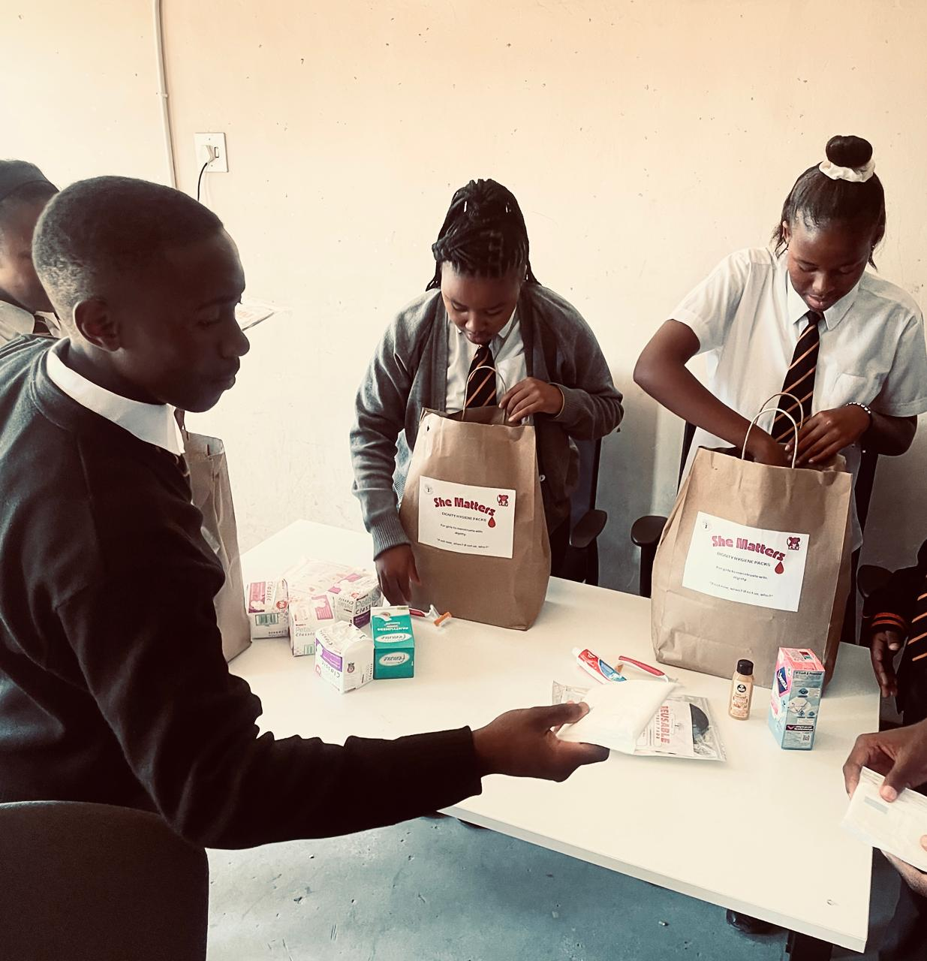
RESULTS
https://youtube.com/shorts/tPQVlOYfjFQ?feature=share
https://youtube.com/shorts/AenGx7ooe3I?feature=share
https://youtube.com/shorts/jtJcCDgNq2A?feature=share
Women’s Voice and Leadership Learning and Sharing Summit 2025

Slide 9
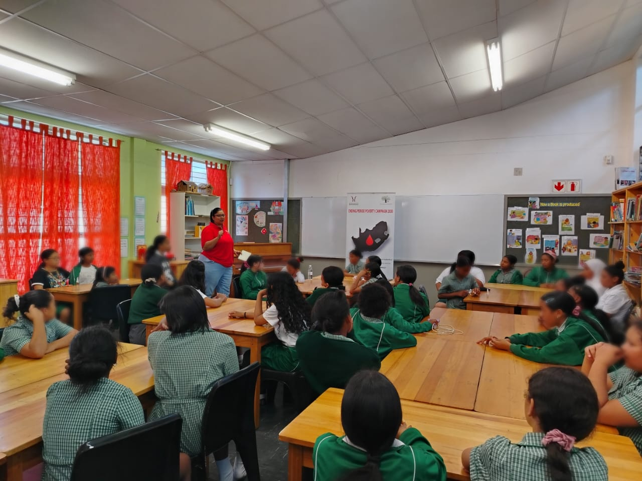
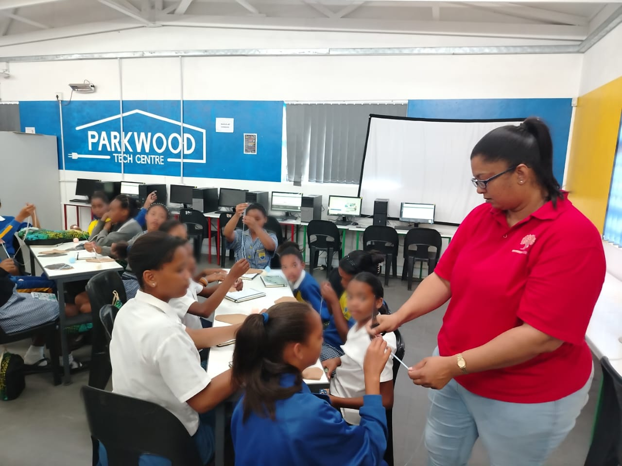
Evidence
Women’s Voice and Leadership Learning and Sharing Summit 2025

Slide 10
CHALLENGES AND LESSONS LEARNT
Cultural and Social Resistance: Changing deeply ingrained cultural and social norms around menstruation can be difficult and slow.
2. Limited Resources: Insufficient funding, inadequate infrastructure, and limited access to menstrual products can hinder efforts to promote menstrual dignity especially for the crisis period poverty is.
3. Stigma and Shame: the change is slow but necessary and it will take more than just teaching boys in school. We need men in leadership positions to join this movement and lead by example
4. Lack of Education and Awareness: Limited knowledge and understanding of menstrual health can perpetuate myths and misconceptions.
5.Policy and Legislative Barriers: Advocating for change can be challenging with so much red tape within written policies leaves the vulnerable still at a disadvantage although it it written for their protection
Women’s Voice and Leadership Learning and Sharing Summit 2025

Slide 11
CHALLENGES AND LESSONS LEARNT
1. Community Engagement is Key: Working closely with local communities, schools, and organizations is crucial for building trust and lasting partnerships.
2. Empowering Girls and Women: We have to keep educating and empowering girls and women to take control of their menstrual health is essential for promoting dignity and challenging societal norms.
3. Involving Boys and Men: Engaging boys and men in the conversation around menstruation can help to break down stigmas and promote a more inclusive environment and make enough noise about it on all our platforms.
4. Flexibility and Adaptability: Being flexible and adaptable in response to changing circumstances, challenges, and opportunities is essential for successful execution of our work.
5. Monitoring and Evaluation: Regularly monitoring and evaluating programs and initiatives can help to identify areas for improvement, measure impact, and inform future strategies.
Women’s Voice and Leadership Learning and Sharing Summit 2025

Slide 12
CHALLENGES AND LESSONS LEARNT
1.Establish a monitoring and evaluation framework: Track progress, identify challenges, and inform future strategies.
2.Conduct regular assessments and evaluations: Assess program effectiveness and identify areas for improvement.
3.Foster a culture of learning and adaptation: Encourage learning, and adaptation to ensure continuous improvement.
4. Staying relevant
Women’s Voice and Leadership Learning and Sharing Summit 2025

Slide 13
SUSTAINABILITY AND REPLICATION
1. Diversify funding sources: Pursue multiple funding sources, including grants, donations, and corporate sponsorships.
2. Develop a social enterprise model: Explore revenue-generating opportunities, such as selling reusable pads and offer our training programs.
3. Establish a reserve fund: Set aside funds to ensure continuity in case of funding disruptions.
Tendering opportunities with local government
4. Train and empower train teachers community leaders to champion menstrual dignity efforts.
5. Foster community ownership: Encourage community members to take ownership of menstrual dignity initiatives.
6. Establish a community advisory board: Create a board comprising community members to provide guidance and oversight.
Women’s Voice and Leadership Learning and Sharing Summit 2025

Slide 14

NEXT STEPS
Publish our textbook
Grow our social media
Partner with like minded organization to create a movement in the SRHR Space
Policy change advocacy with our governmental departments
short film documentary on period poverty as a pandemic.
Women’s Voice and Leadership Learning and Sharing Summit 2025

