Slide 1

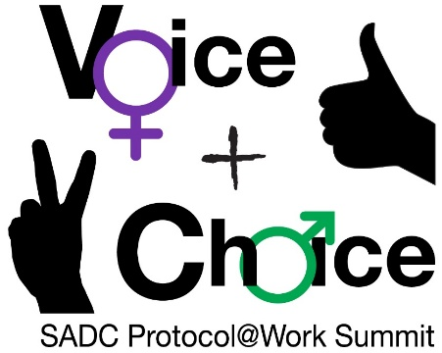





Logo goes here
LEARNING
AND SHARING
SUMMIT 2025
Story of Change Template
(Zimbabwe , Masvingo, 05/03/25)
Presenter: Veeslee Mhepo
Women’s Voice and Leadership Learning and Sharing Summit 2025

Slide 2
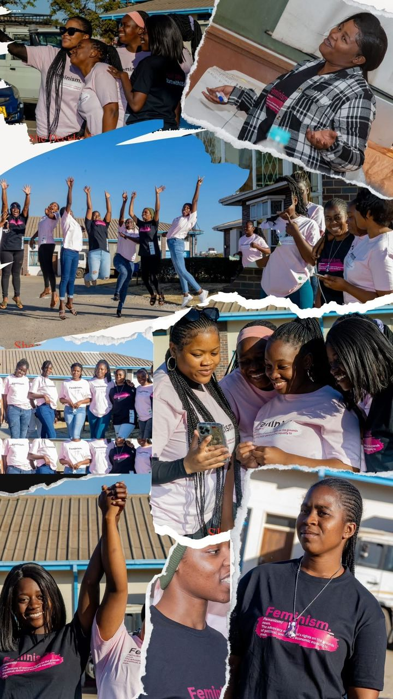
SYNOPSIS
Enhanced Participation of woman
significant progress has been observed in the enhanced participation of women, particularly young women, in budget consultations and public hearings across various communities in Zimbabwe .
The establishment of a dedicated youth seat within the Global Fund Country Coordinating Mechanism (CCM) for Zimbabwe signifies a landmark achievement in the realm of youth advocacy.
The successful advocacy for this seat was spearheaded by the Youth Health Movement alongside key partners such as My Age Zimbabwe and the Advocacy Core Team (ACT), showcasing the power of collective action in enacting policy change.
This transformation occurred in 2024 coinciding with efforts led by My Age Zimbabwe capacity building efforts in advocacy trainings.
The initiatives took place in urban and rural areas of Masvingo, aiming to empower young women and ensure their voices are heard in financial decision-making processes.
Collaborative workshops and outreach programs played a crucial role in fostering this engagement.
Women’s Voice and Leadership Learning and Sharing Summit 2025

Slide 3
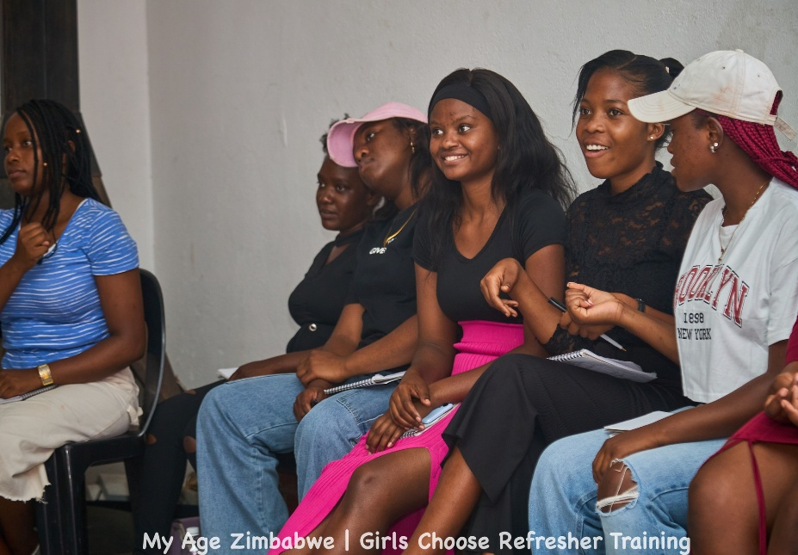
OBJECTIVES
The primary objective of this project was to empower women and girls in Zimbabwe to claim their rights, challenge patriarchal norms, and participate in decision-making processes that affect their lives.
Women’s Voice and Leadership Learning and Sharing Summit 2025

Slide 4
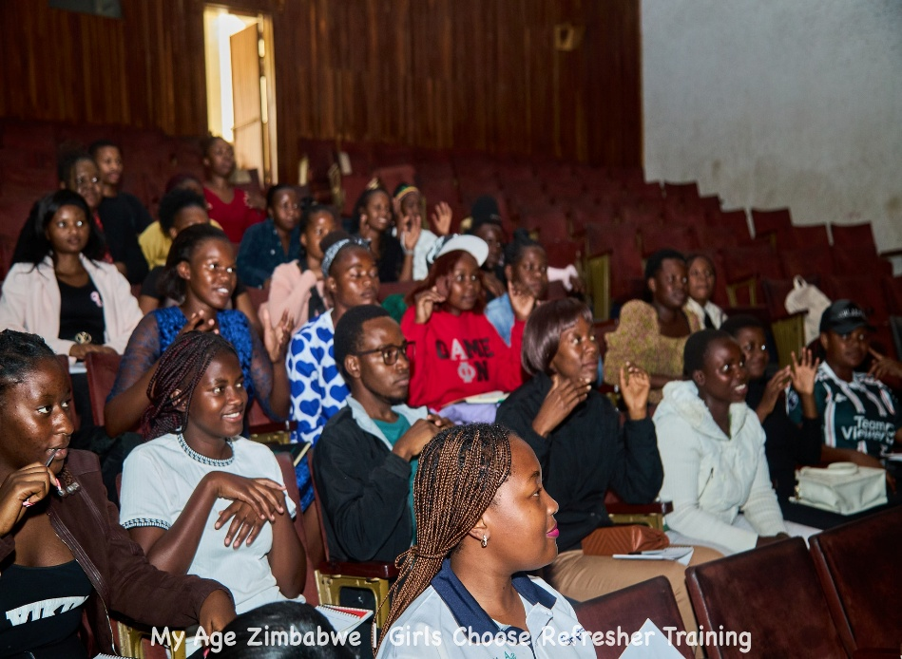
ACTIVITIES
What evidence or means of verification do you have for this change?
evidence of this change can be substantiated through a series of documented outcomes linked to the capacity-building initiatives conducted by My Age Zimbabwe.
These initiatives, which included advocacy training sessions and collaborative workshops in both urban and rural settings, are supported by qualitative data collected through participant feedback, attendance records, and reports generated from the outreach programs.
Additionally, photographic evidence and testimonials from participants further corroborate the transformative impact of these efforts on empowering young women in financial decision-making processes.
Photo
Women’s Voice and Leadership Learning and Sharing Summit 2025

Slide 5
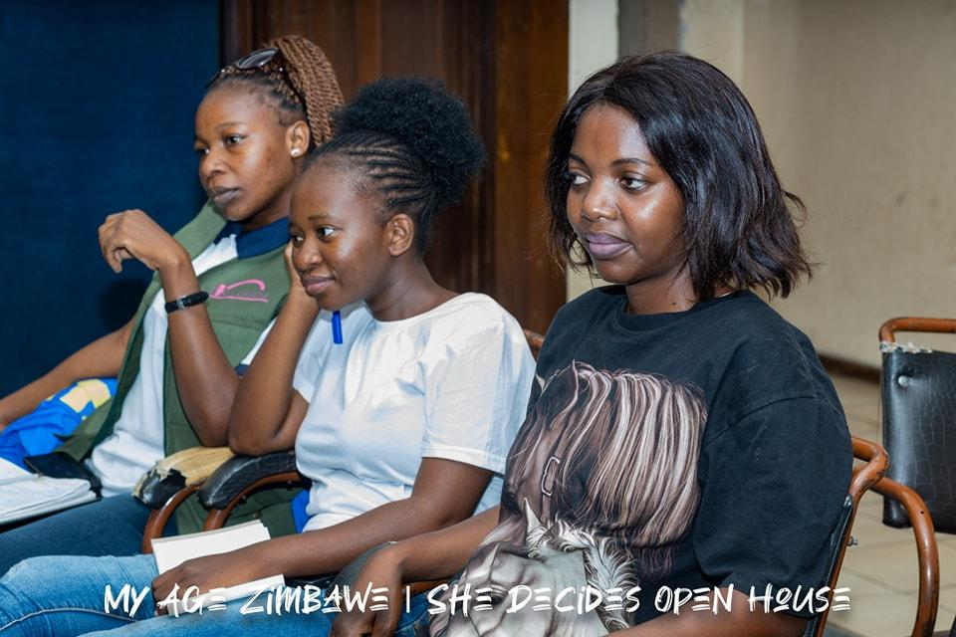
Contribution to change
What contribution did your organisation make to this change?
My Age Zimbabwe has significantly contributed to the increased participation of women, particularly young women, in budget consultations and public hearings throughout various communities in Zimbabwe.
This pivotal transformation, observed in 2024, resulted from our comprehensive capacity-building initiatives, which focused on advocacy training in both urban and rural areas.
Through collaborative workshops and targeted outreach programs, we have effectively empowered young women, ensuring their voices are integral to financial decision-making processes.
Women’s Voice and Leadership Learning and Sharing Summit 2025

Slide 6
Population Group this change most closely related to
Category | Women | Men | Total | % Women
Direct beneficiaries | 30 | 10 | 40 | 75%
Indirect beneficiaries (e.g. through other networks) | 110 | 90 | 200 | 55%
Online beneficiaries (e.g. website access, mailing lists, scholarly articles) | 700- 3,500 | 300- 1500 | 6000 | 60%
Total
Women’s Voice and Leadership Learning and Sharing Summit 2025

Slide 7
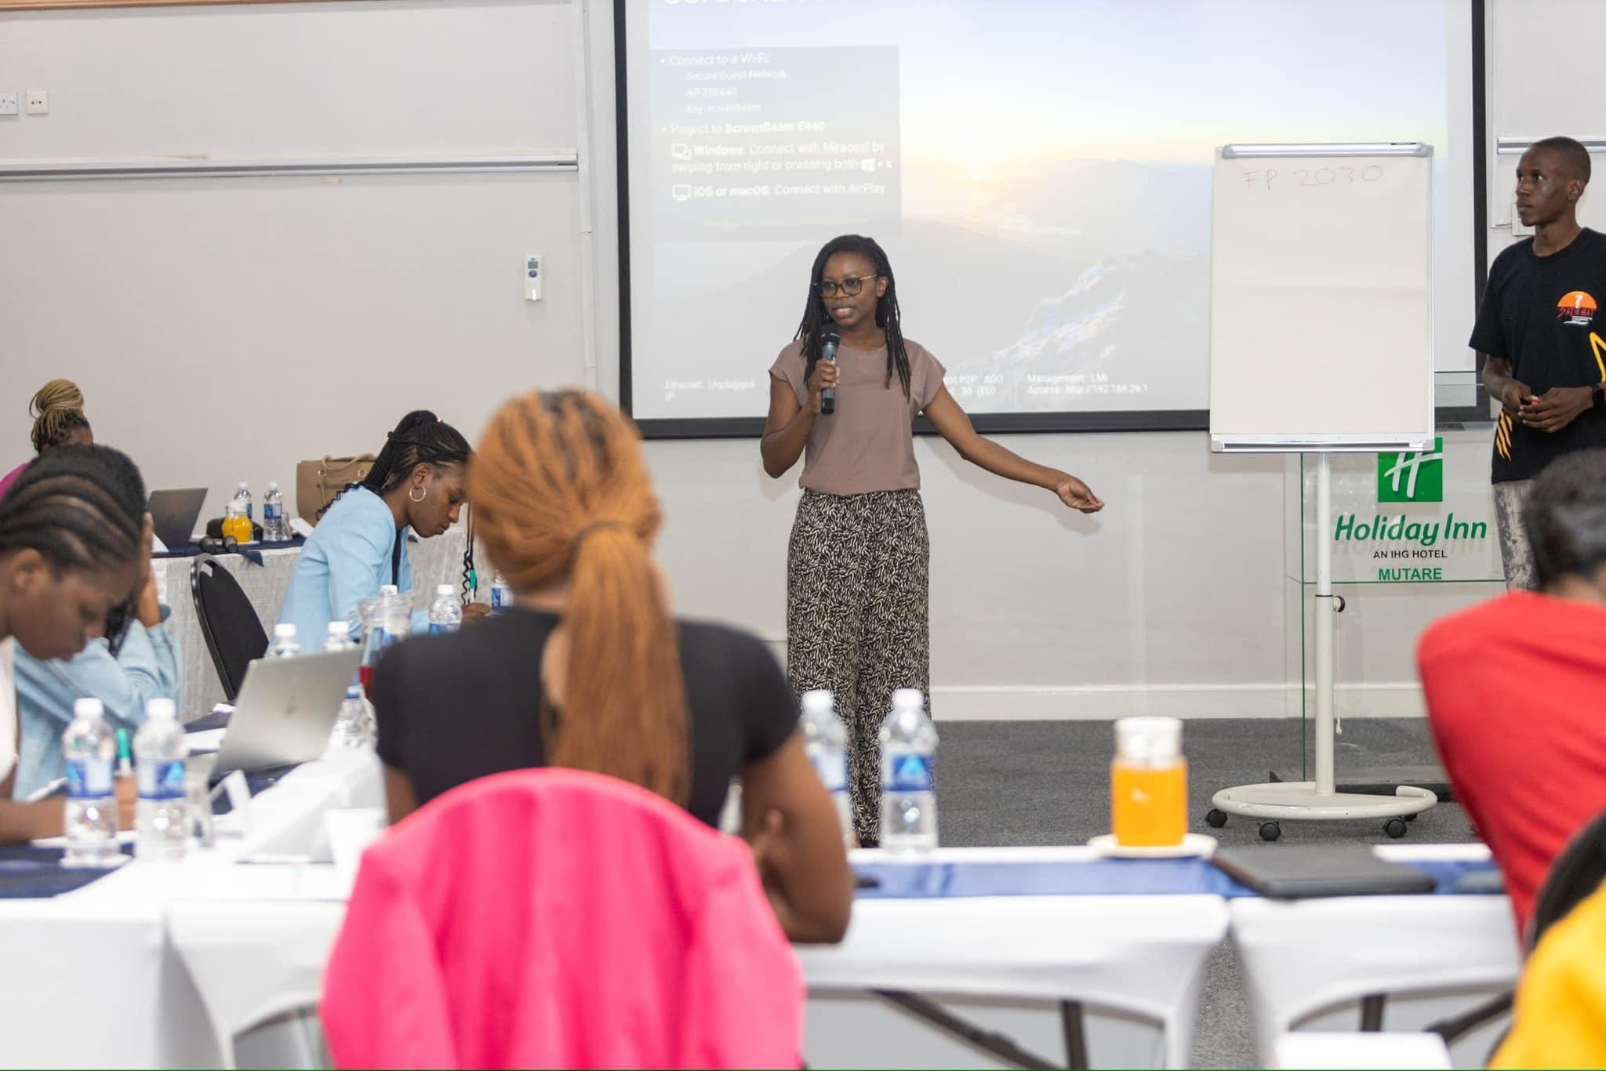
Significance of change
The significance of this change lies in the marked enhancement of women's participation, especially among the youth,
This progress, observed in 2024 alongside capacity building initiatives by My Age Zimbabwe, underscores the importance of empowering young women in financial decision-making.
Young representatives now possess the means to hold both the Principal Recipient and Sub-Recipients accountable for the effective and transparent utilization of funds directed towards youth constituencies.
This newfound representation paves the way for increased responsiveness to the unique challenges faced by the youth population in Zimbabwe.
Such transformative engagement is essential for sustainable development and the promotion of gender equality within the country.
Women’s Voice and Leadership Learning and Sharing Summit 2025

Slide 8
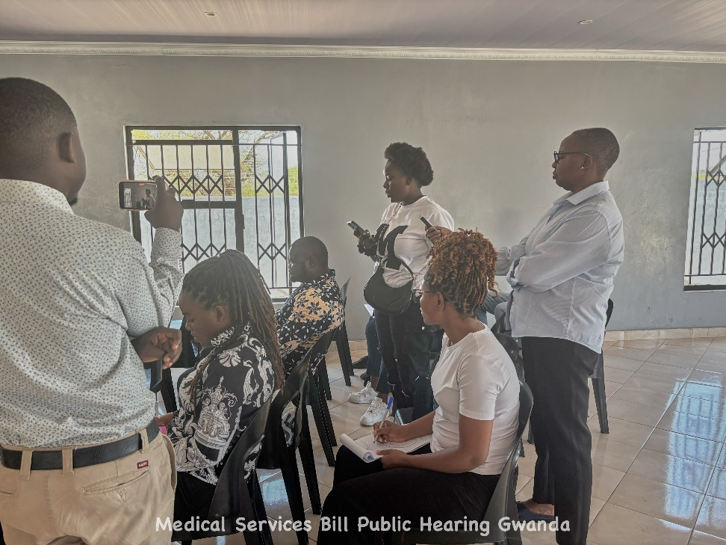
RESULTS
Please share some of your results for example:
These advancements can be attributed to the dedicated capacity-building initiatives spearheaded by My Age Zimbabwe, which included advocacy training sessions designed to amplify the voices of young women in financial decision-making processes.
The outreach programs and collaborative workshops conducted in both urban and rural settings proved instrumental in fostering meaningful engagement and driving positive changes in gender attitudes at both the individual and community levels.
Furthermore, the increased media coverage, including on social media platforms, played a vital role in raising awareness and support for women's participation in governance.
Women’s Voice and Leadership Learning and Sharing Summit 2025

Slide 9
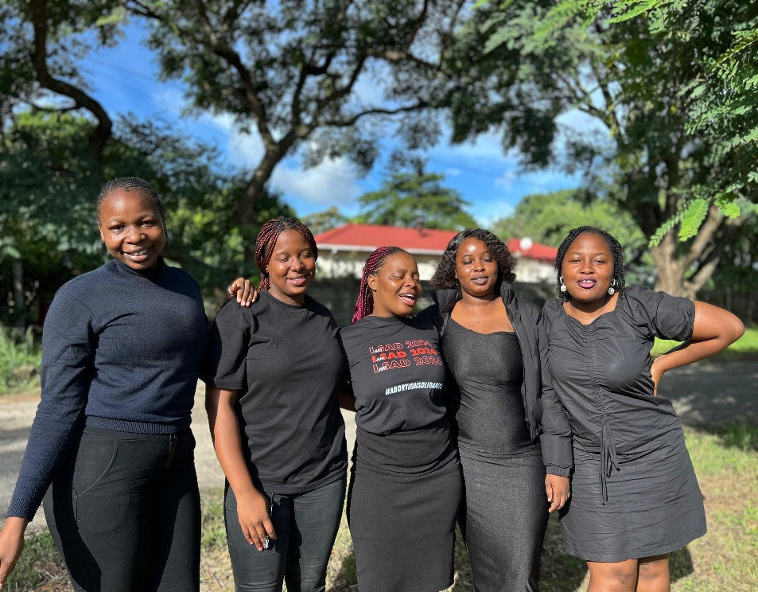
Evidence
The evidence of significant progress in the enhanced participation of women, particularly young women, in budget consultations and public hearings in Zimbabwe is substantiated by a collection of quantitative and qualitative data gathered throughout 2024.
This includes participation statistics from budget consultations, documentation of attendance records, and feedback surveys from participants, which indicate a marked increase in female involvement post-advocacy training initiatives led by My Age Zimbabwe.
Additionally, supporting documents such as workshop agendas, training materials, and participant testimonials further corroborate the effectiveness of the capacity-building efforts undertaken in both urban and rural communities.
These comprehensive records substantiate the claim of transformative engagement, facilitating empowered representation in financial decision-making processes.
Women’s Voice and Leadership Learning and Sharing Summit 2025

Slide 10
CHALLENGES AND LESSONS LEARNT
Challenges encountered.
The integration of My Age Zimbabwe's capacity-building efforts revealed obstacles such as societal norms that traditionally limit women's involvement in public discourse, a lack of access to information regarding budgetary processes, and insufficient representation in decision-making bodies.
Furthermore, logistical issues, including transportation difficulties and inadequate outreach in remote areas, hindered full participation.
Addressing these challenges remains imperative to sustain and deepen the engagement of women in financial decision-making processes.
Women’s Voice and Leadership Learning and Sharing Summit 2025

Slide 11
CHALLENGES AND LESSONS LEARNT
Lessons Learnt
The role of collaborative workshops and outreach programs was pivotal in fostering engagement. By bringing together various stakeholders, including local leaders and civil society organizations, we created a supportive environment that encouraged participation and highlighted the value of diverse perspectives.
It is vital to ensure that these initiatives are not one-off events but part of an ongoing process. Establishing continuous platforms for dialogue and feedback will help sustain and deepen young women's involvement in budget consultations.
Tailoring the initiatives to fit the specific contexts of urban and rural communities has been instrumental. Understanding local dynamics and cultural nuances allowed for more effective outreach and participation strategies.
Implementing robust monitoring and evaluation frameworks is crucial to assess the impact of these initiatives. Collecting data on participation rates and feedback from participants will guide future efforts and improve program delivery.
Women’s Voice and Leadership Learning and Sharing Summit 2025

Slide 12
CHALLENGES AND LESSONS LEARNT
Lessons Learnt
Firstly, the empowerment of young women through education will be prioritized, ensuring they possess the necessary skills to engage in budgetary discussions confidently.
Secondly, ongoing collaboration with stakeholders will be established through regular workshops and outreach programs, fostering a supportive environment that values diverse perspectives.
Additionally, our approach will focus on sustaining engagement by creating continuous platforms for dialogue and feedback, reinforcing the importance of ongoing participation.
To ensure effectiveness, initiatives will be tailored to the unique contexts of urban and rural communities, taking into account local dynamics and cultural nuances.
Finally, a robust monitoring and evaluation framework will be implemented to assess participation rates and gather feedback, guiding future efforts and enhancing program delivery.
Women’s Voice and Leadership Learning and Sharing Summit 2025

Slide 13
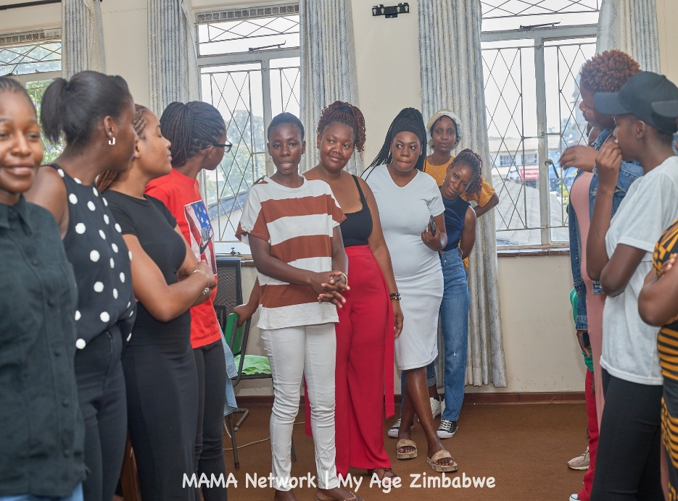
SUSTAINABILITY AND REPLICATION
To sustain the momentum of enhanced participation of young women, it is imperative to establish a robust framework for ongoing training and capacity-building initiatives.
Key strategies include creating partnerships with local organizations and stakeholders to promote continuity in advocacy efforts.
Additionally, developing a cascading model to share best practices and resources across various communities will facilitate the replication of successful approaches.
By integrating these initiatives into existing structures and encouraging diverse organizations to adopt similar methodologies, the transformative gains achieved in 2024 can be further solidified, ensuring that the voices of young women in financial decision-making remain prominent and influential.
Women’s Voice and Leadership Learning and Sharing Summit 2025

Slide 14

NEXT STEPS
The key priorities
focus on sustaining and expanding the enhanced participation of women, especially young women, in budget consultations and public hearings throughout Zimbabwe.
Building on the progress achieved in 2024 through the advocacy training initiatives by My Age Zimbabwe, it is imperative to continue fostering an inclusive environment that empowers these women.
Future efforts should prioritize the establishment of sustainable outreach programs and collaborative workshops that not only amplify their voices in financial decision-making but also address the unique challenges faced by women in both urban and rural settings.
Include evidence here – photos/clippings
Women’s Voice and Leadership Learning and Sharing Summit 2025

