Slide 1

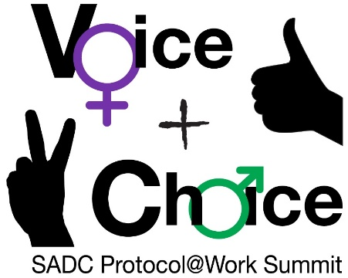





LEARNING
AND SHARING
SUMMIT 2025
Story of Change: Advocacy For Sexual and Reproductive Health Rights among Young Mothers in Tanzania
(Tanzania, Dar es salaam, .../3/2024 and Shadrack J. Msuya)
Women’s Voice and Leadership Learning and Sharing Summit 2025

Slide 2
SYNOPSIS
In order to improve its influence on gender-based violence prevention, access to legal and youth-friendly healthcare services, and sexual and reproductive health (SRH) projects in Tanzania, the Salama Foundation has undergone substantial changes.
Due to SRH education and service availability, adolescent pregnancy rates decreased from 27% in 2015–2016 to 22% in 2024, which is one of the noteworthy accomplishments.
The Foundation has improved maternal and child health outcomes by expanding youth-friendly health services, especially in Uyui District.
In-camera procedures for sexual violence cases, the creation of GBV bureaus within the National Prosecutions Service, and the passage of electoral GBV legislation are all results of advocacy initiatives that have improved survivors' legal rights.
Furthermore, via safe homes, "Mkono kwa Mkono" centers, and child protection programs, the Foundation has increased the availability of support services for GBV survivors. In Tarime District, efforts to prevent female genital mutilation (FGM) have saved more than 100 girls, and partnerships with governmental and non-governmental organizations have increased the effectiveness of the program.
Through community involvement initiatives like the Caravan Route project, which has distributed 2,500 educational materials and reached over 800 boda boda riders, gender equality and GBV prevention have been promoted. These developments demonstrate the Foundation's dedication to promoting gender equality, expanding access to healthcare, and fortifying legal safeguards for marginalized groups.
Women’s Voice and Leadership Learning and Sharing Summit 2025

Slide 3
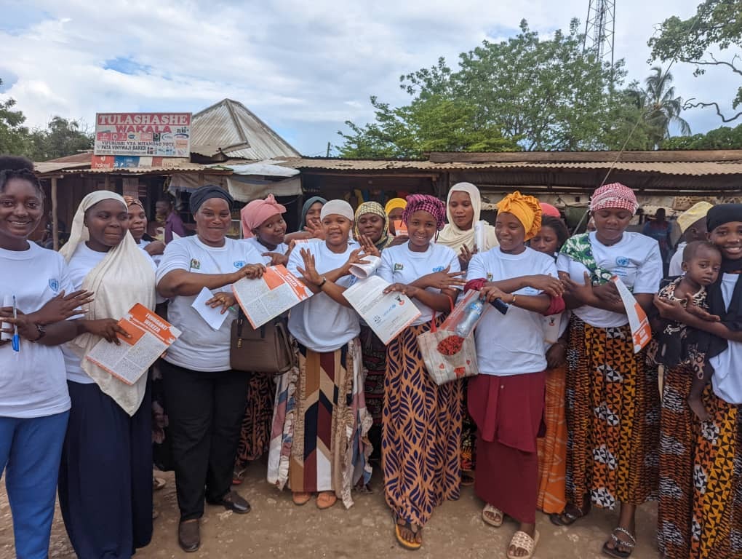
OBJECTIVES
1. Strengthening movement and commitment of young mother's groups/clubs to access quality SRH services and information.
2. Promotion of safer, inclusive, and supportive SRHR policies;
3. Improve access to evidence-based information on CSE and SRHR
4. Improve access to evidence-based information on CSE/SRHR/GBV and effective approaches for young mothers.
Women’s Voice and Leadership Learning and Sharing Summit 2025

Slide 4
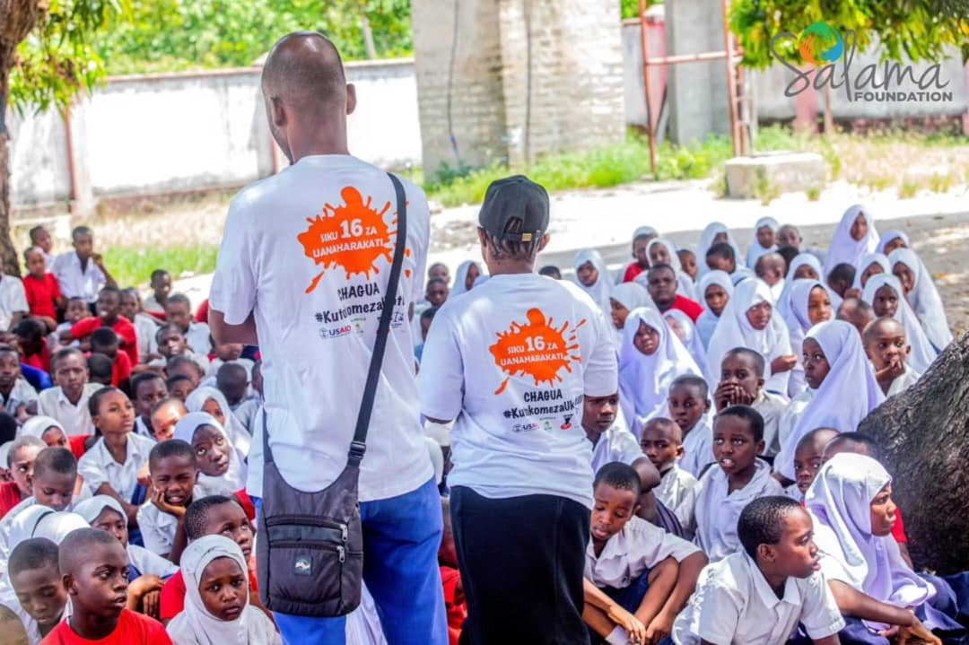
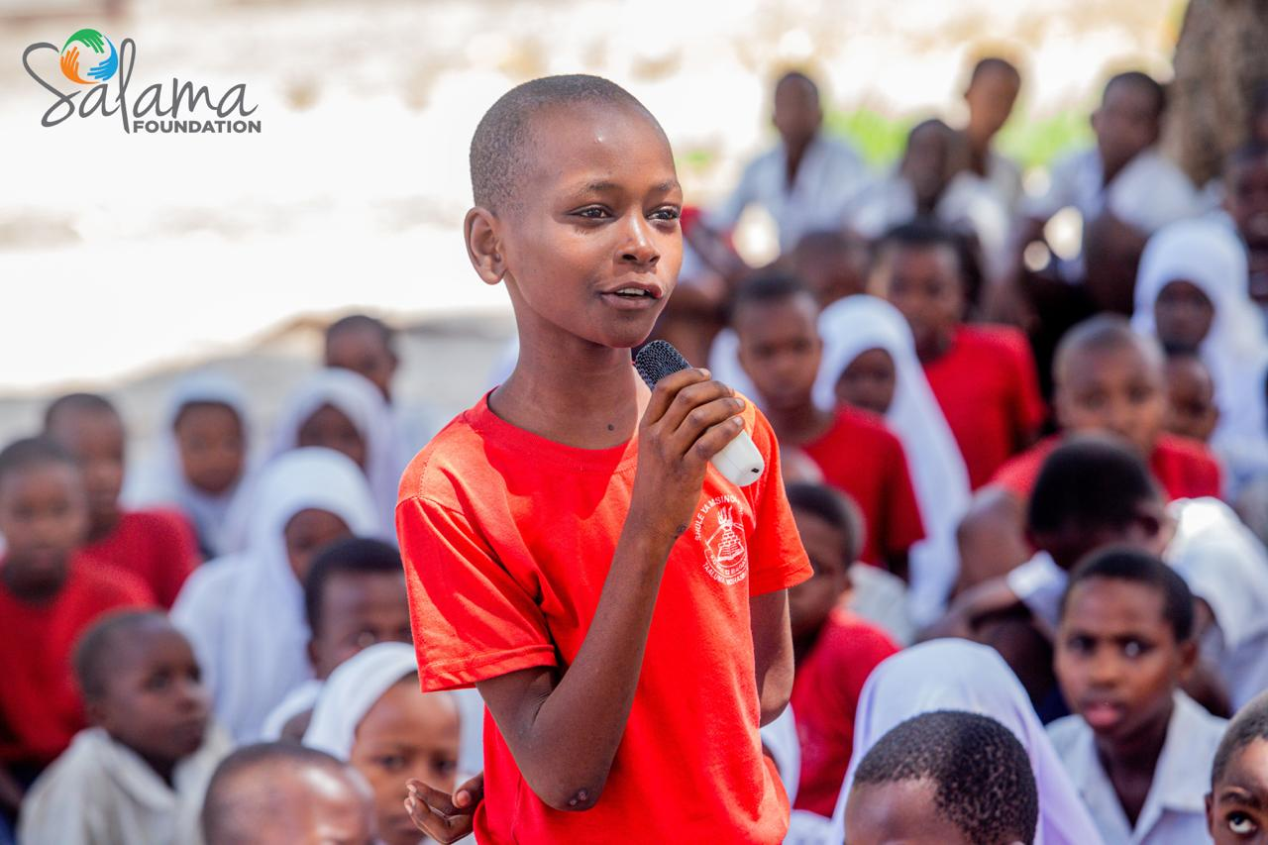
ACTIVITIES
Awareness Campaigns via Social Media Platforms
Training of Key Stakeholders on Sexual Harassment and GBV
Open Dialogue on Gender-Equitable Norms for Development
Radio and Television Advocacy on GBV Prevention
Campaigns Promoting Positive Male Norms
Distribution of Educational Materials on SRH, GBV, and Family Planning
Outreach and Edutainment Programs for GBV and SRHR Awareness
Women’s Voice and Leadership Learning and Sharing Summit 2025

Slide 5
Contribution to change
Advocacy Efforts; Salama Foundation employs SMART advocacy to ensure in establishing and strengthening youth-friendly health centers offering services such as family planning and counseling at Kigoma, Simiyu, Tabora etc.
Over 2,500 IEC materials, such as flyers and brochures, were distributed. These materials focused on educating men and boys about their responsibility in supporting SRHR, promoting gender equality, and advocating for non-violent behaviors.
Community mobilization; Our engagement has been central to the foundation's efforts of empowerment through open dialogues, camapigns.
Recognizing men’s role in preventing GBV; the foundation has conducted dialogues with over 800 boda boda, encouraging them to advocate for SRH education and gender equality.
Direct Actions; We utilized digital advocacy tools (e.g., social media, email campaigns) to engage supporters.
Women’s Voice and Leadership Learning and Sharing Summit 2025

Slide 6
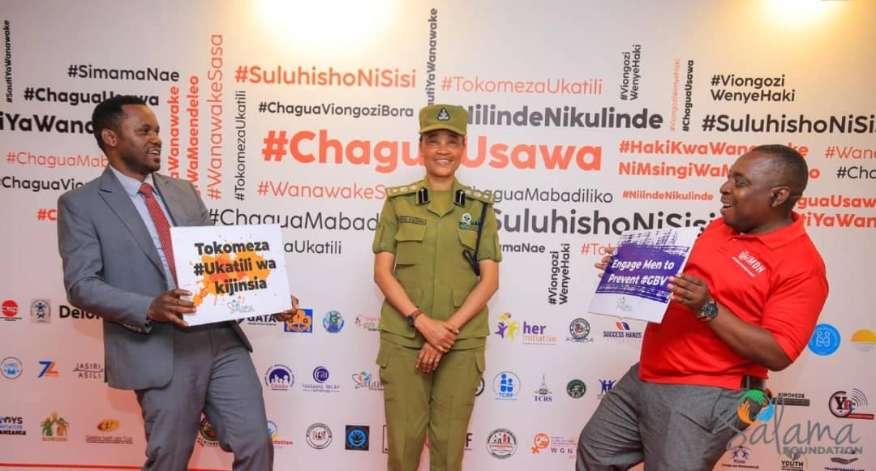
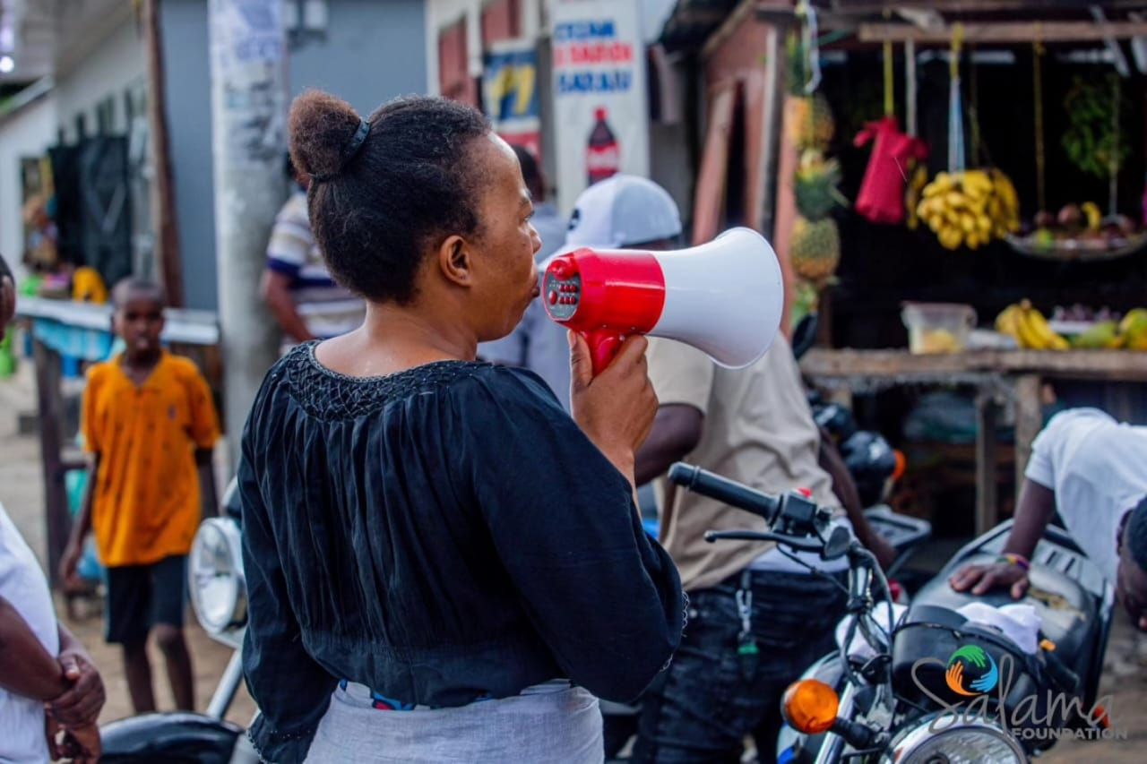
PICTURES

Slide 7
Population Group this change most closely related to
Category | Women | Men | Total | % Women
Direct beneficiaries | 340 | 150 | 490 | 69.4%
Indirect beneficiaries (e.g. through other networks) | 700,000 | 300,000 | 1M | 70%
Online beneficiaries (e.g. website access, mailing lists, scholarly articles) | 6.2 | 4.0 | 10.2M | 60.8%
Total | 6,900,340 | 700,000 | 11.2M | 1.8971184%
Women’s Voice and Leadership Learning and Sharing Summit 2025

Slide 8
Significance of change
The implementation of key policies such as the
National Accelerated Action and Investment Agenda for Adolescent Health and Wellbeing (NAIA-AHW),
the Education and Training Policy, and
the HIV/AIDS Multisectoral Plan has transformed Tanzania’s approach to adolescent health, education, and well-being. These reforms address systemic barriers and create a more inclusive, supportive environment for adolescents, particularly in rural and underserved areas.
The NAIA-AHW has enhanced access to youth-friendly health services, reducing early pregnancies, and STIs by empowering adolescents to make informed health decisions. The Education and Training Policy has improved retention and support for vulnerable groups, such as young mothers, by integrating reproductive health education and reducing dropout rates. This shift breaks the cycle of poverty and improves life prospects for marginalized girls. The HIV/AIDS Multisectoral Plan has introduced targeted interventions for adolescents, reducing HIV transmission rates and stigma, particularly among young women.
Women’s Voice and Leadership Learning and Sharing Summit 2025

Slide 9
Count...
Ongoing of Monthly discussions with young mothers and youth on SRHR, family planning, and access to services, Distributed condoms in public spaces. Use radio and entertainment to raise awareness and lastly Fostered trust and increased healthcare usage.
Impact
Increased Awareness where Youth and mothers learned about their health rights.Youth-Friendly health Services became more accessible and inclusive.There is a community transformation where now we see Empowered individuals make an informed choices.

Slide 10
RESULTS
Reduction in Teenage Pregnancy Rates; One of the most notable achievements in recent years has been the decline in teenage pregnancy rates, which dropped from 27% in 2015/2016 to 22% in 2024.
Expansion of Support Services for Survivors of Violence; we prioritized expanding support services for GBV survivors, establishing 30 "Mkono kwa Mkono" centers and 17 safe houses, alongside implementing the MSLAC initiative. These efforts have improved survivors’ access to legal aid and psychosocial support.
Media coverage (including social media); our intiatives have gained significant pull through strategic 5 media such as Mbeya FM, Ileje FM, BBC Media, Niambie-Clouds FM, and Wasafi Digital reached 21 million listeners along aside with young mother representatives from Young Mothers’ Groups and social media(facebook, instagram, whatsapp, and twitter(X) ). And reached over 10 millions of people and generated 40,000 engangments.
Women’s Voice and Leadership Learning and Sharing Summit 2025

Slide 11
Count...
Changes in gender attitudes at individual and community level; The introduction of youth-friendly health services and reproductive health education shifted attitudes in Kigoma region at kakonko district, reducing stigma around adolescent health. Over 20 girls, women, and men of participants reported improved understanding of gender equality and the importance of supporting vulnerable groups.
Efforts to Combat Female Genital Mutilation (FGM); The Foundation has made progress in eradicating Female Genital Mutilation (FGM) through its partnership with the Network to End Genital Mutilation. In Tarime District, over 100 girls have been rescued from FGM due to combined efforts by the Foundation and its partners.

Slide 12

Evidence
CLIP
Women’s Voice and Leadership Learning and Sharing Summit 2025

Slide 13
CHALLENGES AND LESSONS LEARNT
What have been the main challenges?
Lacked specialized SRHR training. Struggled to provide youth-friendly services due to limited resources, Deep stigma around discussing sexual health influence by norms. Young people i.e. young mothers were avoided seeking services due to fear and mistrust.
Culture practices resitance to the gender sensitive reforms.
How have these challenges been overcome?
Representatives from the coalition worked well with the Salama Foundation team in delivering the activities in their areas as well as sharing reports.
The teamwork, readiness, and collaboration shown by team members and partners has contributed to the achievement and completion of planned interventions within the given time.
Women’s Voice and Leadership Learning and Sharing Summit 2025

Slide 14
CHALLENGES AND LESSONS LEARNT
What lessons have been learned?
Government Commitment is Critical; Engagement with ministries and political authorities ensured strategic cooperation and policy support for GBV prevention and SRHR access.
Community-Led Approaches Work; Mobilizing community members (e.g., young mothers, police, health workers) fostered inclusivity and addressed real needs from the ground up.
Social Media Drives Awareness; Interactive social media campaigns amplified outreach, mobilized support, and bridged gaps between government and communities.
Integration of GBV & SRHR is Effective; Combining GBV prevention with SRHR initiatives created a holistic approach, reaching target groups and addressing interconnected challenges.
Collaboration Ensures Sustainability; Strong partnerships with stakeholders (e.g., community leaders, government) enabled resource optimization and sustained impact.
Key Takeaway:
Multi-stakeholder collaboration, community-driven solutions, and innovative advocacy tools are essential for scalable and sustainable change.
Women’s Voice and Leadership Learning and Sharing Summit 2025

Slide 15
CHALLENGES AND LESSONS LEARNT
How will the lessons learned be applied?
1. Strengthen Government Partnerships; Continue engaging ministries and political authorities to secure policy support and resources for GBV prevention and SRHR initiatives.
2. Scale Community-Led Approaches; Expand mobilization of community members ( young mothers, health workers, religious leaders) to ensure inclusive, grassroots-driven solutions.
3. Leverage Social Media for Advocacy; Use interactive social media campaigns to raise awareness, mobilize support, and foster dialogue between communities and policymakers.
4. Integrate GBV & SRHR Agendas; Combine GBV prevention with SRHR programs in future projects to address interconnected challenges holistically.
5. Foster Multi-Stakeholder Collaboration; Build and maintain strong partnerships with key stakeholders (e.g., community leaders, government, NGOs) to optimize resources and ensure sustainability.
Women’s Voice and Leadership Learning and Sharing Summit 2025

Slide 16
SUSTAINABILITY AND REPLICATION
How can the work be sustained/kept going?
Develop a roadmap for scaling successful initiatives.
Train local leaders and organizations to sustain community-driven efforts.
Monitor and evaluate impact to adapt strategies for greater effectiveness.
Women’s Voice and Leadership Learning and Sharing Summit 2025

Slide 17
How can the work be cascaded to other organisations?
Share Best Practices and Tools
Conduct Capacity-Building Workshops
Foster Partnerships and Networks
Provide Technical Assistance
Leverage Digital Platforms

Slide 18
NEXT STEPS
What are the key priorities going forward?
Salama foundation we are committed to expanding access to evidence-based information on Comprehensive Sexuality Education (CSE), Sexual and Reproductive Health and Rights (SRHR), and Gender-Based Violence (GBV). Our initiatives specifically target underserved communities in remote areas, including Kigoma Rural especially (Kakonko and Kibondo), Geita, Simiyu, Shinyanga, Songwe, Iringa, Njombe, and Mtwara, where access to essential services remains a significant challenge. With increased investment and strategic collaboration, we aim to create an inclusive, supportive, and sustainable environment for young mothers and vulnerable populations, ultimately contributing to long-term social and economic development.
Women’s Voice and Leadership Learning and Sharing Summit 2025

Slide 19
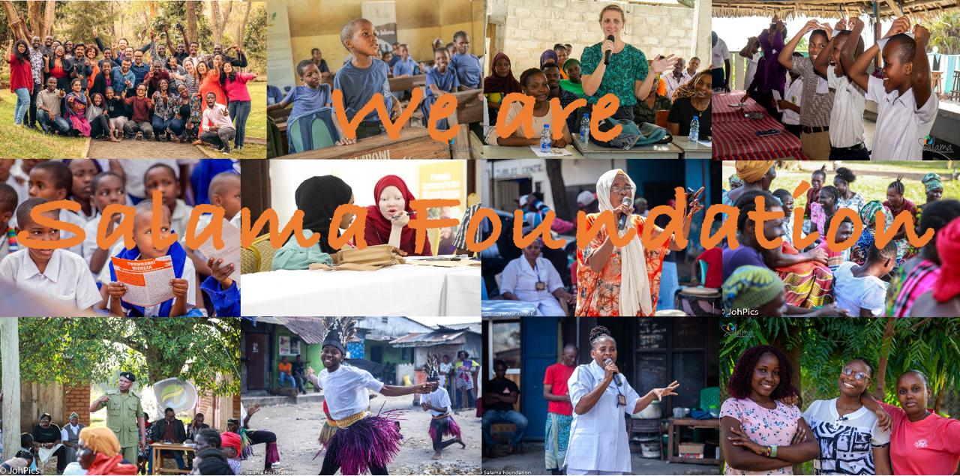
THANK YOU...

