Slide 1







LEARNING
AND SHARING
SUMMIT 2025
Resoketswe Lebjane Foundation
South Africa, Bushbuckridge
Presenter Cincinantia Lebjane
Women’s Voice and Leadership Learning and Sharing Summit 2025

Slide 2
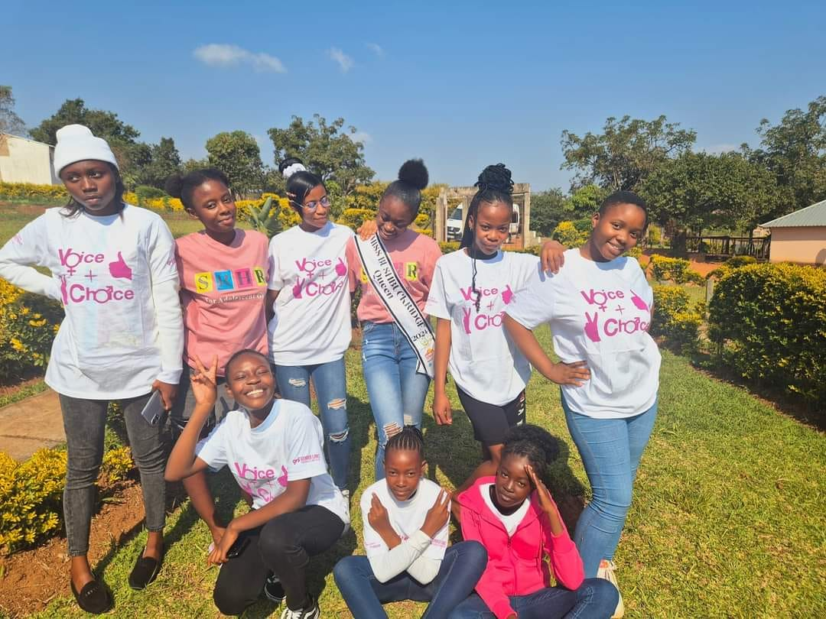
Brief background of the organization
Resoketswe Lebjane Foundation is a non-profit organization founded in 2016 and got registered with Department of Social Development on the 7th of December 2017. Our organization came in response due to a high rate of Human Rights being violated in variance ways. We realized that there was a big gap between marginalized people and access to justice. Many people lack information about the constitution of South Africa. As Resoketswe Lebjane Foundation we render effective basic legal advice and paralegal services to individuals or community groups. Our organization is operating in the deepest rural area of Ehlanzeni District under Bushbuckridge municipality. Our primary targets are found at the villages. People in Bushbuckridge have to travel long distance to access legal consultations. Majority of the people can’t afford to pay the taxi fare makes it difficult for them to access the services due to economically challenges. Our center has a capacity to supply the communities of Bushbuckridge with legal information. Most of our work we do it outside the office by doing door to door campaigns, Community workshops and Community Dialogues. We are the affiliated with Community Advice Office South Africa as a member.
Women’s Voice and Leadership Learning and Sharing Summit 2025

Slide 3
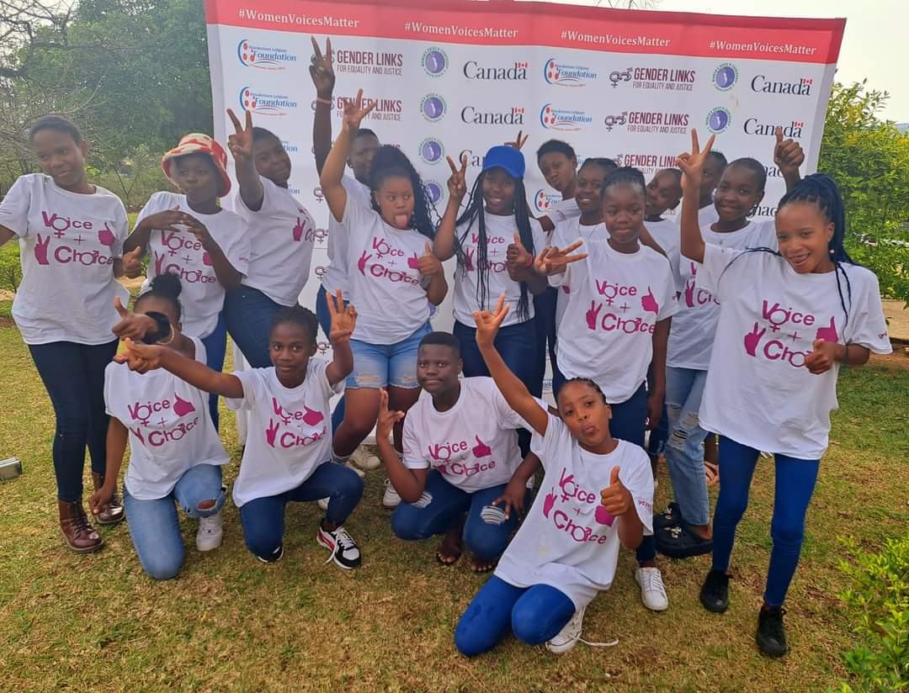
Institution before VCSA
Initially, our organization had only two policies in place.
Although we were registered with SARS, we faced compliance issues.
Our board members initially lacked essential governance skills.
No financial personnel who will make sure that adhere to our financial police for transactions.
Not compliant with the Department of social development.
Women’s Voice and Leadership Learning and Sharing Summit 2025

Slide 4
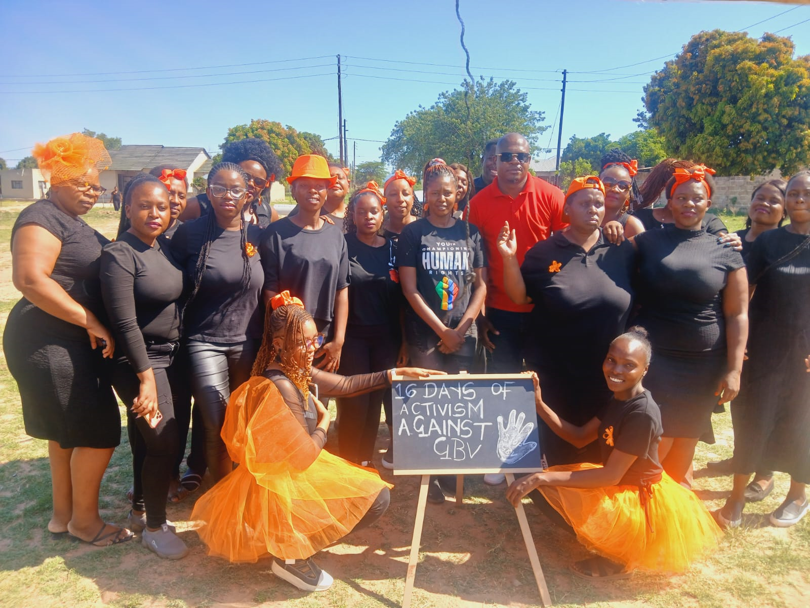
Institution During VCSA
VCSA has assisted us to develop Anti-corruption police that was adopted by our Board members to ensure that corruption within the organization does not take place, and we also develop sexual harassment police that is also used to conduct candidates screening before being hired .Its very important as an organization to do a criminal check on people who have interest to join the organization.
We are annually complaint with SARS our appointed accountant assist us with submitting returns.
As the Department of social development is in the process of deregistering NPO’s that do not submit annual reports. Our organization is proud to say our profile is 100% complaint with DSD
We successfully opened a separate account for VCSA project as requested by Gender links
Women’s Voice and Leadership Learning and Sharing Summit 2025

Slide 5
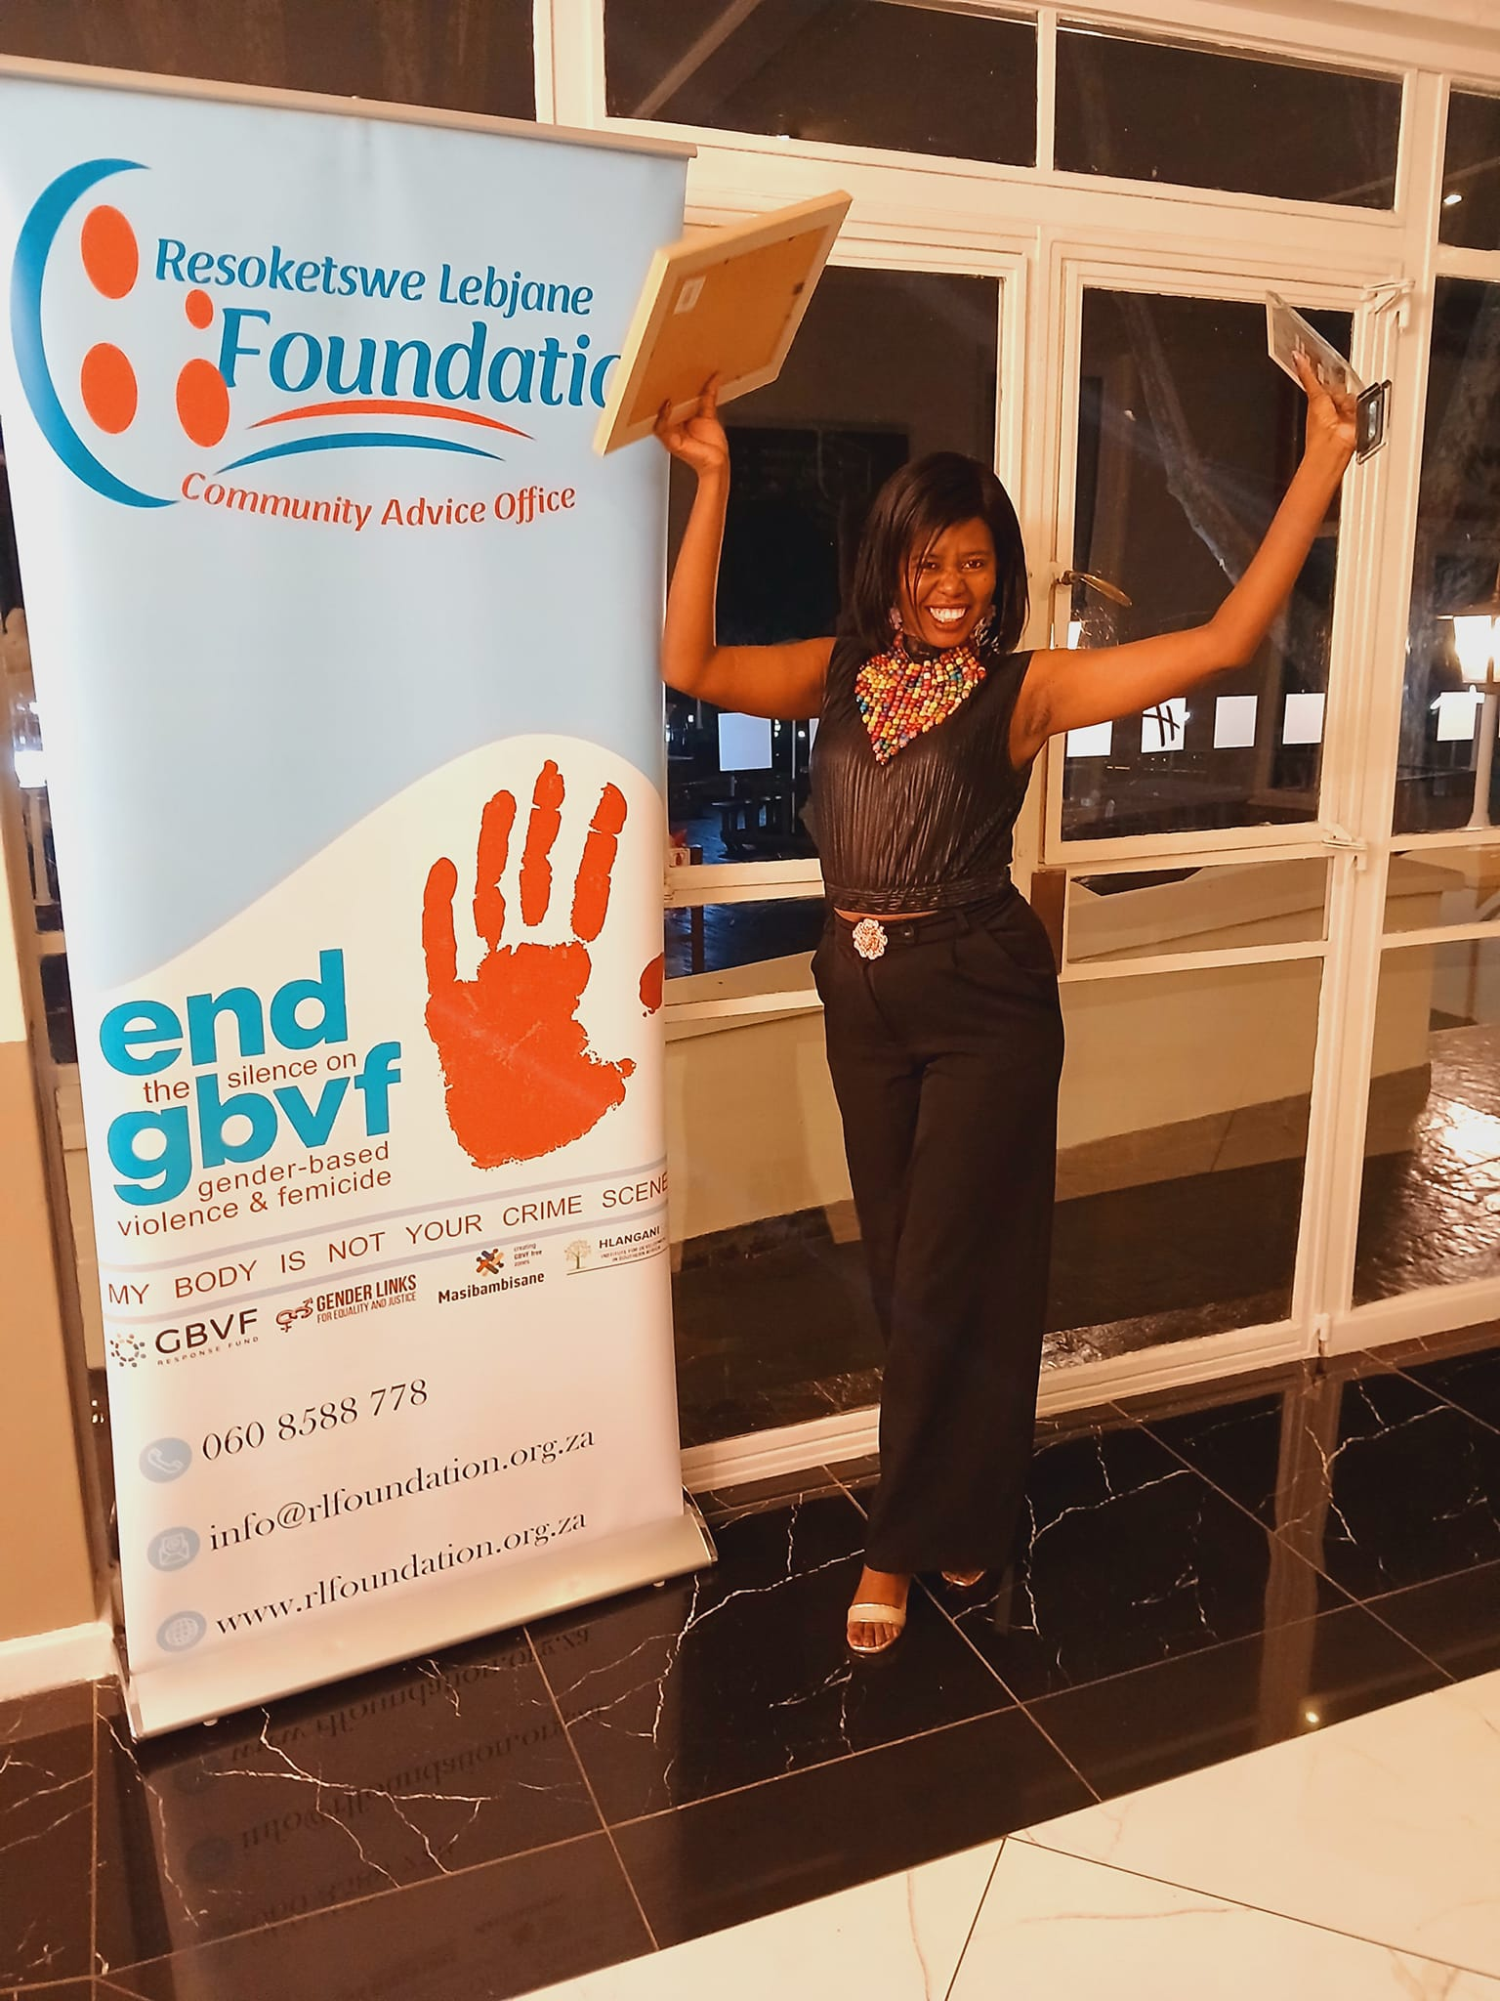
GOVERNANCE
Our current board members are updated at our Department Of Social Development system. As our organization is a women lead undergone we have 80% women and 20% men in our governance.
We meet quarterly in a year. They have undergo governance to make sure that the organization work effectively.
Women’s Voice and Leadership Learning and Sharing Summit 2025

Slide 6
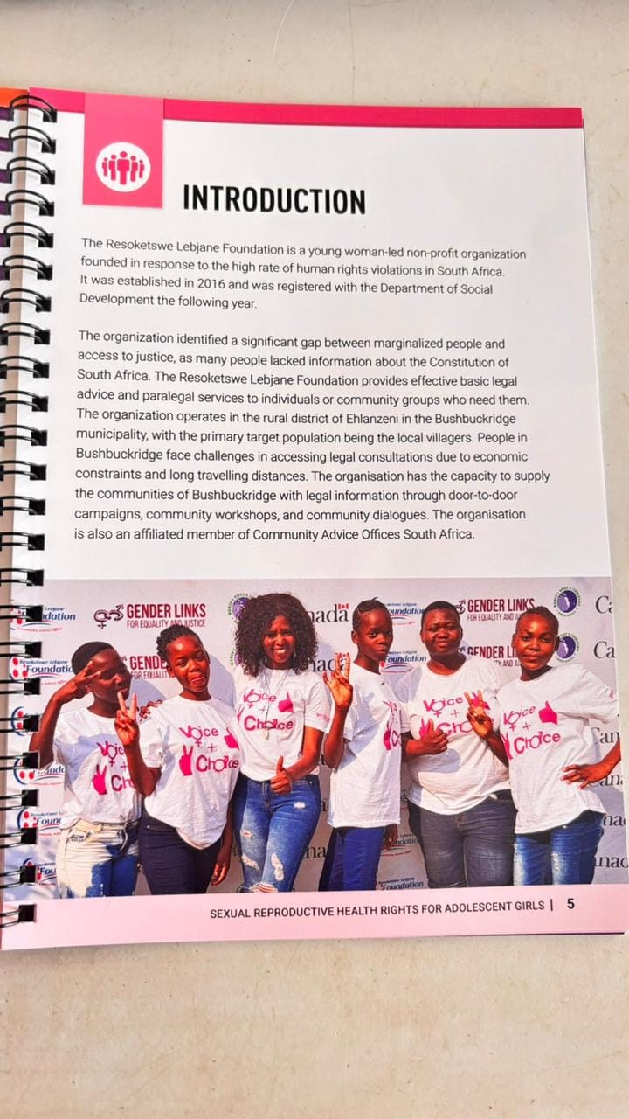
INSTITUTIONAL EFFECTIVENESS
The VCSA has been instrumental in helping us secure qualified personnel to join our organization. Thanks to their support, we are now well-branded with T-shirts, a gazebo, and banners, enhancing our physical resources.
Additionally, our digital resources are connected to our monthly Wi-Fi, ensuring effective communication between our office, clients, partners, and donors.
Women’s Voice and Leadership Learning and Sharing Summit 2025

Slide 7

SUSTAINABILITY AND DIVERSIFICATION
Before VCSA grant- How will the institutional progress be sustained within your organisation?
Our organization diligently responds to numerous calls for proposals to secure project funding, which is essential for sustaining our operational costs and resources.
Recently, we received an incredible gift from Shoprite in collaboration with Capricorn FM. The most exciting part is that we were unaware of the competition—a kind-hearted individual nominated us without our knowledge. Thanks to our significant community footprint, we emerged as the winners for 2025.
Women’s Voice and Leadership Learning and Sharing Summit 2025

Slide 8

Monitoring and Evaluation Systems
VCSA has introduced us to a friendly system that makes our job easier .We can a help desk that has different templates that can be adopted by grantees . We have made use of their event register that consist of items that relate to our reporting system. For financial system we were introduced to the share point system that allow us to do fillings for our financial documents and Gender links can monitor our project process using that system.
During the VCSA grant
Women’s Voice and Leadership Learning and Sharing Summit 2025

Slide 9
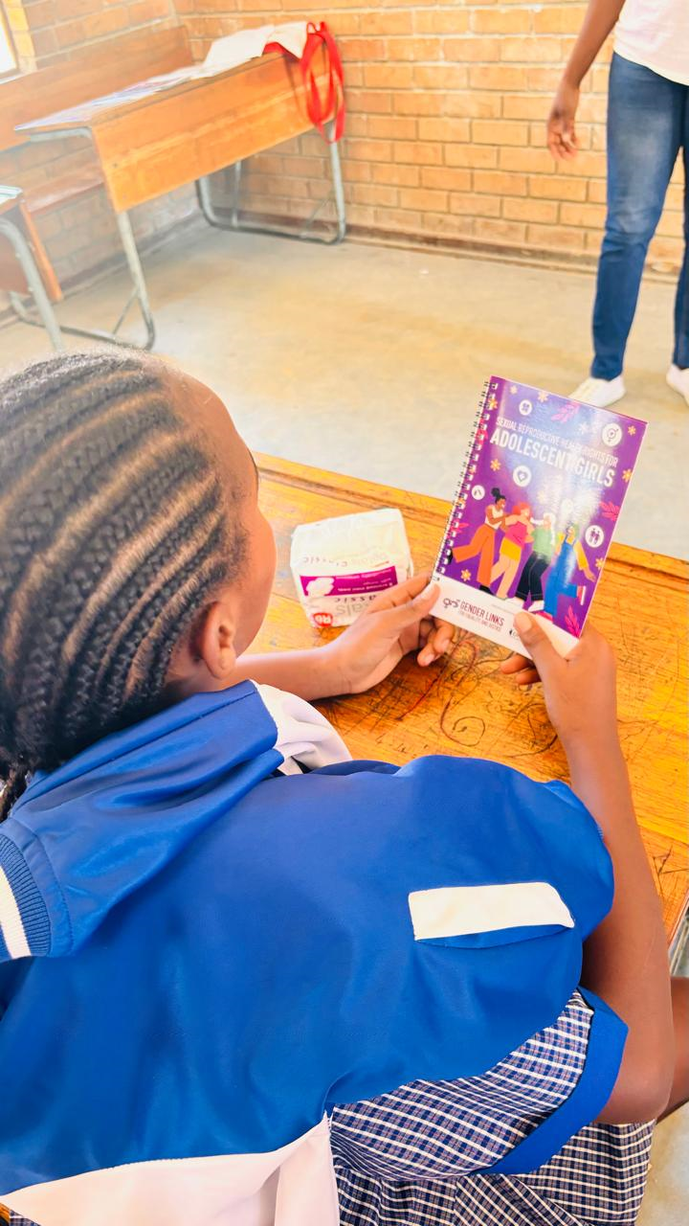
Capacity during VCSA-SA grant
The VCSA has been instrumental in our journey, providing us with invaluable support in various forms. We have received comprehensive training in financial management, monitoring and evaluation, as well as project management. These trainings have significantly enhanced our capabilities, enabling us to implement our projects effectively and efficiently.
Additionally, the VCSA has assisted us in securing qualified personnel to join our organization, further strengthening our team. We are now well-branded with T-shirts, a gazebo, and banners, thanks to their support, which has greatly enhanced our physical resources.
Moreover, our digital resources are connected to our monthly Wi-Fi, ensuring seamless and effective communication between our office, clients, partners, and donors. This connectivity has been crucial in maintaining strong relationships and ensuring the smooth operation of our organization.
Women’s Voice and Leadership Learning and Sharing Summit 2025

Slide 10
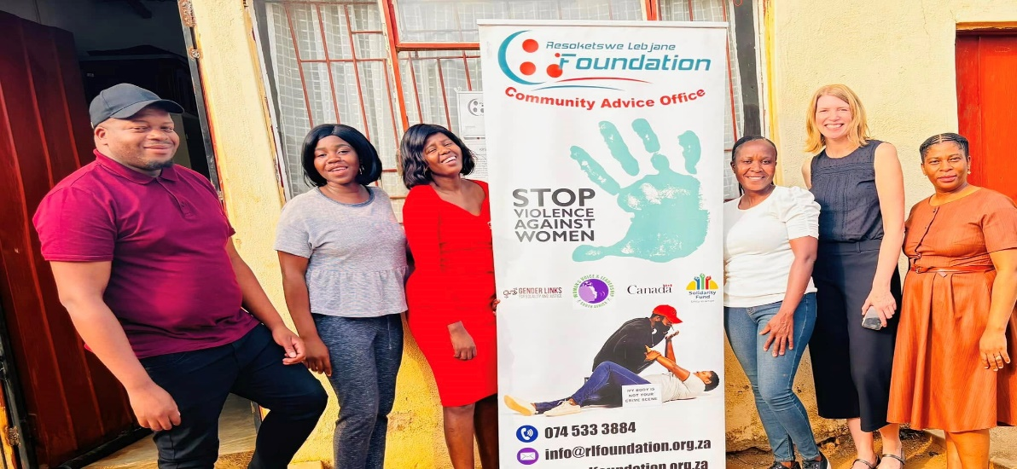
Challenges
What have been the main challenges?
One of our primary challenges was operating the organization in a shared space with our business. This arrangement severely compromised our privacy, making it difficult to maintain confidentiality during client consultations and counseling sessions. The constant background noise from the business environment not only disrupted the tranquility required for these sensitive interactions but also affected the overall experience for our clients. The lack of a dedicated, quiet space hindered our ability to provide the focused, attentive care that our clients deserved, ultimately impacting the quality of our services.
Women’s Voice and Leadership Learning and Sharing Summit 2025

Slide 11
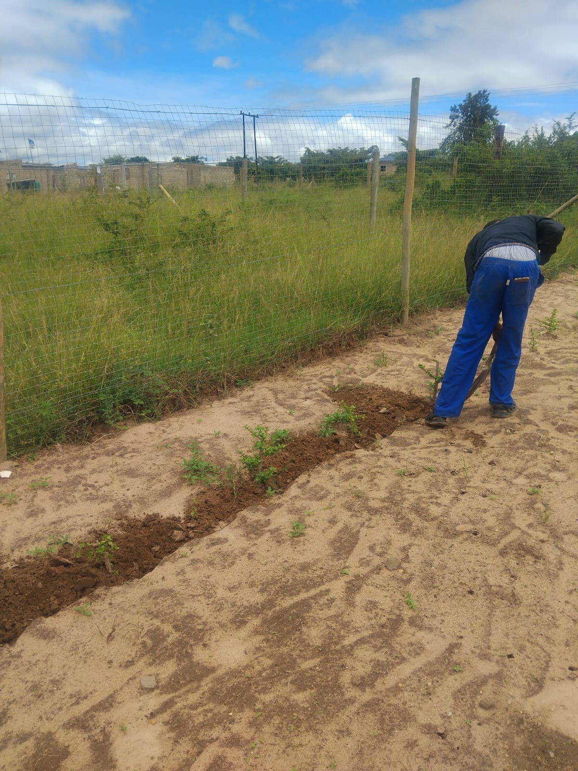
How have these been overcome?
We are excited to announce that we have moved to a spacious, dedicated facility that is exclusively ours. This new environment offers ample room for conducting internal training sessions, which will foster growth and development within our organization. Additionally, the facility supports our food gardening initiatives, enabling us to cultivate fresh produce and promote sustainable living. By planting flowers such as spekboom, we are also contributing to climate change mitigation efforts, underscoring our commitment to environmental

Slide 12
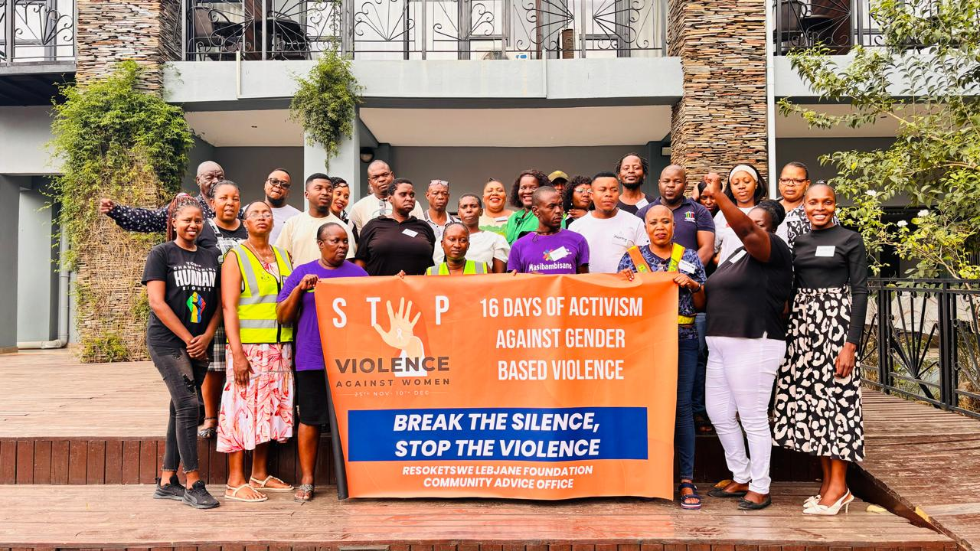
Lesson learned on institutional growth
What lessons have been learned?
We have come to understand the critical importance of collaboration, ranging from the local level to the international stage. Collaboration facilitates networking opportunities and simplifies the process of making referrals, ultimately enhancing our ability to connect and work with others effectively.
How are these being applied?
We initiated a GBVF stakeholders forum that is meet to tackle issues of GBVF within the communities of Bushbuckridge.
Women’s Voice and Leadership Learning and Sharing Summit 2025

Slide 13
