Slide 1







Logo goes here
LEARNING
AND SHARING
SUMMIT 2025
EAGLE WINGS YOUTH INITIATIVE
JOHANNESBURG SOUTH AFRICA 2025
KOKO GRACE
Women’s Voice and Leadership Learning and Sharing Summit 2025

Slide 2
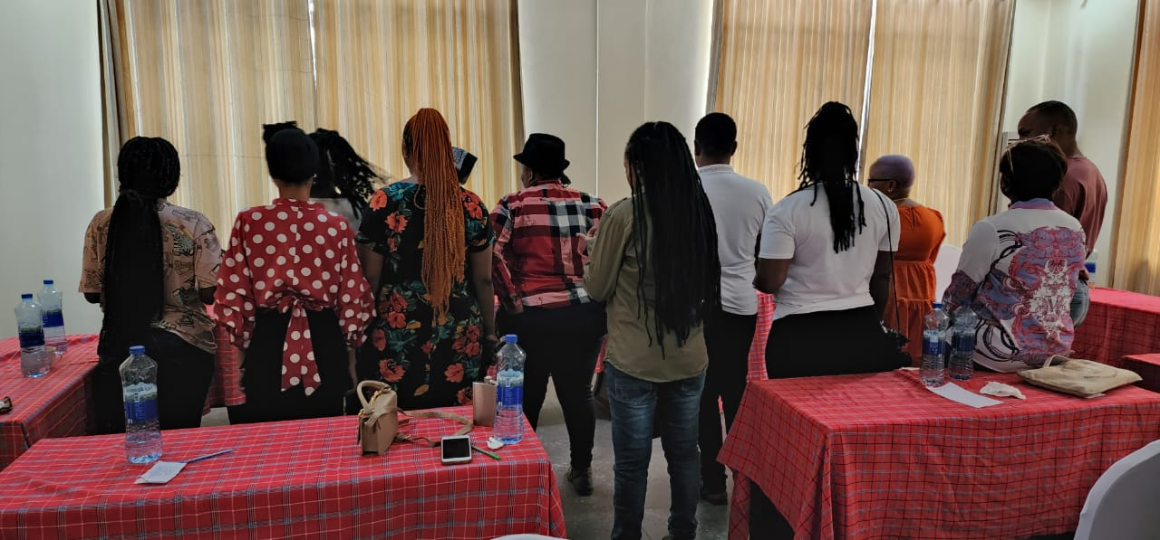
Summary
Our project aim was to build a stronger, more inclusive LBTQ women-led movement advocating for comprehensive SRHR services and the elimination of gender-based violence. Key objectives include:
Strengthening collaboration among CSOs and allies across sectors.
Enhancing the capacity of activists and leaders for effective advocacy.
Generating high-quality evidence to inform and influence SRHR policies.
Add photo or video
Voice and Choice Learning and Sharing Summit 2025

Slide 3
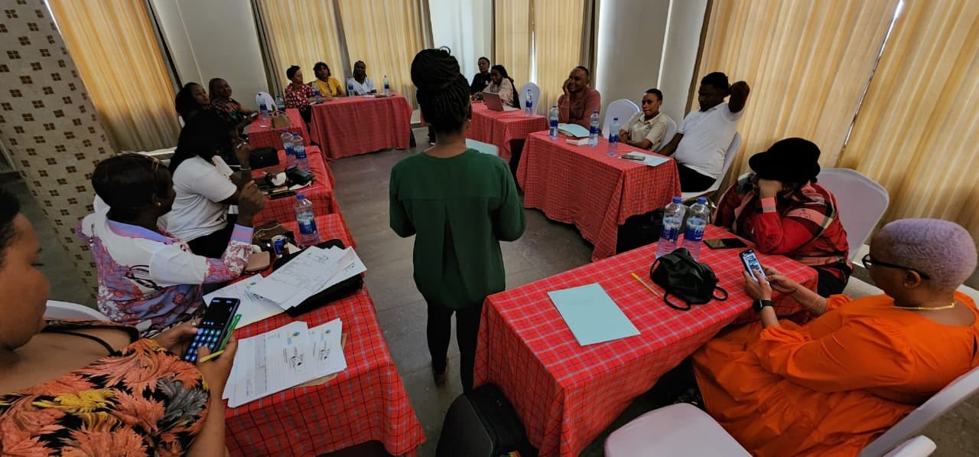
Initiatives and strategies
We generated new evidence on GBV and SRHR access for LBTQ women in Tanzania, ensuring advocacy efforts were based on real experiences. Regular consortium meetings strengthened collaboration and collective action.
We assessed advocacy strengths and gaps among members, designed targeted capacity-building initiatives, and created a unified advocacy platform through roundtable discussions with policymakers.
Add photo or video
Voice and Choice Learning and Sharing Summit 2025

Slide 4
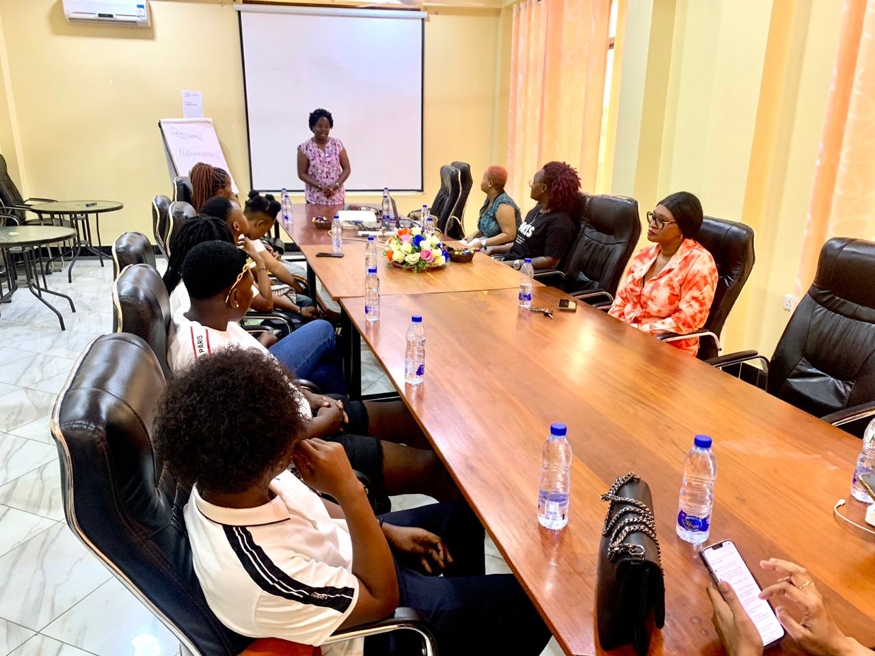
Governance & Resource Allocation
All consortium members participated in decision-making through regular consultative meetings and feedback mechanisms, ensuring everyone had a voice in shaping strategies.
We allocated resources based on each partner’s needs, promoting equity and sustainability. Our capacity-building plans ensured long-term growth and self-sufficiency.
Add photo or video
Voice and Choice Learning and Sharing Summit 2025

Slide 5
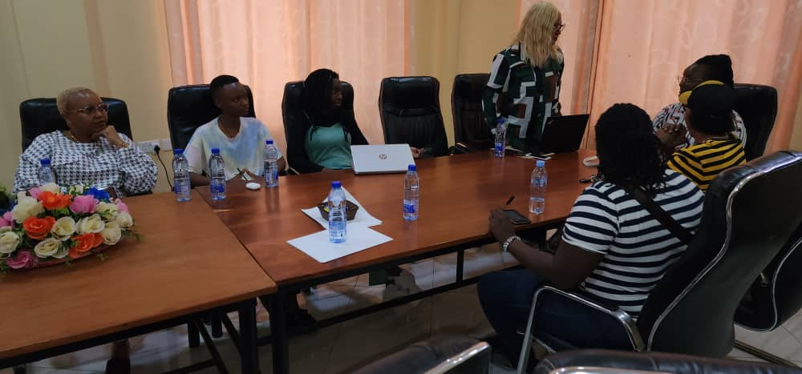
Inclusive Leadership & Coordination
We connected members with experts, facilitating peer learning and knowledge-sharing to strengthen advocacy efforts.
We held regular planning meetings, developed shared advocacy messages for greater impact.
Add photo or video
Voice and Choice Learning and Sharing Summit 2025

Slide 6
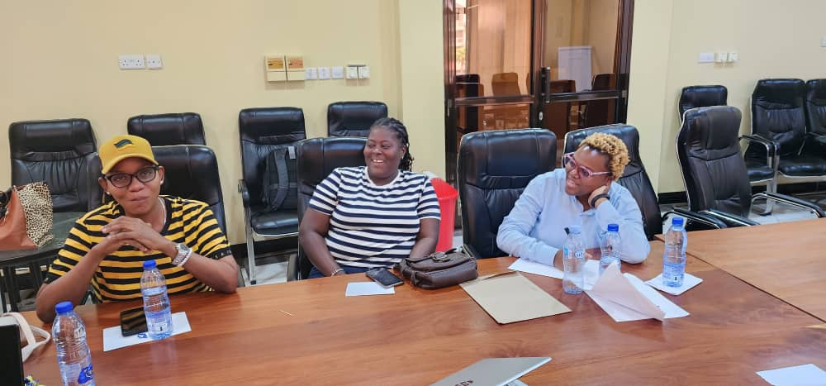
Connecting & Community-Building
We fostered strong partnerships through continuous engagement, transparency, and collaborative initiatives.
Experienced advocates mentored emerging leaders, and regular convenings allowed for skill-sharing and problem-solving.
Add photo or video
Voice and Choice Learning and Sharing Summit 2025

Slide 7
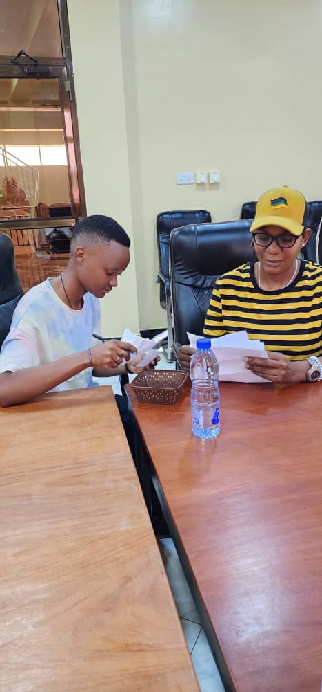
Linking & Learning
We documented lessons learned, shared knowledge through reports and discussions, and adapted strategies based on new insights.
Our research on GBV and SRHR access helped assess advocacy effectiveness and refine strategies for greater impact.
Add photo or video
Voice and Choice Learning and Sharing Summit 2025

Slide 8
NEXT STEPS
Expand capacity-building for grassroots organizations.
Deepen partnerships with policymakers and civil society.
Continue evidence-based advocacy and research.
Institutionalize mentorship and peer learning programs.
Sub granting and capacitate Eagle Wings’ grant making structured
Women’s Voice and Leadership Learning and Sharing Summit 2025

