Slide 1







Logo goes here
LEARNING
AND SHARING
SUMMIT 2025
VCSA Joint Campaigns Template
(Eswatini, Mbabane, 21 Feb,2025, Nelisiwe Dlamini)
Women’s Voice and Leadership Learning and Sharing Summit 2025

Slide 2
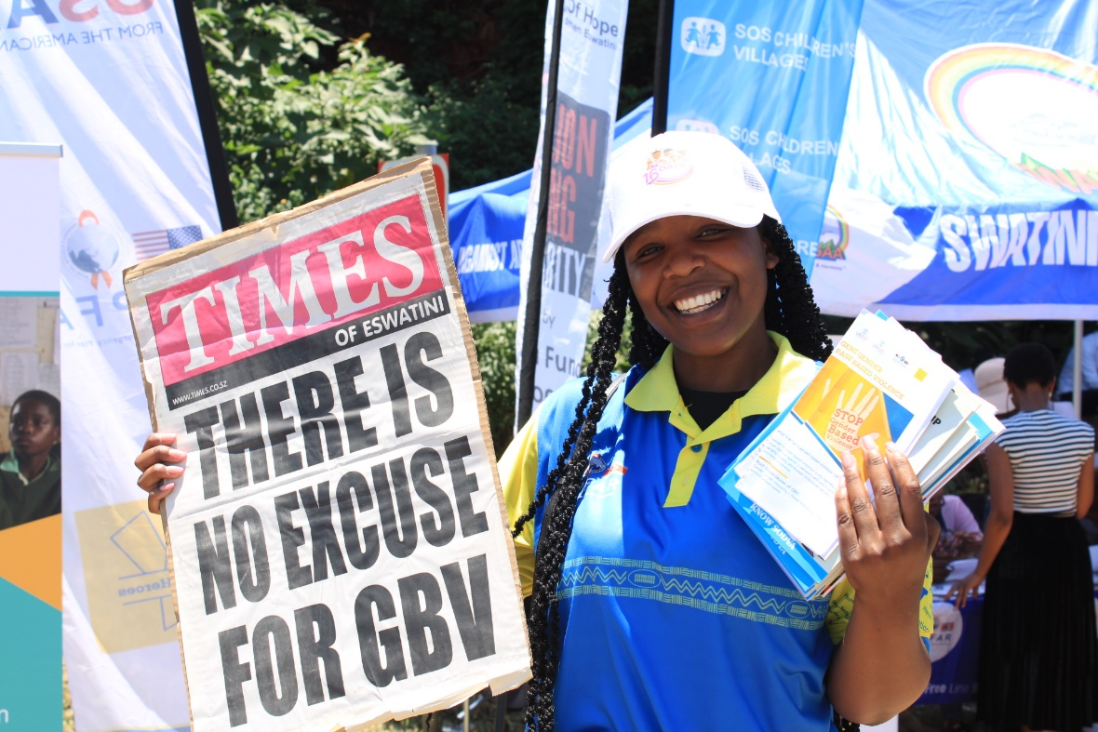
Summary
SWANCEFA organized 2 main campaigns in Eswatini:
National GBV Campaign during the 16 Days of Activism Against GBV under the theme ‘Lets End Gender Based Violence’ #SISONKHE
International Day of the Girl Child under the theme ‘Girls Vision for the Future”
Voice and Choice Learning and Sharing Summit 2025

Slide 3
Dates and themes of your joint campaign/s
 | Date | Theme
1 | 11th October 2024-20th November 2024 | ‘’Girls’ Vision for the Future”
2 | 16 Days of Activism Against GBV | 25th November- 10th December 2024
3
4
5
Voice and Choice Learning and Sharing Summit 2025

Slide 4
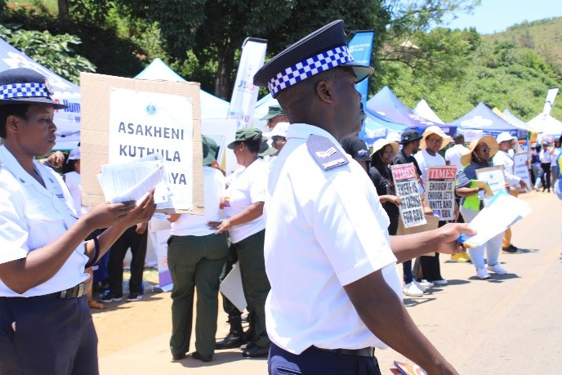
Initiatives and strategies
Advocacy and Awareness: The organization designed and implemented advocacy and awareness campaigns that highlight pressing social justice issues.
Through strategic communication and outreach efforts, we raised public consciousness Gender Based Violence and Challenges faced by the Girl Child.
Collaboration and Coalition Building: In pursuit of large- scale social justice goals, we understood the value of collaboration and coalition building.
We joined forces with other civil society organizations, government, international NGOs, UN family, Embassies, communities, young people, minority groups and the public in general , we could pool their expertise, resources and influence to effect systemic change.
We organized the following activities:
National High Level Launch of the Campaigns
Road Side Campaign
Regional Community Campaigns
Bus Rank Campaigns
Voice and Choice Learning and Sharing Summit 2025

Slide 5
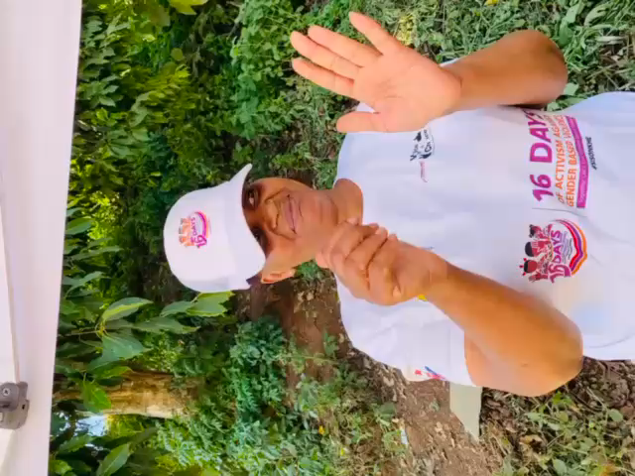
Governance & Resource Allocation
Active participation of all stakeholders
The network conducted a series of virtual and physical update meetings with stakeholders in the duration of the campaigns.
How did you distribute resources across partners to promote equity and sustainability within the movement?
All stakeholders were assigned tasks for ownership and also shared responsibility of the campaign.
Voice and Choice Learning and Sharing Summit 2025

Slide 6
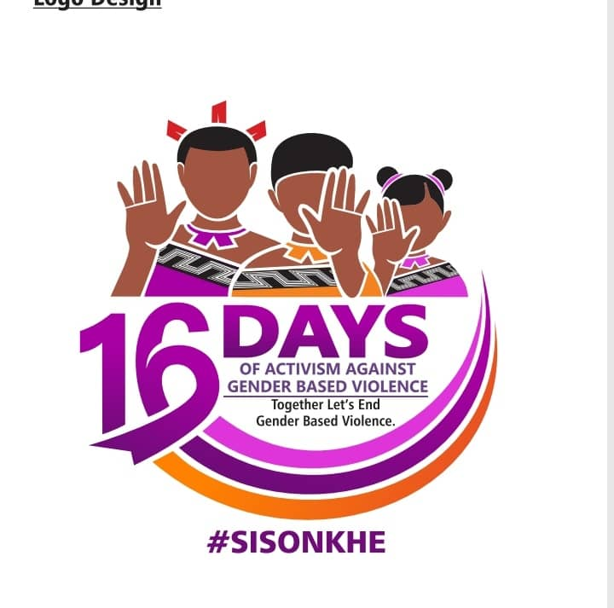
Inclusive Leadership & Coordination
Strategies:
Identification of Target Audiences
determined exactly which stakeholders and decision-makers have the power to make the desired change. These became primary audiences to engage and influence.
Strategically identifying and approaching the target audience is key for mobilizing them into action.
Tailor Your Messaging for Maximum Impact
To effectively engage each target audience, it’s crucial to develop custom messaging that uniquely compels them to action.
When crafting messages, we considered the priorities, values, and incentives that resonate with each specific group.
Build a Coalition and Networking
Building a coalition of diverse voices is a key strategy for successful advocacy campaigns. By bringing together a range of allies, you can create support for your cause. Reach out to individuals and organizations within your existing advocacy network, as well as new faces at relevant events, to gather allies who can support your advocacy efforts.
Voice and Choice Learning and Sharing Summit 2025

Slide 7
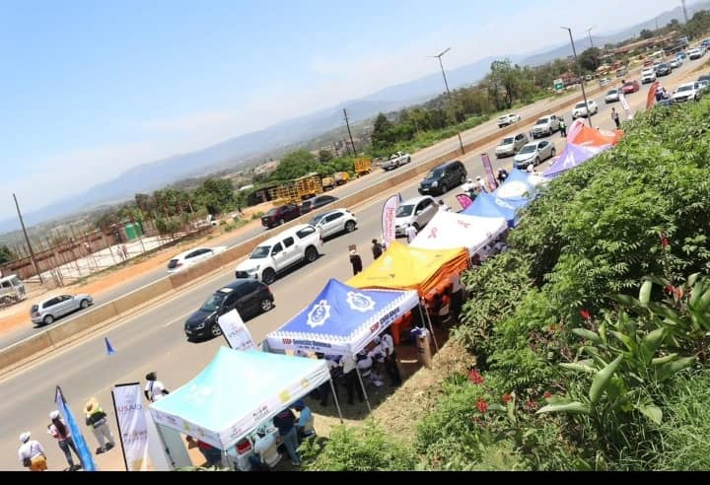
Inclusive Leadership & Coordination
Strategies:
Engaging Community Partners
Grassroots community partners can tremendously influence advocacy through localized mobilization and awareness-raising. They have established access and trust with the directly affected clients, groups, and neighbourhood.
Collaboration Across Sectors
We greatly amplified the campaigns impact by joining forces with other sectors to eliminate duplication, combine expertise, and emphasize the interconnected urgency to decision-makers.
Implementing Digital Advocacy Campaigns
During the campaign and after we were able to reach a wide audience with efficiency and speed through social media that included shareable content, event promotions, targeted ads, hashtag campaigns.
Voice and Choice Learning and Sharing Summit 2025

Slide 8
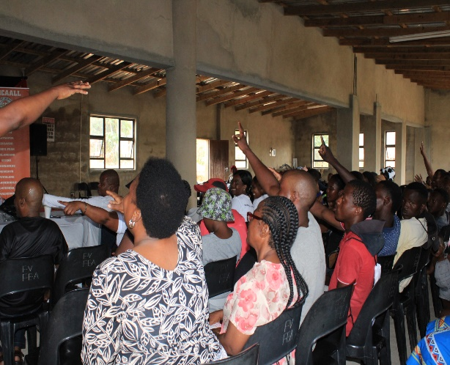
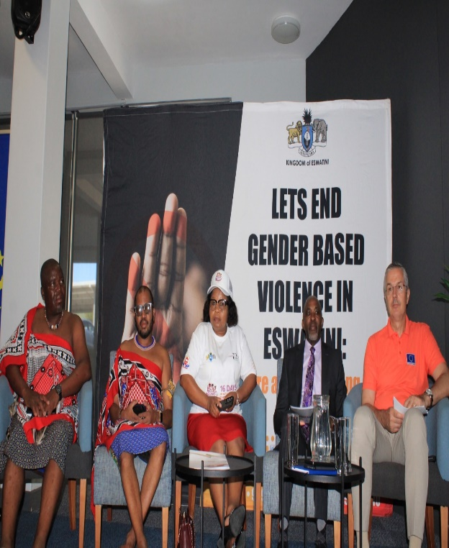
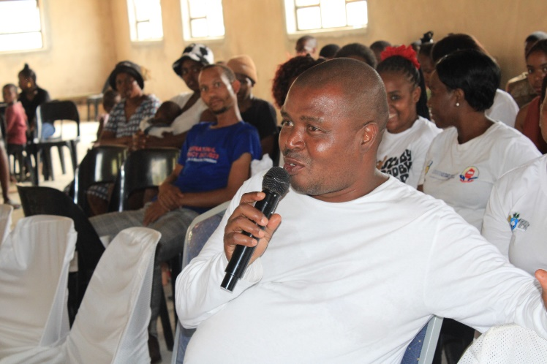
Connecting & Community-Building
What approaches did you use to build and sustain relationships?
1.Engaging audiences regularly
Consistent and meaningful engagement with the audience
Regularly updating supporters about progress, upcoming events and ways to get involved to keep them invested in the campaign.
Encouraging feedback and interaction by creating opportunities for dialogue.
How did you facilitate mentoring, convening, and peer exchanges among professional advocates and emerging leaders?
2. Building long term relationships with stakeholders
Sustaining advocacy campaigns requires building and nurturing long term relationships with key stakeholders.
Developing a network of dedicated supporters to ensure continuous support and resources for your campaign.
Voice and Choice Learning and Sharing Summit 2025

Slide 9
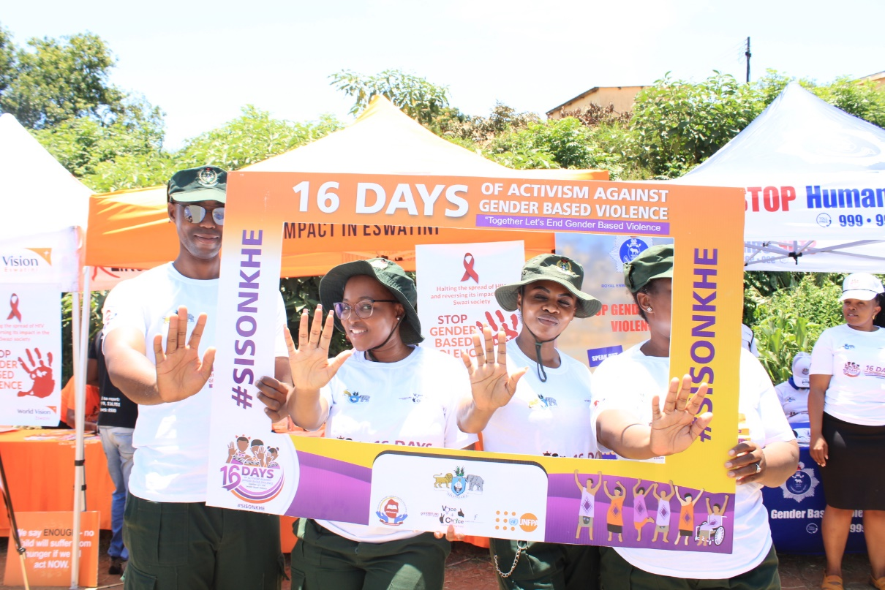
Linking & Learning
How did you foster a culture of continuous learning and best practice sharing within the movement?
1.Encouraging collaboration
Collaborative learning builds on the idea that people learn better when they work together towards a common goal.
Teams are encouraged to share their successes and lessons learnt on projects requiring key skills – creating a culture where idea and experience sharing is a cornerstone of organizational success.
How did you generate and utilize evidence to assess the impact and effectiveness of advocacy efforts within your movement?
The organization used Evidence for Advocacy actions directed at decision makers who hold the power, often to implement a change in policy or law.
Evidence for Advocacy is also about changing public opinion to support an issue or cause, or take a specific form of action to put pressure on decision makers or actively demonstrate support.
Voice and Choice Learning and Sharing Summit 2025

Slide 10
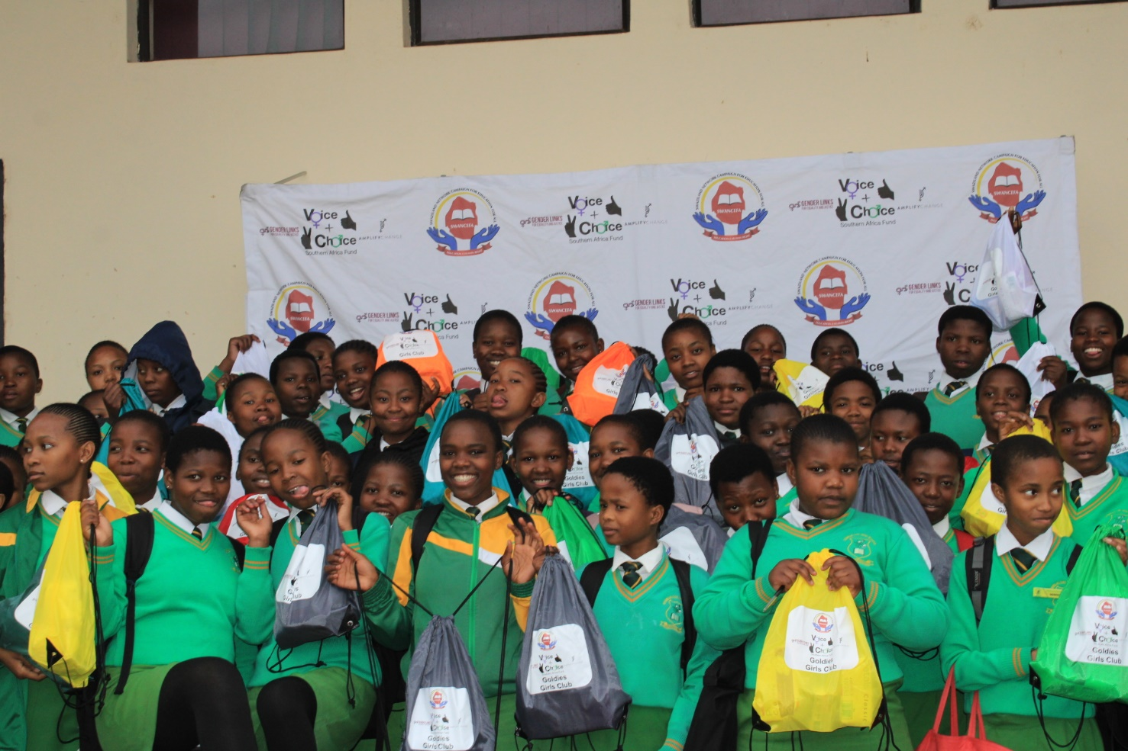
NEXT STEPS
What will be your key priorities moving forward
We have extended the Girls Clubs initiative to 16 more schools
We have also established Boys Clubs in the 16 schools
Women’s Voice and Leadership Learning and Sharing Summit 2025

