Slide 1


Voice and Choice
Summit 2026-
Organisational Development Category
Lesotho | International Human Rights Lab: Driving Institutional Change for Inclusive Justice
Voice and Choice Summit 2026 \ Voice and Choice Summit 2026

Slide 2
Synopsis– brief overview what this is about
Name | Thakane Manong
Designation | Programs Director, THUSO Project Manager
Organisation | International Human Rights Laboratory
Country | Lesotho
Category | Organisational Development
Summary | Thuso Project seeks to address structural discrimination faced by LGBTIQ+ persons in financial services, public infrastructure and GBV response systems through institutional dialogue, capacity building and policy reform.
Voice and Choice Summit 2026 \ Voice and Choice Summit 2026

Slide 3
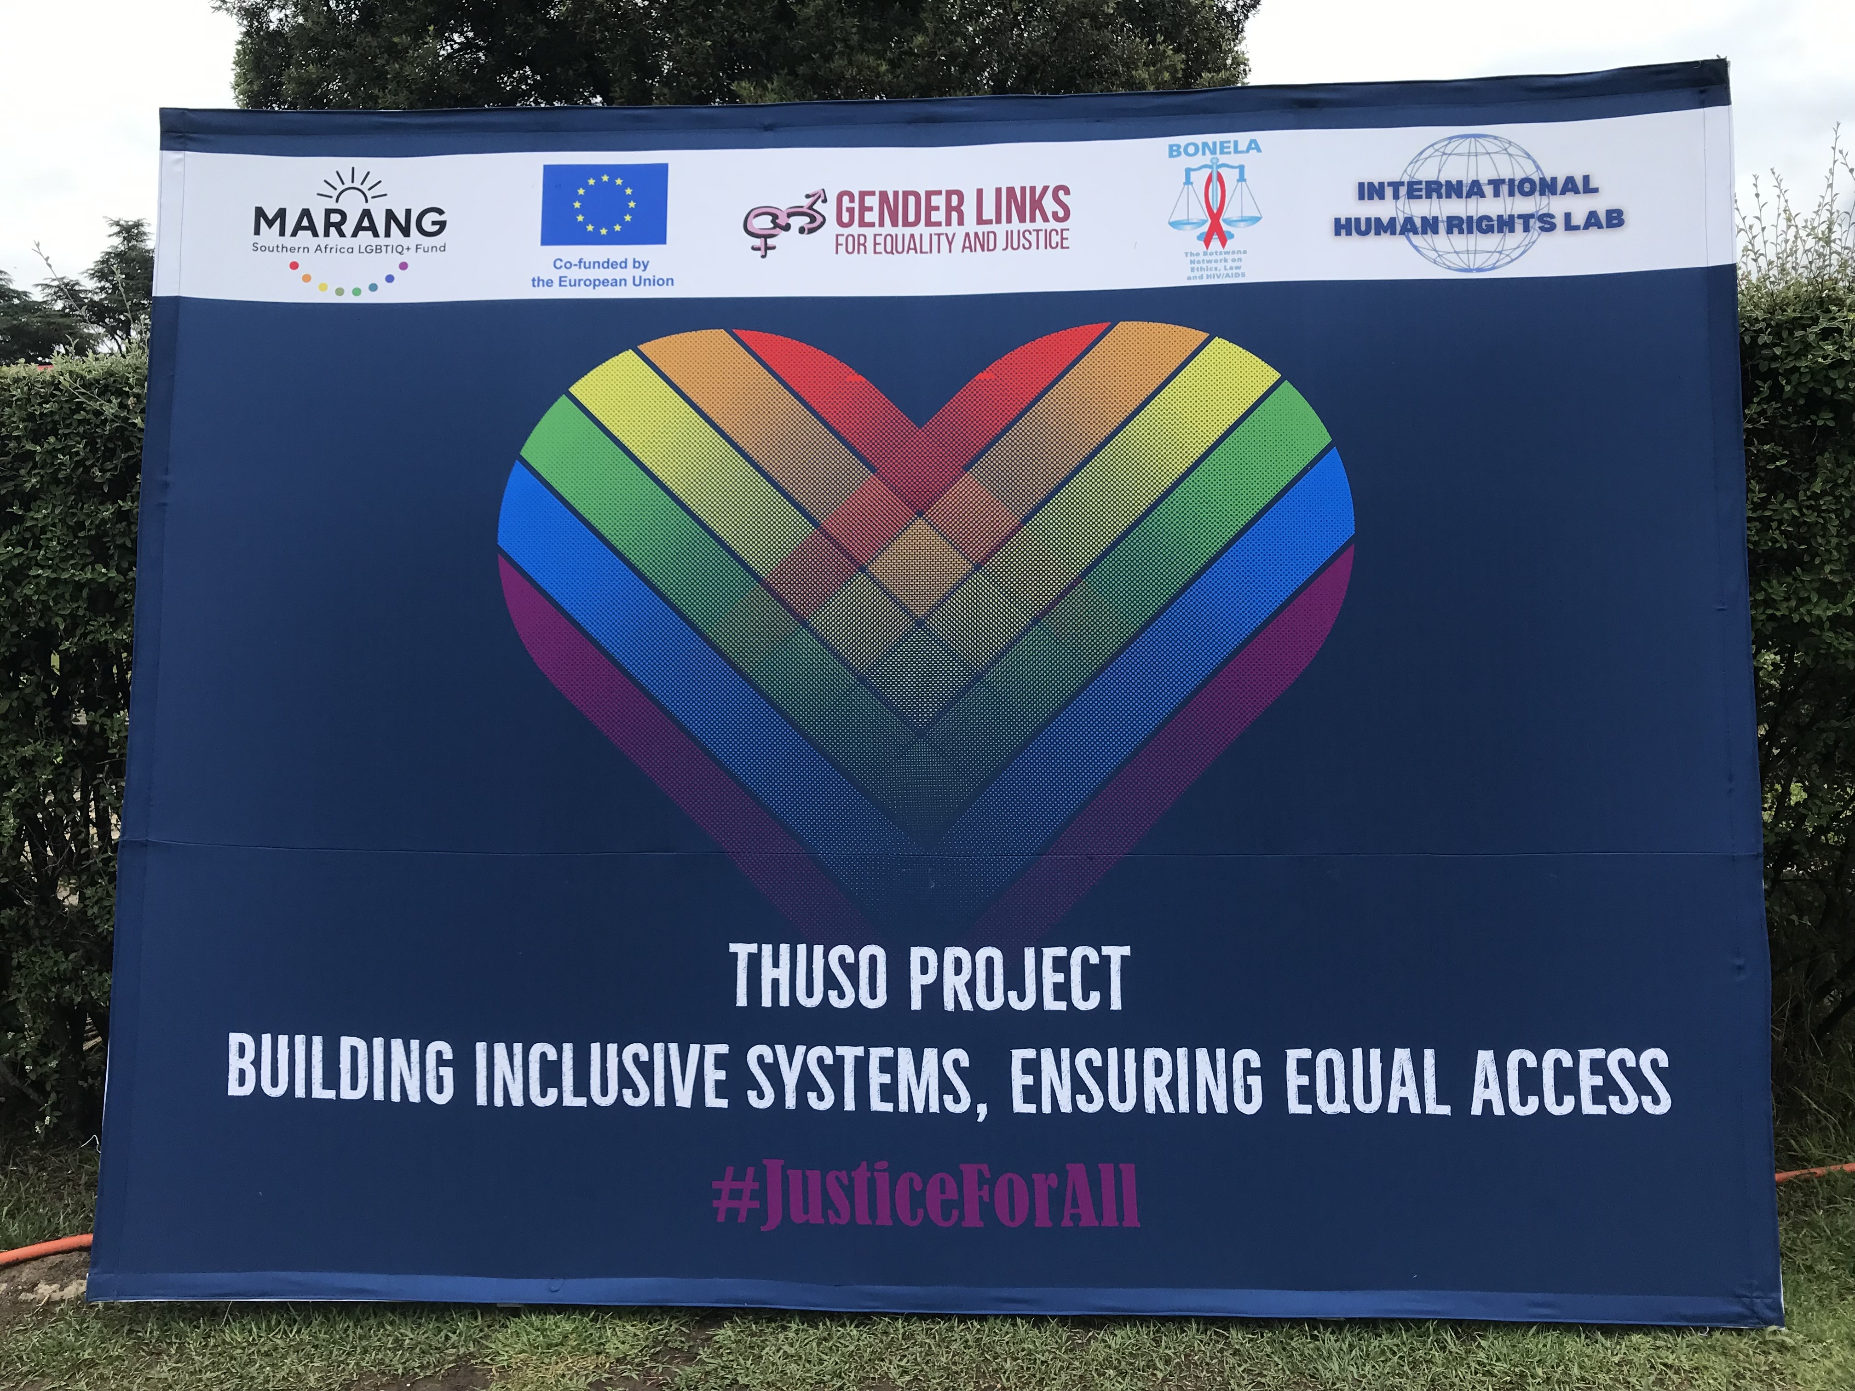
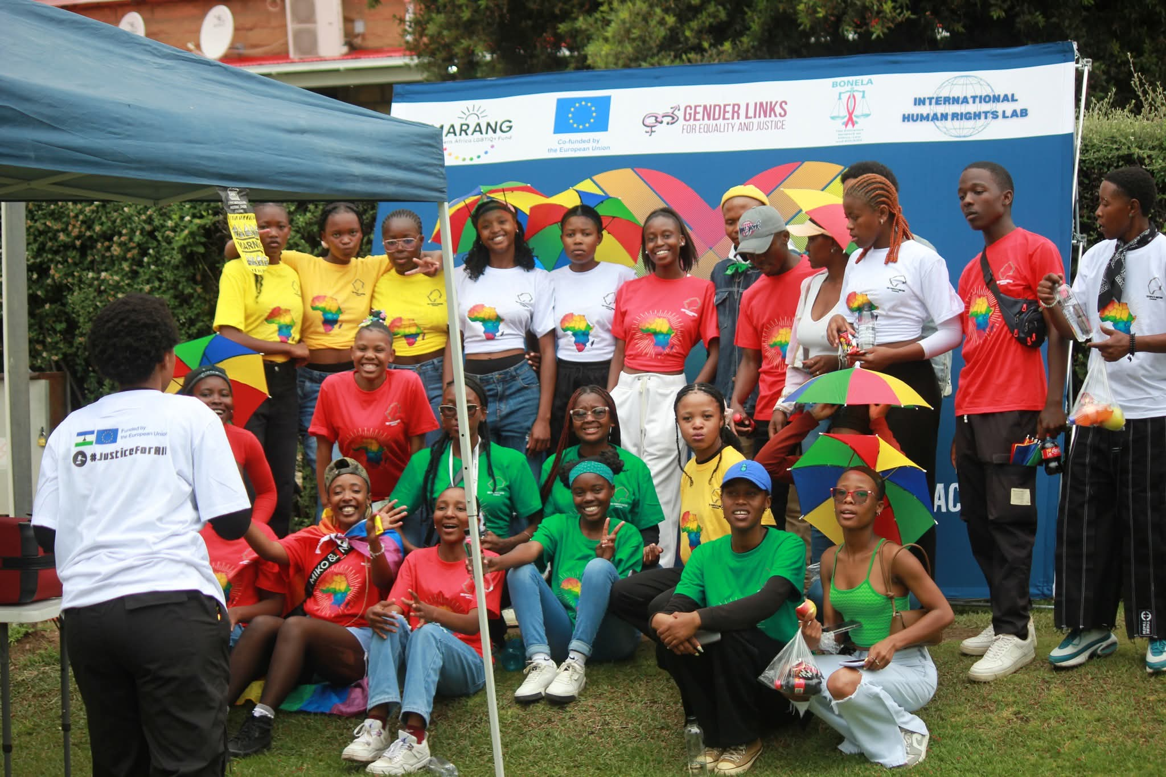
Background(problem, actions, change, evidence)
Background
IHRL is growing youth led organization that aims to promote and protect human rights in Lesotho. Specifically under the Thuso Project, IHRL focuses on advancing equality and dignity of LGBTQI+ persons through strengthening institutional systems. The primary focus area is to ensure inclusive financial services, inclusive public infrastructure and LGBTQI+ sensitive GBV response systems.
Problem
As a growing organization, there is limited organizational capacity as well as limited resources for organization expansion. More so, social stigma continues to affect full project implementation.
Actions
IHRL continues to expand its resource mobilization in order to reach as many people as possible.
Change.
Strengthened relations between IHRL, partners and the donor.
Increased engagement with national institutions
Improved internal coordination and planning
Increased recognition by other stakeholders and GoL.
Voice and Choice Summit 2026 \ Voice and Choice Summit 2026

Slide 4
ODS Baseline Scores
RWVL ODS Baseline Report
Marang ODS Baseline Report
Overall Score
People and Leadership score | 75
Structures, Systems, and Processes Score | 70
Resilience, Care, and Security Score | 62
Finance and sustainability and social entrepreneurship Score | 57
Connections and Visibility Score | 79
Voice and Choice Summit 2026 \ Voice and Choice Summit 2026

Slide 5
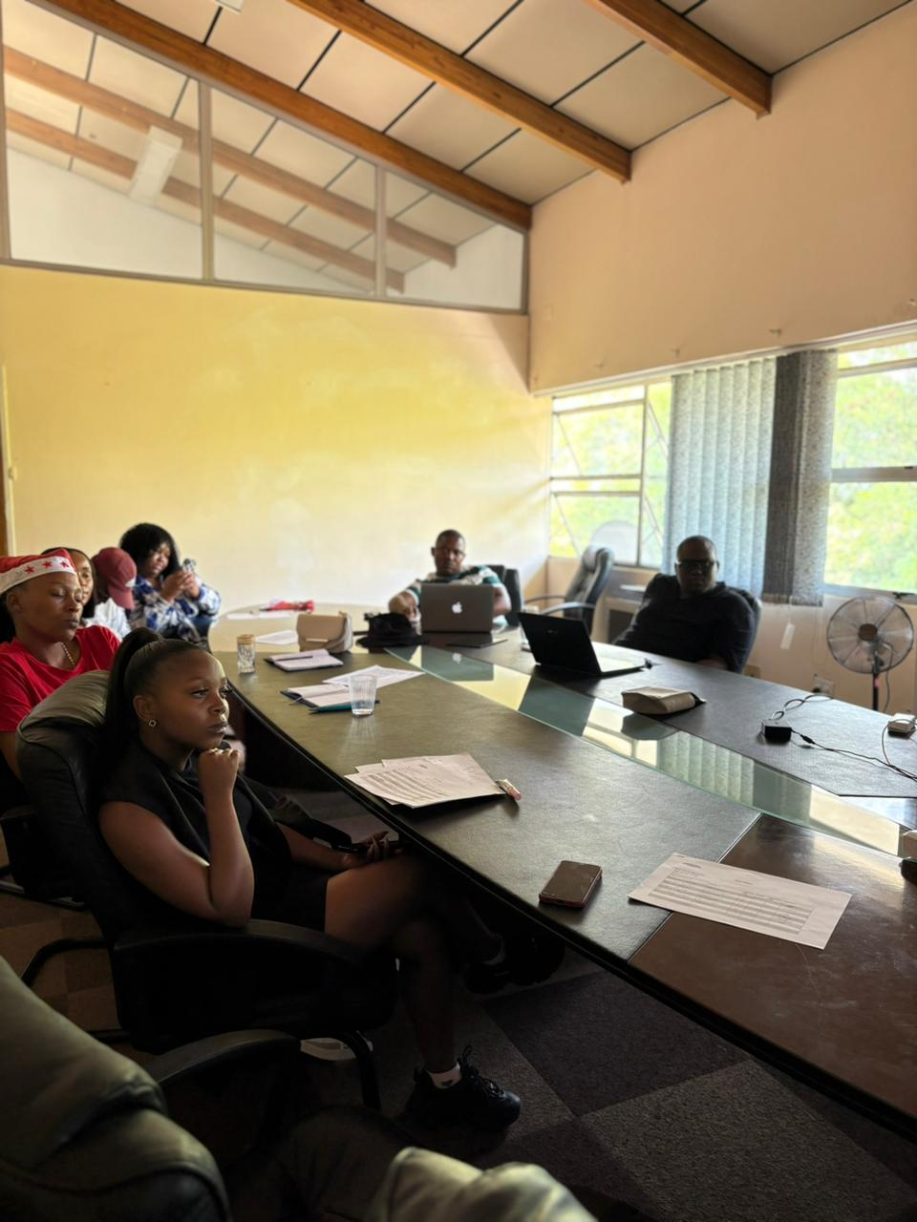
Change
How did the change come about?
The change came about as a result of the organisation receiving funding to implement the THUSO project, which required the organization through its leadership and management with the support of the donor to strengthen its internal systems, partnerships, and institutional engagement
Engagements with funders and partners, alongside donor compliance requirements, highlighted the limitations of IHRL's informal, sponsorship-based operational model and underscored the need for structured systems to support transparency, sustainability and institutional credibility.
These included organisational capacity assessments, internal reflection sessions and technical support engagements focused on finance, procurement and monitoring and evaluation.
Nonetheless, the implementation of the project created an opportunity for organisational growth. The need to coordinate activities with multiple stakeholders, collect evidence, and monitor project outcomes required the organisation to formalise some of its internal processes, improve project management systems, and strengthen collaboration with external partners.
Staff participated in capacity-building programmes, that strengthened understanding of institutional governance, accountability and results-based management. These processes informed the development of internal tools, templates and operational guidelines and helped clarify roles and responsibilities across departments.
Voice and Choice Summit 2026 \ Voice and Choice Summit 2026

Slide 6
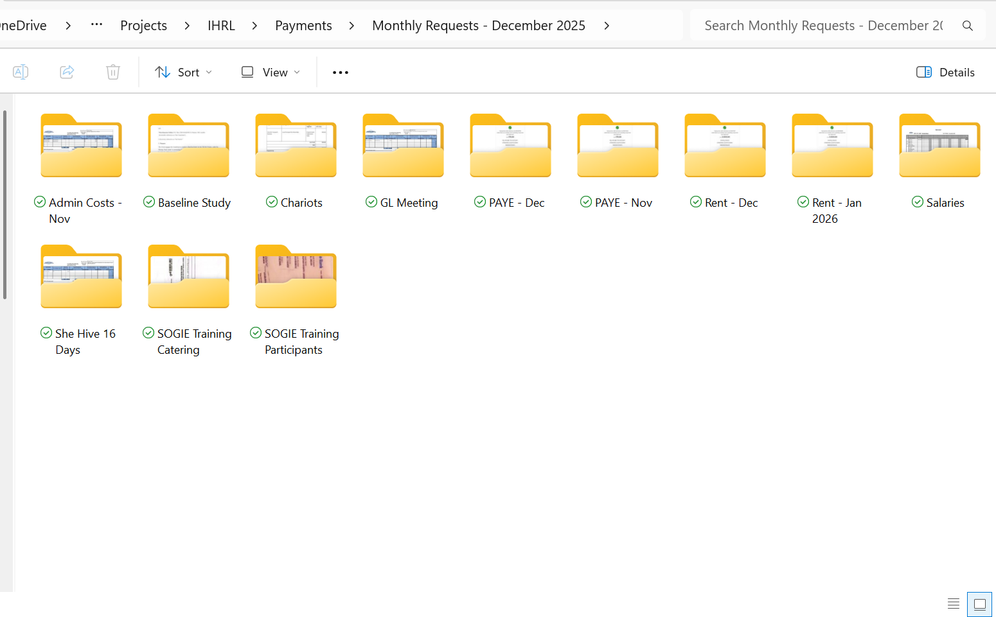
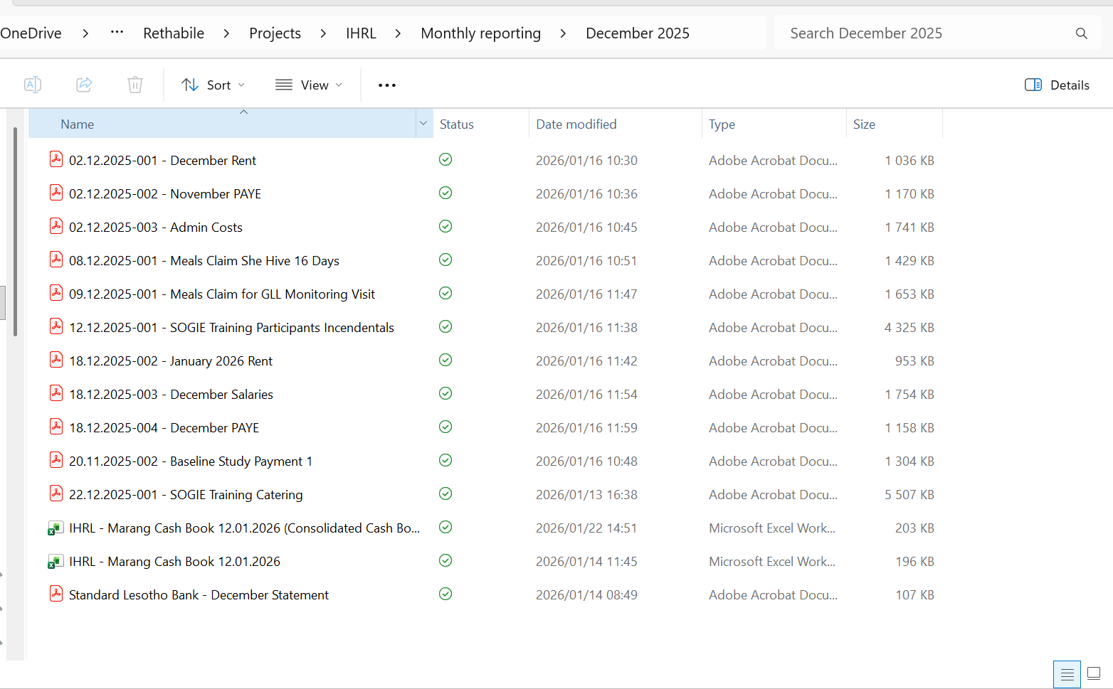
Change cont’d …
What actions were taken by the organization to implement these changes across the organisation?
The organisation began formalising internal systems to improve transparency, accountability, and efficiency. This included the development and adoption of internal operational tools such as financial management procedures, procurement processes, and monitoring and evaluation frameworks.
To support the implementation of the THUSO project, the organisation introduced clearer project planning and management processes. This included the use of workplans, activity trackers, reporting templates, and monitoring tools to ensure that project activities were implemented systematically and that progress could be documented and assessed.
Staff members participated in capacity-building programmes and technical support sessions focused on governance, financial management, procurement, and monitoring and evaluation. These trainings strengthened staff capacity to manage donor-funded projects and improved understanding of compliance requirements, accountability standards, and results-based management.
The organisation increased its engagement with partners, government institutions, and other stakeholders. Structured consultations, stakeholder meetings, and collaborative activities were introduced to strengthen relationships and ensure that project implementation benefited from the expertise and participation of relevant institutions and community partners.
IHRL also strengthened its monitoring and learning systems by introducing structured data collection processes, documentation tools, and reflection spaces to review progress and challenges.
Voice and Choice Summit 2026 \ Voice and Choice Summit 2026

Slide 7
What has changed in the following areas since working with Gender Links.
 | Before due diligence | After due diligence
Financial system | No system | Operational financial management system in place
Separate bank account | No bank account | Organisational bank account opened
Two signatories to the account | No signatories | Available
Financial documentation | Informal | Standardised and formal policy informed financial documentation currently used
Monthly reconciliations and routines | None | Monthly reconciliations and financial routines and reporting timelines established.
Fundraising and Sustainability | Relied on in kind support and ad hoc sponsorships | Structured donor engagement and sustainability plan in place. Efforts to fundraising continuously ongoing
Voice and Choice Summit 2026 \ Voice and Choice Summit 2026

Slide 8
what has changed in the following areas since working with Gender Links.
 | Before due diligence | After due diligence
Safeguarding policy | None | Developed and shared with staff members
Human resources policy | Available | Still in use
Finance policy | Availablle | Operational and improved with board approval
Procurement policy | Available | Operational and improved with board approval
Board functionality | Active | Still active
Anti-corruption/Fraud Policy | Available | Available
Sexual Harassment Policy | Available | Available
Monitoring and Evaluation Systems | Not available | Available
Fundraising and Sustainability | Sponsorships | Structured donor engagement and sustainability plan in place. Efforts to fundraising continuously ongoing
Voice and Choice Summit 2026 \ Voice and Choice Summit 2026

Slide 9
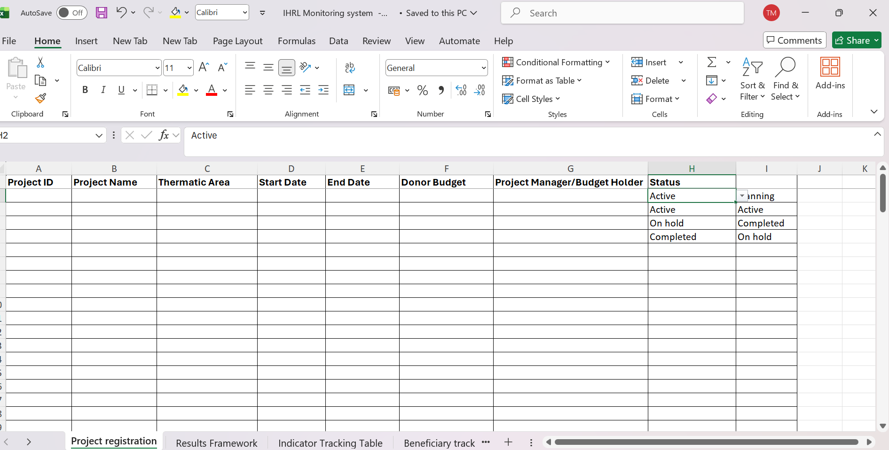
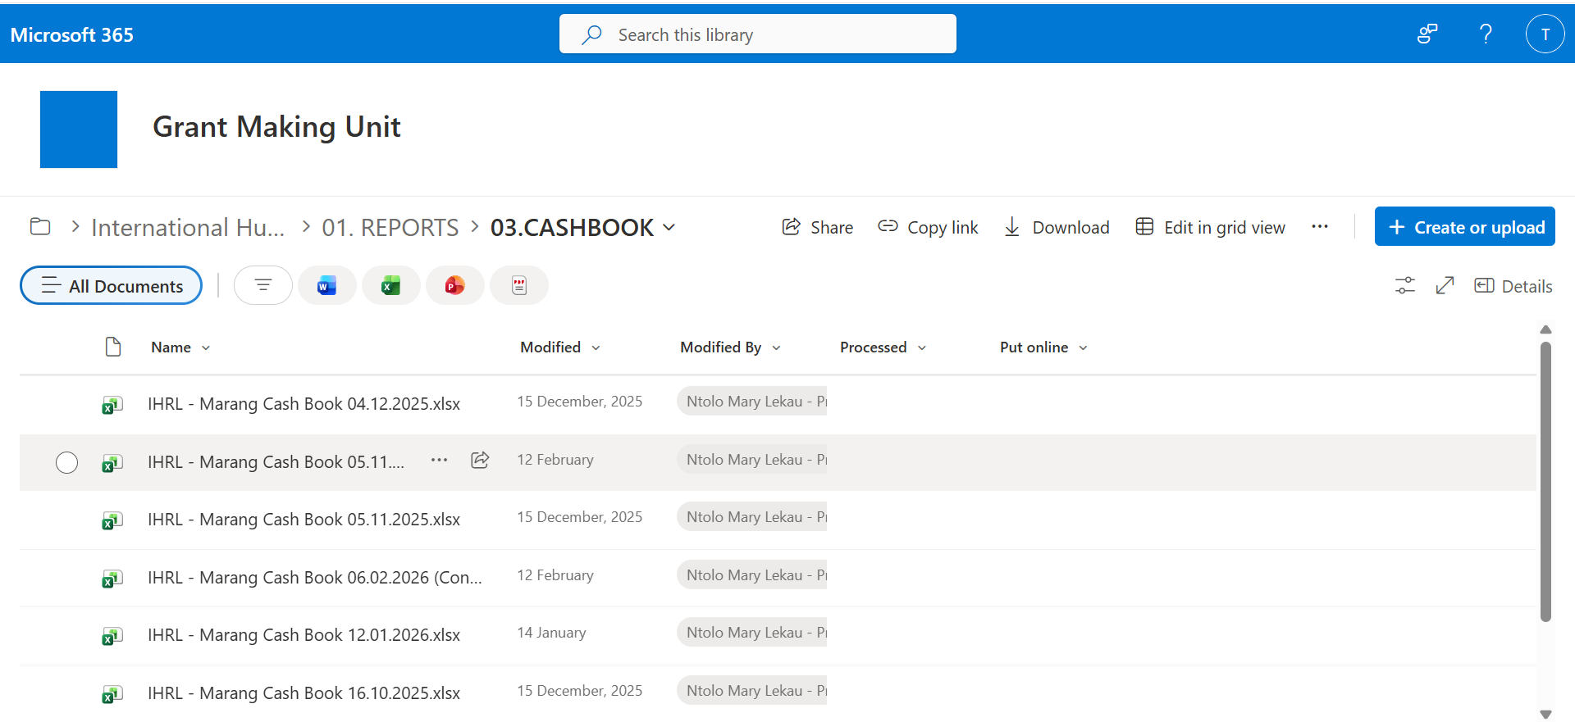
Significance/ Impact
What is the significance of the change?
Transition from an informal sponsorship-based model to a more structured, systems-driven operational framework. Previously, many of IHRL’s activities were implemented through flexible, sponsorship-based arrangements. While this allowed the organisation to respond quickly to emerging opportunities, it also limited its ability to manage larger projects, demonstrate accountability to donors, and build long-term institutional credibility.
Clear operational guidelines, defined oversight mechanisms and financial management processes as well as monitoring tools improved the organisations internal coordination systems.
The change also improved the organisation’s external engagement. By developing clearer systems and processes, IHRL was better positioned to engage with institutional stakeholders, partners, and funders in a more professional and coordinated manner. This strengthened donor confidence and credibility with funders and partners.
Increased capacity to manage grants, budgets and partnerships sustainably.
Stronger foundation for long-term growth, institutional stability and strategic expansion
Through capacity-building programmes and technical support from Gender links, staff gained a deeper understanding of project management, financial accountability, and results-based management.
The organisation is now better equipped to manage donor-funded projects, demonstrate impact, and expand its partnerships and programmes.
Voice and Choice Summit 2026 \ Voice and Choice Summit 2026

Slide 10
Challenges and Lessons Learnt
Challenges and Mitigation
Challenges
Limited internal technical capacity in finance and M&E at the outset
Capacity constraints while implementing systems alongside ongoing program delivery
Previous informal systems did not meet donor requirements And the the organisation also needed to invest time and resources into strengthening internal systems and institutional structures.
Mitigation
Conducted structured capacity-building sessions on finance, procurement and M&E
Sought technical support and guidance from GL where necessary
Developed clear internal templates and standard operating procedures
Phased implementation of systems to avoid overwhelming staff
Strengthened internal communication to ensure shared understanding of changes
What lessons have you learnt
Donor compliance and accountability strengthen credibility rather than restrict flexibility
Clear role definition improves efficiency and reduces internal friction
Early investment in monitoring and evaluation improves reporting quality and strategic decision-making
Change management requires patience, leadership buy-in and continuous learning
Institutional systems are essential for sustainability.
Voice and Choice Summit 2026 \ Voice and Choice Summit 2026

Slide 11
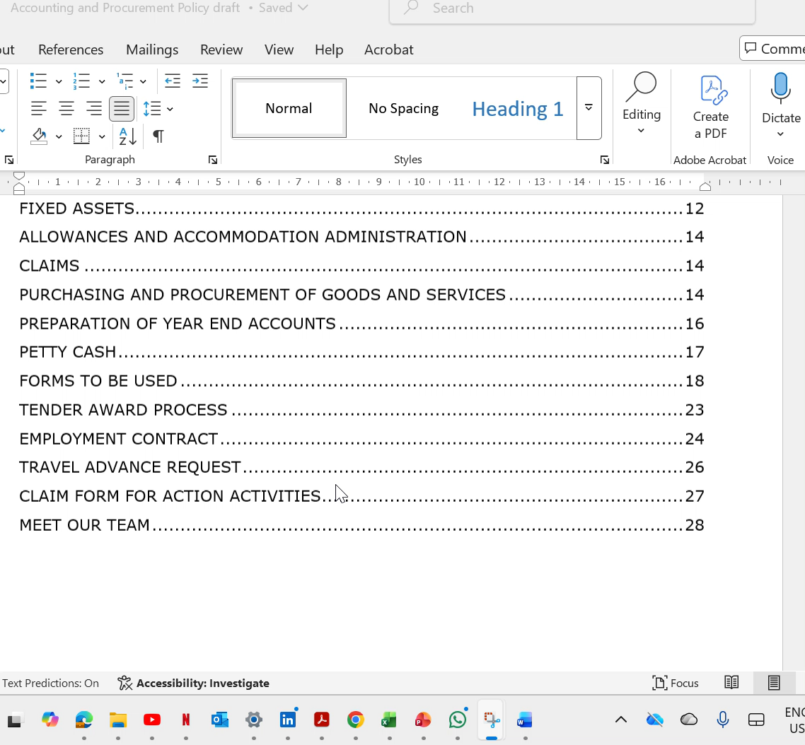
Sustainability
Institutional systems are now embedded in daily operations rather than project-specific processes
Clear policies, templates and standard operating procedures guide finance, procurement and M&E practices
The skills and knowledge gained through capacity-building initiatives have strengthened staff understanding of governance, compliance, and results-based management.
Regular internal reviews and reporting cycles reinforce compliance and transparency
Capacity building is ongoing, ensuring skills are retained and strengthened within the team
Through strengthened relationships with partners and institutions, the organisation has created visibility and credibility for potential collaborations. A skill that will help the organization maintain its operational system while expanding programs
What can be replicated?
Integrating donor compliance into everyday workflows instead of treating it as an external requirement
Prioritising staff training on governance, accountability and results-based management
Developing simple, practical templates rather than overly complex systems
Using organization self assessments and reflection processes to gauge growth
Voice and Choice Summit 2026 \ Voice and Choice Summit 2026

Slide 12
Next Steps
Continue staff capacity development in compliance, reporting and results-based management
Develop a long-term sustainability and resource mobilisation strategy beyond project-based funding
Institutionalise quarterly financial and program performance reviews linked to strategic objectives
Position IHRL for larger multi-year grants through strengthened institutional credibility and systems readiness
The organisation will continue to strengthen relationships with government institutions, civil society partners, and community stakeholders.
Successful strategies and operational models developed during the project can be adapted and scaled to support similar initiatives in other projects.
Voice and Choice Summit 2026 \ Voice and Choice Summit 2026

