Slide 1


Voice and Choice Summit 2026-Organisational Development Category
Title/Name of the Story of Organizational Change
South Africa – “Mosadi ithlokomele” protecting women and Girls against the scourge of GBVF to secure better future.
Voice and Choice Summit 2026 \ Voice and Choice Summit 2026

Slide 2
Synopsis– brief overview what this is about
Name | LADI WILHEMINA PHOFU
Designation | PROJECT DIRECTOR AND FOUNDER
Organisation | USIZO COMMUNITY DEVELOPMENT PROJECTS
Country | SOUTH AFRICA
Category | ORGANISATIONAL DEVELOPMENT
Summary | "MOSADI ITHLOKOMELE," a powerful Sesotho phrase meaning "Woman, take charge and protect yourself," this phrase serves as the cornerstone of our current project. Our initiatives are meticulously designed to confront the pervasive and devastating issues of Gender Based Violence and Femicide (GBVF) directed to women and girls in South Africa USIZO COMMUNITY DEVELOPMENT PROJECTS works to combat and confront factors that enable GBVF to thrive at community level.
Voice and Choice Summit 2026 \ Voice and Choice Summit 2026

Slide 3
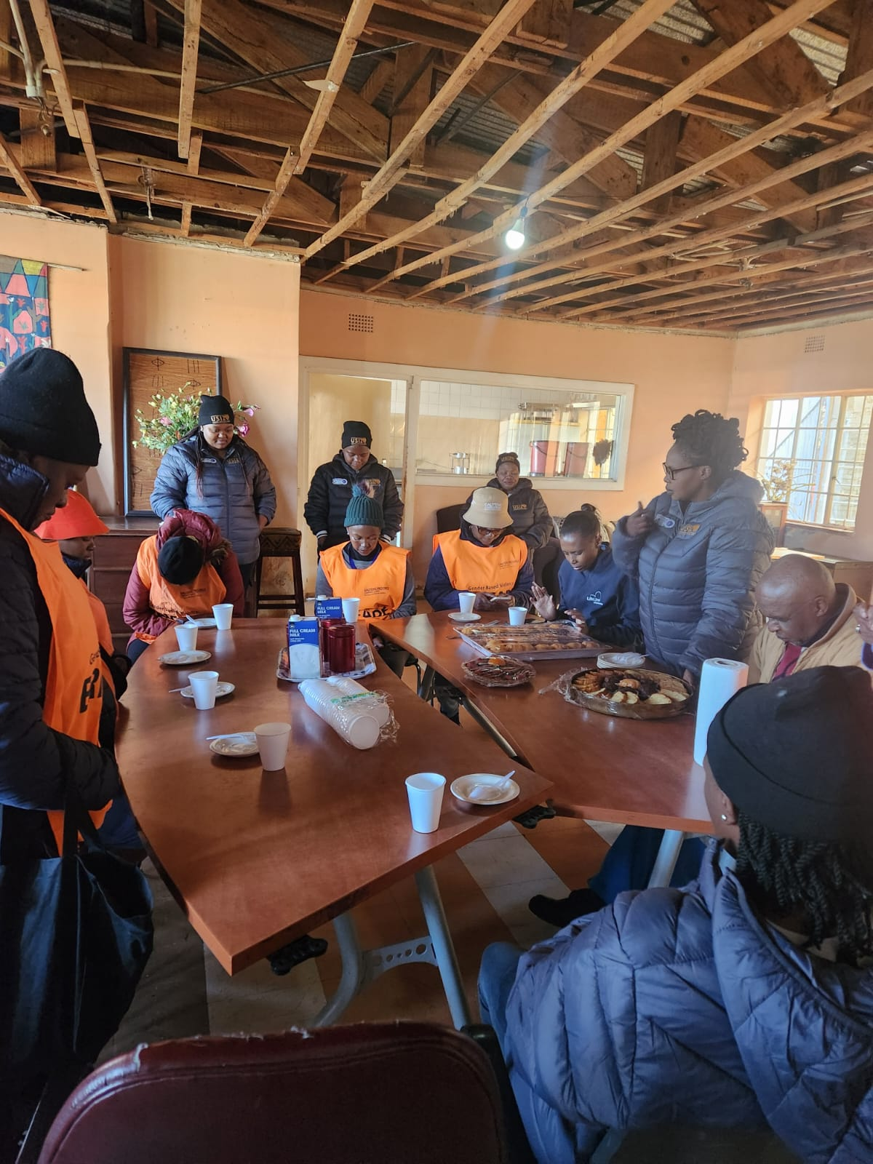
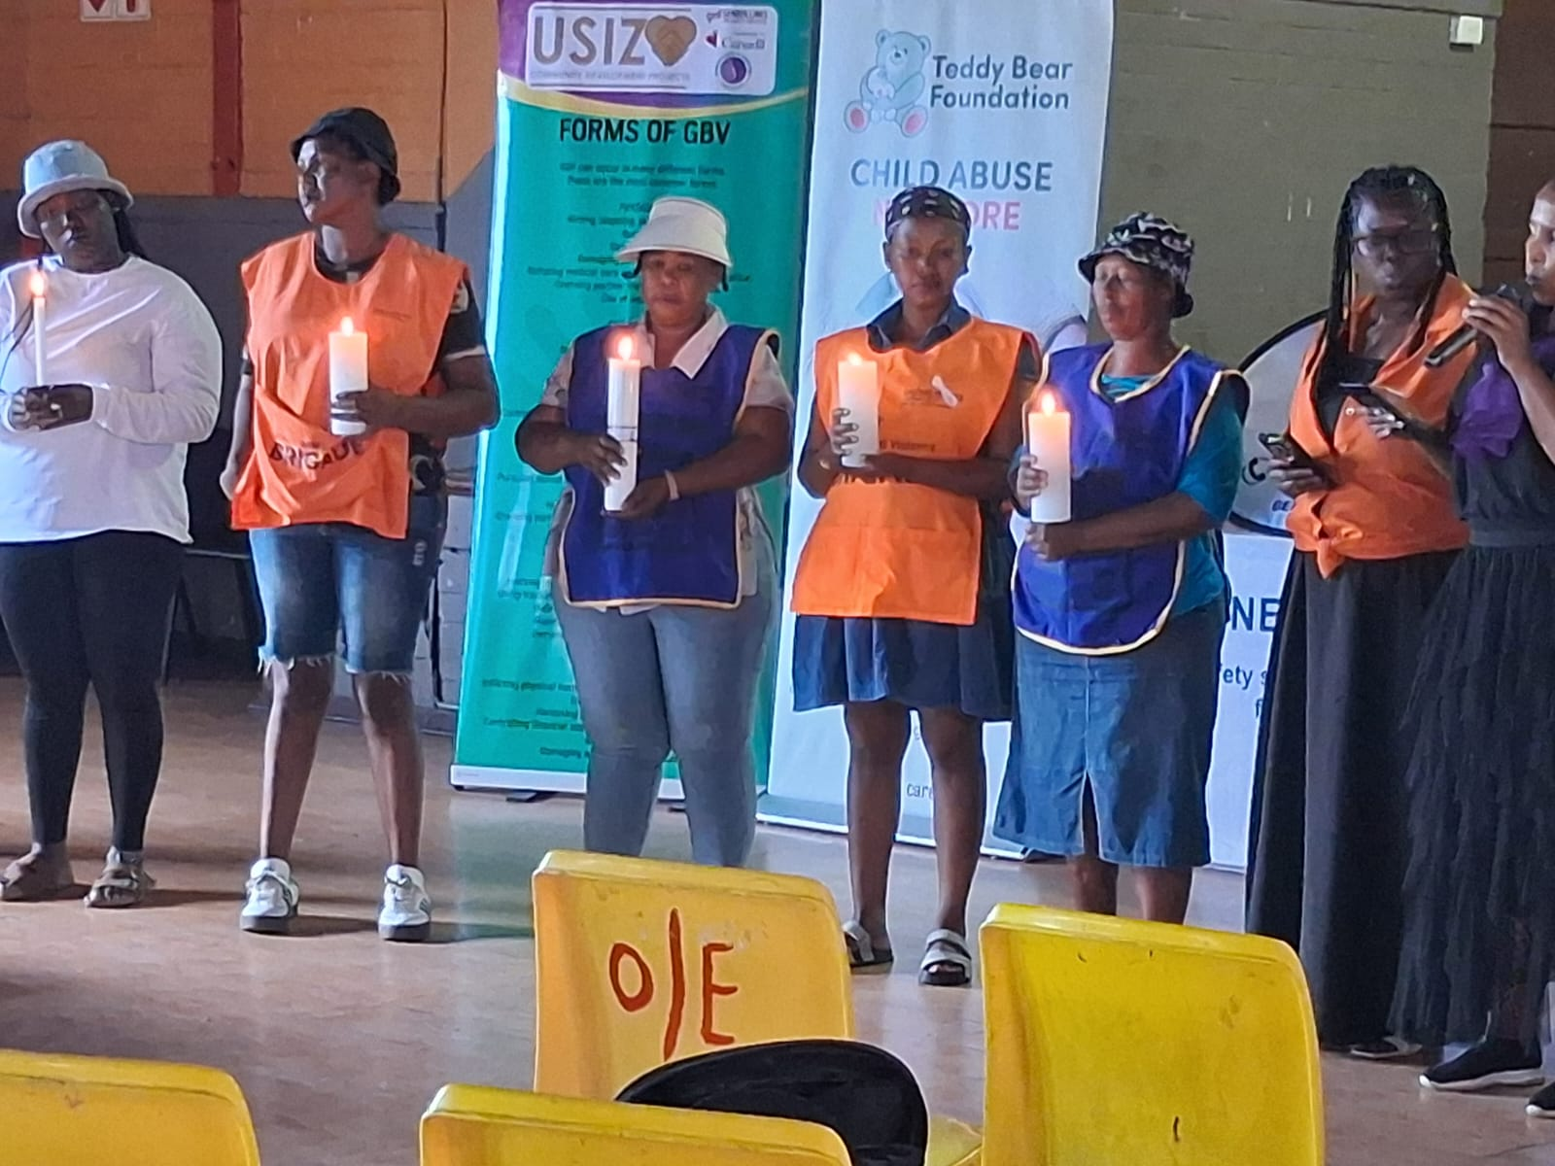
Background(problem, actions, change, evidence)
What organizational challenges do you face?
Funding instability and insufficient donor support continues to be a huge challenge affecting staff and planned programs.
Donor influence on organizational decision making forcing the organization to focus and prioritize funder driven programs rather than community needs at ground level.
Shortages of trained personnel, especially in specialised fields such as trauma counselling, social work project management.
No psycho-social support for frontline staff and Volunteers exposed to traumatic cases exacerbating emotional exhaustion and a high staff turnover.
Evidence: Include Photos or videos
Voice and Choice Summit 2026 \ Voice and Choice Summit 2026

Slide 4
ODS Baseline Scores- find yours!
RWVL ODS Baseline Report
Marang ODS Baseline Report
Overall Score
People and Leadership score
Structures, Systems, and Processes Score
Resilience, Care, and Security Score
Finance and sustainability and social entrepreneurship Score
Connections and Visibility Score
Voice and Choice Summit 2026 \ Voice and Choice Summit 2026

Slide 5
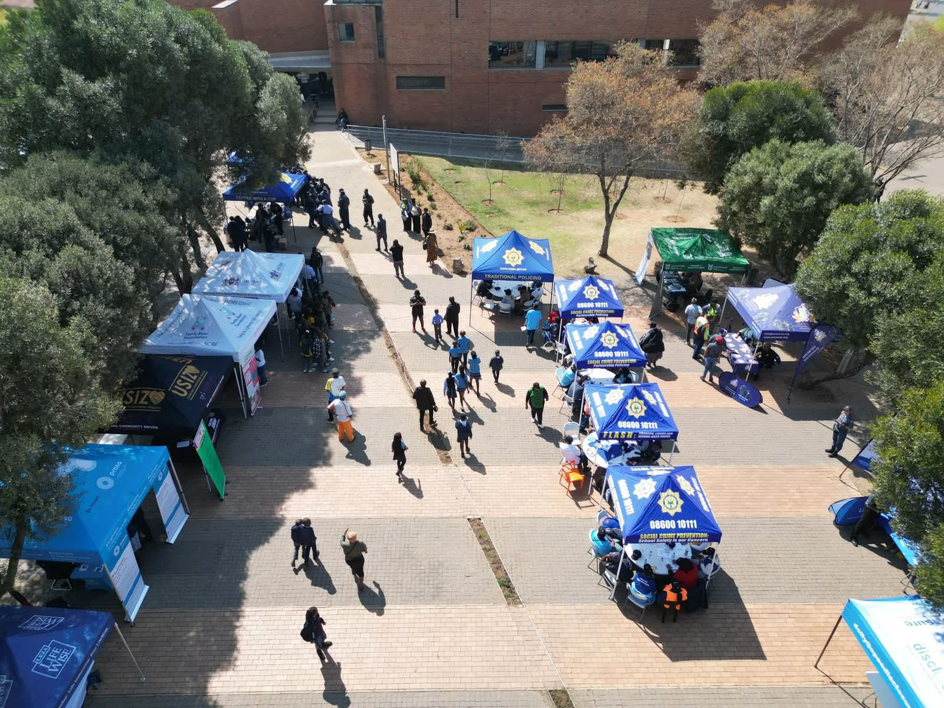
Change
How did the change come about?
Change came about through a collaborative effort of staff members and volunteers participation in a number of workshops aimed at improving the quality of our work.
Team Leaders implement staff workshops and trainings such as the “Do No Harm” a training designed to capacitate our staff to handle and deal with sensitive issues of Gender Based Violence and Femicide. Ensuring that their efforts do not unintentionally cause harm or re-traumatization.
Workshop on correct data recording and standardization of registers and monitoring and evaluation tools these trainings are based on what team leaders have learned and gathered through attending GL Academy.
To ensure that what is taught is practiced throughout the organization. Team leaders conduct reviews and assessments on the effectiveness and challenges posed by the change introduced and also access the practicality of what has been introduced.
Evidence: Include Photos or videos
Voice and Choice Summit 2026 \ Voice and Choice Summit 2026

Slide 6
What has changed in the following areas since working with Gender Links.
 | Before due diligence | After due diligence
Financial system
Separate bank account | The organization had one bank account for all transactions. | We have recently opened a separate account to separate the transactions for the RWVL project.
Two signatories to the account | The organization has two signatories on the banking account. | The organization has three signatories all three approve transactions.
Financial documentation | No effective digital filing system paper based invoices and financial records. | Introduction of a shared drive invoices are organized and uploaded online.
Monthly reconciliations and routines | No monthly reconciliations recorded | Monthly reconciliations recorded verification of all transactions.
Fundraising and Sustainability | Fundraising team is available but less effective. | Fundraising committee is more active and implement strategies to raise funds.
Voice and Choice Summit 2026 \ Voice and Choice Summit 2026

Slide 7
what has changed in the following areas since working with Gender Links.
 | Before due diligence | After due diligence
Safeguarding policy | Not available | Staff safeguarding policy in place regular staff training to curb abuse, including sexual Harassment.
Human resources policy | Human resource policy Available. | Human resource policy available reviewed annually.
Finance policy | Finance policy available. | Financial policy available reviewed quarterly.
Procurement policy | Finance policy forms part of procurement | Financial policy available reviewed quarterly.
Anti-corruption/Fraud Policy | Not available | Currently being developed
Sexual Harassment Policy | Available reviewed Biannually | Available reviewed Biannually
Monitoring and Evaluation Systems | Has always been Available | Now effective and easy to use monitoring and to evaluate and monitor project progress.
Fundraising and Sustainability | Fundraising committee available. | New strategies developed better performance
Voice and Choice Summit 2026 \ Voice and Choice Summit 2026

Slide 8
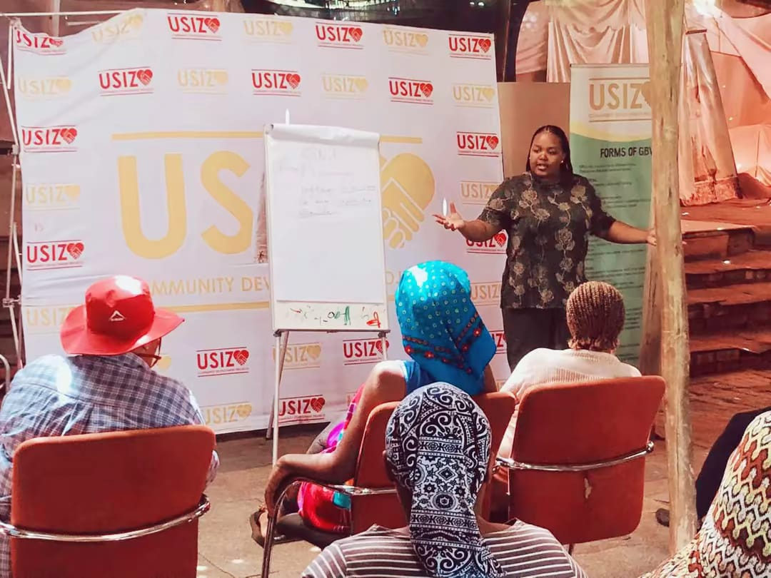
Significance/ Impact
What is the significance of the change?
The significance of the change is that it has assisted us to grow as an organization and make our impact more effective.
Usizo Community Development project is able to function more professionally and assist more victims of GBVF in poor communities.
Empowerment of Staff and improvement of the Quality of work delivered to the communities we serve.
Ensure continuity of work through improvement of our systems and ensure data is protected but also readily available when needed.
Beneficiaries of our organization gain more from the expertise brought thorough organizational development.
Evidence: Include Photos or videos
Voice and Choice Summit 2026 \ Voice and Choice Summit 2026

Slide 9
Challenges & Lessons learnt
Challenges & mitigation
Limitations to technology especially in poor communities that we serve beneficiaries do not have sufficient access to technology.
Working in high-violence communities places staff at personal risk, especially during home visits, community mobilisation, or when challenging harmful social norms.
Increasing demand of GBV related services with limited resources.
What lessons have you learnt?
Programmes are more effective when all partners, team members, and community stakeholders are committed from the start.
Prioritisation of staff well-being, provide mental‑health support, and build team cohesion, attain better service quality and staff retention.
Programs of GBVF must be evidence based to allow measurement of progress and access the progress of the project.
Voice and Choice Summit 2026 \ Voice and Choice Summit 2026

Slide 10
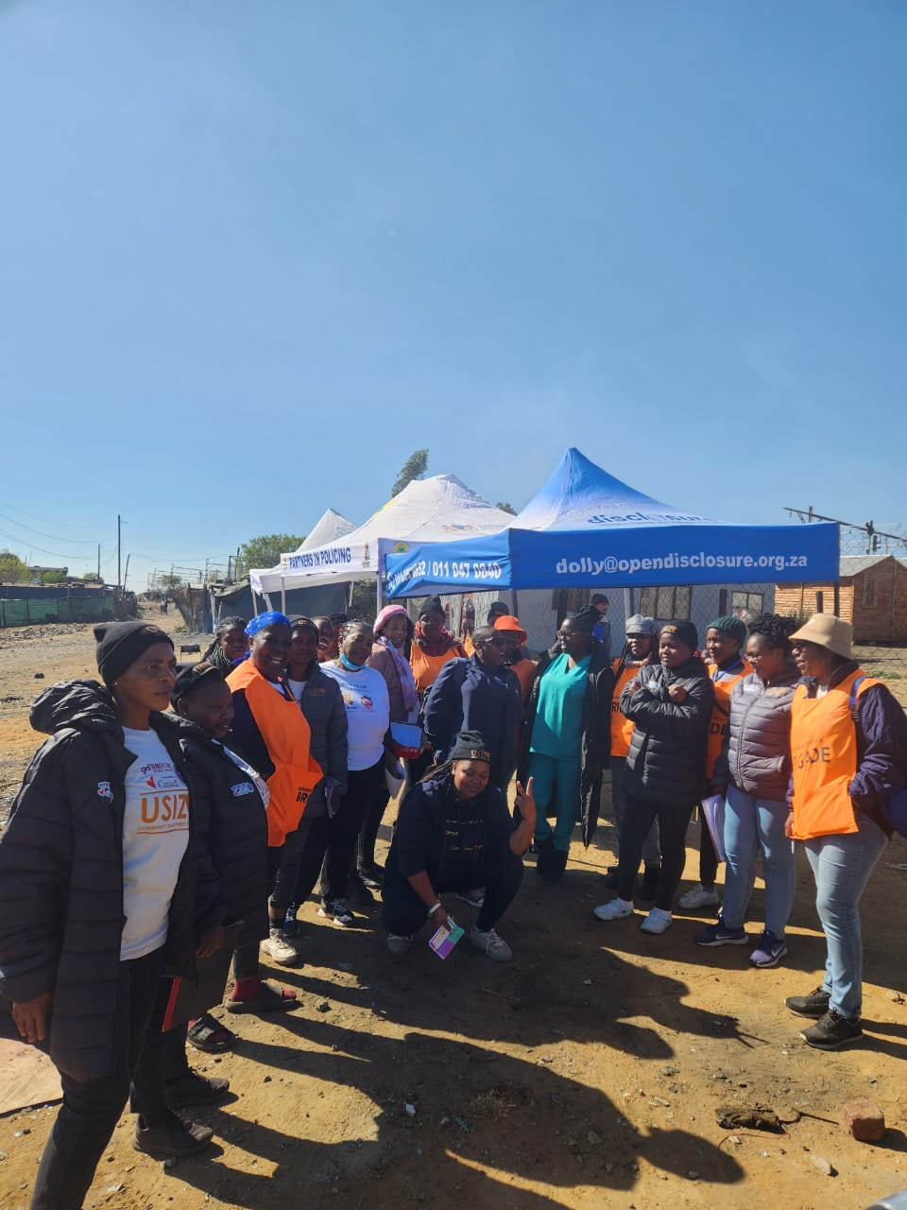
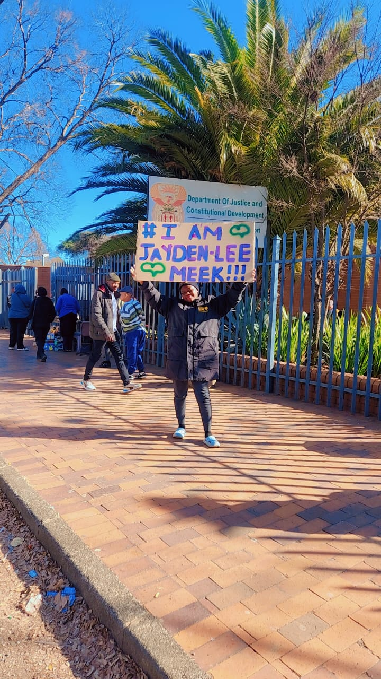
Sustainability
How will the change be sustained in your organization.
Ensure that change is collectively driven by staff members to ensure it lasts and is practiced.
Invest in capacity-strengthening of staff, management, and partners to sustain change more effectively.
Intentionally cultivate care, reflection, staff support for better performance and reduce staff turnover.
Formalisation of organisational policies and continuous review to ensure that the organization run effectively.
Evidence: Include Photos or videos
Voice and Choice Summit 2026 \ Voice and Choice Summit 2026

Slide 11
Next Steps
What are your plans?
We aim to scale up evidence‑based GBV prevention initiatives, especially in under‑resourced communities this will help us to reach more beneficiaries. Strengthen partnerships with other organizations and stake holders ensure expansion of our organisation’s activities.
Strengthen survivor services expanding trauma counselling and psycho-social support for our staff members.
Providing more mobile or in-community services for survivors who cannot travel
Strengthening referral pathways with police, clinics, courts, and shelters
Establishing safe spaces/satellite centres in more communities
Voice and Choice Summit 2026 \ Voice and Choice Summit 2026

