Slide 1






LEARNING
AND SHARING
SUMMIT 2025
Break The silence, End The Violence
UNLIMITED HOPE ALLIENCE TRUST
Zimbabwe, Goromonzi
06/02/25
Mary Chigumira
Women’s Voice and Leadership Learning and Sharing Summit 2025

Slide 2

Achieved/planned objective
SOCIAL MEDIA VISIBILITY
Our social media campaign raised awareness about GBV, child marriages and child protection, engaging a wider audience and promoting a culture of prevention and support.
We also successfully established connections with key partners and generous individuals who provided donations like sanitary kits which included disposable and washable pads, bathing soap, towels etc.
Through online social media campaigns, we mobilized online support for advocacy efforts, rallying people to engage, donate and volunteer.
Women’s Voice and Leadership Learning and Sharing Summit 2025

Slide 3
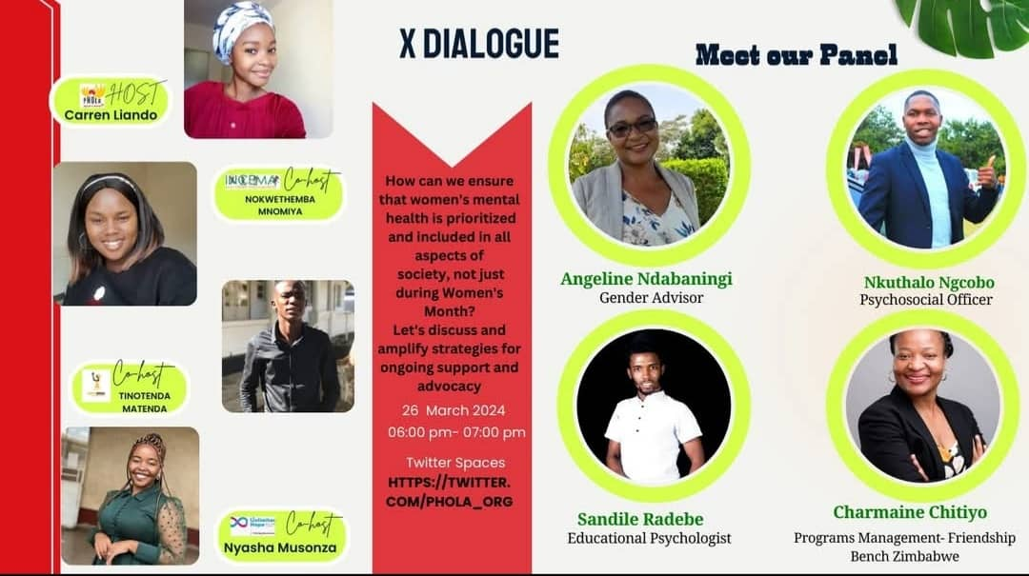
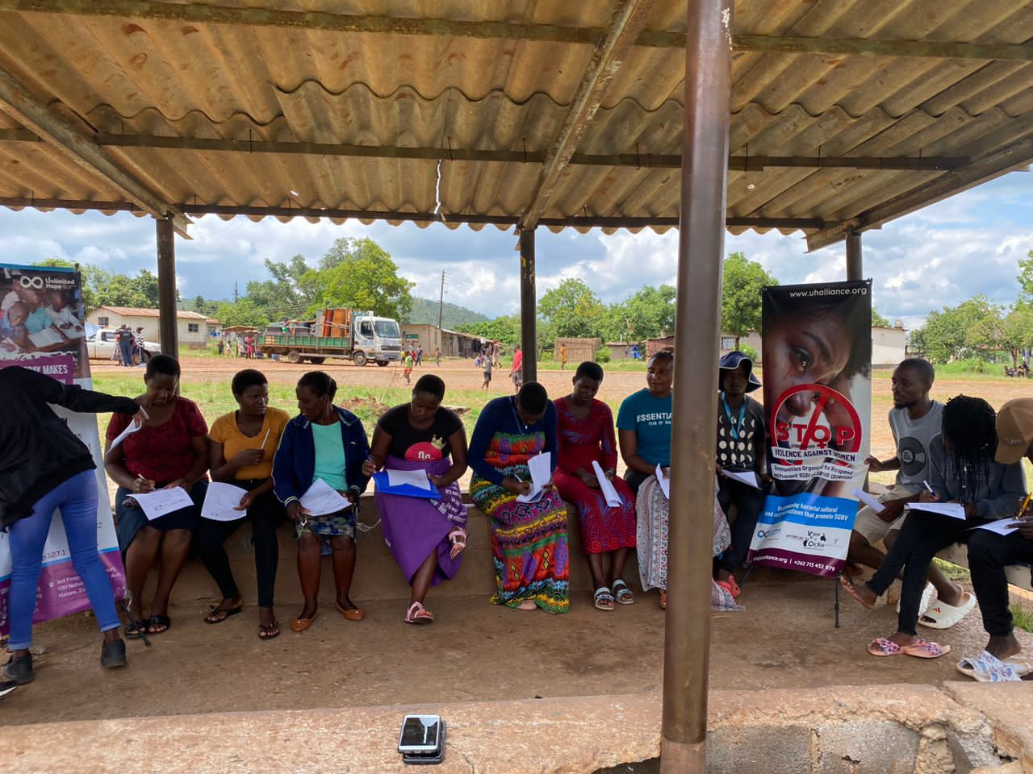
PARTNERS AND NETWORKS
VCSA GRANTEE COLLABORATION
We were able to work with fellow grantees, including GRIT, PHOLA,ROOTS INCEMA and MAC, forstering a strong network of like-minded organisations commited to combact GBV.
During the 16 Days of Activism, we collectively presented “I AM A MAN AGANIST GBV,”a powerful campaign promoting male engagement and advocacy in preventing the issues of GBV.
By working together, we mobilised our collective stregnths, expertise, and resources to create a louder, more unified voice aganist the issues of GBV.
This collaboration enhanced our advocacy efforts, contributing to a broader movement for social change.
Women’s Voice and Leadership Learning and Sharing Summit 2025

Slide 4
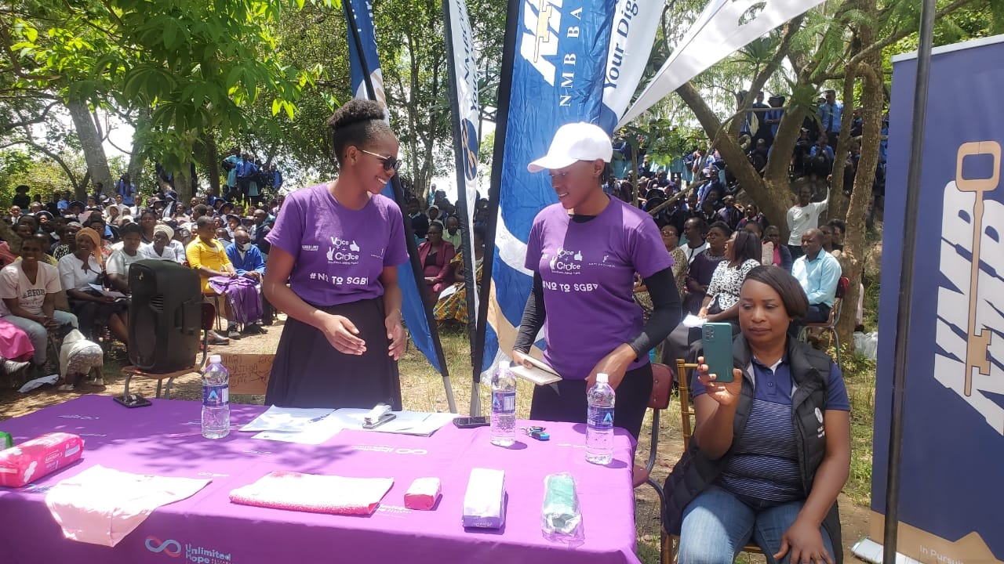
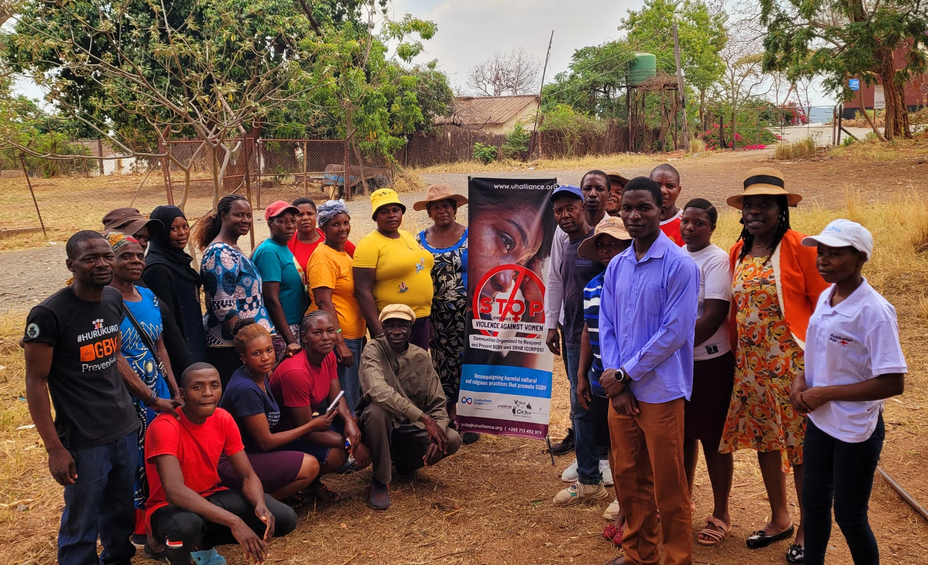
PARTNERSHIPS BEYOND VCSA GRANTEES
We collaborated with CARE Zimbabwe, ministry of women affairs, Musasa project, Child Rights Collation, ZADT, ZNCWC and other international organizations on a dialogue during the 16 Days of Activism, strengthening our efforts to prevent GBV.
Through out joint dialogue, we effectively engaged with the community, raising awareness and promoting action against GBV.
By collaborating with established organizations, we contributed to sustainable and long-term solutions.
Our partnership with CARE Zimbabwe facilitated knowledge sharing capacity building, enhancing our collective expertise.
Women’s Voice and Leadership Learning and Sharing Summit 2025

Slide 5
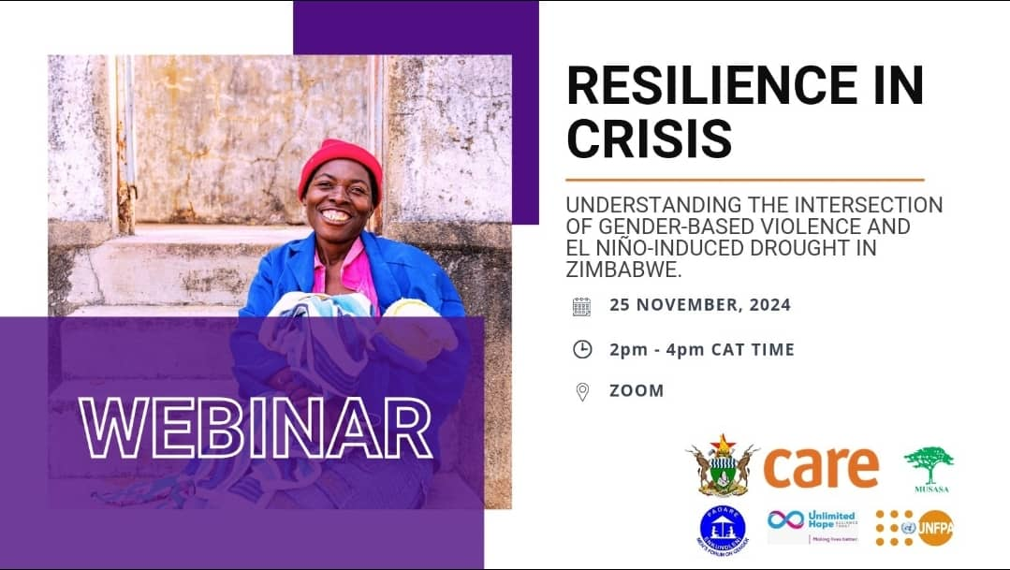
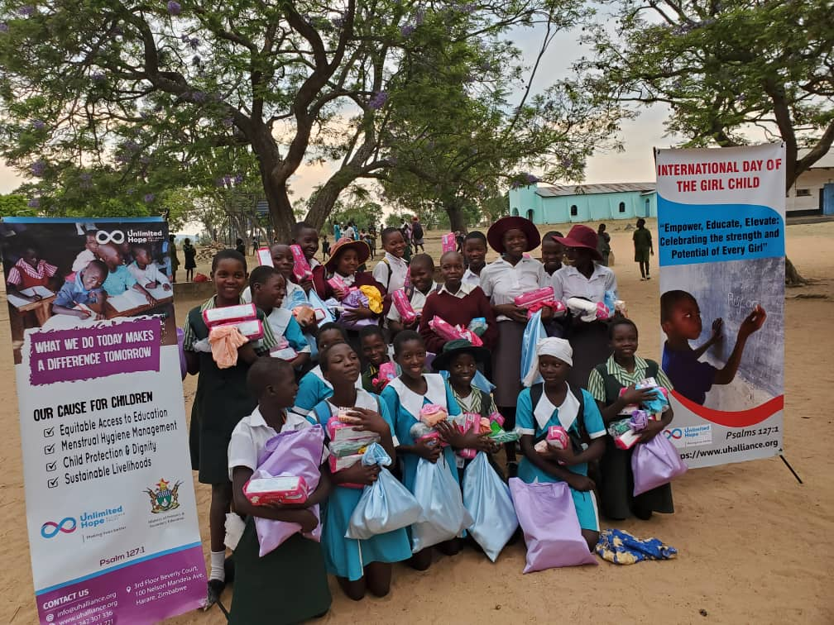
BUILDING ALLIANCES ONLINE
We built alliances with various organizations through or social media activities.
Our partners include, private sectors, banks, donors, women’s support groups and other organizations.
We collaborated with these stakeholders to prevent GBV .
Women’s Voice and Leadership Learning and Sharing Summit 2025

Slide 6
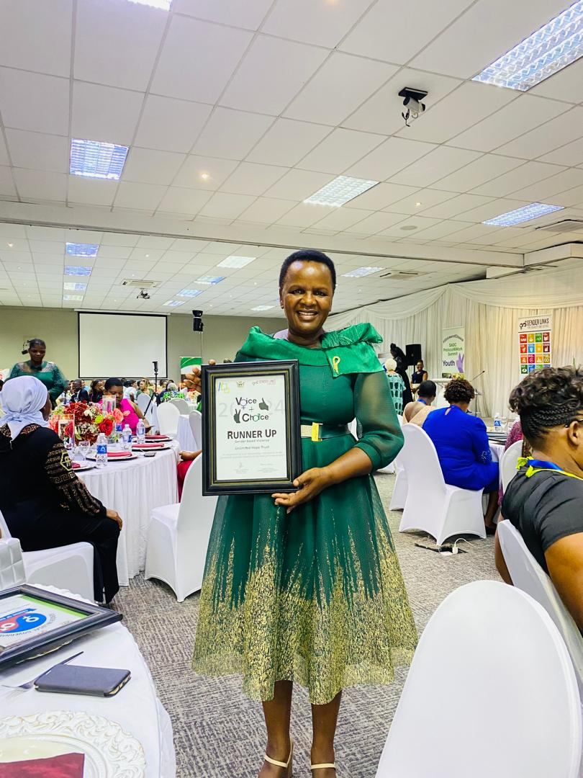
IMPACT
SOCIAL MEDIA IMPACTS
Social media platforms such as WhatsApp, played a pivotal role in our efforts, allowing us to communicate and educate people about GBV, early child marriages and child protection.
The comment sections on our social media platforms became a vibrant space for people to share their opinions, fostering participation and sparking meaningful discussions around SRHR and GBV.
Social media platforms facilitated community engagememnt, discussions, and collectives action around GBV cases.
The #Ending GBV hashtag campaign had a significant impact in raising awareness about SRHR and GBV, and mobilizing survivours.
Women’s Voice and Leadership Learning and Sharing Summit 2025

Slide 7
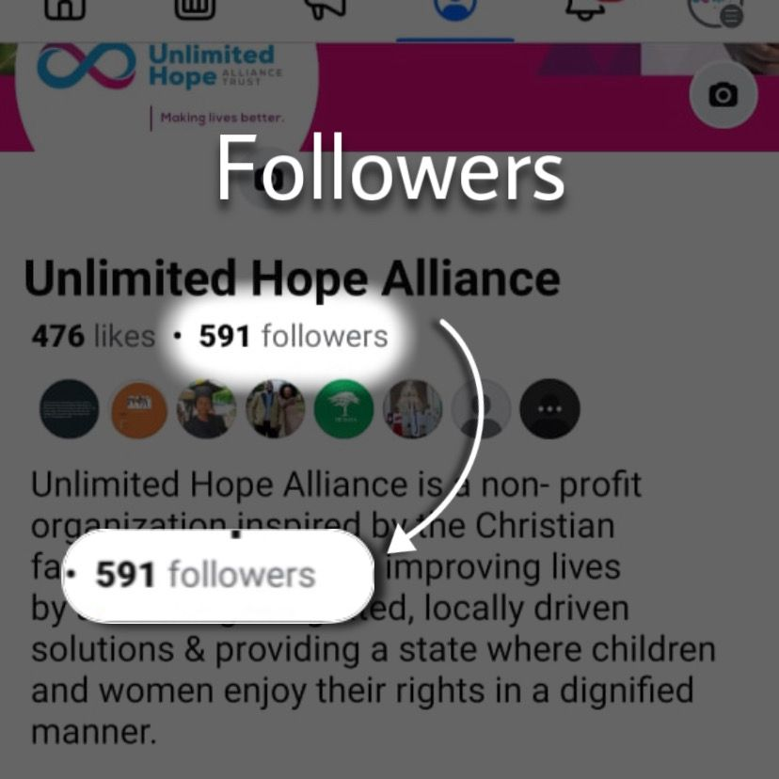
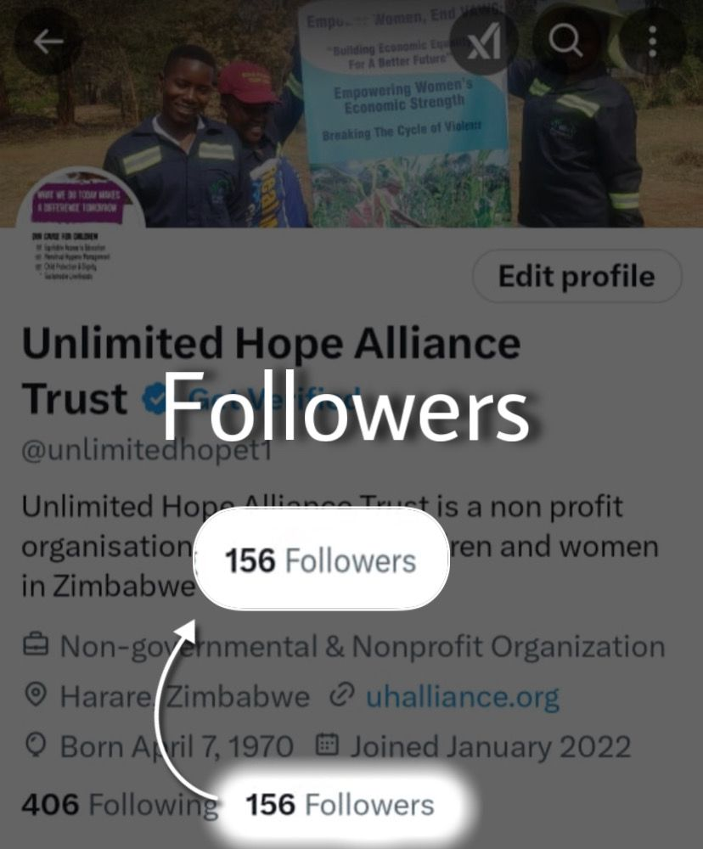
Followers | Before VCSA | Current
Facebook | 150 | 591
Twitter | 83 | 156
Tik-Tok | N/A | N/A
YouTube | 13 | 13
Instagram | N/A | N/A
FACEBOOK FOLLOWERS
TWITTER FOLLOWERS
Women’s Voice and Leadership Learning and Sharing Summit 2025

Slide 8
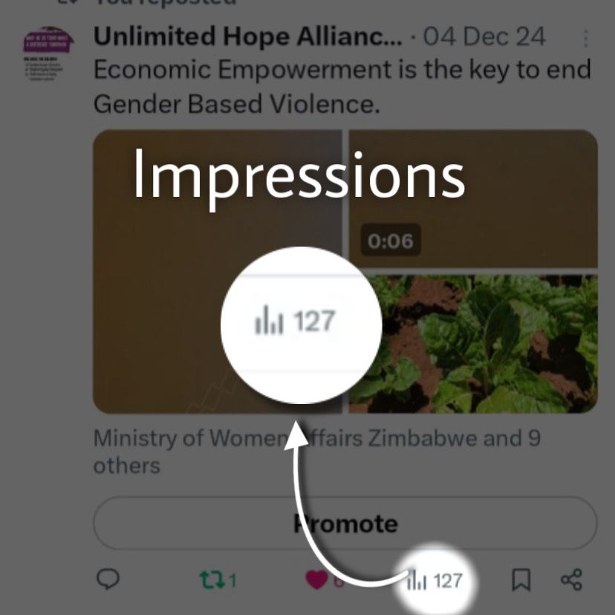
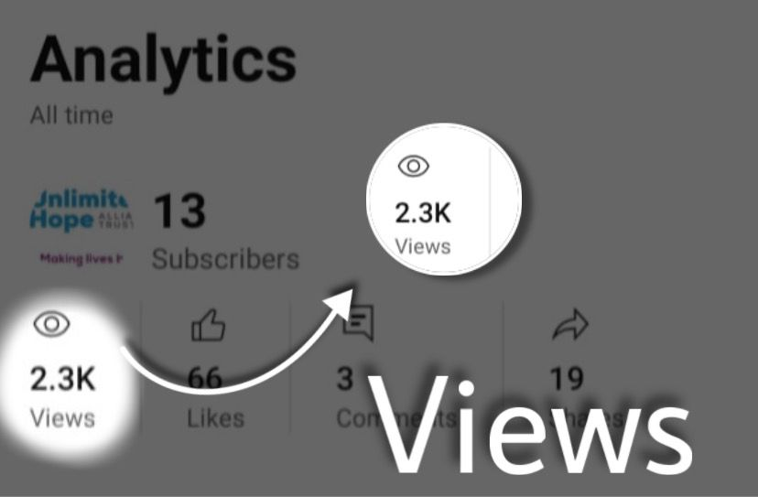
Impressions | Before VCSA | Current
Facebook
Twitter | 253 | 650
Tik-Tok | N/A | N/A
YouTube | 1400 | 2300
Instagram | N/A | N/A
YOUTUBE VIWES
TWITTER IMPRESSIONS
Women’s Voice and Leadership Learning and Sharing Summit 2025

Slide 9
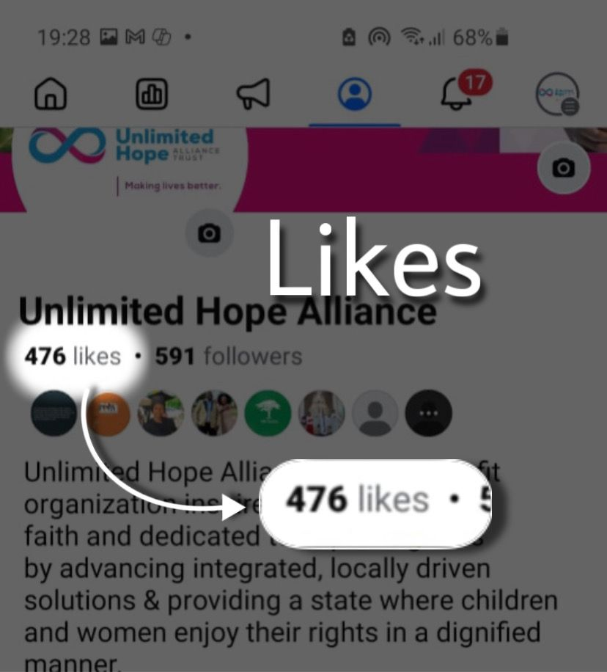
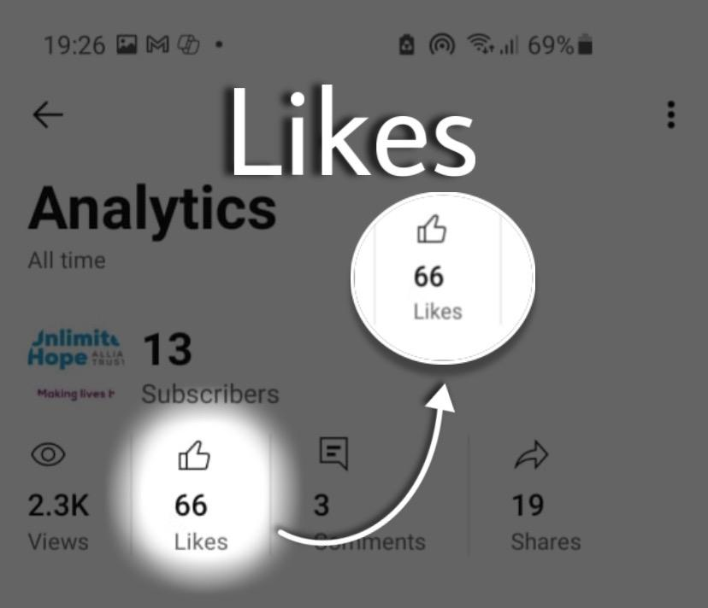
Likes | Before VCSA | Current
Facebook | 125 | 476
Twitter | 300 | 650
Tik-Tok | N/A | N/A
YouTube | 56 | 66
Instagram | N/A | N/A
FACEBOOK LIKES
YOUTUBE LIKES
Women’s Voice and Leadership Learning and Sharing Summit 2025

Slide 10
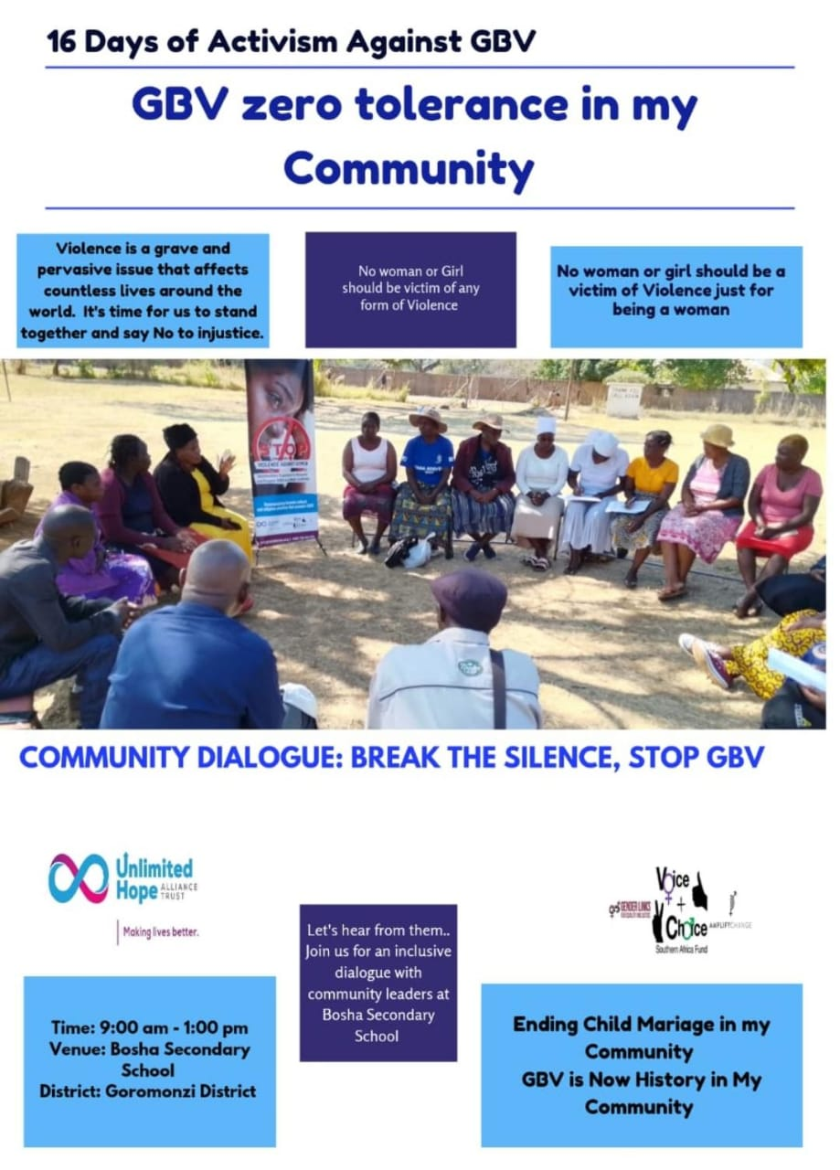
ADDITIONAL EVIDENCE
We managed to protect community members identities and personal information, especially those of GBV survivors and their shared stories.
We also tracked social media engagement and impact and collected community feedback to improve online engagement.
The organization also trained community members and partners on social media use, providing GBV training as well with appointed leaders during online discussions.
We hosted online events for community members to engage with experts, for example the 16 Days of Activism which was streamed live on Facebook
Women’s Voice and Leadership Learning and Sharing Summit 2025

Slide 11
CHALLENGES AND LESSONS LEARNT
CHALLENGES AND SOLUTIONS
CULTURAL AND SOCIAL NORMS- We addressed harmful practices causing GBV in the communities.
LIMITED ACCESS TO INFORMATION – We overcame this challenge by partnering with local communities to develop context-specific programs and messaging, using mobile outreach service to reach remote areas.
STIGMA AND SHAME - To reduce stigma and shame, we promoted a survivor-centered approach, prioritizing the needs, safety and dignity of survivors by ensuring that online communities are moderated to prevent harassment, victim-blaming, other forms of harm.
LESSONS AND FUTURE APPLICATIONS
CULTURAL SENSITIVITY – Acknowledging cultural sensitivity is crucial for developing context-specific programs. We will invest in capacity-building and training programs for healthcare and community workers to ensure culturally sensitive support for survivors.
RECOGNIZING COMMUNITY OWNERSHIP – This is key to effective GBV prevention and response. We will increase community-led initiatives, empowering local leaders to drive GBV prevention and response effort.
Encourage communities to make use of WhatsApp when reporting their cases, to increase knowledge and prevention.
Women’s Voice and Leadership Learning and Sharing Summit 2025

Slide 12
NEXT STEPS
EXPAND SOCIAL MEDIA PRESENCE: Explore and utilize additional platforms like Tik Tok and Instagram to increase visibility, reach audiences, and amplify the GBV awareness campaign.
MONITOR AND RESPOND TO COMMENTS: To be able to respond promptly to online comments and messages.
STRGNTHEN COMMUNITY ENGAGEMENT: Establish community outreach programs to foster relationships with local leaders and the community members.
MONITOR AND EVALUATE SOCIAL MEDIA ANALYTICS: To be able to track engagement insights to understand audience behavior and adjust the strategy accordingly.
CULTURAL SENSITIVITY: To develop programs that respect different cultures.
Women’s Voice and Leadership Learning and Sharing Summit 2025

Slide 13
THANK YOU

