Slide 1


Voice and Choice Summit 2026-Story of Change Category
Malawi: Young Women Reclaim Bodily Autonomy through Legal Literacy
Ulemu Hannah Kanyongolo
Voice and Choice Summit, Johannesburg, 15th-17th March 2026
Voice and Choice Summit 2026 \ Voice and Choice Summit 2026

Slide 2
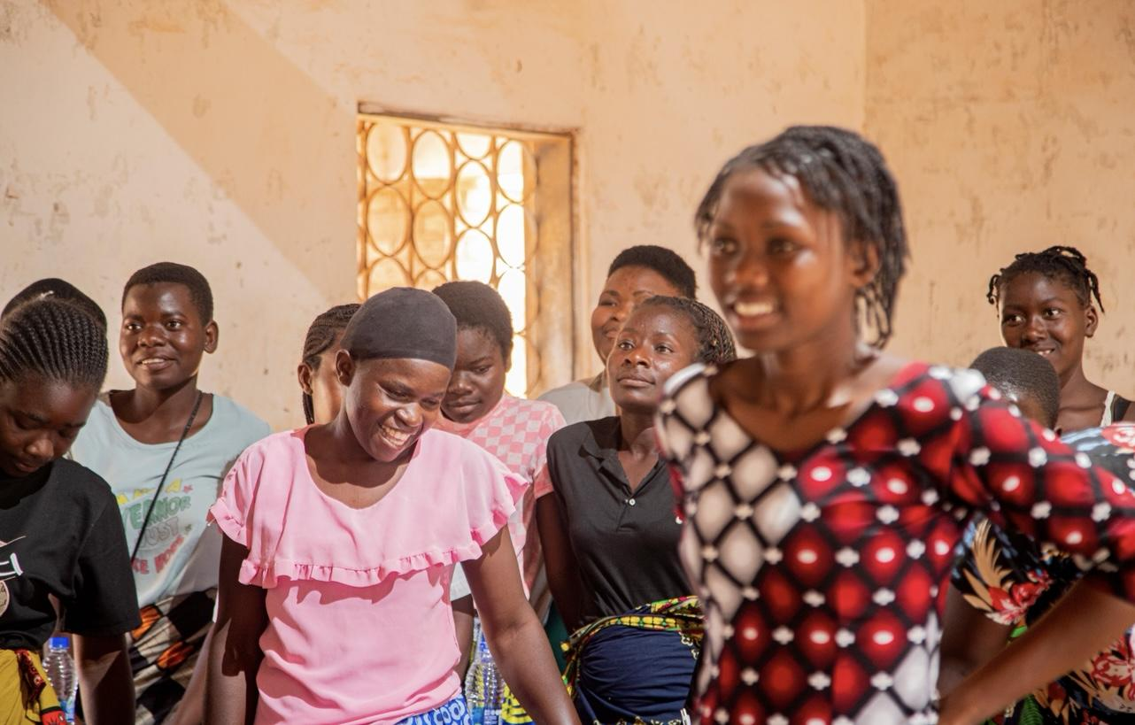
Background
Thupi Langa, Ufulu Wanga (My Body, My Rights) was implemented as part of WOSSO advocacy plan.
Implemented by the Young Feminists Network (YFN), a feminist and youth-led organization based in Malawi.
Project consisted of capacity-building and focus group discussions with young women aged 18-30 in Zomba, Blantyre and Mzuzu.
Necessitated by knowledge gap when it comes to SRHR laws and bodily autonomy, especially amongst young women in peri-urban and rural communities in Malawi.
Young women have limited access to SRHR services and are unable to challenge violations of rights because they are unaware of legal processes. This results in them suffering in silence.
Project aimed to increase legal literacy amongst young women to enable them to access SRHR services and information, and to empower them to enforce their rights.
The project also aimed to contribute to feminist movement-building in Malawi by facilitating collaboration among feminist organizations, grassroots groups, and young women.
Voice and Choice Summit 2026 \ Voice and Choice Summit 2026

Slide 3
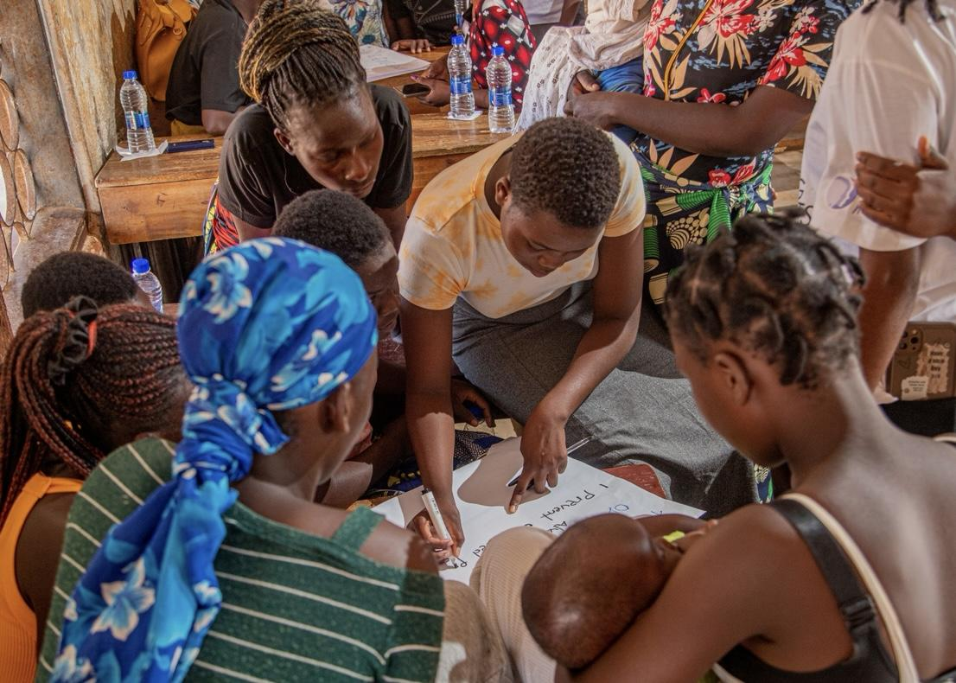
The Change
Focus group discussions were facilitated by YFN, focused on SRHR and young women's bodily autonomy.
Presentations were first made by YFN members, and then participants were split into groups in which they discussed their experiences in accessing SRHR services, their perceptions of law and stigma surrounding women's sexual and reproductive health.
Participants then came together to discuss SRHR more broadly, including strategies for improving SRHR access in their communities. Songs and dance were incorporated as tools of expression, healing, and solidarity.
Activities were primarily led by members of YFN- young feminists with a wide array of expertise. All participants were actively involved and led different sessions.
YFN also hosted a webinar aimed at building the capacity of young feminists to understand SRHR issues and to implement activities relating to legal literacy. Webinar was facilitated by YFN members and members of Nyale Institute, organisation which focuses on reproductive justice.
Voice and Choice Summit 2026 \ Voice and Choice Summit 2026

Slide 4
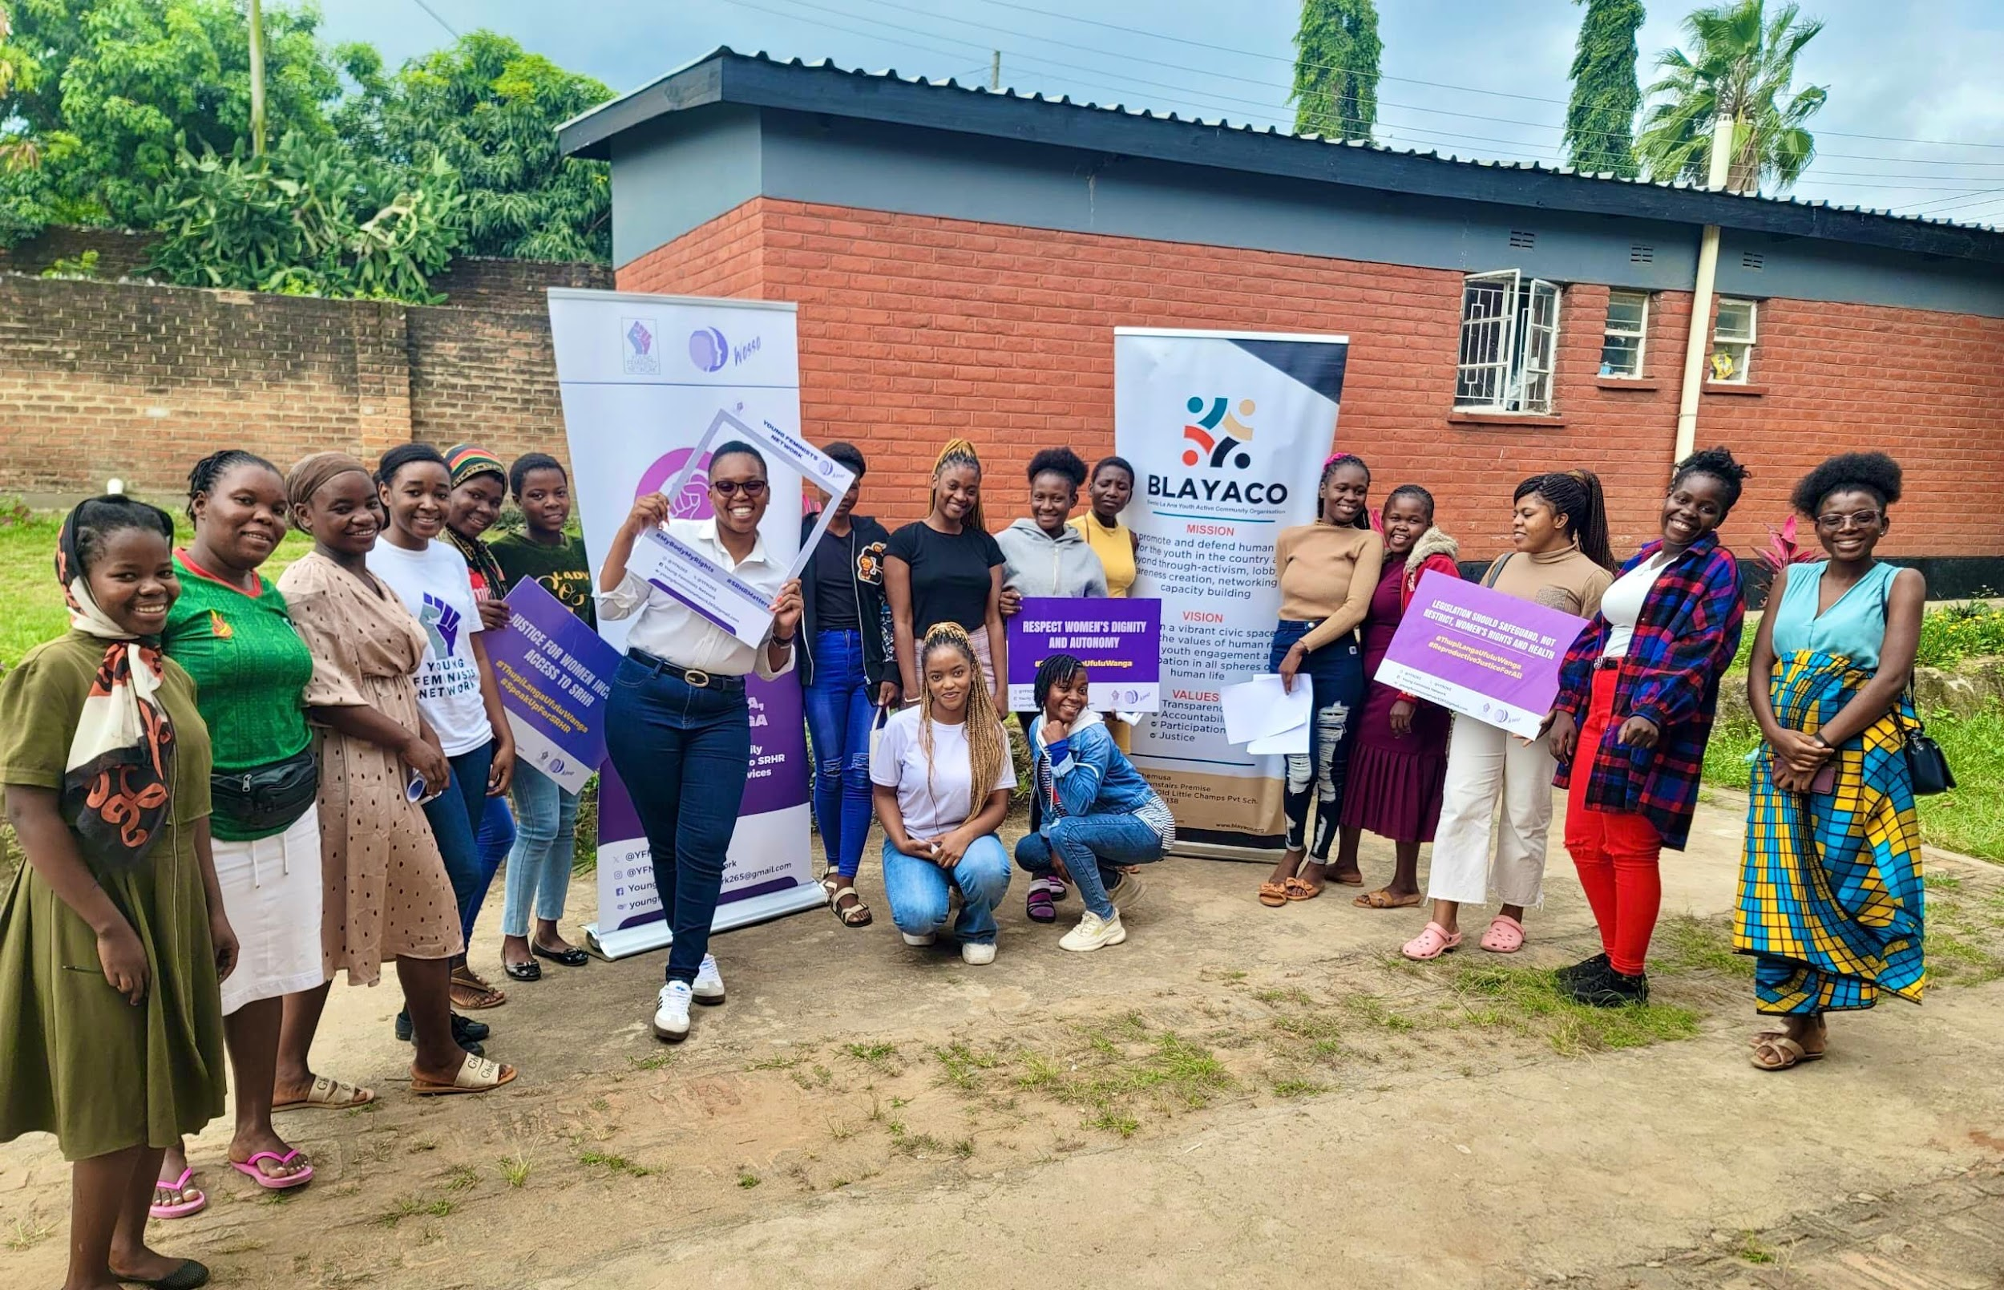
The Change
Most significant change happened during FGDs. Common theme: patriarchal norms and attitudes contribute to the stigma surrounding women's sexual and reproductive health. There was also an acknowledgement that women internalize patriarchal attitudes.
Positive shift in mindset (personal, collective). They began to view SRHR to an important part of their lives that requires their agency. Increased confidence, willingness to support peers.
Primary beneficiaries: young women participants. They gained practical knowledge, experienced emotional and psychological benefits. FGDs served as safe spaces.
Secondary beneficiaries: feminist organizations and grassroots groups that engaged with the project. Built and strengthened relationships and made a commitment to continue movement-building for SRHR. Within YFN, project contributed to institutional learning.
Before the project, SRHR was considered a taboo topic, and this resulted in a lot of misinformation, stigma and fear. Young women did not know that SRHR is a legal issue. Many young women viewed healthcare settings as intimidating.
Following the project, participants are more legally empowered and willing to engage with SRHR as rights-holders and not just passive vessels. They now have a better understanding of autonomy and agency, defeating the mentality of SRHR being an embarrassing thing to talk about or access.
Voice and Choice Summit 2026 \ Voice and Choice Summit 2026

Slide 5
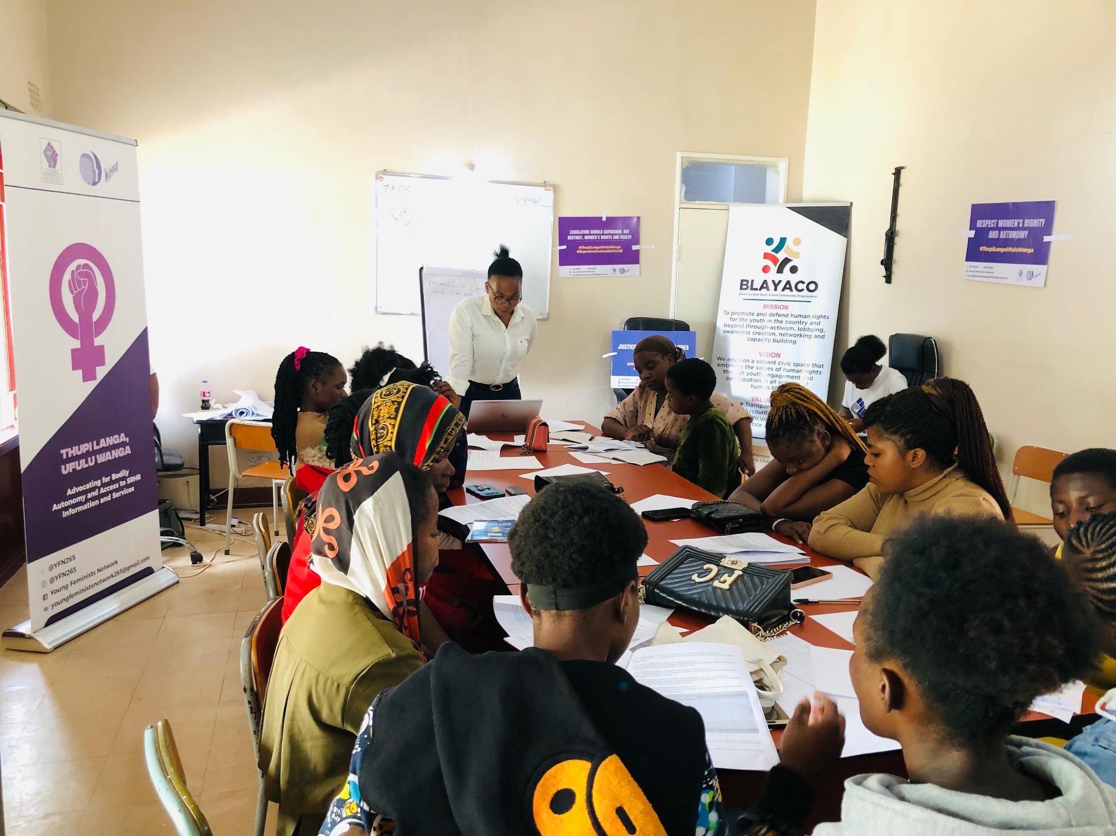
Significance of Change
By positioning SRHR as an issue to do with bodily autonomy and human rights, the project strengthens feminist advocacy and movement-building.
Young women as active citizens who can demand justice and accountability as it concerns them and their bodies.
Also significant for the broader feminist movement. By creating safe spaces for the young women to collectively analyse how stigma and patriarchal norms manifest in their lives, the project helped transform individual experiences of shame into shared political consciousness.
In line with WOSSO vision, project encouraged young women to speak out and emphasised importance of holding space for one another
Opportunity for further community-based advocacy, peer education, and strategic communications, all of which may also be geared towards legal and policy reform efforts.
Voice and Choice Summit 2026 \ Voice and Choice Summit 2026

Slide 6
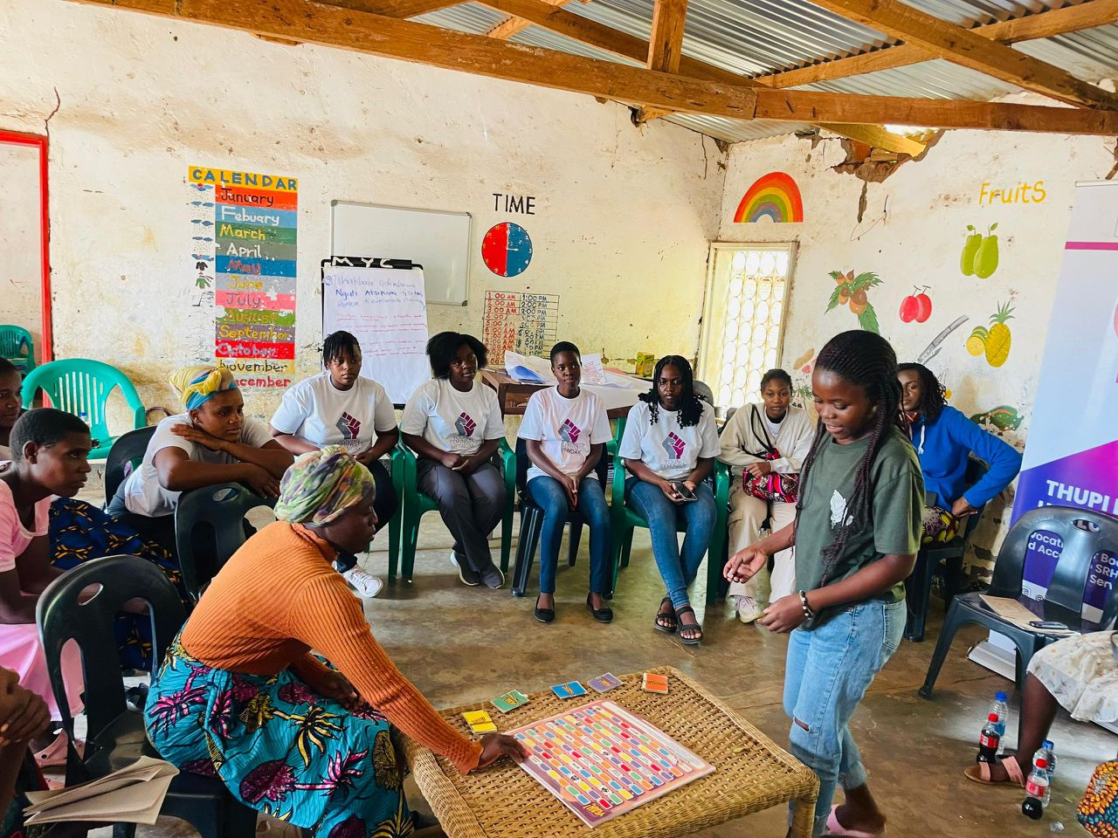
Sustainability
The legal literacy content developed through Thupi Langa, Ufulu Wanga will be incorporated into YFN's ongoing community dialogues and advocacy campaigns.
YFN will develop a toolkit in English and local languages in collaboration with other feminist groups.
Peer-to-peer knowledge sharing: Several participants expressed interest. Enables change to continue organically within communities.
YFN has built relationships has cultivated a safe space for ongoing engagement. These relationships will help in sustaining the change and will enable follow-ups and check-ins.
Project structure was low-cost and adaptable allowing us to implement in diverse contexts without specialized infrastructure.
YFN will scale the model by training additional young feminists as facilitators. YFN already has four chapters in Zomba, Blantyre, Lilongwe, and Mzuzu and will therefore use existing organizational structures to scale the project.
Voice and Choice Summit 2026 \ Voice and Choice Summit 2026

Slide 7
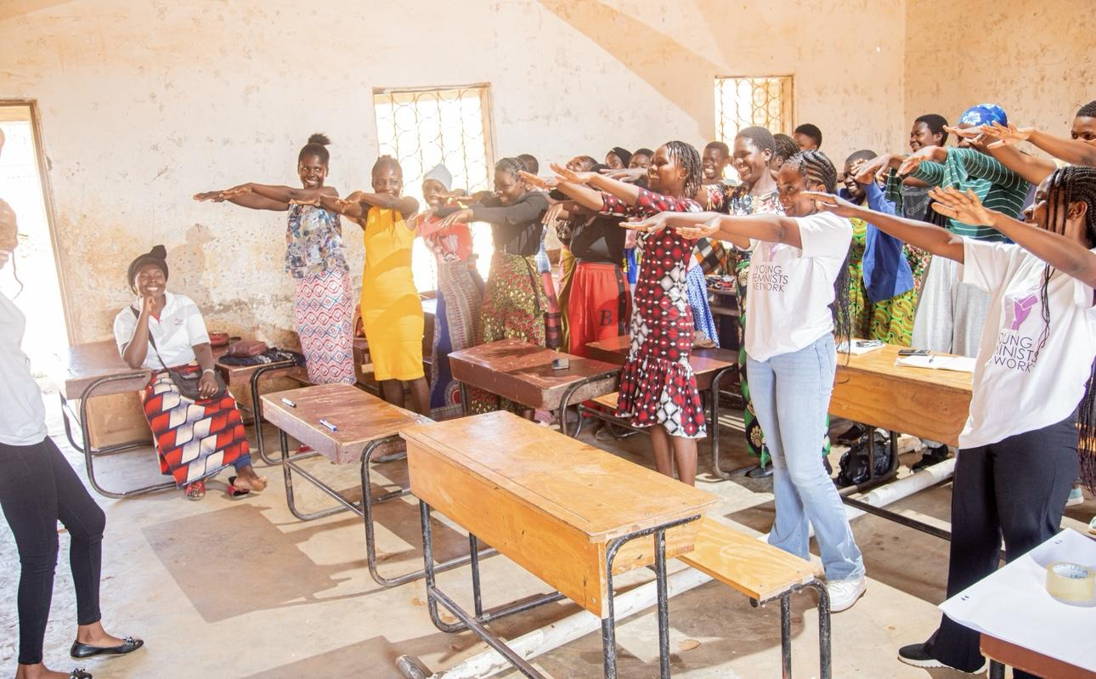
Beneficiaries
Number of;
Female – Direct beneficiaries: 95
Male – Direct beneficiaries: 0
Female – Indirect beneficiaries (e.g. through other networks): 200
Male – Indirect beneficiaries (e.g. through other networks): 50
Female – Online beneficiaries (e.g. website access, mailing lists, scholarly articles): 40
Male – Online beneficiaries (e.g. website access, mailing lists, scholarly articles): 20
Voice and Choice Summit 2026 \ Voice and Choice Summit 2026

Slide 8
Challenges & Lessons learnt
Deeply Entrenched SRHR Stigma- Framed SRHR as a human rights issue not a moral debate, centered bodily autonomy, created women-only safe spaces
Legal Literacy Gap- Simplified legal concepts into accessible language, linked rights to everyday scenarios, emphasised enforceability not just theoretical rights
Sustainability & Resource Constraints-Leveraged existing YFN chapters, encouraged peer-to-peer knowledge diffusion rather than dependency on experts
Legal reform is not enough
Safe spaces are political strategy
Collective reflection reduces shame
Voice and Choice Summit 2026 \ Voice and Choice Summit 2026

Slide 9
Next Steps
Develop Feminist SRHR Toolkit
In English and local languages
Based on lessons from the initial dialogues
In collaboration with organizations such as Nyale Institute
2. Link Community Dialogues to Policy Advocacy
Use lived experiences and insights from FGDs to strengthen research and law reform efforts
Strengthen engagement with health authorities
3. Deepen Movement-Building
Collaborate with more grassroots feminist groups
Build capacity of YFN
Share model regionally within SADC networks
Integrate SRHR legal empowerment into YFN’s core programming
Voice and Choice Summit 2026 \ Voice and Choice Summit 2026

