Slide 1


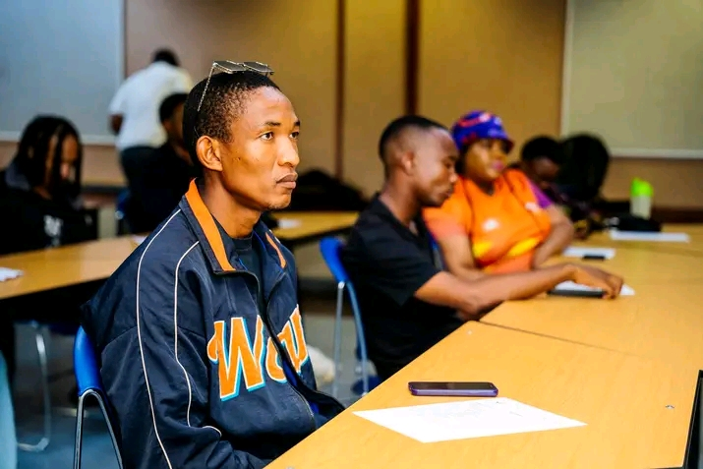
Voice and Choice Summit 2026-Leadership Category
Your logo goes here
Title/Name of the Stoty:Botswana🇧🇼Leading the way to LGBTIQ+ Inclusion For Transformational Change
Voice and Choice Summit 2026 \ Voice and Choice Summit 2026

Slide 2
Name | TUMELO DADDY THAKADU
Designation | COMMUNITY REACTOR/MOBILISER
Organisation | FRIENDS OF DIVERSITY
Country | BOTSWANA
Category | LEADERSHIP (YOUNG LEADER)
Summary | Botswana is positioning itself as a leader in promoting LGBTIQ+ inclusion, aiming to create meaningful social transformation. By advancing equality, protecting human rights, and fostering acceptance, the country seeks to drive positive change that benefits individuals, communities, and national development.
Voice and Choice Summit 2026 \ Voice and Choice Summit 2026

Slide 3
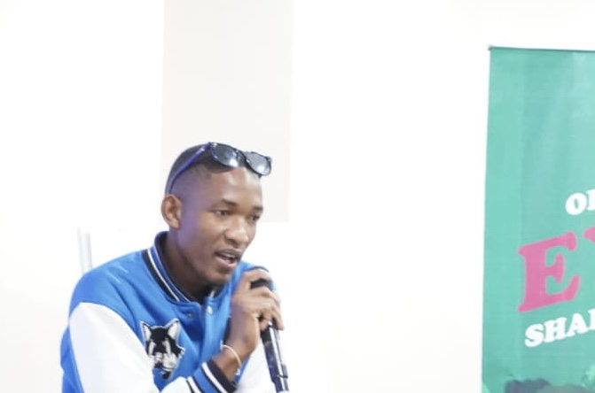
Background
About Tumelo Daddy Thakadu
Community activist and mentor
Works with Friends of Diversity
Advocate for people-powered change
Focuses on dignity, safety, and inclusion
Evidence: Include Photos or videos
Voice and Choice Summit 2026 \ Voice and Choice Summit 2026

Slide 4
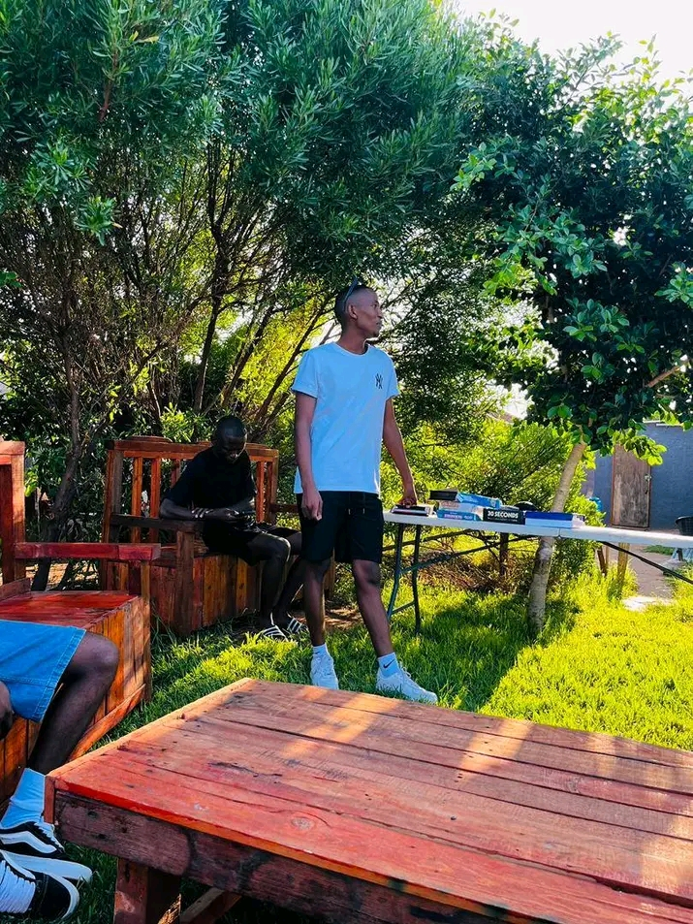
Background
Youth-led community transformation in Botswana
Focus on LGBTIQ+ inclusion and dignity
Community-powered intervention: Open Hands
Driving visibility, safety, and inclusive service access
The Challenge Before the Intervention
Isolation and stigma affecting LGBTIQ+ individuals
Limited access to affirming healthcare
Barriers to psychosocial support
Silence, fear, and invisibility in daily life
Situation
Voice and Choice Summit 2026 \ Voice and Choice Summit 2026

Slide 5

Change
The Open Hands Intervention
Community outreach in real-life spaces
Listening-first approach
Identifying service gaps in:
Healthcare,Mental health and Safety.
Direct engagement with Healthcare providers
Collaboration with teachers,social workers and frontliners
Training On respectful,affirming services
Promoting inclusive language and practices
Voice and Choice Summit 2026 \ Voice and Choice Summit 2026

Slide 6
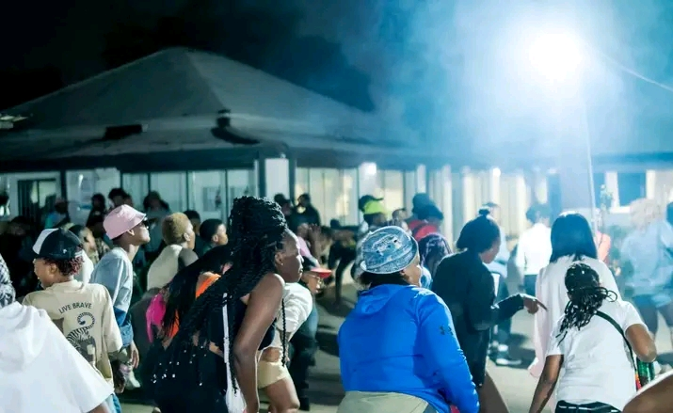
Impact
Impact Achieved
Increased LGBTIQ+ visibility
Greater access to inclusive healthcare
Growth in support groups and workshops
Improved safety and wellbeing
Reduced stigma
Creating safe and affirming spaces platforms for shared lived experience
Strengthening community solidarity
Access to accurate information impact
Increased service uptake
Higher workshop attendance
Positive community feedback
Greater inclusion in public spaces
Voice and Choice Summit 2026 \ Voice and Choice Summit 2026

Slide 7
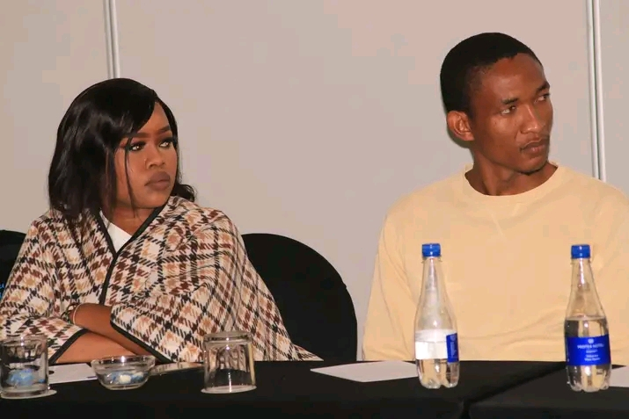
Recognition
Advocacy leadership engagement with Advocacy organisation such as BONELA and LEGABIBO
Speaking invitations at youth forums and community events
Social media impact
Voice and Choice Summit 2026 \ Voice and Choice Summit 2026

Slide 8
Challenges & Lessons learnt
Challenges
Social Stigma,Discrimination and violence
Barriers to Healthcare Access
Lack or loss of Funding and social support
Mental Health
Mitigation
Mental health awareness
Social Stigma strategies
Legal change alone does not guarantee safety and equality
Mental health services and safe spaces are essential for marginalised communities
Inclusive healthcare systems are critical for public health
Social acceptance is as important as legal rights.
Voice and Choice Summit 2026 \ Voice and Choice Summit 2026

Slide 9

Sustainability
Sustainability Strategy
Community ownership of interventions
Continuous engagement
Feedback loops
Ongoing training for service providers
Embedding inclusion in public systems
Voice and Choice Summit 2026 \ Voice and Choice Summit 2026

Slide 10
Next Steps
Scaling the Model
Collaboration with LGBTIQ+ organizations
Partnerships with human rights groups
Replication of successful models across Botswana
Long-term, durable transformation
Voice and Choice Summit 2026 \ Voice and Choice Summit 2026

