Slide 1






Logo goes here
LEARNING
AND SHARING
SUMMIT 2025
Institutional Development Template
(South Africa , Lichtenburg, 10 January 2025 and Natasha Nthutang)
Women’s Voice and Leadership Learning and Sharing Summit 2025

Slide 2
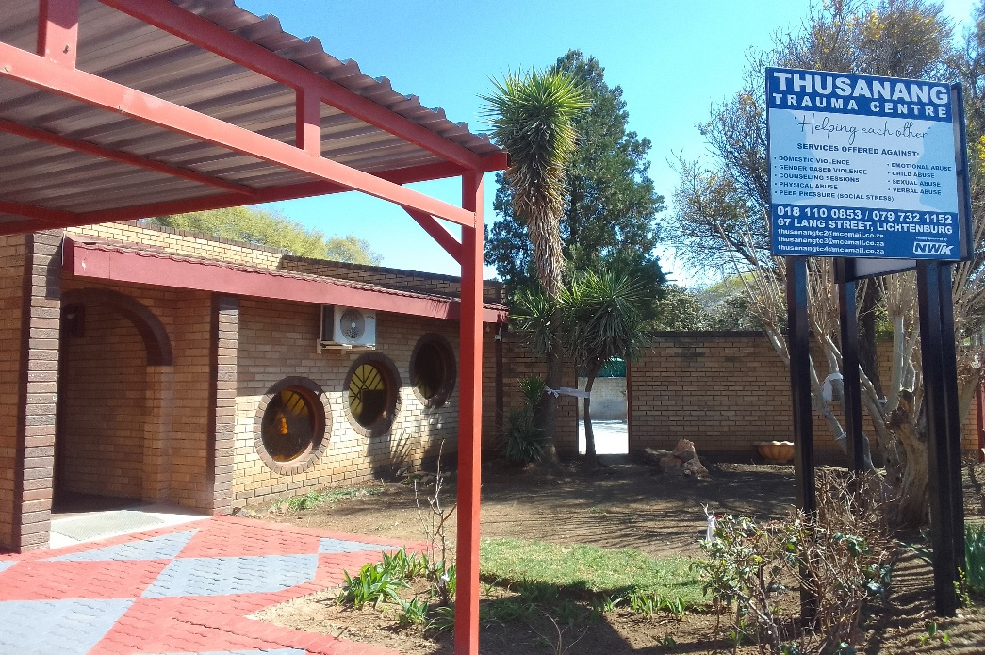
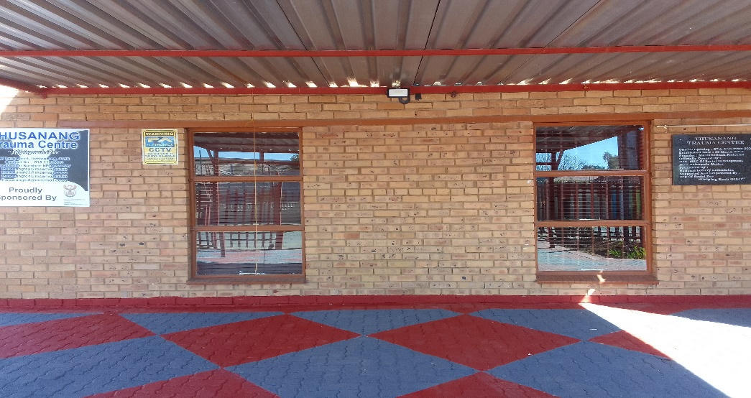
Brief background of the organisation
Thusanang Trauma Centre is a Non-Profit Organisation that was establishes in 2010,it is situated in Ditsobotla Local Municipality.
It offer its services to 21 Wards (villages, Farms and Townships)
Priority targets are abused women and children
Include photos or videos
Women’s Voice and Leadership Learning and Sharing Summit 2025

Slide 3
Institution before RWVL
Current situation- Baseline
Financial, Monitoring & Evaluation, Sexual Harassment, Recruitment Policies ,
Not registered for VAT/ the organization is a Non-Profit
SARS Tax ref no: 9020393220
Governance/board members in place and office management
The organisation has finance system in place PFMA is used and a financial policy and procurement policy as a guideline on how finances must be utilized.
Target at end line
The organisation is currently busy with registration of COIDA
Women’s Voice and Leadership Learning and Sharing Summit 2025

Slide 4
Registrations
Current situation- Baseline
The organisation is registered with SARS …..
The organization is registered as a NPO:097-587 with Department of Social Development.
FNB bank Cheque account under the name of the organisation.
Target at end line
Women’s Voice and Leadership Learning and Sharing Summit 2025

Slide 5
People and Leadership
Current situation- Baseline
Vision:From Trauma to Resilience, building a world where survivors of violence find healing, support and empowerment.
Mission: To link victims with resources and ensuring that services are accessible to empower them to take their rightful stand in the society.
The organisation is relevant as the services of the organisation are relevant to the needs of the community
The organisation in compliant and it is a legal entity.
Target at end line
Women’s Voice and Leadership Learning and Sharing Summit 2025

Slide 6
Structures, Systems, and Processes
The organization owns a building, it has office equipment's and two (02) vehicles to run the operation of the Centre.
The organization is monitored by Department of Social Development Quarterly. We also allow client to evaluate service rendered.
The organization has policies in place that are adhered to, for example
- Norms and standards
Sexual harassment Policy
Human resource Policy
Monitoring and evaluation Policy
Financial Policy
Risk Assessment Policy
Procurement Policy
Vehicle Policy
Target at end line
Women’s Voice and Leadership Learning and Sharing Summit 2025

Slide 7
Resilience, Care, and Security
Security
Information of victims are kept in locked cabinets for access control and to ensure confidentiality.
Passwords are used to mitigated unauthorized access to information.
Alarm system is used to re-enforce security, and burglars on windows and doors. The area is also monitored by CCV cameras.
Sustainability
The organization will raise funds and continue to source funds to ensure sustainability.
Target at end line
The organisation is planning to have security officers who will guard the premises for 24 hours to strengthen security before end of the year 2026
Women’s Voice and Leadership Learning and Sharing Summit 2025

Slide 8
Finance and sustainability and social entrepreneurship
Current situation- Baseline
The organisation is funded by Department of Social Development in terms of program implementation. It also depends of other funders like National Lotteries Commission for infrastructure and Vehicles.
The organisation will continue to request funds from different funders to ensure sustainability.
Financial policies and procedures are followed at all time.
The organisation renders quality service to avoid secondary victimization (value for money)
Target at end line
The organisation is planning to have income generating projects to empower victims who need financial help
(economic empowerment for victims of GBVF)
Women’s Voice and Leadership Learning and Sharing Summit 2025

Slide 9
Connections and Visibility
The organisation is visible to community members because of the community outreach programs that are conducted such as
Door to door campaigns
Information sharing
Presentations at school and churches
Radio station presentations
Media (TikTok and Facebook)
Annual General meetings are used to give feed back to donors and community members on how money was utilized and program implementation.
The organization also participate in different forums.
Women’s Voice and Leadership Learning and Sharing Summit 2025

Slide 10
GOVERNANCE charismatic
ORGANOGRAM
Organogram
Target at end line
BOARD MEMBERS 07
SOCIAL WORKER 01
PROJECT MANAGER 01
ADMINISTRATION
MANAGER 01
FINANCIAL
MANAGER 01
MEN’S COORDINATOR
01
VICTIM SUPPORTERS 06
HOUSEKEEPER 01
GROUND MAN 01
Women’s Voice and Leadership Learning and Sharing Summit 2025

Slide 11
PROGRAMME OF ACTION
Current situation- Baseline
Planning for implementation is done though weekly, quarterly and year plans
Case registers, intakes, attendance registers, monthly and annual activity reports, narrative reports and audited financial statements are used as primary source of data
Target at end line
The organisation is planning to established support groups within the community.
Women’s Voice and Leadership Learning and Sharing Summit 2025

