Slide 1







LEARNING
AND SHARING
SUMMIT 2025
Institutional Development Template
South Africa Northern Cape
Francis Baard district Municipality
Phokwane local municipality
58 Thompson Street Hartswater
4 – 7 March 2025
Mrs Irda Lebatla
Women’s Voice and Leadership Learning and Sharing Summit 2025

Slide 2
Brief background of the organisation
THABANG COMMUNITY DEVELOPMENT CENTRE is operational since 2001 and registered as a NPO 037/615 since 2005. In 2001, a group of women were concerned about the abject poverty, high levels of illiteracy, unemployment, and high levels of HIV & AIDS. This status quo prompted the women to start an organization that provided information to the communities. Since then, Thabang grew and developed to be a province wide organization that looks at the interest of the communities.
After some 10 years, Thabang renewed itself and strategically changed the name from THABANG INFORMATION CENTRE to THABANG COMMUNITY DEVELOPMENT CENTRE to incorporate its new vision and mission to ensure that they remain relevant to the people its serve. Currently
Women’s Voice and Leadership Learning and Sharing Summit 2025

Slide 3
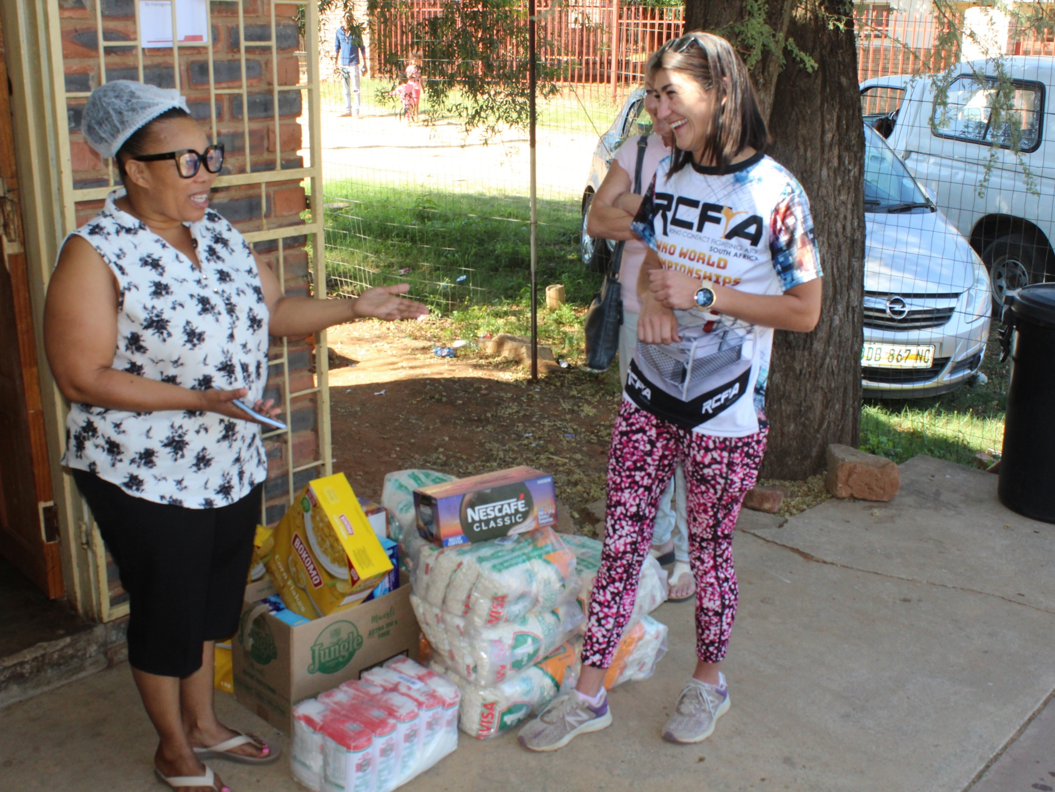

Slide 4
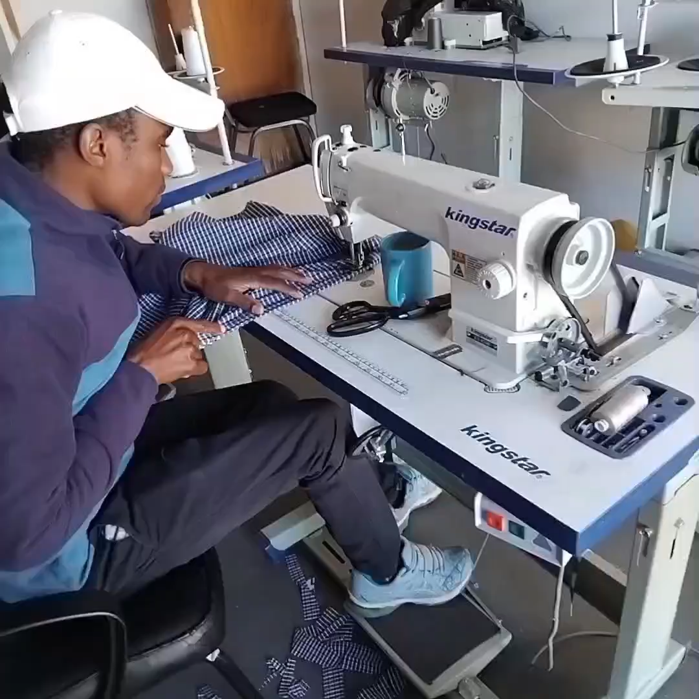
SUSTAINABILITY PLAN IN ACTION

Slide 5
Institution before RWVL
Current situation- Baseline
All HR policies are in place
VAT Registration None
In place SARS PBO, COIDA,UIF BBEE & CSD
Thabang CDC has a functional Board of Directors, which provides strategic guidance and oversight.
The organization has a clear management structure, with defined roles and responsibilities.
The Finance Department of THABANG COMMUNITY DEVELOPMENT CENTRE is committed with the director, staff, and board to ensure that all financial matters are managed with care, integrity, and consistency within the best interests of THABANG COMMUNITY DEVELOPMENT CENTRE.
VAT registration not yet register
Women’s Voice and Leadership Learning and Sharing Summit 2025

Slide 6
Registrations
Current situation- Baseline
The mention systems and documents are in place
Bank dedicated accounts are actively used
Women’s Voice and Leadership Learning and Sharing Summit 2025

Slide 7


People and Leadership
Current situation- Baseline
Vision, mission and core values is well understood.
How relevant are your strategies as an organisation
Is your organisation in compliance to all legal requirements of your work
Women’s Voice and Leadership Learning and Sharing Summit 2025

Slide 8
People and Leadership
Current situation- Baseline
How relevant are your strategies as an organisation
Thabang CDC has grown from a small information centre to a fully operational community development centre, and provide life changing services to the communities in needs, especially in areas (SDR) HIV, TB, PEP & PREP GBV support, and skills development.
The social enterprise project has started with a sewing project, handcraft , beads, ,entrepreneurs, skills programs and wanted to expand the economical activities to create job opportunities for the key and vulnerable groups
Women’s Voice and Leadership Learning and Sharing Summit 2025

Slide 9
People and Leadership
Current situation- Baseline
Is your organisation in compliance to all legal requirements of your work
Thabang CDC are complaint
Checklist in place to ensure for compliance and reviewing in specific legal areas if the need arise.
Women’s Voice and Leadership Learning and Sharing Summit 2025

Slide 10
Structures, Systems, and Processes
Current situation- Baseline
Do you have adequate infrastructure and materials to support your operations.
Thabang CDC has increased its staff complement to include project coordinators, peer educators, fieldworkers, and caregivers, indicating its ability to attract and retain talent.
The organization has relocated to new offices and owns various assets, including computers, laptops, and vehicles, demonstrating its investment in infrastructure.
The list of external source of income , applications pending and successful are available on request. Operational budget are available
Actively IT and communication system in place
Office Space for admin and services delivery
Vehicles for Outreach and other need new vehicle
Shelter & Care Facilities are provided through the referral system if needed by community
secure area for storing food medical supplies, and essential resources are enough
Women’s Voice and Leadership Learning and Sharing Summit 2025

Slide 11
Structures, Systems, and Processes
Current situation- Baseline
How robust are your Monitoring and Evaluation Systems
Attendance register will be regularly monitored updated, weekly, and monthly meetings with staff, board meeting once a quarter.
Monthly, quarterly, and annual narrative progress reports will be monitored according to the requirements.
The centre to be monitored and evaluated by a SA /social worker.
Weekly and monthly Keeping of statistics accurately to consolidate reports.
Records keeping of everything in the project (Asset’s register) and updated regularly if needed.
Minutes taking at the meeting will also serve as a monitoring reporting tool to keep the stakeholders, departments, funders, and community informed about the progress of the project.
The organization makes use of the new electronical systems namely (XERO) for all the financial reports to be monitored by the appointed auditor.
Consultative and feedback meetings with stakeholder groups and the community at large
Households’ visits on victims, survivors, and perpetrators
Surveys and complain box
Regular follow ups on court preparations and services (referrals)
Facilitate and monitoring and report the impact of victims.
Women’s Voice and Leadership Learning and Sharing Summit 2025

Slide 12
Structures, Systems, and Processes
Current situation- Baseline
Sexual Harassment Policy
Anti-corruption/Fraud Policy
Administrative and financial routines
All policies listed are in place
This policy is applicable to all personnel responsible for financial management and accounting, all managers who are directly involved with budget management and expenditure and the accounting officer of (Name of Organization).
The Board of the organization will exercise its financial responsibility with regard to the monetary and material assets of the organization.
The Board have a Finance Committee to ensure proper financial control and accountability are being implemented.
Women’s Voice and Leadership Learning and Sharing Summit 2025

Slide 13
Resilience, Care, and Security
Current situation- Baseline
What are your strategies for mitigating physical and digital security risks.
How will the institutional progress be sustained within your organisation?
Physical Security Strategie
Signed visitor book to monitor entry and exit.
Restrict unauthorized access to sensitive areas.
Use security company to patrol the premises
Daily make use of staff to patrol and report
Active emergency plans in place
Staff members are being trained Train staff and volunteers in safety procedures. proper lighting in all areas and alarm systems and outside bins to deter break-ins
Store important documents in locked cabinets.
Limitation to physical access to sensitive files.
Women’s Voice and Leadership Learning and Sharing Summit 2025

Slide 14
Resilience, Care, and Security
Current situation- Baseline
What are your strategies for mitigating physical and digital security risks.
How will the institutional progress be sustained within your organisation?
Digital Security Strategies
quarter and ensure strong passwords and enable two-factor authentication where needed.
365 firewalls and antivirus software are up to date
Encrypt sensitive data to prevent unauthorized access.
Maintain regular backups of critical information.
Use encrypted emails and secure messaging platforms.
Educate staff on identifying phishing scams.
Restrict Wi-Fi access with secure passwords.
Monitor network activity for suspicious behavior.
Staff training and awareness
Conduct regular cybersecurity workshops.
Induction conduct quarterly employees on safe internet practices and data handling.
Women’s Voice and Leadership Learning and Sharing Summit 2025

Slide 15
Resilience, Care, and Security
Current situation- Baseline
How will the institutional progress be sustained within your organisation?
Thabang CDC offers comprehensive services, and breastfeeding women
Woincluding prevention, care, and support programs. HIV, TB, and STI Prevention, Care, and Support
Thabang CDC engages with various stakeholders, including community members, government departments, and NGOs, to ensure its programs are responsive to community needs.
The organization focuses on vulnerable populations, including orphans, vulnerable children, and families affected by HIV, TB, and GBV.
Victims and survivors of GBV, including women, children, and marginalized groups.
Vulnerable populations at risk of GBV.
Women and girls
LGBTQI community
Sex workers
Children and adolescents
Pregnant men with disabilities
The organization provides skills development and training programs to empower community members.
Thabang CDC has established a social economic enterprise, which provides income-generating opportunities for community members. The organization provides skills development and training programs to empower community members.
Women’s Voice and Leadership Learning and Sharing Summit 2025

Slide 16
Finance and sustainability and social entrepreneurship
Current situation- Baseline
How diversified are your sources of funding.
How do you hope to improve your Financial Sustainability and social entrepreneurship
Financial policies and procedures
Value for money
Budget Planning in place to ensure resources are allocated efficiently and effectively.
Regular financial monitoring and reporting to track income and expenses and exercise Cost-Effective Programs make provision for unforeseen financial challenges and ensure continuity of services.
Grants from various sources, including government, private foundations, and international organizations and strengthening Donor Engagement develop targeted fundraising campaigns. Establish partnerships with businesses and corporations to secure funding and in-kind support.
Thabang CDC register the Social Enterprise: and will expand social enterprise initiatives to generate sustainable income. Request for training and capacity-building initiatives for board members.
Ensure transparent financial practices and accountability in all operations
Policy Review: Regularly review and update governance policies to align with best practices and regulatory requirements.
Stakeholder Engagement: quarterly engage stakeholders in decision-making processes to ensure their input and support.
Women’s Voice and Leadership Learning and Sharing Summit 2025

Slide 17
Connections and Visibility
Please explain if the organization effectively communicates its work to donors and participants?
Thabang CDC engages on a regular basis with various stakeholders, including community members, government departments, and NGOs, to ensure its programs are responsive to community needs.
The organization has a strong partnerships with caregivers, social workers (SW), Health facilities VEP Trauma councillors, grace crises centre and South African Police Service (SAPS).
These partnerships have been providing support to victims, ensuring timely access to medical facilities, and offering continuous follow-up on cases of violence. This collaborative approach has strengthened the centre governance and enhanced its effectiveness in addressing GBV.
Women’s Voice and Leadership Learning and Sharing Summit 2025

Slide 18
GOVERNANCE
Current situation- Baseline
Thabang CDC has a Board of Directors responsible for overseeing the organization's strategic direction, ensuring accountability, and maintaining transparency in all operations.
The Executive Management team, led by the Executive Director, is responsible for implementing the strategic plans and managing day-to-day operations.
The active steering , financial and stakeholder committees are established to provide expert guidance on specific areas such as finance, programs, and community engagement.
Regular stakeholder forums are conducted to engage community members, partners, and beneficiaries in decision-making processes and gather their input on key issues.
Thabang CDC promotes participatory decision-making by involving staff, volunteers, and community members in the planning and implementation of programs.
The organization responsible people must be transparency and accountability and given regularly feedback on its activities, financial status, and outcomes to stakeholders. Financial audits and performance evaluations are conducted to maintain high standards.
Regular democratic elections and term of office must be limited for board members to ensure fresh perspectives and prevent the concentration of power term are only 2 years.
Thabang CDC our feedback mechanisms, such as suggestion boxes questionaries, surveys and community meetings, to gather input from beneficiaries and address any concerns or grievances promptly
Women’s Voice and Leadership Learning and Sharing Summit 2025

Slide 19
PROGRAMME OF ACTION
Current situation- Baseline
Planning for implementation
Reporting and documentation
Thabang CDC Conduct needs assessments to identify the specific needs of the community and target groups to determine the actual needs of beneficiaries.
The objectives have been aligned with the overall mission and vision of Thabang CDC
Having a implementation plan to ensure timely completion of activities.
Engage stakeholders, including community members, partners, and beneficiaries, in the planning process and monitor and evaluate the progress for improvements.
Annual report Feedback to stakeholders, including the board of directors, donors, and community members.
Conduct quarterly impact assessments to evaluate the effectiveness of programs and measure their impact on the community. This helps demonstrate the value of Thabang CDC's work and attracts additional support.
Ensure accurate and transparent financial reporting, including detailed records of income, expenses, and funding sources. Financial audits should be conducted regularly to maintain credibility and trust.
Thabang CDC reports regularly on its achievements, challenges, and success stories with the broader community through social media, and public events. This helps raise awareness and support for Thabang CDC's initiatives.
Women’s Voice and Leadership Learning and Sharing Summit 2025

