Slide 1







Logo goes here
LEARNING
AND SHARING
SUMMIT 2025
(Lesotho, Refiloe Harris)
Women’s Voice and Leadership Learning and Sharing Summit 2025

Slide 2
INTRO
Human Rights are interrelated, interconnected and indivisible; just as abortion is inseparable from SRHR ie, the rest of the thematic focus areas
The rigid and restrictive abortion laws in Lesotho constitute a significant barrier to the full realization of the SRHR, which is fundamental to right to health. Ensuring comprehensive and accessible reproductive healthcare is essential for upholding human rights and advancing gender equality.

Slide 3
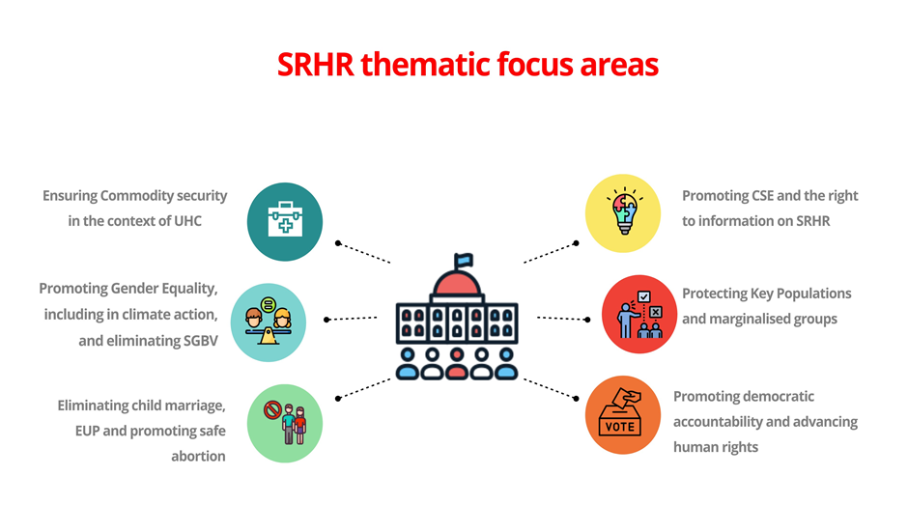
SYNOPSIS
A positive change in attitudes and significant progress towards the decriminalization of safe abortion in Lesotho, observed during the course of 2024 while implementing the “Unmuting & Amplifying Echoes of AGYW” project
“Decriminalization of Safe Abortion” advocacy grew stronger and gained more visibility and exposure. Through all its programs, She-Hive’s continued abortion advocacy has led to a number of portfolios that try to combat GBV and promote SRHR. Eg Ministry of Gender’s stakeholder engagement network.
Photo
Women’s Voice and Leadership Learning and Sharing Summit 2025

Slide 4
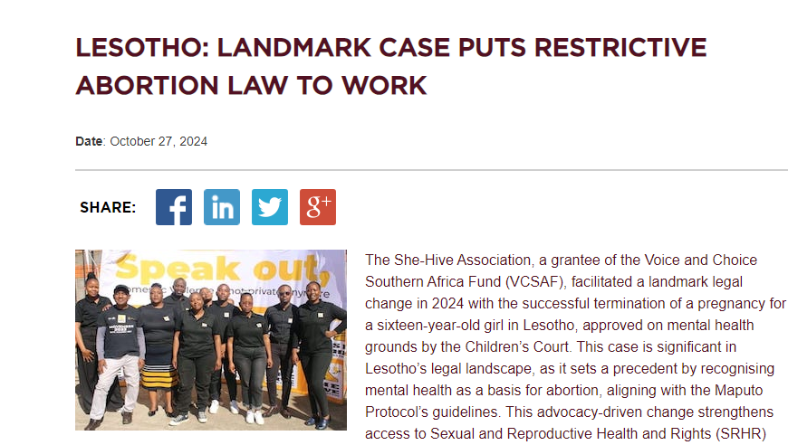
OBJECTIVES
Reduce systemic issues like stigma, stereotypes and change (influence) societal norms towards issues of abortion
Changes in, and implementation of policies and laws.
Increasing access to SRHR resources, information and services
To contribute towards of SDG goals 3, 5 and 10 by reduction of all forms of GBV, stigmatization and discrimination of young women’s SRHR related issues.
Photo
Women’s Voice and Leadership Learning and Sharing Summit 2025

Slide 5
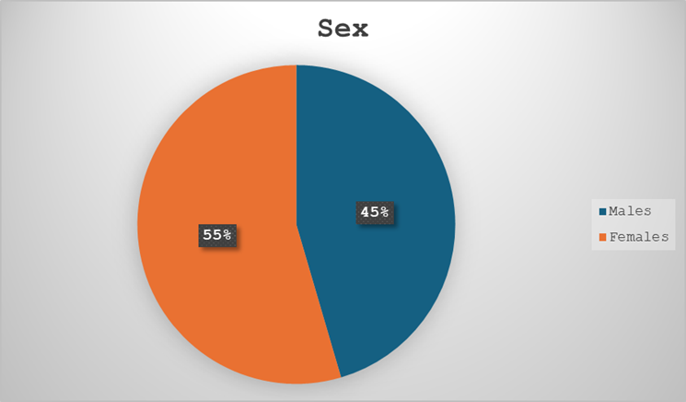
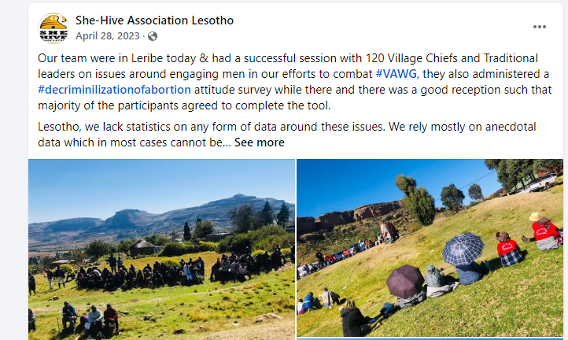
ACTIVITIES
Administering an attitude survey on community leaders, then use the analysed report to support advocacy – having 45% male agreeing to participate in the survey was a big win
Provide PSS and use the case management report to pursue advocacy – 16 years old girl who fell pregnant due to trauma bonding, but we succeeded to get a court order for the termination of the pregnancy
Host a number of dialogues to engage participants on safe abortion related topics – physical, social and mass media dialogues were hosted
Photo
Women’s Voice and Leadership Learning and Sharing Summit 2025

Slide 6
Contribution to change
SESSIONS WITH COMMUNITY LEADERS: focused on equipping them with knowledge and strategies to advocate for policy change as most mentioned that they are overburdened with cases of unsafe abortions in communities they are leading.
Invited to serve in a number of National & International portfolios:
DATA ANALYSIS: data collected from community leaders through questionnaires was analysed to understand their perceptions, attitudes and level of knowledge abortion laws and their impact. The findings showed understanding of the concept, there was a notable support for abortion in specific situations like rape or life-threatening conditions. Opinions on abortion legality were mixed, with a slight majority favouring legalisation.
Mass & Social Media: the aim was to raise awareness and engage the general public on the importance of decriminalisation of safe abortion. The show provided a platform for open dialogue, addressing misconceptions and fostering understanding among listeners about the socio-economic and health impacts of unsafe abortions
Women’s Voice and Leadership Learning and Sharing Summit 2025

Slide 7
Population Group this change most closely related to
Category | Women | Men | Total | % Women
Direct beneficiaries | 142 | 58 | 200 | 72
Indirect beneficiaries (e.g. through other networks) | 886 | 661 | 1547 | 57
Online beneficiaries (e.g. website access, mailing lists, scholarly articles)
Total | 1028 | 719 | 1747 | 61
Women’s Voice and Leadership Learning and Sharing Summit 2025

Slide 8
Significance of change
Community leaders were actively involved in sharing their insights and commitments to influencing grassroots attitudes, this observed in the high number of active participation in the baseline & end line assessment tool we administered during the very info sessions.
The National Working group of the SADC PF SRHR project in Lesotho, SAASA interim committee and country representative, invitation to give a presentation at Gender’s Stakeholder Forum on Safe abortion.
A 16 years old girl diagnosed with trauma bondage was granted a court order for administration of abortion through our continued advocacy throughout our programs (PSS). The first time that financial and mental issues are considered grounds for abortion in Lesotho).
The ministry of gender’s involvement (supported by GIZ,) which has seen the formation of a stakeholder engagement in advocating for decriminalization of safe abortion. Marks a milestone as the conversation has started within the state.
Access to abortion related information and statistics from relevant line ministries like Ministry of health is easily accessible because of our involvement network (stakeholder engagement)
Women’s Voice and Leadership Learning and Sharing Summit 2025

Slide 9
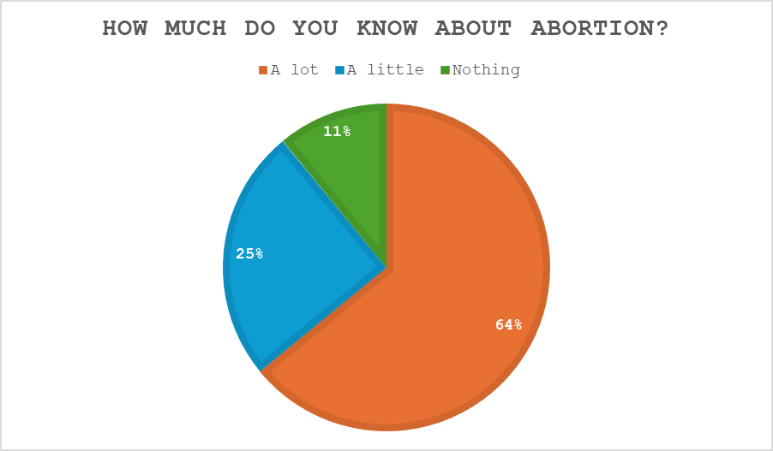
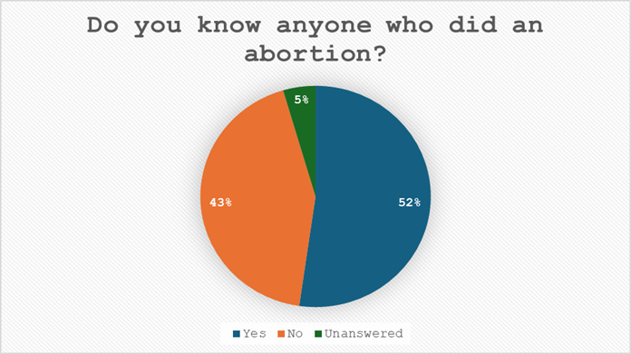
RESULTS
Women’s empowerment
A 16 years old girl who was granted abortion due to her financial and mental situations reduced her bearing the brunt of responsibility while she is a child herself
Public participation
Radio shows, facebook postings and tiktok engagements and Community leaders participation invoked dialogues within their communities.
Media coverage (including social media)
Tiktok participation, facebook postings, radio shows and print media
Tool administration
A few responses linked abortion to societal issues like unplanned pregnancies, rape, and conflicts, while most village chiefs noted visible outcomes like abandoned corpses. Overall, the responses reflect diverse levels of understanding and attitudes toward abortion
Women’s Voice and Leadership Learning and Sharing Summit 2025

Slide 10
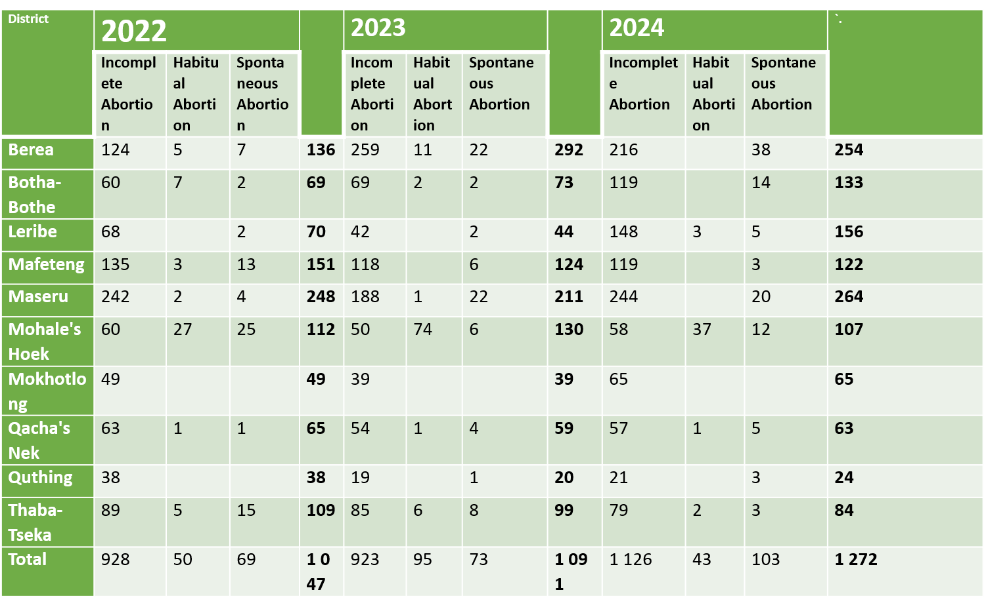
Evidence
16 years old girl who fell pregnant due to trauma bonding, but we succeeded to get a court order for the termination of the pregnancy
We influenced Gender’s Anti-GBV Stakeholder Coordination to have safe abortion as one of the topics hence the Stakeholder Consultative Forum on Safe Abortion and Prevention of Sexual and Gender Based Violence
Take on the human rights violation perspective and the social stigma/norms linking to GBV
Most of the districts where we engaged communities and capacitated community leaders about Safe Abortion in an effort to change their perspective about abortion have an increase in the number of post abortion care admissions.
Women’s Voice and Leadership Learning and Sharing Summit 2025

Slide 11
CHALLENGES AND LESSONS LEARNT
Stigma towards abortion is still rigid and persistent as some funders resist any participation by their grantees e.g LPPA could not honor our invitations as a stakeholder because of terms of their contract with a funder who did not want them being a part of any abortion advocacy activities.
There is still, vigorous, need for sensitization withing media entities as some Radio presenters demonstrated their biases on abortion making it difficult to carry the media advocacy, coarse through during some of the radio shows. (more on the defensive side than educational side)
With enough and or relevant support, the abortion advocacy can grow bigger
Women’s Voice and Leadership Learning and Sharing Summit 2025

Slide 12
CHALLENGES AND LESSONS LEARNT
What lessons have been learned?
The National Security Services were making implementation uncomfortable when they were asking about our participants, their contacts and places of our implementation, means we should have had a more intense stakeholder engagement. Our focus was more on community leaders
The media needs to be capacitated to be gender sensitive or to be professional about expressing their opinion while being presenters
Administering an attitude survey on community leaders, then use the analysed report to support advocacy – having 45% male agreeing to participate in the survey was a big win
Women’s Voice and Leadership Learning and Sharing Summit 2025

Slide 13
SUSTAINABILITY AND REPLICATION
Use our role as part of the Southern Africa Safe Abortion Alliance Committee member (the committee was founded by VCSA grantees) to continue advocacy for “decriminalisation of safe abortion
Consultative Stakeholder Forum on Safe Abortion and SGBV prevention by Department of Gender supported by GIZ
We hope to have sessions with community leaders of three more districts where have just recently established new relationships with the aim to introduce all our programming & projects.
Resource mobilisation for the continuation of the “UNMUTING AND AMPLIFYING ECHOES OF AGYW- ADVOCACY FOR DECRIMINALISATION OF SAFE ABORTION”
Women’s Voice and Leadership Learning and Sharing Summit 2025

Slide 14
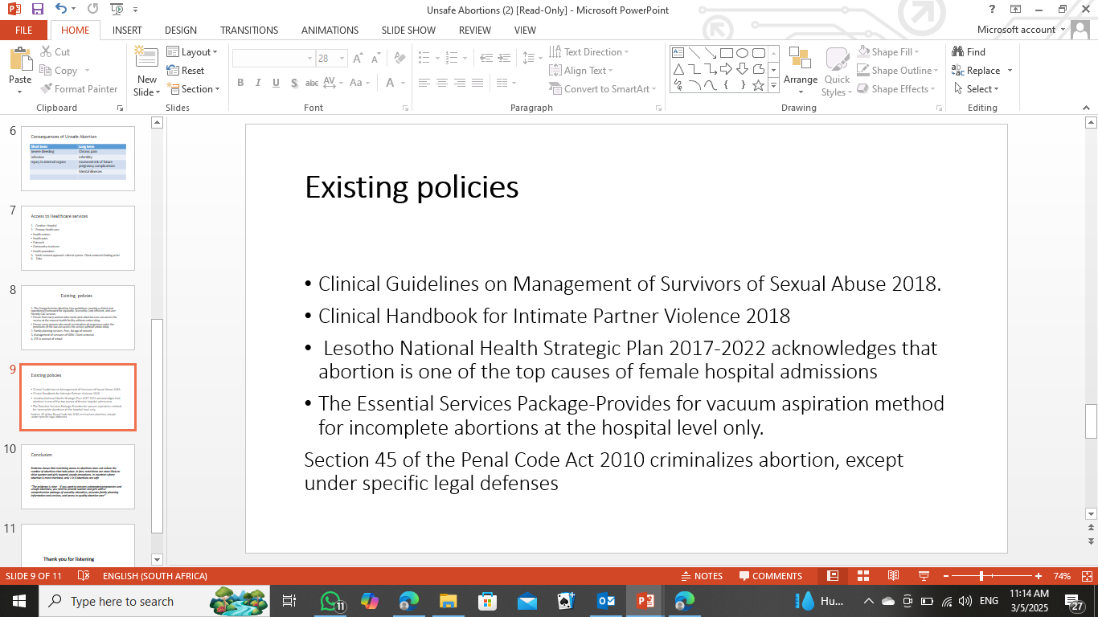
NEXT STEPS
Sensitization of media personnel on abortion related issues
Exerting more pressure on the Ministry of gender to continue the conversation in the stakeholder (network) engagement.
To inform community leaders and general community of existing safe abortion related policies
Women’s Voice and Leadership Learning and Sharing Summit 2025

