Slide 1







LEARNING
AND SHARING
SUMMIT 2025
Organization: Coalition for Women Human Rights Defenders Tanzania
Country – Tanzania
City - Dar es Salaam
Presenter: Hilda Stuart Dadu, National Coordinator
Women’s Voice and Leadership Learning and Sharing Summit 2025

Slide 2
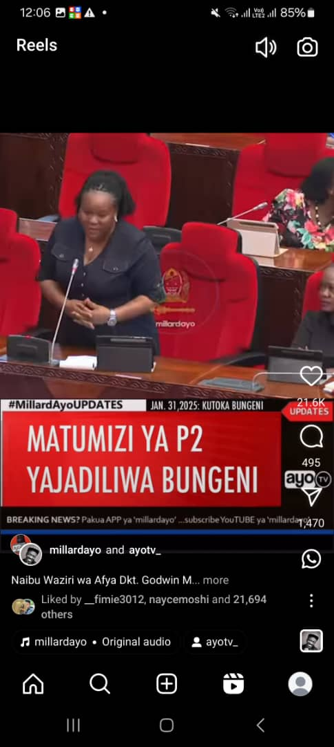
SYNOPSIS
For the first time in history, Tanzanian Parliament has openly discussed the need for legal transformation to allow termination of pregnancy in case of rape or incest.
The discussion was brought by member of Parliament Felister Njau during ordinary sessions of Tanzania Parliament in Dodoma on 31st January 2025
Women’s Voice and Leadership Learning and Sharing Summit 2025

Slide 3
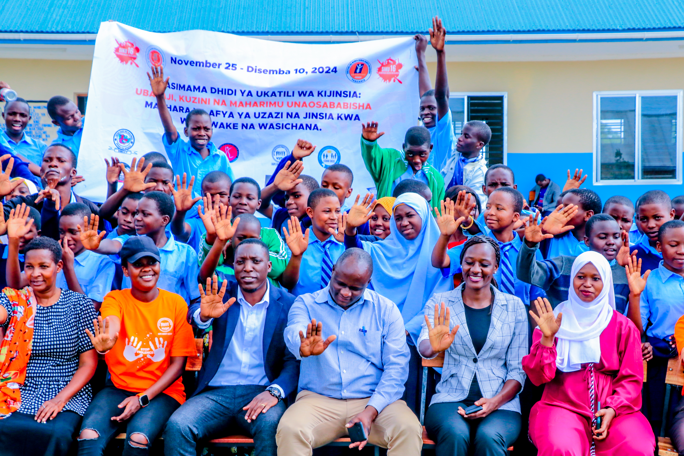
OBJECTIVES
The project was about building vibrant repro rights movement in Tanzania.
The project expected to reduce discrimination and stigma and legal barriers for safe abortion and post abortion services in Tanzania to save women and girls lives
Women’s Voice and Leadership Learning and Sharing Summit 2025

Slide 4
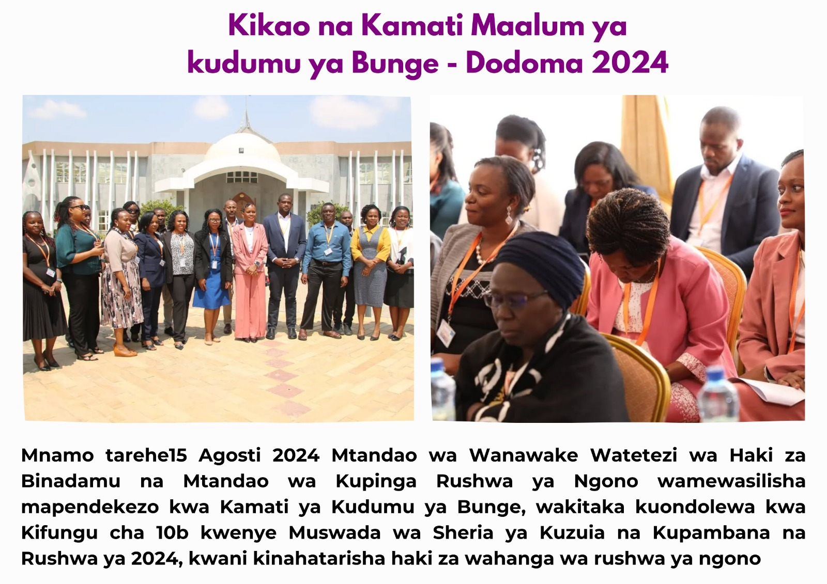
ACTIVITIES
Documented Incest and Rape Cases in Tanzania to justify the increase of unsafe abortion
Engaged Parliamentary Committee responsible for health and gender on SRHR legal changes
Joined litigation case under Sexual Reproductive Right to challenge legal barriers for women and girls access to SRHR particularly legal safe abortion
Trained Women Human Rights Defenders on public interest strategic litigation to increase allies on SRHR advocacy through litigation
Created public awareness on the need for legal transformation to increase women access to SRHR services
Women’s Voice and Leadership Learning and Sharing Summit 2025

Slide 5
Contribution to change
The Coalition contributed documents on Incest and Rape Cases in Tanzania to justify the increase of unsafe abortion for strategic public interest litigation case on safe abortion under Sexual Reproduction Group .
The Coalition joined other stakeholders to engage Parliamentary Committee responsible for health and gender on SRHR legal changes
The empowerment of Women Human Rights Defenders on strategic public interest litigation increased allies on SRHR advocacy throughout the country
Public awareness created through various media particularly social media and IEC materials on the need for legal transformation to increase women access to SRHR services reached out to the policy and decision makers
Women’s Voice and Leadership Learning and Sharing Summit 2025

Slide 6
Population Group this change most closely related to
Category | Women | Men | Total | % Women
Direct beneficiaries | 1,551 | 99 | 1,650 | 94%
Indirect beneficiaries (e.g. through other networks) | 425 | 75 | 500 | 85%
Online beneficiaries (e.g. website access, mailing lists, scholarly articles) | 4,729 | 3,152 | 7,882 | 60%
Total | 6,705 | 3,152 | 10,032 | 66.8%
Women’s Voice and Leadership Learning and Sharing Summit 2025

Slide 7
Significance of change
The parliament discussion is significant for the advocacy on legal transformation, as it can increase confidence among members of Reproductive Health Group to continue with advocacy through strategic public interest litigation.
The discussion is an entry point for Coalition’s further engagement of policy and decision makers.
As one of the most viewed and followed institutions through media, Parliament debate has a potential to increase public awareness on the SRHR issues addressing norms and traditions which avoided public to speak out on issues related to abortion.
Women’s Voice and Leadership Learning and Sharing Summit 2025

Slide 8
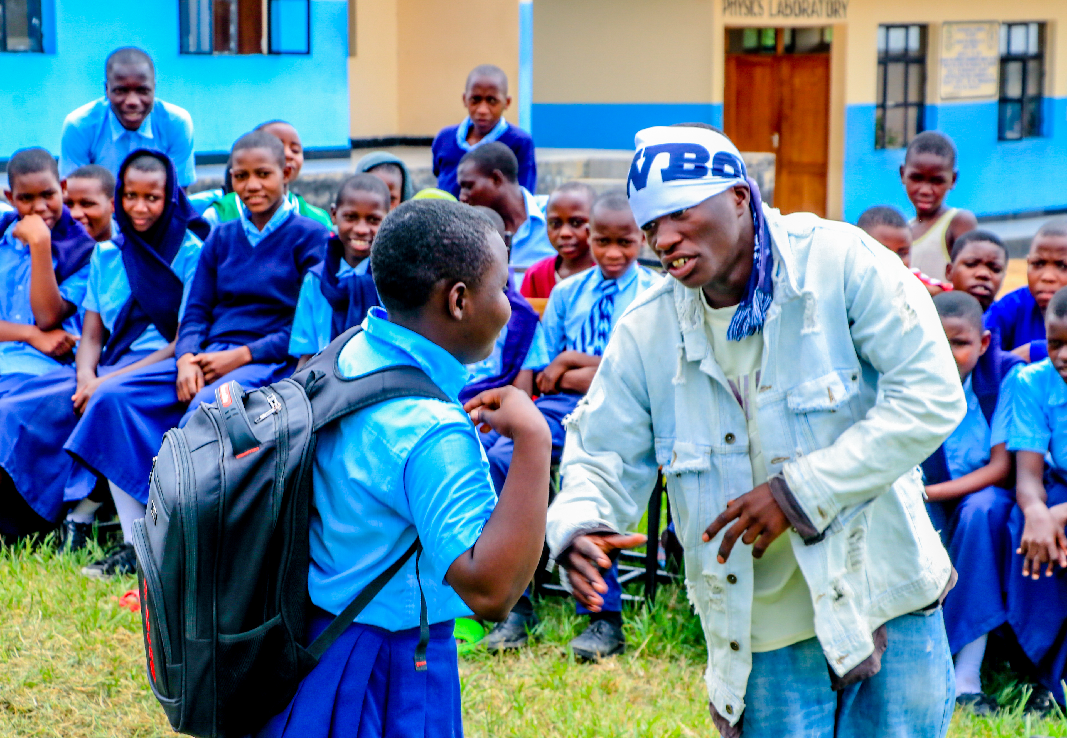
RESULTS
500 Incest and Rape in relation to unsafe termination of pregnancy produced for evidence based advocacy on SRHR
30 women human right defenders empowered on public interest litigation
500 factsheets to guide women human right defenders and increase awareness on SRHR legal barriers printed and distributed
Women Human Rights Defenders supported to organize theatre for development to create public awareness on SRHR
Report on Incest and Rape incidents in relation to termination of pregnancy in Tanzania
https://www.cwhrds.or.tz/documents/CWHRDs%20TZ%20Incest%20&%20Rape%20SRHR%20Report%20-%20Final%2025.07.2023%20b.pdf
Women’s Voice and Leadership Learning and Sharing Summit 2025

Slide 9
Evidence
Social media publications have contributed to the increased awareness among the public include policy and decisions makers. The evidence are some of social media published by the Coalition during its interventions
Online media have also indicated evidence of project results
https://swahilitimes.co.tz/2024/02/dkt-mollel-serikali-inalifanyia-kazi-suala-la-sheria-kuruhusu-utoaji-mimba/
https://habarileo.co.tz/utoaji-mimba-unachangia-10-ya-vifo/
https://www.facebook.com/photo/?fbid=760181232953624&set=pcb.760181306286950
https://www.facebook.com/photo.php?fbid=760181236286957&set=a.402596535378764&type=3
https://www.instagram.com/p/DDJXU89qK7H/?utm_source=ig_web_copy_link&igsh=MzRlODBiNWFlZA==
Women’s Voice and Leadership Learning and Sharing Summit 2025

Slide 10
CHALLENGES AND LESSONS LEARNT
What have been the main challenges? How have these challenges been overcome?
Donor Priorities: Ever changing donor priorities affecting advocacy on SRHR. Coalition networks in advocacy have sometimes affected by lack of resources. This prompted Coalition to increasingly approach Donors interested in SRHR in Tanzania to support legal review to eliminate legal barriers for women to access safe SRHR services.
Human Rights Legislation: Changes in human rights laws and their enforcement impacting SRHR rights and protections. CWHRDs has joined force with other reproductive rights defenders to litigate the case against the discriminatory penal law that restrict girls and women to access safe service.
Advocacy and Activism: Strengthening or weakening of coalitions and networks that support the SRHR movement due the regional and country changing context. Coalition has increased the resilience to WHRDs members of the Coalition and RRD through empowerment and capacity building in advocacy focusing on SRHR and removal of legal barriers and Strategic Litigation. Coalition has worked with the UN Health for all Group to establish a SRHR movement by using Universal Periodic Reports
Women’s Voice and Leadership Learning and Sharing Summit 2025

Slide 11
CHALLENGES AND LESSONS LEARNT
What lessons have been learned?
Local, Regional and international alliances are important in advocating for changes particularly when addressing SRHR issues
Changing donor priorities can heavily affect advocacy work around SRHR
Women’s Voice and Leadership Learning and Sharing Summit 2025

Slide 12
CHALLENGES AND LESSONS LEARNT
How will the lessons learned be applied?
Continue to forge regional and international alliances in addressing SRHR issues as sometimes changing local context can affect advocacy around SRHR
Continue to work in alliances to share resources as well as increase diversity of sources of income
Women’s Voice and Leadership Learning and Sharing Summit 2025

Slide 13
SUSTAINABILITY AND REPLICATION
How can the work be sustained/kept going?
How can the work be cascaded to other organisations?
Coalition has increased skills of advocacy to WHRDs who are likely to continue to carry out advocacy work within their organizations
The Coalition has fundraised from two sources to support the work around SRHR advocacy
Women’s Voice and Leadership Learning and Sharing Summit 2025

Slide 14
NEXT STEPS
To continue advocacy on SRHR using international mechanism such as UPR as evidenced in the social media link on the continuing of SRHR activities this year 2025
https://www.facebook.com/photo.php?fbid=902238785414534&set=a.402596535378764&type=3
https://www.facebook.com/photo.php?fbid=902238798747866&set=a.402596535378764&type=3
Women’s Voice and Leadership Learning and Sharing Summit 2025

