Slide 1



Voice and Choice
Summit 2026-Story of Change Category
Title/Name of the Story
Flow Without Fear: Advocacy for Menstrual Health and Bodily Right
(South Africa, Johannesburg, 16 March 2026- Carren Liando)
Voice and Choice Summit 2026 \ Voice and Choice Summit 2026

Slide 2
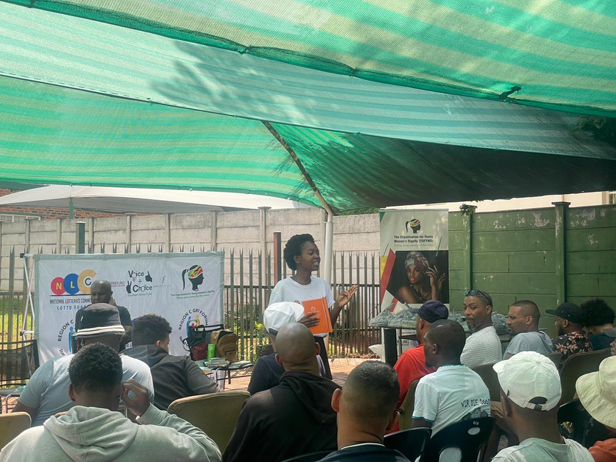
Background
What were the key objectives of the project?
Implement an advocacy plan that supports organizational growth, introduces news ideas and adopts innovative and participatory facilitation appraches.
Eradicate period poverty and ensure girls and young women can fully participate in education and community life.
Engage men and boys to challenge harmful gender norms, promote positive masculinity, and advance gender equality
To strengthen SRHR community level by engaging community leaders and young people to increase awareness and advocacy
What were the situation before
The organization was already implementing one-day SRHR and menstrual health interventions to young women and girls in schools, churches, and low-income communities.
Initial sessions with men and boys had begun to introduce conversations on SRHR and gender equality.
However, the programmes were not yet fully structured or expanded for long-term engagement and wider community impact.
The project was and is still implemented in the Northen Johannesburg
Evidence: Include Photos or videos
Voice and Choice Summit 2026 \ Voice and Choice Summit 2026

Slide 3
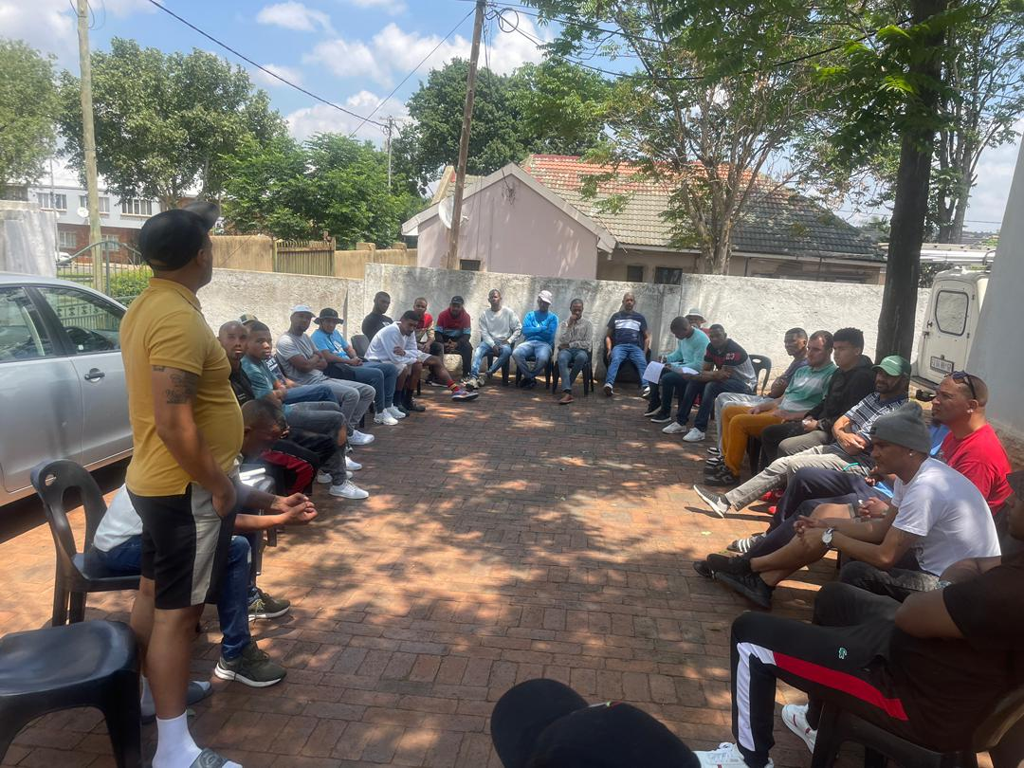
Background
Who was most affected by the problem and how?
Young people, women and men across all age groups
One day programs had impact but data and stories of change were not consistently capture
Limited data affected future planning and evidence-based decision making
Previously, all participants were under a single SRHR project: now, distinct projects have expanded the organization’s reach.
Project H.I.M (Project Health, Intergrity and Masculine) was birthed through the advocacy plan focusing on men and boys in challenging harmful masculinity and social norms
What issue(s) did the project address?
Strengthened data collection and monitoring systems to better capture program outcomes and stories of change
Address gaps in menstrual health education, access to sanitary products and community engagement, particularly with men and boys
Brough in innovative ideas and approaches through the fellowship, improving evidence-based planning and overall organizational impact
Expanded the organization’s programmatic scope by introducing new SRH initiatives reaching diverse age groups and genders
Evidence: Include Photos or videos
Voice and Choice Summit 2026 \ Voice and Choice Summit 2026

Slide 4
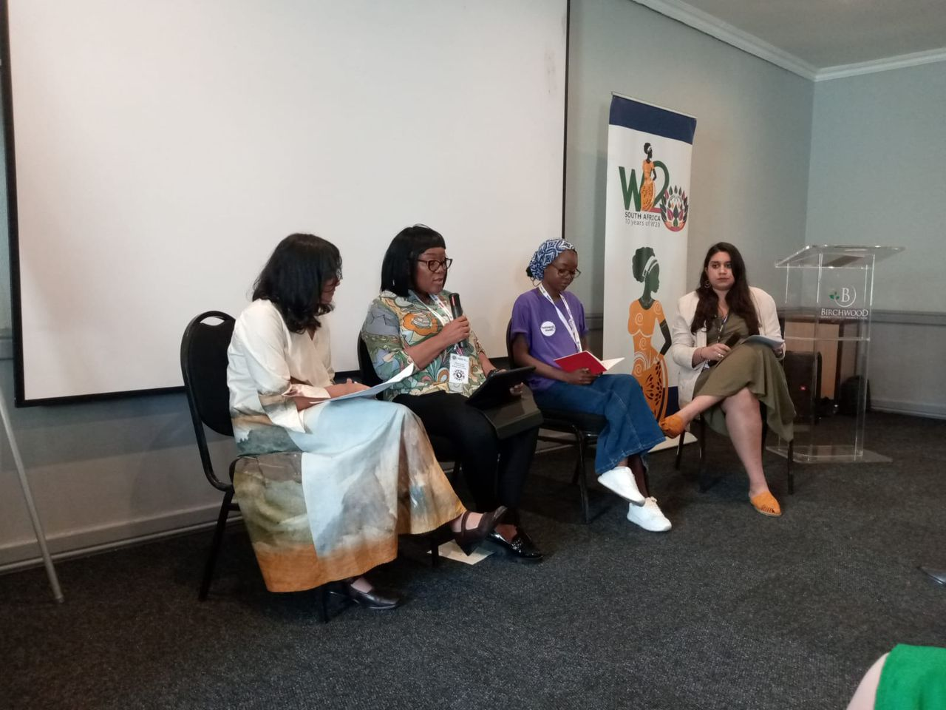
Change
• What activities or actions brought about the change?
RWVL WOSSO fellows are implementing projects within their organizational, existing budget. Fortunately, Genderlinks provided the fellows to participate in big spaces like the W20, G20, and Beijin Plus 30.
Received exposure, created partnerships, networking and learning. Had direct communication with Shoprite Holding CEO at the W20 who shared contacts of powerful people within the SRHR spaces and assisted in purchasing dignity packs.
Through WOSSO, PUSH FORWARD FOR EQUALITY it is providing young people to write blogs and highlight issues, drawing attention to spaces like W20 and increasing TOFYWD’s recognition.
Participated in Beijing +30, gaining communication experience and learning best practices, bringing new ideas and international exposure to the organization.
Evidence: Include Photos or videos
Voice and Choice Summit 2026 \ Voice and Choice Summit 2026

Slide 5
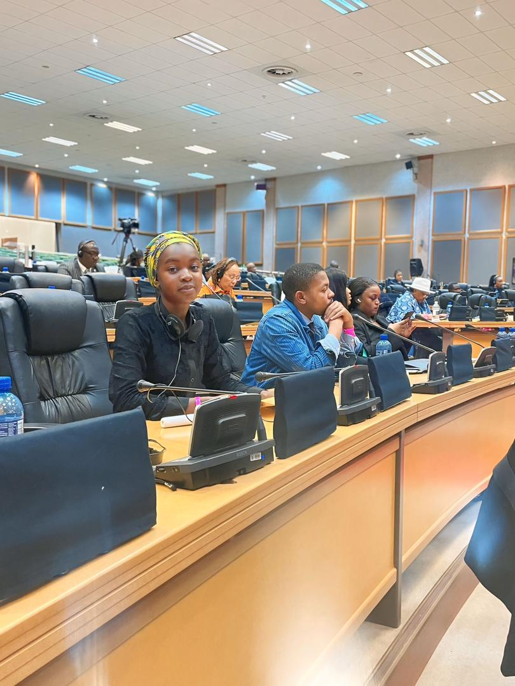
The change
Evidence: Include Photos or videos
Who led and participated in bringing about the change.
Leadership of the Intervention The Fellow led the initiative by designing key tools including a consent form, Gender Attitude Survey (pre and post), and an SRHR Knowledge and Attitudes Questionnaire to measure impact and guide the sessions.
Community Participation The program engaged traditional leaders, men and boys, and women beneficiaries who actively participated in discussions on Sexual and Reproductive Health and Rights (SRHR) and positive masculinity.
Interventions Implemented The first sessions were conducted in November and December, focusing on SRHR awareness, challenging harmful gender norms, and strengthening community leadership. Follow-up sessions will take place in March.
Sustainability Through Empowerment After completing the sessions, participants will join economic empowerment programs. Women will receive additional skills training such as baking, soap making, sewing, and other livelihood skills, facilitated by identified local women and organizations.
Voice and Choice Summit 2026 \ Voice and Choice Summit 2026

Slide 6
Significance of Change
Please provide further information on what this change means for the movement and its goals
Community Champions: Men and boys who participated are becoming trusted voices promoting SRHR, gender equality, and positive masculinity in their communities.
Shifting Attitudes: The change shows progress in challenging harmful gender norms and encouraging healthier, respectful relationships.
Community Ownership: The movement is now supported not only by organizations but also by community members who influence others.
Advancing the Movement’s Goals: This contributes to reducing gender-based violence, increasing SRHR awareness, and building long-term community leadership.
Evidence: Include Photos or videos
Voice and Choice Summit 2026 \ Voice and Choice Summit 2026

Slide 7
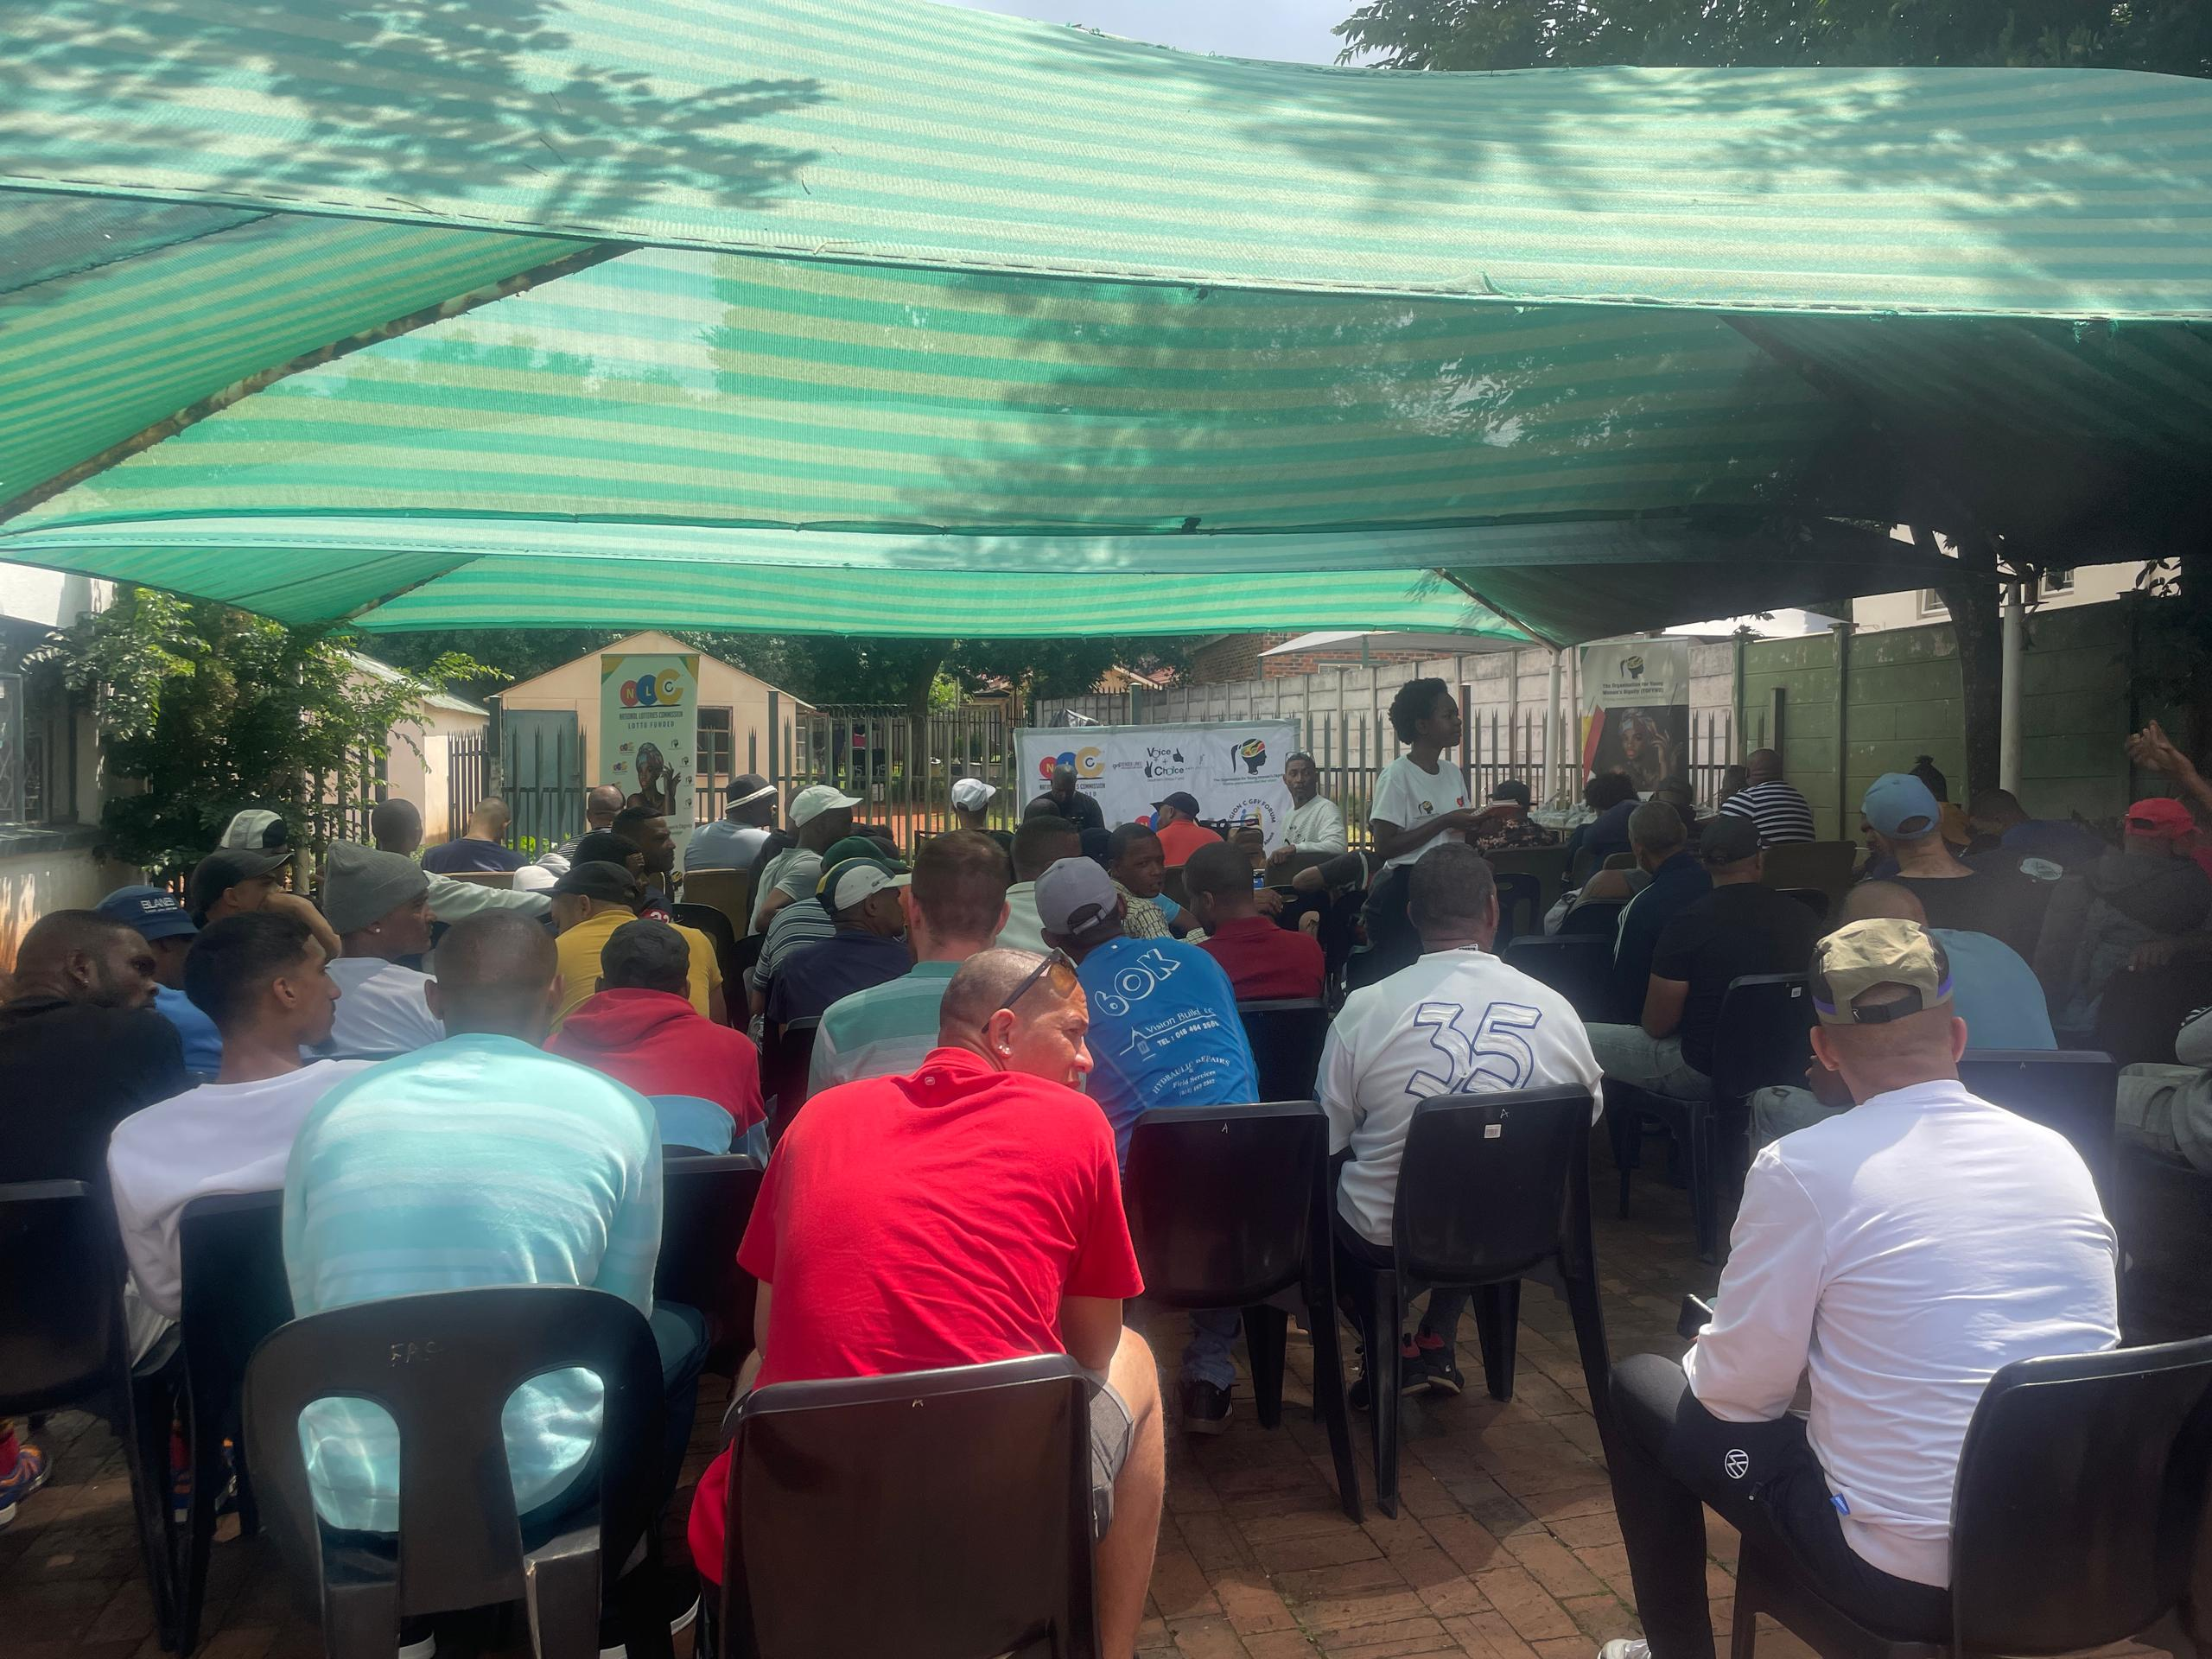
Sustainability
What sustainability measures were put in place for the work?
How do you intend to sustain the work or scale up?
Continue linking SRHR education with skills training for women such as baking, soap making, sewing, and other livelihood opportunities to strengthen long-term impact.
Replicate the SRHR and gender dialogue sessions with additional groups of men, boys, women, and traditional leaders in other communities.
Support trained men and boys to become peer educators, helping them lead conversations on SRHR, positive masculinity, and gender equality.
Evidence: Include Photos or videos
Voice and Choice Summit 2026 \ Voice and Choice Summit 2026

Slide 8
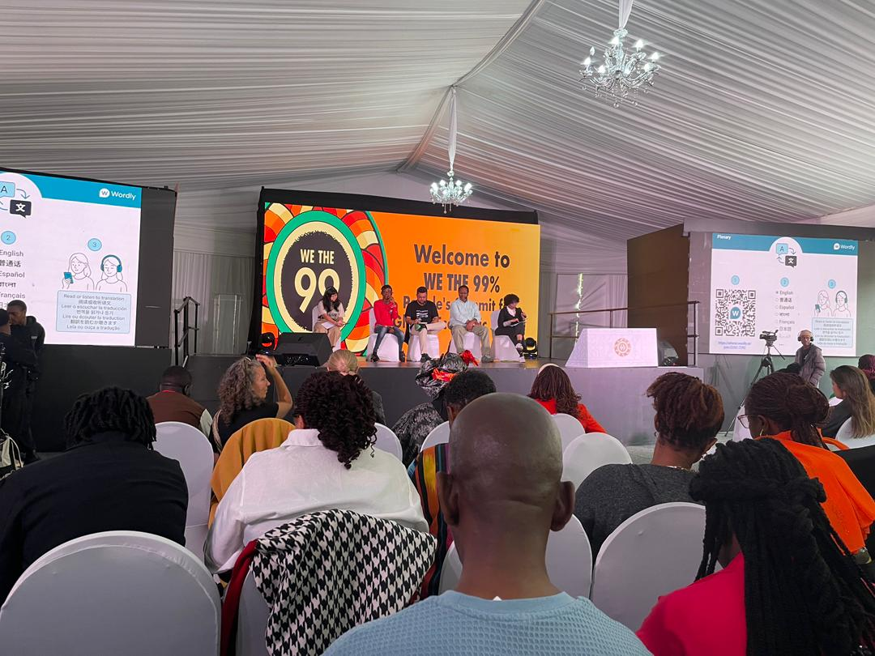
Beneficiaries
Number of;
Female – Direct beneficiaries- 641
Male – Direct beneficiaries-409
Female – Indirect beneficiaries (e.g. through other networks)-360
Male – Indirect beneficiaries (e.g. through other networks)- 140
Female – Online beneficiaries (e.g. website access, mailing lists, scholarly articles) 22143
Male – Online beneficiaries (e.g. website access, mailing lists, scholarly articles) 10905
Evidence : Include Photos or videos
Voice and Choice Summit 2026 \ Voice and Choice Summit 2026

Slide 9
Challenges & Lessons learnt
Challenges & mitigation
Limited Resources: Implementing the program with little or no budget made it difficult to expand activities and reach more participants.
Deeply Rooted Social Norms: Some community members still hold strong traditional beliefs about gender roles and SRHR, which can slow down attitude and behavior change.
What lessons have you learnt?
Change is Possible Meaningful community change can be achieved even when working with limited or zero budget through commitment and creativity.
Power of Partnership Collaborating with community members, traditional leaders, and local organizations strengthened the impact of the interventions.
Community Ownership Matters When men, boys, and women actively participate, they become champions who promote SRHR awareness and gender equality in their communities.
Small Actions Create Lasting Impact Even simple interventions such as dialogues, awareness sessions, and skills sharing can lead to sustainable change
Voice and Choice Summit 2026 \ Voice and Choice Summit 2026

Slide 10
Next Steps
What are your plans?
Implement skill development session
The next step is to continue strengthening community engagement and dialogue around gender equality and accountability. We have already started mobilizing young people, as well as men and boys, for the upcoming June Walk and Talk event, which will create a platform for open conversations and collective reflection. Through this process, we aim to deepen awareness, encourage community participation, and build momentum for continued action.
Voice and Choice Summit 2026 \ Voice and Choice Summit 2026

