Slide 1



Voice and Choice
Summit 2026-Story of Change Category
Title/Name of the Story
Engaging Communities for Menstrual Health and SRHR
(South Africa, Johannesburg, 16 March 2026- Denise Mazhandu)
Voice and Choice Summit 2026 \ Voice and Choice Summit 2026

Slide 2
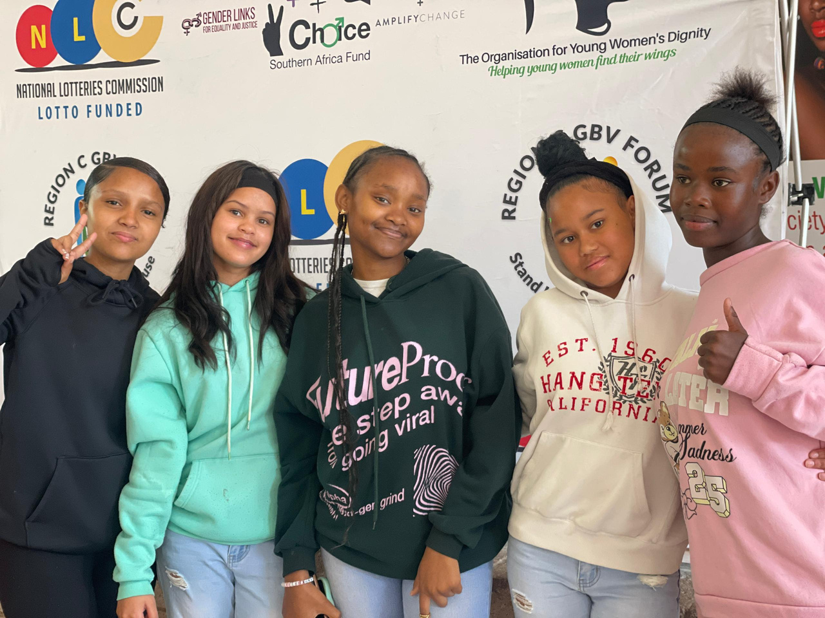
Background
What were the key objectives of the project?
Train young women and men as SRHR and menstrual health ambassadors.
Increase community awareness on menstrual health, SRHR, and GBV prevention.
Engage men and boys in menstrual health and gender justice conversations.
Expand grassroots outreach in underserved communities.
Strengthen inclusive advocacy for women, girls, and LGBTQI+ communities.
What were the situation before
Limited awareness of menstrual health and SRHR in low-income communities
Men and boys are rarely involved in menstrual health and GBV discussions
Few trained community advocates to share accurate SRHR
Restricted organizational capacity and resources for outreach activities
No structural programmes previously.
Poor data collection
The project was and is still implemented in the Northen Johannesburg
Evidence: Include Photos or videos
Voice and Choice Summit 2026 \ Voice and Choice Summit 2026

Slide 3
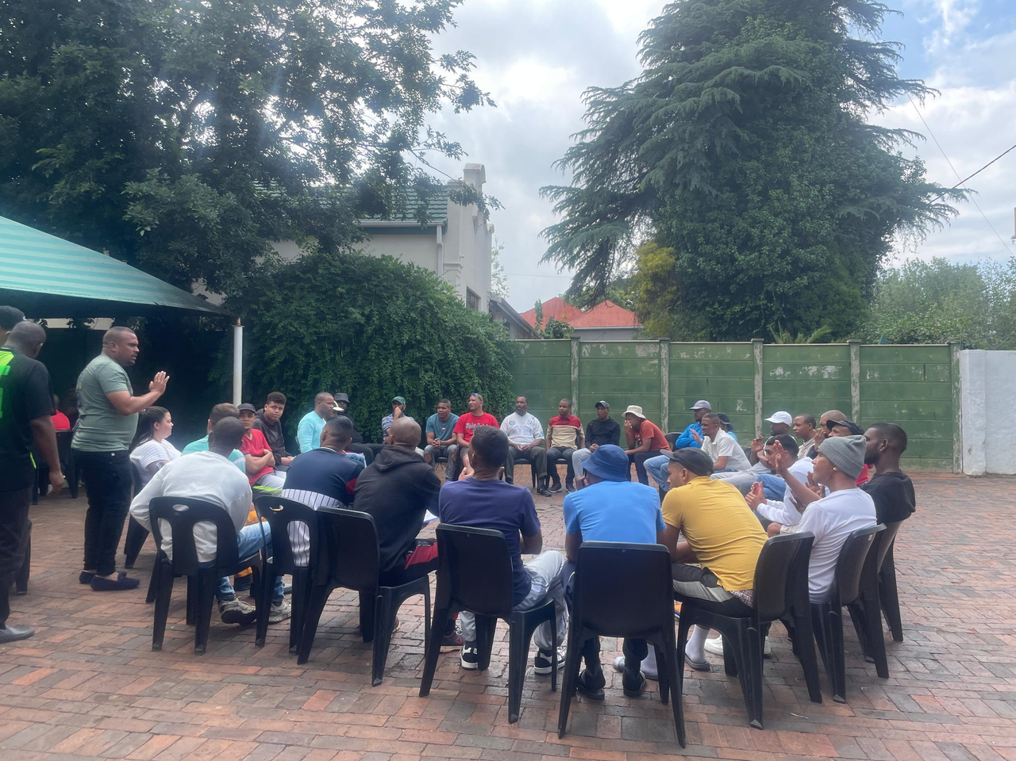
Background
Who was most affected by the problem and how?
Adolescent girls and young women in low-income communities were the most affected
Lack of access to safe and affordable sanitary products resulting in missed school days, reduced learning opportunities and limited participation in socio and economic activities
Limited knowledge of menstrual and reproductive health
Absence of supportive community engagement and prevailing harmful gender norms further marginalized girls, reducing their confidence and opportunities for leadership or advocacy
What issue(s) did the project address?
Period poverty- providing access to safe and affordable sanitary products
Lack of menstrual and sexual/reproductive health right
Harmful gender norms by involving men and boys
New ways of collecting data using the Gender Attitude Survey form
Evidence: Include Photos or videos
Voice and Choice Summit 2026 \ Voice and Choice Summit 2026

Slide 4
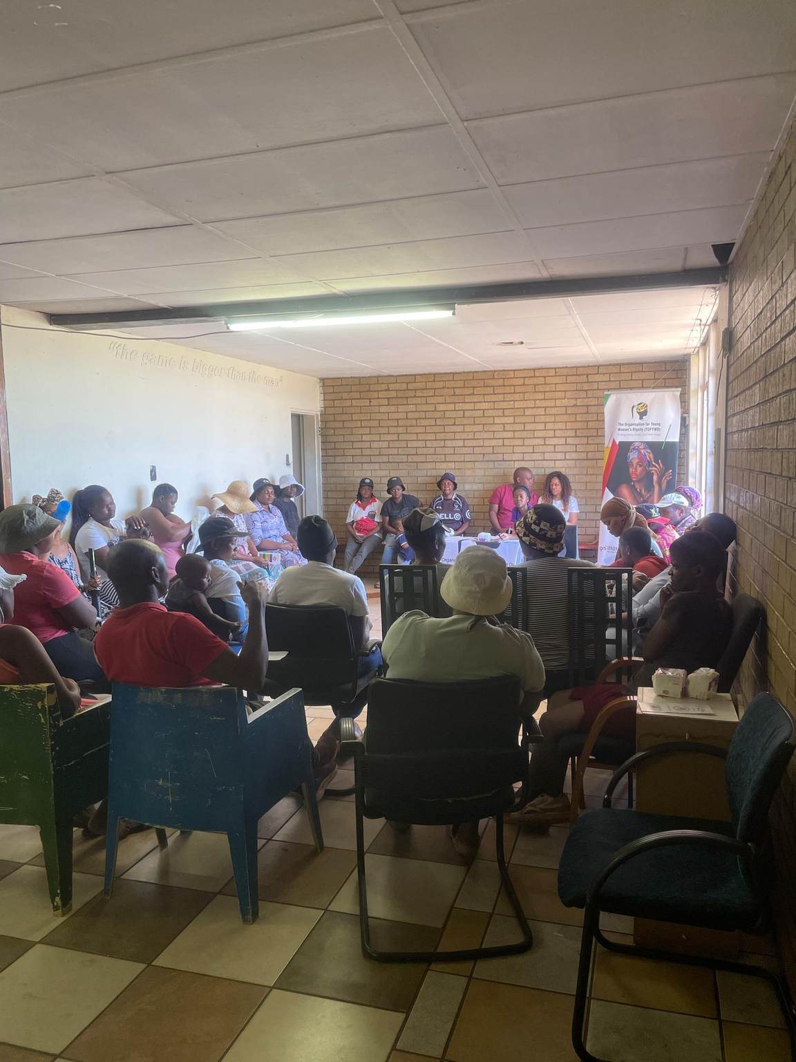
Change
• What activities or actions brought about the change?
The organisation welcomed a new fellow through the RWVL Fellowship, who brought fresh ideas and innovation. The fellow supported the development of structured organisational programmes. This has helped expand initiatives such as Project H.I.M, Khanya Ntombi, and Bloom Beyond GBV.
Moreover, change came about through intentional community engagement, dialogue, and capacity-building initiatives that created safe spaces for reflection, learning, and accountability. We engaged men, boys, community leaders, and the LGBQTI+ community, topics around harmful norms around masculinity and silence around GBV were openly challenged. Increased knowledge on SRHR and GBV strengthened confidence, shifted attitudes, and encouraged participants to take ownership as advocates within their communities.
What activities or actions brought about the change?
Distributed dignity packs to young people in schools and as well low income communities of Norther Johannesburg
Facilitated an interactive SRHR and GBV sessions with men and boys including the 75 men and boys from a rehabilitation centre in Roodepoort
To conducted a follow-up session to reinforce learning and deepen commitment among participants
Facilitated to community leaders, young people in Jerusalem on SRHR, GBV, and community mobilization strategies
Initiated advocacy implementation within communities in partner with the Region C forum group
Empowered the LGBQTI+ community through a stakeholder-led empowerment session
To introduced plans for data collection training to strengthen evidence-based advocacy
Encouraged men and boys to act as SRHR and GBV champions, providing peer guidance and leadership
Evidence: Include Photos or videos
Voice and Choice Summit 2026 \ Voice and Choice Summit 2026

Slide 5
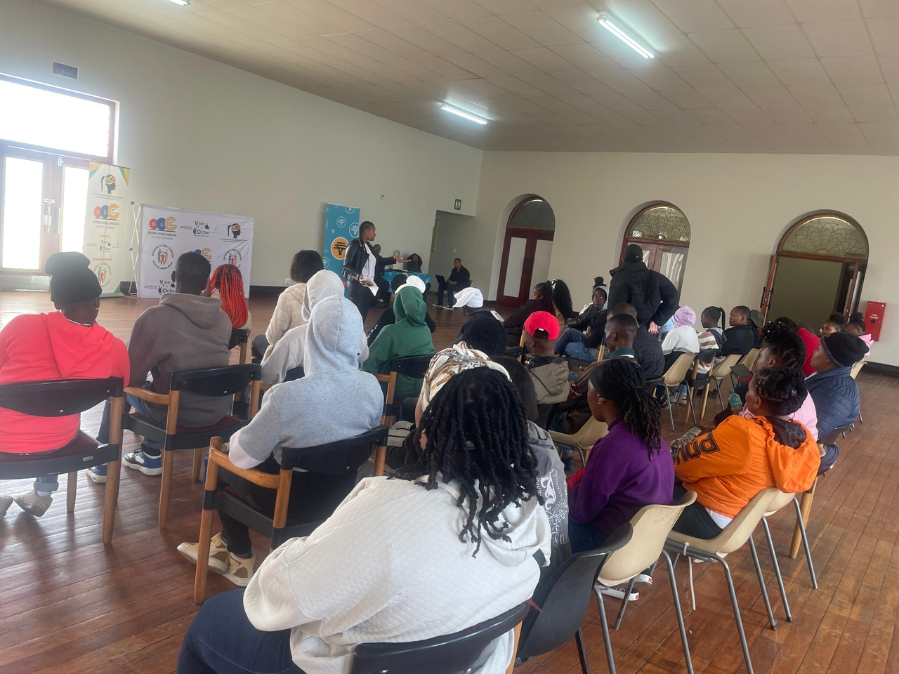
The change
Evidence: Include Photos or videos
Who led and participated in bringing about the change.
The session was led by a the TOFYWD team and the WOSSO fellow who facilitated the dialogue and guided the discussions.
Participants actively engaged in the process and contributed their perspectives and experiences.
They will now take the learning forward into their communities and homes to drive continued change.
• Describe what the change was, when and where it happened
• Was the change positive or negative?
• Who benefited, and in what way?
• What is the situation now?
During the session held in the community space, participants began to re-author their stories around power, responsibility, and gender equality. What once felt like fixed norms were questioned, and new possibilities for action and accountability were named.
This was a positive shift, as participants moved from silence and observation to agency and intention. They are now carrying these alternative stories into their homes and communities, strengthening conversations and small daily actions that reflect change.
Voice and Choice Summit 2026 \ Voice and Choice Summit 2026

Slide 6
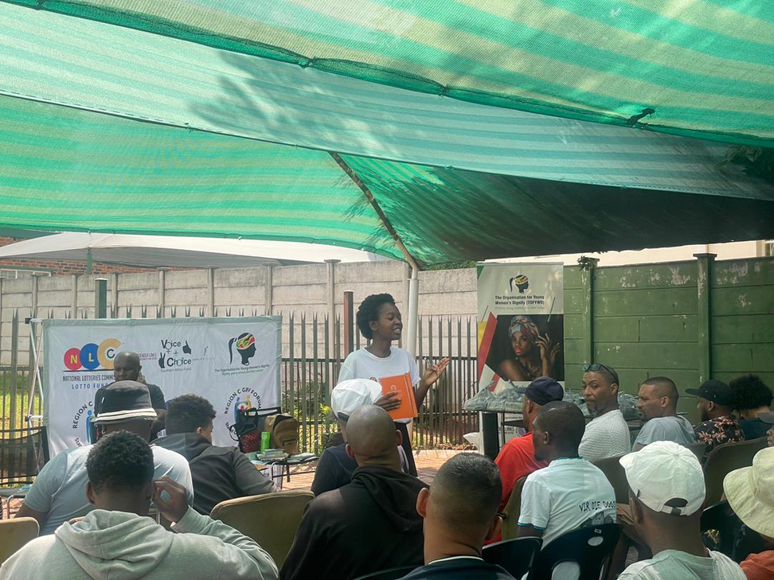
Significance of Change
Please provide further information on what this change means for the movement and its goals
The transformation among men and boys in Roodepoort marks a critical shift for the SRHR and GBV movement. The was designed to position men not as passive participants, but as go-to leaders and trusted voices within their communities. This goal is now taking shape.
Men who participated in the sessions have become approachable figures when: Violent incidents occur in the community, Other men need guidance on relationships, consent, or SRHR issues
Harmful stereotypes about masculinity and sexual health arise
By stepping into these roles, they are actively challenging toxic masculinity and breaking the silence around Sexual and Reproductive Health and Rights (SRHR). Instead of reinforcing stigma, they are helping normalize conversations about consent, accountability, emotional wellbeing, and respectful partnerships.
A powerful outcome emerged during the sessions at the rehabilitation center: participants identified other men within the group as safe individuals with whom they could share their grievances and personal struggles. This is a significant milestone. It reflects the program's intention to build a brotherhood model — a supportive community where men speak freely, hold each other accountable, and redefine strength as vulnerability and responsibility.
For the movement, this means:
Community-led advocacy is beginning to sustain itself
Men are becoming allies in preventing GBV
SRHR conversations are shifting from taboo to everyday dialogue
Leadership is being localized and owned by the community
This change strengthens the long-term goal of creating safer, more equitable communities where men actively protect, advocate, and model positive masculinity aligned with SRHR principles.
What effect this change may have on the next steps in this area of work.
Evidence: Include Photos or videos
Voice and Choice Summit 2026 \ Voice and Choice Summit 2026

Slide 7
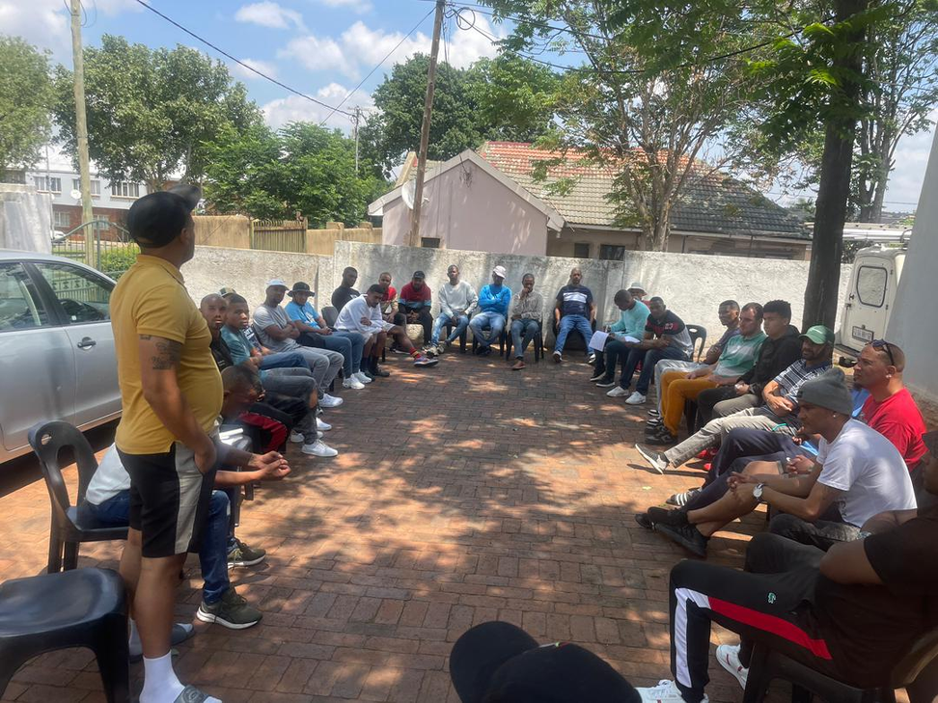
Sustainability
What sustainability measures were put in place for the work?
How do you intend to sustain the work or scale up?
To sustain the work, the project will strengthen data collection and analysis in order to better understand the impact and guide future interventions. Based on the experience from the session, more than one engagement will be conducted with the groups, allowing enough time for deeper reflection and stronger outcomes.
The Organization for Young Women’s Dignity (TOFYWD) will continue supporting the work by providing further interventions with the beneficiaries. Partnerships with other organizations will also be established to facilitate additional conversations and expand the reach of the initiative.
Evidence: Include Photos or videos
Voice and Choice Summit 2026 \ Voice and Choice Summit 2026

Slide 8
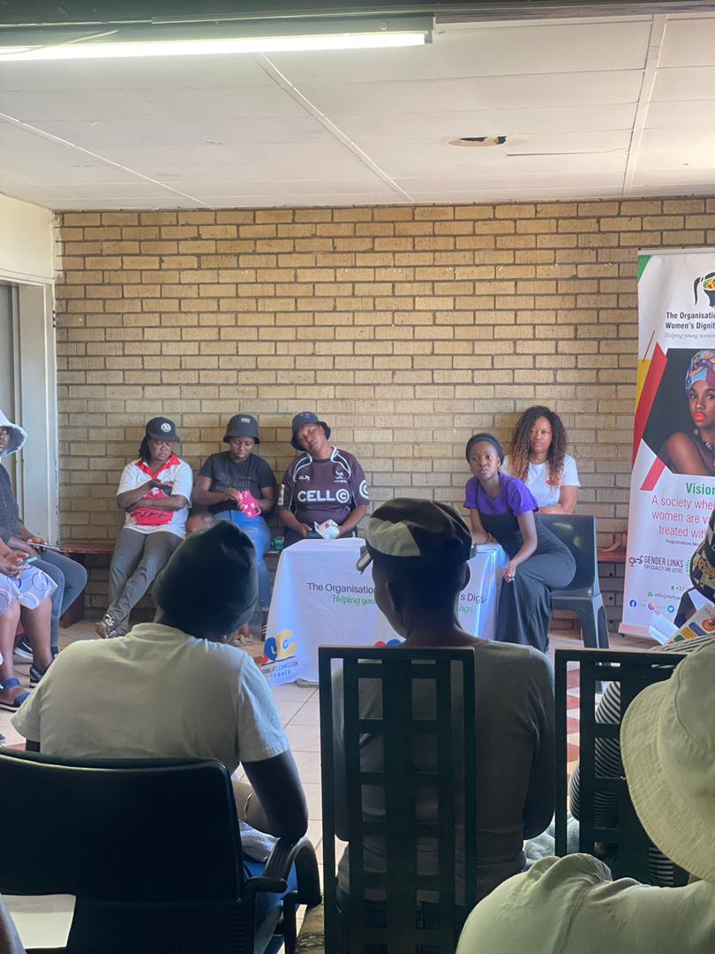
Beneficiaries
Number of;
Female – Direct beneficiaries
Male – Direct beneficiaries
Female – Indirect beneficiaries ( through other networks)
Male – Indirect beneficiaries (e.g. through other networks)
Female – Online beneficiaries (e.g. website access, mailing lists, scholarly articles)
Male – Online beneficiaries (e.g. website access, mailing lists, scholarly articles)
Evidence : Include Photos or videos
Voice and Choice Summit 2026 \ Voice and Choice Summit 2026

Slide 9
Challenges & Lessons learnt
Challenges & mitigation
One of the main challenges in implementing these programs is financial limitations. The work is currently being carried out on a very tight budget, which restricts the full implementation of planned activities. To mitigate this, partnerships with other organizations are pursued to share resources, although this can sometimes affect the pace and scope of implementation.
What lessons have you learnt?
A key lesson learned is the importance of flexibility, collaboration, and adequate time when working with communities. Limited resources and complex social contexts highlighted the need to build strong partnerships and to plan multiple engagements rather than single sessions to achieve deeper impact.
The experience also reinforced the importance of prioritizing safety and trust when working in high-risk communities, as well as strengthening data collection and reflection to better understand the change that is happening and guide future interventions.
Voice and Choice Summit 2026 \ Voice and Choice Summit 2026

Slide 10
Next Steps
What are your plans?
Strengthenig data collection and analysis to better measure impact and guide future interventions
Conduct multiple follow-up engagements with beneficiary groups to deepen reflection and improve outcomes.
Continue community interventions and support for beneficiaries
Build partnerships with other organization to expand conversations and increase the reach of the initiative.
Voice and Choice Summit 2026 \ Voice and Choice Summit 2026

