Slide 1







Logo goes here
LEARNING
AND SHARING
SUMMIT 2025
Story of Change Presentation
South Africa, Johannesburg, 06 March 2025
Presented By Zintle Khobeni de Lange
Women’s Voice and Leadership Learning and Sharing Summit 2025

Slide 2
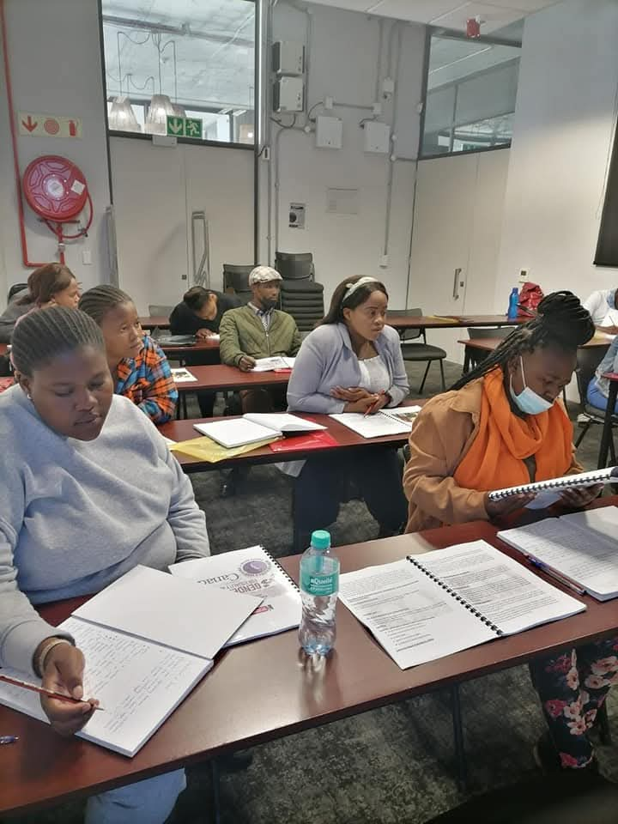
SYNOPSIS
Describe the change that will occur.
What the change will be?
This project will build on the success of our previous WVL-funded initiative, which empowered GBV survivors with basic legal skills & communities with human right education.
Encouraged survivors to report their experiences, both formally and informally.
When and where it will take place?
The new phase will be implemented in the City of Cape Town, specifically targeting GBV hotspots in the Cape Metro. (Isivivana Centre)
Implementation will take place over the grant period.
The project will focus on increasing survivor support, capacity building, and public engagement to challenge GBV-related stigma and ensure that survivors can access justice and support services.
Who will lead and participate in bringing about the change.
Led by TGPSA, in collaboration with trained GBV survivors, local community-based organizations, and key stakeholders, including service providers and law enforcement.
Photo
Women’s Voice and Leadership Learning and Sharing Summit 2025

Slide 3
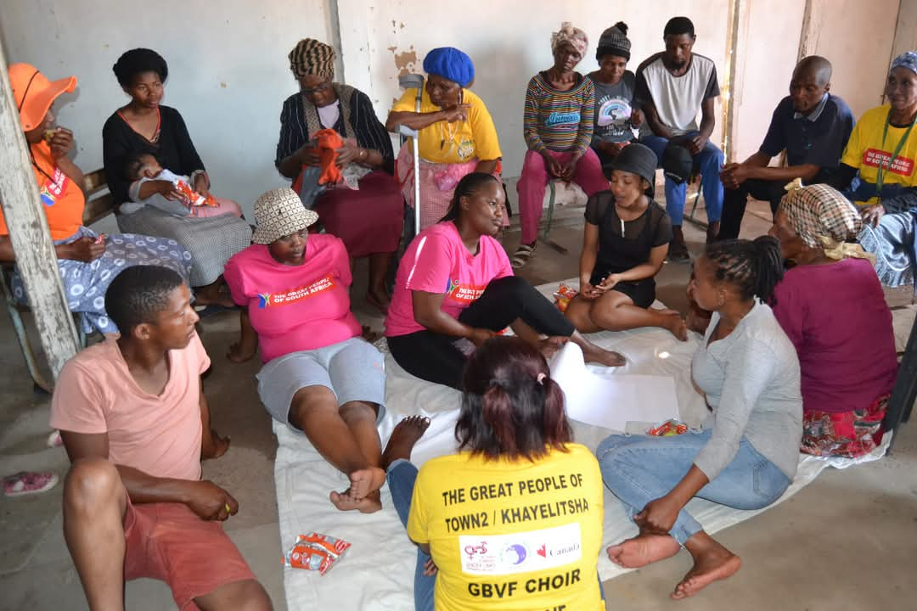
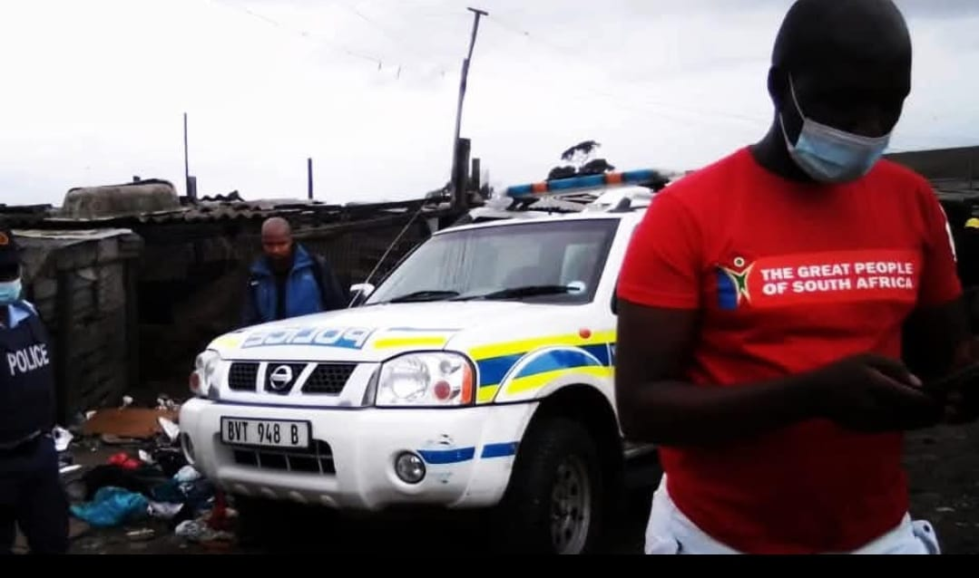
OBJECTIVES
What will the process/project aim to achieve?
Expand survivor-led advocacy and support networks.
Increase reporting in GBV cases
Increase public awareness and reporting of GBV cases.
Provide capacity-building training for survivors and community members.
Advocate for fair and transparent survivor selection processes in GBV support programs to avoid political interference.
Photo
Women’s Voice and Leadership Learning and Sharing Summit 2025

Slide 4
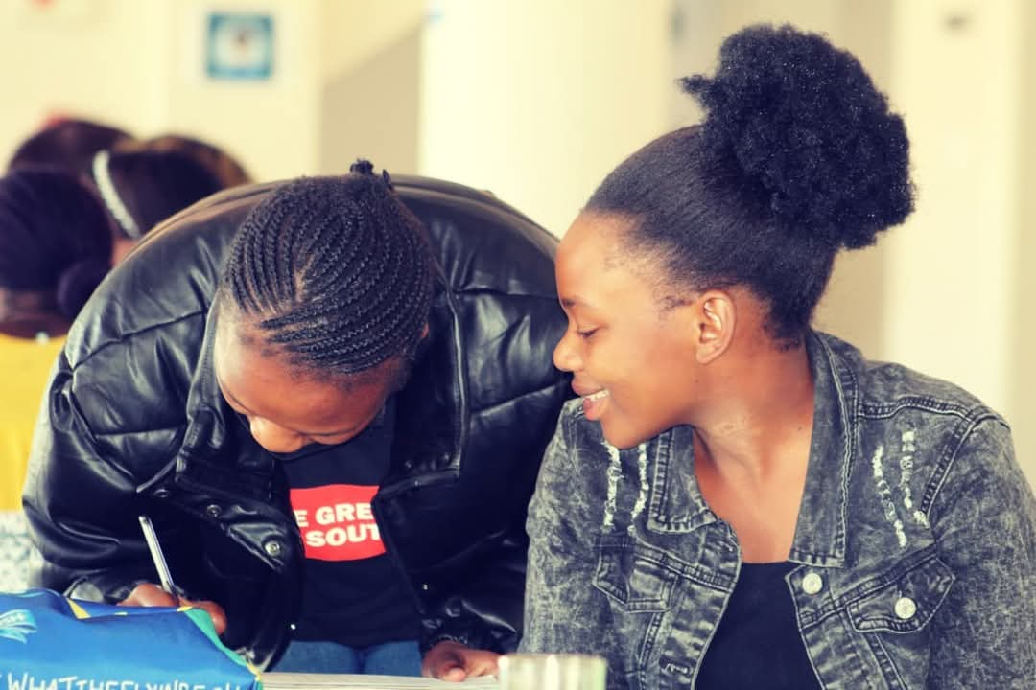
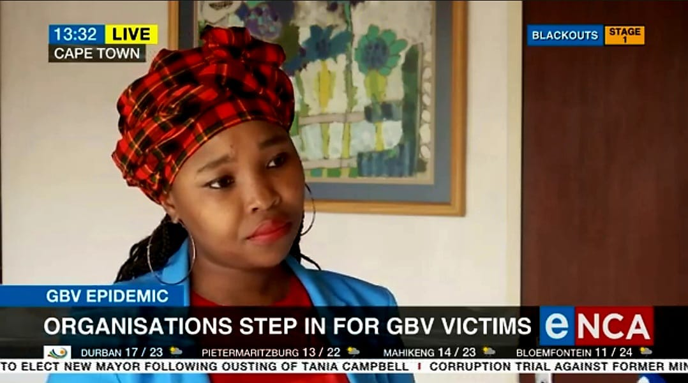
Planned Activities
What evidence or means of verification will you have for this change?
We will track progress through:
Documentation of survivor testimonies and case referrals.
Training reports and participant feedback.
Media coverage, including social media engagement and traditional news reports.
Policy and procedural changes in how GBV programs are implemented.
Comparative analysis of reporting trends in targeted hotspots before and after the project.
Photo
Women’s Voice and Leadership Learning and Sharing Summit 2025

Slide 5
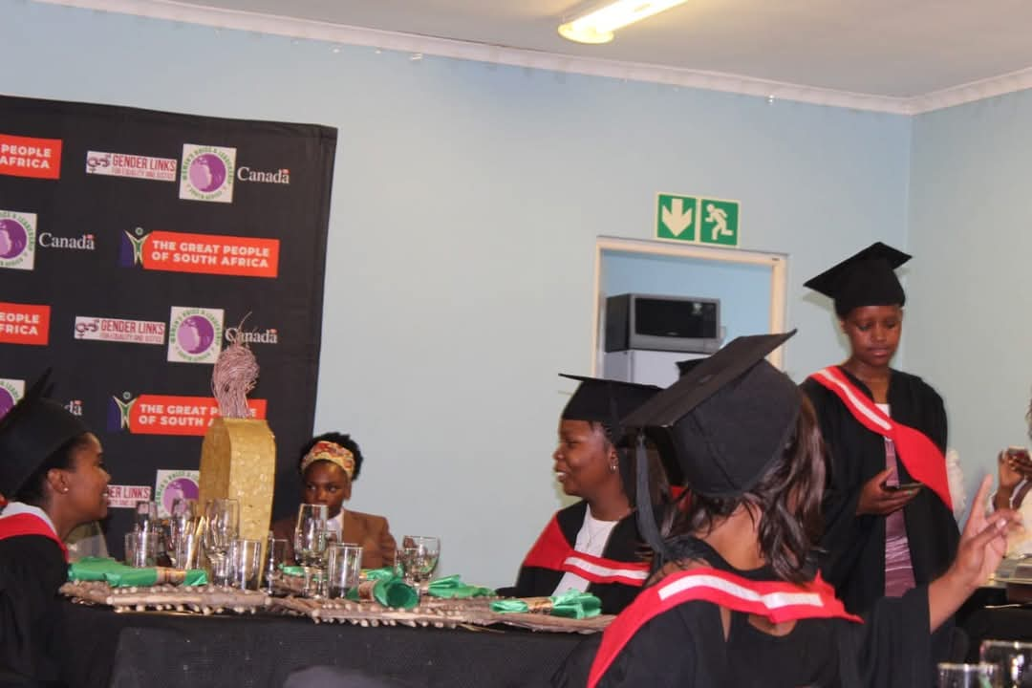
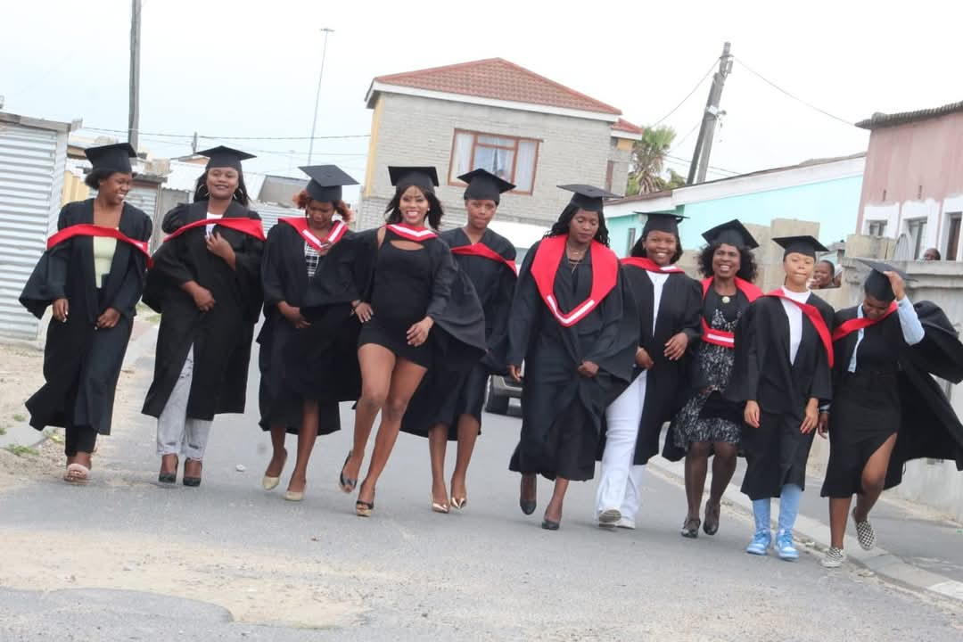
Contribution to change
What contribution will your organization make to this change? Please describe the advocacy work and actions your organization plans to take to contribute to this change.
Our organization will:
Train new GBV survivor leaders to extend peer support and advocacy.
Facilitate community engagement sessions to shift attitudes around GBV.
Engage local media to amplify survivor voices and advocate for systemic change.
Work with relevant authorities to ensure that GBV survivors are not excluded from support programs due to political affiliations.
Women’s Voice and Leadership Learning and Sharing Summit 2025

Slide 6
Population Group this change will impact
Category | Women | Men | Total | % Women
Direct beneficiaries | 1000 | 150 | 1150 | 86 %
Indirect beneficiaries (e.g. through other networks) | 250 | 50 | 300 | 83 %
Online beneficiaries (e.g. website access, mailing lists, scholarly articles) | 500 | 100 | 600 | 83 %
Total | 1750 | 300 | 2050 | 85%
Women’s Voice and Leadership Learning and Sharing Summit 2025

Slide 7
Significance of change
What will be the significance of the change? Please provide further information on what this change will mean for the movement and its goals, and what effect this change may have on the next steps in this area of work.
This project will strengthen survivor-centred GBV prevention and response mechanisms within Cape Town, ensuring that support is available to all survivors regardless of race or background.
The initiative will also contribute to broader efforts to combat GBV through public participation, media advocacy, and survivor leadership.
Lessons from this project have a potential to inform national strategies on GBV and improve survivor support in other peri-urban and rural areas.
Women’s Voice and Leadership Learning and Sharing Summit 2025

Slide 8
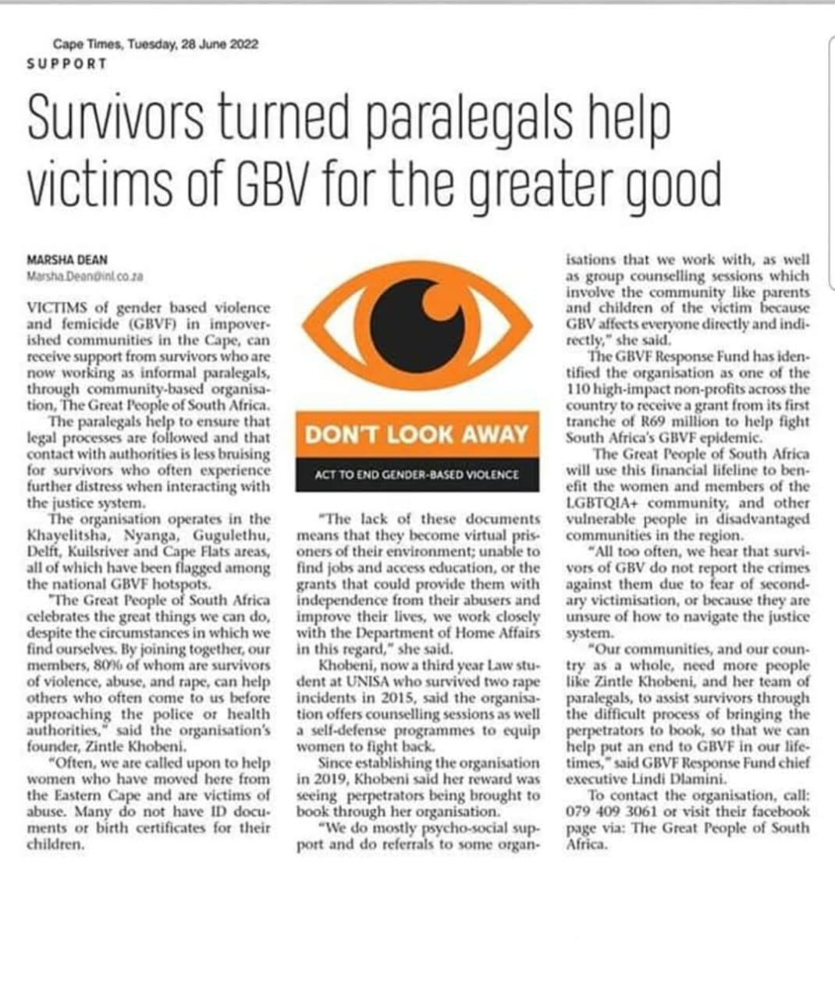
RESULTS
Please share some of the results you aim to achieve.
Women’s empowerment – More survivors will gain paralegal and leadership skills and become peer advocates.
Public participation – Increased community engagement in GBV prevention and response.
Media coverage – Greater visibility of GBV issues and survivor-led advocacy.
Capacity building – Expanded training for survivors, service providers, and community groups.
Changes in gender attitudes – Reduction of stigma and increased support for survivors.
Include evidence here – photos/clippings
Women’s Voice and Leadership Learning and Sharing Summit 2025

Slide 9
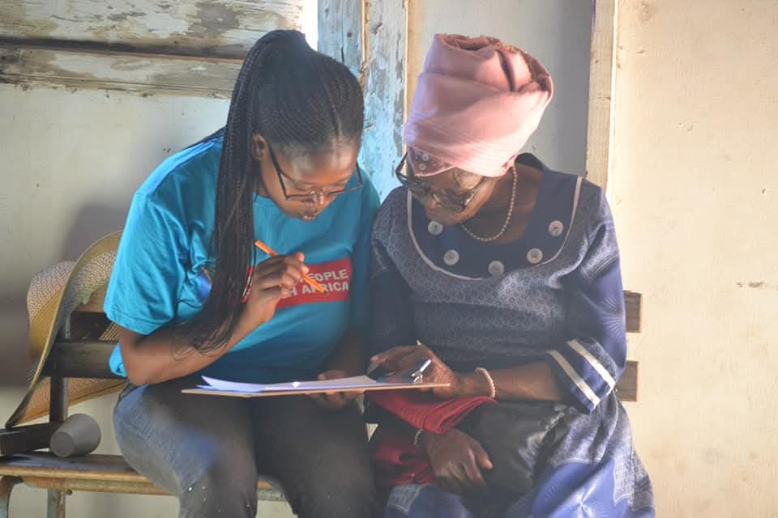
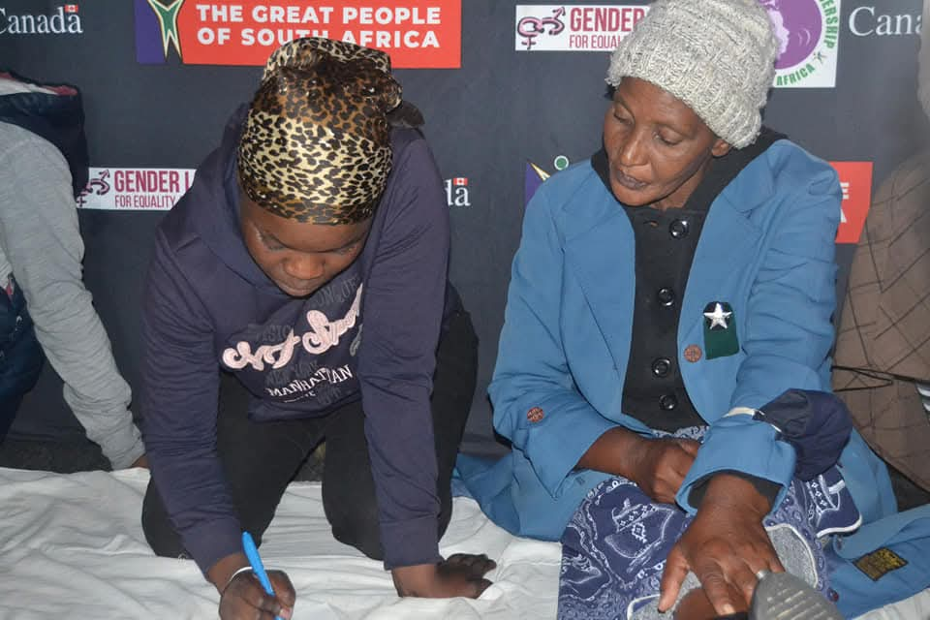
Evidence
What evidence or means of verification will you have for your organization's contribution to this change?
1. Survivor Engagement & Leadership Development
Training Reports & Attendance Records: Tracking the number of survivors trained and the skills they acquire.
Survivor Testimonies: Personal stories highlighting increased confidence, leadership, and support for other survivors.
2. Increased GBV Reporting & Access to Support Services
Referral Records: Documenting the number of survivors referred to legal, medical, and psychosocial services.
Comparison Data: Analysis of GBV reporting rates before and after project implementation.
3. Community Engagement & Awareness Raising
Community Dialogue Reports: Feedback from participants on awareness sessions.
Public Attitude Surveys: Assessing changes in gender perceptions and GBV awareness.
4. Media Coverage & Public Advocacy
News Articles & Broadcasts: Coverage in newspapers, radio, TV, and online media.
Social Media Analytics: Engagement metrics (likes, shares, comments) demonstrating public interest.
5. Institutional & Policy Influence
Policy or Procedural Changes: Modifications by local government or service providers due to advocacy efforts.
Letters of Support: Endorsements from key stakeholders recognizing the impact of the project.
Include evidence here – photos/clippings
Women’s Voice and Leadership Learning and Sharing Summit 2025

Slide 10
Anticipated Challenges and Lessons to Learn
What are the main challenges you anticipate? How do you plan to overcome these challenges?
Mistrust in formal reporting systems – Strengthen community-based reporting mechanisms.
Resource constraints – Leverage partnerships and media engagement to sustain momentum
Women’s Voice and Leadership Learning and Sharing Summit 2025

Slide 11
SUSTAINABILITY AND REPLICATION
How will the work be sustained/kept going?
Ongoing training programs and mentorship for survivors.
Strengthened community partnerships to continue advocacy beyond the project duration.
How will the work be shared or cascaded to other organisations?
Documentation and sharing of best practices with other organizations to replicate and scale the model.
Women’s Voice and Leadership Learning and Sharing Summit 2025

Slide 12
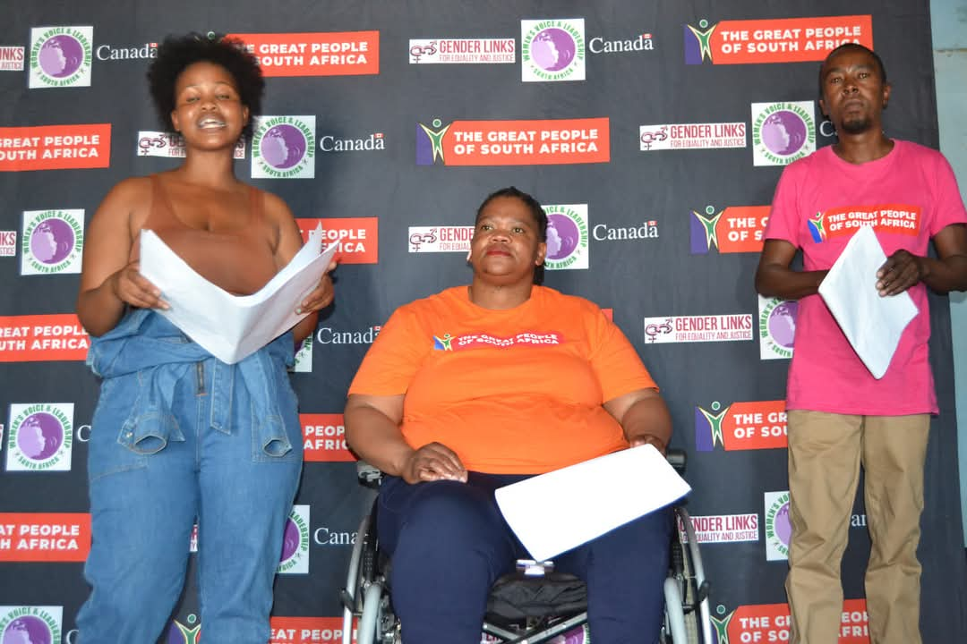
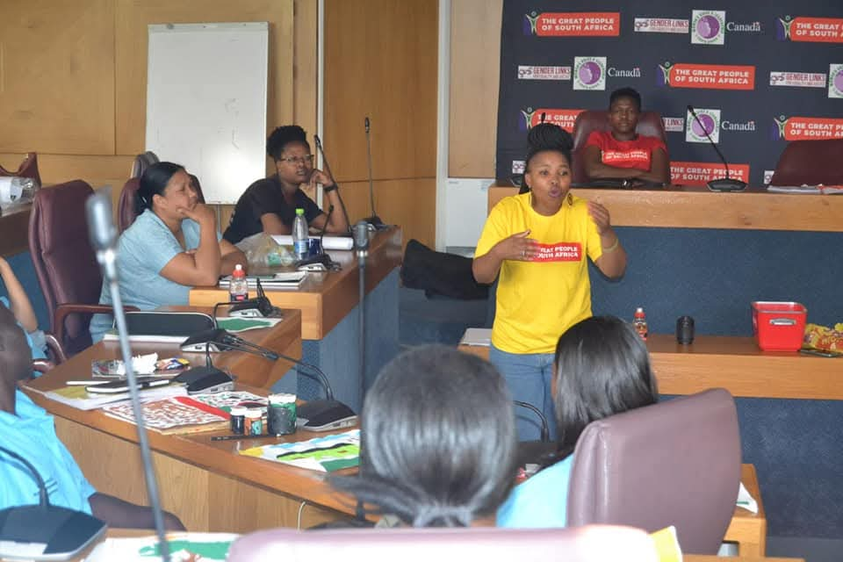
NEXT STEPS
What will be the key priorities moving forward?
Expanding survivor-led paralegal training, community awareness programs and advocacy beyond the Cape Metro.
Strengthening engagement with policymakers for systemic reforms.
Securing additional funding to sustain and scale the initiative.
Include evidence here – photos/clippings
Women’s Voice and Leadership Learning and Sharing Summit 2025

