Slide 1







here
LEARNING
AND SHARING
SUMMIT 2025
Drivers of Change
Zimbabwe, Bulawayo, 17 February 2024
Presented by Methembe Songo
"Gender equality is more than a goal in itself.
It is a precondition for meeting the challenge of reducing poverty,
promoting sustainable development and building good governance." - Kofi Annan
Women’s Voice and Leadership Learning and Sharing Summit 2025

Slide 2
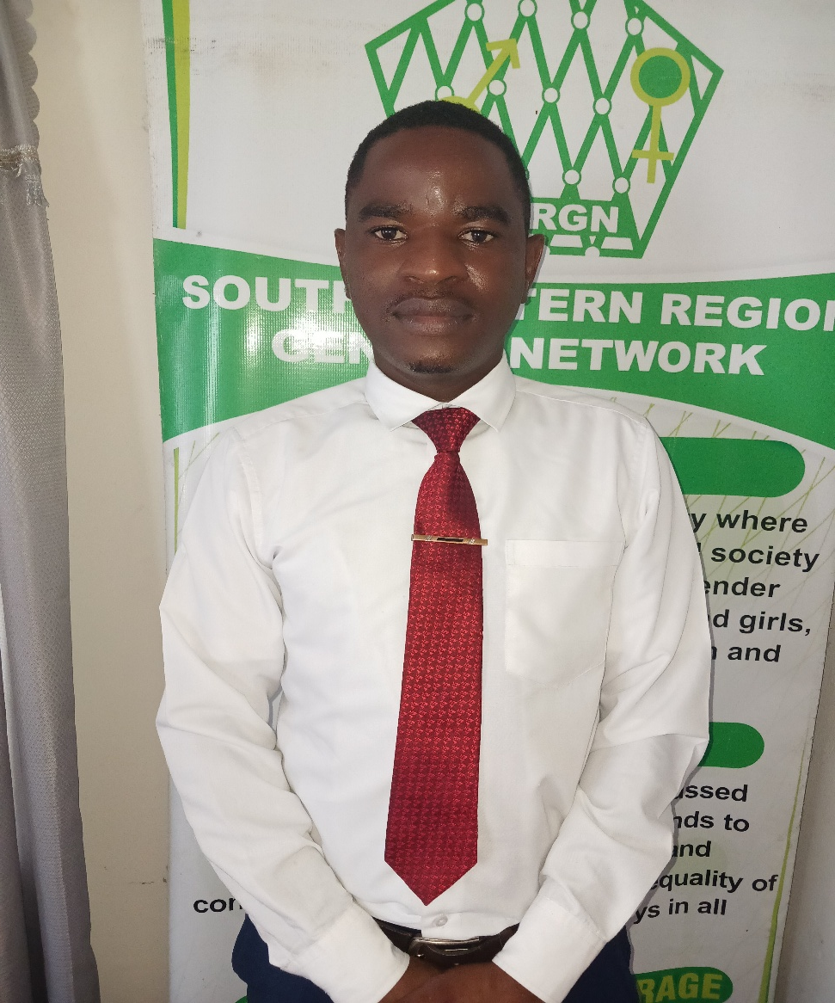
Who is this leader?
Who you are?
Methembe Songo Programmes Manager (SWRGN)
Where you are from?
Bulawayo, Zimbabwe
What you do?
I am HeForShe Champion promoting gender equality, inclusion and women empowerment in Mangwe District
What makes you unique?
I am a men who leads in advocating for human rights
I have facilitated participation of women in policy and decision making processes.
Women’s Voice and Leadership Learning and Sharing Summit 2025

Slide 3
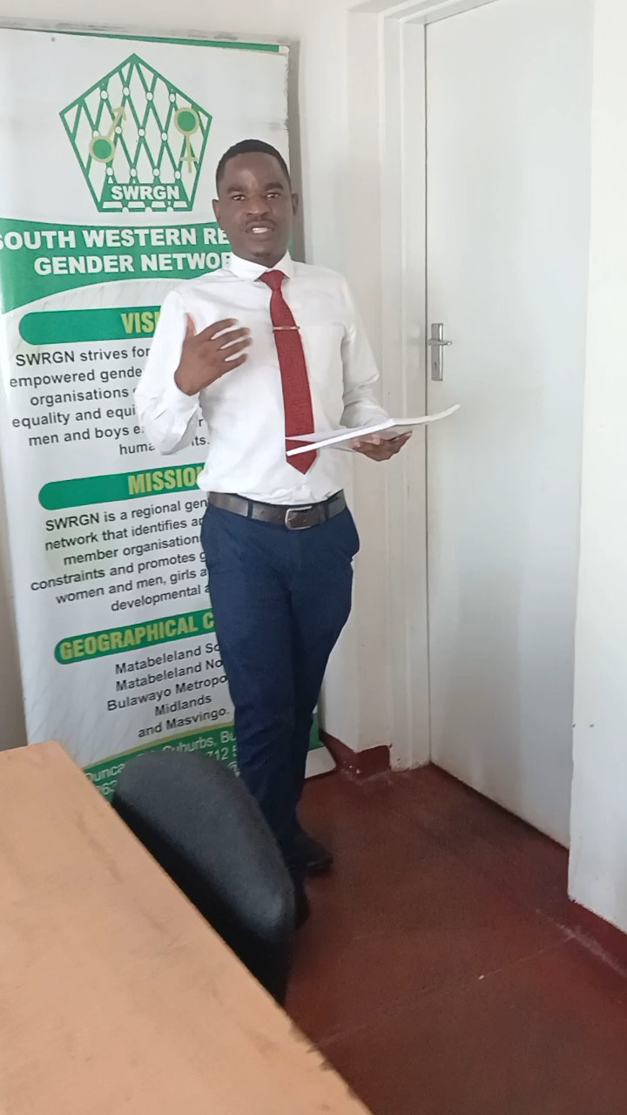
What drives you?
DETAIL
Vision
I envision a just inclusive equal and prosperous society
Objectives
Your commitment to gender equality
I commit to take a leading role as a driver of change in promoting gender equality and women empowerment.
I commit to ensure that women and girls have access to quality SRHR services
Women’s Voice and Leadership Learning and Sharing Summit 2025

Slide 4
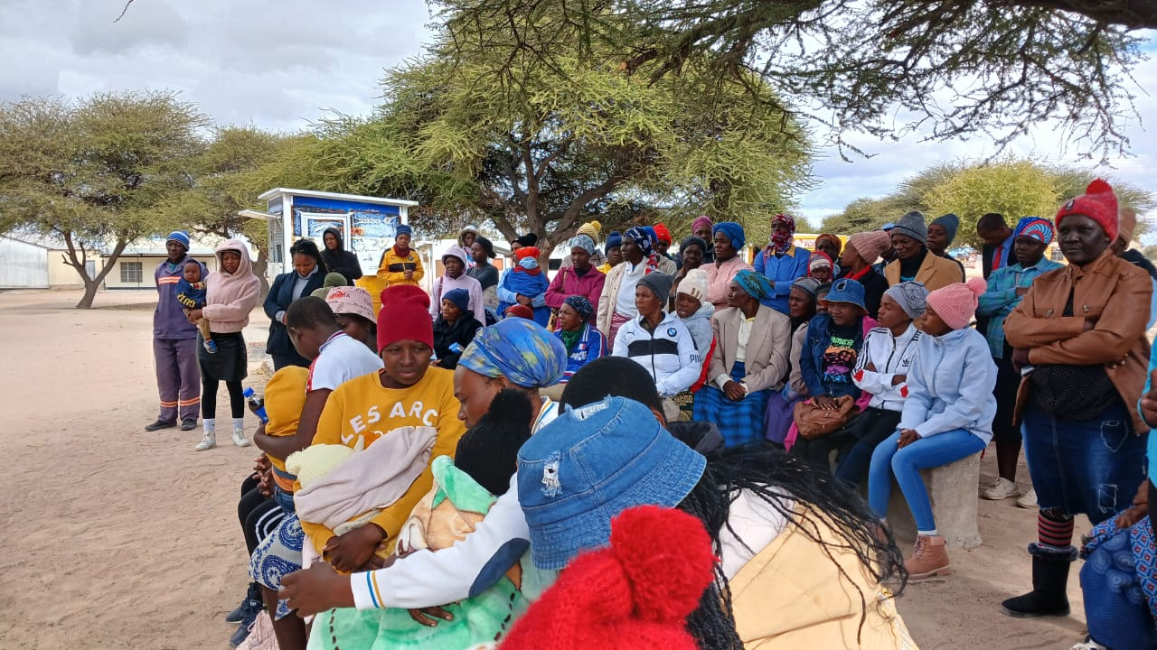
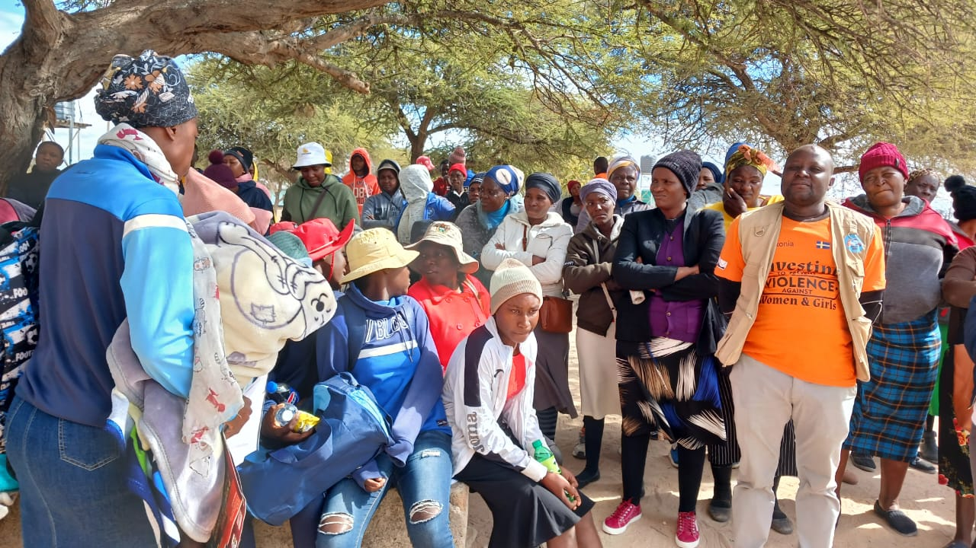
What do you do?
DETAIL
Describe the nature of the work the Driver of change does
Facilitating safe dialogue spaces on GEWE campaigns
Engagement of men and boys in gender dialogue and gender justice discourse
Include photos or videos
Women’s Voice and Leadership Learning and Sharing Summit 2025

Slide 5
Personal achievements
DETAIL
Describe your personal achievements
Participated in various researches on gender equality and women
In my Masters study did a research on the Gendered impact
Women’s Voice and Leadership Learning and Sharing Summit 2025

Slide 6
Change at the individual level
What has changed in this person’s life? Why has it changed
What skills; knowledge; values and attitudes has the beneficiary gained through working with GL?
Who else has been responsible for this change?
Women’s Voice and Leadership Learning and Sharing Summit 2025

Slide 7
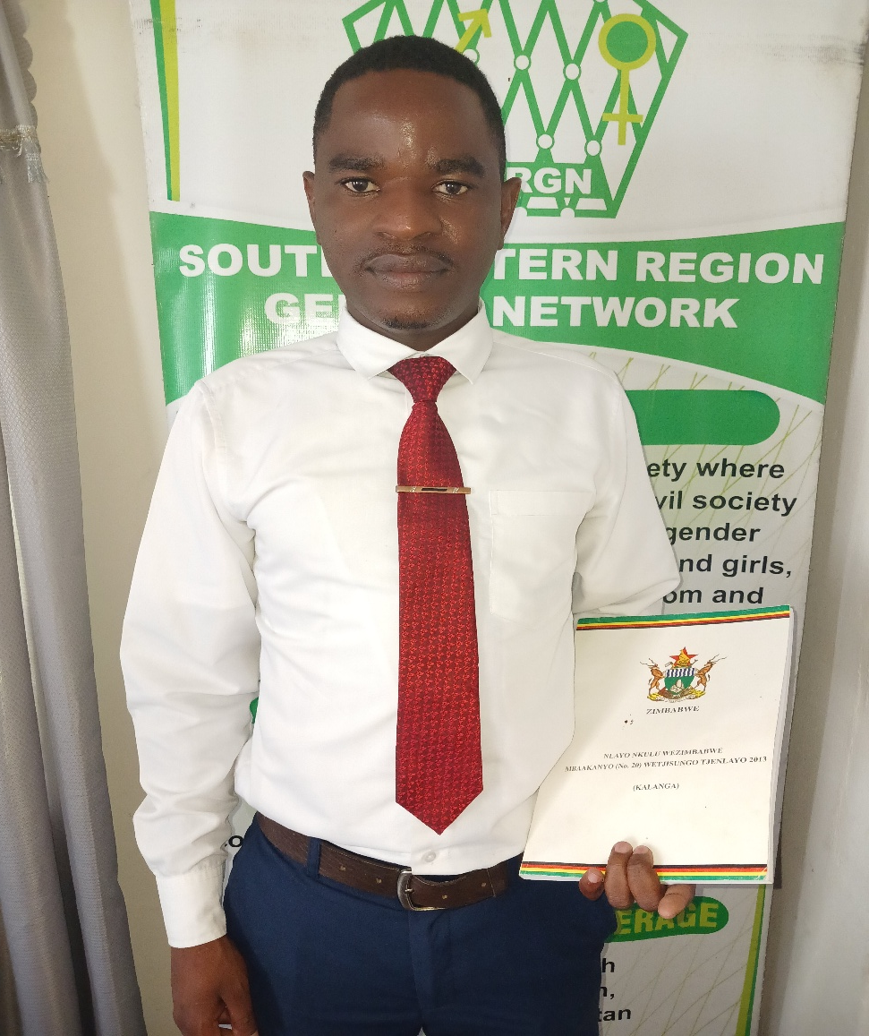
Achievements at community level
What are your greatest achievements at community level?
How is change in one person’s life influencing other lives?
What innovation has this person brought to their learning?
Use
Women’s Voice and Leadership Learning and Sharing Summit 2025

Slide 8
Achievements at societal level
How have this person’s actions changed laws, policies and or practices?
How is this person creating new knowledge? How is this being fed back to GL?
Women’s Voice and Leadership Learning and Sharing Summit 2025

Slide 9
Leadership qualities
What leadership qualities enable you to make the changes you are making?
Please show how your leadership skills have impacted at individual, community and policy level.
Share videos/photos of evidence
Women’s Voice and Leadership Learning and Sharing Summit 2025

Slide 10
Contribution to gender equality
Explain your contributions to gender equality in your locality
Share videos/photos of evidence
Women’s Voice and Leadership Learning and Sharing Summit 2025

Slide 11
Next steps
What are your future plans?
Facilitate male dialogues on SRHR
Engagement of traditional or religious leaders on SRHR
Policy Advocacy
Use graphics and tables to illustrate next steps
Women’s Voice and Leadership Learning and Sharing Summit 2025

