Slide 1







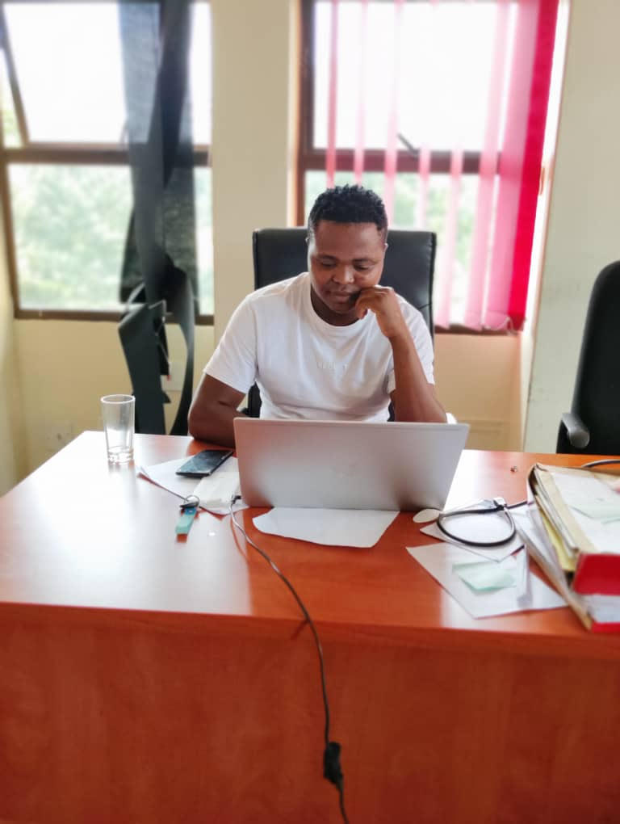
LEARNING
AND SHARING
SUMMIT 2025
Institutional Template
(eSwatini, Mbabane, 05/03/2025
Esihle Mdluli
Women’s Voice and Leadership Learning and Sharing Summit 2025

Slide 2
Brief background of the organisation
Voice Of Our Voices’ mission is to see a healthy, compassionate, vibrant Eswatini that is safe for all citizens, including sex workers. VOOV’s priority areas are as follows. To advocate for social change and the protection of sex workers, linking sex workers with service providers, Distribution of health commodities to sex workers, Enhance knowledge and skills of vulnerable women who are disproportionately affected by HIV and AIDS, To protect and care for themselves and those affected. Strengthen linkages between service providers and vulnerable women to collaboratively provide information on HIV and AIDS, and quality services,
Women’s Voice and Leadership Learning and Sharing Summit 2025

Slide 3
Institution before VCSA Funding
Goal set at the beginning of Genderlinks | Organization status before | Organization status now | Achievement
The organization should have clearly defined resource mobilization strategy that includes working with government, private sector partners and donors. | Organization was having a written resource mobilization strategy that includes working with two or more of the listed partners: | Organization's written strategy includes working with multiple partners and is referenced frequently and changed as necessary. (updates for mobilization strategy) | 100%
The organization should be able set realistic annual funding targets, in line with their resource mobilization strategy, and has succeeded in meeting its targets in previous years. | Organization has targets and 50% have been met annually. (annual funding targets & Actual report) | Organization has annual targets and 75% have been met annually. (annual funding targets & reports) | 75%
Women’s Voice and Leadership Learning and Sharing Summit 2025

Slide 4
Institution before VCSA OPERATIONS
Goal set at the beginning of Genderlinks | Organization status before | Organization status now | Achievement
The organization should have key operational polices in place, that cover topics including travel, finance, HR and administration. | Policies are written and shared with staff. Leadership review policy and ensure staff adhere to policy. | Comprehensive Policies are written and promote transparency; staff are oriented and fully understand how the policies work. Policies are regularly reviewed and applied in a consistent manne | 80%
The organization should have effective filing systems for easy storage and retrieval of information. | Organization was having a set of systems for filing and staff are trained on the system but are not utilizing consistently | Organization has an updated filing system, staff are trained on the system, and the organization is able to actively use the system for effective knowledge management. | 90%
Women’s Voice and Leadership Learning and Sharing Summit 2025

Slide 5
Institution before VCSA FINANCIAL
Goal set at the beginning of Genderlinks | Organization status before | Organization status now | Achievement
The organization to utilizes an appropriate accounting system. | Organization maintains an electronic accounting system (cash book, general ledger and supplier module) and they have network in place which allows multiple users. It produces a single currency report for external analysis | The organization uses appropriate technology (accounting, payroll, inventory, etc.) to meet its financial management needs. These systems are fully integrated to enable ease of use. The system is able to generate several specific management and Donor reports. | 100%
The organization spends finances according to the budget throughout the project period. | Organization stays within budget in terms of overall and categories. If issues arise the organization has a system for discussing and finding a solution. | Organization stays within budget in terms of overall and categories, with no or very minimal variances | 90%^
Women’s Voice and Leadership Learning and Sharing Summit 2025

Slide 6
Institution before VCSA Strategic
Goal set at the beginning of Genderlinks | Organization status before | Organization status now | Achievement
The Organization should have a standardized system for storage of hard copy and electronic data and reports | The Organization case files are in lockable cabinets but not up to date (filing is one month behind schedule) | The Organization case files are in lockable cabinets and are up to date (filing is complete up to one week prior to the assessment date). All electronic files are organized in shared drive and backed up weekly | 90%
The organization should have a process for ensuring quality control of its services/better service provision. | Organization has documented program quality control system, but has not been able to ensure consistent quality | Organization has process in place to ensure quality, it is used, and staff are held accountable for quality assurance. | 70%
Women’s Voice and Leadership Learning and Sharing Summit 2025

Slide 7
Registrations
Prior to the commencement of the grant, Voice of Our Voices was officially registered as an organization with a legally recognized status. In addition, the organization maintained a functioning bank account, indicating a level of financial accountability and sustainability that supported its eligibility for funding opportunities
Women’s Voice and Leadership Learning and Sharing Summit 2025

Slide 8
Capacity during VCSA-SA grant
Through our affiliation with VCSA-SA, Voice of Our Voices has benefited from valuable capacity-building opportunities, particularly in the form of knowledge sharing with Sinkhe, a fellow organization with significant experience in sex worker advocacy and support.
Women’s Voice and Leadership Learning and Sharing Summit 2025

Slide 9
Challenges
Stigma and Discrimination: Despite progress in advocacy, sex workers continue to experience significant stigma and discrimination from various sectors of society, including law enforcement and healthcare providers, impeding access to vital services.
Women’s Voice and Leadership Learning and Sharing Summit 2025

Slide 10
Lesson learned on institutional growth
Importance of Community Engagement: Collaboration with sex workers and their communities has proven essential for effective service provision and advocacy, highlighting the importance of community-led solutions
Women’s Voice and Leadership Learning and Sharing Summit 2025

