Slide 1


Voice and Choice
Summit 2026-Story of Change Category
South Africa: Networking helped Tamia find her voice and inspire others beyond sanitary dignity
Voice and Choice Summit 2026 \ Voice and Choice Summit 2026

Slide 2
Synopsis– brief overview what this is about
Name | Tamia Moses
Designation | Free The Period Ambassador and social media influencer
Organisation | MT Foundation
Country | South Africa
Category | Sexual & Reproductive Health and Rights
Summary | Sub categories: Menstrual health Youth engagement STEM Girls
Voice and Choice Summit 2026 \ Voice and Choice Summit 2026

Slide 3
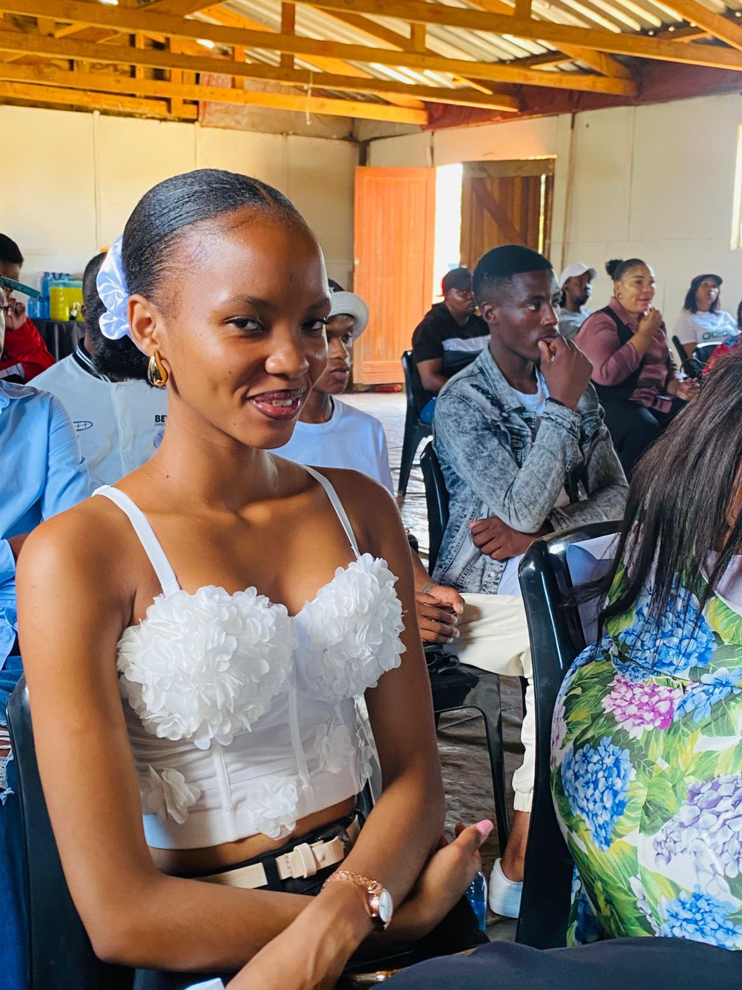
Background(problem, actions, change, evidence)
Problem
Tamia Moses, from Heidedal in Bloemfontein, struggled with confidence and public speaking despite being a runway model.
She often stayed in the background and did not use her voice to influence others.
At community level, young women also lacked platforms to discuss menstrual health, gender equality, and empowerment.
Actions
The MT Foundation, through the Free The Period initiative, provided opportunities including:
Participation in workshops, events, and panel discussions
Mentorship, networking platforms, and leadership exposure
Community outreach and sanitary dignity programmes
Social media advocacy support and ambassador training
Voice and Choice Summit 2026 \ Voice and Choice Summit 2026

Slide 4
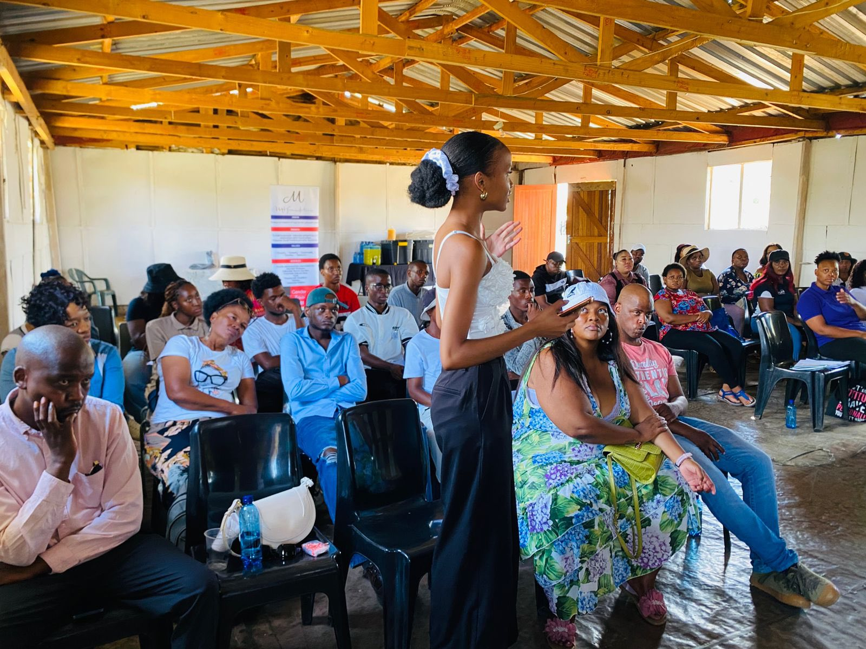
Background(problem, actions, change, evidence)
Change
Tamia developed confidence, leadership skills, and a strong public voice.
She transitioned from being shy and withdrawn to becoming an active ambassador who speaks publicly, networks with partners, and uses social media to promote gender equality and menstrual health awareness.
She is now a role model for other young women in her community.
Evidence
Testimony from Tamia describing her journey from “hiding in the corner” to confidently networking and speaking. (video link attached)
Observation from MT Foundation leadership confirming her growth and active representation.
Community feedback showing her influence inspires others to attend events and speak up.
Visible social media presence promoting advocacy messages and Foundation programmes.
Video https://www.facebook.com/share/v/1GiiRniSwY/
Photo
Voice and Choice Summit 2026 \ Voice and Choice Summit 2026

Slide 5
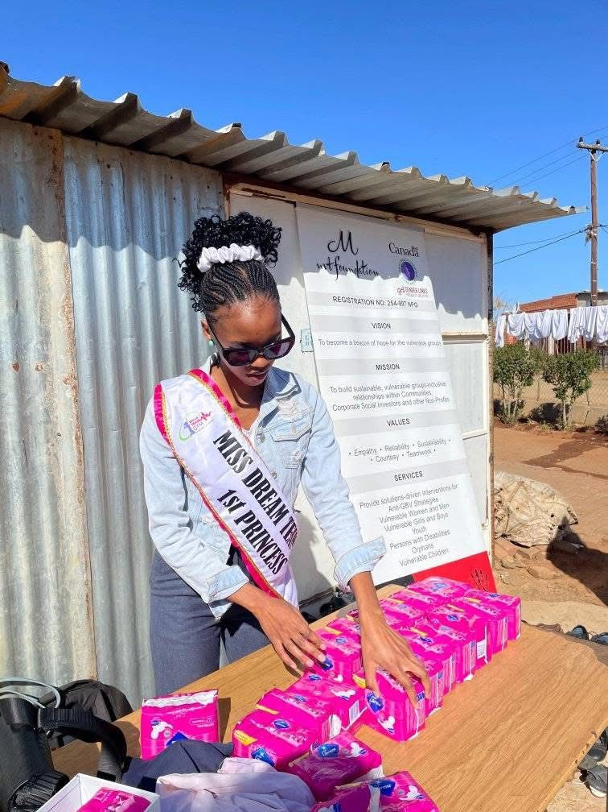
Background
Tamia, a young woman from Heidedal, represents many girls who lacked confidence, support, and opportunities to grow.
Many girls face period poverty, limited access to menstrual health information, and stigma, which affects school attendance and self-esteem.
Girls also have low exposure to STEM opportunities, reducing their confidence to participate in science, technology, and leadership spaces.
There was a need to support, empower, and create platforms for girls to speak, learn, and believe in their future.
Project Focus
The MT Foundation implemented Free The Period (sanitary dignity and empowerment) and Girls Who Code (STEM exposure and skills development) to address these challenges and empower the girl child.
Voice and Choice Summit 2026 \ Voice and Choice Summit 2026

Slide 6
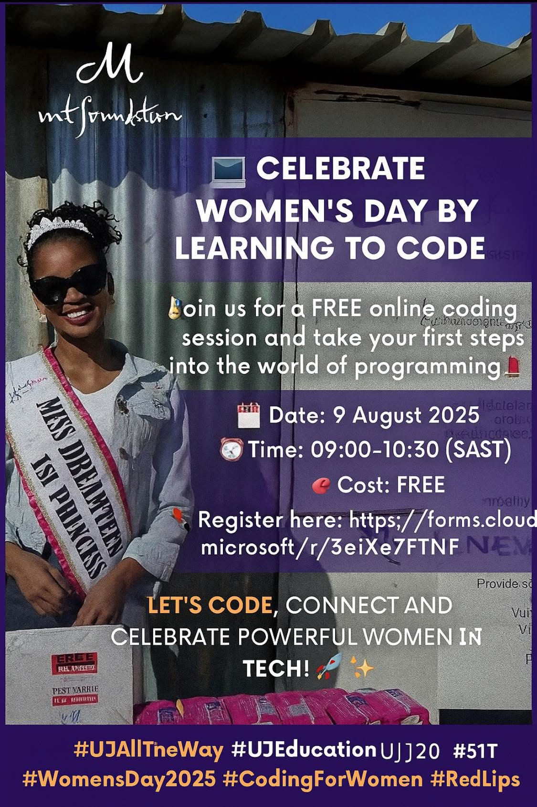
Context
Menstrual health stigma and silence prevent girls from asking questions or seeking help.
Limited female role models and mentorship in communities reduce motivation and confidence.
Girls often have low self-esteem and fear of speaking in public, which limits leadership development.
There is unequal access to STEM opportunities, especially for girls from disadvantaged communities.
Poverty and social challenges increase the risk of school dropout, gender inequality, and vulnerability.
Communities needed safe spaces where girls can talk openly, learn skills, and support each other.
There was a need for programmes that combine health dignity, confidence building, leadership, and digital skills.
The MT Foundation introduced Free The Period and STEM Girls to respond to these challenges and empower the girl child.
Voice and Choice Summit 2026 \ Voice and Choice Summit 2026

Slide 7
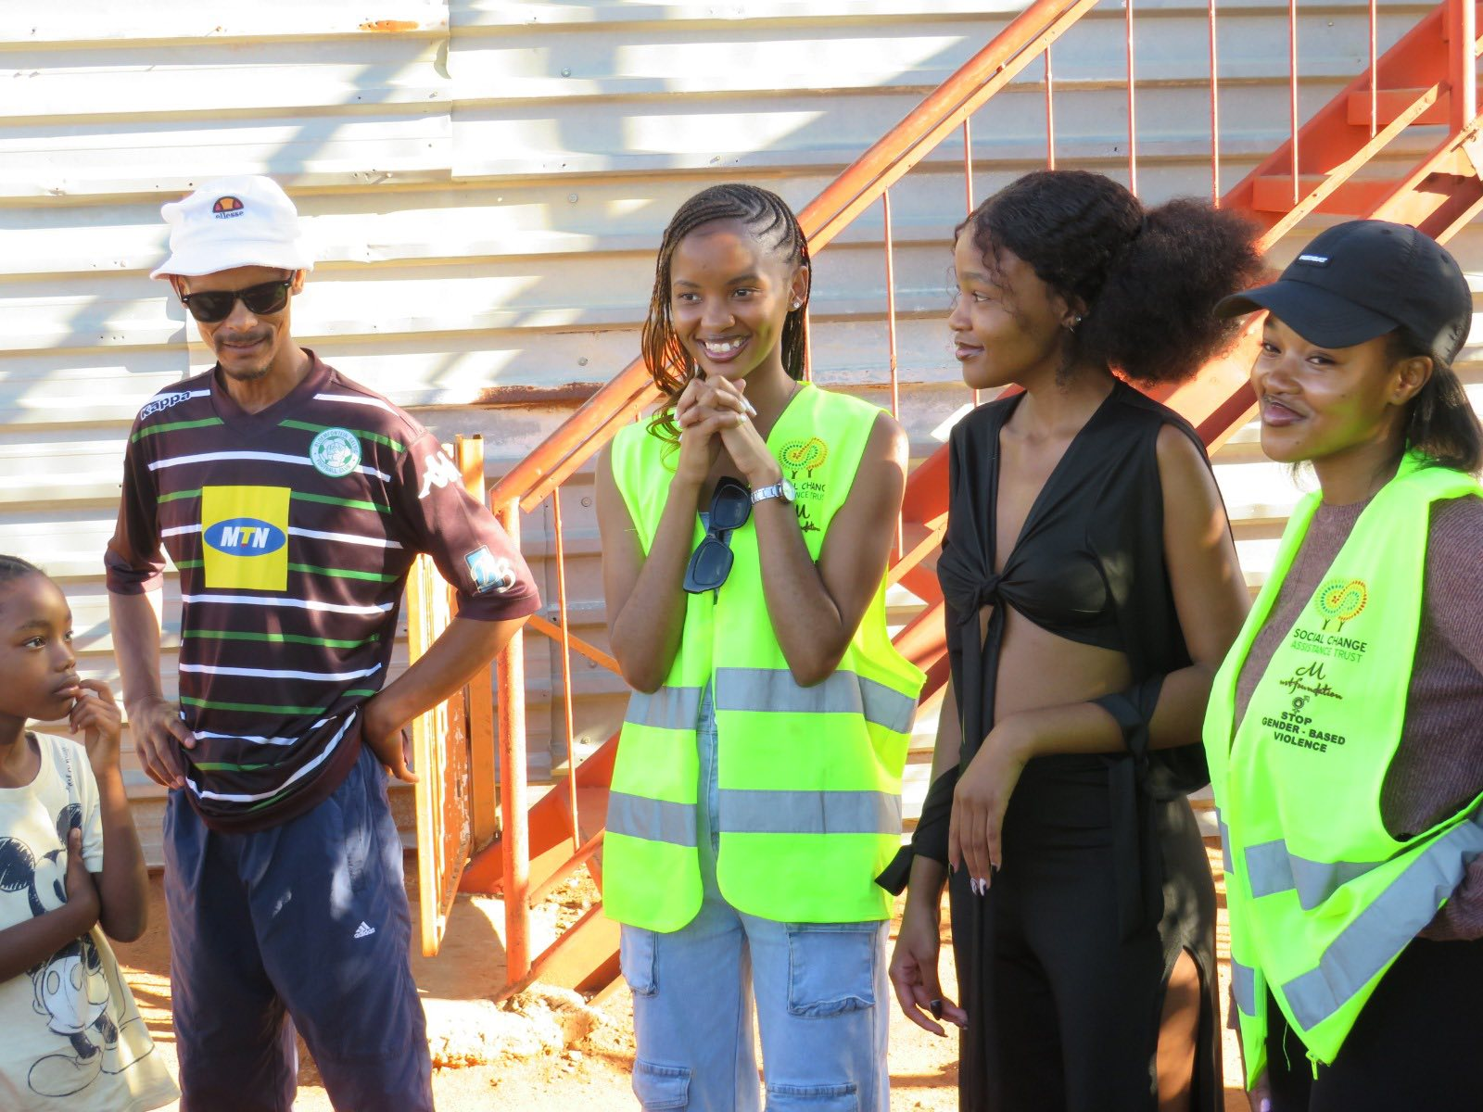
Actions
Tamia:
Stepped out of her comfort zone to speak publicly and share ideas.
Networked with mentors, ambassadors, and community leaders to build connections.
Used social media platforms to raise awareness about menstrual health, gender equality, and empowerment.
Actively participated in community outreach, distributing sanitary products and supporting Free The Period initiatives.
Engaged in advocacy and mentorship, inspiring other young women to speak up and take action.
Supported STEM and digital skills through Girls Who Code programmes.
Became a role model in her community, showing girls they can lead, learn, and advocate for themselves.
Voice and Choice Summit 2026 \ Voice and Choice Summit 2026

Slide 8
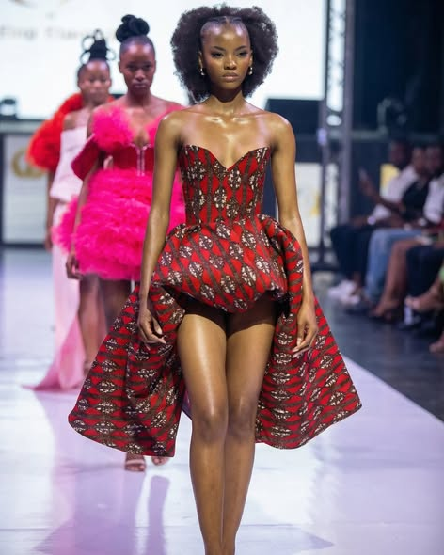
The change – impact
Tamia became a role model for other young women in Heidedal and surrounding communities.
Through Free The Period, she helped girls access sanitary products and learn about menstrual health, reducing stigma.
She inspired girls to explore STEM skills, showing them they can succeed in technology and leadership fields.
Tamia engages communities, attends workshops, and leads events, encouraging participation and advocacy.
She actively uses social media to share positive messages, raise awareness, and promote the MT Foundation’s initiatives.
Her work empowers others to speak up, gain confidence, and take leadership roles.
Her journey shows that personal growth leads to community impact, inspiring change beyond herself.
Voice and Choice Summit 2026 \ Voice and Choice Summit 2026

Slide 9
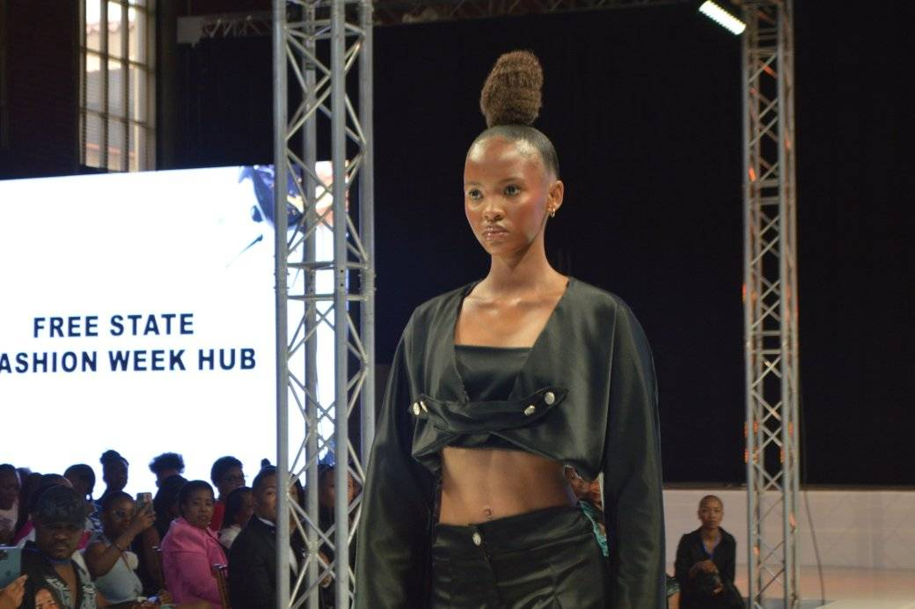
Significance of the Change
Tamia’s growth shows that personal confidence can inspire others; when one girl speaks up, and continue to inspire through modelling.
She became a role model for young women in her community, demonstrating that leadership and advocacy are possible.
Her journey shows that empowerment is more than providing products; it’s about building skills, confidence, and a voice.
Through social media and events, Tamia helps raise awareness about menstrual health, GBV, gender equality, and STEM opportunities.
She contributes to reducing stigma around menstruation and encourages girls to report gender-based challenges.
Tamia’s example strengthens community networks and advocacy, showing the impact of mentorship and collaboration.
Her change opens opportunities for mentoring other girls, scaling up empowerment and leadership programs.
Voice and Choice Summit 2026 \ Voice and Choice Summit 2026

Slide 10
Beneficiaries
 | Number of participants
Female – Direct beneficiaries | 500
Male – Direct beneficiaries | 150
Female – Indirect beneficiaries (e.g. through other networks) | 400
Male – Indirect beneficiaries (e.g. through other networks) | 120
Female – Online beneficiaries (e.g. website access, mailing lists, scholarly articles) | 0
Male – Online beneficiaries (e.g. website access, mailing lists, scholarly articles) | 0
Total | 1 170
Voice and Choice Summit 2026 \ Voice and Choice Summit 2026

Slide 11
Challenges & Lessons learnt
Shyness and low confidence → Mitigation: Attended workshops, panel discussions, and mentorship sessions to build public speaking skills.
Limited leadership experience → Mitigation: Given opportunities to lead events, network with partners, and represent the MT Foundation.
Fear of using social media for advocacy → Mitigation: Training on social media engagement and positive messaging.
Lack of role models in her community → Mitigation: Connected with mentors, ambassadors, and community leaders for guidance.
Balancing personal growth with community work → Mitigation: Encouraged to plan activities and gradually step out of her comfort zone.
Confidence grows with action – stepping into new opportunities helps overcome fear.
Networking is powerful – engaging with mentors and peers opens doors and builds influence.
Using your voice inspires others – sharing experiences encourages young women to speak up.
Personal growth and advocacy go hand in hand – helping others strengthens your own leadership.
Voice and Choice Summit 2026 \ Voice and Choice Summit 2026

Slide 12
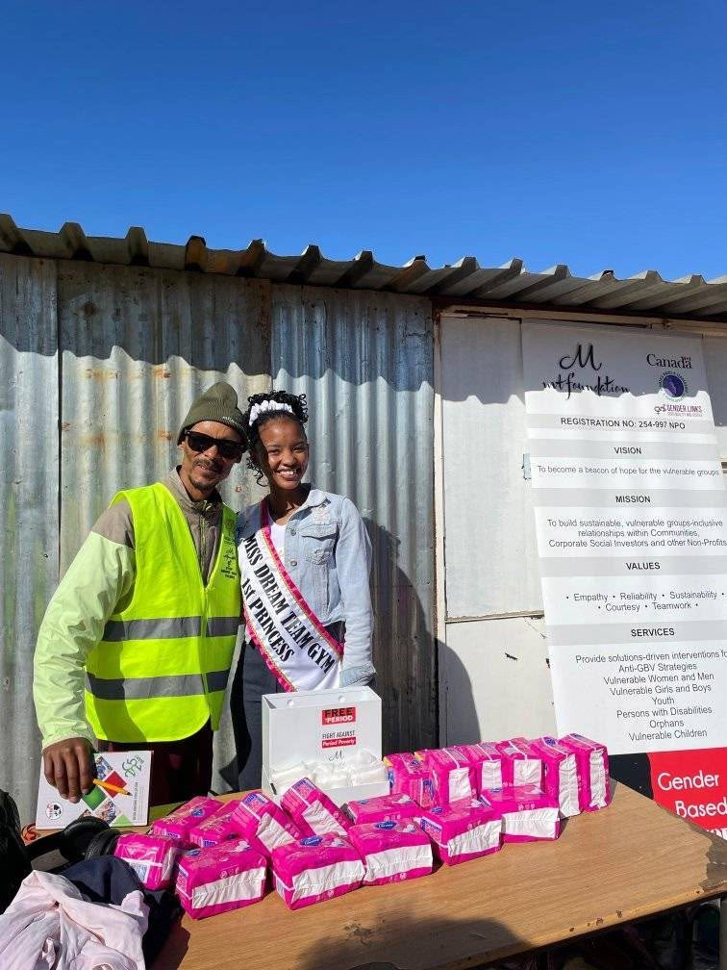
Sustainability
Tamia will continue her role as a Free The Period Ambassador and social media advocate, inspiring and educating others.
She will attend community events, workshops, and campaigns, using her voice to support girls and young women.
Ongoing mentorship and skills development will help her grow as a leader and guide new ambassadors.
Tamia will mentor more girls, sharing her experience to help them gain confidence and leadership skills.
She will use social media to share advocacy messages, programme updates, and lessons learned, reaching a wider audience.
By building partnerships with schools, communities, and organisations, she will help scale the impact of programmes like Free The Period and STEM Girls.
Her continued involvement ensures long-term empowerment, leadership development, and a resilient community of girls who support each other.
Voice and Choice Summit 2026 \ Voice and Choice Summit 2026

Slide 13
Next Steps
Continue her modelling journey to build confidence, visibility, and use her platform to inspire young girls.
Remain an active ambassador for the MT Foundation Free The Period programme, supporting sanitary dignity and menstrual health awareness.
Support and mentor younger girls in STEM Girls activities to encourage interest in science and technology careers.
Use her social media influence to share positive messages, opportunities, and education for young people.
Expansion Areas:
Gender-Based Violence (GBV):Raise awareness and encourage reporting. Why?: Many young women face violence and need trusted voices and information.
HIV/AIDS Awareness: Promote prevention education, testing, and reducing stigma. Why?: Young people are still vulnerable and need accurate information.
Sexually Transmitted Infections (STIs):Educate about prevention, symptoms, and treatment. Encourage responsible health choices. Why?: Early education helps protect health and future wellbeing.
Voice and Choice Summit 2026 \ Voice and Choice Summit 2026

