Slide 1
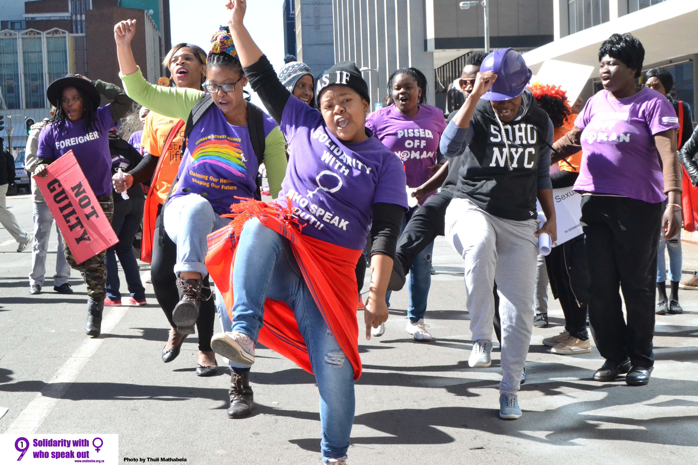


Voice and Choice Summit 2026-Story of Change Category
From Feminist Political Education to Systemic Change
South Africa, Johannesburg, March 2026
Presentation by: Nompumelelo Mathabela | One in Nine Campaign
Voice and Choice Summit 2026 \ Voice and Choice Summit 2026

Slide 2
Synopsis– brief overview what this is about
Name | Nompumelelo Mathabela
Designation | Coordinator
Organisation | One in Nine Campaign
Country | South Africa
Category | Story of Change
Summary | Through the Siqhubeka Ukwakha – Rebuilding Our Communities project, the One in Nine Campaign uses feminist political education to support grassroots activists to understand and challenge systems of power. This story follows Thabsie Mabezane, whose participation deepened her political consciousness and leadership. She went on to strengthen the Lebo Basadi Foundation, establish AfroPride Art’s as a platform for queer liberation, and advocate for inclusive shelter policies for displaced LGBTIQ+ people. Her journey demonstrates how feminist political education can transform individuals into leaders driving systemic change.
Voice and Choice Summit 2026 \ Voice and Choice Summit 2026

Slide 3
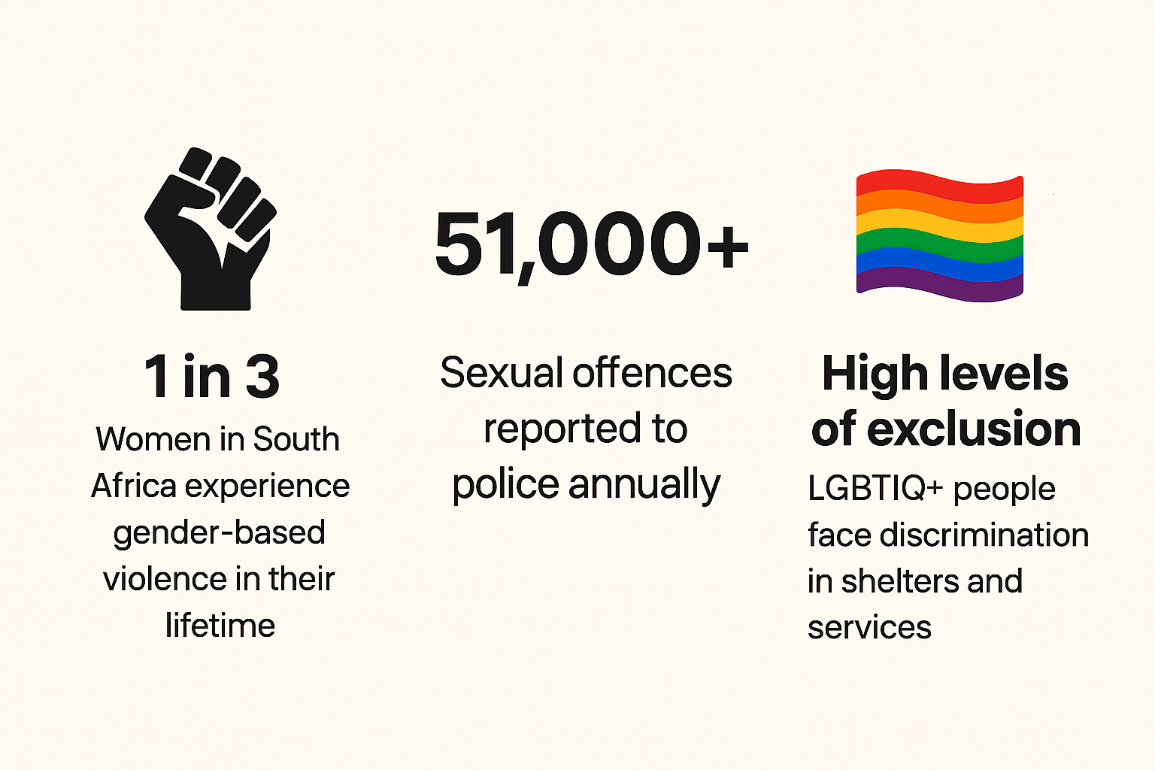
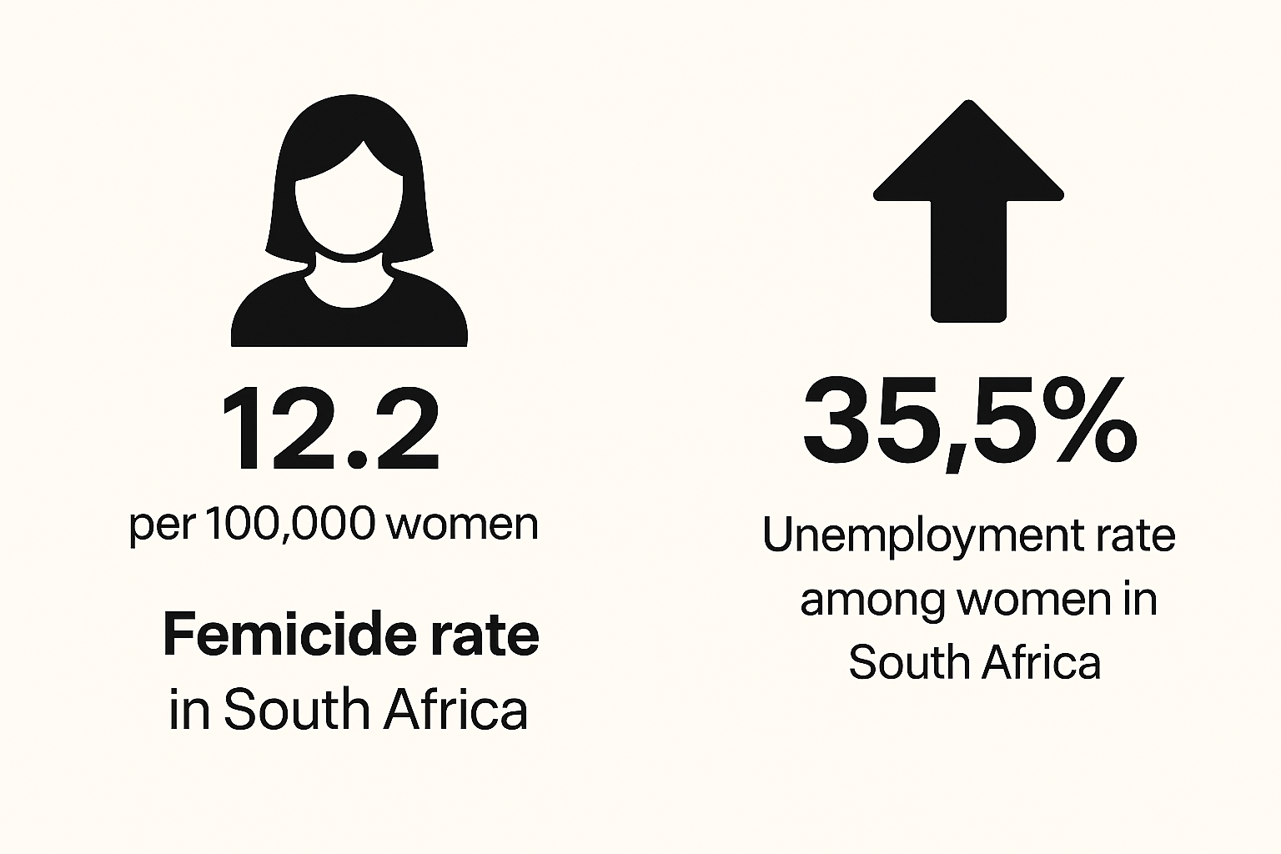
Rebuilding Communities Through Feminist Political Education
Context / Problem
South Africa continues to face high levels of gender-based violence, inequality, and exclusion of marginalised voices, particularly women and LGBTIQ+ people. Many community activists work on the frontlines of these crises but lack access to feminist political education spaces that help them analyse power, patriarchy, and structural inequality shaping their realities.
Voice and Choice Summit 2026 \ Voice and Choice Summit 2026
Voice and Choice Summit 2026 \ Voice and Choice Summit 2026

Slide 4
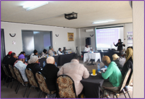
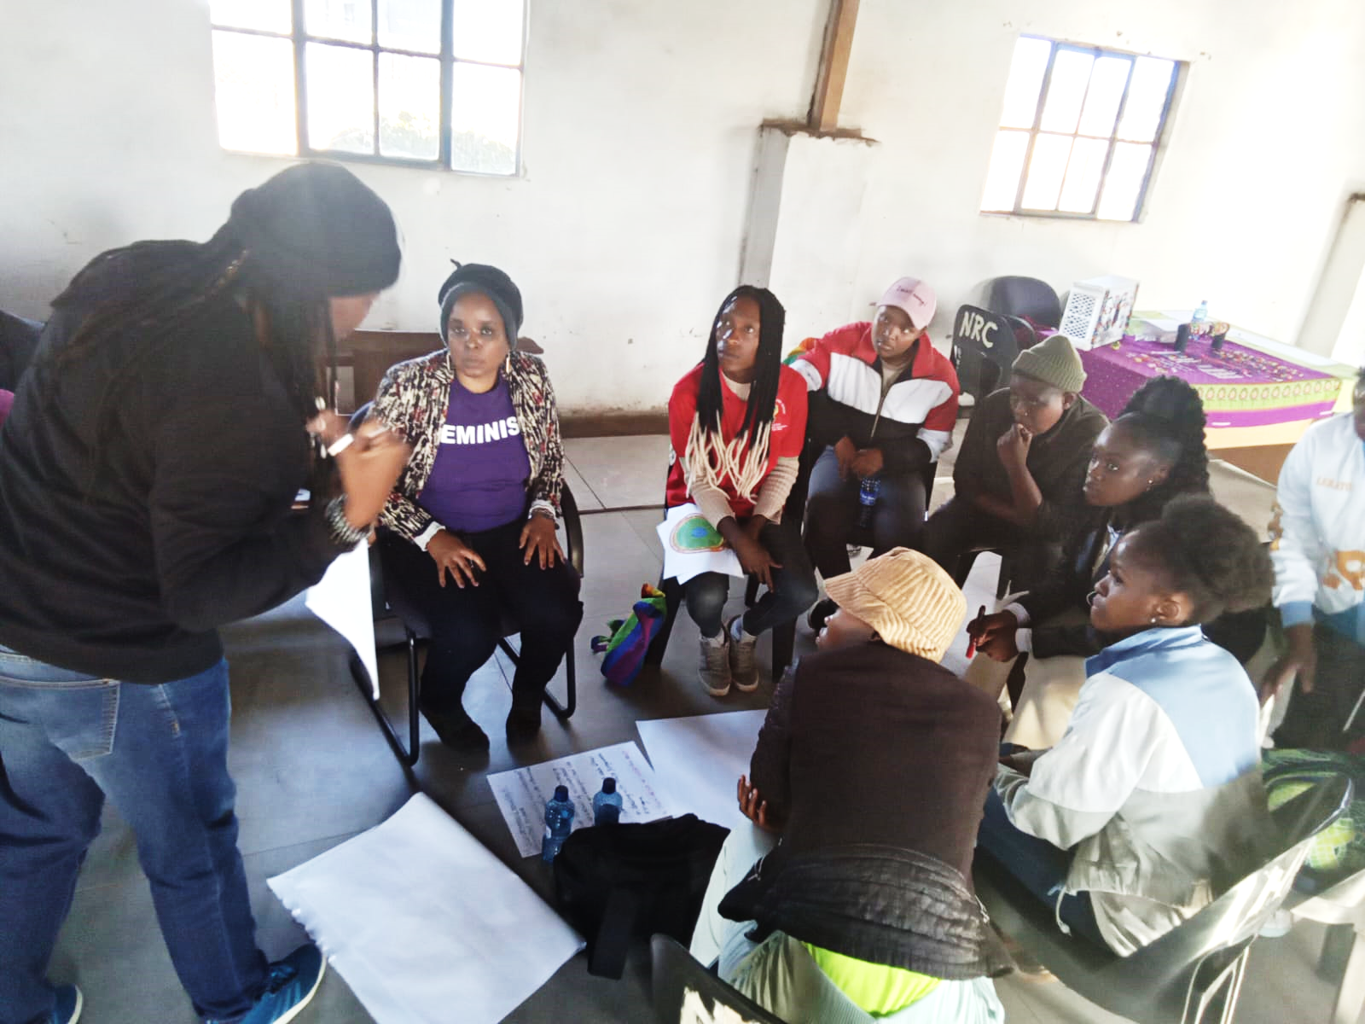
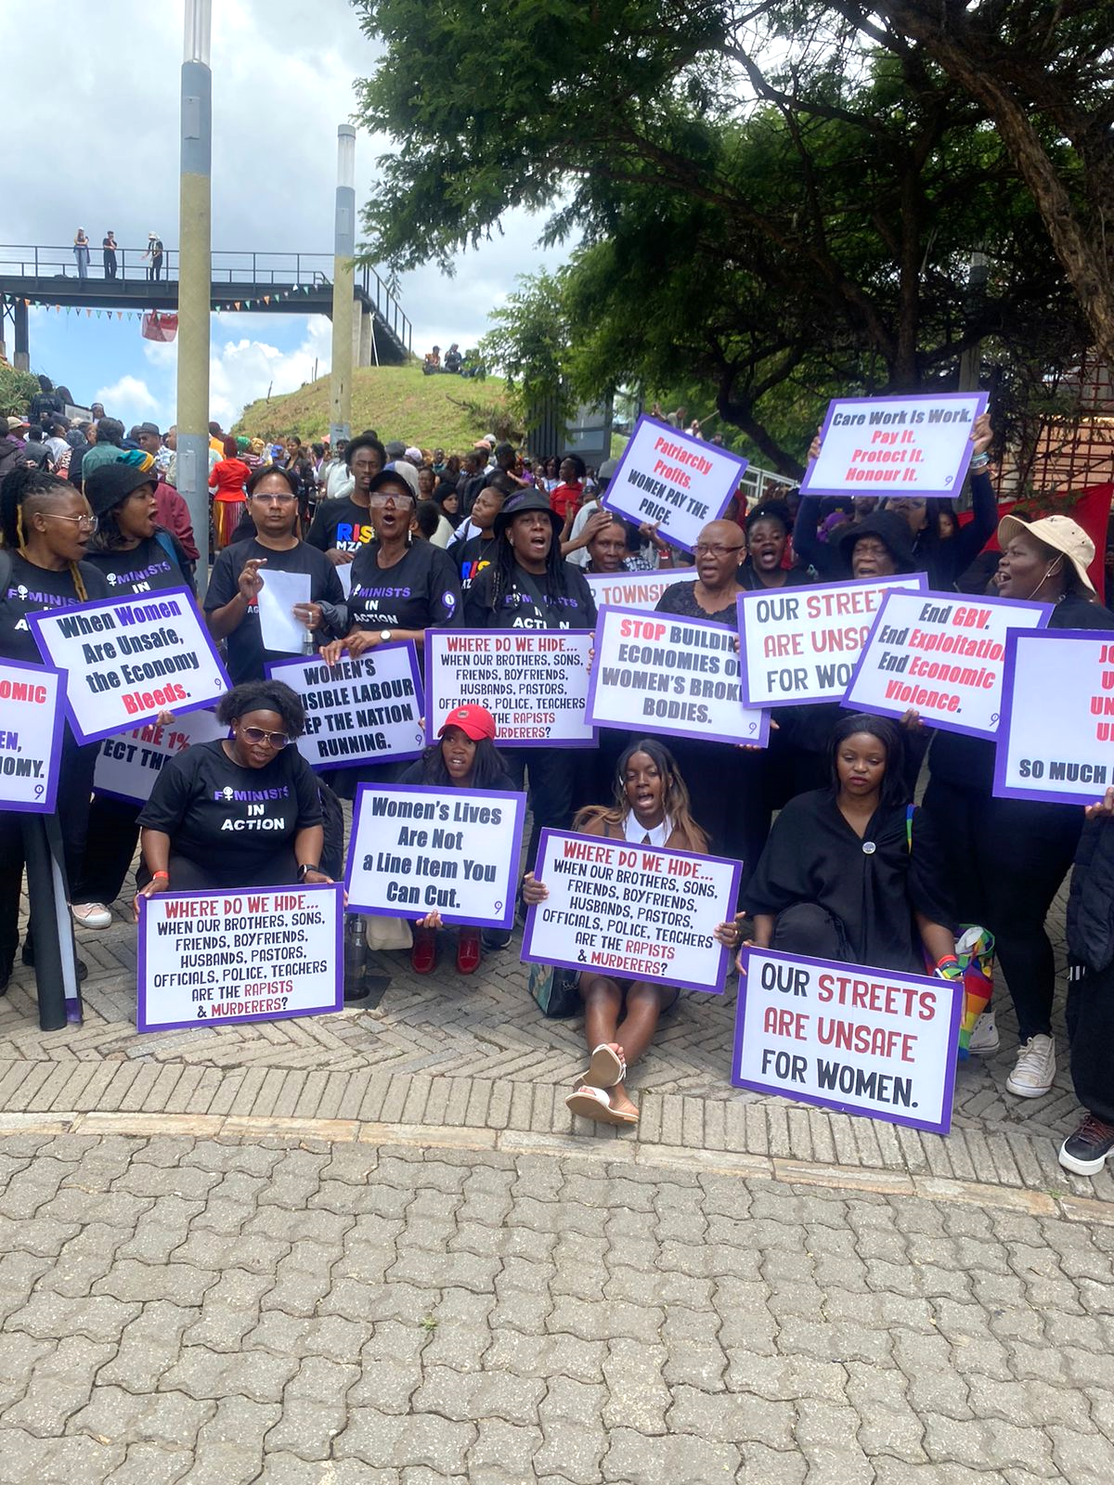
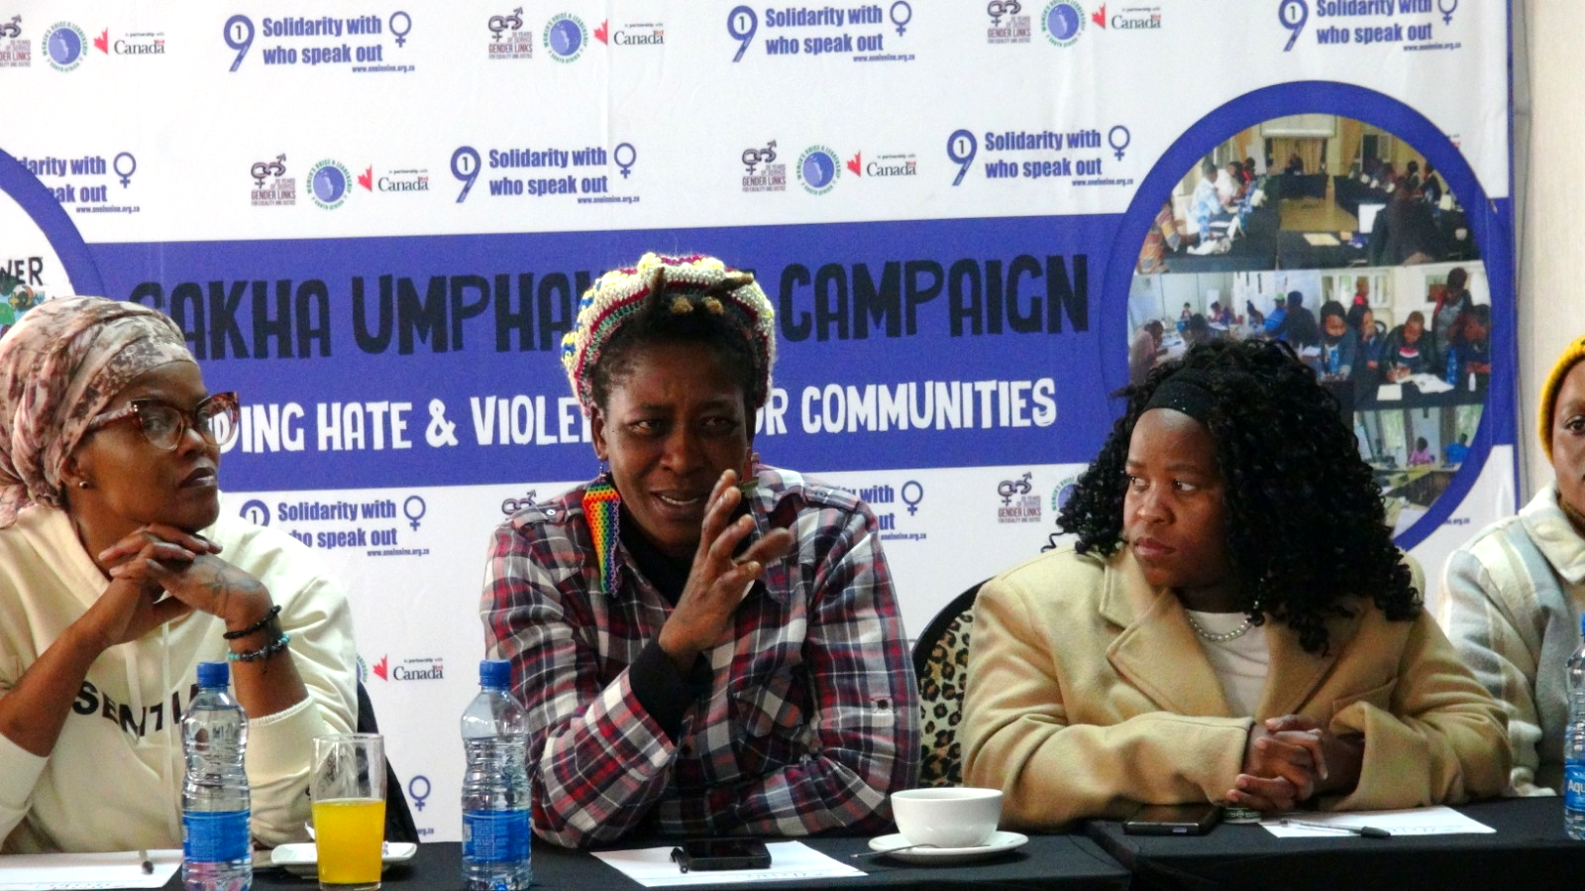
Our Response
Through the Siqhubeka Ukwakha project, working with community-based organisations and activists, we facilitated feminist political education workshops that created spaces for activists to reflect on lived experiences, build political consciousness, strengthen leadership, and develop strategies for collective action.
Change Emerging
Participants developed stronger political clarity, leadership, and movement-building capacity, enabling them to organise within their communities and challenge systems that perpetuate inequality.
Voice and Choice Summit 2026 \ Voice and Choice Summit 2026
Voice and Choice Summit 2026 \ Voice and Choice Summit 2026

Slide 5
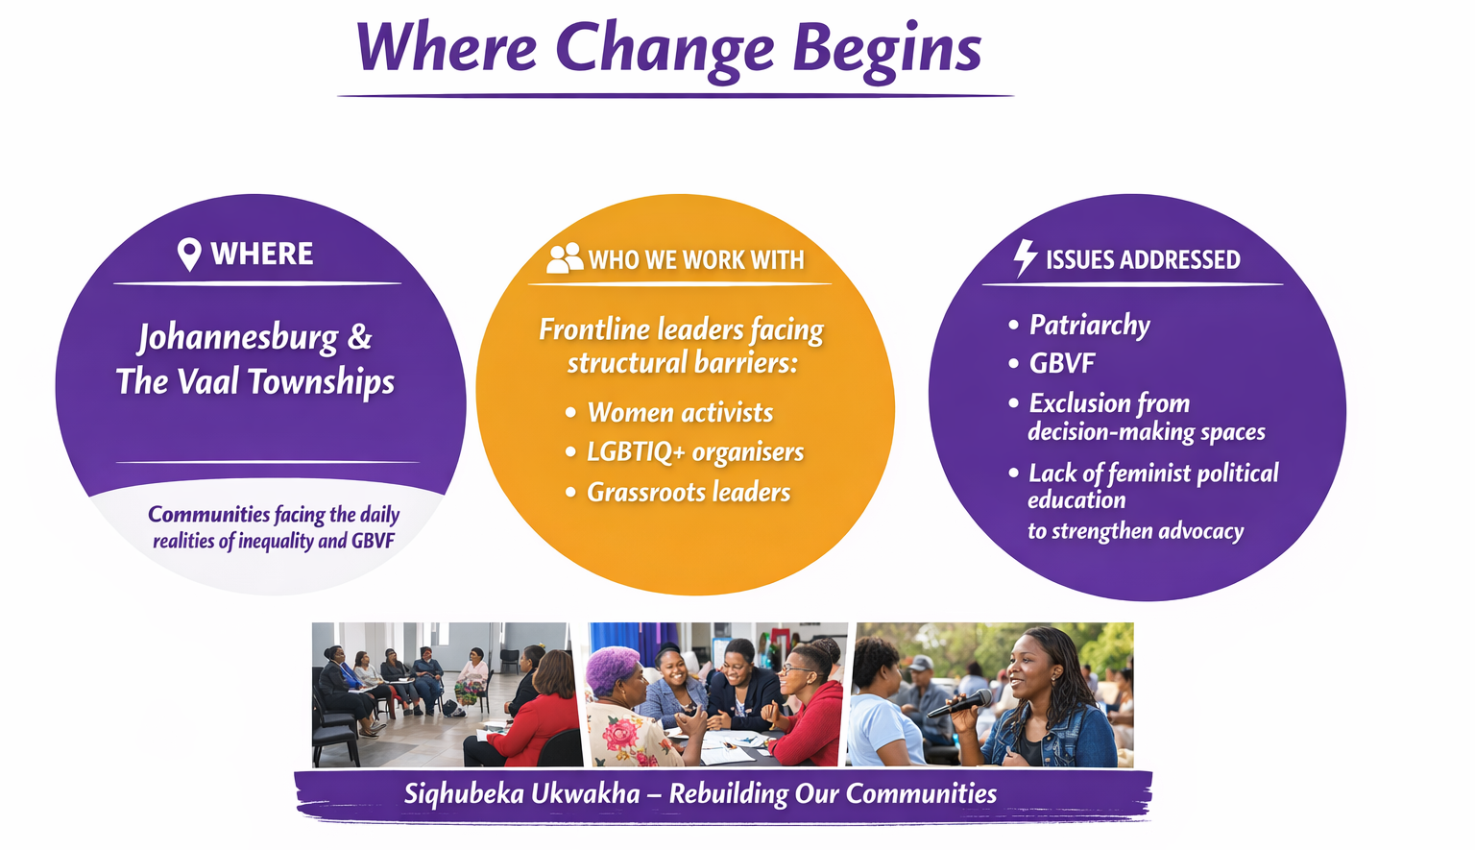
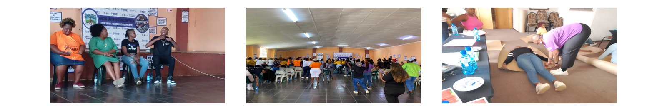
Context
Voice and Choice Summit 2026 \ Voice and Choice Summit 2026
Voice and Choice Summit 2026 \ Voice and Choice Summit 2026

Slide 6
Actions
Feminist Political Education & Leadership Development
Activities included:
Feminist political education workshops & Community Dialogues
Art for liberation sessions
Advanced leadership training
Healing and mentorship spaces
Thabsie Mabezane – Grassroots Leader
Through these spaces Thabsie:
• Deepened her understanding of intersectionality and systems of power
• Strengthened her leadership and organising skills
• Gained tools for movement building and advocacy
“My learning journey with 1in9 transformed how I understand power, leadership, and collective liberation.”
Applying the Learning
Thabsie used these tools to:
• Strengthen her organisation, Lebo Basadi Foundation
• Advocate for LGBTIAQ+ inclusive shelter policies
• She started a creative space using art for liberation tools she learned in the project.
• Facilitate community and organisational workshops e.g. CSVR, UN and other spaces.
Recognition
Sunday World Community Service Award
Social Justice Rising Star Award
Voice and Choice Summit 2026 \ Voice and Choice Summit 2026
Voice and Choice Summit 2026 \ Voice and Choice Summit 2026

Slide 7
The change – impact
Through the feminist political education, We transformed grassroots participants into leaders influencing communities and institutions.
✔ Stronger feminist leadership ✔ Greater political clarity about systems of oppression ✔ Increased community advocacy and organising
Participants moved from learning → action → leadership.
Examples: Selected for awards, Human Rights projects, built healing and economic initiatives, engaged communities.
PERSONAL TRANSFORMATION
Shifted participants' activism from identity issues, generational trauma, victim identity, isolated violent experiences.
COLLECTIVE ACTION
Participants began linking their lived struggles and organising collectively for community transformation.
STRUCTURAL ADVOCACY
Feminist political education became community power. Participants challenged institutions, built healing spaces, and strengthened collective feminist organising.
Voice and Choice Summit 2026 \ Voice and Choice Summit 2026
Voice and Choice Summit 2026 \ Voice and Choice Summit 2026

Slide 8
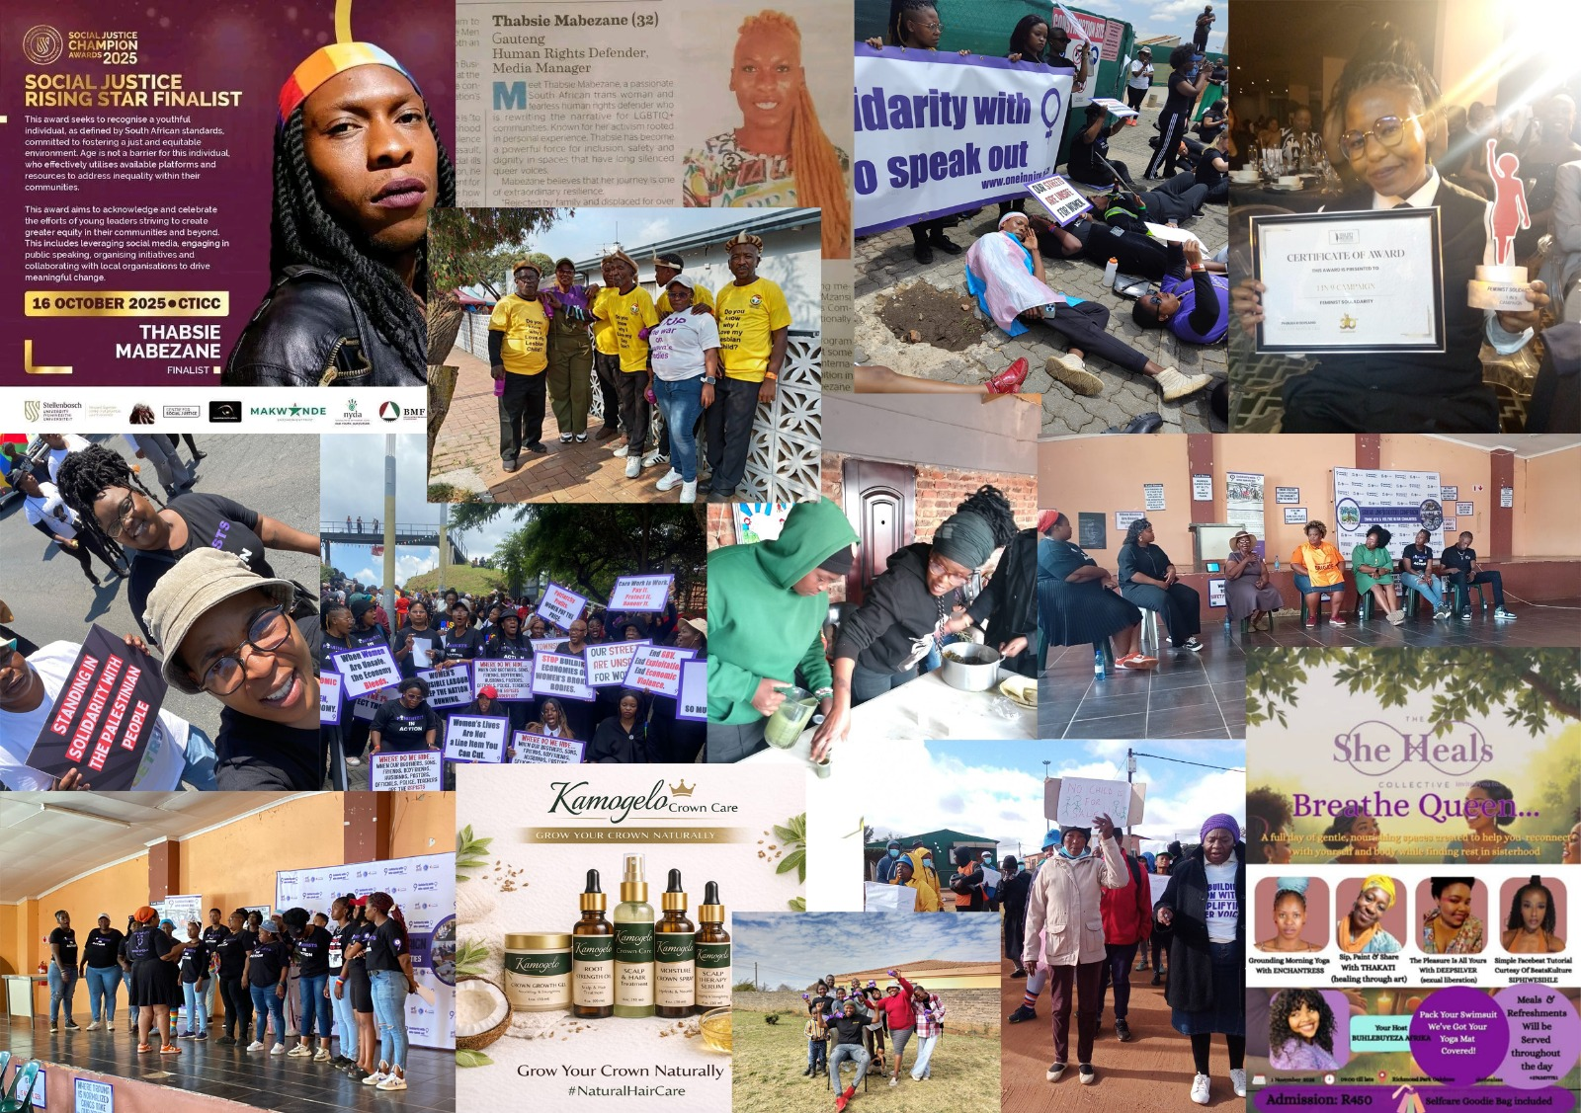
Significance of the Change
Movement Impact:
From community members affected by GBVF to organisers, advocates, facilitators and healers shaping local responses.
Collective Transformation
What it means for the Future:
Feminist political education isconsciousness raising and healing, itproduces leaders who drive systemicchange.
Next steps are to scale the project to reachmore community activist across SouthAfrica.
Voice and Choice Summit 2026 \ Voice and Choice Summit 2026
Voice and Choice Summit 2026 \ Voice and Choice Summit 2026

Slide 9
Beneficiaries
 | NUMBER OF PARTICIPANTS
Female – Direct beneficiaries | 110
Male – Direct beneficiaries | 45
Female – Indirect beneficiaries (e.g. through other networks) | 700+
Male – Indirect beneficiaries (e.g. through other networks) | 350+
Female – Online beneficiaries (e.g. website access, mailing lists, scholarly articles) | 1905
Male – Online beneficiaries (e.g. website access, mailing lists, scholarly articles) | 290
Total | 3400+
Voice and Choice Summit 2026 \ Voice and Choice Summit 2026
Voice and Choice Summit 2026 \ Voice and Choice Summit 2026

Slide 10
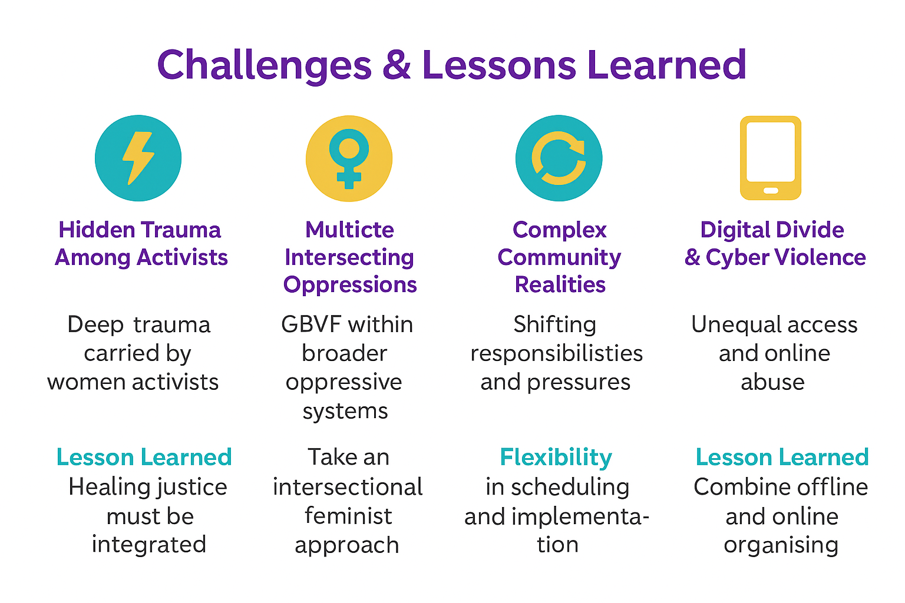
Challenges & Lessons learnt
Deep Trauma carried by women activists | GBVF is only one layer of oppression affecting women and marginalised communities. | Shifting responsibilities, economic pressures, and community crises. | Digitial divide and cyber violence.
LESSONS LEARNED
Healing Justice must be intergrated into our programmes. | Take an intersectional feminist approach to dealing with GBVF | Flexiility in scheduling and implementation | combine offline community organising, digital access awareness, and online safety.
Voice and Choice Summit 2026 \ Voice and Choice Summit 2026
Voice and Choice Summit 2026 \ Voice and Choice Summit 2026

Slide 11
Sustainability
COMMUNITY LEADERSHIP
COLLECTIVE MOVEMENT BUILDING
One in Nine will expand partnerships and political educations spaces to scale feminist leadership across communities in all provinces.
KNOWLEDGE TRANSFER
Voice and Choice Summit 2026 \ Voice and Choice Summit 2026
Voice and Choice Summit 2026 \ Voice and Choice Summit 2026

Slide 12
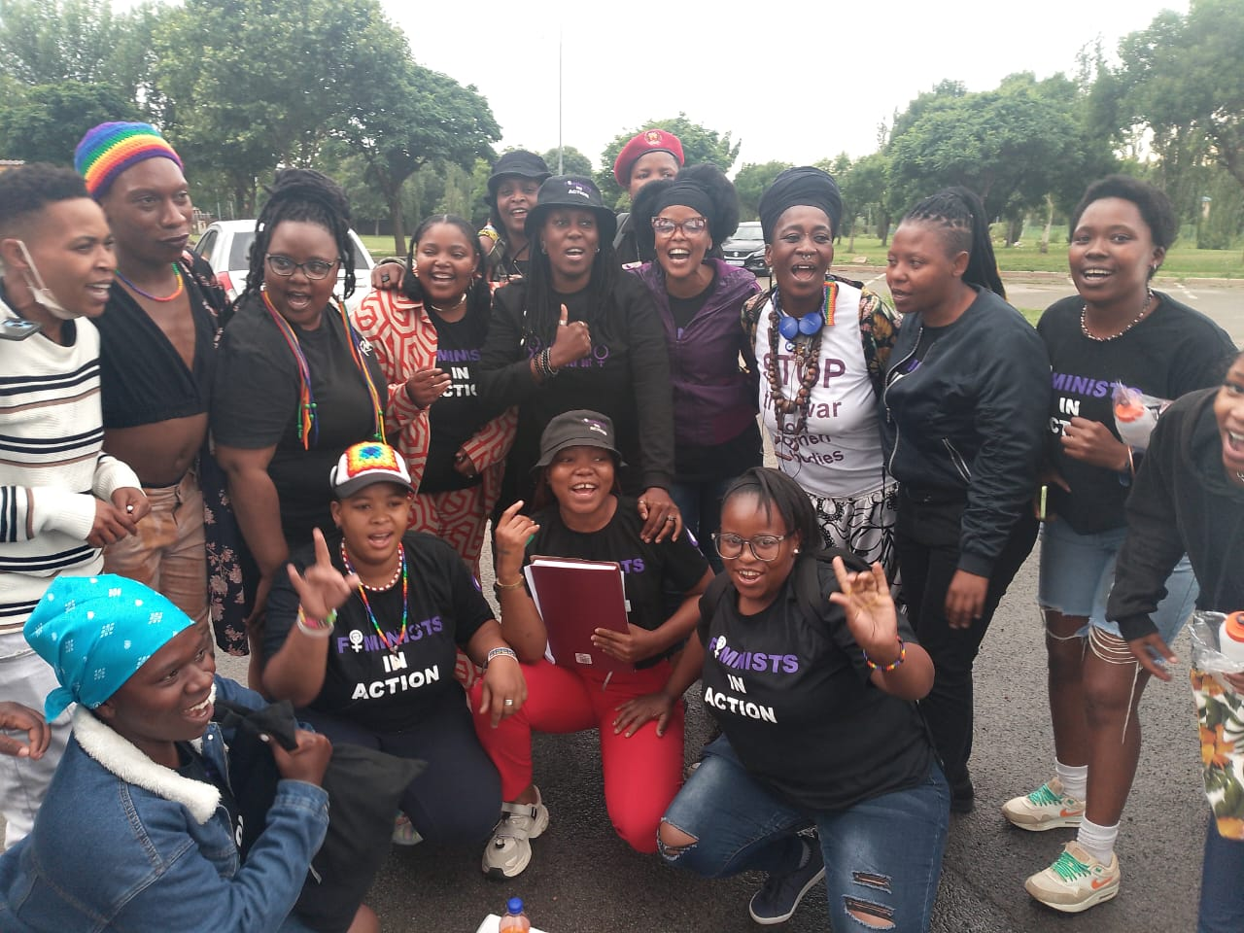
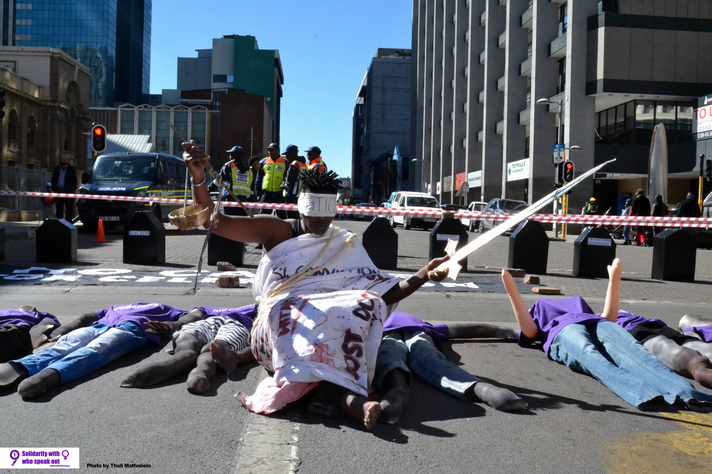
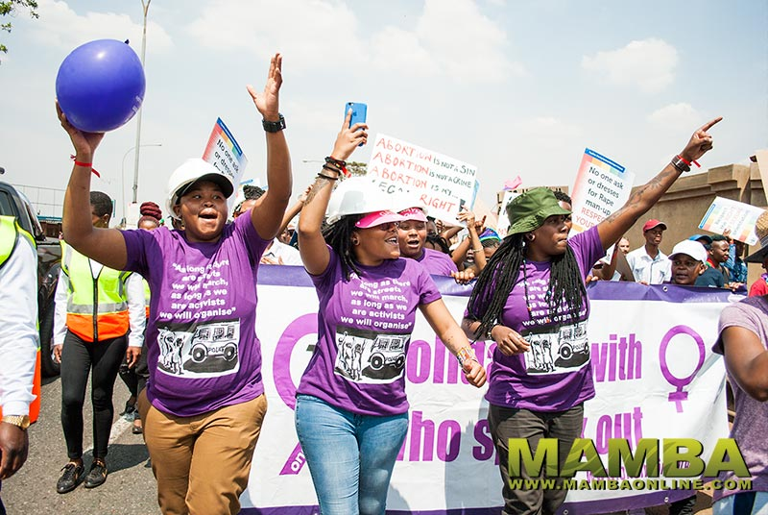
Next Steps
Feminist Alliances → Community Dialogue → Accountability → Evidence → Justice
Ending violence against women requires shifting attitudes, strengthening communities, and building movements rooted in justice, healing, and collective power.
Voice and Choice Summit 2026 \ Voice and Choice Summit 2026
Voice and Choice Summit 2026 \ Voice and Choice Summit 2026

