Slide 1


Voice and Choice Summit 2026-Story of Change Category
Namibia: From 60,000 Signatures to Draft Abortion Law Reform
(Namibia, Windhoek, 2020-2026, and Ndiilokelwa Nthengwe )
VCRC Health and Research Institute
Voice and Choice Summit 2026 \ Voice and Choice Summit 2026

Slide 2
Synopsis– brief overview what this is about
Name | Ndiilokelwa Nthengwe
Designation | Executive Director
Organisation | VCRC Health and Research Institute
Country | Namibia
Category | Story of Change
Summary | This story traces Namibia’s shift from silence under the 1975 Abortion and Sterilisation Act to national policy momentum and a 2026 constitutional challenge. Through grassroots mobilisation (60,000-signature petition), research, coalition-building, and digital advocacy, VCRC helped catalyse a draft reform policy and reposition abortion as a public health and constitutional rights issue.
Voice and Choice Summit 2026 \ Voice and Choice Summit 2026

Slide 3
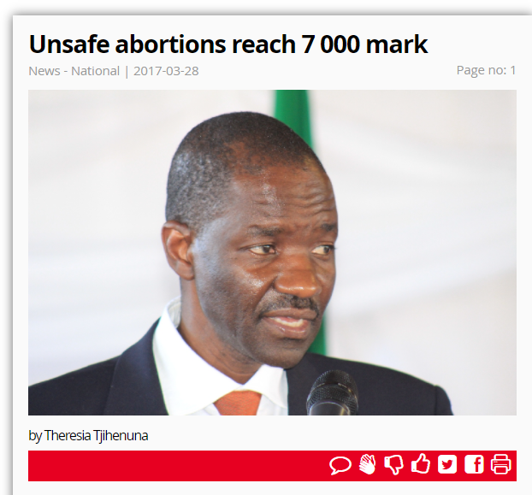
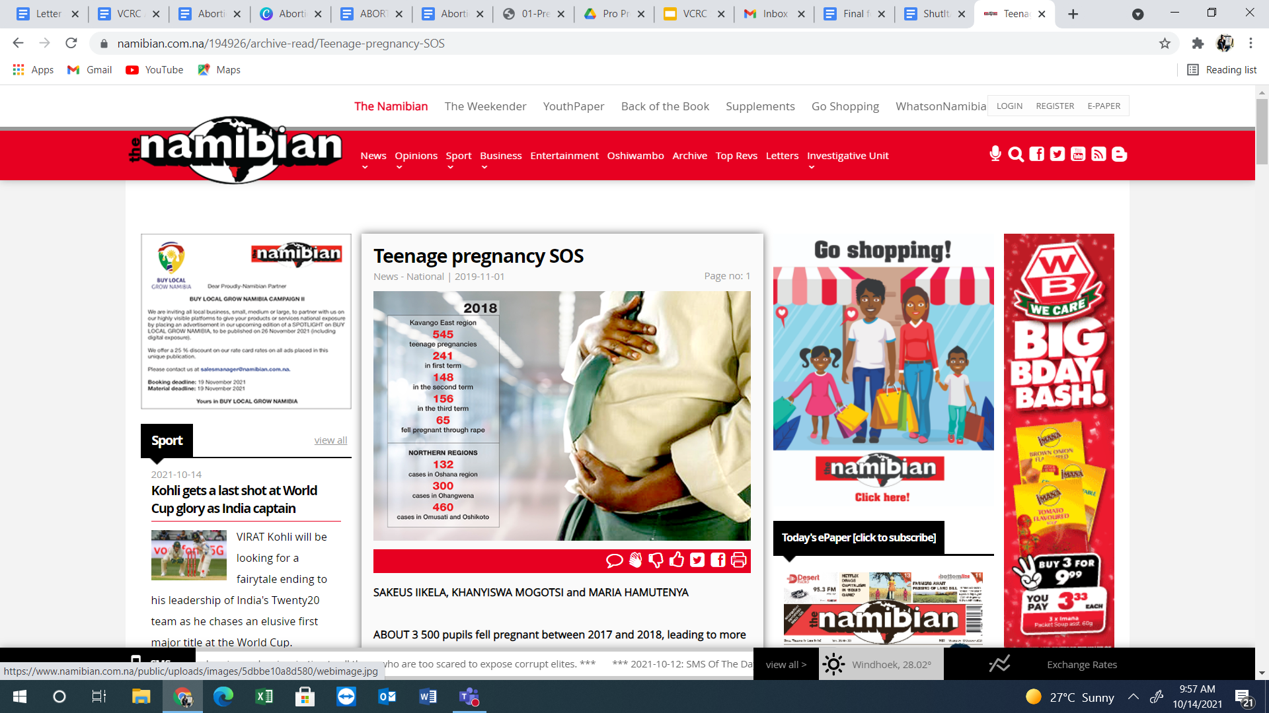
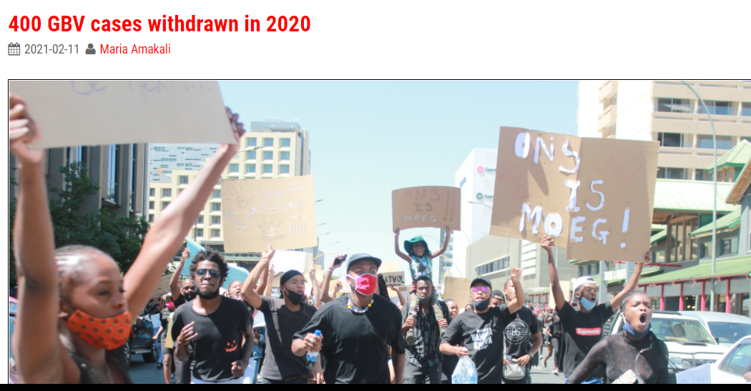
Background(problem, actions, change, evidence)
Give some background. Briefly describe the context or problem.
Namibia’s 1975 apartheid-era Abortion and Sterilisation Act severely restricts abortion. Unsafe abortions contribute to ±13% of preventable maternal deaths. Over 7,000 complications were recorded in 2017 alone (likely underreported). Rural, poor, young and LGBTQIA+ persons are most affected.
Voice and Choice Summit 2026 \ Voice and Choice Summit 2026

Slide 4
Background(problem, actions, change, evidence)
Give some background. Briefly describe the context or problem.
Actions Taken:
60,000-signature national petition (2020)
500+ community mobilisers trained
2,000+ people reached through SRHR dialogues (6 regions)
4 research papers (2021–2026)
13 multimedia advocacy productions
Submission to Parliament (2021)
Participation in National Reform Committee
The Change:
Draft abortion reform policy developed (2025)
Government acknowledgment that the law is outdated
Constitutional litigation filed in 2026
Voice and Choice Summit 2026 \ Voice and Choice Summit 2026

Slide 5
Where: Nationwide, Namibia Focused regions: Kavango West, Oshikoto, Omusati, Ohangwena, Oshana
Who was most affected:
Rural women and girls
Survivors of sexual violence
Young people
Low-income communities
LGBTQIA+ individuals
Issues Addressed:
Criminalisation of abortion
Unsafe procedures & maternal deaths
Contraceptive shortages
Stigma & exclusion
Policy stagnation
Voice and Choice Summit 2026 \ Voice and Choice Summit 2026

Slide 6
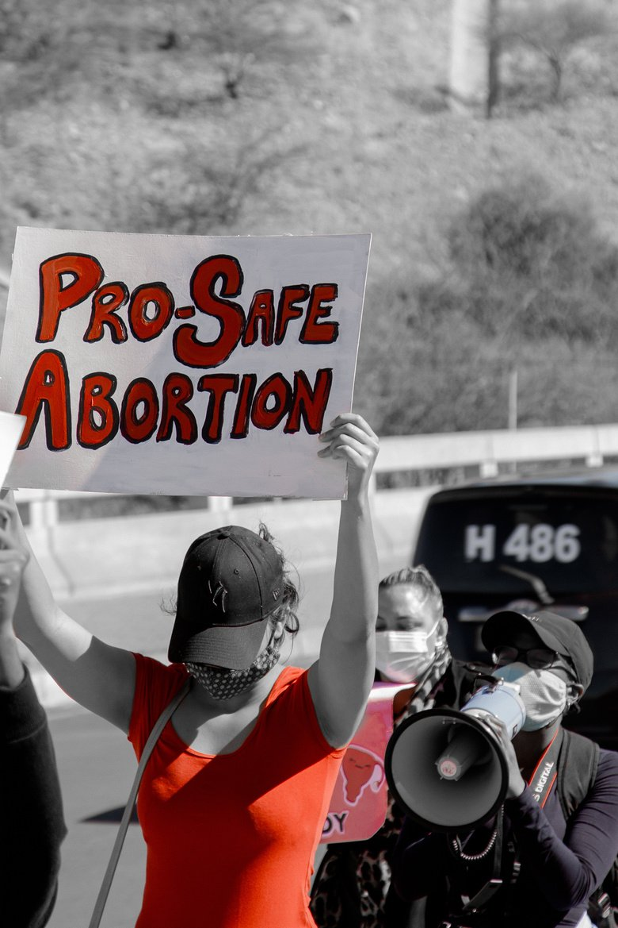
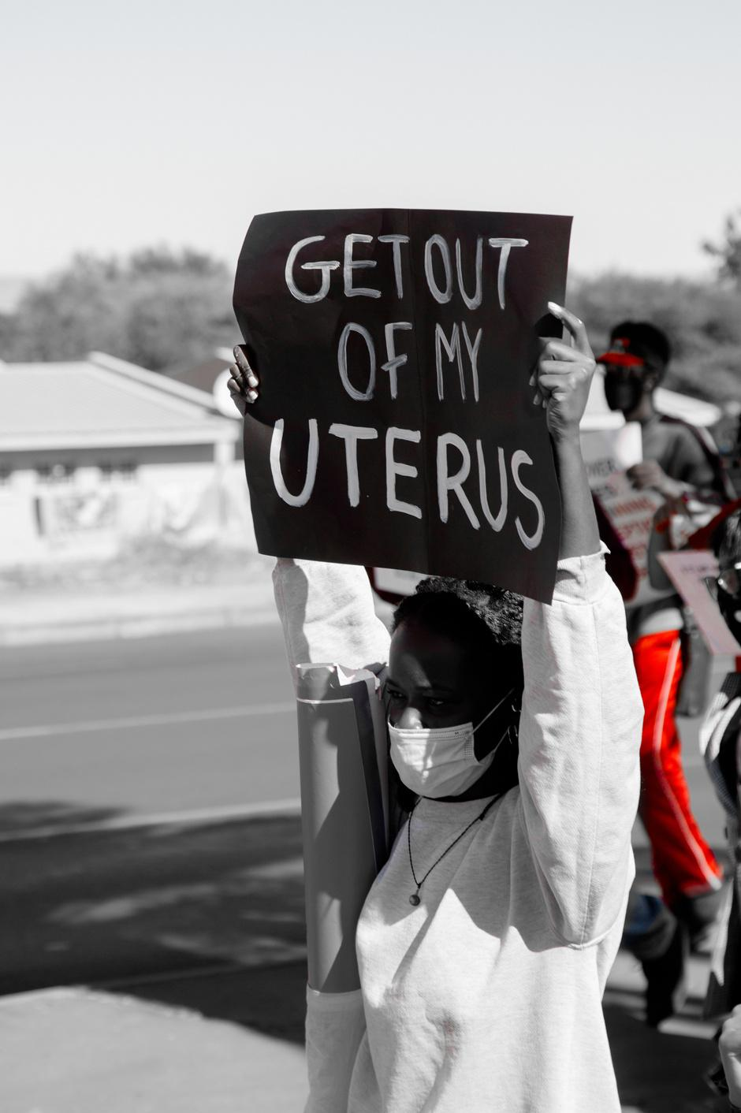
Actions
How did the change come about?
Key Activities:
Nationwide petition (60,000 signatures)
Evidence-based research publications
Regional SRHR workshops
Parliamentary submissions
Digital storytelling & queer-inclusive narratives
Coalition-building (IPPF, UNFPA, ARASA, SheDecides, SAAF)
Voice and Choice Summit 2026 \ Voice and Choice Summit 2026

Slide 7
The change – impact
What Changed:
First official policy draft recommending abortion law reform (2025)
Government publicly acknowledged law is outdated
Shift from silence to national debate
Inclusion of public health lens
Who Benefited:
2,000+ direct community beneficiaries
60,000+ online engagements
500+ mobilisers empowered
Current Situation:
Draft policy awaiting legislative advancement
Constitutional High Court challenge launched (2026)
Positive change — but reform not yet finalised.
Voice and Choice Summit 2026 \ Voice and Choice Summit 2026

Slide 8
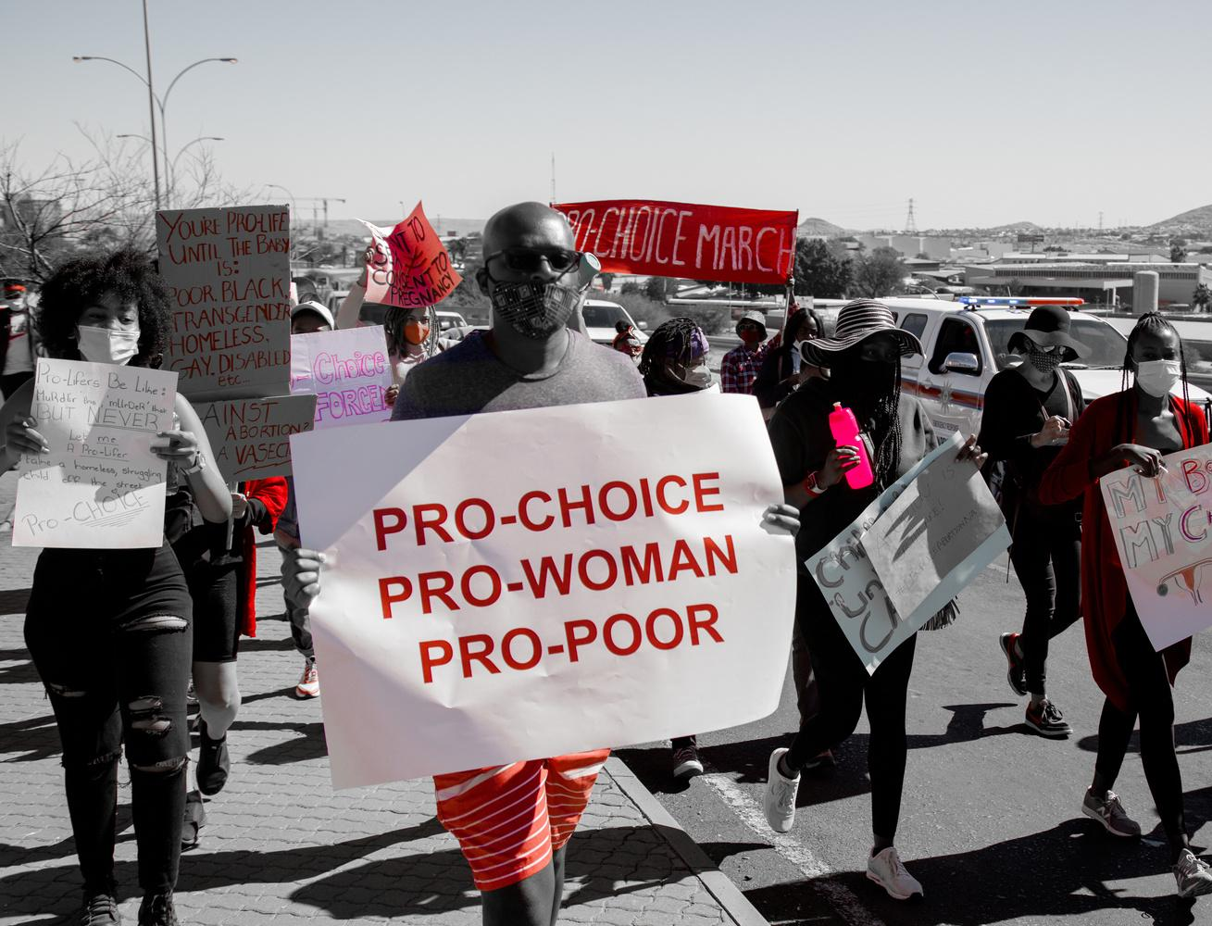
Significance of the Change
This marks the first structured national momentum toward abortion reform in decades.
For the movement:
Validates grassroots advocacy
Embeds abortion in public health & constitutional discourse
Strengthens intersectional feminist coalition
Next-Level Impact:
Litigation could set national precedent
Potential SADC regional influence
Accelerates integration of safe abortion into healthcare systems
Voice and Choice Summit 2026 \ Voice and Choice Summit 2026

Slide 9
Beneficiaries
 | Number of participants
Female – Direct beneficiaries | 2000
Male – Direct beneficiaries | 1000
Female – Indirect beneficiaries (e.g. through other networks) | 70,000
Male – Indirect beneficiaries (e.g. through other networks) | 500
Female – Online beneficiaries (e.g. website access, mailing lists, scholarly articles) | 5000
Male – Online beneficiaries (e.g. website access, mailing lists, scholarly articles) | 1000
Total | 79,500
Voice and Choice Summit 2026 \ Voice and Choice Summit 2026

Slide 10
Challenges & Lessons learnt
Challenges & mitigation
Deep stigma & religious opposition
Political hesitation
Slow legislative processes
Resource constraints
What lessons have you learnt?
Evidence + mobilisation = credibility
Intersectionality strengthens movements
Policy engagement must be paired with litigation
Digital storytelling shifts public narrative
Voice and Choice Summit 2026 \ Voice and Choice Summit 2026

Slide 11
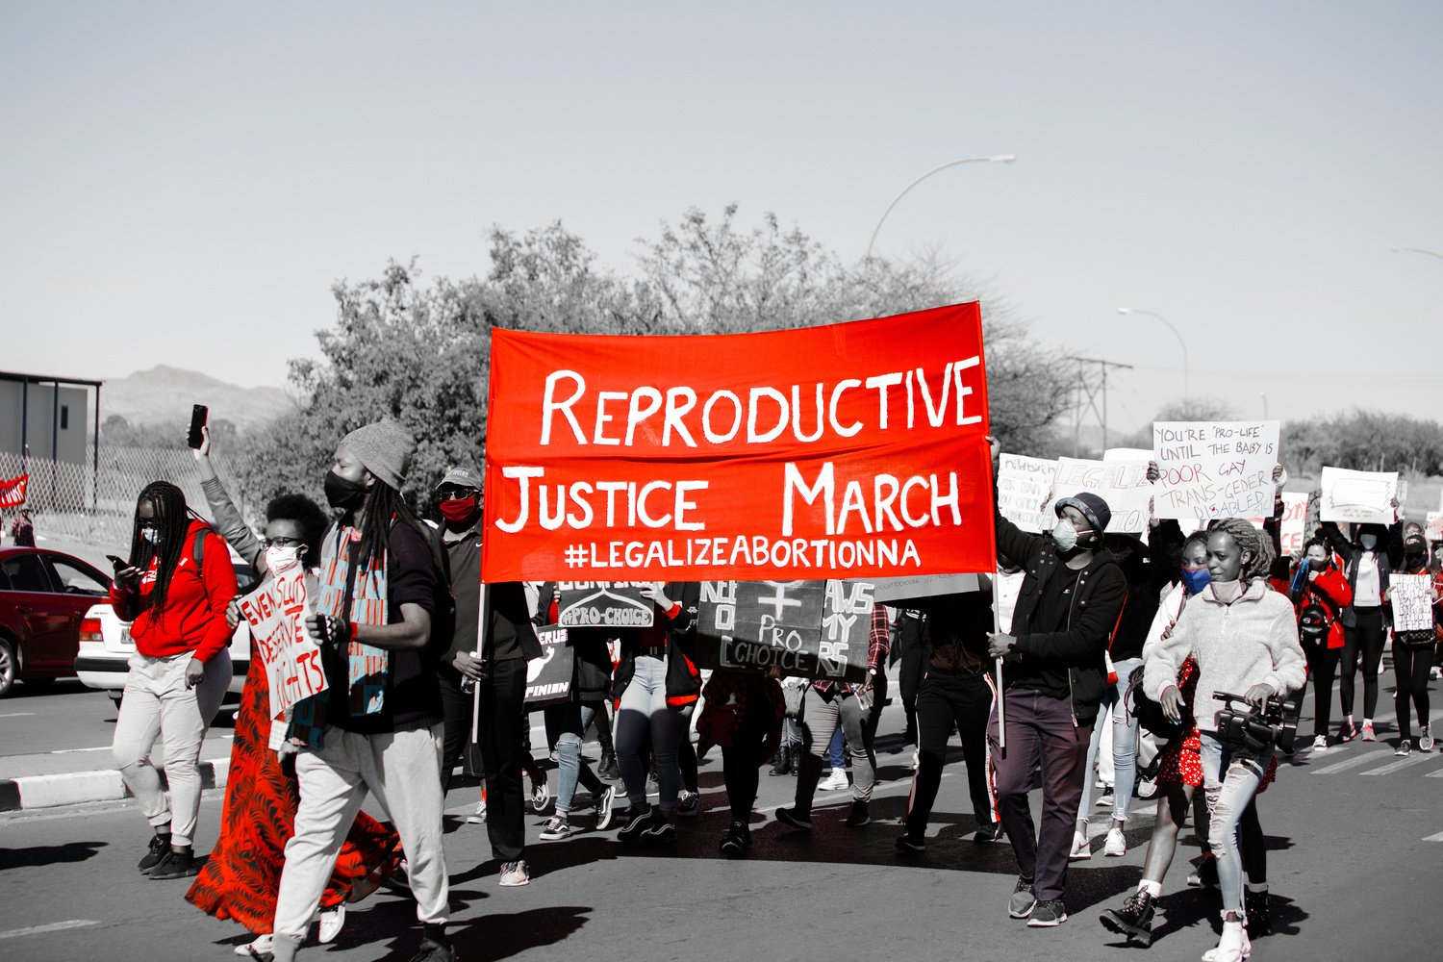
Sustainability
Measures in Place:
500+ mobiliser network
Annual Feminist Festival (300+ attendees)
Ongoing research pipeline
Digital advocacy platform
Government committee representation
Scale-Up Strategy:
Constitutional litigation (2026)
Continued public health framing
Expanded youth & rural outreach
Regional advocacy partnerships
Voice and Choice Summit 2026 \ Voice and Choice Summit 2026

Slide 12
Next Steps
File and argue High Court constitutional case (2026)
Advocate for enactment of Reproductive Health & Termination of Pregnancy Act
Expand community SRHR education
Strengthen commodity security advocacy
Deepen SADC regional collaboration
Voice and Choice Summit 2026 \ Voice and Choice Summit 2026

Slide 13
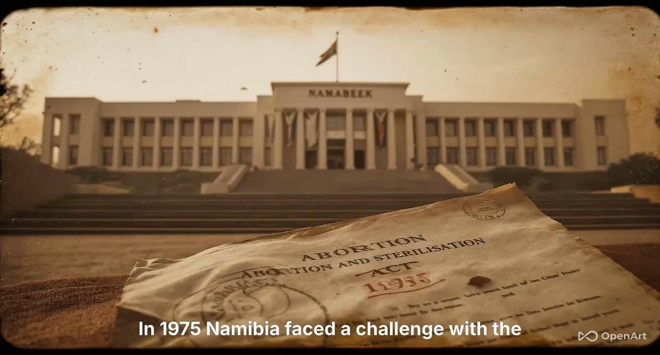
Voice and Choice Summit 2026 \ Voice and Choice Summit 2026

