Slide 1


Voice and Choice Summit 2026-Story of Change Category
South Africa: From Knowledge to Choice: Advancing sexual and reproductive health and rights for young people.
(South Africa, Limpopo Province, March 2026. Leah Sebola)
Voice and Choice Summit 2026 \ Voice and Choice Summit 2026

Slide 2
Synopsis– brief overview what this is about
Name | Leah Sebola
Designation | Managing Director
Organisation | Youth Action Health
Country | South Africa
Category | Sexual and Reproductive Health and Rights
Summary | Youth Action Health empowered young people to become Sexual and Reproductive Health and Rights (SRHR) advocates in their schools and communities. Through peer-led training and collaboration with schools, young people gained accurate SRHR knowledge, advocacy skills, and leadership capacity. Learners are now able to lead conversations, challenge harmful norms, and promote informed decision‑making among their peers.
Voice and Choice Summit 2026 \ Voice and Choice Summit 2026

Slide 3
Background(problem, actions, change, evidence)
Give some background. Briefly describe the context or problem.
Problem: Adolescents and young people in the Capricorn District face limited access to accurate Sexual and Reproductive Health and Rights (SRHR) information. Harmful gender norms, stigma, and misinformation often prevent open discussions about sexuality, gender equality, and gender-based violence in schools. In many cases, schools depend on external organisations for SRHR education, which means that once projects end, the support disappears.
Actions: Youth Action Health implemented a youth-led approach by training 10 SRHR advocates at M.E. Makgato High School. The advocates were equipped with knowledge and skills to lead peer education, promote SRHR awareness, and create safe spaces for discussions among learners.
Change: The training established a group of young advocates within the school who now support peer-to-peer learning and continue SRHR conversations even beyond the organisation’s direct intervention.
Voice and Choice Summit 2026 \ Voice and Choice Summit 2026

Slide 4
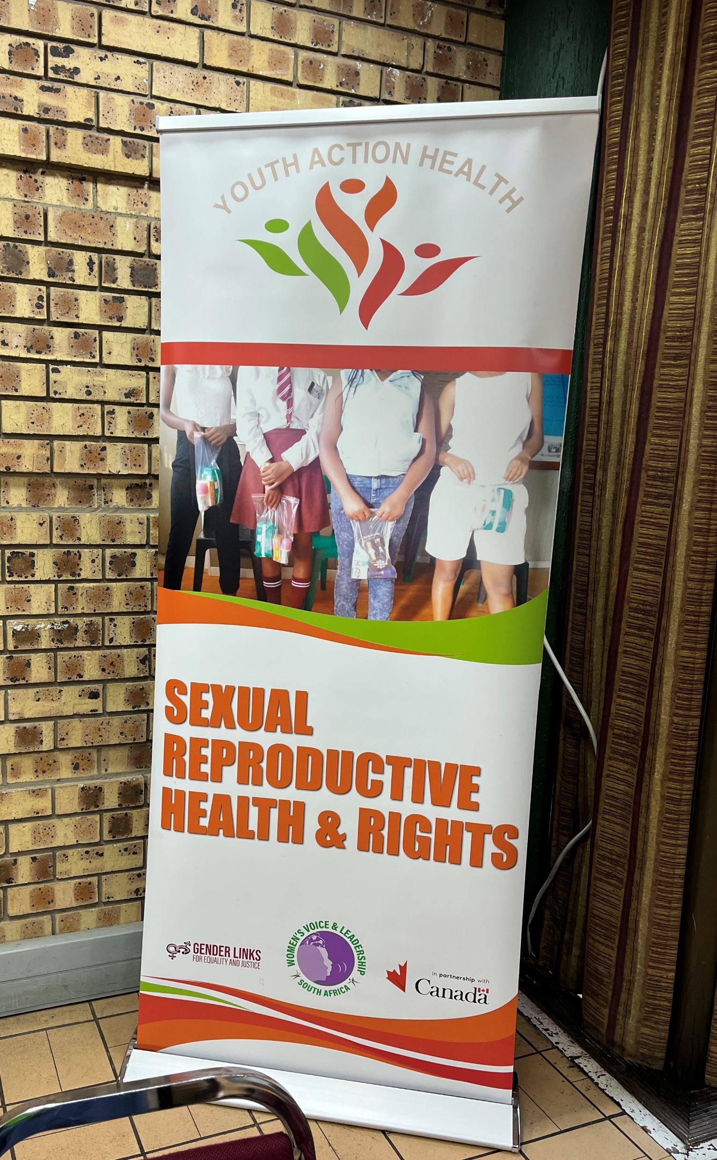
Background
Briefly describe the context or problem the project set out to address.
Organisation: Youth Action Health is a youth-led organisation based in the Capricorn District, Polokwane Municipality, Limpopo, South Africa. The organisation works to advance Sexual and Reproductive Health and Rights (SRHR), prevent gender-based violence (GBV), and empower young people through advocacy, education, and peer-led interventions.
Project Objectives: • Increase SRHR knowledge among adolescents • Promote gender equality and prevent GBV • Strengthen youth leadership and advocacy in schools • Create sustainable peer-led structures for SRHR awareness
Situation Before the Project: Many schools lacked youth-friendly spaces to discuss SRHR issues. Learners had limited access to accurate information and often relied on external organisations for short-term interventions.
Voice and Choice Summit 2026 \ Voice and Choice Summit 2026

Slide 5
Context
Location: The project was implemented in the Capricorn District in Limpopo Province, South Africa, specifically at M.E. Makgato High School.
Who Was Affected: Adolescents and young people in schools were most affected by the lack of SRHR information, stigma around sexuality, and harmful gender norms.
Issues Addressed: • Limited access to SRHR information • Gender inequality and harmful social norms • Lack of sustainable youth advocacy structures in schools • Limited opportunities for young people to lead conversations on their health and rights.
Voice and Choice Summit 2026 \ Voice and Choice Summit 2026

Slide 6
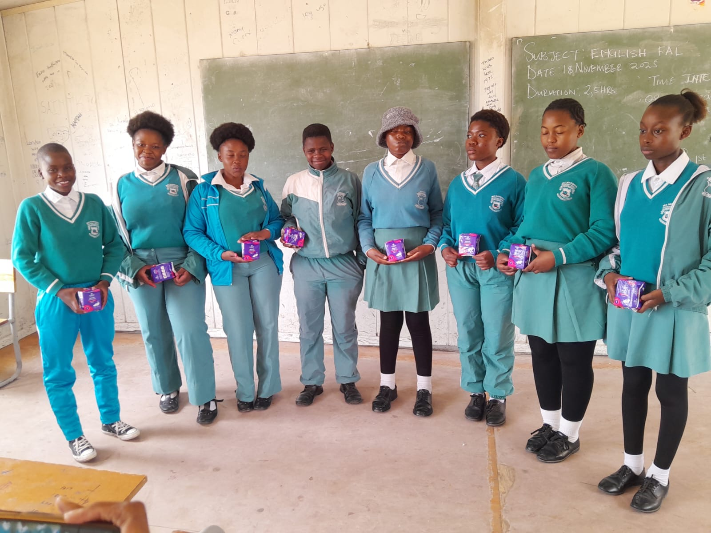
Actions
How did the change come about?
Youth Action Health led the intervention by implementing a peer-led movement-building approach.
Key actions included: • Training 10 learners as SRHR advocates at M.E. Makgato High School • Equipping advocates with knowledge on SRHR, gender equality, and GBV prevention • Supporting advocates to conduct peer-to-peer discussions and awareness activities • Working closely with Learner Support Agents to ensure continuity of the programme • Providing sanitary pads to the trained advocates as part of activities linked to the International Day of the Girl Child
Through these actions, the organisation strengthened youth leadership and created a sustainable network of young advocates who can continue promoting SRHR within the school community.
Voice and Choice Summit 2026 \ Voice and Choice Summit 2026

Slide 7
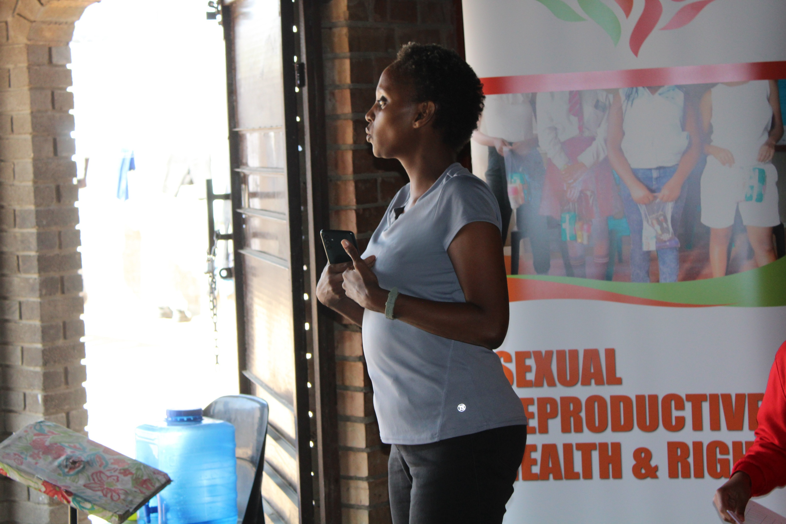
The change – impact
The training of SRHR advocates at M.E. Makgato High School created a shift from short-term awareness activities to sustainable youth-led advocacy within the school.
Through the project:
Young people gained the confidence and knowledge to openly discuss SRHR issues and support their peers. The trained advocates now act as peer educators who promote awareness, challenge myths and stigma, and encourage learners to seek accurate information and services.
Voice and Choice Summit 2026 \ Voice and Choice Summit 2026

Slide 8
Significance of the Change
By training young advocates within the school:
Learners become active leaders and change-makers, not just beneficiaries of programmes.
Schools gain internal capacity to sustain SRHR conversations and awareness.
Harmful gender norms and stigma surrounding SRHR can gradually be challenged through peer influence and continuous dialogue.
The initiative contributes to a broader movement for youth empowerment, gender equality, and the protection of sexual and reproductive health rights in schools and communities.
Voice and Choice Summit 2026 \ Voice and Choice Summit 2026

Slide 9
Beneficiaries
 | Number of participants
Female – Direct beneficiaries | 10
Male – Direct beneficiaries | 0
Female – Indirect beneficiaries (e.g. through other networks) | 50
Male – Indirect beneficiaries (e.g. through other networks) | 0
Female – Online beneficiaries (e.g. website access, mailing lists, scholarly articles) | 0
Male – Online beneficiaries (e.g. website access, mailing lists, scholarly articles) | 0
Total
Voice and Choice Summit 2026 \ Voice and Choice Summit 2026

Slide 10
Challenges & Lessons learnt
One of the main challenges experienced during the project was limited time within school schedules to conduct comprehensive SRHR sessions. Schools often operate under tight academic timetables, which made it difficult to facilitate longer discussions on sensitive topics such as gender-based violence, relationships, and sexual and reproductive health. In addition, stigma and discomfort around discussing SRHR issues sometimes limited open participation among learners.
To address these challenges, Youth Action Health worked closely with Learner Support Agents and school management to identify appropriate times for engagement, including after-school sessions and dedicated programme slots where possible. The organisation also strengthened a peer-led approach by training SRHR advocates, ensuring that conversations and awareness activities could continue within the school environment even outside formal sessions.
A key lesson from this process is that building youth leadership within schools is essential for sustainability. By equipping young people with knowledge and advocacy skills, schools are able to maintain SRHR conversations beyond the organisation’s direct involvement. The experience also reinforced the importance of collaboration with schools and local partners to create supportive environments where young people feel safe to discuss health and rights issues.
Voice and Choice Summit 2026 \ Voice and Choice Summit 2026

Slide 11
Sustainability
To ensure sustainability, Youth Action Health focused on building internal advocacy structures within schools.
By training SRHR advocates and working with Learner Support Agents, the organisation created a system where young people can continue leading awareness activities even after the project ends. This approach strengthens local ownership and ensures that SRHR conversations remain active within the school community.
Voice and Choice Summit 2026 \ Voice and Choice Summit 2026

Slide 12
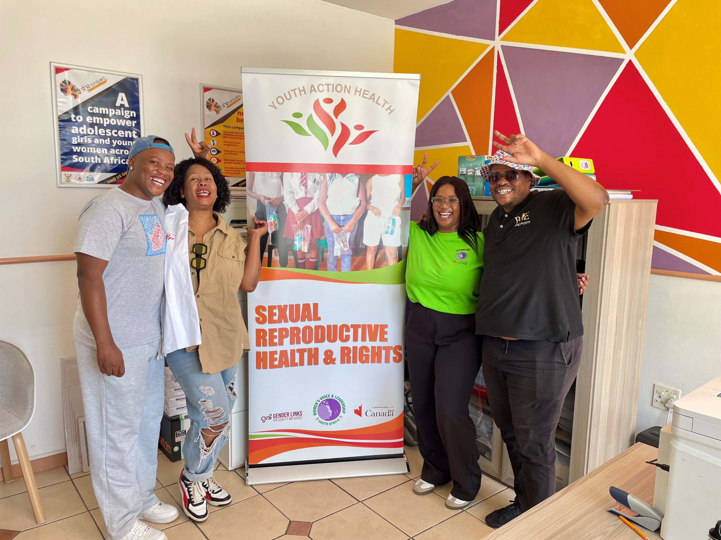
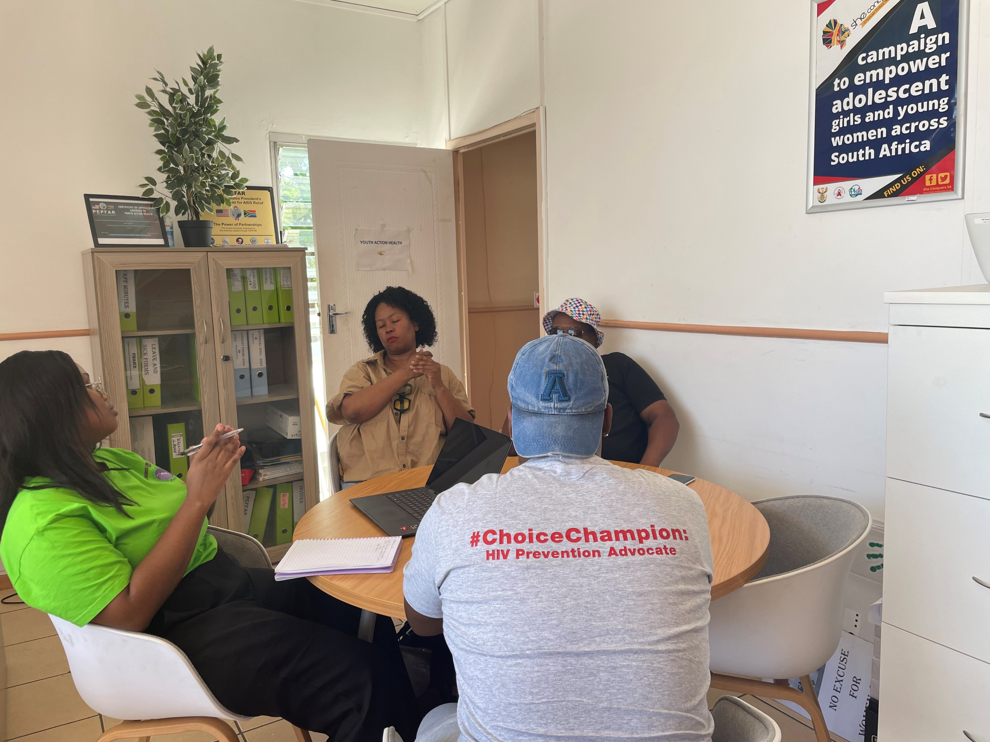
Next Steps
Youth Action Health plans to expand its work through digital platforms and media engagement.
The organisation is launching the Youth Action Health Podcast, where young people and experts will discuss SRHR, gender equality, and youth empowerment. The first episode is expected to be released before the end of March 2026.
Voice and Choice Summit 2026 \ Voice and Choice Summit 2026

