Slide 1


Voice and Choice Summit 2026-Story of Change Category
“Zimbabwe: Engaging men as champions for change in Bindura rural.”
Presenter: Rita Tiriboyi
Date: 16 March 2026
Voice and Choice Summit 2026 \ Voice and Choice Summit 2026

Slide 2
Synopsis– brief overview what this is about
Name | Rita Tiriboyi
Designation | Director
Organisation | Ree Inspiration for Girl-child Empowerment (RIGE)
Country | Zimbabwe
Category | Stories of change – SRHR
Summary | A story of change: Advocacy on engaging men as champions for access to Sexual Reproductive Health & Rights (SRHR) services in Bindura Rural, Mashonaland Central Province.
Voice and Choice Summit 2026 \ Voice and Choice Summit 2026

Slide 3
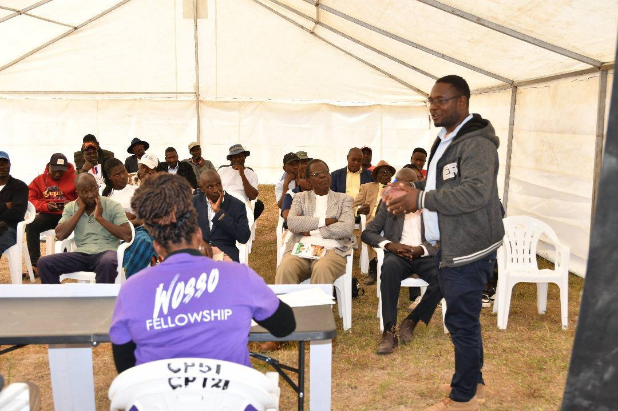
Background(problem, actions, change, evidence)
Since its inception in 2020, RIGE made significant efforts, in Bindura rural, to empower women with information and access to SRHR services. However, men, who play a critical role in the decision-making process, have largely been excluded from these initiatives. This exclusion contributed to barriers such as restricted access to menstrual health services, family planning, and vital antenatal and postnatal care for women. Many men in these communities lacked awareness of the benefits of SRHR access, not only for their partners and daughters but also for themselves. However, initial outreach efforts had shown that when men are educated about the importance of SRHR, they express a willingness promote these services. Rita under WOSSO fellowship, which ran from August 2024 to October 2025, then did an advocacy aimed at empowering men in Bindura as SRHR champions, fostering a supportive environment where women can freely access the services they need. More men started attending RIGE programs as a result.
Voice and Choice Summit 2026 \ Voice and Choice Summit 2026

Slide 4
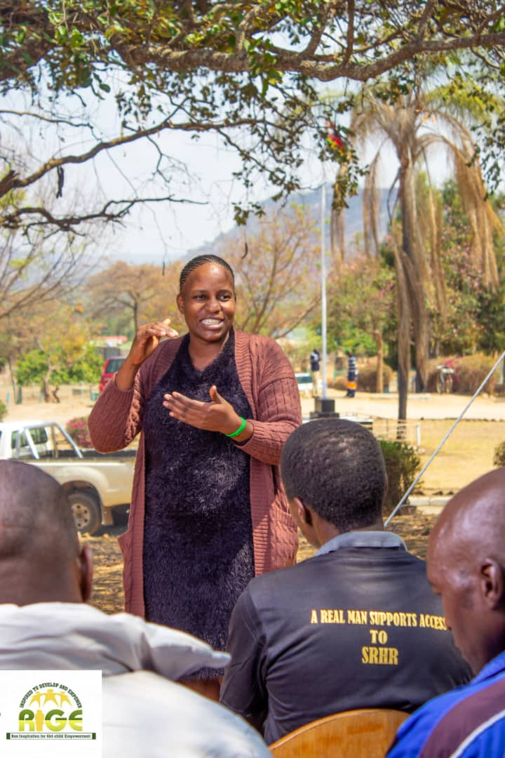
Background
The expected outcomes of the advocacy were as follows:
An increased number of men directly reached with education on why it is important for women and communities to have access to SRHR services. Initial efforts done by RIGE (as of August 2024) had reached only 290 men. A total of 400 would be reached by October 2025.
Development of one key advocacy message to be put on a community banner to encourage men to support access to SRHR in collaboration with local government and SRHR service providers within Bindura Rural. This would be supported by social media advocacy campaign/s.
An increased number of local leaders and policy makers directly reached to integrate SRHR education into existing community programs and advocate for legal and policy changes that promote male involvement in SRHR. Initial efforts in this regard had reached only 11 village heads in ward 10 Bindura rural. At least 20 leaders in total (chiefs, district medical health leaders, councillors, ministry of women, religious leaders) would be reached by October 2025.
Voice and Choice Summit 2026 \ Voice and Choice Summit 2026

Slide 5
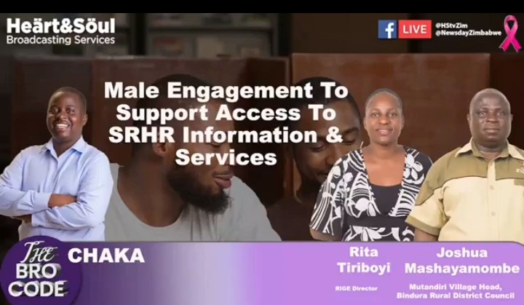
Context
The male engagement advocacy was implemented in Bindura rural ward 10 where I am based.
Women were largely affected by lack of support to access SRHR services and information which resulted in unreported maternal deaths, poor menstrual hygiene, unwanted pregnancies, child marriages amongst many SRHR related problems.
The advocacy empowered men to champion access to the above mentioned services and information and to continue educating fellow men to do likewise.
Voice and Choice Summit 2026 \ Voice and Choice Summit 2026

Slide 6
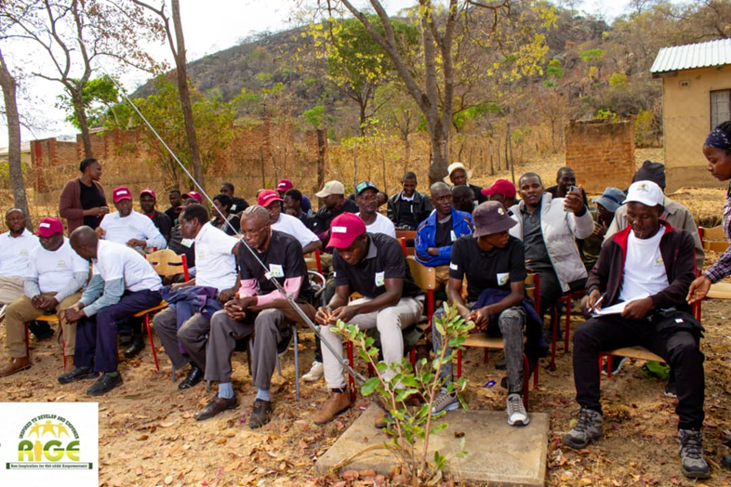
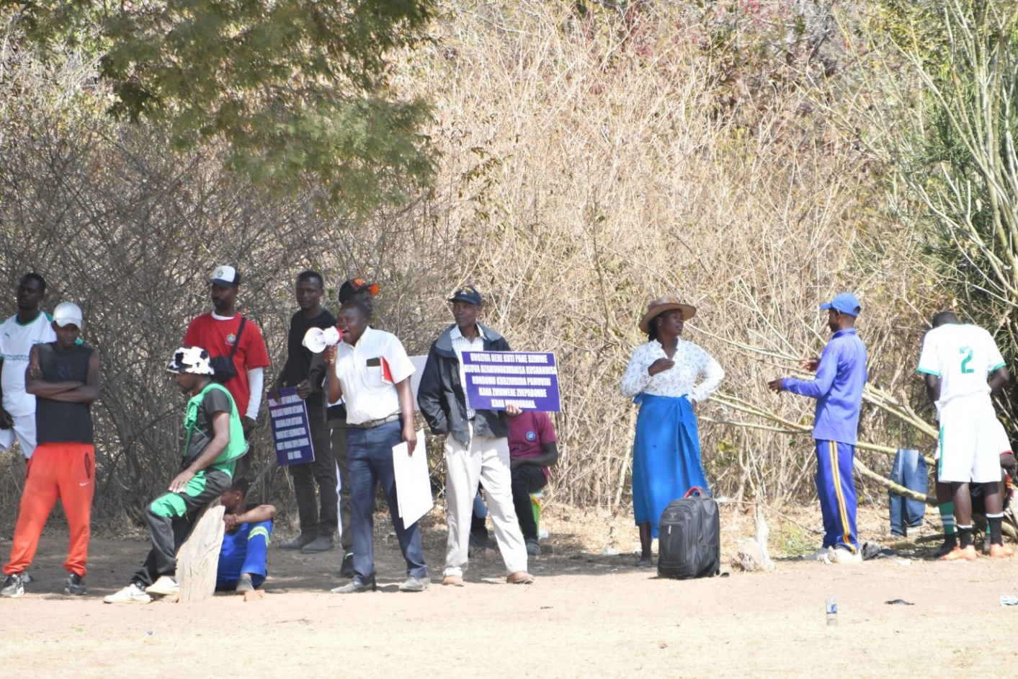
Actions
As part of the advocacy journey, Rita led men’s forums which included SRHR focused group discussions and soccer tournaments. She also led a policy dialogue which was attended by Chief Masembura From Bindura Rural District Council along with his councillors and village heads. The dialogue was also attended by policy influencers drawn from Bindura Municipality, Ministry of Health, Ministry of women affairs and service providers from National AIDS council, Zimbabwe National Family planning Council and Zimbabwe Republic police.
Voice and Choice Summit 2026 \ Voice and Choice Summit 2026

Slide 7
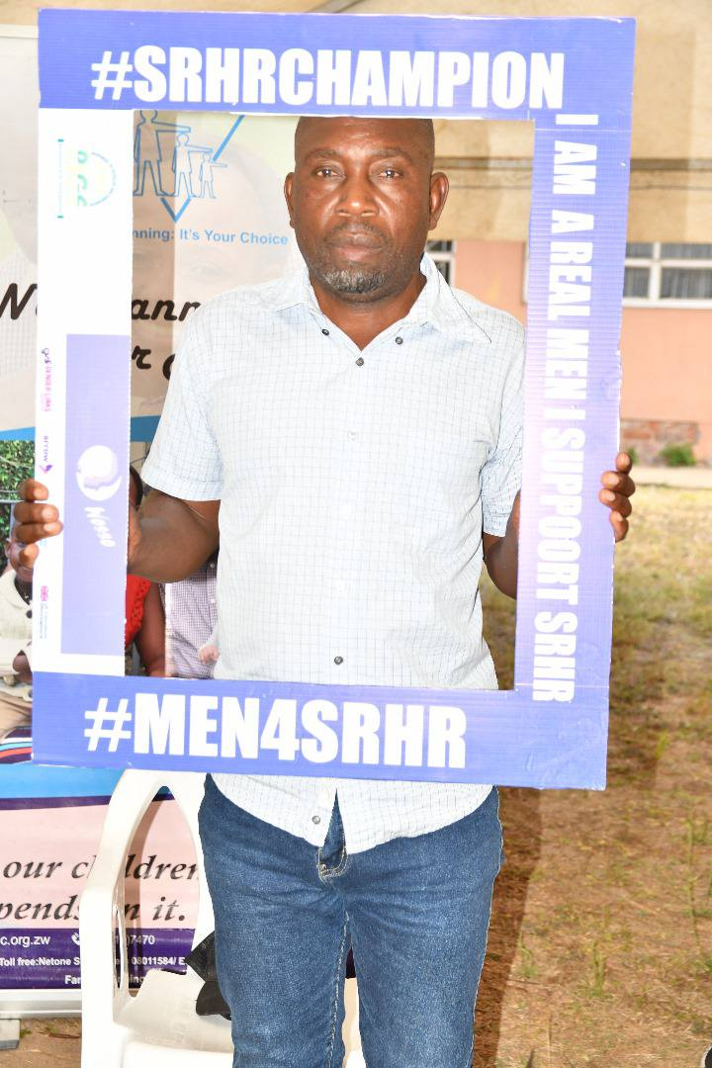
The change – impact
• The main outcome noted as part of change was the increase in number of men who attended RIGE advocacy programs from 290 as of August 2024 to 550 by Dec 2025.
During the two SRHR soccer tournaments held during the advocacy period, men, identified as champions, came up with their own advocacy messages which were put on placards to educate fellow men from the community of Bindura rural.
• On another, the chief custodian of all traditional leaders within Bindura rural, chief Masembura welcomed the advocacy initiative and gave it the green light to continue post funding, taking advantage of the existing community structures. A move that is likely contributing the sustainability of men empowerment and engagement to continue championing change.
• At the moment men keep sharing lessons obtained from the advocacy. The local leaders take advantage of some of the community gathering to acknowledge and share lessons obtained from this advocacy initiative.
Voice and Choice Summit 2026 \ Voice and Choice Summit 2026

Slide 8
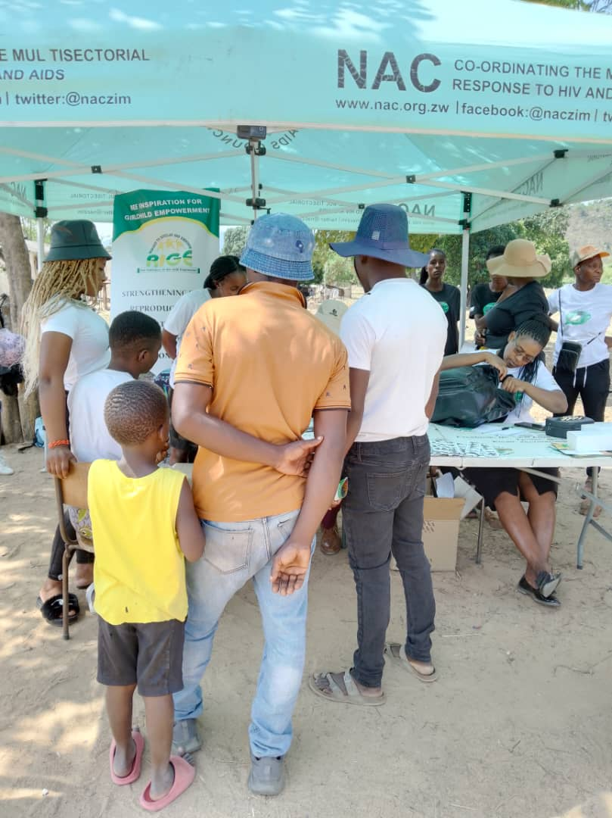
Significance of the Change
The change mentioned means both men and women will enjoy informed access to SRHR services. It also has an impact on reducing SRHR related gender based violence and exploitation.
The change will also have a positive effect on policies related to access to SRHR services and enable continuous men to men conversations around championing access to these services.
Voice and Choice Summit 2026 \ Voice and Choice Summit 2026

Slide 9
Beneficiaries
 | Number of participants
Female – Direct beneficiaries | 100
Male – Direct beneficiaries | 550
Female – Indirect beneficiaries (e.g. through other networks) | 120
Male – Indirect beneficiaries (e.g. through other networks) | 50
Female – Online beneficiaries (e.g. website access, mailing lists, scholarly articles) | 500
Male – Online beneficiaries (e.g. website access, mailing lists, scholarly articles) | 200
Total | 1520
Voice and Choice Summit 2026 \ Voice and Choice Summit 2026

Slide 10
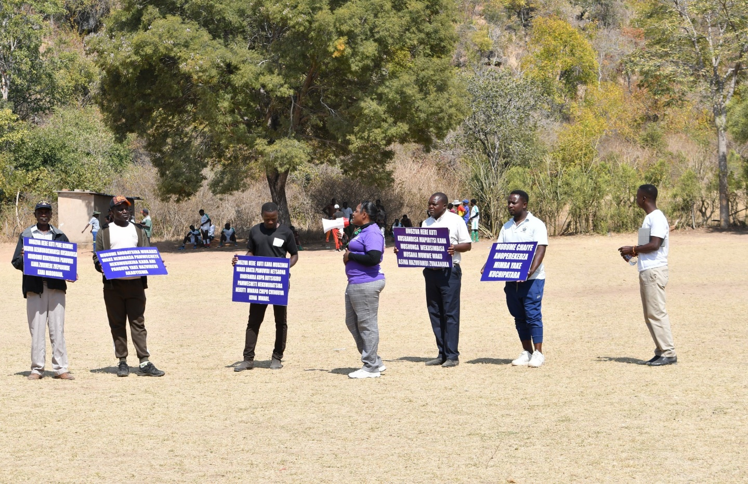
Challenges & Lessons learnt
At first many men were not forthcoming since they linked RIGE programs to women empowerment. Bindura Rural District Council officials who were also males largely helped to mobilise relevant men as champions from the community. Use of sports (soccer) also attracted more men to the advocacy programs.
Advocacy efforts may yield better results if men are engaged as allies.
Voice and Choice Summit 2026 \ Voice and Choice Summit 2026

Slide 11
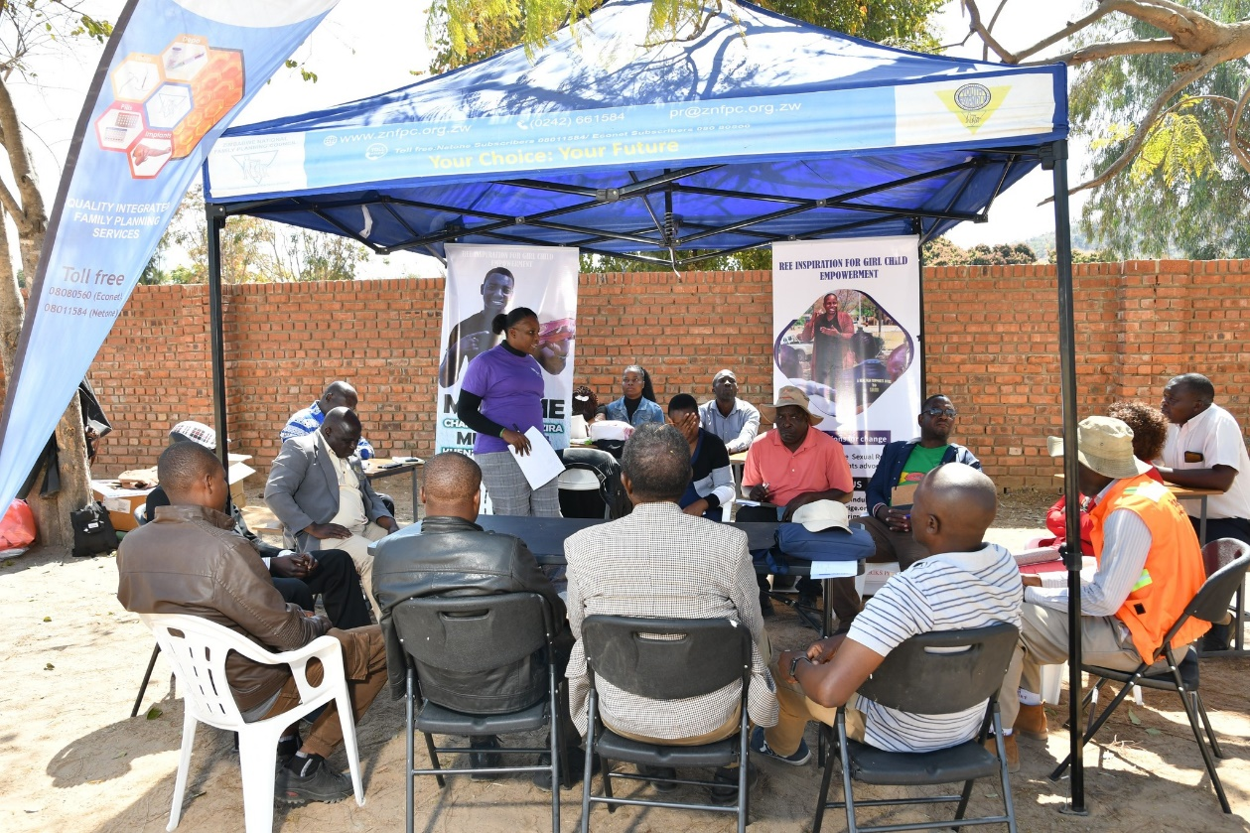
Sustainability
Sustainability measures put in place were to mainstream male engagement and empowerment into existing community structures. RIGE will maintain a Memorandum of Understanding with local government to remain a social development partner, thereby maintaining influence in its operations including by laws (local policies)
RIGE will also maintains its relations with key stakeholders and SRHR service providers so as to influence service provision in the community.
Voice and Choice Summit 2026 \ Voice and Choice Summit 2026

Slide 12
Next Steps
Continue advocacy on social media platforms in the absence of funding to continue physical programming.
Take advantage of community gatherings within Bindura and continue engaging and educating men to champion change not only for access to SRHR but for the achievement of gender equity.
Will keep using my voice to advocate for access to SRHR services, for gender equality and women empowerment since my vision is to see all women realizing their potential to the fullest.
Source for more funding to scale up advocacy operations from ward and district level to provincial and national levels.
Voice and Choice Summit 2026 \ Voice and Choice Summit 2026

