Slide 1


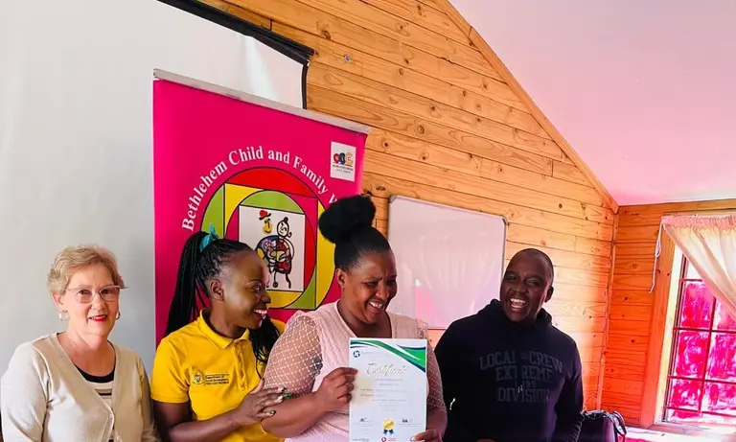
Voice and Choice
Summit 2026-Story of Change Category
South Africa: Female GBV survivor becomes independent against all odds
(South Africa, Bethlehem (Free state), 15 March 2026 , Khumbudzo Simethi)
Voice and Choice Summit 2026 \ Voice and Choice Summit 2026

Slide 2
Synopsis– brief overview what this is about
Name | Khumbudzo Simethi
Designation | Program manager and social worker
Organisation | Bethlehem child and family welfare
Country | South Africa
Category | Stories of change
Summary | This is a story about a survivor of domestic violence which she suffered from for more than 10 years. This is her story of transitioning from a victim to a survivor by becoming independent and economically empowered.
Voice and Choice Summit 2026 \ Voice and Choice Summit 2026

Slide 3
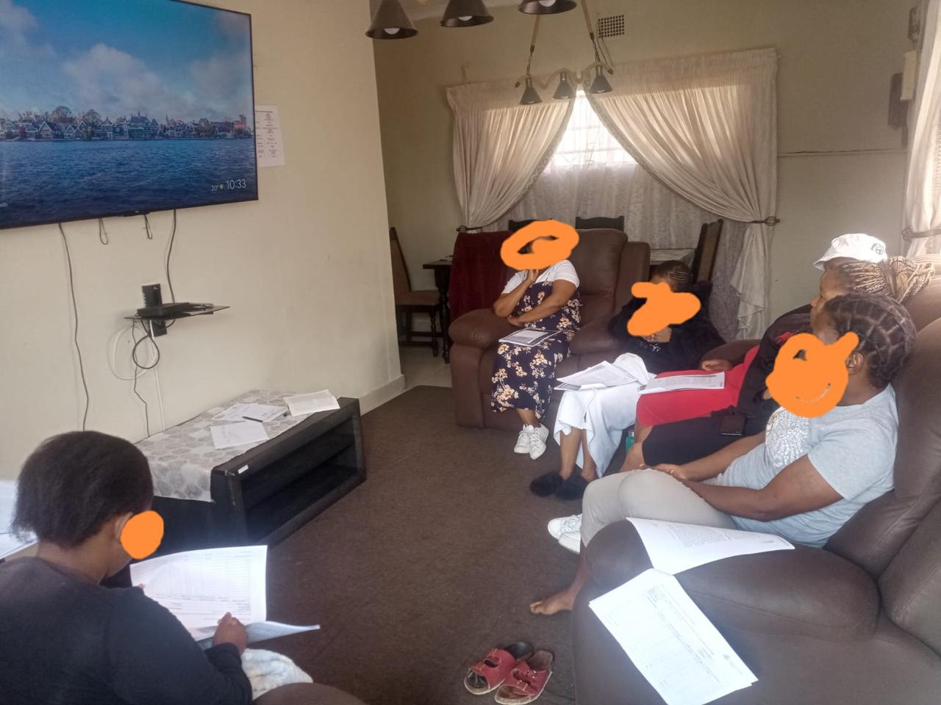
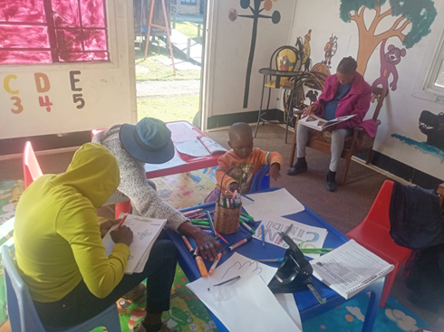
Background
The survivor was a Female victim of domestic she suffered at the hands of her South African husband. Her and her husband are legally married in South Africa. Her 4 children were secondary victims of domestic violence. The survivor’s life was a risk as she almost died when her husband hit her with an axe on her head.
The actions taken to help the survivor, was to admit her and her children in our safe shelter for protection.
The survivor and her 4 children are now safe, have a place to stay in another town-starting her life afresh. The survivor became economically empowered and independent as she now has 3 jobs.
The survivor and her children in the safe shelter
Voice and Choice Summit 2026 \ Voice and Choice Summit 2026

Slide 4
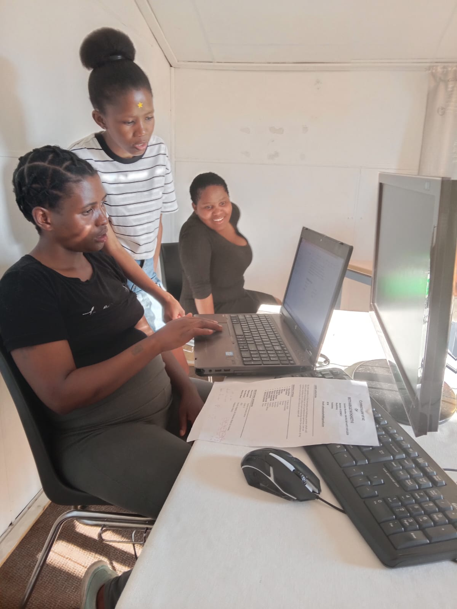
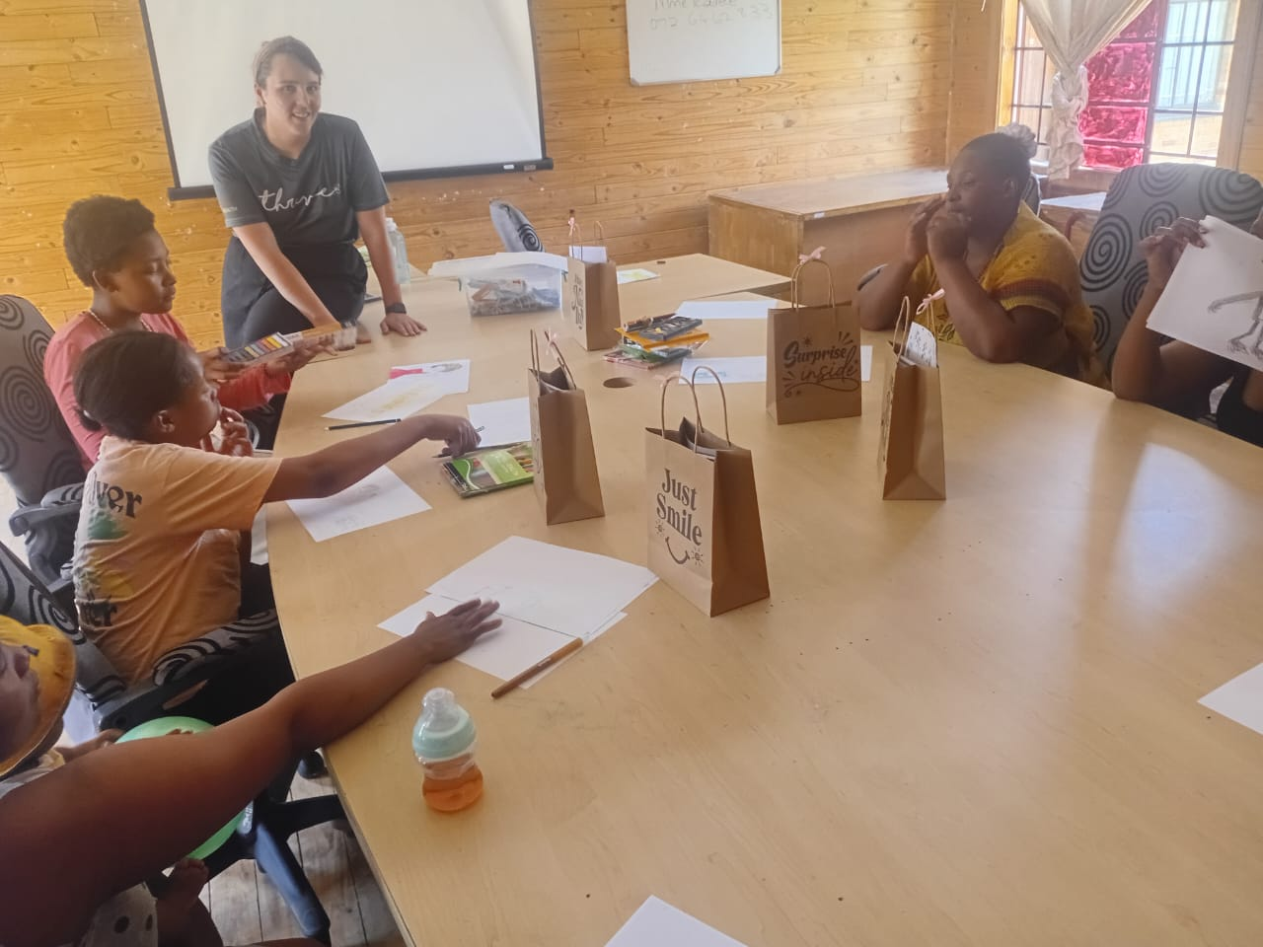
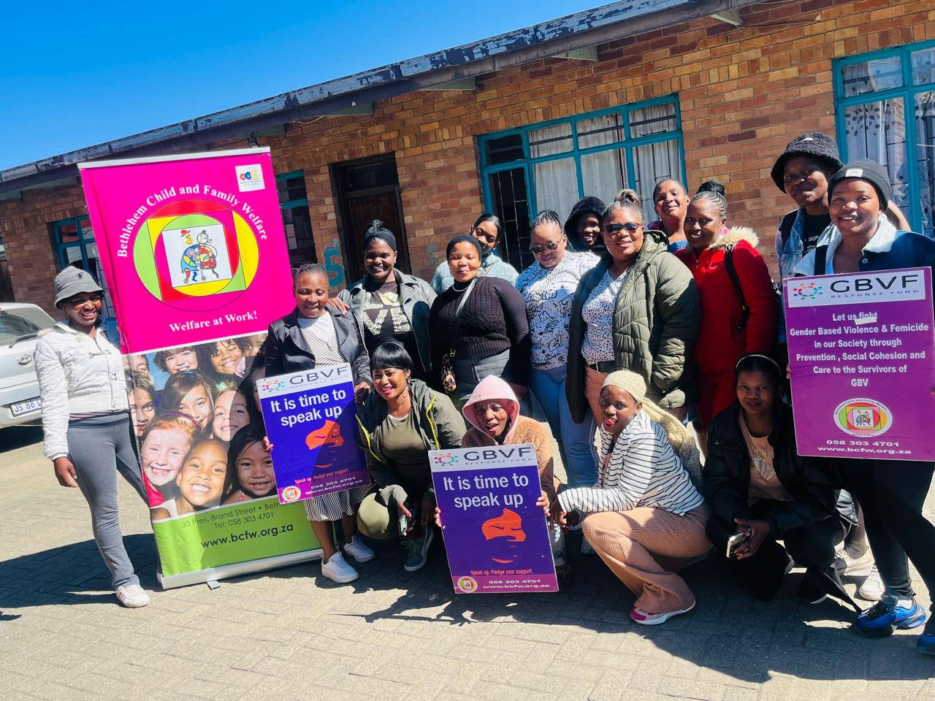
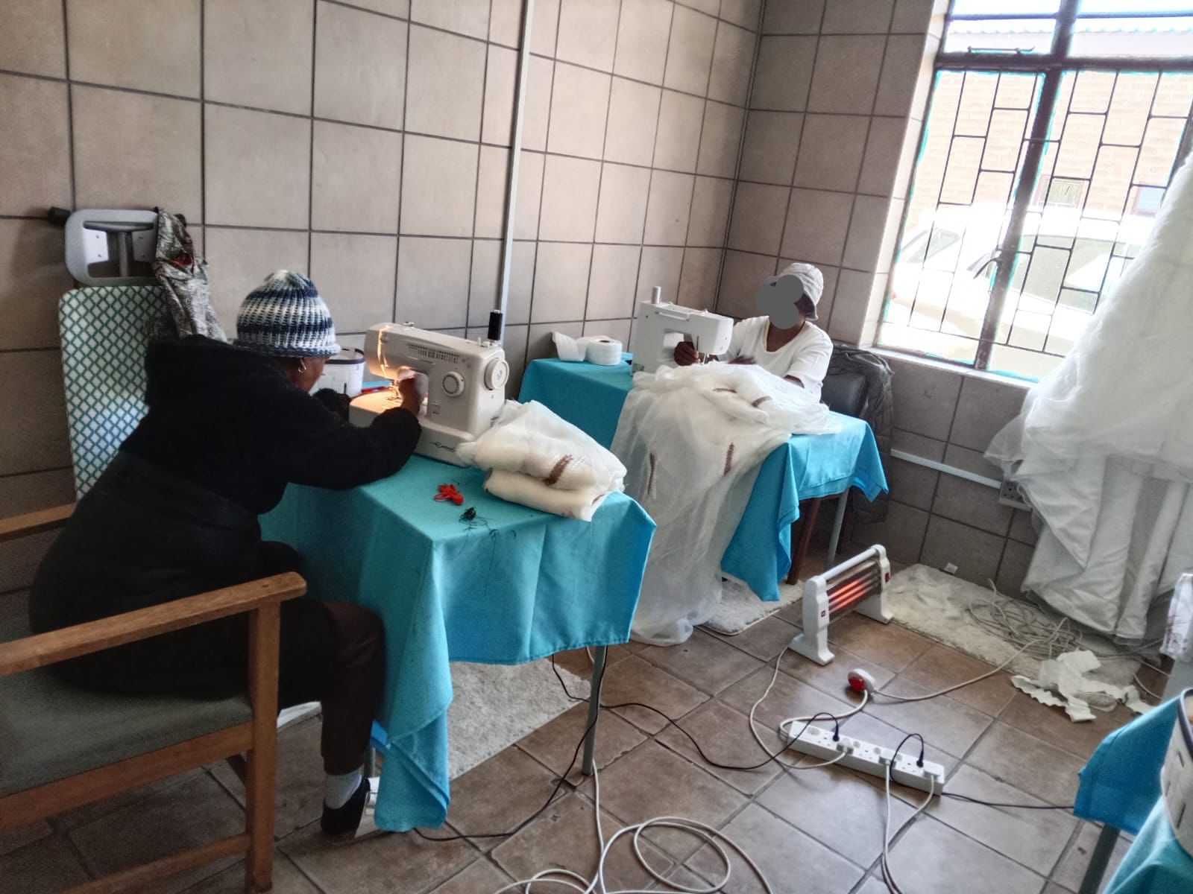
Background
The key objectives of the project were as follows:
Saving the survivor’s life by admitting her and her children in a safe shelter
Providing her with counselling and psychosocial support to help her heal from her trauma
Empowering the survivor to become economically empowered and independent through skills development and assistants with job applications
The situation of the survivor was bad before, she was living under abuse, for years she saw no way out because she was unemployed and a Lesotho citizen, she depended on her husband (a South African citizen) for financial support and going back to Lesotho to live in poverty was not an option for her.
Bethlehem child and family welfare is behind this project.
Skills development training
Voice and Choice Summit 2026 \ Voice and Choice Summit 2026

Slide 5
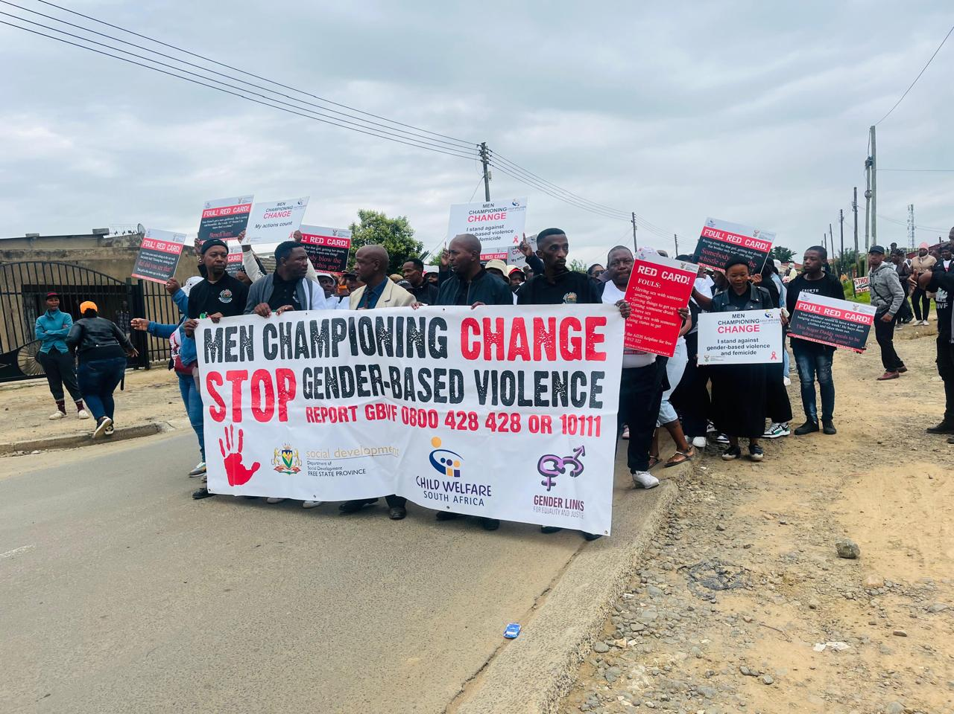
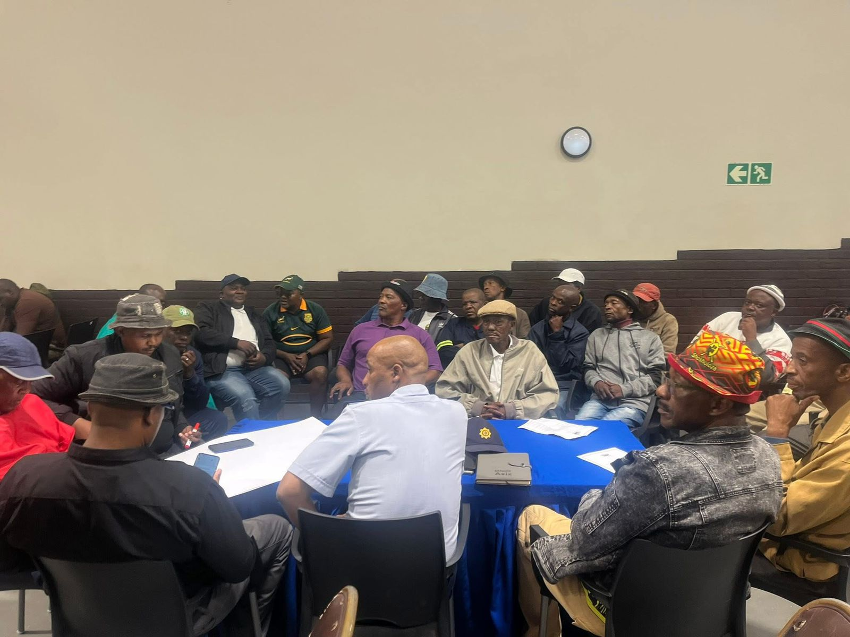
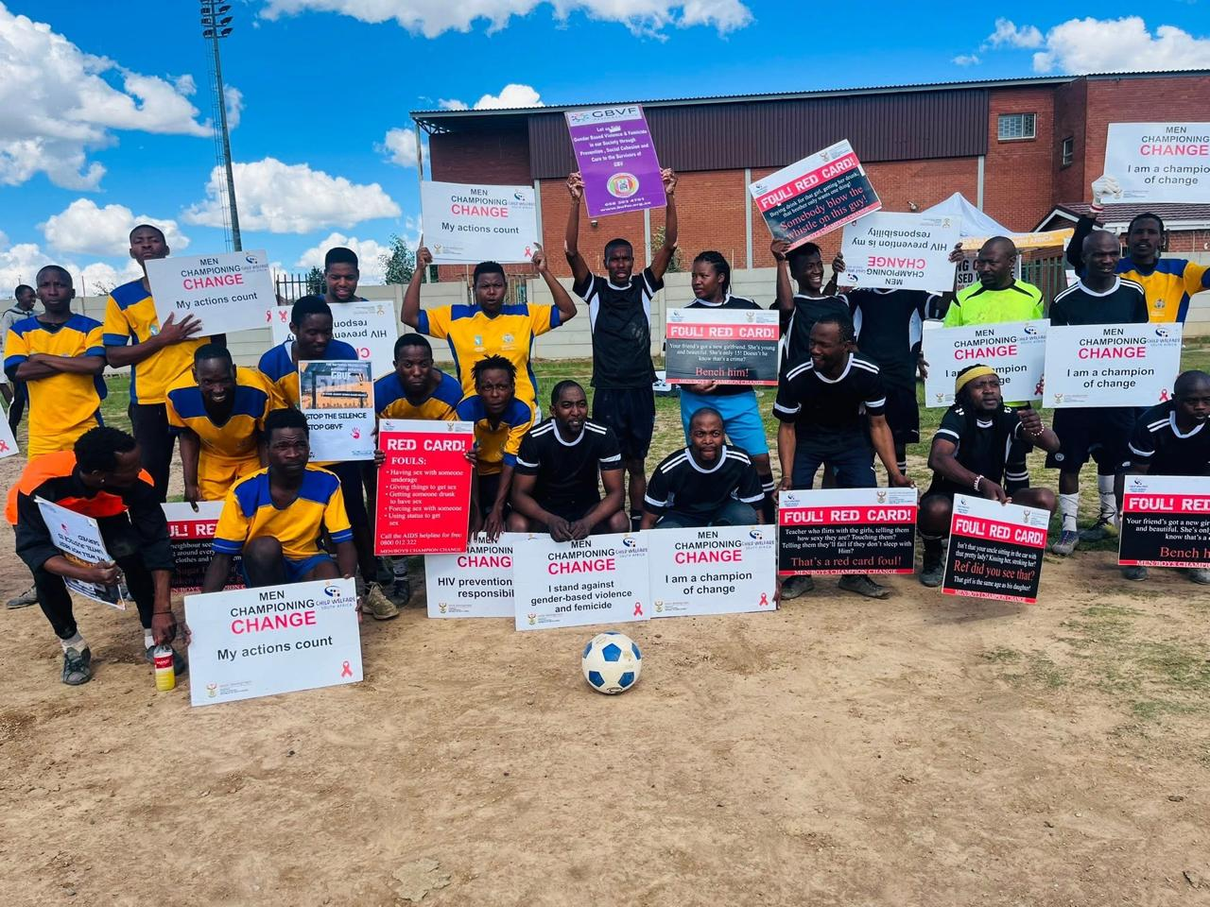
Context
We are based in Bethlehem in the Free state and this is where this project was implemented
The survivor and her 1st born child were mostly affected by the abuse because her child wanted to commit suicide because she could not live anymore with the abuse from her father. The survivor lived In constant fear and she almost lost her life. Her husband abused her further by refusing to apply for her South African permanent residency at home affairs so that she can obtain a South African ID as they have been legal married for more than 15 years.
The issues addressed in this project were domestic violence, security and unemployment
Addressing GBVF through by men championing change program
Voice and Choice Summit 2026 \ Voice and Choice Summit 2026

Slide 6
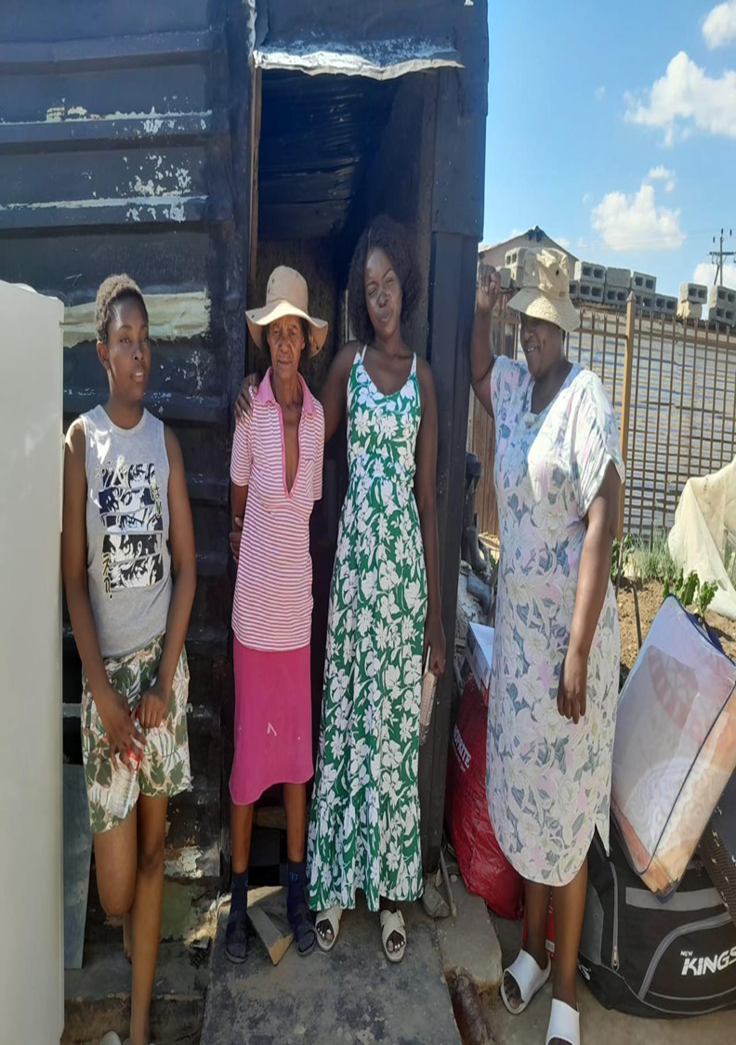
Actions
The following activities brought about the change:
The survivor approached the social workers in Ladybrund where she was staying for help and they referred her to our shelter and she was admitted immediately with her children.
The survivor was provided with counselling and psychosocial support from the shelter’s social worker to help her heal from the trauma. She has made good progress and is also seeing a psychologist for further therapy.
The survivor’s 3 children were referred to child protection social worker by the shelter’s social worker for counselling as they were secondary victims to the abuse.
The survivor was assisted by the organization (cleaner and housemother) in getting a rented place to stay in Bethlehem as it was her wish to move.
The survivor was assisted with applications of jobs and she managed to get 2 cleaning services jobs from the shelter’s social worker and another one as a farm worker with the help of the shelter’s cleaner. She is now economically empowered.
The survivor was assisted with protection order application filed against her husband by the social worker in Ladybrund.
The survivor was assisted in changing the beneficiary of her children’s child support grant from the father. She now has full access to her children’s grant.
Bethlehem child and family welfare shelter manager and social worker led the change.
The survivor at her new home
Voice and Choice Summit 2026 \ Voice and Choice Summit 2026

Slide 7
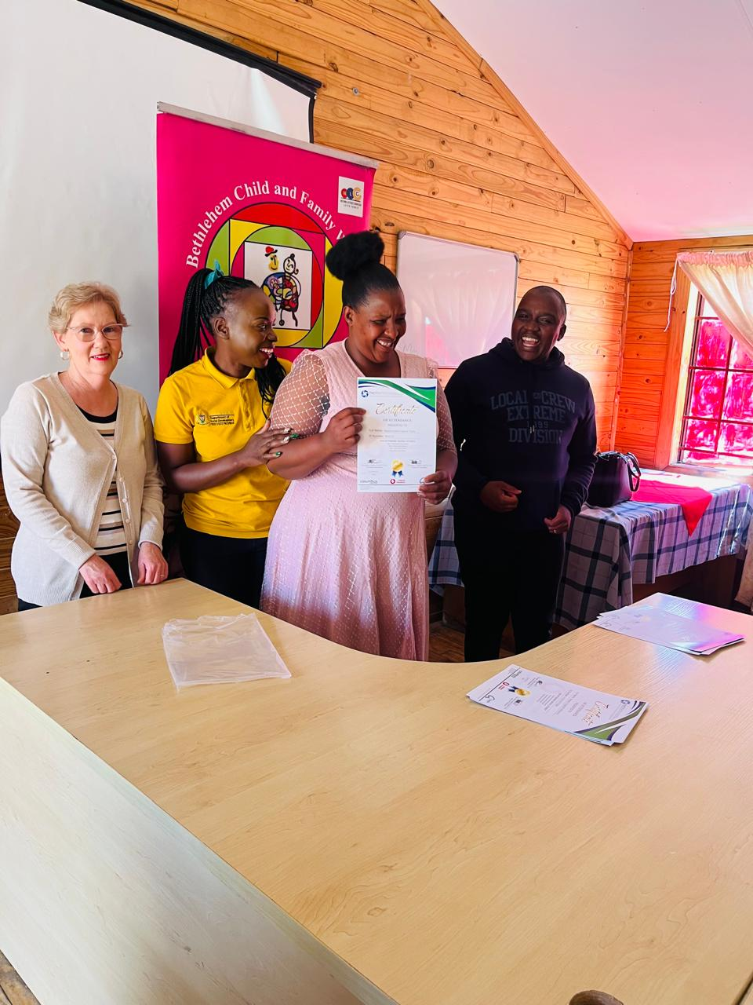
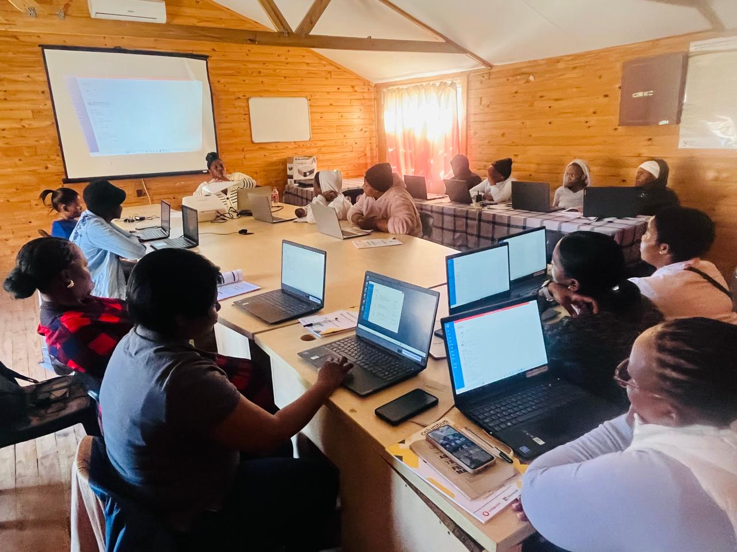
The change – impact
The impact made is that the survivor has a safe and affordable place to stay with her children away from the perpetrator.
She is economically empowered as she has job as a farm worker where she is going to be paid R1500 fortnight, this means that she will be able to take care of her children and herself financially.
She acquired a certificate in computer literacy whilst she was in the shelter, the certificate will open doors for better office jobs. She can now sew, use a computer and can do gardening which she learned from the skills development classes whilst she was staying in the shelter. This skills will help her to continue surviving and thriving in the world.
The change was very positive as the survivors' life completely changed for the better. The survivor and her children benefited from this change because they are now safe, away from the abusive husband and father, they now live happy and in harmony. The survivor is now employed and no longer dependent on the husband.
• The situation now is that the survivor ‘s life is no longer at risk, she has started her life afresh with her children, she no longer lives in danger and she is economically empowered.
Computer literacy classes and graduation ceremony
Voice and Choice Summit 2026 \ Voice and Choice Summit 2026

Slide 8
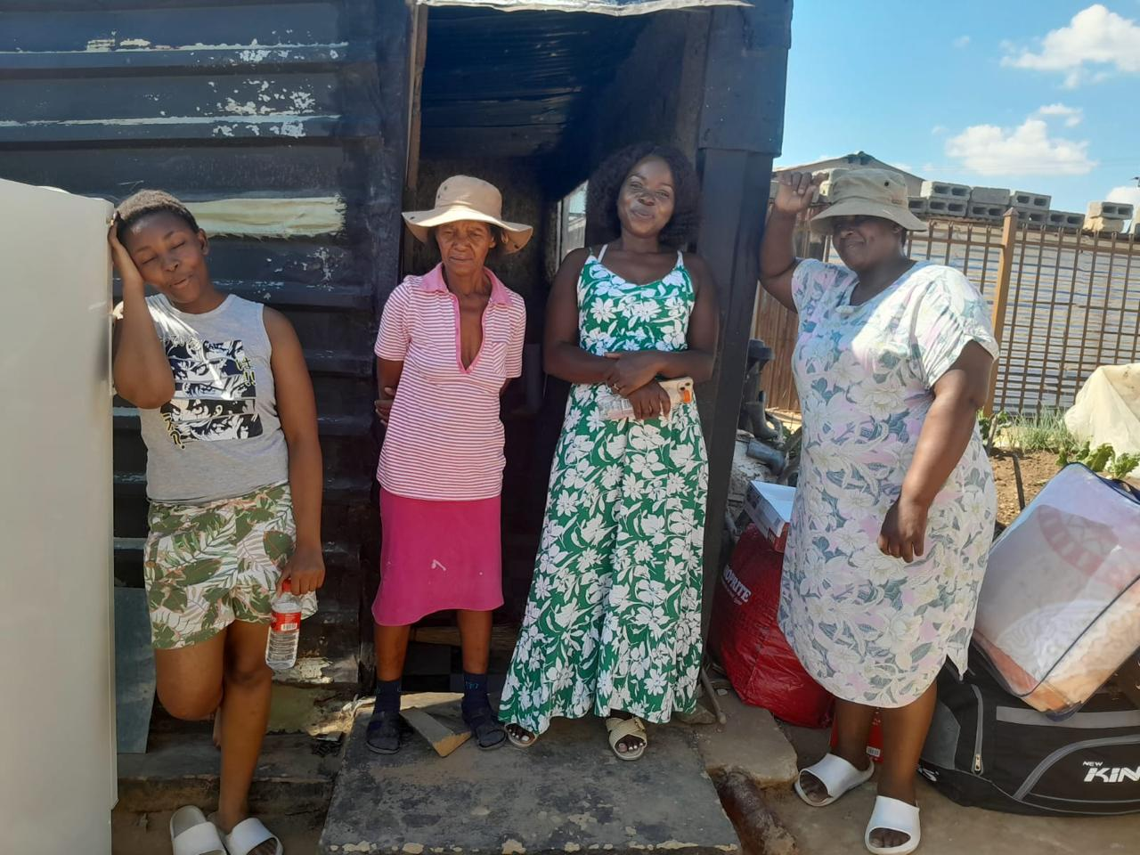
Significance of the Change
The survivor’s life has changed greatly and transformed for the better. She has been abused for so many years with her children. She felt trapped without a way out until she got a wake-up call when her child wanted to commit suicide because of the abuse.
Our goal is always to turn a victim into a survivor holistically. We have responded to pillar 3 ,4 and 5 of the national strategic plan on GBVF.
The survivor and her children have been put to safety, their lives are no longer in danger, they have been provided with care, support and healing whilst in our shelter.
They are now starting their lives afresh; the survivor is economically empowered by the 3 jobs she acquired and her childrens child support grants from SASSA.
Her biggest concern was how will she take care of her 4 children without a job hence she stayed in an abusive marriage because the husband was the main bread winner and she was unemployed, worse of all from Lesotho and chances of getting a job were slim.
Her children are happy and enjoy living in Bethlehem, they made new friends.
The survivor at her new home
Voice and Choice Summit 2026 \ Voice and Choice Summit 2026

Slide 9
Beneficiaries
 | Number of participants
Female – Direct beneficiaries | 13
Male – Direct beneficiaries | 4
Female – Indirect beneficiaries (e.g. through other networks)
Male – Indirect beneficiaries (e.g. through other networks)
Female – Online beneficiaries (e.g. website access, mailing lists, scholarly articles)
Male – Online beneficiaries (e.g. website access, mailing lists, scholarly articles)
Total | 17
Voice and Choice Summit 2026 \ Voice and Choice Summit 2026

Slide 10
Challenges & Lessons learnt
Challenges & mitigation
Place to stay- It was a challenge for the client to get an affordable and decent place to stay which made her exceed her stay in the shelter. However we managed her to get her a decent and affordable place to stay after a month of searching, she now occupies a 2 bedroom shack.
Unemployment- For 6 months the survivor could not get a job even after sending CV’s around. However 2 people gave her a cleaning job at their places. The cleaner who works in the organization connected the survivor with a farm worker who then explained the situation of the survivor to her boss, the boss fortunately gave her the job.
SASSA child support grant transfer- SASSA does not allow Lesotho citizen to become beneficiaries SA grants even though their children are south African. We then resolute to getting the same cleaner who found her a job to apply on her behalf and the application was approved.
Child maintenance- For a long time the survivor did not want to take her husband to maintenance court because she was afraid of him and did not want her to know where she was. This was mitigated by helping the survivor apply for protection order against the husband. The protection order made her feel safe and she is now ready to go to maintenance court so that the husband can maintain his children as he is employed and therefore can afford. This will lesson the burden on the survivor.
What lessons have you learnt?
To advocate more for survivors at the local municipality so that they give survivors stands to build their homes so that they do not have to pay rent. To assist survivors to register for RDP houses.
To listen to the survivors when they say they are not ready to face their perpetrators and take measures that will make them feel safe like protection orders. To be patient with the survivors and let them take steps when they are ready.
To introduce new effective and impactful skills development like hair making, nail designing and make up.
Voice and Choice Summit 2026 \ Voice and Choice Summit 2026

Slide 11
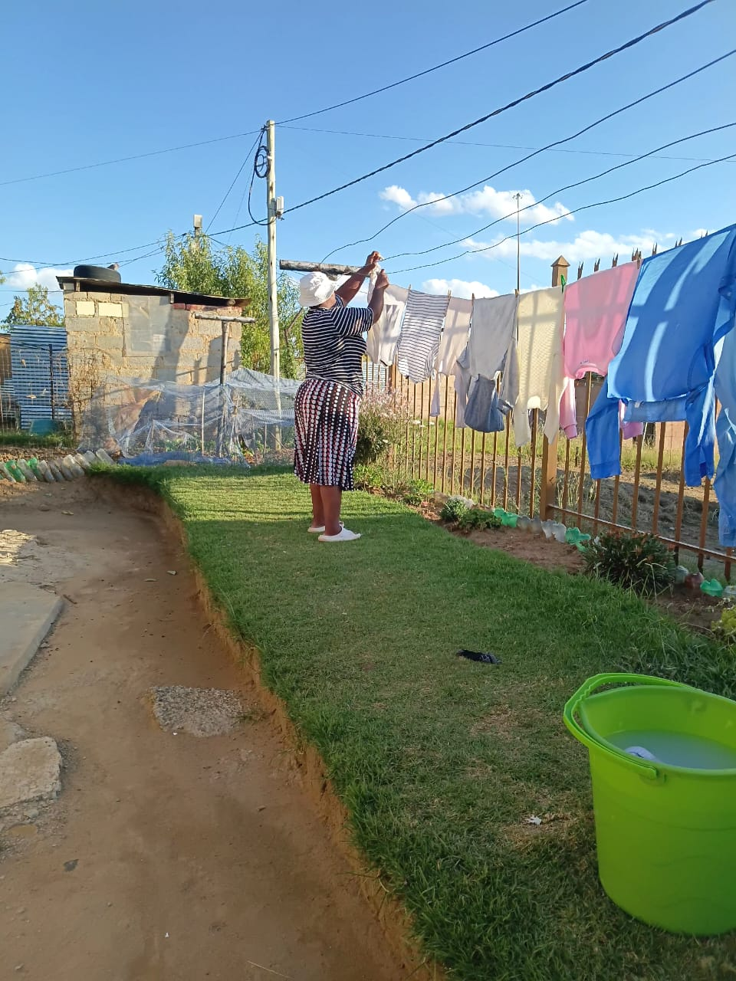
Sustainability
The change will be sustained by providing after care services to the survivor and her children since they will still be living in Bethlehem. They will be assisted by the organization for any help they need because the organization has a social worker who provides victim empowerment services.
The job the survivor got in the farm is a permanent job, so she will be able to provide for her children going forward. Her children’s CSG grants will continue to pay out until her children are 18 years old.
The survivor will be monitored if she is still attending the counselling sessions by liaising with the psychologist.
The other 2 weekend jobs she received will continue as the 2 people who hired indicated that they will need her services for the whole year.
The protection order will stay intact forever meaning the survivor and her children will continue to be safe.
The organization will start the process of referring the client to maintenance court to make sure that the husband pays child support for the children since he is working so that the financial burden cannot be on the mother alone.
The survivor at her new job (Cleaning services)
Voice and Choice Summit 2026 \ Voice and Choice Summit 2026

Slide 12
Next Steps
Our next steps:
To partner with the local TVET college to enroll victims we admit in the shelter for courses so that they may get qualifications in order to qualify for good jobs and in the long run become economically empowered and independent. To also partner with local shops/companies who can hire survivors of GBV.
To partner with a beautician who will train survivors of GBV how to do hair, nails and makeup as this is a lucrative because where the survivors who are unemployed can become entrepreneurs and have an income to support themselves. Women are always doing their hair, nails and makeup so this business is growing and has a market.
To partner with a local psychologist from Mondea hospital who once came to conduct a psychosocial support group sessions in the shelter, the survivors enjoyed it, the plan is to get the psychologist to come on a monthly basis.
To continue conducting more awareness campaigns for prevention of GBVF as it has been declared as a national disaster by the president of SA so we plan to continue fighting on the streets and recruiting men to join us in the fight against GBVF using men championing change program.
Voice and Choice Summit 2026 \ Voice and Choice Summit 2026

