Slide 1



Voice and Choice Summit 2026-Story of Change Category
Mauritius: When Parents Choose Love Over Fear. The Story of Le Salon Arc-En-Ciel Presenter: Annie Osawaru and Brooklyn Huet Organisation: Collectif Arc En Ciel(CAEC), Mauritius
Voice and Choice Summit 2026 \ Voice and Choice Summit 2026

Slide 2
Synopsis– brief overview what this is about
Name | Annie Osawaru & Brooklyn Huet
Designation | Director & Communication and Event Coordinator
Organisation | Collectif Arc En Ciel (CAEC)
Country | Mauritius
Category | Story of Change
Summary | Co-created with parents themselves and guided by our facilitator, psychologist Amanda Sadien, this initiative provides a safe and inclusive space where families can come together to learn, reflect, and support one another. Through dialogue, education, and shared experiences, the initiative helps parents move from confusion, fear, and social pressure toward understanding, acceptance, and advocacy.
Voice and Choice Summit 2026 \ Voice and Choice Summit 2026

Slide 3
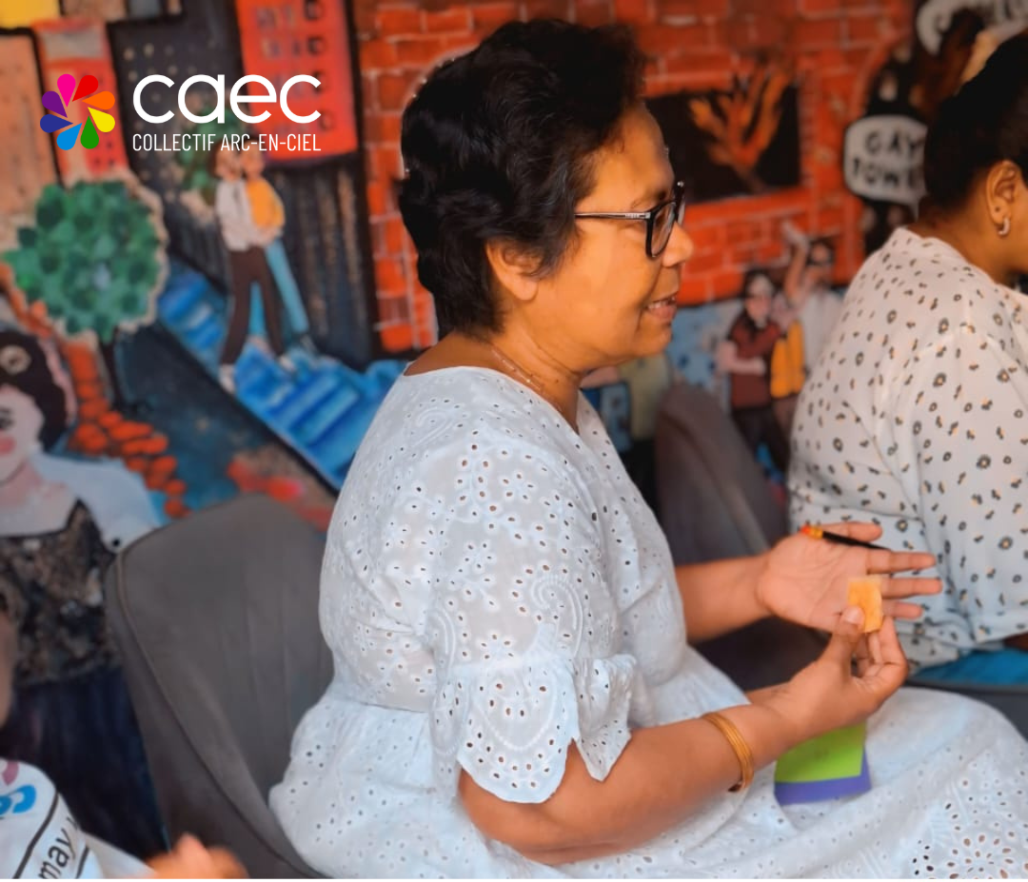
Background(problem, actions, change, evidence)
In Mauritius, LGBTQIA+ people still face stigma and discrimination, and many parents feel confused or unprepared when their children come out, often due to social pressure and lack of information.
To address this gap, Collectif Arc-En-Ciel created Le Salon Arc-En-Ciel, a peer support space where parents can learn, share experiences, and better understand and support their LGBTQIA+ children.
Through these sessions, parents gain knowledge, build empathy, and strengthen their relationships with their children, contributing to safer and more supportive family environments.
Voice and Choice Summit 2026 \ Voice and Choice Summit 2026

Slide 4

Background
Parents rarely had spaces to talk openly about their experiences
Many families faced these challenges alone and in silence
Misconceptions about sexual orientation and gender identity were common
Parents wanted to support their children but lacked the knowledge and tools
The absence of supportive spaces meant that fear often replaced dialogue.
Voice and Choice Summit 2026 \ Voice and Choice Summit 2026

Slide 5
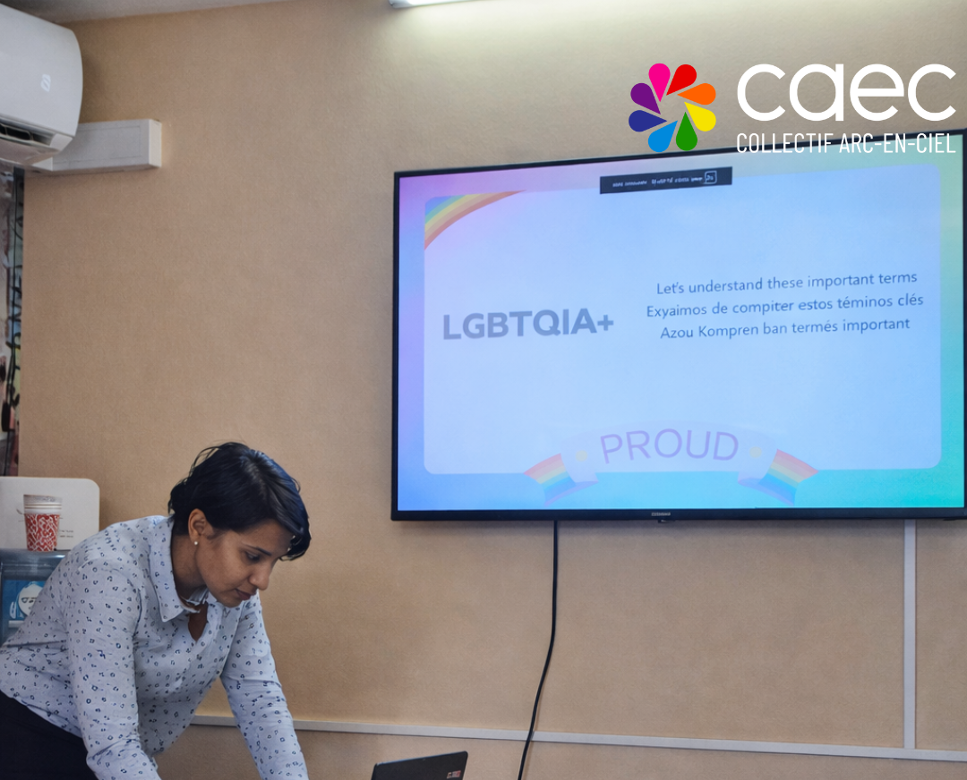
Context
The initiative is implemented in Mauritius by Collectif Arc-En-Ciel (CAEC), one of LGBTQIA+ rights organisation.
It focuses on parents and family members of LGBTQIA+ individuals, who often struggle to understand and support their children.
Many parents face challenges shaped by cultural expectations, religious beliefs, social stigma, and limited access to accurate information.
Le Salon Arc-En-Ciel creates a safe space where parents can reflect, learn, and support one another in their journey.
Voice and Choice Summit 2026 \ Voice and Choice Summit 2026

Slide 6
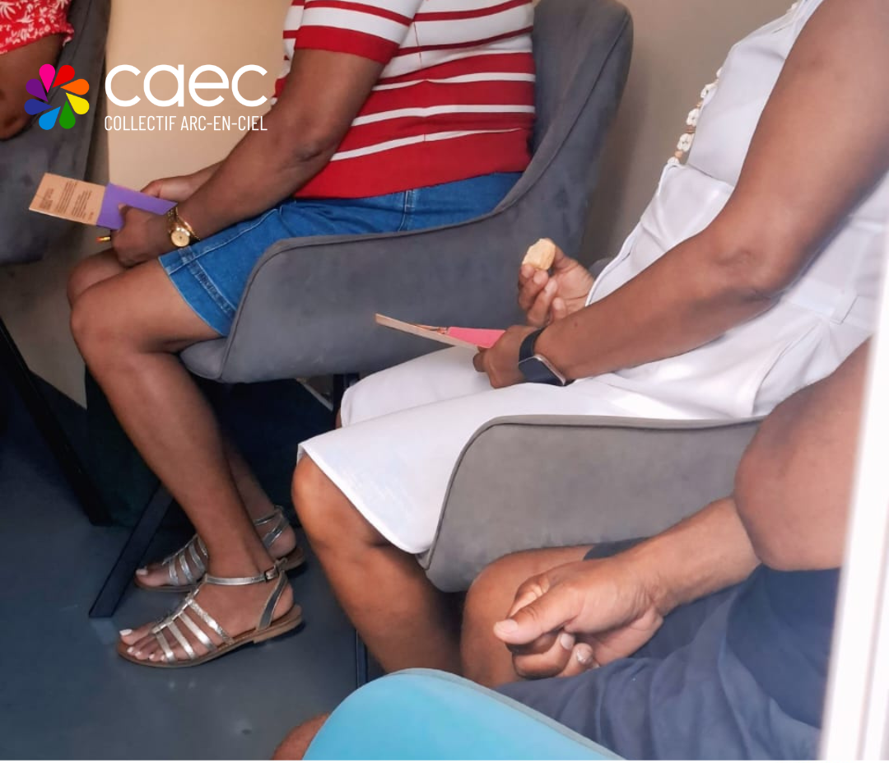
Actions
Bi-monthly peer support sessions were created, facilitated by a trained psychologist, to provide a safe and structured space for parents.
The sessions encourage open dialogue, sharing personal experiences, and reflecting on stigma, cultural beliefs, and family challenges.
Parents also gain knowledge on sexual orientation and gender identity and practical tools to better support their children.
The space is co-created and parent-led, where participants actively shape the discussions, priorities, and agenda based on their own lived experiences.
Voice and Choice Summit 2026 \ Voice and Choice Summit 2026

Slide 7

A Moment That Changed the Room
During one session, parents listened to the testimony of an LGBTQIA+ individual who had grown up without parental support.
The story highlighted the deep emotional impact of rejection and the powerful importance of parental acceptance.
Hearing these lived experiences deeply moved the parents and sparked meaningful reflection and discussion.
For many participants, this moment became a turning point, helping them better understand the role they play in their child’s wellbeing.
Voice and Choice Summit 2026 \ Voice and Choice Summit 2026

Slide 8

The change – impact
Through the sessions, many parents began to shift their perspectives and better understand LGBTQIA+ identities and experiences.
Parents reported improved communication with their children, greater empathy, and stronger family relationships.
One parent shared: “Since attending this session, it helped me understand my daughter so much more. It opened a new way for me to see the world.” showing how dialogue and knowledge can transform fear into acceptance.
Voice and Choice Summit 2026 \ Voice and Choice Summit 2026

Slide 9
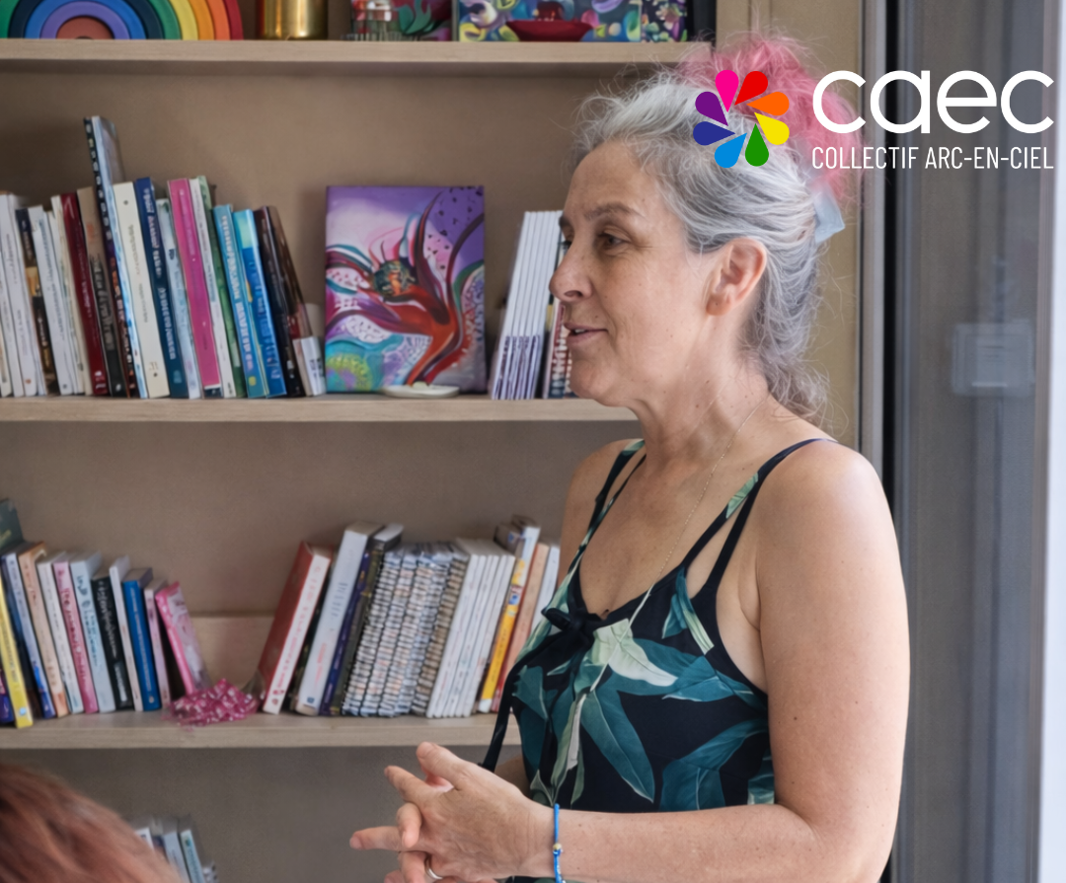
Significance of the Change
The impact goes beyond individual families, as parents who once felt uncertain are now becoming allies and advocates for acceptance.
Supportive families create safe spaces for LGBTQIA+ youth and help influence schools, communities, and extended family networks.
When parents stand beside their children, it strengthens mental health, wellbeing, and lays the foundation for lasting social change.
Voice and Choice Summit 2026 \ Voice and Choice Summit 2026

Slide 10
Beneficiaries
 | Number of participants
Female – Direct beneficiaries | 16
Male – Direct beneficiaries | 2
Female – Indirect beneficiaries (e.g. through other networks) | 2
Male – Indirect beneficiaries (e.g. through other networks) | 0
Female – Online beneficiaries (e.g. website access, mailing lists, scholarly articles) | 0
Male – Online beneficiaries (e.g. website access, mailing lists, scholarly articles) | 0
Total | 20
Voice and Choice Summit 2026 \ Voice and Choice Summit 2026

Slide 11
Challenges & Lessons learnt
Challenges & mitigation
Parents balancing participation with work schedules
Overcoming deeply rooted social and cultural stigma
Addressing sensitive emotional experiences within families
What lessons have you learnt?
Parents need non-judgmental spaces to reflect and learn
Personal stories are powerful tools for change
Peer support creates stronger and more sustainable transformation than traditional awareness campaigns.
Voice and Choice Summit 2026 \ Voice and Choice Summit 2026

Slide 12

Sustainability
Sessions are held regularly every two months
Parents co-create future topics and activities
Sessions may be decentralised across the island to reach more families
Participants are encouraged to become advocates within their communities
This approach builds a self-sustaining network of informed and supportive parents.
Voice and Choice Summit 2026 \ Voice and Choice Summit 2026

Slide 13
Next Steps
Expand participation across Mauritius to reach more parents and families seeking support.
Create joint sessions with parents and their children to strengthen dialogue and rebuild trust within families.
Develop resources and awareness tools for schools and educators to promote understanding and inclusion.
Strengthen parent advocacy for LGBTQIA+ inclusion, with the long-term vision of building a national network of parents supporting LGBTQIA+ rights and wellbeing.
Voice and Choice Summit 2026 \ Voice and Choice Summit 2026

Slide 14
Closing Message
Le Salon Arc-En-Ciel shows that change begins at home, and when families transform, society can transform too.
Voice and Choice Summit 2026 \ Voice and Choice Summit 2026

