Slide 1


Voice and Choice
Summit 2026-Story of Change Category
"Break the Silence - End the Cycle of Violence."
Eswatini, University of Limkokwing
17 March 2026
SAKHILE DLAMINI
Voice and Choice Summit 2026 \ Voice and Choice Summit 2026

Slide 2
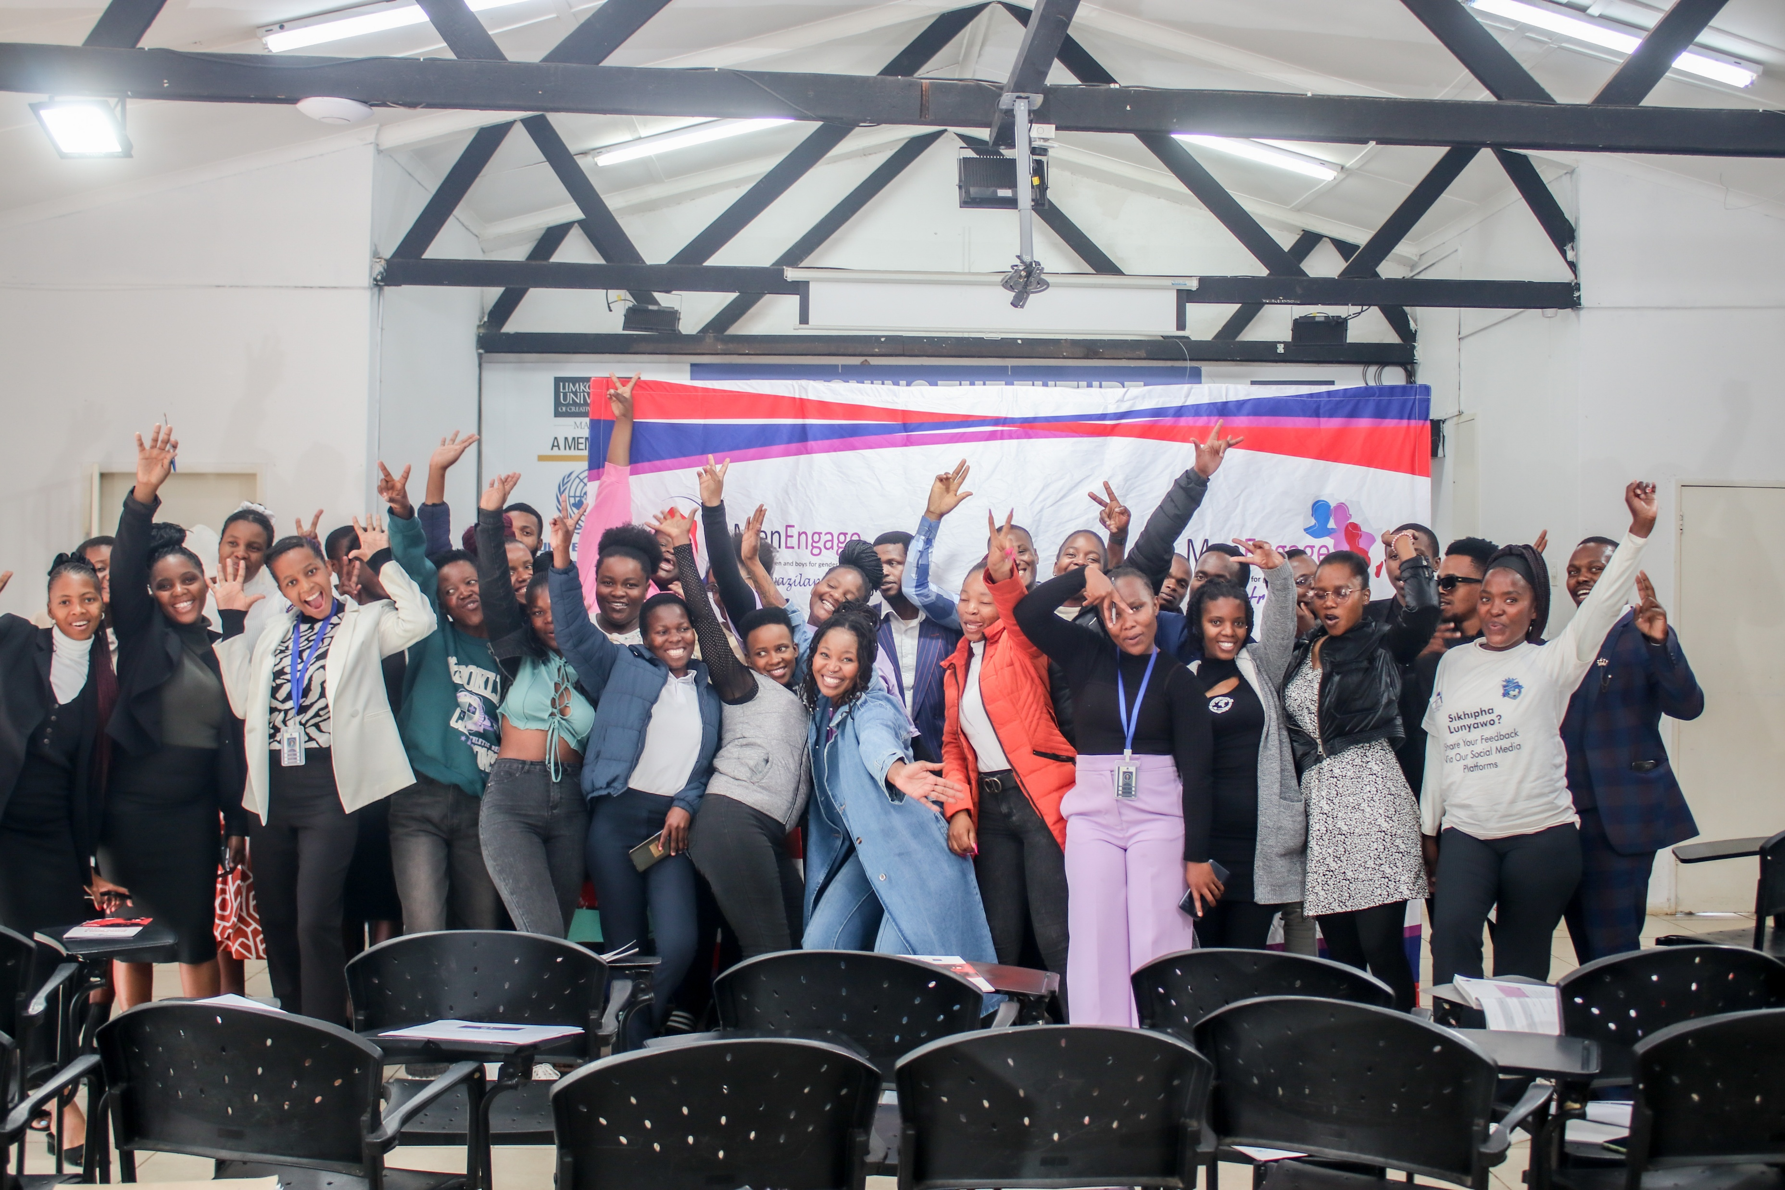
Background
Briefly describe the context or problem the project set out to address.
The Issue:
Gender-Based Violence (GBV) and Intimate Partner Violence (IPV) are critical issues for youth in Eswatini’s tertiary institutions.
Deeply rooted patriarchal norms and societal pressures often normalize violence, hindering students' academic success, mental health, and personal development.
Our Response:
A comprehensive Gender Transformative program implemented at Limkokwing University of Creative Technology.
Implemented by: WOSSO Fellow Sakhile Dlamini in partnership with the MenEngage Eswatini National Coordinator.
Project Objectives:
1. Increase Awareness: Equip students with knowledge on the signs, effects, and prevention of GBV and IPV.
2. Empower Healthy Relationships: Educate students on healthy relationship dynamics and conflict resolution.
3. Challenge Norms: Address cultural attitudes that normalize violence through critical dialogue.
Voice and Choice Summit 2026 \ Voice and Choice Summit 2026

Slide 3
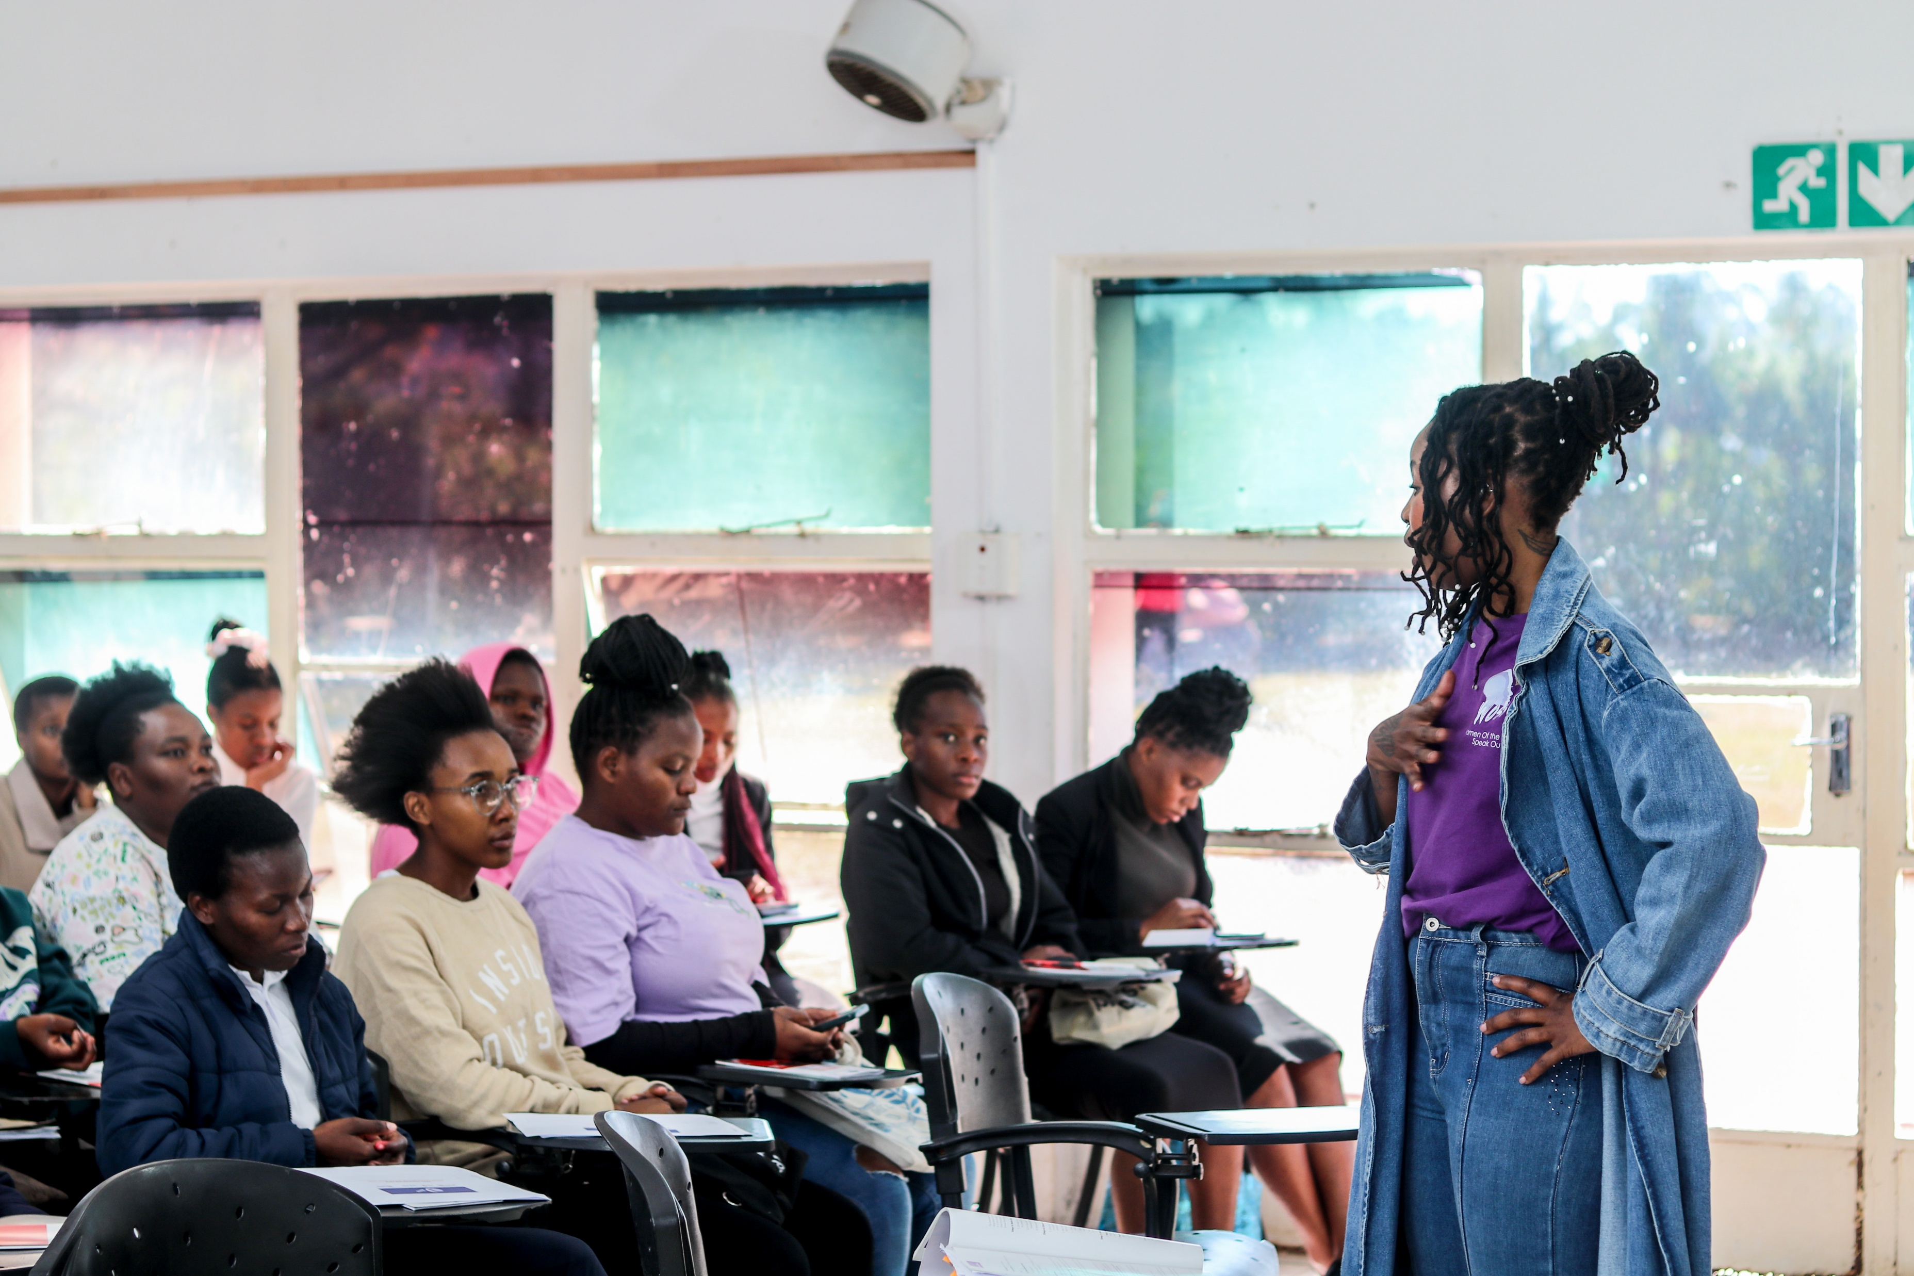
Change
How did the change come about?
• Intensive Engagement: We moved beyond a standard workshop. A dedicated cohort of 40 students (26 women, 14 men) participated in a transformative journey of 8 weekly sessions (expanded from the initial 6 due to demand).
• Transformative Methodology: Using the SONKE Gender Justice MenEngage training manual, we guided students through a deep belief-change cycle, fostering critical dialogue on deconstructing harmful norms.
• Collaborative Leadership: Sessions were co-facilitated by myself and the MenEngase Eswatini National Coordinator, creating a vital "brave space" for both young men and women.
• From Learners to Leaders: The process actively transformed participants from passive listeners into committed advocates.
Voice and Choice Summit 2026 \ Voice and Choice Summit 2026

Slide 4
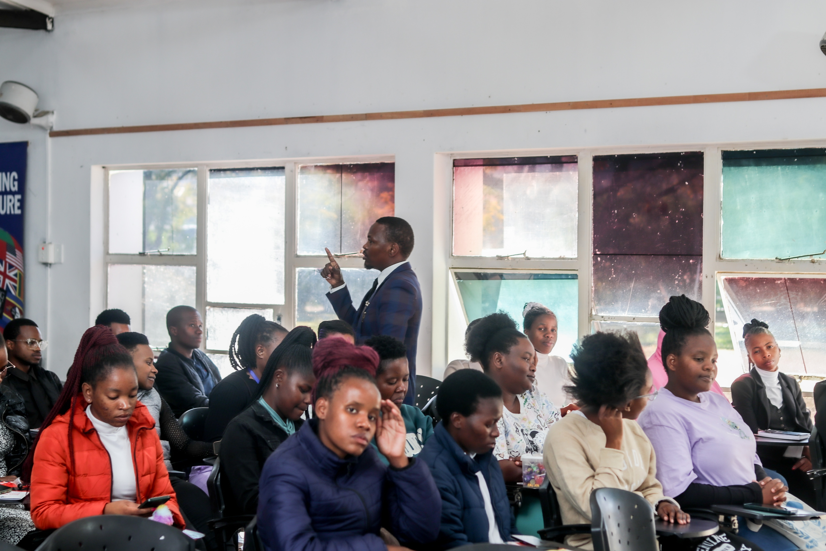
The change
Describe the change that has occurred?
Before the Project:
Pre-evaluation data showed participants often adhered to harmful gender stereotypes.
Many normalized IPV, sometimes justifying violence and blaming victims.
Knowledge of healthy relationships was limited, and silence was mistaken for neutrality.
After the Project:
Participants moved from passive awareness to deep, critical introspection about the social roots of violence.
They now understand that silence perpetuates harm.
This shift is powerfully symbolized by their collective pledge to reject violence and speak out against it – marking the birth of a student-led movement for cultural change.
Student leaders are now planning to integrate this content into future campus events.
Voice and Choice Summit 2026 \ Voice and Choice Summit 2026

Slide 5
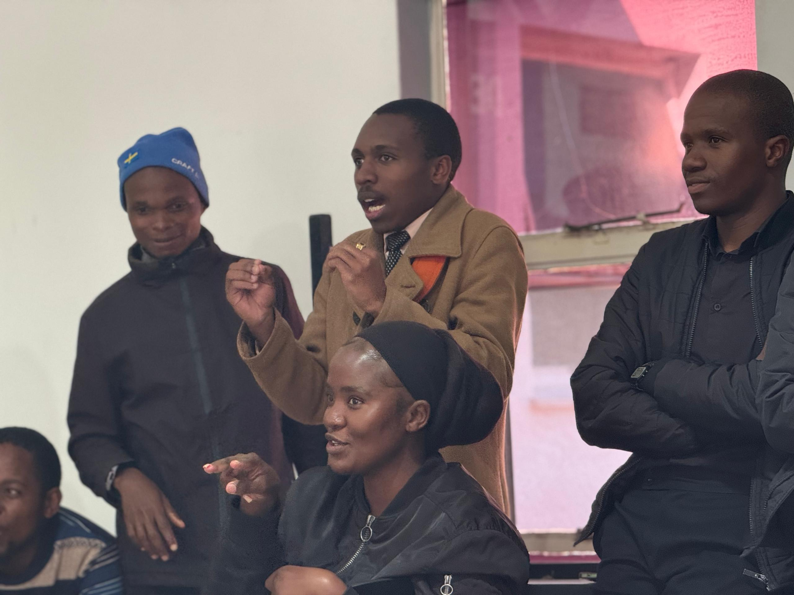
Significance of Change
Breaking the Cycle: This signifies a critical shift from basic awareness to actionable attitude transformation among youth, which is essential to break the intergenerational cycle of violence.
A Grassroots Movement is Born: The collective pledge is more than a personal commitment; it marks the emergence of a genuine, youth-led movement ready to challenge norms within their own peer networks.
A Proven Model: The project has successfully created a vital safe space for transformative dialogue that didn't previously exist at this scale. It demonstrates the immense power of targeted, gender-transformative education.
Strengthened Capacity: The invaluable partnership with MenEngage Eswatini has created a proven, replicable model for student-led interventions, strengthening local activist networks.
Voice and Choice Summit 2026 \ Voice and Choice Summit 2026

Slide 6
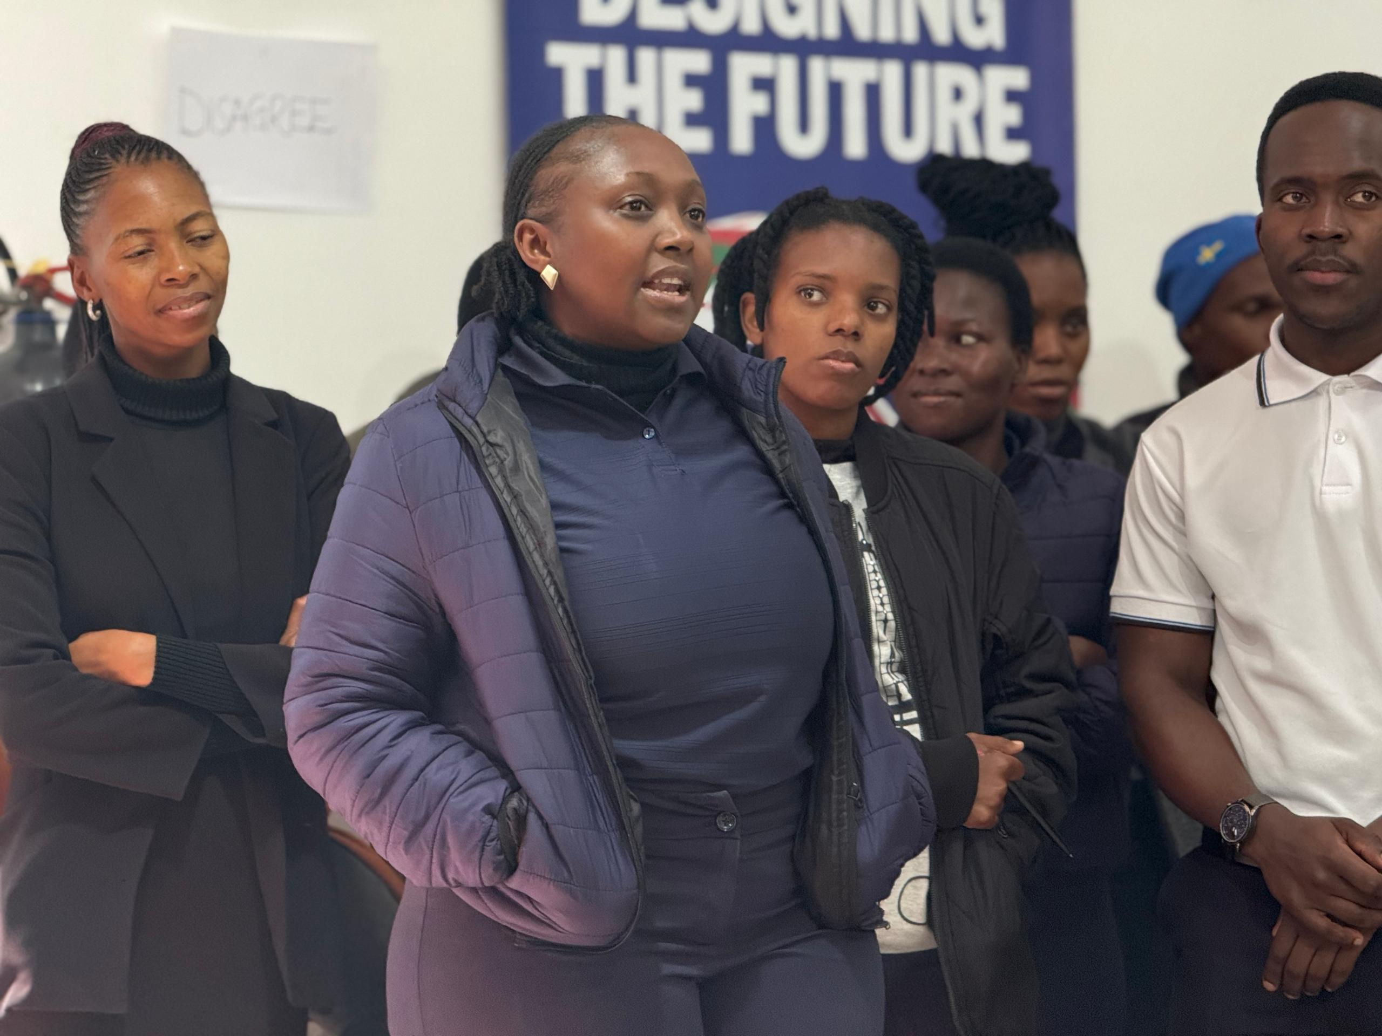
Sustainability
Sustaining the Change:
Peer Advocacy Network: The trained cohort of 40 students is now an energized network of peer advocates, committed to leading by example.
Ongoing Partnerships: Collaborations with student governance bodies are in place for regular peer-led awareness events.
Technical Support: Our strengthened partnership with MenEngage Eswatini provides lasting mentorship and curriculum support.
Scaling Up the Impact:
Advocate with Evidence: We will use our compelling outcomes and documented methodology to advocate for similar programs in other universities.
Formal Partnerships: Pursue partnerships with tertiary institutions to integrate sessions into orientation programs or curricula.
Seek Funding: Actively pursue diversified funding to expand participant reach and train more facilitators, growing this from a pilot into a national movement.
Voice and Choice Summit 2026 \ Voice and Choice Summit 2026

Slide 7
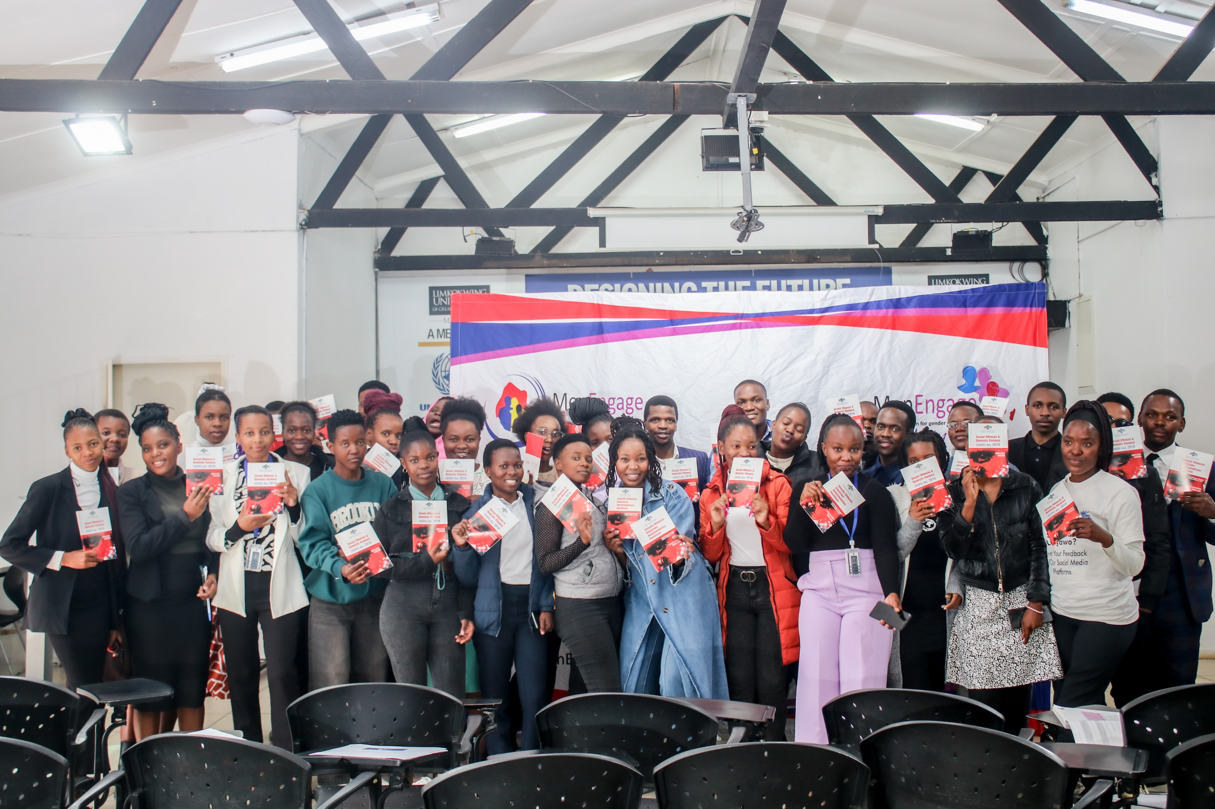
Beneficiaries
Direct Beneficiaries:
  Female: 26
  Male: 14
  Total: 40 empowered peer advocates.
Indirect & Online Beneficiaries:
Female (Indirect): [Estimate number, e.g., 200+] Through peer networks and planned awareness events.
Male (Indirect): [Estimate number, e.g., 150+] Through peer networks and planned awareness events.
Online: To be expanded through future social media campaigns and digital stories.
Voice and Choice Summit 2026 \ Voice and Choice Summit 2026

Slide 8
Challenges & Lessons learnt
Challenges & mitigation
Challenge: Initial difficulty securing direct, high-level institutional engagement for policy change.
Mitigation: We shifted focus to a ground-up approach, successfully engaging students directly. Their visible commitment and demand then sparked interest from student governance bodies, creating a more organic path to influence campus culture.
Challenge: Limited funding restricts the number of students who can participate in such intensive sessions.
Mitigation: The overwhelming demand from students is now powerful evidence we can use to advocate for more funding and to integrate this model into existing university structures and budgets.
What lessons have you learnt?
Authentic, transformational change starts with investing in and empowering youth. When given a safe space and the right tools, they don't just learn - they become the most powerful advocates for change within their own communities.
Voice and Choice Summit 2026 \ Voice and Choice Summit 2026

Slide 9
Next Steps
  Formalize the Movement: Support the trained student cohort to formally establish their peer advocacy network.
  Implement Planned Events: Execute the awareness events and talks co-planned with student governance bodies, with our ongoing support.
  Document and Share: Create a compelling "Story of Change" report and short video, using our photos and quotes to advocate for scale-up with other universities and potential donors.
  Develop a Replication Plan: Work with MenEngage Eswatini to create a simple guide for implementing this model in other tertiary settings.
  Pursue Partnerships: Initiate formal discussions with the leadership of other universities in Eswatini to introduce the program.
Voice and Choice Summit 2026 \ Voice and Choice Summit 2026

Slide 10
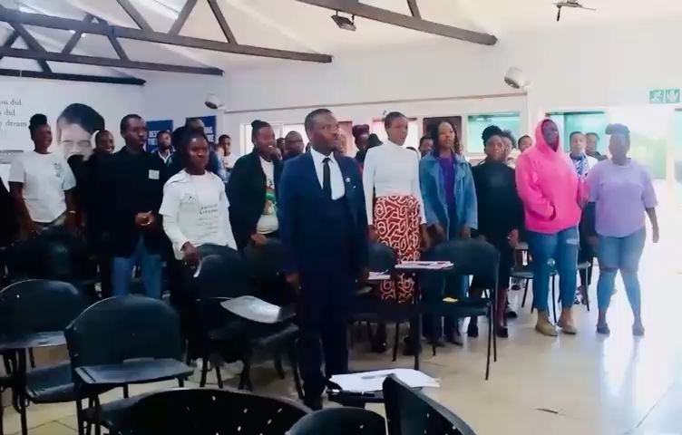
THANK YOU!
Voice and Choice Summit 2026 \ Voice and Choice Summit 2026

