Slide 1

Voice and Choice
Summit 2026-Story of Change Category
Your logo goes here
Title/Name of the Story
South Africa: Rural women break GBV silence in Vhembe District
March 2026
(Country, location, date and presenter)
Please use your own photos to make your presentation unique.
Quotes and any other visuals make your presentation more engaging!
Voice and Choice Summit 2026 \ Voice and Choice Summit 2026

Slide 2
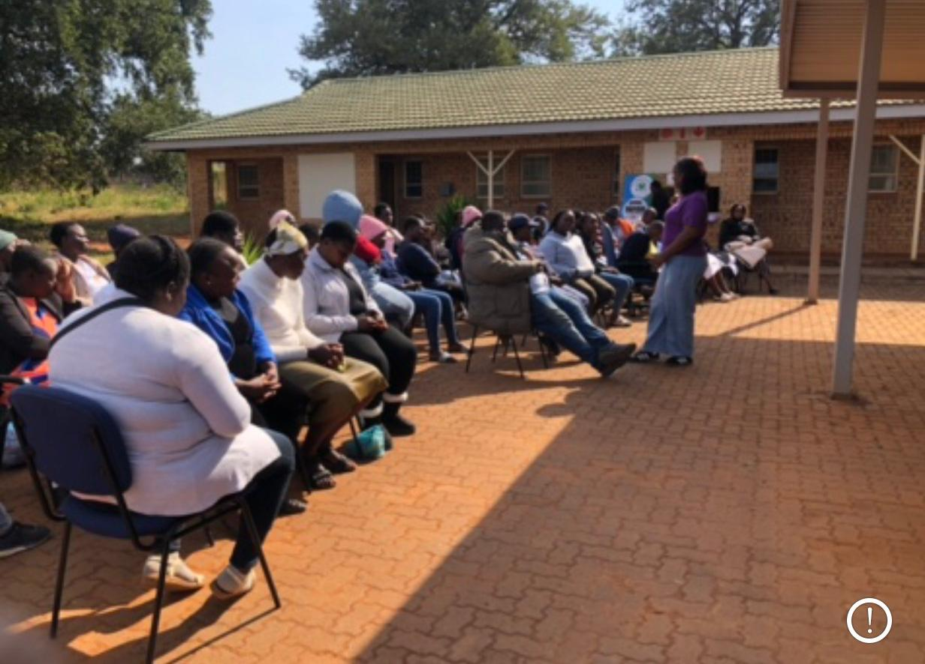
Background
Briefly describe the context or problem the project set out to address.
What were the key objectives of the project?
Increase rural women’s awareness and recognition of GBV, their legal rights (especially under the Domestic Violence Act), and available support services in Ha-Makuya and Malamulele.​
Challenge harmful cultural and patriarchal norms, stereotypes, and stigma that normalise GBV and silence victims, by facilitating inclusive women–men, youth, and leader dialogues.​
Equip religious and traditional leaders as frontline responders who can challenge stereotypes, provide informed counseling, and make appropriate referrals to clinics, shelters, and police.
Address period poverty and advance SRHR and economic justice by running school-based campaigns and distributing reusable sanitary pads to keep girls in school.​
Build youth capacity to prevent and speak out against GBV and SRHR violations through camps and advocacy activities.​
Generate context-specific research evidence on GBV perceptions and awareness in Ha-Makuya to inform tailored strategies and policy advocacy at district and national level
What was the situation before the project?
Before the project, rural women in Ha-Makuya and Malamulele faced high GBV vulnerability that was largely hidden and normalised.
GBV was widespread but severely underreported because of deep stigma, fear of retaliation, and community beliefs that violence was a private or culturally accepted matter.​
Awareness of GBV, rights under the Domestic Violence Act, and available support services (clinics, shelters, police, CBOs) was low, leaving survivors isolated and unsure where to seek help.
​Patriarchal norms, rigid gender roles, and expectations that marriage should confine women to the home limited women’s mobility, access to work or skills training, and participation in community decision-making.
​
Voice and Choice Summit 2026 \ Voice and Choice Summit 2026

Slide 3
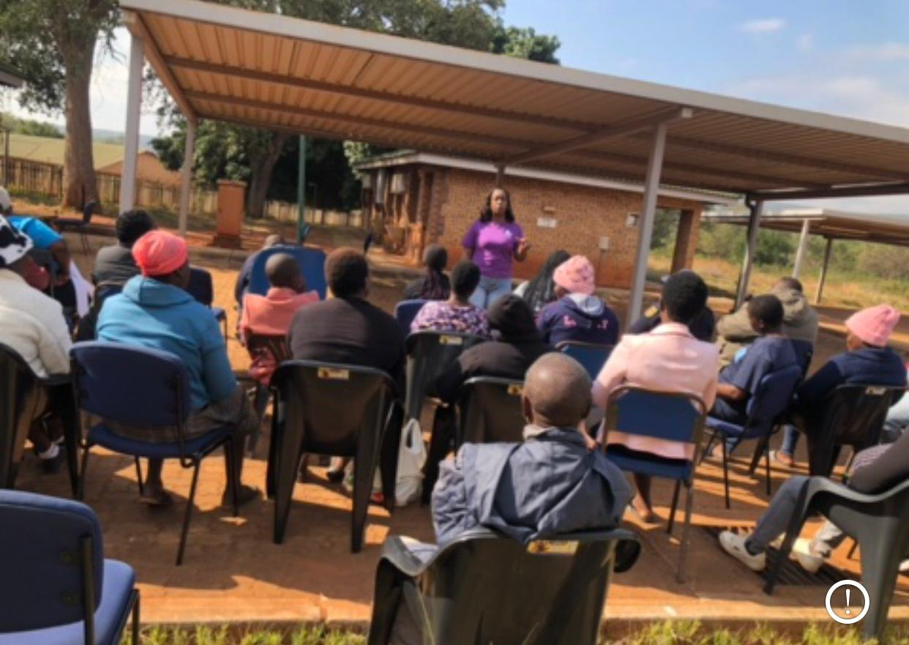
Continuation of background:
Poverty, unemployment, and substance abuse intensified household tensions and cycles of violence, while weak or distant services (e.g. clinics, unresponsive police) discouraged reporting.
​There was a major rural research gap: little locally grounded data on GBV perceptions and awareness in Vhembe, which meant policies and programmes largely overlooked the realities of villages like Ha-Makuya.
Who is the organisation behind the project?
Life savers foundation and Social welfare in TECH
Where are you based / Where is the project being implemented?
The project is based in South Africa, in rural communities in the Vhembe District of Limpopo Province, specifically in the villages of Ha-Makuya and Malamulele
Who was most affected by the problem and how?
Women in Ha-Makuya experienced multiple forms of GBV that were normalised by culture and patriarchy, leaving them fearful of reporting and trapped by poverty and economic dependence.
They had low awareness of their rights and of nearby services, so many endured abuse in silence, with limited mobility and few realistic options to leave violent relationships.
Children were indirectly affected through exposure to violence at home and its emotional and economic impacts, including instability and insecurity.
Men, traditional leaders, and pastors were also affected as they operated within harmful norms that discouraged intervention, often witnessing violence but lacking tools or confidence to respond supportively.

Slide 4
Continuation background:
What issue(s) did the project address?
Persistent Gender-Based Violence (GBV) against rural women, which was normalized, underreported, and hidden by stigma, fear of retaliation, and culturally rooted silence.
Harmful patriarchal norms and rigid gender stereotypes that confined women to the home, limited their mobility and work opportunities, and discouraged them from speaking out or participating in community and political life.
Limited awareness of legal rights (including the Domestic Violence Act) and poor knowledge of available support services such as clinics, shelters, police, and community organizations.
Period poverty and weak Sexual and Reproductive Health and Rights (SRHR) for schoolgirls, which contributed to absenteeism, shame, and unequal educational opportunities.
Economic injustice, where poverty, unemployment, and economic dependence on abusive partners trapped women in violent relationships and restricted their pathways to independence.

Slide 5
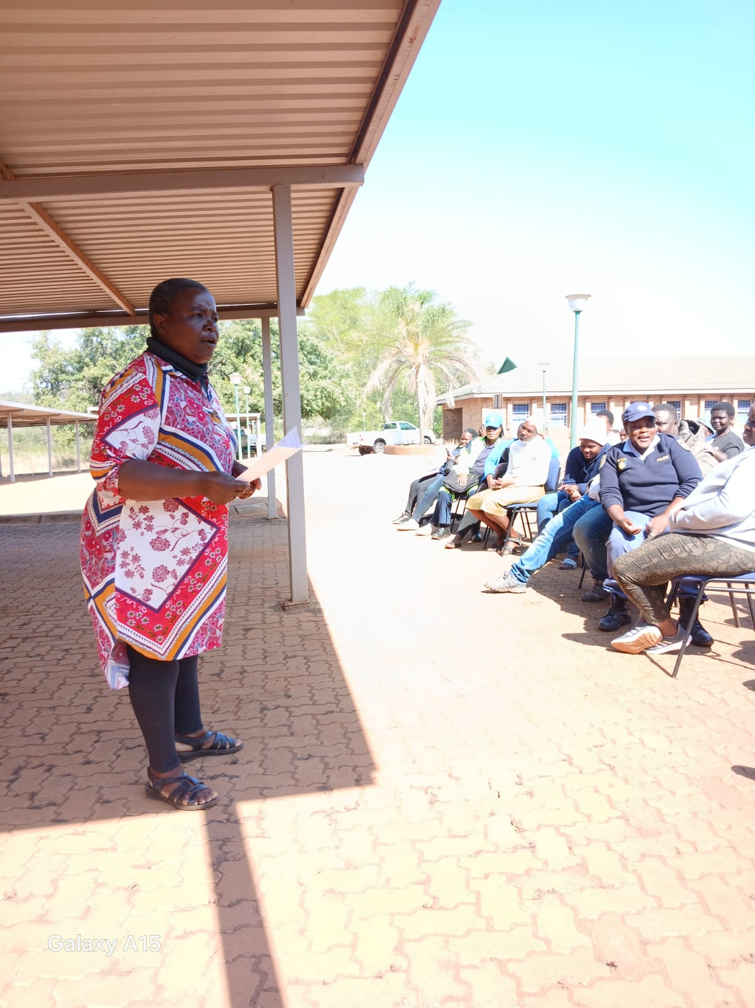
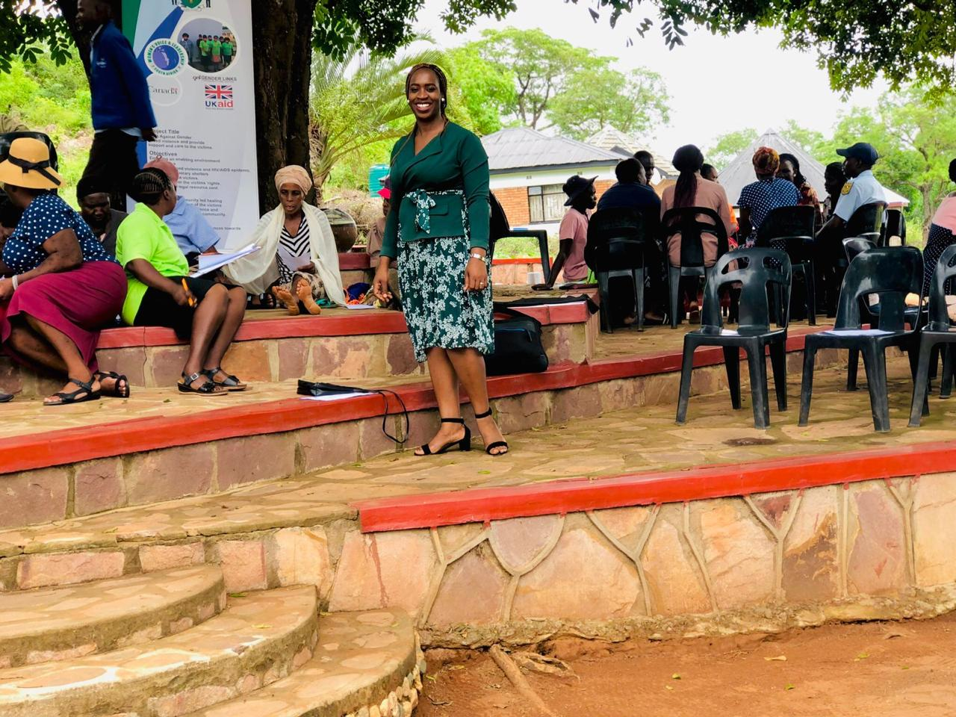
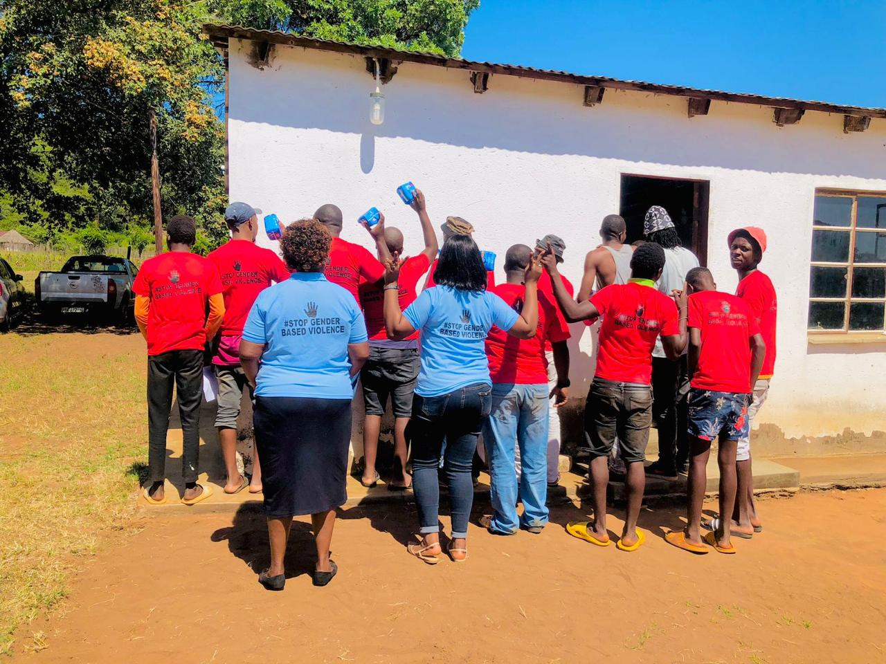
Change
How did the change come about?
• What activities or actions brought about the change?
Targeted GBV awareness campaigns in Ha-Makuya and Malamulele taught women and communities about GBV, how to recognize abuse, rights under the Domestic Violence Act, and where and how to report.
​Inclusive women–men community dialogues created safe spaces to unpack patriarchy, poverty, culture, and rigid gender roles, reducing stigma and building empathy and accountability across genders.
​Training for religious and traditional leaders equipped them as frontline responders to challenge harmful norms, counsel survivors, refer them to clinics, shelters, and police, and speak against GBV from the pulpit and traditional platforms.
​School-based period poverty campaigns in secondary schools distributed reusable sanitary pads, ran menstrual health and rights workshops, and engaged boys to break stigma, which reduced girls’ absenteeism and linked SRHR to economic justice.
​Youth camps combined GBV and SRHR education, building young people’s knowledge and advocacy skills to prevent violence and promote positive, non-violent masculinities.
​Primary research on “Perceptions and Awareness of Gender-Based Violence among Women in Ha-Makuya, Vhembe District” generated local evidence that informed tailored interventions and strengthened advocacy with authorities.
Voice and Choice Summit 2026 \ Voice and Choice Summit 2026

Slide 6
Continuation of change:
• Who led and participated in bringing about the change.
The project was led by Khensani Shivambu as coordinator under the WOSSO Fellowship, working through Life Savers Foundation, Bethesda Christian Church, and Social Welfare in Tech.
Rural women from Ha-Makuya and Malamulele were central actors, sharing experiences, engaging in dialogues and research, and shifting from survivors to advocates.
Men, including community members and youth, participated in men’s forums and mixed dialogues, committing to challenge harmful behaviors and support victims.
Religious and traditional leaders took part as trained frontline responders, providing counselling, referrals, and public messaging against GBV and stereotypes in churches and community platforms.
Local youth from secondary schools were actively involved through GBV and SRHR camps and school campaigns, helping to challenge stigma and support girls’ continued education.

Slide 7
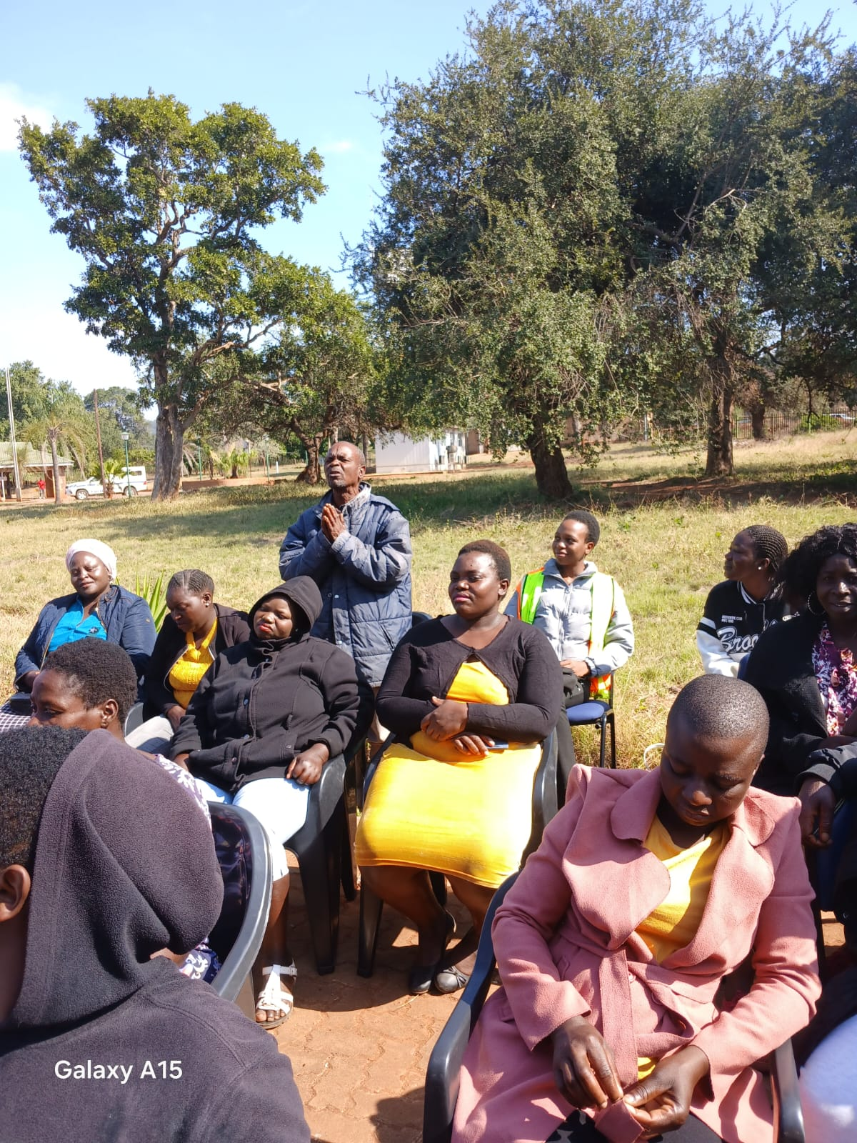
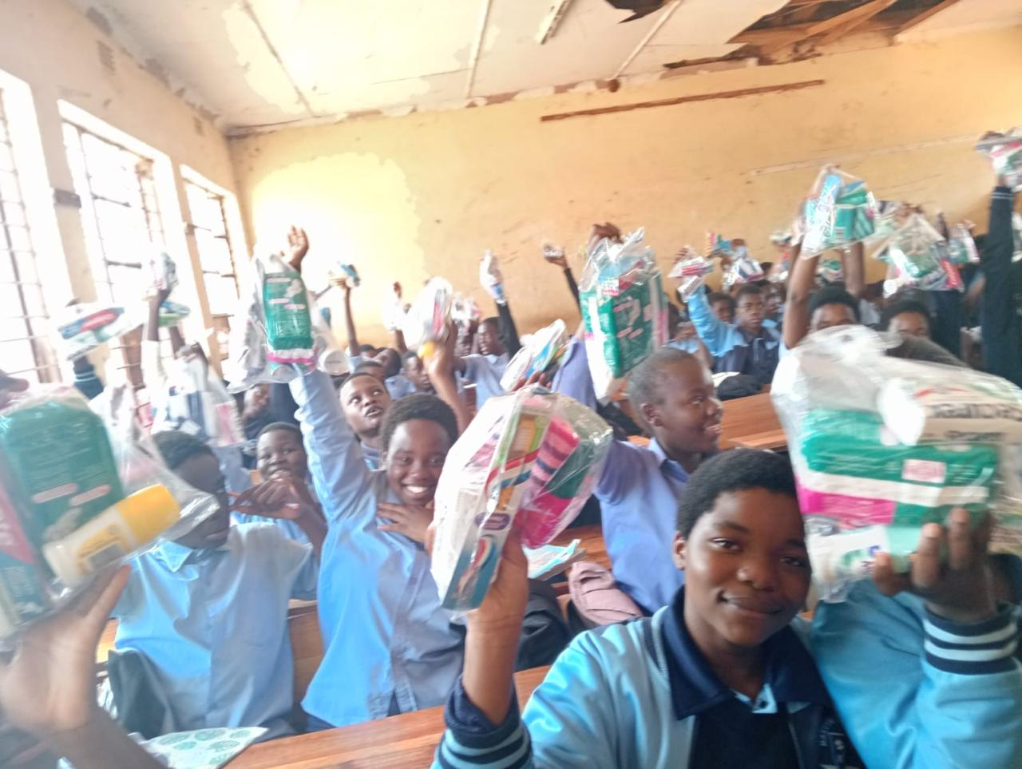
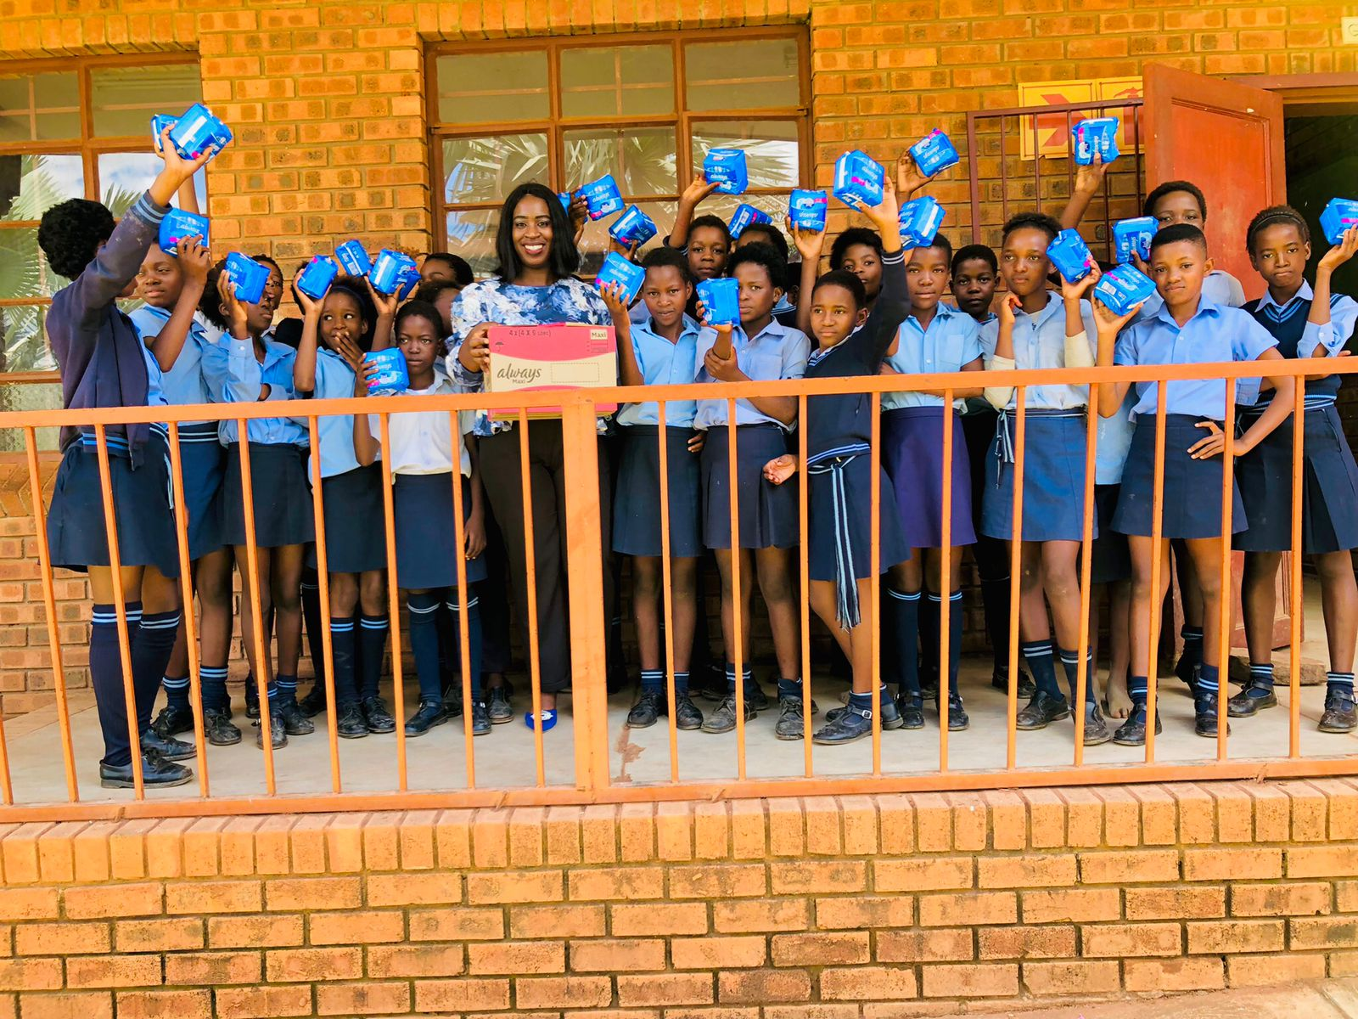
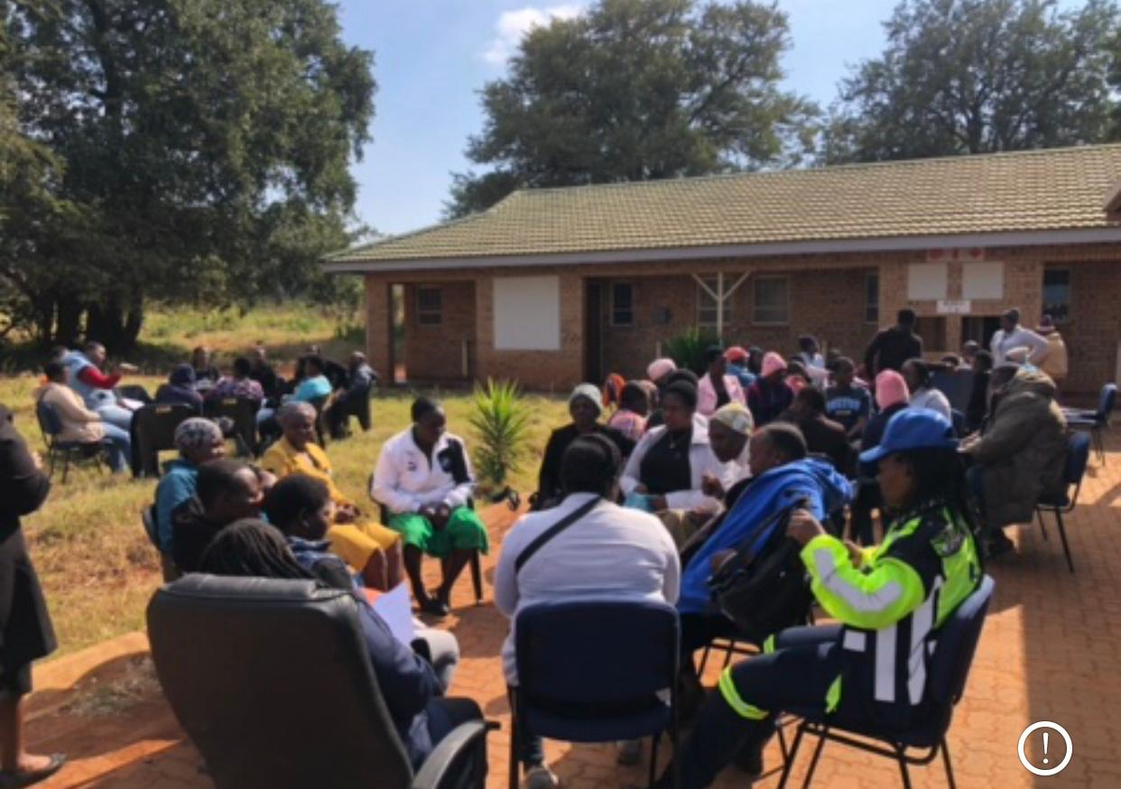
The change
Describe the change that has occurred?
• Describe what the change was, when and where it happened
The change was a shift from silence and normalisation of GBV to open dialogue, rights awareness, and collective action in rural Vhembe. It unfolded between 2023 and 2025 in the villages of Ha-Makuya and Malamulele in Limpopo, South Africa.
Before the project, many women quietly endured violence, viewing it as part of culture or marriage, with little knowledge of their rights or available services. Through awareness campaigns, dialogues, and leader trainings, women began to name abuse, understand the Domestic Violence Act, and seek help without shame.
At the same time, men, pastors, and traditional leaders moved from being passive bystanders to active allies, speaking out against GBV, making referrals, and challenging harmful norms in churches, forums, and community meetings. In schools, girls started to stay in class during their periods because of reusable pads and menstrual health education, while boys learned to reject stigma and support their peers.
Taken together, these shifts turned scattered, isolated experiences of suffering into a shared community commitment to safety, dignity, and gender equality in rural Vhembe during the 2023–2025 period.
• Was the change positive or negative?
The change was clearly positive. As a third person, one could say:
The change strengthened rural women’s confidence, rights awareness, and willingness to report abuse.
Community leaders and men became more accountable, speaking out against GBV and supporting survivors.
Girls’ continued school attendance improved through period-poverty interventions, enhancing their future prospects.
Local networks, evidence, and partnerships for GBV response and prevention became stronger and more coordinated.
Voice and Choice Summit 2026 \ Voice and Choice Summit 2026

Slide 8
Continoution of the change:
Who benefited, and in what way?
Rural women in Ha-Makuya and Malamulele gained the most, as they became more aware of their rights, more confident to report abuse, and better connected to clinics, shelters, police, and church-based support.
Girls in local secondary schools benefited from period-poverty interventions, reusable pads, and SRHR education, which helped them stay in school consistently and participate with greater dignity.
Children in affected households experienced safer, more stable home environments as parents learned about GBV, sought help, and began to challenge violent norms.
Religious and traditional leaders benefited by gaining practical knowledge, counseling skills, and referral pathways, enabling them to respond more effectively and compassionately to GBV cases in their communities.
Men in the villages also benefited by being engaged as allies rather than treated only as perpetrators; they deepened their understanding of GBV, reflected on harmful masculinities, and took ownership of change.
Around Ha-Makuya, men went further and formed a dedicated GBV Forum for Men, creating a structured space to hold one another accountable, challenge peers’ abusive behaviour, promote positive fatherhood, and stand publicly with survivors.

Slide 9
Continoution of the change:
What is the situation now?
The situation now is that GBV is no longer treated as an inevitable, private matter in these communities, but as a shared problem that people name, discuss, and act on. Women in Ha-Makuya and Malamulele understand their rights, know where to go for help, and feel more confident to report abuse and support one another.
Community dialogues, church programmes, and youth activities have made conversations about GBV, patriarchy, and economic dependence more open and less shame-filled. Religious and traditional leaders now intervene more actively, offering counselling, referrals, and public messages that condemn violence instead of excusing it.
Men have begun to position themselves as allies, including through the formation of a GBV Forum for Men around Ha-Makuya, where they challenge harmful behaviours, promote positive masculinities, and support survivors. Overall, there is a stronger sense of collective responsibility for women’s safety, girls are better able to stay in school, and local structures are more responsive to GBV than before.

Slide 10
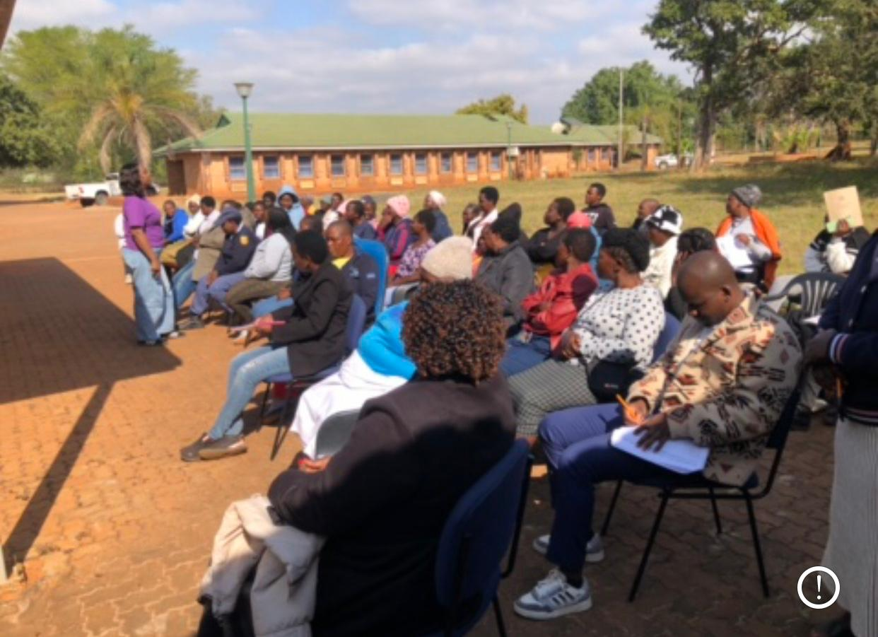
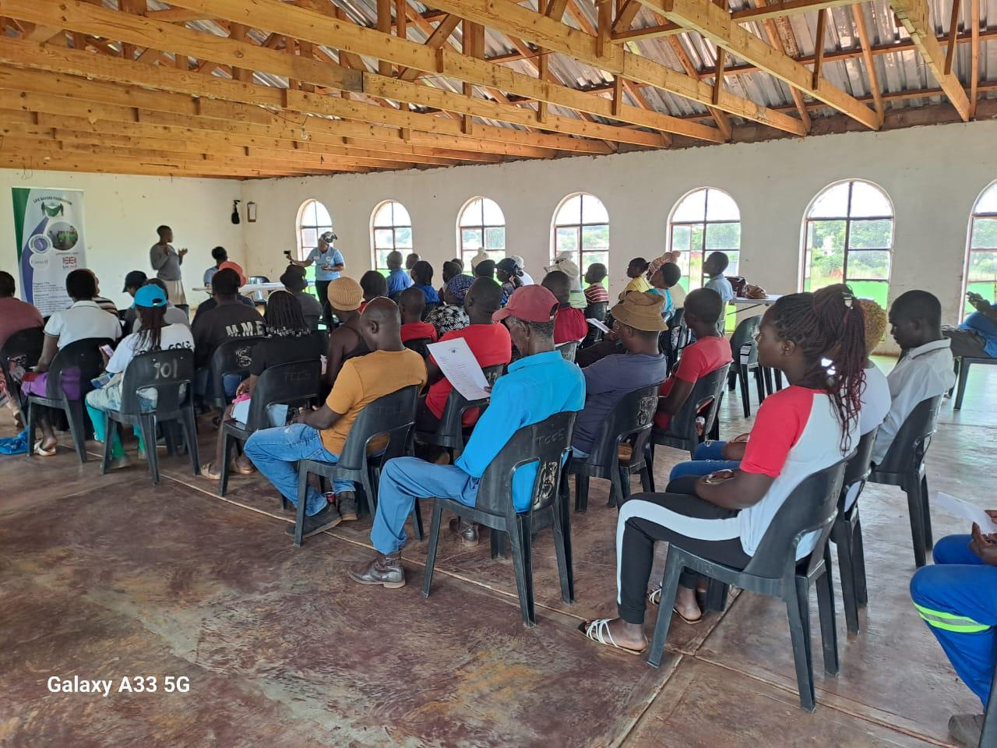
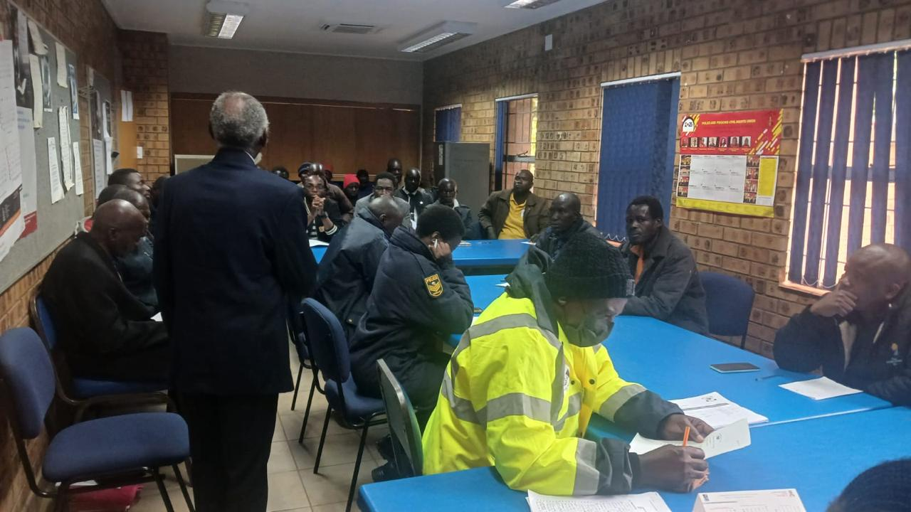
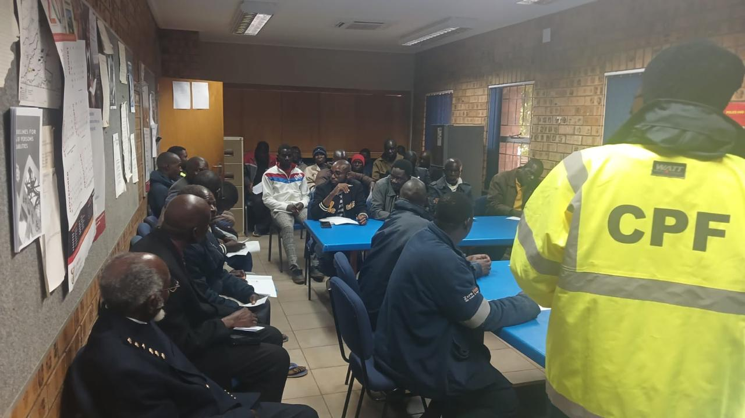
Significance of Change
Please provide further information on what this change means for the movement and its goals
This change strengthens the broader gender equality movement by proving that rural women and communities in places like Ha-Makuya and Malamulele can drive deep, structural shifts rather than only receiving support.
It shows that core movement strategies centering survivors’ voices, challenging patriarchy, engaging men as allies, and grounding advocacy in local evidence are effective even in underserved, culturally conservative contexts.
The emergence of trained religious and traditional leaders, active men’s forums, and more confident women advocates aligns directly with goals to end GBV and femicide, expand women’s political participation, and advance economic justice, because local power-holders are now using their influence to protect rather than control women.
By generating rural GBV data and building community-led models such as dialogues, youth camps, school-based SRHR work, and a GBV Forum for Men, the project offers a practical blueprint that can be replicated and scaled in other districts.
In this way, the change does not sit in isolation; it feeds the movement with evidence, tested approaches, and new rural leaders who can speak on national platforms, shape policy, and push for resources that leave no community behind.
Voice and Choice Summit 2026 \ Voice and Choice Summit 2026

Slide 11
What effect this change may have on the next steps in this area of work.
This change lays a strong foundation for deeper, more ambitious work in rural GBV prevention and response. It means that future efforts can move beyond awareness-raising into more systemic interventions, because communities in Ha-Makuya and Malamulele have already shown readiness to engage, organise, and lead.
Trained religious and traditional leaders, the emerging GBV Forum for Men, and school-based SRHR structures create concrete entry points for expanding programmes, piloting new models, and testing community-led accountability mechanisms.
The local evidence generated on women’s perceptions and awareness of GBV can now be used to advocate for dedicated district budgets, mobile clinics, one-stop centres, and stronger implementation of the National Strategic Plan on GBVF.
In practical terms, the next steps are likely to include scaling the model to neighbouring villages, deepening economic empowerment for women, formalising partnerships with government departments, and positioning rural leaders from this project as voices in provincial and national advocacy spaces.

Slide 12
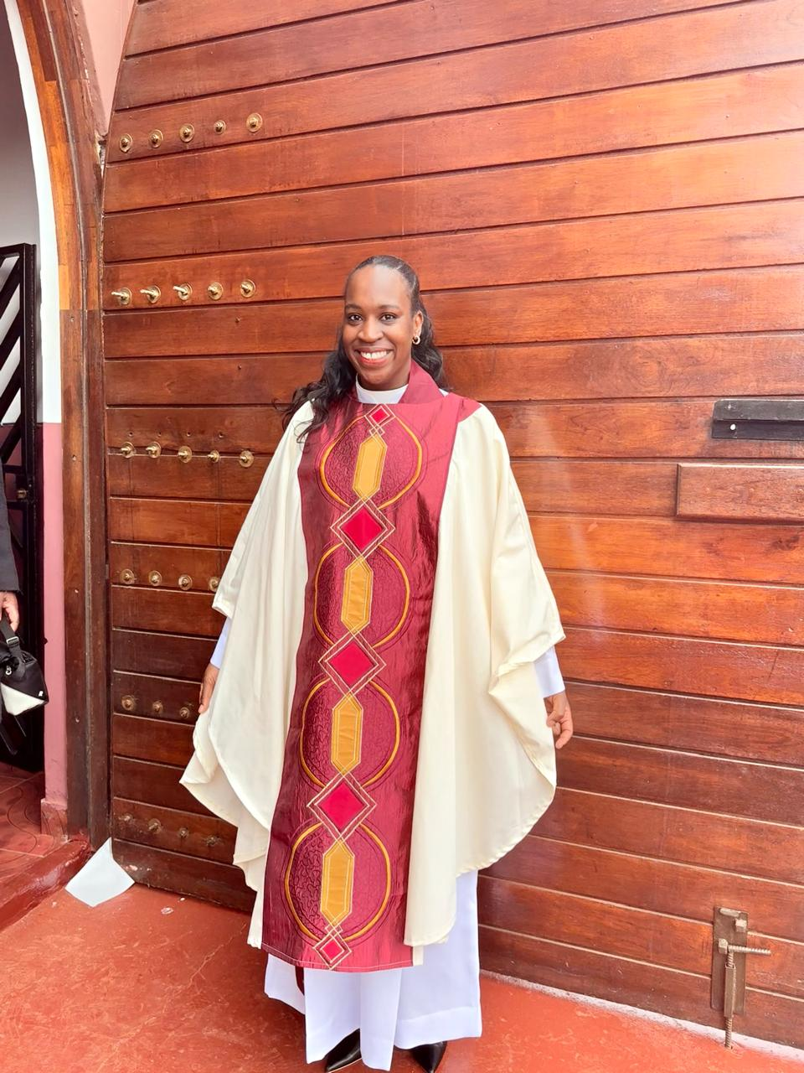
Sustainability
What sustainability measures were put in place for the work?
How do you intend to sustain the work or scale up?
Several sustainability measures have already been put in place, and they position this work for both continuity and growth. At community level, GBV and SRHR discussions have been built into ongoing programmes at Bethesda Christian Church and partner congregations, so dialogues, counselling, and youth sessions continue as part of regular ministry rather than as once-off events.
Trained religious and traditional leaders now mentor new champions and serve as permanent referral points, ensuring that survivors can still access guidance and support even after the initial project phase. Schools in Ha-Makuya and Malamulele are linking with NGOs and local businesses for continued sanitary pad donations and integrating menstrual health and rights into life skills, which keeps the period-poverty work alive beyond external funding.
Community-based organisations like Life Savers Foundation are planning to replicate the Ha-Makuya research model in more villages, using data to lobby for dedicated GBV budgets, mobile clinics, and one-stop centres, which anchors the work in policy and resources rather than short-term projects.
​
Voice and Choice Summit 2026 \ Voice and Choice Summit 2026

Slide 13
Continuation Sustanibility:
A key milestone for long-term sustainability is the project coordinator’s journey from being a WOSSO Fellow to becoming an ordained female pastor, which remains rare in many religious spaces. This shift dramatically strengthens her ability to sustain and scale the work: as an ordained leader, she now has formal moral authority, access to pulpits, church decision-making structures, and interfaith platforms where she can challenge GBV, harmful theology, and patriarchy from within the faith sector.
Her position makes it easier to negotiate with church boards, convene dialogues, and embed GBV and SRHR curricula into church programmes, women’s fellowships, and youth ministries. It also offers a powerful role model to girls and women in rural Vhembe, demonstrating that women can hold spiritual authority and speak publicly against violence and injustice.
As a pastor, she can deepen partnerships with other churches, religious councils, and community forums, using sermons, pastoral counselling, and church networks to keep GBV prevention on the agenda long after project grants end. This combination of embedded community structures, expanding research, and faith-based leadership provides a strong pathway to sustain the work locally and to scale it to other villages, districts, and eventually national advocacy spaces.

Slide 14
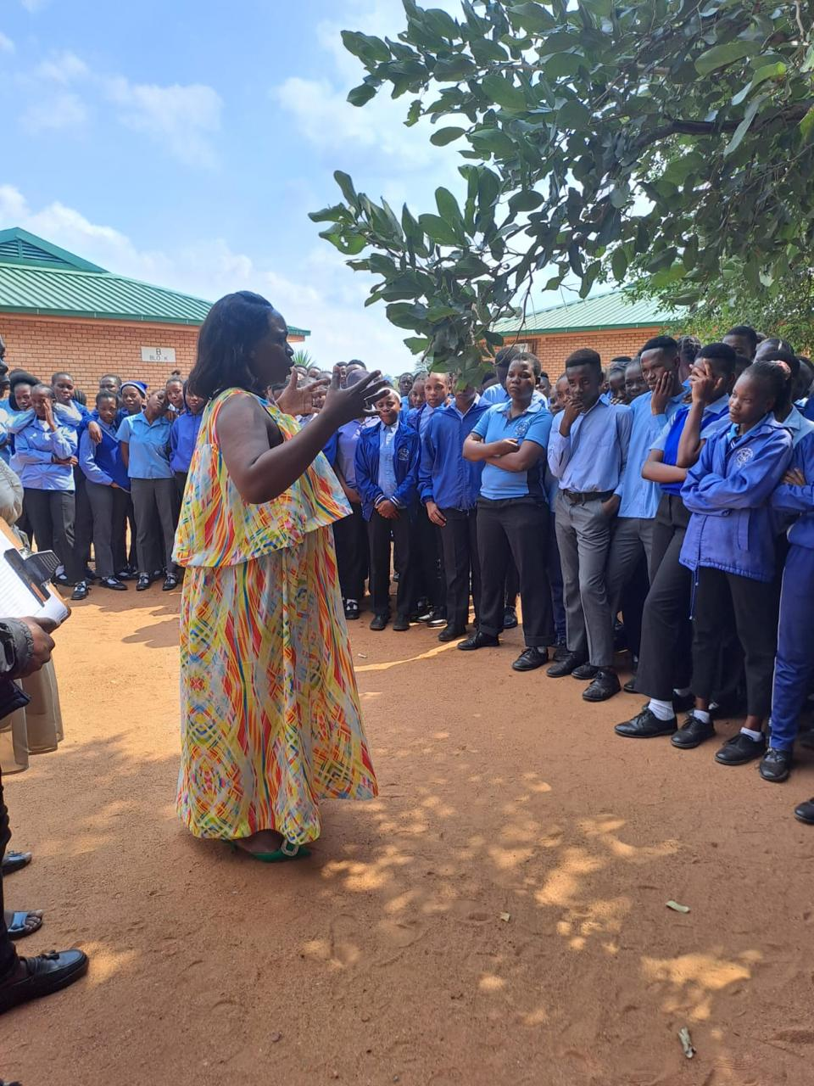
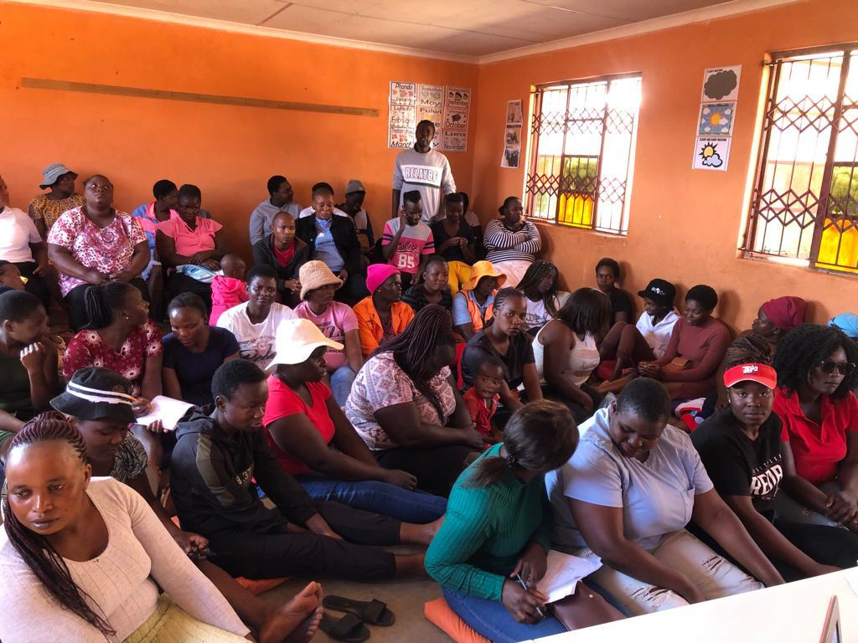
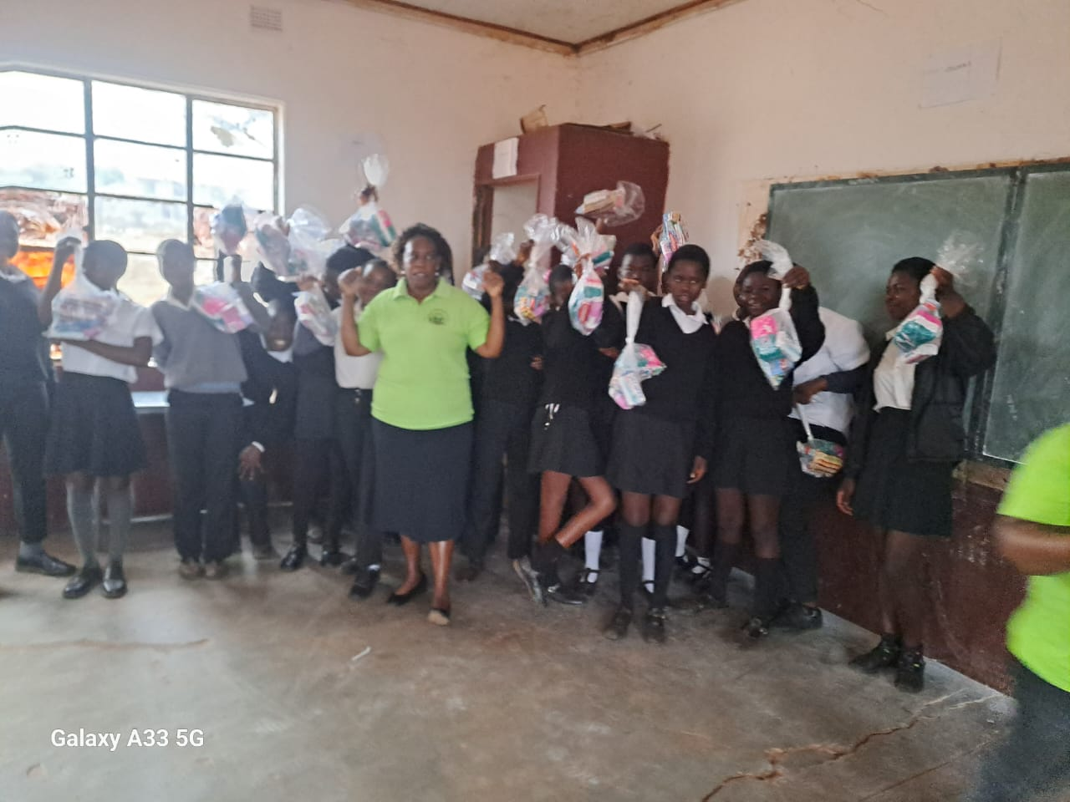
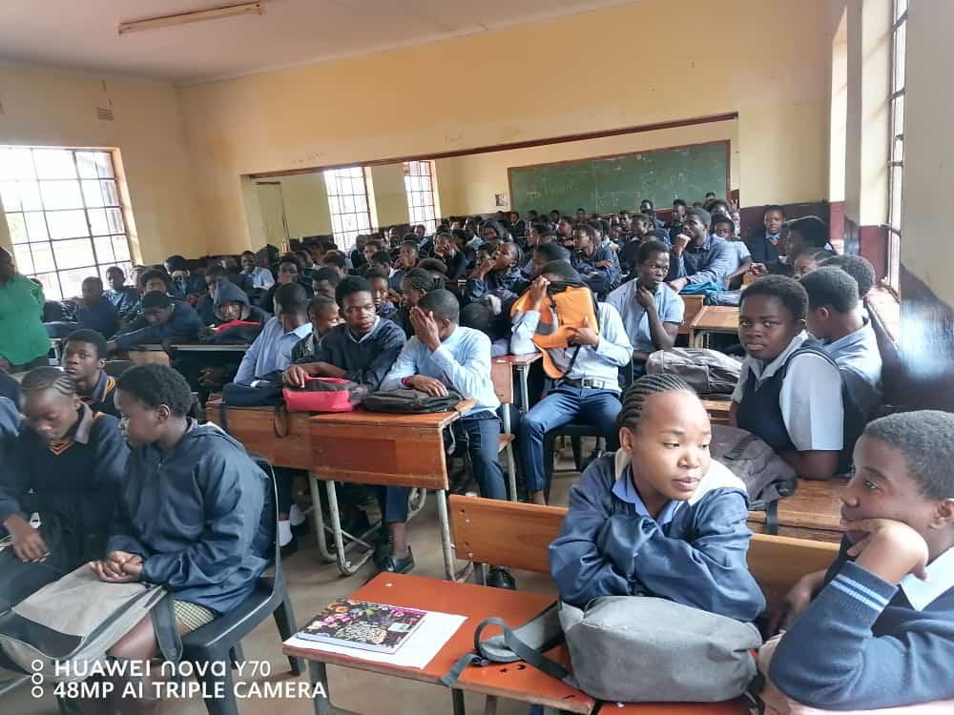
Beneficiaries
Number of;
Female – Direct beneficiaries = 1049
Male – Direct beneficiaries 503
Female – Indirect beneficiaries (e.g. through other networks) 200
Male – Indirect beneficiaries (e.g. through other networks)
Female – Online beneficiaries (e.g. website access, mailing lists, scholarly articles)= 0
Male – Online beneficiaries (e.g. website access, mailing lists, scholarly articles)=0
Voice and Choice Summit 2026 \ Voice and Choice Summit 2026

Slide 15
Next Steps
What are your plans?
My plans build on the gains already made and focus on deepening, sustaining, and scaling the work in rural Vhembe and beyond.
Continue and strengthen church- and community-based GBV and SRHR programmes in Ha-Makuya and Malamulele, using my position as an ordained female Pastor to keep these issues on the pulpit, in women’s fellowships, and in youth ministries.
Expand the GBV Forum for Men around Ha-Makuya, supporting men to mentor other men and boys, promote positive masculinities, and create village-level accountability for ending violence.
Replicate the Ha-Makuya research and dialogue model in at least three additional rural sites in Vhembe and Limpopo, generating evidence to lobby for dedicated GBV budgets, mobile services, and one-stop centres at district level.
Build stronger partnerships with schools, NGOs, and businesses to secure sustainable pad supplies and integrate menstrual health and GBV prevention into life-skills curricula across more schools.
Use provincial and national platforms, including civil society and faith-based networks, to bring rural women’s voices and data into policy discussions and to advocate for full implementation of the National Strategic Plan on GBVF.
Voice and Choice Summit 2026 \ Voice and Choice Summit 2026

Slide 16
Challenges & Lessons learnt
Challenges & mitigation
Key challenges included resistance to a woman leading GBV work, men’s difficulty in unlearning harmful norms, and limited resources and inconsistent services.
These were addressed by building trust through faith and culture-sensitive messaging, creating safe men’s forums for reflection and change, using positive male role models, strengthening partnerships with churches, CBOs, and schools, and steadily demonstrating the benefits of non-violent, equal relationships for families and the wider community.
What lessons have you learnt?
Lasting change in GBV prevention is only possible when communities lead it themselves; external projects must plug into existing faith, cultural, and CBO structures rather than sit alongside them.
Women’s leadership in rural and religious spaces is both transformative and contested; persistence, integrity, and grounding advocacy in shared values (faith, family well‑being, dignity) help overcome resistance.
Men are not a homogenous “problem group”; when they are invited in as partners and given non‑shaming spaces to talk, many are willing to unlearn harmful norms and become powerful allies.
Dialogues work best when they connect GBV to everyday realities—economy, culture, faith, and children’s futures—rather than treating it as a stand‑alone “women’s issue.”
Combining awareness activities with tangible support (like pad distribution, clear referral pathways, and counselling) builds credibility and makes it more likely that people will act on what they learn.
Local evidence from research and community feedback is essential for influencing duty bearers; data from places like Ha‑Makuya strengthens advocacy for budgets, services, and policy implementation.
Finally, change is slow and iterative; setbacks, pushbacks, and relapses are part of the process, so patience, consistent presence, and ongoing relationship-building are as important as any single activity.
Voice and Choice Summit 2026 \ Voice and Choice Summit 2026

