Slide 1
SADC PROTOCOL@WORK Sexual and reproductive health and rights
(Including HIV and AIDS, gender-based violence, and sexual and reproductive health)

Slide 2
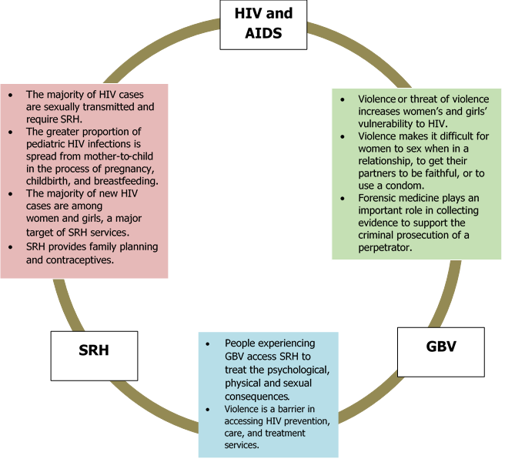

Slide 3
Breakdown of case studies
A total of 75 good practices on Sexual and Reproductive Health and Rights were presented at Summits between 2017 and 2018.
Of these 31 were on gender-based violence (GBV), 30 on health, and 14 on HIV and AIDS.

Slide 4
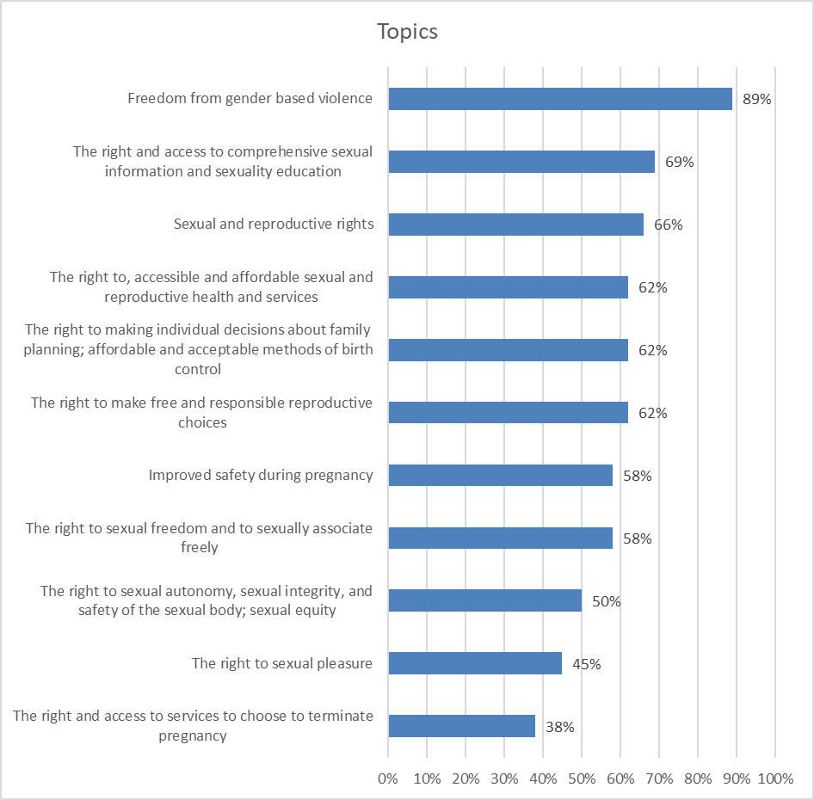
topics

Slide 5
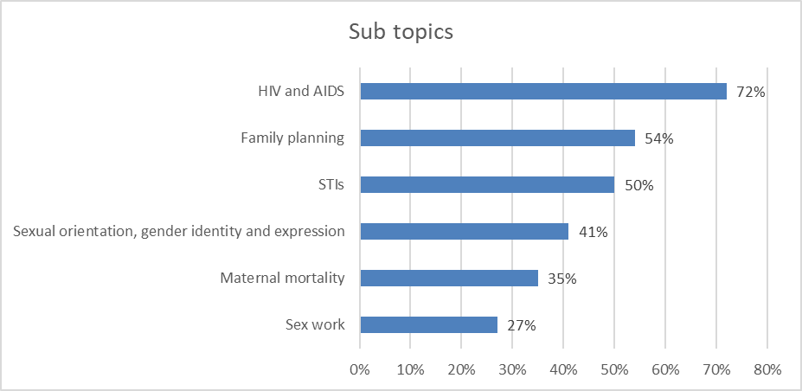
Sub topics

Slide 6
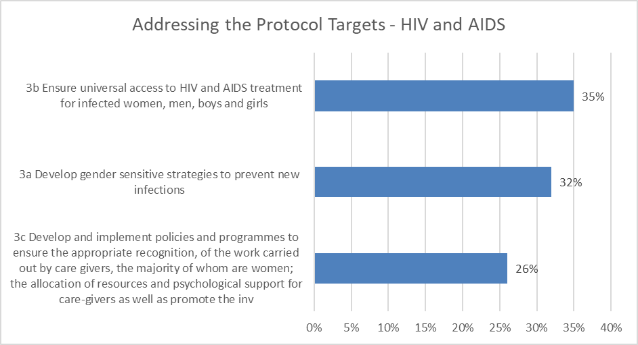
Hiv and aids

Slide 7
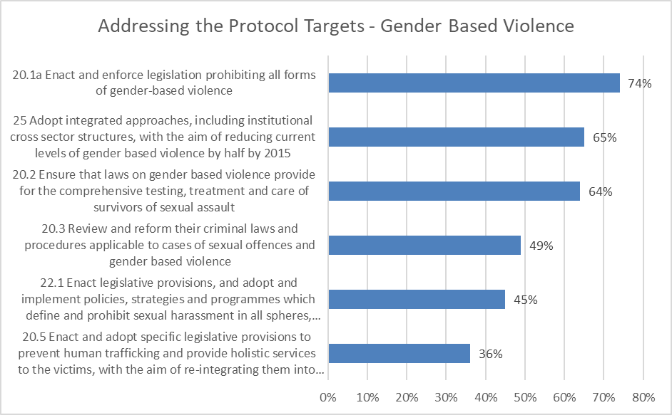
Gender based violence

Slide 8
srhr

Slide 9
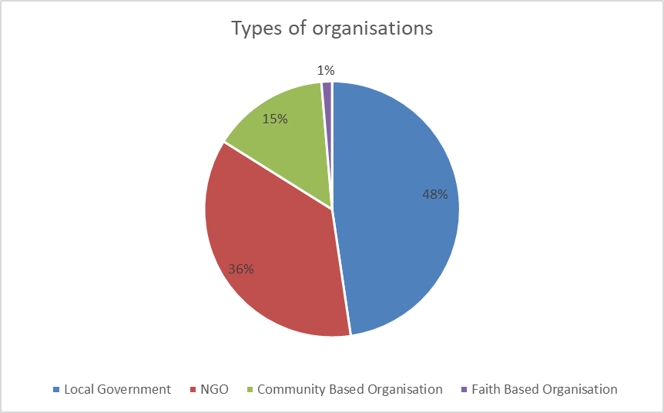

Slide 10
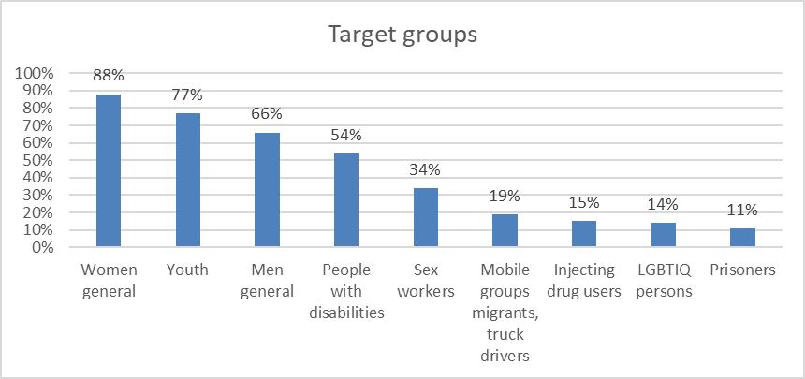

Slide 11
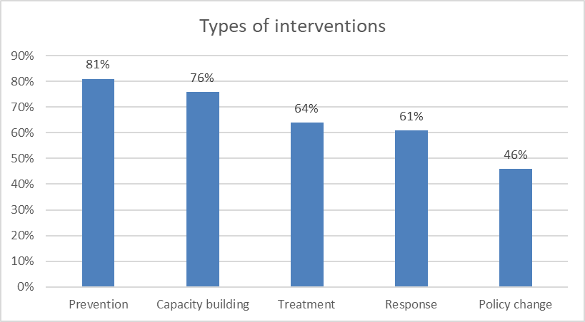

Slide 12
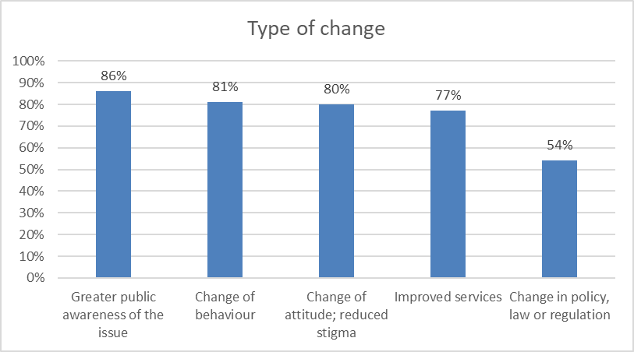

Slide 13
Next steps
Only 14 of the 75 case studies in this category focused primarily on HIV and AIDS. This is very low and might be indicative of fatigue around HIV and AIDS. This problematic as
In contrast there were relatively high numbers of submissions on GBV. The challenge is despite all the good practices levels of GBV are not decreasing. Moving forward there needs to be an analysis of what works in the short, medium and long term to prevent all forms of GBV.
Levels of maternal mortality in the SADC is unacceptably high. More initiatives are required to demand better quality, accessible and an increase in reproductive health services.
A glaring absence in the case studies was on sexual harassment. None of the case studies focused on sexual harassment. This is particularly concerning during a time when the issue was so prominent with launch of the global MeToo campaign.
Issues of sexual and reproductive health and rights are particularly significant for sex workers and LGBTIQ persons. Both groups face stigma and discrimination within communities and when accessing services.

