Slide 1



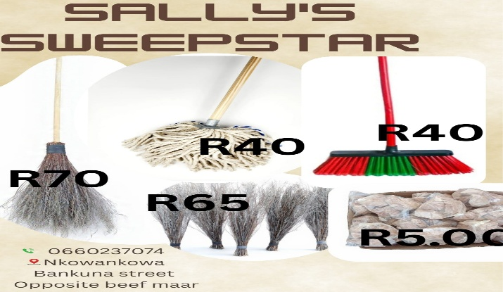
PROMOTING GENDER-INCLUSIVEE LOCAL ECONOMIC DEVELOPMENT IN SOUTH AFRICA
ESTABLISHED ENTREPRENEURS
NAME OF THE BUSINESS: SALLY’S SWEEPSTAR
PARTICIPANT NAME: SALMINA GAHADZA
COUNCIL: GREATER TZANEEN MUNICIPALITY

Slide 2
MY EXPERIENCE DURING SUNRISE CAMPAIGN
Key lesson from Life Skill and Entrepreneurship training
LIFE SKILL TRAINING:
CONFIDENCE
PROBLEM SOLVING
FINANCIAL MANAGEMENT
Memorable moments(e.g Mentorship, Group Work, Support etc)
MENTORSHIP: We have mentors from experienced entrepreneur.
GROUP WORK: I have learned how to work as a group.
SUPPORT: I have received support from GENDELINKS, MENTORS, THE MUNICIPALITY

Slide 3
HOW MY LIFE HAS CHANGED
Personal growth (confidence, independence, safety)
CONFIDENCE: I can now believe in myself and my abilities.
INDEPENDENCE: I can now stand for myself
SAFETY: before I was not safe, now I know how to say NO to abuse.
Family impact (children, relationships, community respect)
CHILDREN: after attending the workshop I am happy and even my children are happy
RELATIONSHIPS: strengthening the bond with my family members.
COMMUNITY RESPECT: gaining trust from my community.
Income changes or lifestyle improvements
It has brought a big change in my life
I can now save money for myself
I can even afford the lifestyle I want
I can even take my children out for lunch

Slide 4
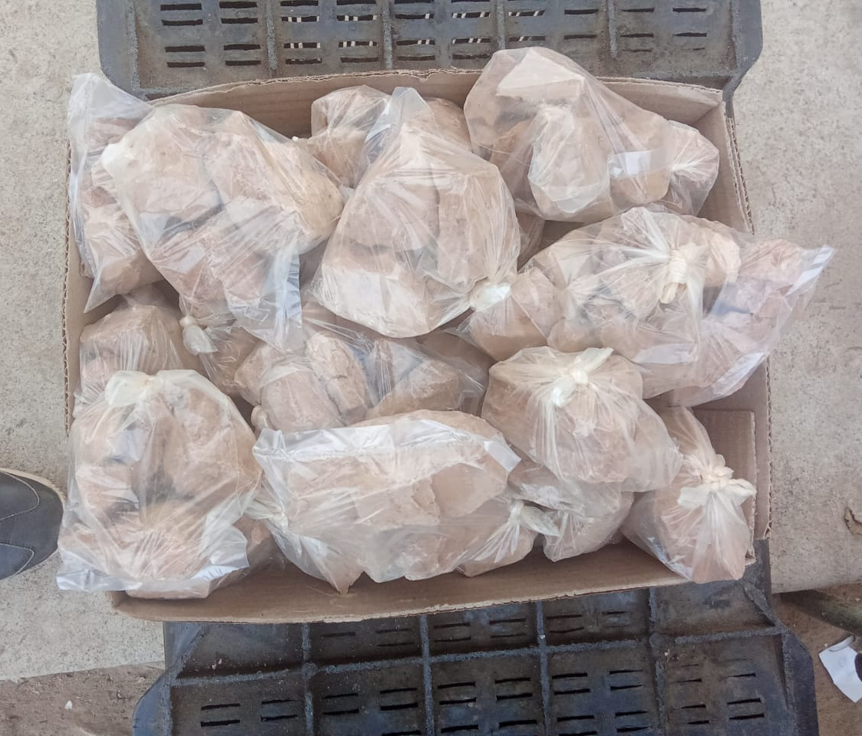
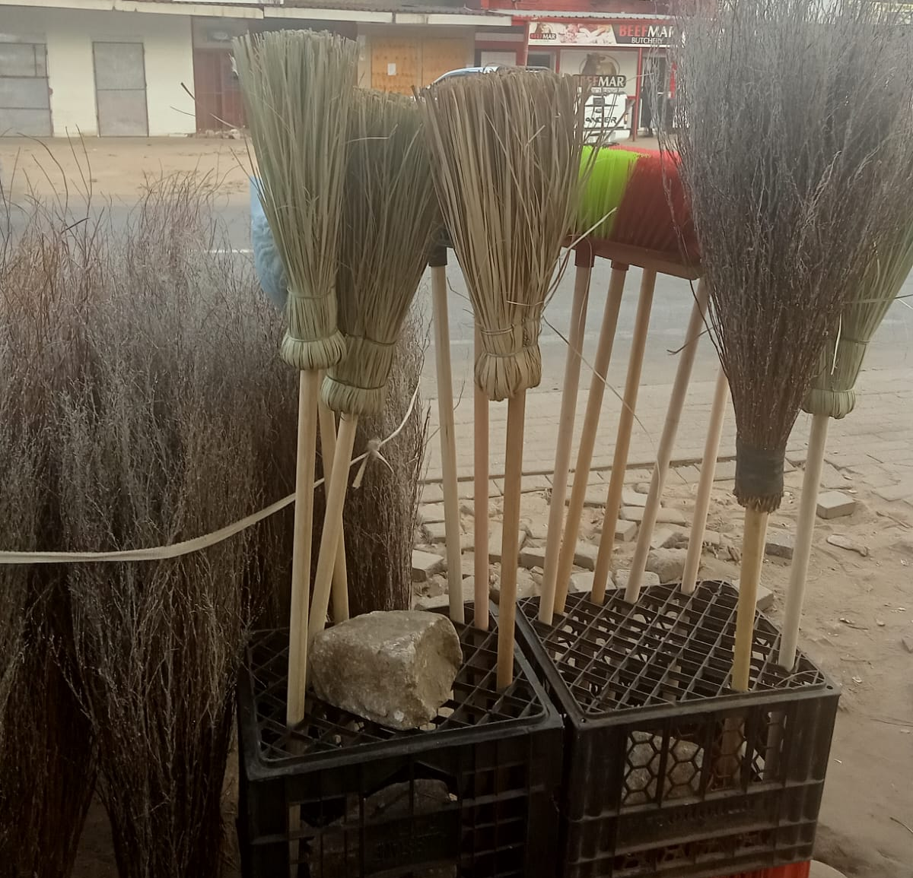
PLEASE DESCRIBE THE BUSINESS
Name of business and products/services offered:
Name of the business: SALLY’S SWEEPSTAR
Products/services offered: BROOMS ,MOPS, AVOCADOS AND CLAYSOIL
Achievements so far Challenges still faced and how they’re managed:
Overcoming personal struggles.
I have overcome self-doubt and fear

Slide 5
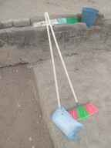
CUSTOMER BASE AND COMPETION?
Who are your customers?
Schools, community members
Have you increased the number of customers since starting the LED Programme? Yes
How did you do this? I have been doing door to door to sell my products.
Who is your competition? shops
How do you handle competition in your business? By reducing my product’s prices

Slide 6
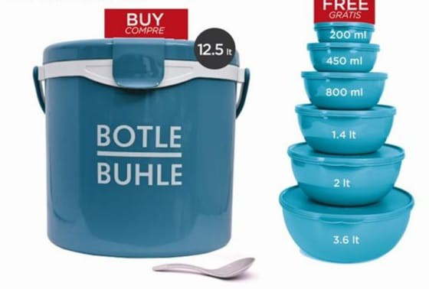
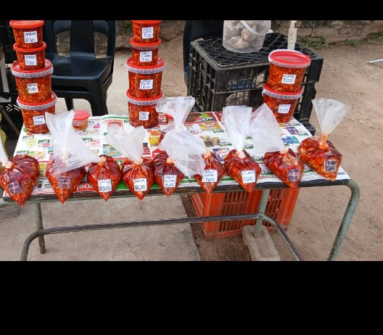
NEW PRODUCTS OR SERVICES?
Do you have any new business products or services?YES
What new products are in the business? BUTLE BUHLE PRODUCTS
How are they performing compared to your initial products?NO
How do you advertise/market your products?WORD OF MOUTH
Evidence

Slide 7
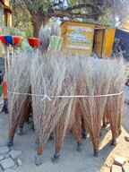
QUALITY AND PACKAGING
Are your customers happy with the quality of your products or services? YES
If you have answered yes please give more information. There are returns or complains
Do you have any branding available for your products? Explain. NO
Have you changed the packaging or marketing of your business to attract more customers? Please explain.NO

Slide 8
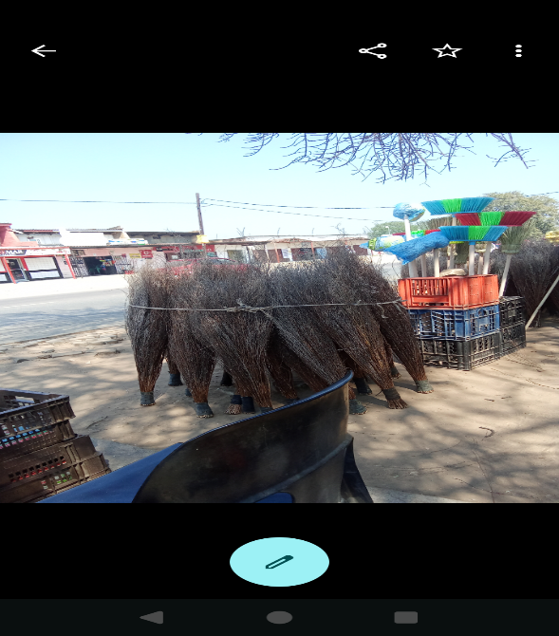
BUSINESS MANAGEMENT
Have you hired more staff? How many full-time and how many part-time?NO
How do you manage your stock and check regularly? Please explain. I record the incoming and outgoing finances.
Have you been able to price your products better so that you can earn a surplus from the business? Please explain. YES, when people take credit I add more.
Evidence

Slide 9
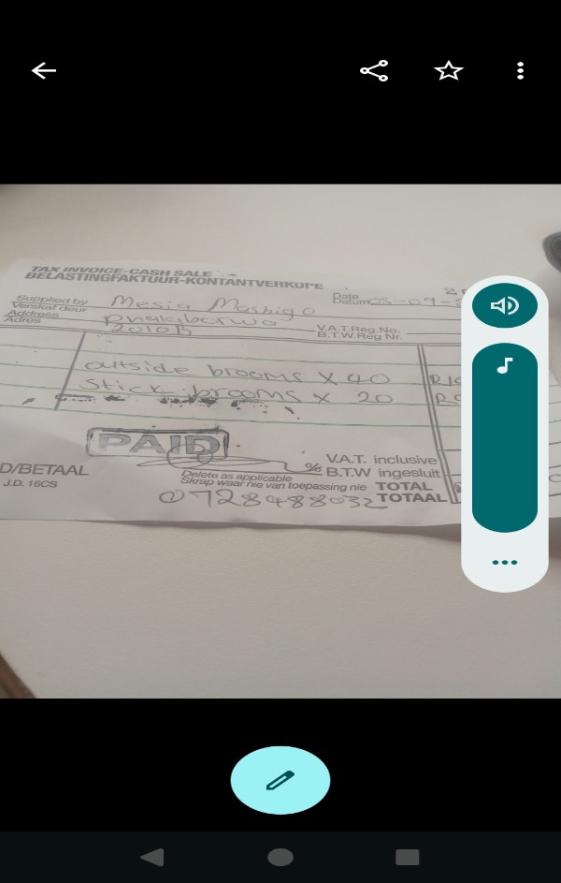
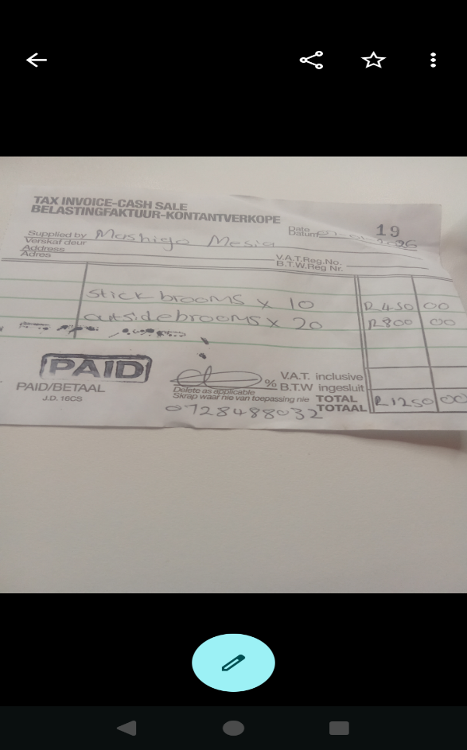
FINANCIAL MANAGEMENT
Do you have a record-keeping system in place? Explain.Yes
If yes, how is it helping you to manage your business? It helps me to run my business in a good way and makes my stock easy
Do you have a bank account for your business? NO
Evidence

Slide 10
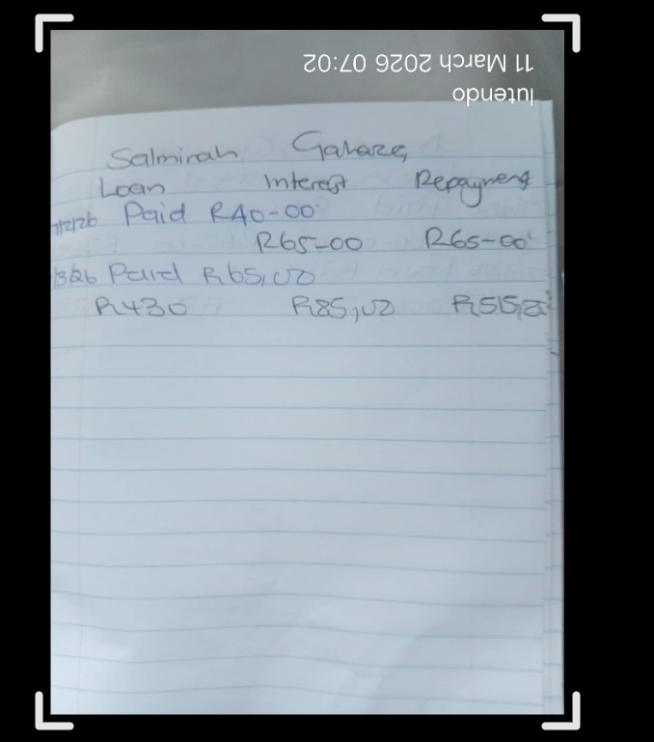
SAVINGS AND SELF SUFFICIENCY
Are you a member of a savings group?YES
Are you saving money? How much have you been able to save so far?YES ,R510
Have you managed to increase household income? YES
Evidence

Slide 11
INCOME AND EXPENSES FOR THE BUSINESS FOR PAST THREE TO SIX MONTHS
INCOME
EXPENSES
ITEM | AMOUNT
SALES | R19760
CHILD SUPPORT GRANT | R3360.00
TOTAL | R23120
ITEM | AMOUNT
STOCK | R13500
WAGES | R4000
TRANSPORT | R1800
TOTAL | R19300

Slide 12
CHALLENGES
What challenges have you experienced in your business? Is don’t have shelter to work on when it’s raining.
How have you addressed these? I now bought umbrellas for protection.

Slide 13
SUSTAINABILITY
How will you sustain your business? by investing in group savings.
What other sustainability measures are you putting in place for your business? I am looking forward investing in other businesses

Slide 14
WHAT PLANS HAVE YOU MADE TO GROW YOUR BUSINESS IN THE NEXT 6 MONTHS?
Expanding product line: butle buhle
Increasing online presence:
Social media
Enhancing customer experience: I look for feedback from my customers regarding my products
Targeting new customer
Evidence

Slide 15
ADDITIONAL INFORMATION?
What other changes have you experienced in your business? Explain. More customers are coming through everyday
Do you have any additional information to share?
I would like to move to a bigger space and establish my business in other areas.

