Slide 1


Voice and Choice Summit 2026-Organisational Development Category
South Africa – Resoketswe Lebjane Foundation : GBVF School Club
Voice and Choice Summit 2026 \ Voice and Choice Summit 2026

Slide 2
Synopsis– brief overview what this is about
Name | Bontle Precedence Selekane
Designation | Bushbuckridge, Mpumalanga
Organisation | Resoketswe Lebjane Foundation
Country | South Africa
Category | Organisational Growth
Summary | Resoketswe Lebjane Foundation's GBVF School Club empowers young girls in schools to combat Gender-Based Violence and Femicide (GBVF) and promote human rights. Through interactive sessions, workshops, and awareness campaigns, learners gain knowledge and skills to recognize and resist GBV- Understand their human rights and the Constitution. Develop leadership and advocacy skills. Create a safe and supportive school environment. The club engages learners through educational workshops and presentations. Peer-led discussions and support groups. Awareness campaigns and events (e.g., 16 Days of Activism) Partnerships with local stakeholders for resources and support by empowering young girls with information and skills, Resoketswe Lebjane Foundation aims to reduce GBV, promote gender equality, and create a safer, more supportive environment for all learners.
Voice and Choice Summit 2026 \ Voice and Choice Summit 2026

Slide 3
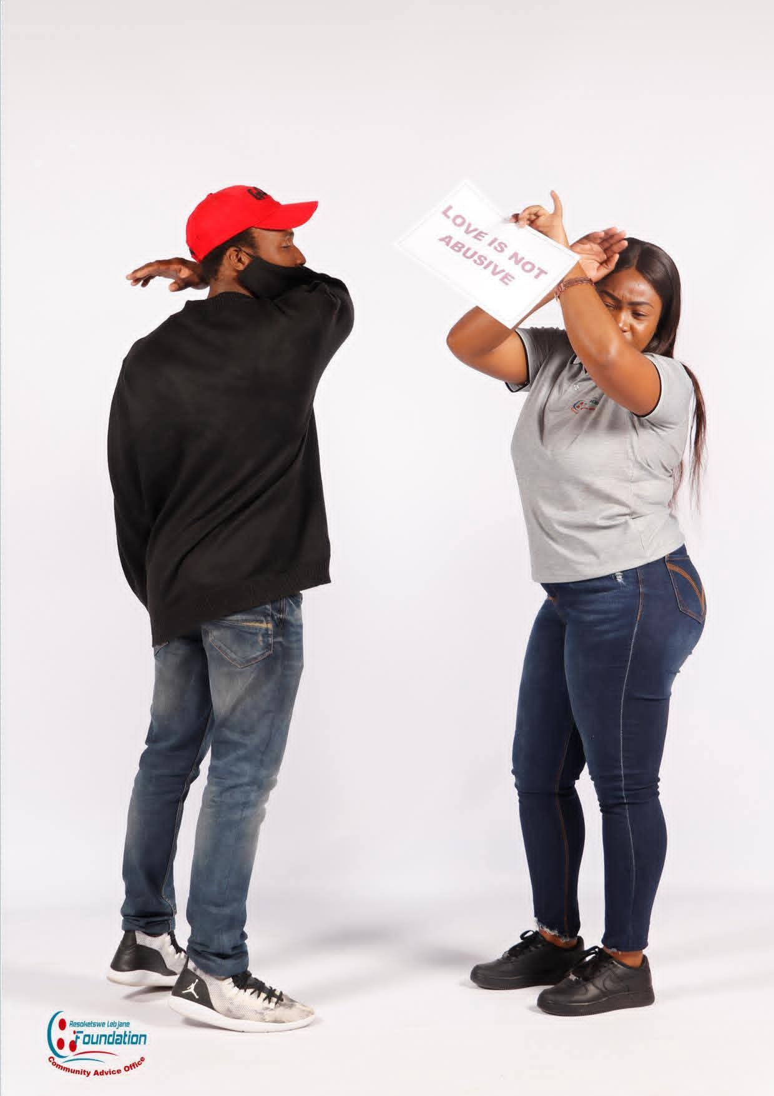
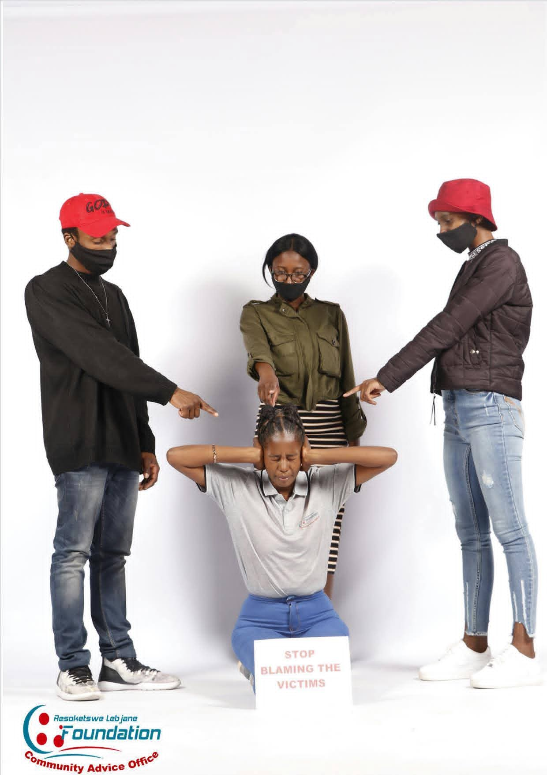
Background(problem, actions, change, evidence)
Resoketswe Lebjane Foundation is a nonprofit organization, established in 2016 and officially registered with DSD in 2017, it addresses the high rate of human rights violations in South Africa. We identified a gap between marginalized communities and access to justice, often due to a lack of information about the Constitution. Our focus is on providing effective basic legal advice and paralegal services to individuals and community groups, with a primary focus on women and girls, who are disproportionately affected by Gender-Based Violence. We aim to empower them to stand against GBV and access their rights.
Voice and Choice Summit 2026 \ Voice and Choice Summit 2026

Slide 4
ODS Baseline Scores- find yours!
RWVL ODS Baseline Report
Marang ODS Baseline Report
Overall Score
People and Leadership score | 8.1
Structures, Systems, and Processes Score | 7.7
Resilience, Care, and Security Score | 7.4
Finance and sustainability and social entrepreneurship Score | 7.2
Connections and Visibility Score | 7.7
Voice and Choice Summit 2026 \ Voice and Choice Summit 2026

Slide 5
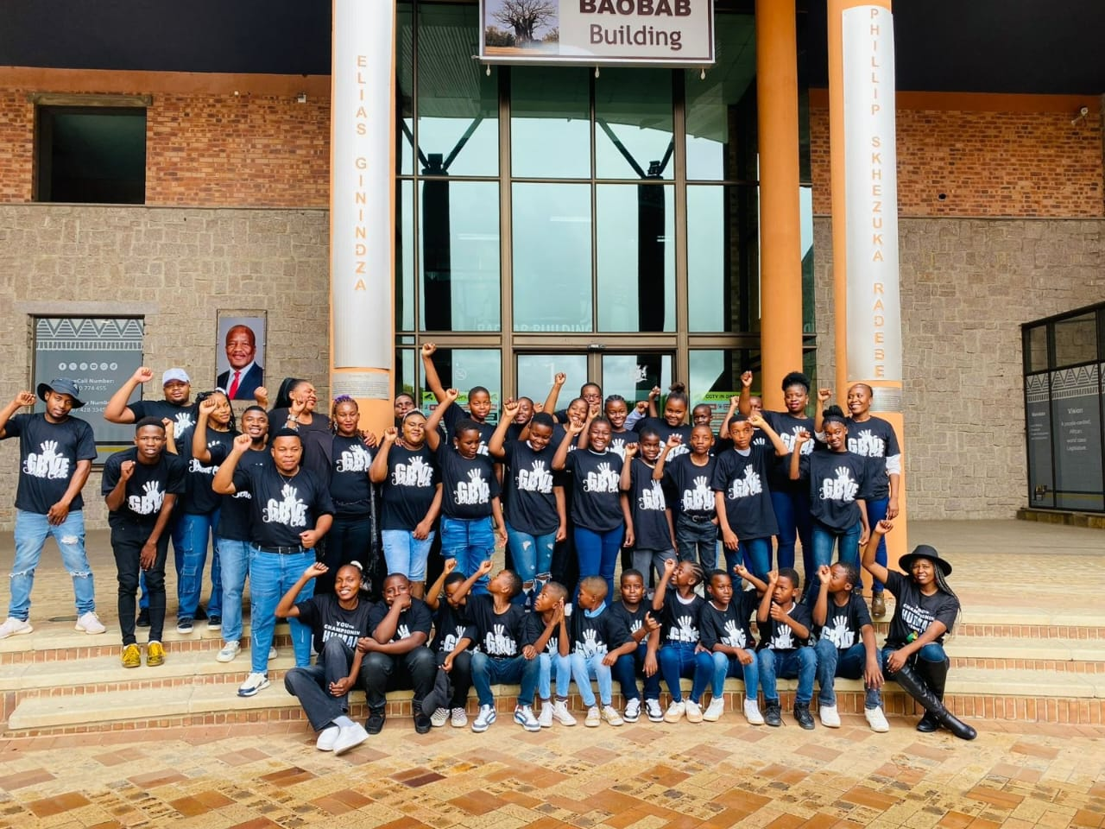
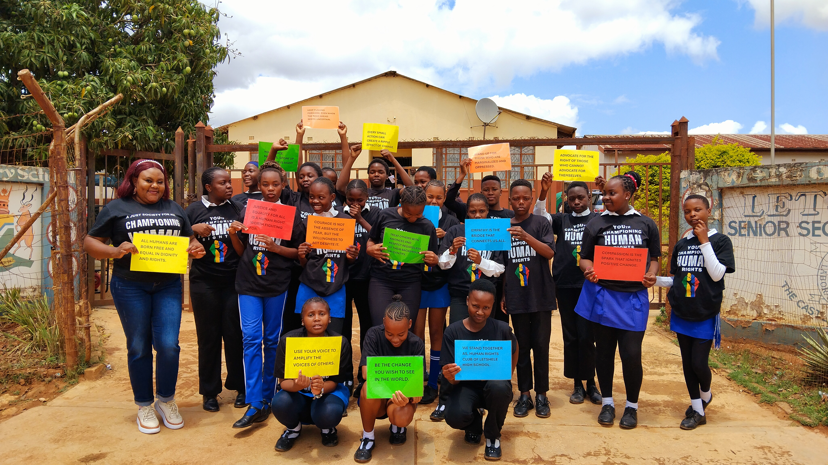
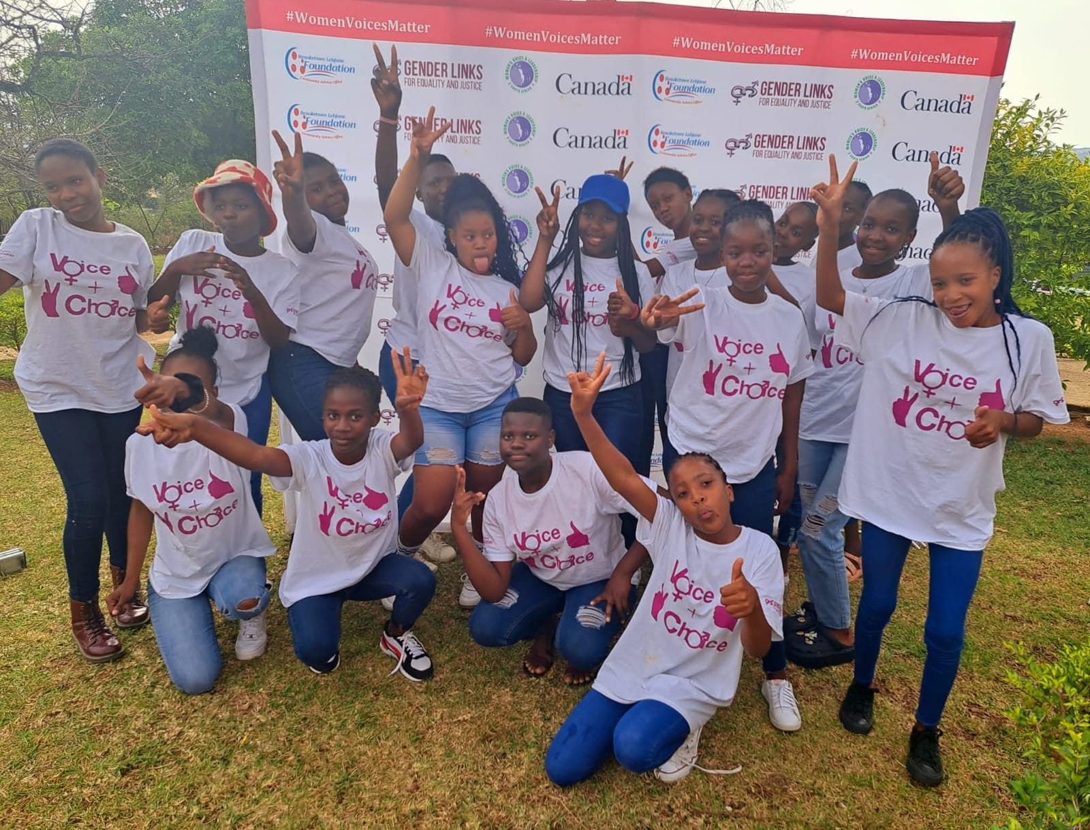
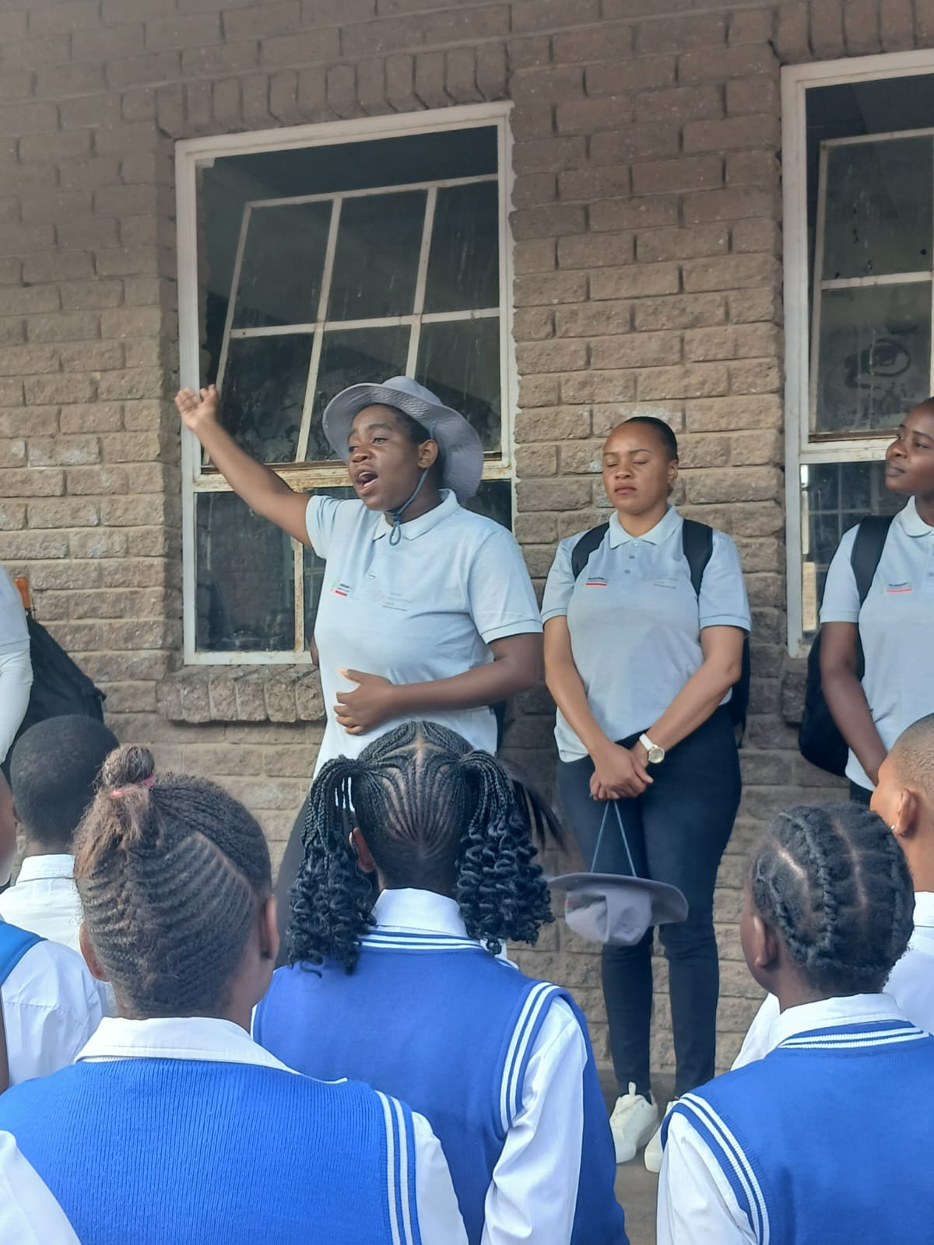
Change
The change came about through the implementation of school clubs GBVF and Human Rights and the Sisterhood project, which educated learners about human rights, GBV, and antibullying. These initiatives raised awareness, identified cases, and provided support, making schools more engaged and equipped to deal with issues.
The Resoketswe Lebjane Foundation led the initiatives, partnering with schools and involving learners, staff, and Sisterhood Advocates. The GBVF and Human Rights clubs had 14-47 learners per school, while Sisterhood project reached entire schools through presentations done during assembly.
Our organization has adopted schools for GBVF and Human Rights clubs, conducting presentations on GBV and anti-bullying. Empowering young adolescent girls is a core focus through initiatives like Voice and Choice, we've addressed Sexual Reproductive Health Rights (SRHR) with girls, equipping them with knowledge and skills for informed decisions and advocacy.
Voice and Choice Summit 2026 \ Voice and Choice Summit 2026

Slide 6
What has changed in the following areas since working with Gender Links.
 | Before due diligence | After due diligence
Financial system | Everything was done manually, records and slips would be filed. | We got introduced to sharepoint, all records are done online.
Separate bank account | Gender links is the first funder, so the account belonged solely to Gender links. | Every funder wishes to have their own account , for better accountability.
Two signatories to the account | The Chairperson and Treasurer of the Board are the designated signatories, overseeing and approving all transactions to ensure financial accountability and transparency | The Chairperson and Treasurer of the Board are the designated signatories, overseeing and approving all transactions to ensure financial accountability and transparency
Financial documentation | Everything was filed manually | We use sharepoint.Everything is done online
Monthly reconciliations and routines | We used to do it manually . | We report monthly online using sharepoint before the 7th of every month.
Fundraising and Sustainability | In the beginning we were doing the little we can since the was no funding yet, for exposure we showed up in the community to be seen and known by the community , the kind of services we provide. | Nedbank offers us with furniture,. FNB comes to the office and assist in opening accounts for our staff free of charge. Taxi drivers offer transportation to our workers when they go for social services . We also have a small garden in our organization.
Voice and Choice Summit 2026 \ Voice and Choice Summit 2026

Slide 7
what has changed in the following areas since working with Gender Links.
 | Before due diligence | After due diligence
Safeguarding policy | Not implemented | Implemented
Human resources policy | Not implemented | Implemented
Finance policy | Implemented | Implemented
Procurement policy | Not implemented | Not implemented
Board functionality | Implemented | Implemented
Anti-corruption/Fraud Policy | Not implemented | Implemented
Sexual Harassment Policy | Not implemented | Implemented
Monitoring and Evaluation Systems | Implemented | Implemented
Fundraising and Sustainability | Not implemented | Implemented
Voice and Choice Summit 2026 \ Voice and Choice Summit 2026

Slide 8
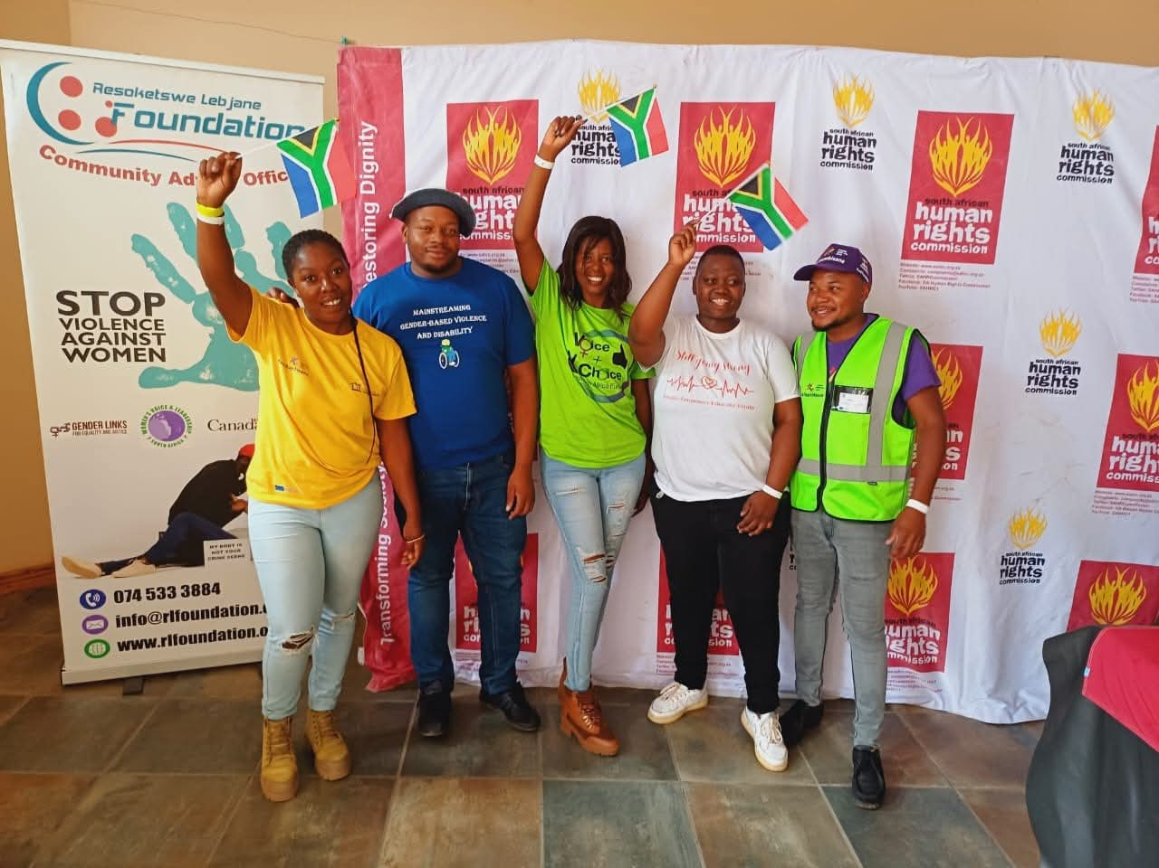
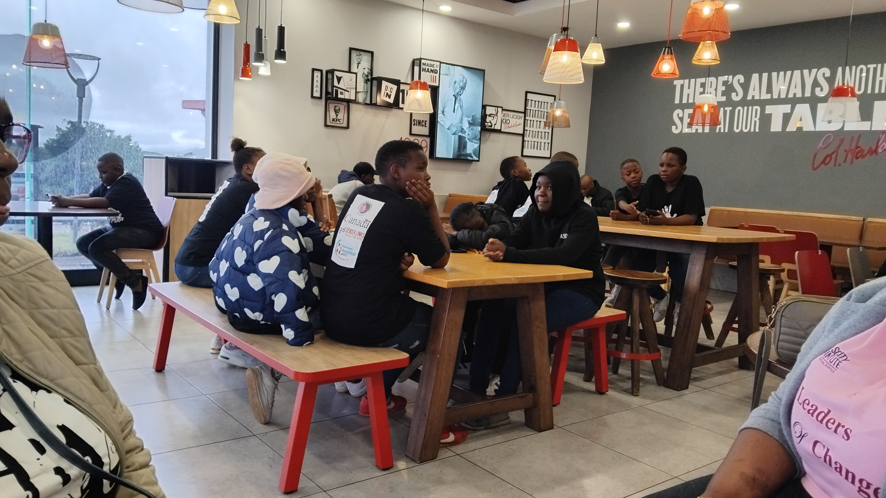
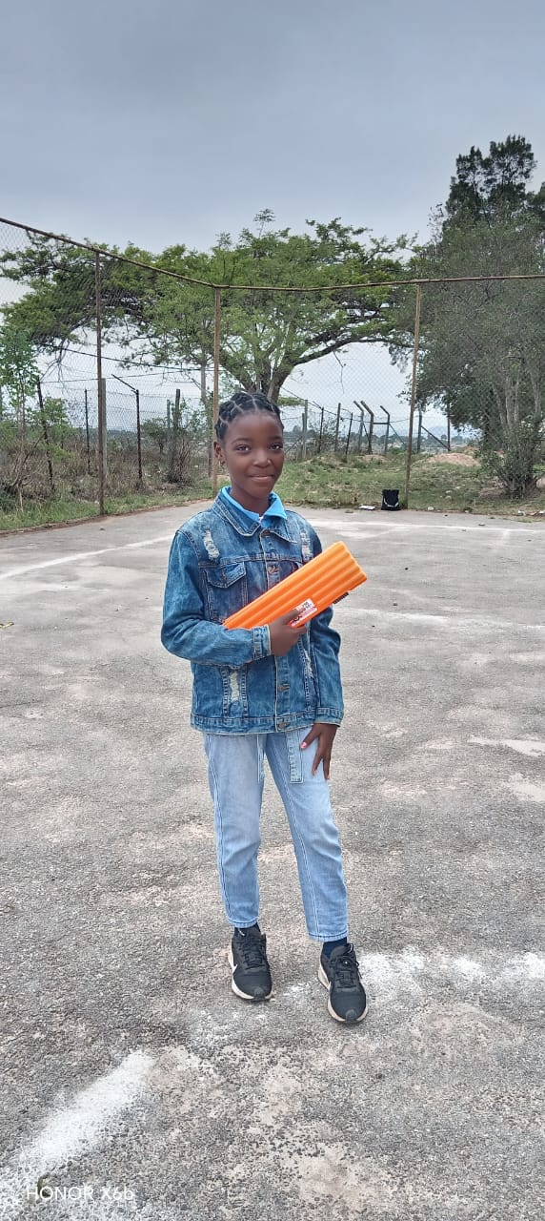
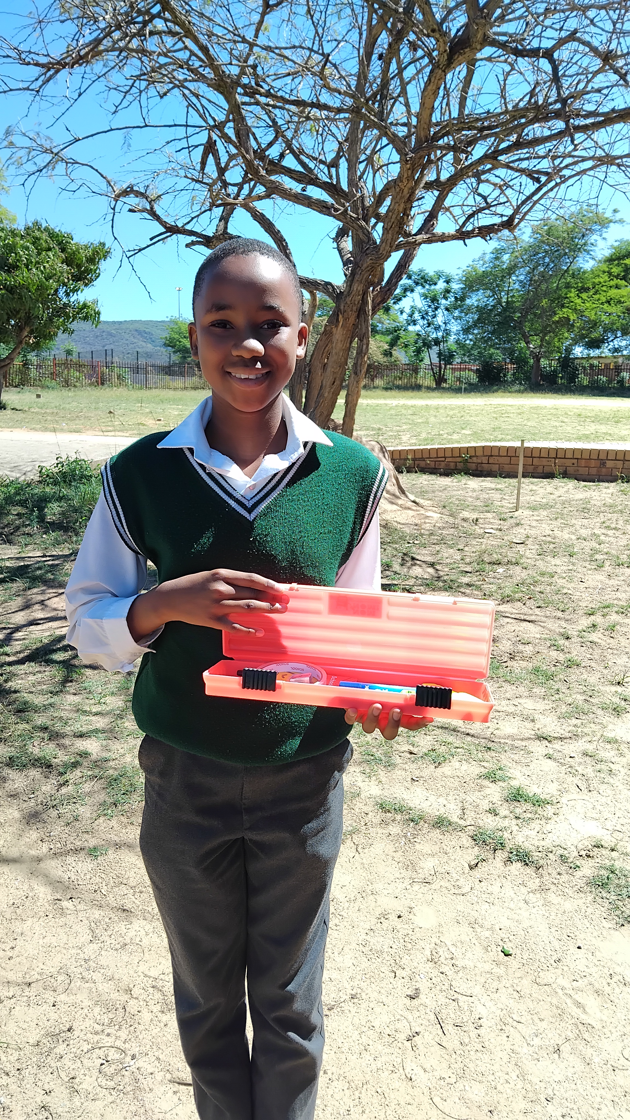
Significance/ Impact
The change empowered learners to recognize their potential, dream beyond their circumstances, and strive for more. It helped them understand that their background doesn't define their future, and involvement in the right programs can lead to growth and opportunities.
The GBVF school club thrived after a parents' meeting, where objectives were shared and support was garnered. Fun, interactive sessions and a trip to Mbombela Legislature inspired learners to envision themselves in new spaces.
The Human Rights club's documentary showcased the impact of involvement, motivating learners to look beyond their circumstances and strive for more. Many discovered their potential, gained confidence, and began dreaming of a brighter future
The Sisterhood Advocates play a key role in amplifying the impact of GBVF school clubs by showcasing our work and values. By partnering with schools we've previously worked with, we leverage existing relationships and trust. This collaboration enables schools to confidently engage with us, knowing our track record and the benefits our clubs bring to learners. Essentially, Sisterhood Advocates help 'champion' the GBVF clubs, increasing visibility and buy-in for sustained impact
Voice and Choice Summit 2026 \ Voice and Choice Summit 2026

Slide 9
Challenges & Lessons learnt
School Clubs Challenges:
Student Engagement: Keeping the learners engaged.
Mitigation: Involving students in decision-making, plan fun events, and recognize their efforts.
2. Time Constraints: Balancing academics and club activities.
- Mitigation: Schedule club meetings strategically, prioritize tasks, and set different times to meet for club sessions.
Through the GBVF school clubs we were able to develop leadership skills through hands on experience and taking ownership of projects.
It was great teamwork and collaboration with the School managing team this helped strengthen bonds and get more work done in schools.
Adaptability became a tool to work with the schools. The GBVF school clubs needed to roll with changes, like exam schedules for learner availability.
We made sure to celebrate every small wins , because celebrating tiny victories keeps learners motivated and engaged.
We listened to the learners , understanding their needs and interests makes the club more impactful and fun.
Voice and Choice Summit 2026 \ Voice and Choice Summit 2026

Slide 10
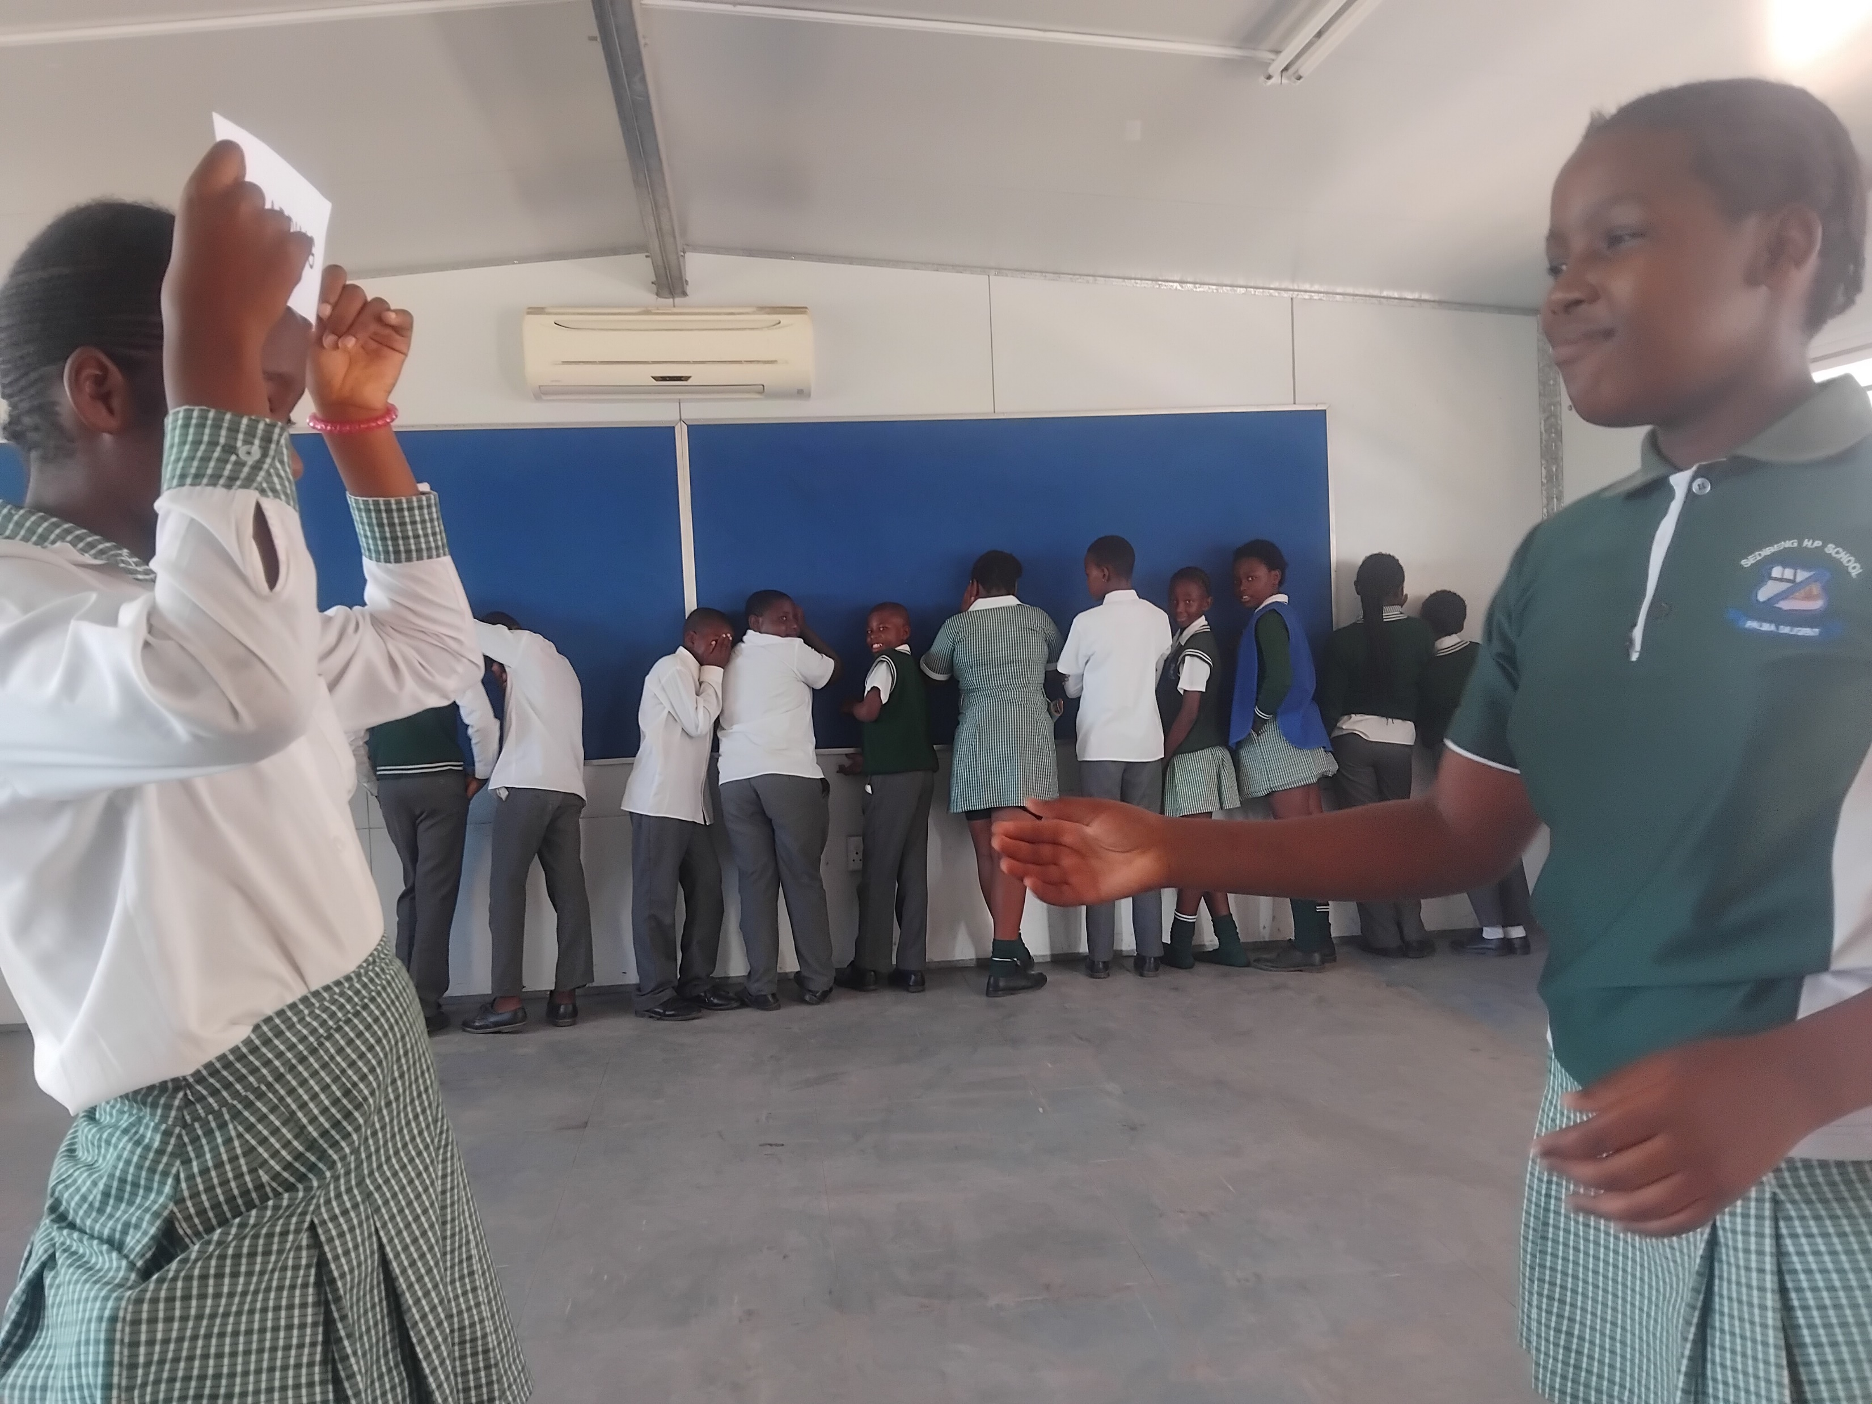
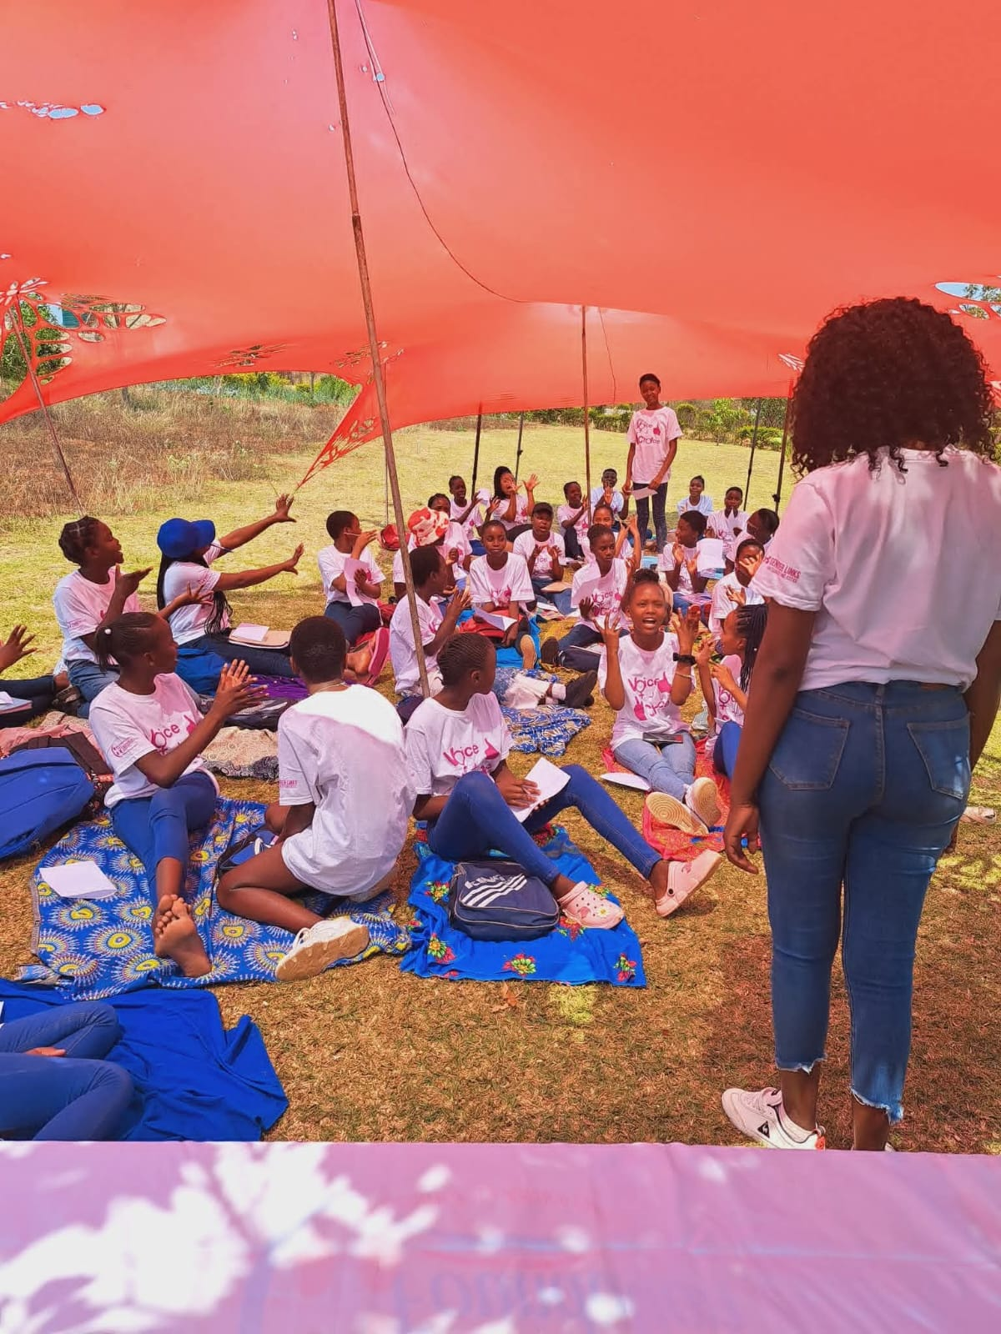
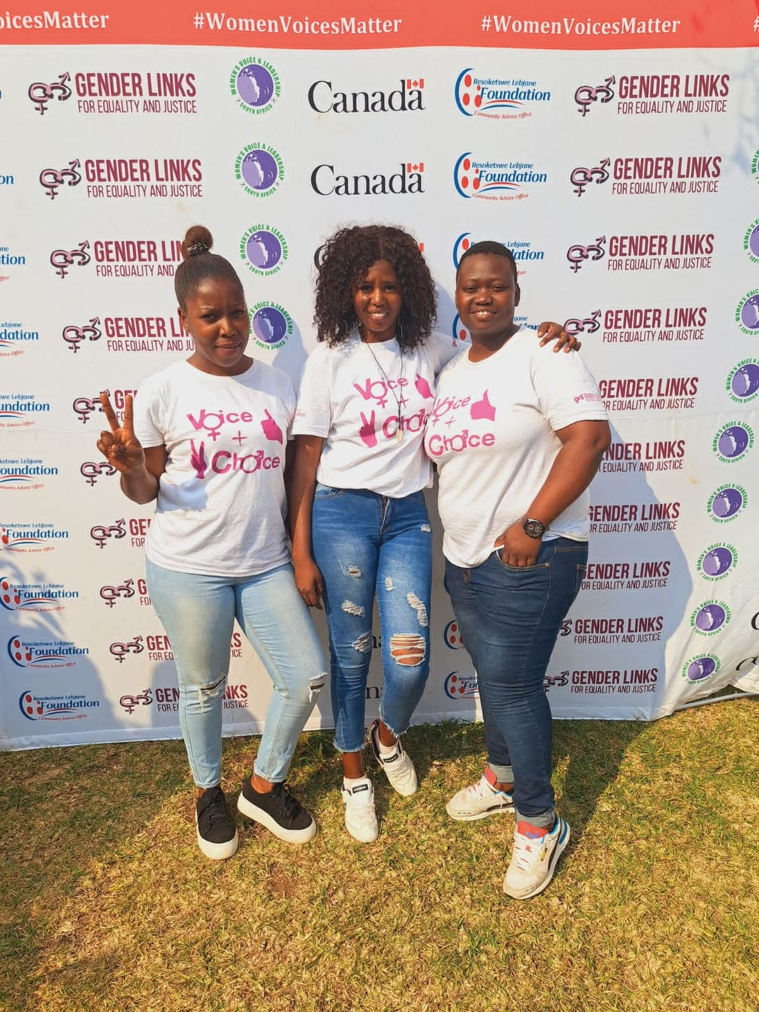
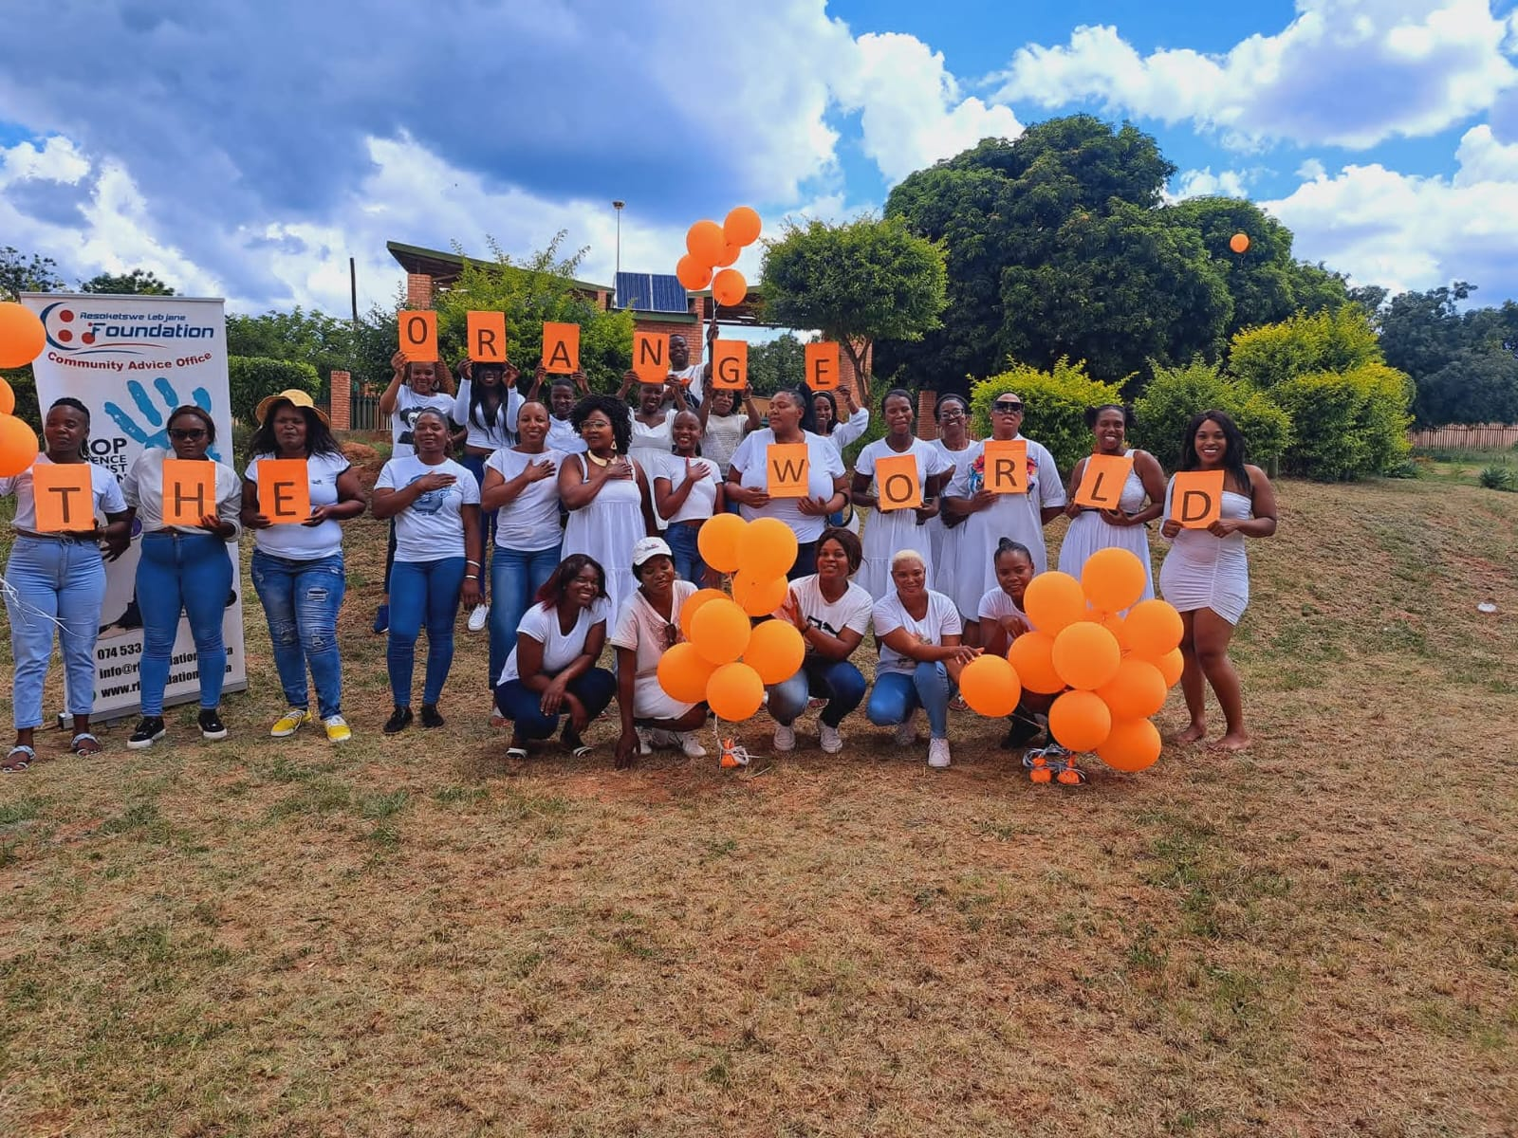
Sustainability
To sustain impact, we'll keep schools engaged through regular meets and greets, promoting youth-led advocacy, and integrating GBVF awareness into curricular. We'll launch an after-school programme equipping learners with practical skills like CV writing, job interviews, email writing, and entrepreneurship addressing gaps in the current curriculum. This empowers youth for employment and self-employment, ultimately reducing unemployment. Other grantees can replicate our model by leveraging partnerships for resources, embedding GBVF awareness in school programmes, and offering skills-based after-school initiatives.
Voice and Choice Summit 2026 \ Voice and Choice Summit 2026

Slide 11
Next Steps
-Our next steps as an organization is the will to launch an after-school programme for learners, providing a safe space to explore GBV awareness, career guidance, and life skills. This initiative responds to feedback from youth who felt underserved in navigating career choices and life decisions. By partnering with schools where we've established GBVF clubs, we'll engage the broader school community in human rights advocacy, empowering learners to drive change. This programme aims to equip youth with knowledge, skills, and experience, boosting their future opportunities and reducing vulnerability to unemployment.
Voice and Choice Summit 2026 \ Voice and Choice Summit 2026

Slide 12

Human Rights Club Documentary

