Slide 1

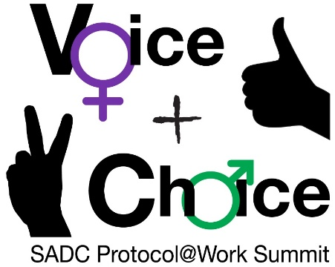





LEARNING
AND SHARING
SUMMIT 2025
iNtsika ye Themba- Activators of Change
(South Africa, Cape Town, 5-6 March 2025
Lauren King
Women’s Voice and Leadership Learning and Sharing Summit 2025

Slide 2
SYNOPSIS
Describe the change that has occurred.
The iNtsika yeThemba program of Justice Desk Africa is transforming the lives of boys and young men in communities in part of Cape flats by equipping them with the tools to become ethical leaders and allies in the fight against gender-based violence (GBV). Established to challenge harmful masculinities and provide mentorship, this program has helped shape a new generation of young men committed to justice and equality.
Since its launch, the program has reached hundreds of boys, particularly in high-risk communities like Nyanga, where violence and crime rates are among the highest in South Africa. Through mentorship, counseling, and empowerment sessions, iNtsika yeThemba has enabled boys to redefine masculinity in a positive and non-violent way.
Women’s Voice and Leadership Learning and Sharing Summit 2025

Slide 3
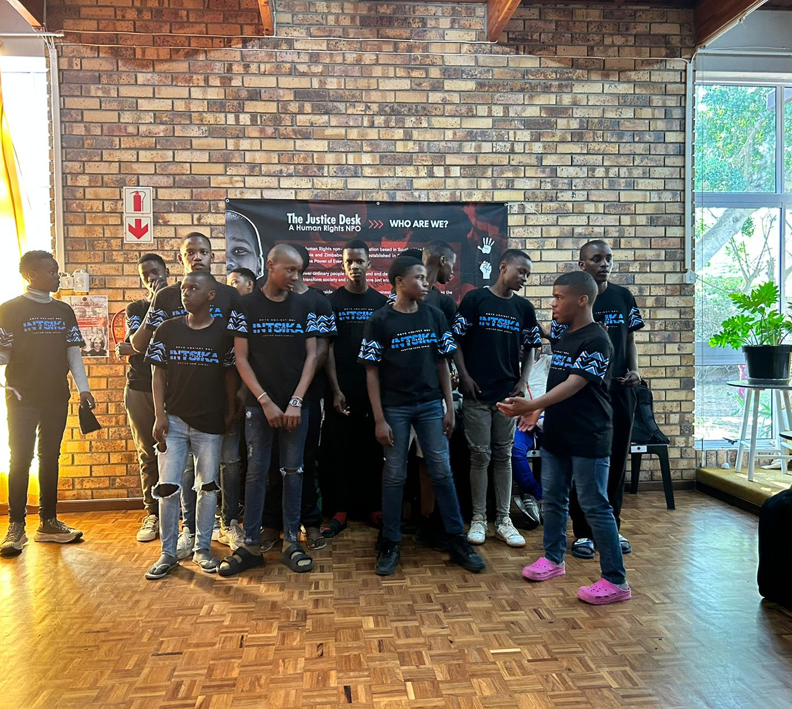
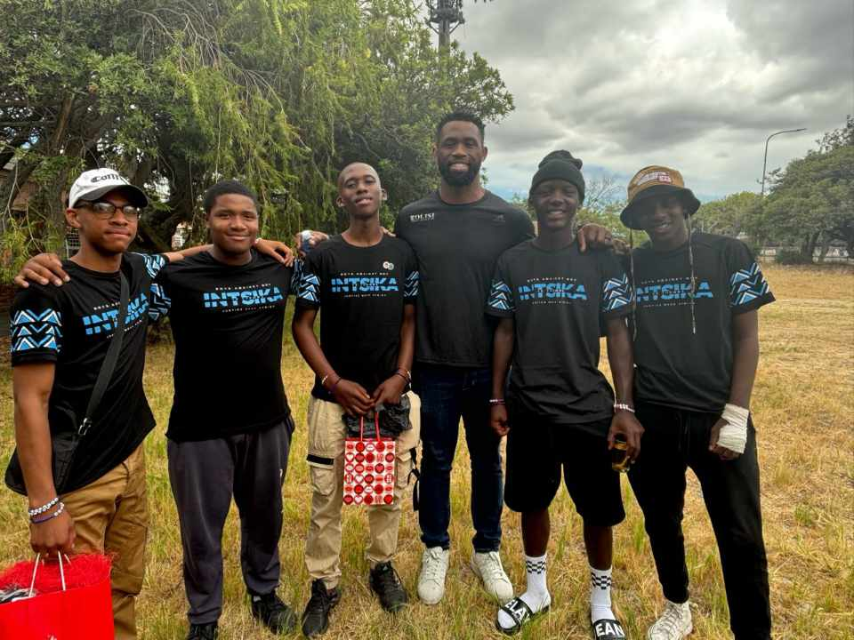
Photos

Slide 4
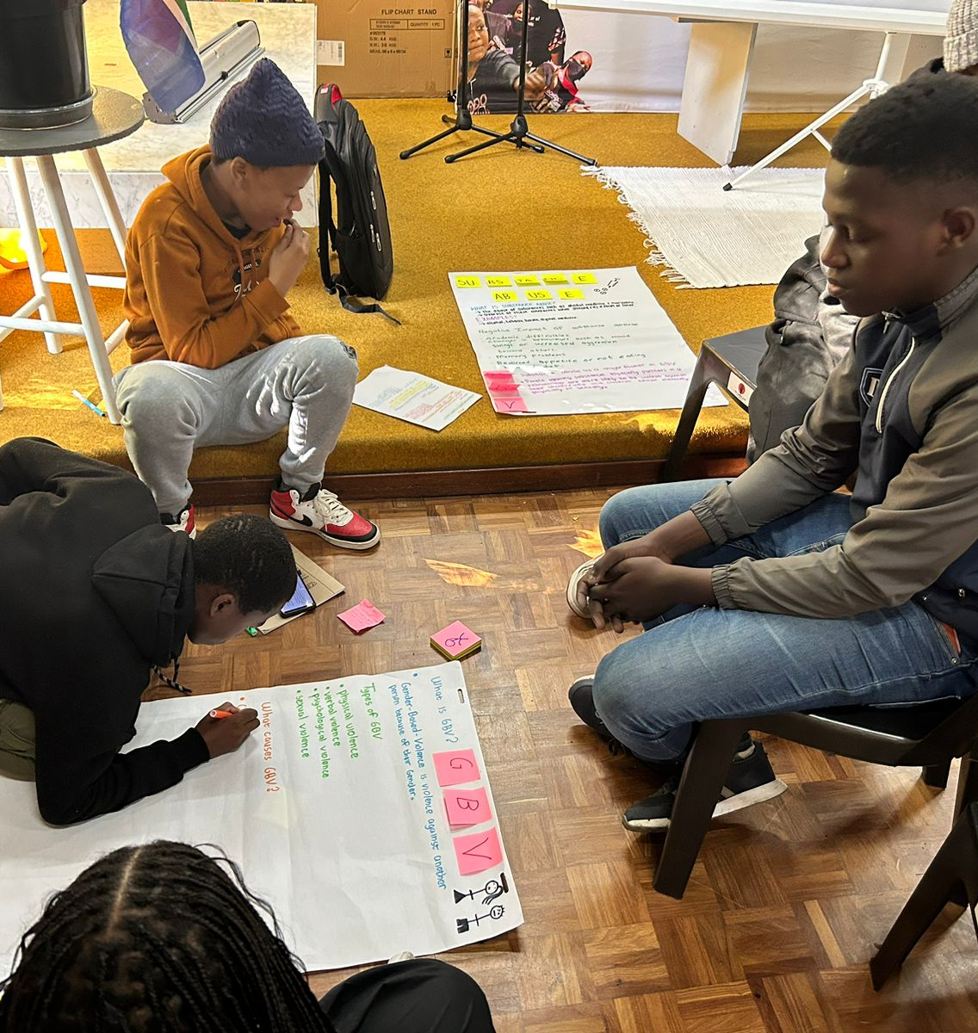
OBJECTIVES
Challenge harmful gender norms and toxic masculinity.
Equip boys with leadership skills to advocate for gender justice.
Provide mentorship and safe spaces for boys to discuss emotions, conflict resolution, and personal growth.
Reduce violence and GBV by fostering accountability among young men.
Women’s Voice and Leadership Learning and Sharing Summit 2025

Slide 5
ACTIVITIES
What evidence or means of verification do you have for this change?
Workshops and Mentorship: Monthly empowerment sessions that focus on leadership, gender justice, and emotional intelligence.
Counseling and Support: Boys receive one-on-one and group counseling to navigate personal and societal challenges.
Community Engagement: Participants take part in outreach programs, educating peers and communities on gender equality.
Women’s Voice and Leadership Learning and Sharing Summit 2025

Slide 6
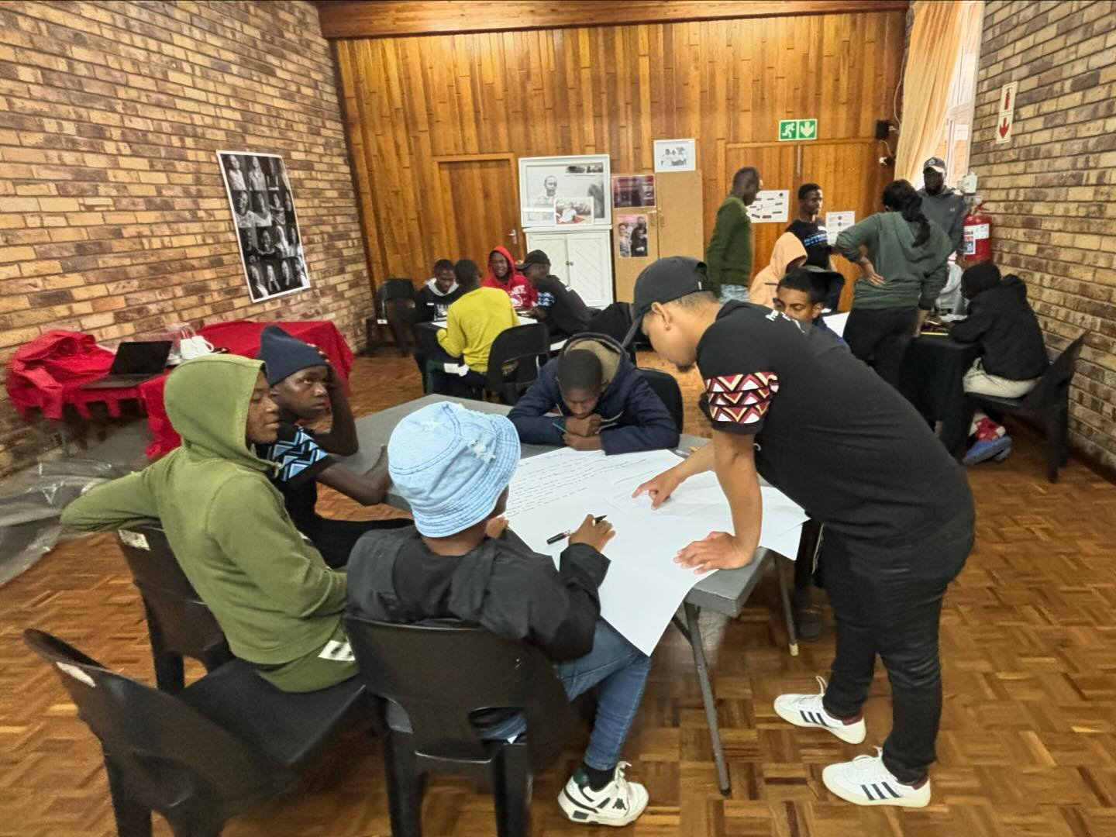
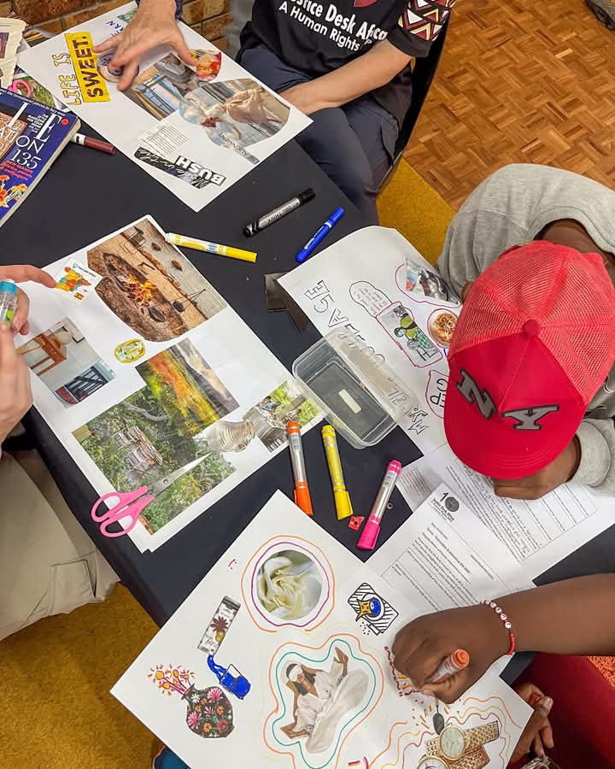
Photos

Slide 7
Contribution to change
What contribution did your organisation make to this change?
Justice Desk Africa has played a vital role in transforming attitudes towards masculinity by:
Advocating for policy change in schools and communities to create safer environments.
Training mentors and facilitators who guide the boys throughout the program.
Engaging in media campaigns to spread awareness and inspire other communities to take action.
Partnering with schools to integrate gender justice education into curriculum
Women’s Voice and Leadership Learning and Sharing Summit 2025

Slide 8
Population Group this change most closely related to
Category | Women | Men | Total | % Women
Direct beneficiaries | 32552 | 15411 | 47933 | 67.91%
Indirect beneficiaries (e.g. through other networks) | 50856 | 107421 | 158277 | 32.13%
Online beneficiaries (e.g. website access, mailing lists, scholarly articles) | 27417.25 | 50917.75 | 78335 | 65%
Total | 110795.25 | 173749.75 | 284545 | 38.94%
Women’s Voice and Leadership Learning and Sharing Summit 2025

Slide 9
Significance of change
What is the significance of the change?
The program primarily focuses on boys aged 13–18 in high-risk areas. By empowering them to become ethical leaders, the program significantly reduces GBV cases and promotes safer communities.
The change signifies:
A shift in gender attitudes among young men.
Stronger community engagement in fighting GBV.
A sustainable model for addressing harmful masculinities
Women’s Voice and Leadership Learning and Sharing Summit 2025

Slide 10
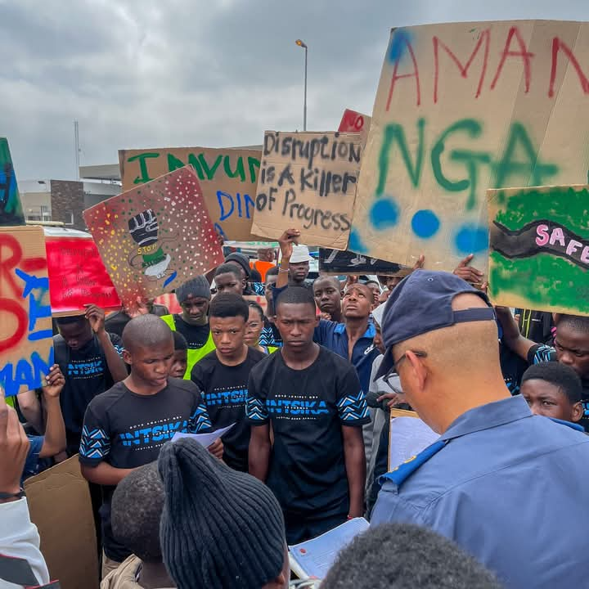
RESULTS
Public Participation: More boys and young men are advocating for gender justice.
Capacity Building: Hundreds of boys trained as peer leaders.
Changes in Gender Attitudes: Participants demonstrate increased empathy and accountability.
Media Coverage: The program has been featured on platforms like Good Hope FM and Cape Town TV.
Women’s Voice and Leadership Learning and Sharing Summit 2025

Slide 11
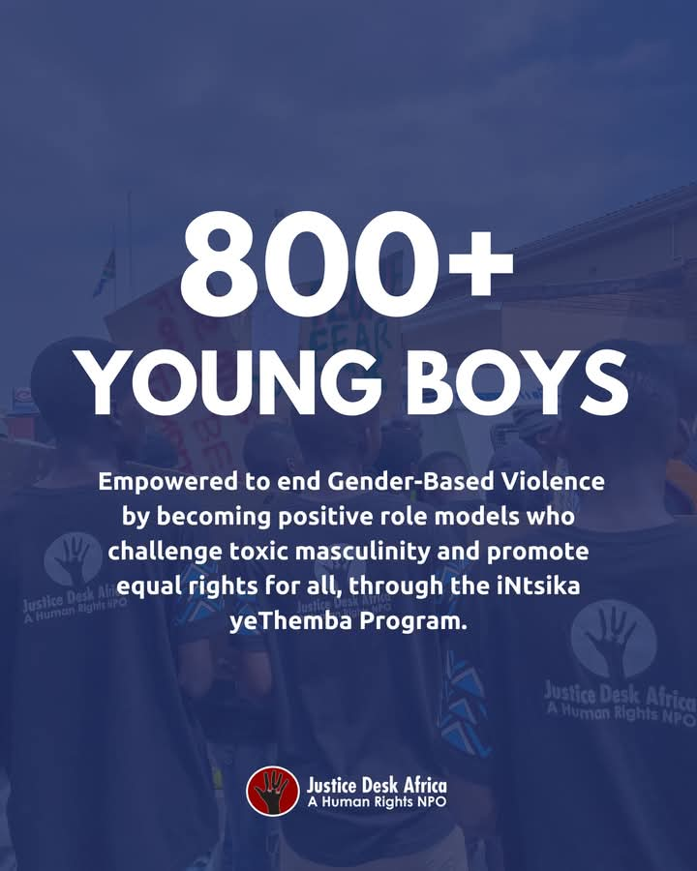
Evidence
Justice Desk Africa has documented the impact of the iNtsika yeThemba program through various means of verification, including testimonials, reports, media coverage, and program data.
Include evidence here – photos/clippings
https://www.youtube.com/watch?v=ei-6m2jRgEk
Women’s Voice and Leadership Learning and Sharing Summit 2025

Slide 12
CHALLENGES AND LESSONS LEARNT
Challenges faced:
Cultural resistance to discussions on gender equality.
Limited funding to expand the program.
Psychological trauma among boys due to past experiences.
How challenges were overcome:
Engaging community leaders to foster acceptance.
Seeking external funding and partnerships.
Providing professional counseling support.
Women’s Voice and Leadership Learning and Sharing Summit 2025

Slide 13
CHALLENGES AND LESSONS LEARNT
What lessons have been learned?
Change takes time, and community buy-in is crucial.
Mentorship plays a key role in sustainable impact.
Women’s Voice and Leadership Learning and Sharing Summit 2025

Slide 14
CHALLENGES AND LESSONS LEARNT
How will the lessons learned be applied?
Strengthen partnerships with traditional leaders, parents, and educators to foster broader community acceptance of gender justice initiatives.
Conduct more community awareness sessions to address cultural resistance and misconceptions about gender equality.
Train more male mentors and role models to guide boys through personal and social challenges.
Integrate trauma-informed practices into workshops to create a safe space for open discussions.
Advocate for the integration of gender justice education into school curricula, ensuring long-term impact.
Women’s Voice and Leadership Learning and Sharing Summit 2025

Slide 15
SUSTAINABILITY AND REPLICATION
The program can be sustained and expanded by:
Training more mentors to reach larger groups of boys.
Integrating the program into school systems for long-term impact.
Partnering with more organizations to increase reach and resources.
Women’s Voice and Leadership Learning and Sharing Summit 2025

Slide 16
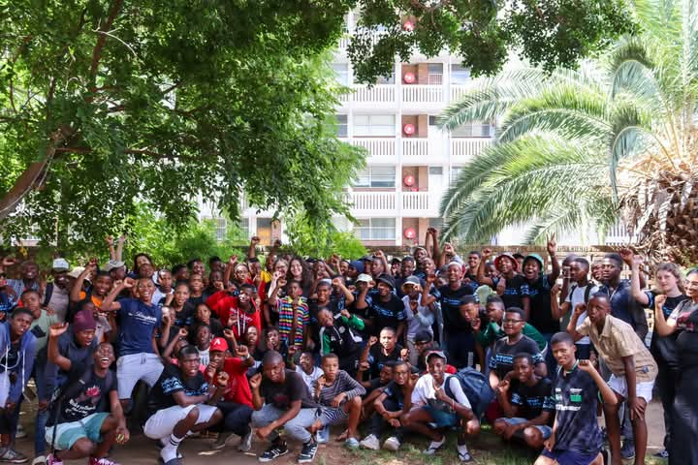
NEXT STEPS
Key priorities going forward
Expand the program to more regions, including Zimbabwe and Zambia.
Strengthen advocacy efforts to influence national policies on GBV education.
Develop digital learning tools to enhance accessibility.
Women’s Voice and Leadership Learning and Sharing Summit 2025

