Slide 1







LEARNING
AND SHARING
SUMMIT 2025
Institutional Development Template
(South Africa, KZN Pietermaritzburg, 4-7 March 2025 and Busisiwe Gabela)
Please use your own photos to make your presentation unique.
Quotes and any other visuals make your presentation more engaging!
Women’s Voice and Leadership Learning and Sharing Summit 2025

Slide 2

Introduction
SERVICE: PSYCHO-SOCIAL AND SUPPORT SERVICES
Project Aim:
This project aims to break the cycle of Gender-Based Violence (GBV) through targeted support for Sexually Reactive Children (SRCs), their caregivers, families, communities and Gender based violence survivors, while building community resilience in KwaZulu-Natal and beyond.
Women’s Voice and Leadership Learning and Sharing Summit 2025

Slide 3
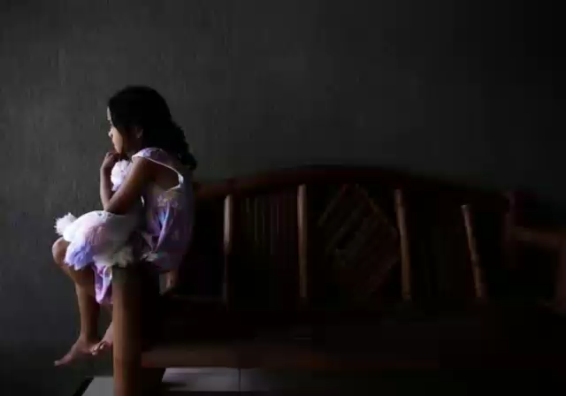
Brief background of the organisation
Incema is a Non-Profit Organisation that provides psycho social and support services to children who are sexually acting out/ with inappropriate sexual behaviours. Our program includes service for their parents and caregivers.
The program aims to break the cycle of sexual violence likely to be committed by previously violated children
Incema psycho social services were also extended to persons experiencing Domestic Violence and other GBV related matters.
Our comprehensive service is inclusive of prevention, support and Behavioural change activities for communities and schools where Sexually Reactive Children resides or go to school
Women’s Voice and Leadership Learning and Sharing Summit 2025

Slide 4
Institution before RWVL
CURRENT SITUATION- BASELINE
Incema had fortunately benefitted from the WVL 1, Voice and Choice and now RWVL
Before WVL1:
Incema was registered as an NPO with DSD since June 2014.
The organisation had NPO certificate, SARS Tax number
Functional Bank account
No formal policies but guiding documents such as: Staff code of conduct
: Monitoring and Evaluation
:Finance and procurement
:Manuals guiding project implementation
Incema had no finance supporting documents such as
: Reimbursement claim forms
:Requisition forms and Petty cash voucher
AFTER WVL1 AND DURING VCSA
Registered for Section 18 A
Registered for VAT
Developed Policies such as :
HR Policy
Finance policy
Procurement policy
Subsistence and Travel Policy
Safeguarding policy
Anti Corruption policy
Health and Safety policy
Staff development policy
Sexual Harassment policy
Women’s Voice and Leadership Learning and Sharing Summit 2025

Slide 5
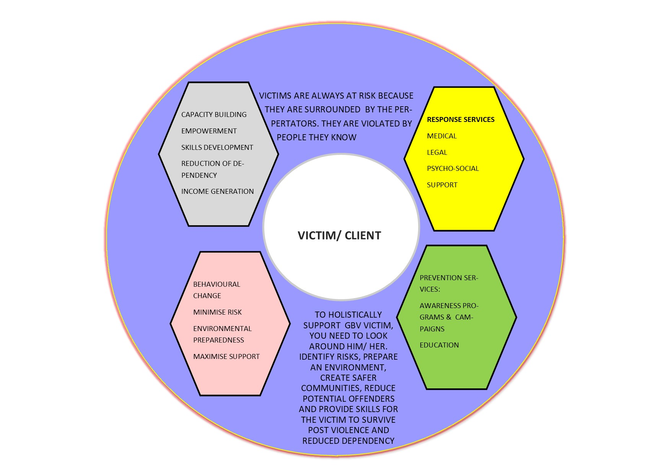
To achieve with RWVL
Current situation- Baseline: Linked to policies
We now have all the relevant policies: We hope to be able to implement our daily activities in line with the policies.
Occupational health and safety: In line with this: We hope to focus on staff wellbeing to improve our productivity and minimize staff burnout.
To be able to claim VAT from SARS, follow all protocols to enable the organisation to claim.
Staff development: To work and collaborate with partners grantees to access more knowledge, capacitate our team and improve their skills.
Programs: Collaborate with partner organisations to provide comprehensive service to our clients and expand our reach.
Women’s Voice and Leadership Learning and Sharing Summit 2025

Slide 6
People and Leadership
Current situation- Baseline
Incema understand its vision and is operating in line with its mission and core values.
Our co function is on child protection and GBV is the main contributing factor.
Our service is in compliance with SA Constitution, Children’s Act, Child Justice Act and all other relevant legislations.
We employ qualified officials who are registered with relevant bodies ( Councils)
Our employees are vetted on child protection through form 29
Our employees get SAPS clearance before joining the organisation
Our board members also get vetted and sign declaration forms before joining the organisation.
Our team seek consent from parents or caregivers prior to providing service to a minor
Clients reached through psycho social services by October 2024
Stats: WVL1
182 SRC’s
821 DV clients
375 GBV court support
Staff: We had 4 staff members before WVL. Staff increased to 9 in 2020, 24 in 2022 and had given 14 in-service trainees whom we have given work experience
Partnered with UKZN and had an intern psychologist on site
Board of Directors: We have qualified six (6)board of directors skilled in multidisciplinary services
Women’s Voice and Leadership Learning and Sharing Summit 2025

Slide 7
Structures, Systems, and Processes
Current situation- Baseline
Policies are in place
We have work equipment
Human resources: we have 10 staff members
Developed a digital work space through Monday.com
Safe office space
Office space at the magistrate court
Office space at Berg street primary school
We get audited annually
We have functional website and social media pages
We intend to Upgrade our website and use it as main marketing space
Staff wellness program to use as income generating program
Child care private practice to generate income for sustainability purpose
To get our own office space
Before WVL we had only received funding from National Lotteries Commission of R 154295,00. After WVL we then received funding from NDA an amount R300 000 ,00 Solidarity an amount of R250 000,00 GBVF1 an amount of R500 000,00 HCRF an amount of R1,700000,00 and Community Chest an amount of R30000,00. In 2022 alone we managed more than R2 000 0000.00

Slide 8
Resilience, Care, and Security
We did not have a health and safety policy.
There was no designated position for employee wellness.
We were unaware of the role of an Occupational Health and Safety Officer in the workplace.
While we had a first aid kit available for employees, we lacked a designated health and safety officer.
Received a training on occupational health and safety.
Appointment of a Health and Safety Officer.
Ensuring that exit points are easily accessible in case of emergencies.
Displaying essential emergency contact information, including ambulance, fire department, and police details.
Assigning a responsible person to manage first aid kits and fire extinguishers."
Women’s Voice and Leadership Learning and Sharing Summit 2025

Slide 9
Finance and sustainability and social entrepreneurship
Current situation- Baseline
We lacked proper financial documentation.
There was no standardized financial reporting template.
We did not have a finance policy in place.
Fund management was minimal, as we had received funds from only one donor.
While we engaged in fundraising, we did not maintain proper financial records or deposit funds into a bank.
We were unfamiliar with the concept of Value for Money."
Target at end line
We started to have signed policies.
We learnt about finance systems, documents and
We received more funds from other funders simply because we were able to manage funds from WVL.
We wish to expand our services to intellectual disability schools.
We need to network more in order for us to get more funds and skills.
Make sure that we keep our organisation in a good standing in terms management of funds.
Value for money
Women’s Voice and Leadership Learning and Sharing Summit 2025

Slide 10
Connections and Visibility
Please explain if the organization effectively communicates its work to donors and participants?
The organization will actively communicate with both internal and external stakeholders, including partners and donors.
We are focused on expanding our network, particularly with organizations involved in child protection, to enhance our visibility.
To reach a wider audience, we are prioritizing social media and our website. Ideally, we would like to have a dedicated social media employee to ensure consistent engagement. Additionally, we are strengthening relationships with our partners, donors, and stakeholders to foster collaboration and continuous learning.
Women’s Voice and Leadership Learning and Sharing Summit 2025

Slide 11
GOVERNANCE
Current situation- Baseline
Incema has a Board of Directors, which is selected during the Annual General Meeting in the presence of stakeholders and partners.
The selection process is conducted democratically, allowing stakeholders and partners to vote for the nominated candidates.
We plan to review our strategies for board selection and explore new approaches to establishing a successful Board of Directors.
Additionally, we aim to secure funding to provide travel allowances for board members attending meetings."
Women’s Voice and Leadership Learning and Sharing Summit 2025

Slide 12
PROGRAMME OF ACTION
Our organization faced challenges due to limited staff, which restricted our ability to expand.
Limited funds affected our visibility, making networking opportunities difficult. As a result, we were unable to implement many programs.
Additionally, our engagement in networking was minimal since we did not invest much in social media.
Further registrations to enhance our reach.
Establishing sub-offices in magistrate courts to expand our services.
Placing social workers in select schools to provide essential support.
Extending our services to schools for individuals with intellectual disabilities.
Implementing proper documentation and reporting systems to improve accountability and efficiency."
Women’s Voice and Leadership Learning and Sharing Summit 2025

