Slide 1






LEARNING
AND SHARING
SUMMIT 2025
RWVL Joint Campaigns
South Africa, Cape Town, March 2025
OurClimateAGENDER
Women’s Voice and Leadership Learning and Sharing Summit 2025

Slide 2
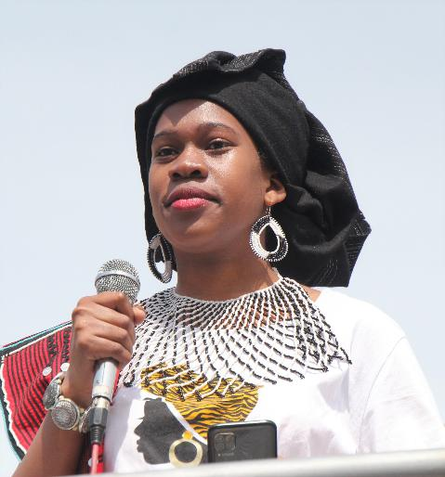
Summary
The project aims to address the lack of inclusivity and equity in climate policies, focusing on the disproportionate impact of climate change on women, marginalised genders and LGBTQIA+ individuals in South Africa. It seeks to integrate stronger gender perspectives across programmes, partnerships, and policy debates to ensure that marginalised voices are heard and valued in climate leadership and policy-making.
Add photo or video
Voice and Choice Learning and Sharing Summit 2025

Slide 3
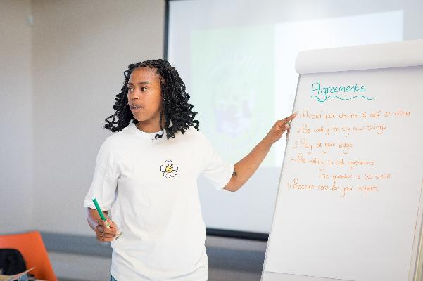
Initiatives and strategies
How will your initiative contribute to building stronger and more inclusive movements?
Our initiative strengthens and diversifies movements by partnering with community organizations, raising awareness, supporting marginalised individuals, advocating for inclusive policies, amplifying voices, and continuously adapting based on feedback.
What strategies will you use to strengthen collaboration and solidarity?
We will build strong partnerships with trusted organisations, ensure inclusive engagement, and facilitate shared learning. Additionally, we will provide support and wellbeing resources, amplify marginalised voices, and continuously evaluate and adapt our strategies.
Add photo or video
Lisakhanya Mathiso an intersectional youth and climate justice activist participant from the YouLead 2019 programme.
Voice and Choice Learning and Sharing Summit 2025

Slide 4
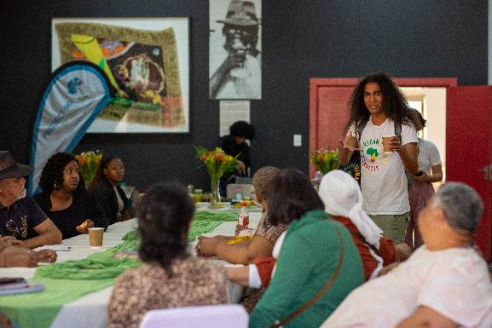
Governance & Resource Allocation
How will you ensure active participation and decision-making from all members?
To ensure active participation and decision-making from all members, we will create inclusive spaces for dialogue and provide training on advocacy and leadership. We will also implement participatory decision-making processes and establish regular feedback mechanisms.
How will you distribute resources across partners to promote equity and sustainability within the movement?
To promote equity and sustainability, we will allocate resources based on partners' needs, maintain transparency in resource sharing, and provide capacity-building support. Additionally, we will promote sustainable practices and regularly evaluate resource distribution to ensure effectiveness.
Add photo or video
Climate resilience breakfast and dialogue 2024 with youth and communities.
Voice and Choice Learning and Sharing Summit 2025

Slide 5
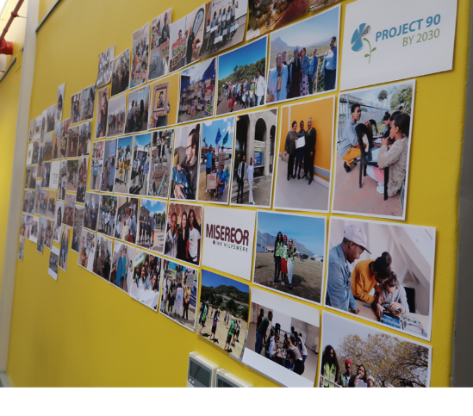
Inclusive Leadership & Coordination
How will you leverage expertise and diverse connections to strengthen advocacy efforts?
We will leverage expertise and diverse connections by collaborating with partners like ACA, Educo Africa, and Nature Connect, and engaging gender experts for training and reviews. Additionally, we will build networks with other organisations, share personal narratives, and develop educational resources.
What strategies will you implement to coordinate campaigning?
To coordinate campaigning, we will engage with current networks, involve partners in planning, and ensure unified messaging. We will also utilise digital platforms, engage communities through events, and implement monitoring and evaluation processes.
Partners and networks are key to success
Voice and Choice Learning and Sharing Summit 2025

Slide 6
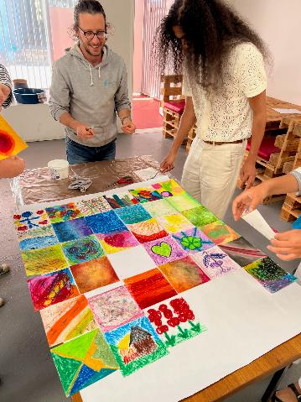
Connecting & Community-Building
What approaches will you use to build and sustain relationships within the advocacy community?
We will build and sustain relationships within the community by maintaining regular communication, engaging in collaborative projects, and organising networking events. Additionally, we will provide mutual support, align goals and values, and offer capacity-building opportunities.
How will you facilitate mentoring, convening, and peer exchanges among professional advocates and emerging leaders?
To facilitate mentoring, convening, and peer exchanges, we will establish mentorship opportunities, support peer learning groups, and organise workshops and dialogues. We will also host networking events, utilise online platforms, and showcase success stories to inspire and motivate advocates.
P90 team collaborating on a picture of gratitude at a wellbeing workshop
Voice and Choice Learning and Sharing Summit 2025

Slide 7
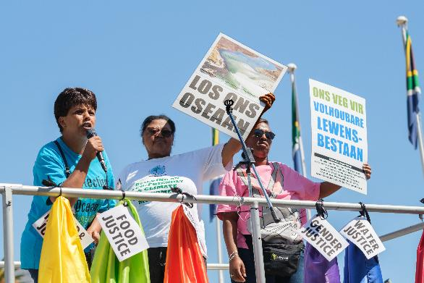
Linking & Learning
How will you foster a culture of continuous learning and best practice sharing?
We will foster a culture of continuous learning and best practice sharing by organising regular training sessions, establishing learning communities, and creating knowledge-sharing platforms. Additionally, we will implement mentorship programs, encourage feedback and reflection, and recognise achievements to motivate continuous improvement.
What mechanisms will you use to document and share lessons learned?
To document and share lessons learned, we will use structured reporting, develop case studies, and maintain a learning journal. We will also host reflection sessions, create digital resource page, and conduct regular evaluations to ensure effective knowledge sharing.
Our partners representing frontline communities at the “March for System Change” action 2024
Voice and Choice Learning and Sharing Summit 2025

Slide 8
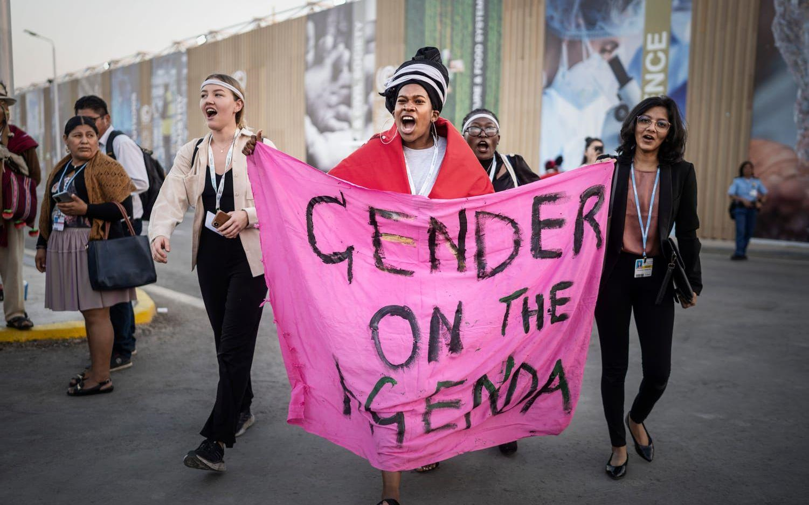

NEXT STEPS
What will be your key priorities moving forward?
Strengthening gender-responsive climate policies and building capacity and knowledge within Project 90 by 2030.
Enhance our community engagement, support women, marginalised genders and LGBTQIA+ activists to amplify their voices and advocate for inclusive climate policies.
Foster continuous learning, strengthen partnerships, and implement robust monitoring and evaluation processes to monitor our progress.
Movement Building
Women’s Voice and Leadership Learning and Sharing Summit 2025

