Slide 1

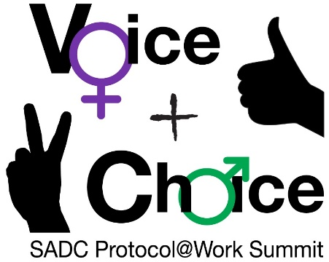





LEARNING
AND SHARING
SUMMIT 2025
RWVL Joint Campaigns Template
South Africa, Cape Town, 4-7 March 2025
(Juliana Davids: Triangle Project)
Women’s Voice and Leadership Learning and Sharing Summit 2025

Slide 2
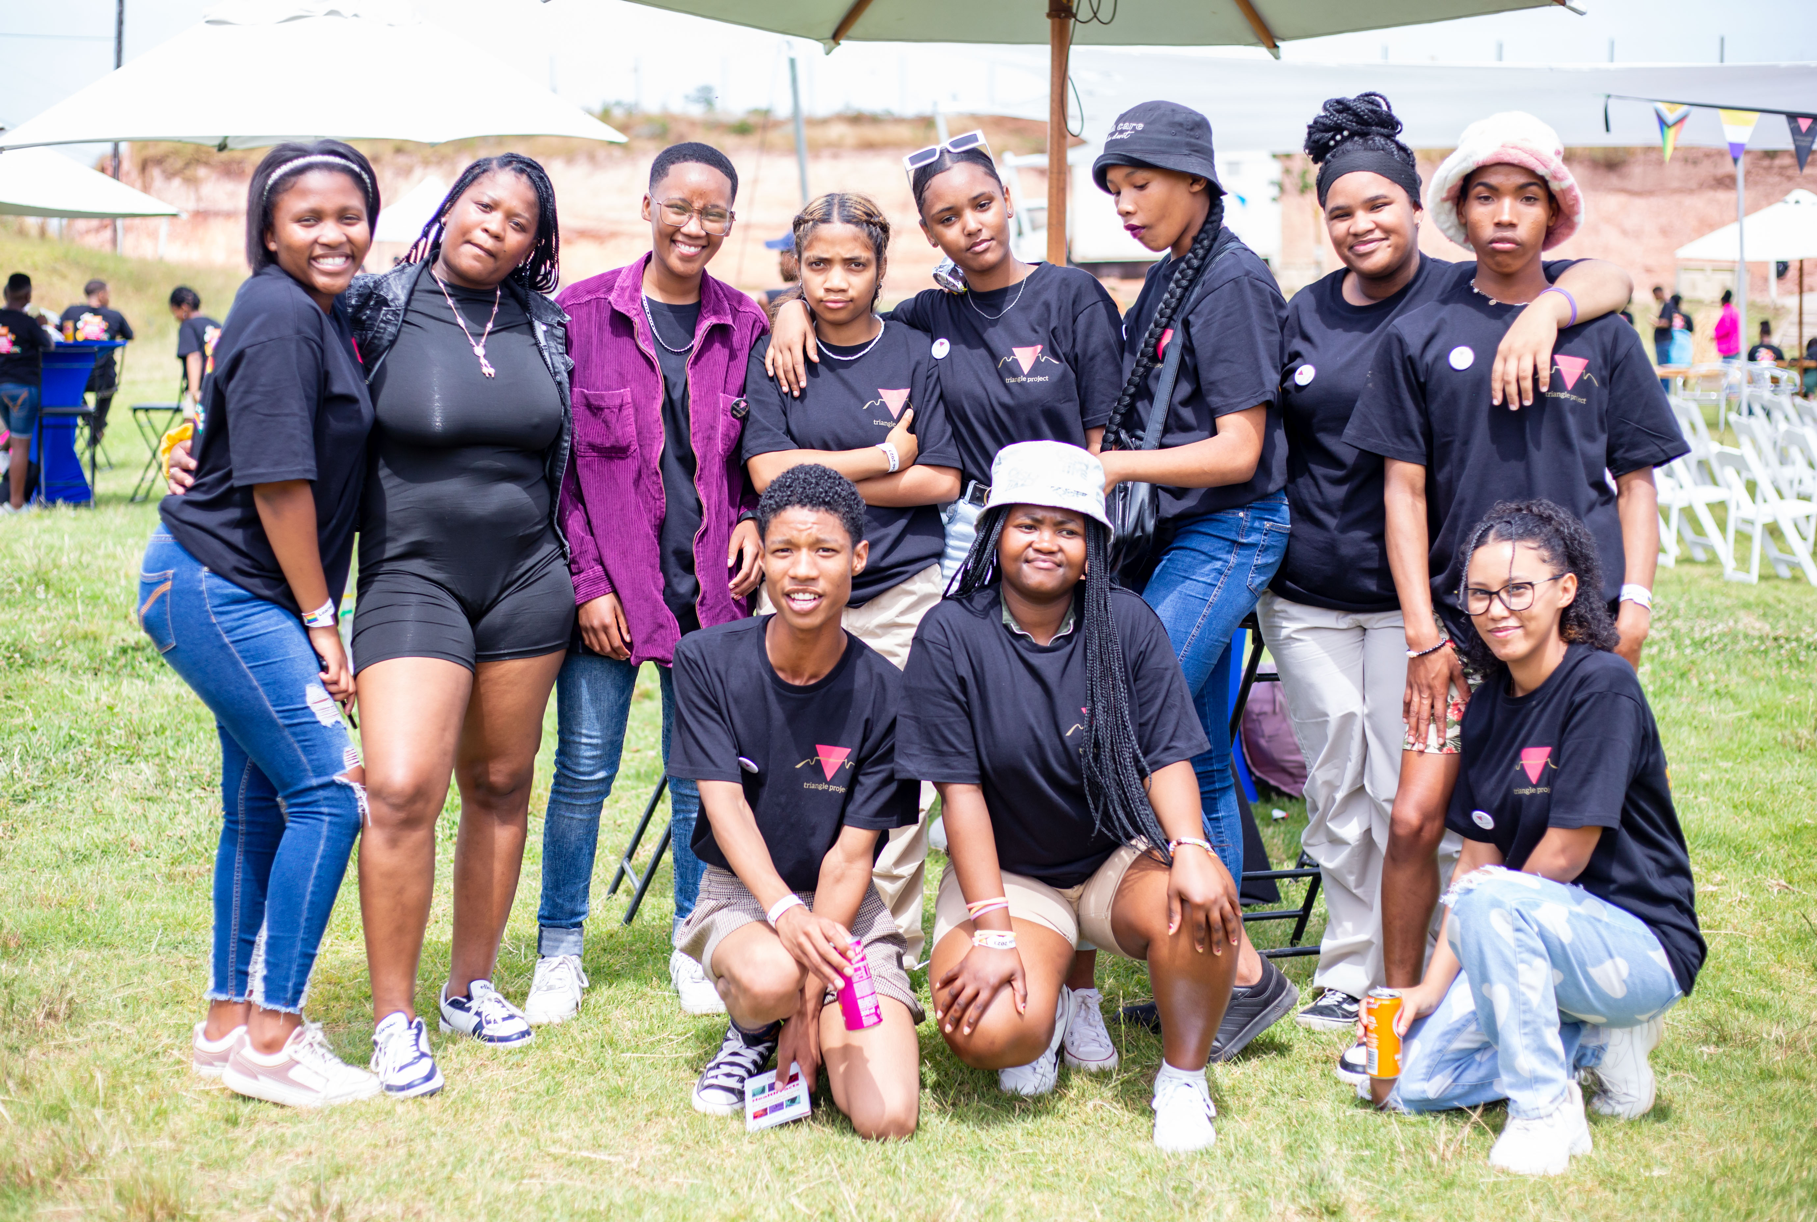
Summary
The Triangle Project: School, Project
The Triangle Project and CIAS Project are dedicated to empowering LGBTQI+ youth to lead and advocate for systemic change by challenging discriminatory power structures and promoting inclusive policies.
Triangle Project believes that fostering LGBTQI+ youth leadership and activism can create a ripple effect of change that builds collective power and leads to radical inclusion and restorative justice.
The CIAS Project envisions an educational environment that nurtures justice-centered solidarity among LGBTQI+ learners, educators, and key role players, working towards a society free of homo-, trans-, and intersex-phobia.
By supporting schools and educational institutions, CIAS advocates for equal access to public education and builds collective power to ensure a future free from oppression.
https://youtu.be/LQjo125rrf8
Voice and Choice Learning and Sharing Summit 2025

Slide 3
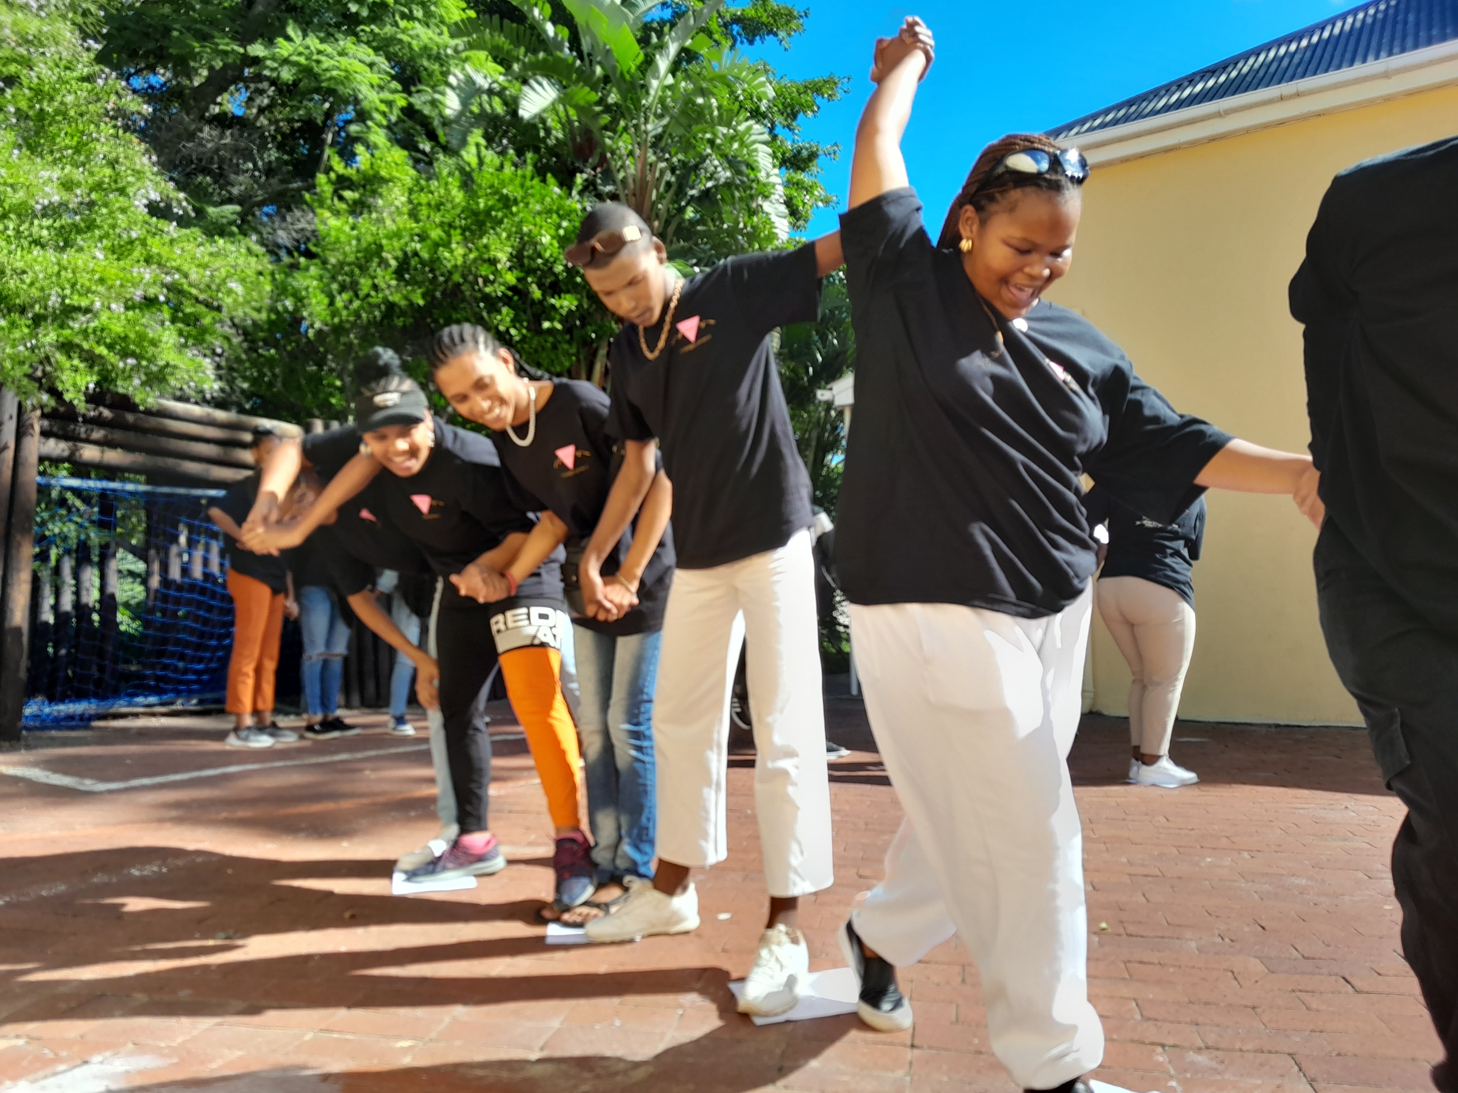
Initiatives and strategies: How will your initiative contribute to building stronger and more inclusive movements?
Empowering Learners – Training, advocacy skills, and safe spaces for queer students to lead change.
Engaging Educators – SOGIESC training, inclusive curricula, and allyship within schools.
Policy & Systemic Change – Challenging discrimination, influencing policies, and strengthening accountability.
Impact: A sustainable, intersectional movement for safer, more inclusive schools.
Add photo or video
Voice and Choice Learning and Sharing Summit 2025

Slide 4
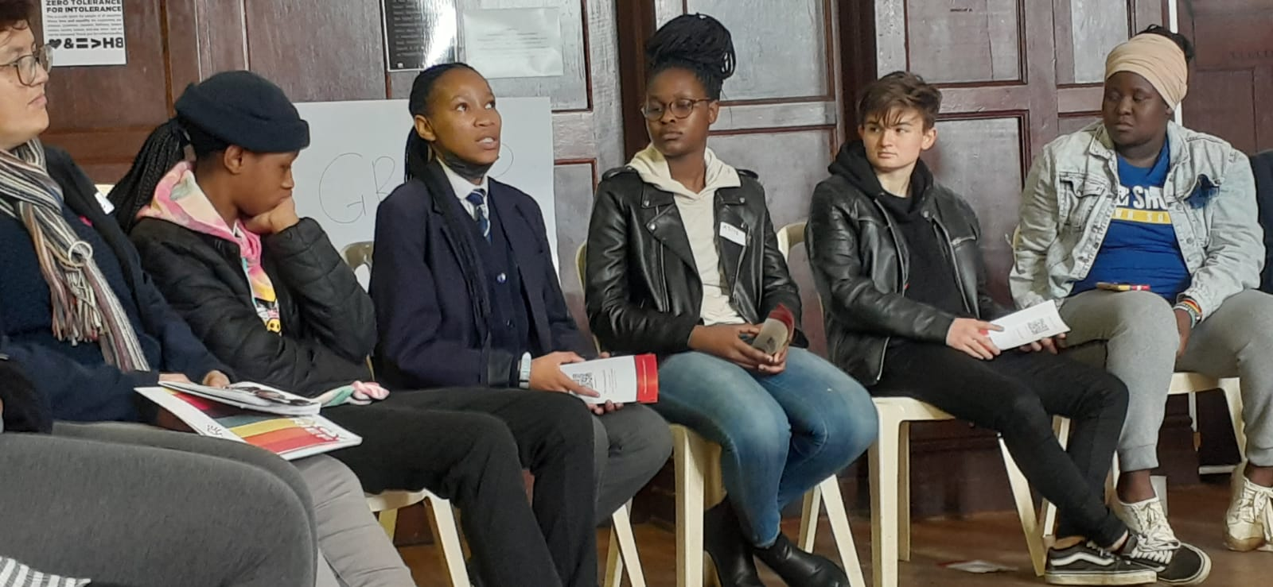
Governance & Resource Allocation
How will you ensure active participation and decision-making from all members?
Learner-Centered Approach – Prioritizing youth voices through leadership training, peer networks, and learner-led initiatives.
Collaborative Structures – Engaging students, educators, and parents in co-designing solutions and shaping programme priorities.
Accessible & Inclusive Spaces – Ensuring diverse participation by addressing barriers related to language, culture, and safety.
Transparent Decision-Making – Regular check-ins, open forums, and feedback mechanisms to keep all stakeholders involved.
Shared Leadership – Distributing decision-making power across different levels, ensuring meaningful contributions from all members.
Voice and Choice Learning and Sharing Summit 2025

Slide 5
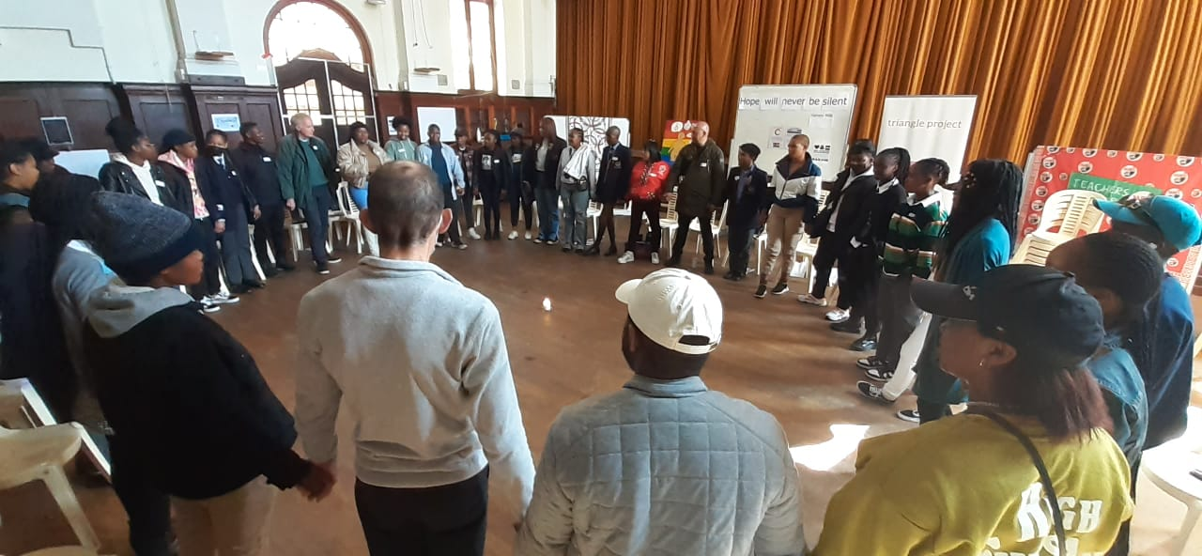
Governance & Resource Allocation
How will you distribute resources across partners to promote equity and sustainability within the movement?
Needs-Based Allocation – Distribute resources based on the unique needs of learners, educators, and community partners.
Capacity-Building Support – Provide training, materials, and funding to strengthen grassroots leadership.
Transparent & Inclusive Decision-Making – Ensure all partners have a voice in resource distribution through participatory budgeting.
Long-Term Investment – Prioritize sustainable funding models, including local partnerships and skill development.
Shared Infrastructure – Develop open-access toolkits, knowledge hubs, and shared platforms to maximize impact.
Voice and Choice Learning and Sharing Summit 2025

Slide 6
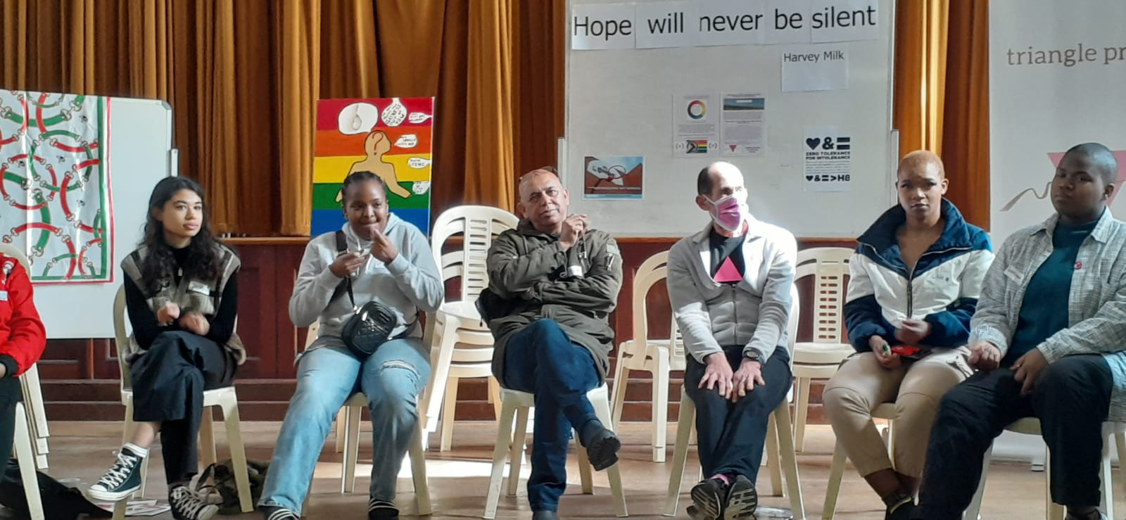
Inclusive Leadership & Coordination
What strategies will you implement to coordinate campaigning?
Learner-Led Advocacy – Support students in leading campaigns through training, mentorship, and peer networks.
Multi-Stakeholder Collaboration – Partner with educators, parents, activists, and policymakers to amplify impact.
Digital & Grassroots Mobilisation – Use social media, storytelling, and community actions to drive awareness and engagement.
Policy & Legal Engagement – Advocate for inclusive school policies and challenge discriminatory practices.
Data-Driven Advocacy – Collect and use real experiences and research to strengthen campaign messages.
Sustained Action Plans – Develop year-round campaign cycles with clear goals, milestones, and accountability.
Voice and Choice Learning and Sharing Summit 2025

Slide 7
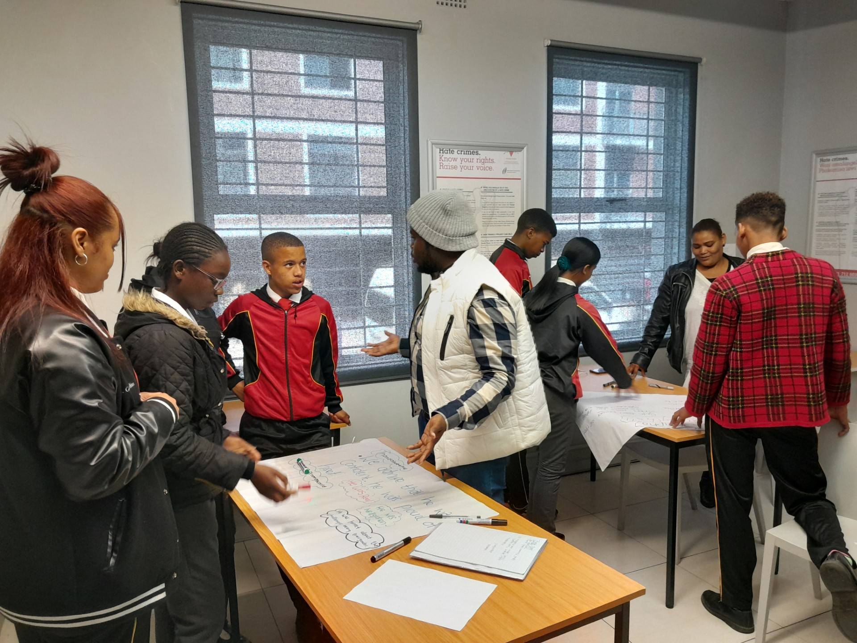
Connecting & Community-Building
What approaches will you use to build and sustain relationships within the advocacy community?
Collaborative Networks – Strengthen alliances with learners, educators, activists, and policymakers through joint initiatives.
Regular Engagement – Host community dialogues, strategy meetings, and skill-sharing sessions to maintain active participation.
Mutual Support & Solidarity – Center care and well-being in activism, ensuring spaces for healing and collective resilience.
Clear Communication Channels – Use digital platforms, newsletters, and accessible resources to keep partners informed and engaged.
Long-Term Commitment – Build trust through consistent action, accountability, and shared leadership.
Voice and Choice Learning and Sharing Summit 2025

Slide 8
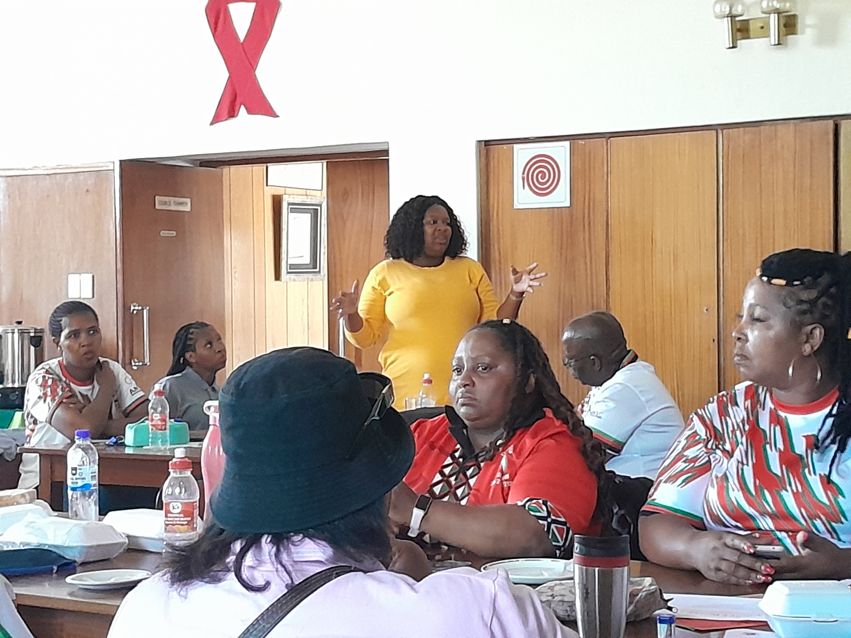
Connecting & Community-Building
How will you facilitate mentoring, convening, and peer exchanges among professional advocates and emerging leaders?
Structured Mentorship Programmes – Pair emerging leaders with experienced advocates for skill-building and guidance.
Regular Convenings & Retreats – Organise workshops, roundtables, and wellness retreats to strengthen connections and collaboration.
Peer Learning & Exchanges – Create cross-district learning spaces for sharing strategies, challenges, and best practices.
Digital Knowledge Hubs – Develop online platforms for continuous engagement, resource sharing, and collective problem-solving (Imbawula Podcast)
Community-Led Leadership Development – Center grassroots voices in shaping mentorship structures and advocacy priorities.
Voice and Choice Learning and Sharing Summit 2025

Slide 9
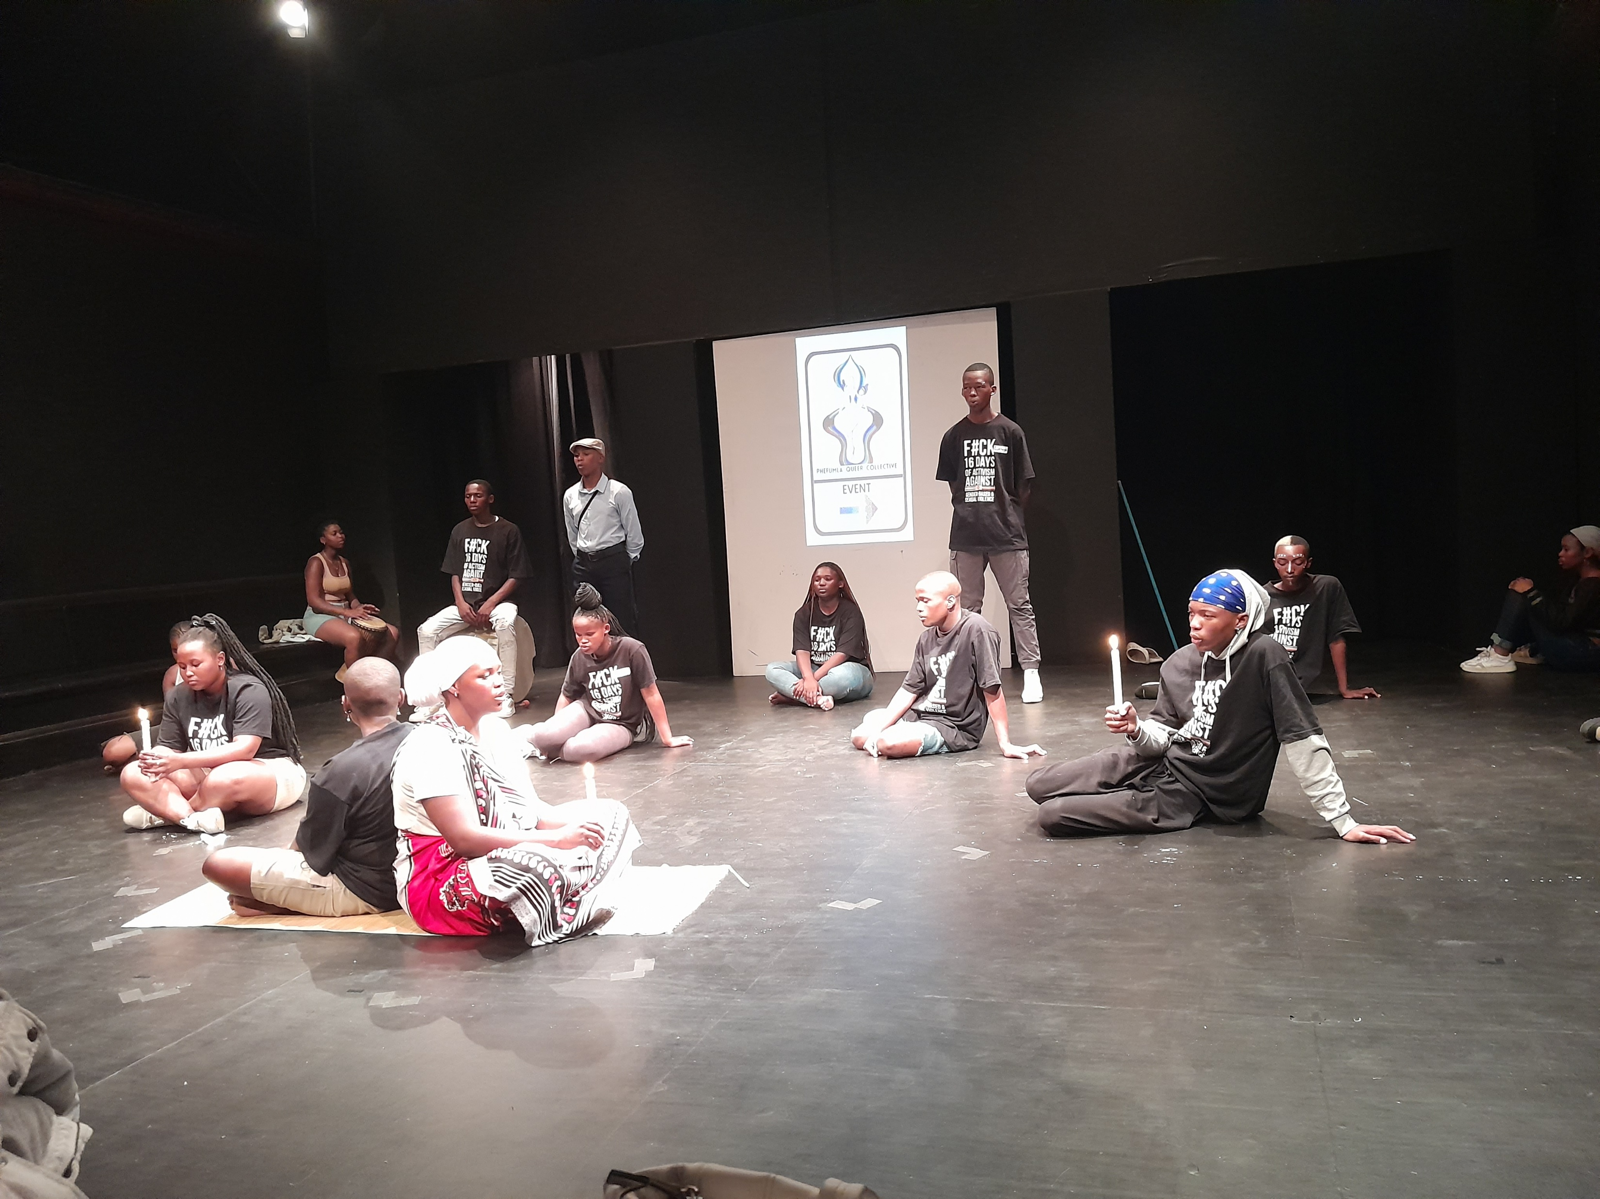
Linking & Learning
How will you foster a culture of continuous learning and best practice sharing?
Learning Communities – Create spaces for ongoing dialogue, where advocates and emerging leaders can share experiences, insights, and challenges.
Regular Training & Workshops – Offer skill-building sessions on key topics like SOGIESC, advocacy strategies, and leadership development.
Peer-Led Sharing – Encourage peer mentoring and the exchange of best practices through collaborative forums and learning circles.
Resource Development – Compile toolkits, case studies, and success stories to document and share effective strategies.
Feedback Loops – Implement regular feedback mechanisms to assess needs, adjust practices, and celebrate successes.
Innovation & Experimentation – Support and fund pilot projects that explore new methods and approaches, fostering a culture of experimentation and adaptation.
Voice and Choice Learning and Sharing Summit 2025

Slide 10
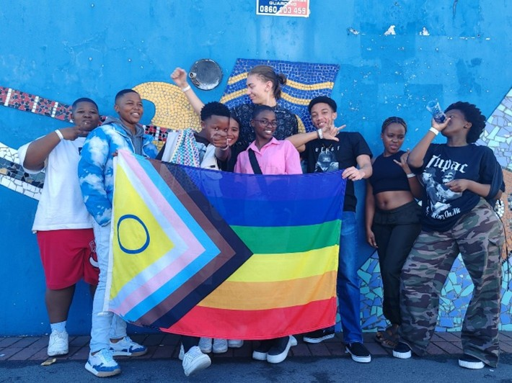
Linking & Learning
What mechanisms will you use to document and share lessons learned?
Reflection & Evaluation – Implement quarterly reviews with stakeholders to assess progress, challenges, and insights.
Storytelling & Case Studies – Collect personal stories, case studies, and success stories to illustrate lessons learned and impact.
Digital Platforms – Create an online resource hub or blog to share documents, videos, and toolkits with the broader community.
Reports & Publications – Publish annual or bi-annual reports summarizing key lessons, trends, and outcomes.
Community Presentations – Host webinars, workshops, or community forums to present lessons learned and invite feedback.
Peer Exchanges & Learning Circles – Facilitate cross-organizational or regional exchanges for deeper reflection and learning.
Voice and Choice Learning and Sharing Summit 2025

Slide 11
NEXT STEPS
What will be your key priorities moving forward:
Amplifying Learner-Led Advocacy – Strengthen youth leadership through training, mentorship, and creating platforms for queer learners to lead change.
Expanding Educator Engagement – Continue providing SOGIESC-focused professional development for educators to foster inclusive and safe school environments.
Policy Influence & Systemic Change – Advocate for comprehensive policy reforms that support LGBTQIA+ rights and protections in schools.
Building Sustainable Partnerships – Strengthen alliances with community organizations, government bodies, and academic institutions to ensure long-term impact.
Ensuring Equity in Resource Distribution – Prioritize equitable access to resources, focusing on underserved and rural areas to build a broad-based movement.
Documenting & Sharing Impact – Continue collecting data, stories, and lessons learned to refine strategies and showcase progress within the movement.
Our key community partners include: Public Schools, Imbawula Podcast, Queer Food Growing Collective, Community Solidarity Spaces amongst others.
Women’s Voice and Leadership Learning and Sharing Summit 2025

