Slide 1







LEARNING
AND SHARING
SUMMIT 2025
Sisonke National Sex Workers Movement in South Africa
Amandla weSex Workers: Building Economic Power for Sex Workers.
Women’s Voice and Leadership Learning and Sharing Summit 2025

Slide 2

Summary
Building Movements through long-term economic empowerment
Bridging gaps between entrepreneurs and sex workers and other Key Populations.
Through building economic empowerment for sex workers, they are able to form movements to influence and shape the industry into one that is safer and beneficial for them.
Voice and Choice Learning and Sharing Summit 2025

Slide 3
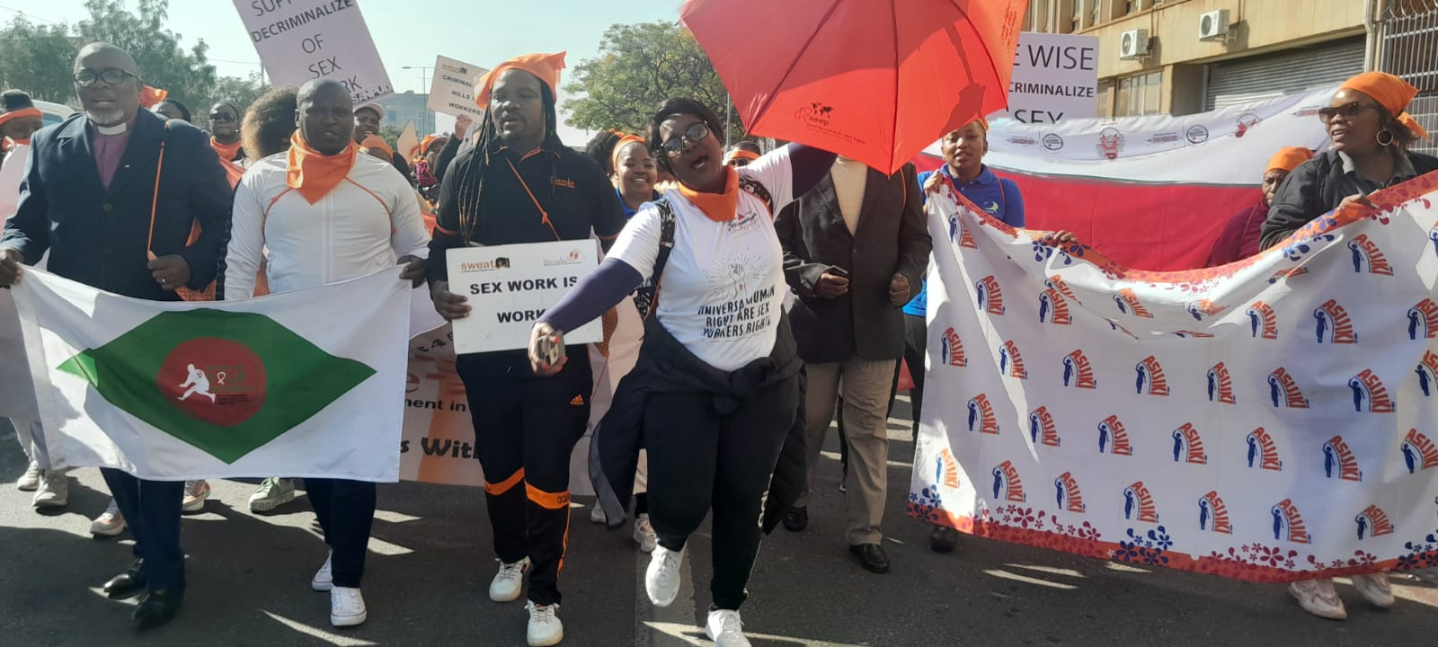
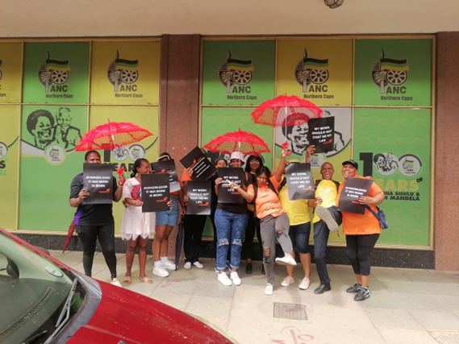
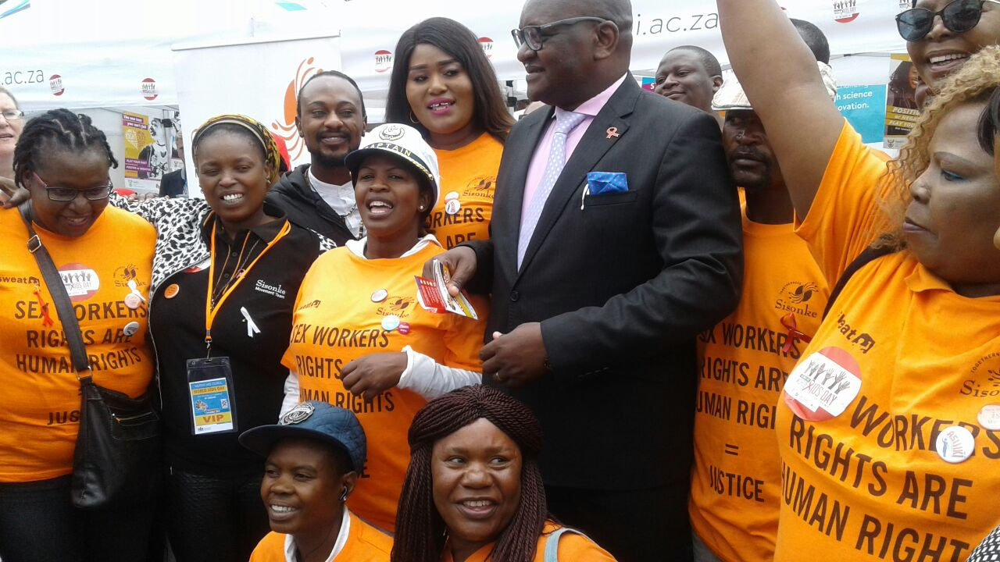
Initiatives and strategies
How will your initiative contribute to building stronger and more inclusive movements?
  Sisonke already has strong sex worker-led movement.
  Recognition that intersectional and inclusive movements must be built.
  Providing space for economic empowerment and linking with women in business.
What strategies will you use to strengthen collaboration and solidarity?
  Our initiative will bridge gap between women in business and sex workers.
  Offering vocational training, entrepreneurship development and law reform advocacy.
  Encourage savings groups and joint entrepreneurships.
Voice and Choice Learning and Sharing Summit 2025

Slide 4
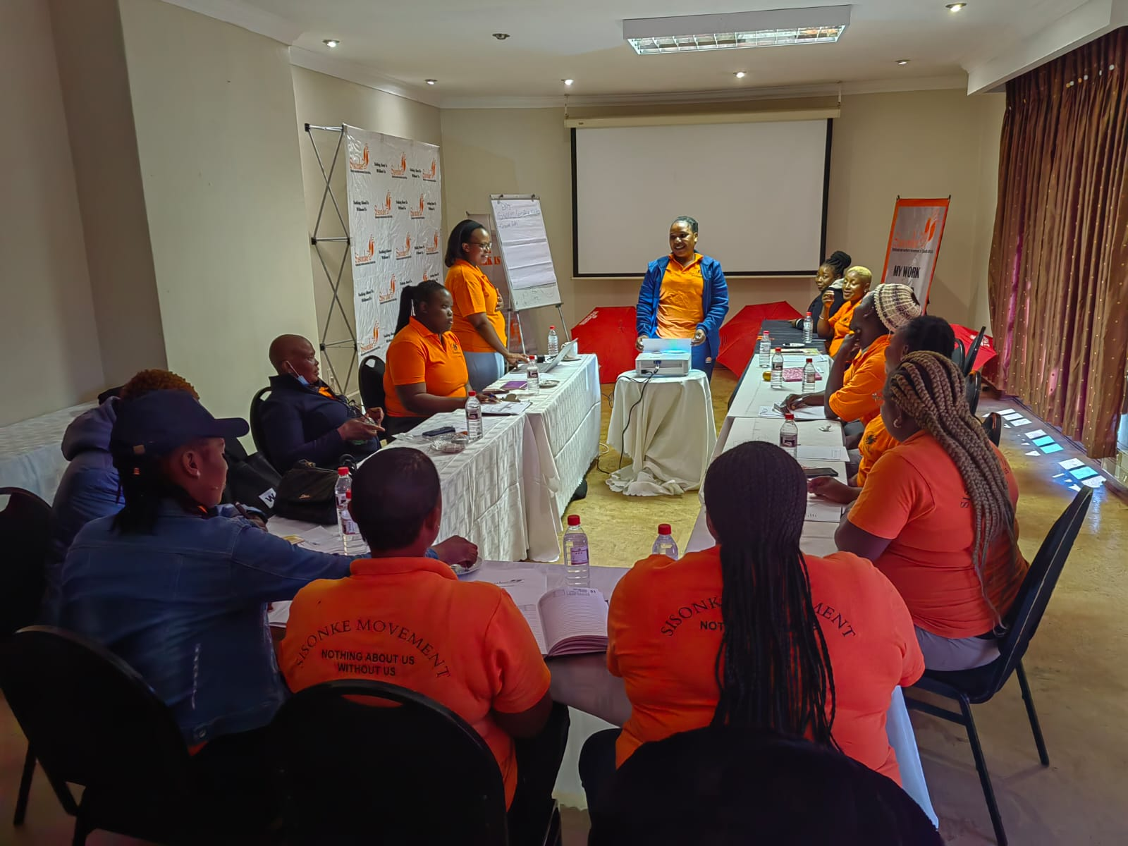
Governance & Resource Allocation
How will you ensure active participation and decision-making from all members?
  Participants will have choice to choose type of skills development they want.
  Participation in platforms such as Civil Society Forum from local to national level, allow sex workers to take part in decision-making processes and network with other organisations.
  Sensitisation of stakeholders is key in creating meaningful participation in advocacy for sex workers’ rights.
How will you distribute resources across partners to promote equity and sustainability within the movement?
  Economic development creates opportunities for starting business, which leads to sustainable means of generating income.
Voice and Choice Learning and Sharing Summit 2025

Slide 5
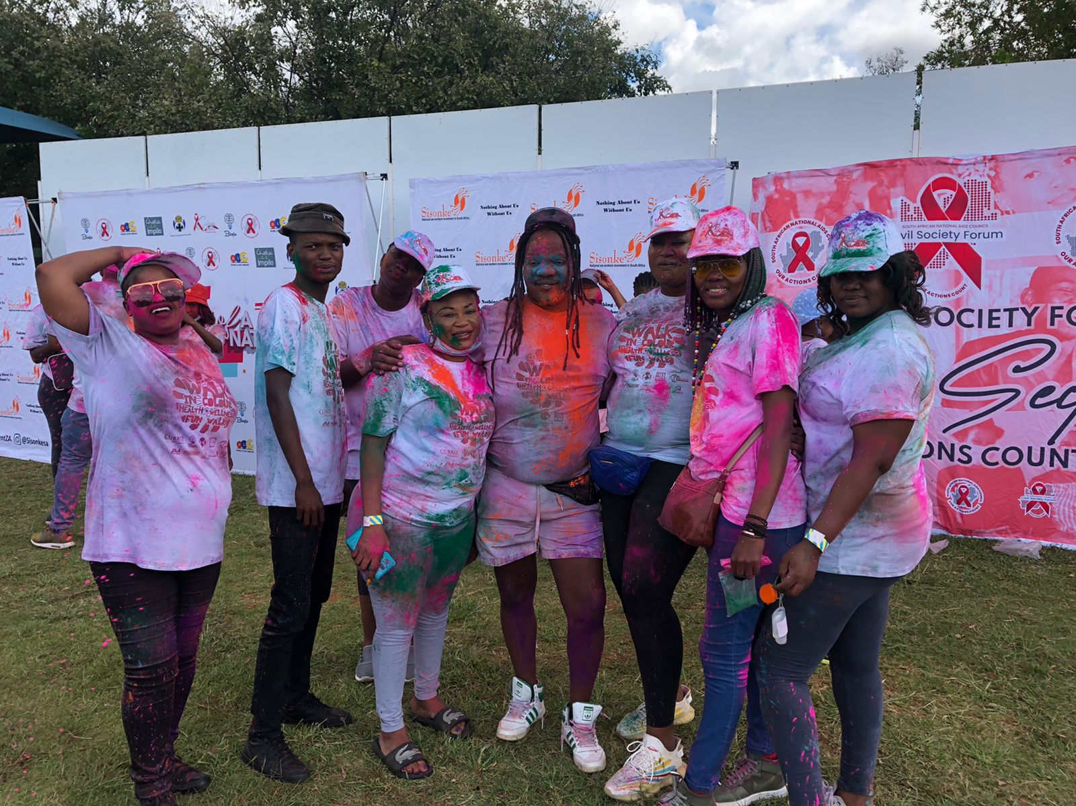
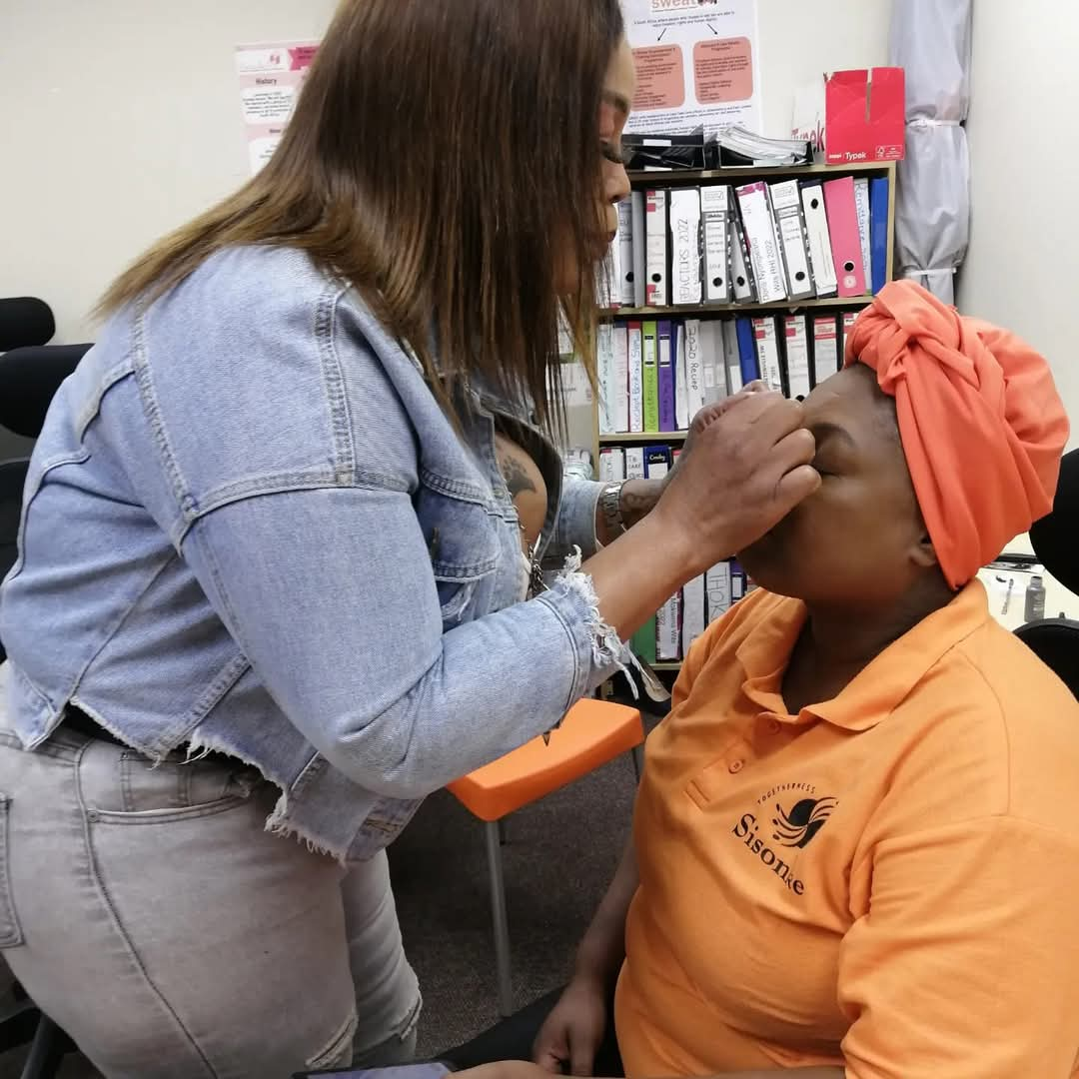
Inclusive Leadership & Coordination
How will you leverage expertise and diverse connections to strengthen advocacy efforts?
  Our years of advocacy work has grown our network of relevant and influential stakeholders in human rights, health, legal and social sectors.
  Currently working with FinMark Trust in research and development of digital financial systems for informal sectors.
  Started a pilot program with Foi Science; sex workers are learning how to develop their own organic products, including hairline, anti-aging, feminine hygiene, and trauma healing products.
What strategies will you implement to coordinate campaigning?
  Existing mobilization and awareness-raising strategies (community dialogues, legal literacy workshops, Izwilethu newsletter).
  New strategies such as markets for sex workers to display and promote their businesses.
Voice and Choice Learning and Sharing Summit 2025

Slide 6
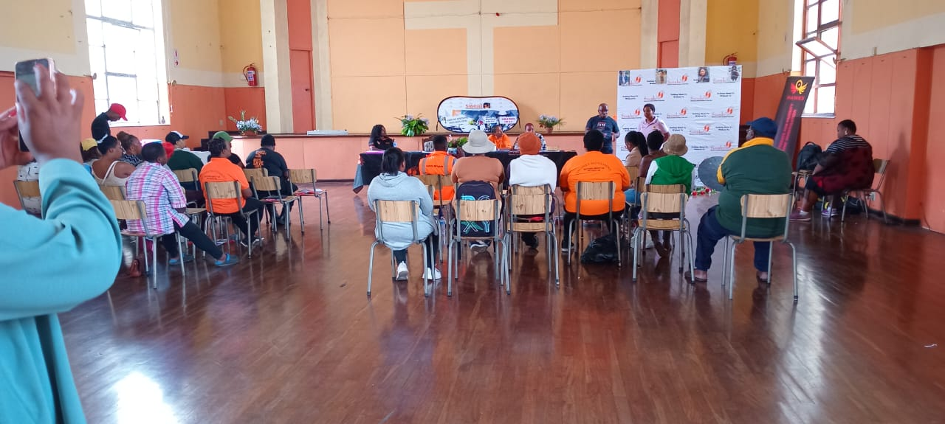
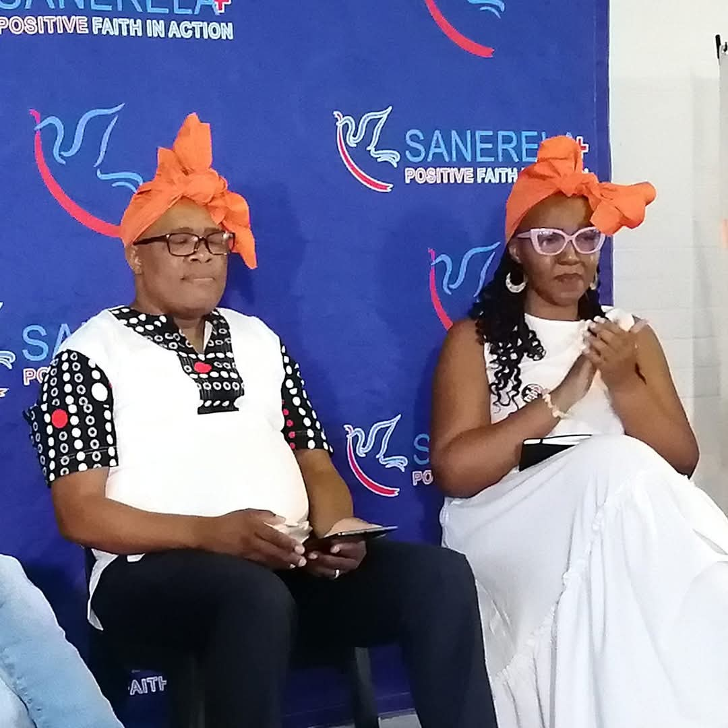

Connecting & Community-Building
What approaches will you use to build and sustain relationships within the advocacy community?
  Use of digital platforms and hybrid events (webinars, summits, dialogues).
  Active participation in events hosted by other stakeholders, to show solidarity.
  Consistent communication and support is key for everyone who participants in the project.
How will you facilitate mentoring, convening, and peer exchanges among professional advocates and emerging leaders?
  Consistent mentorship sessions between women in business and sex workers, to gain knowledge and resources.
  Facilitating workshops on financial literacy, digital tools, legal and policy literacy.
Voice and Choice Learning and Sharing Summit 2025

Slide 7
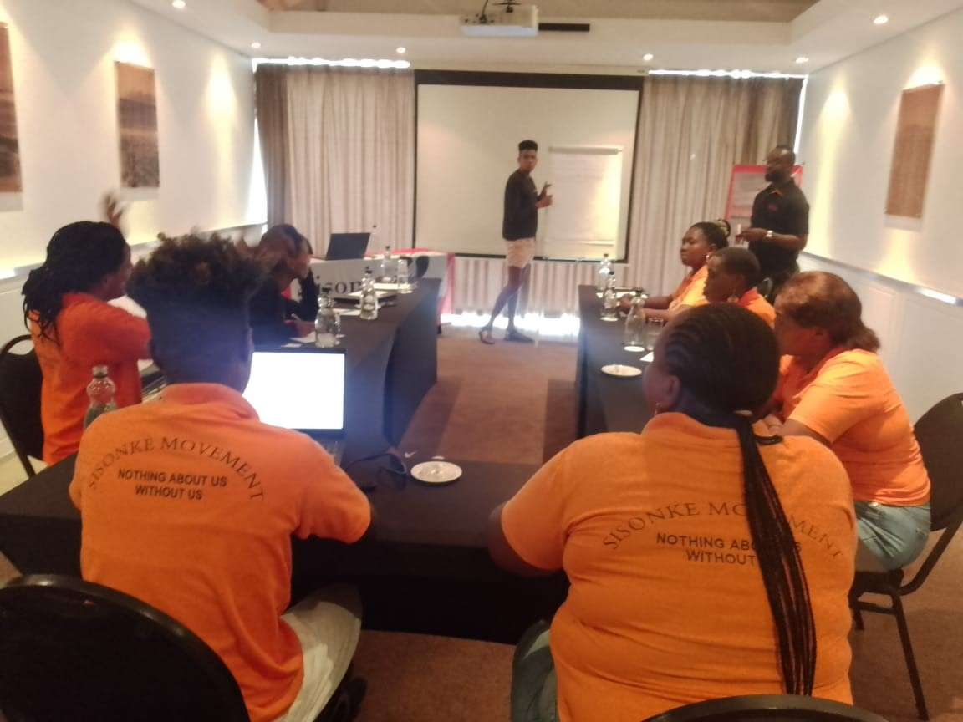
Linking & Learning
How will you foster a culture of continuous learning and best practice sharing?
  Facilitating spaces for developing joint businesses, savings groups or projects leads to culture of learning, solidarity and support.
  Mentors/Entrepreneurs will be sources of knowledge and share best practice.
What mechanisms will you use to document and share lessons learned?
  Social Media platforms are best for sharing progress of initiative.
  Continuous engagements/interviews with sex worker participants will show journey throughout process, providing detailed stories of change.
  We will host events (such as marketplace) where sex workers will promote their businesses and other initiatives.
Add photo or video
Voice and Choice Learning and Sharing Summit 2025

Slide 8
NEXT STEPS
What will be your key priorities moving forward?
  Identifying more women in business to invite to be part of the initiative.
  Facilitate meetings with potential partners and stakeholders to present initiative to them, starting process of developing training programs and tools.
  Identify sex workers who want to become entrepreneurs, develop skills and gain knowledge.
  Approach relevant government departments to lobby for additional support.
Women’s Voice and Leadership Learning and Sharing Summit 2025

